Slide 1

Computing Challenges and Developments for CBM
Volker Friese
Helmholtzzentrum für Schwerionenforschung
Guwahati, 28 September 2019

Slide 2
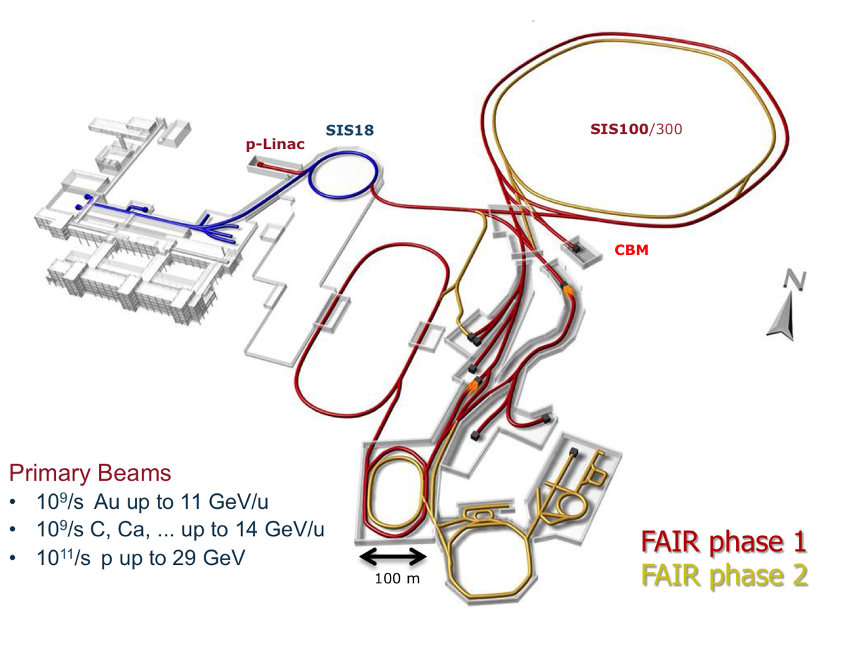
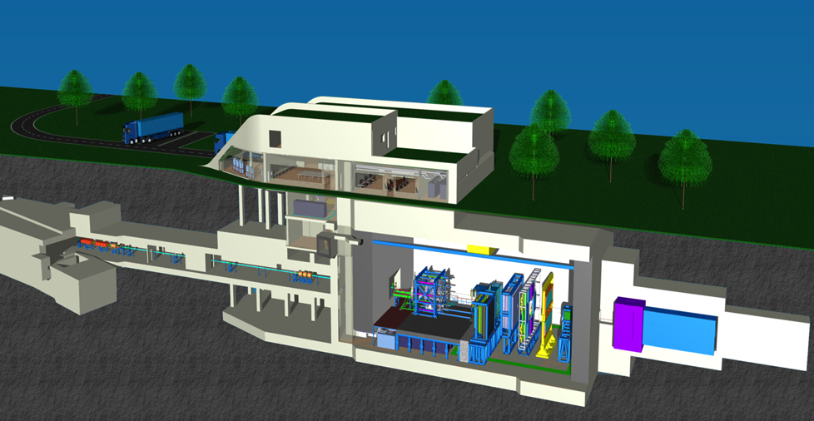
CBM – A Big Data-Producer

Slide 3
Computing in CBM
CBM Computing has to provide the software and related tools required to
operate the experiment
  configuration, control, DAQ, online data processing, data storage
analyse data
  reconstruction, PID, data access
simulate the detector setup
  detectors, electronics, data acquisition
That‘s generic. So, what‘s particular for CBM?

Slide 4
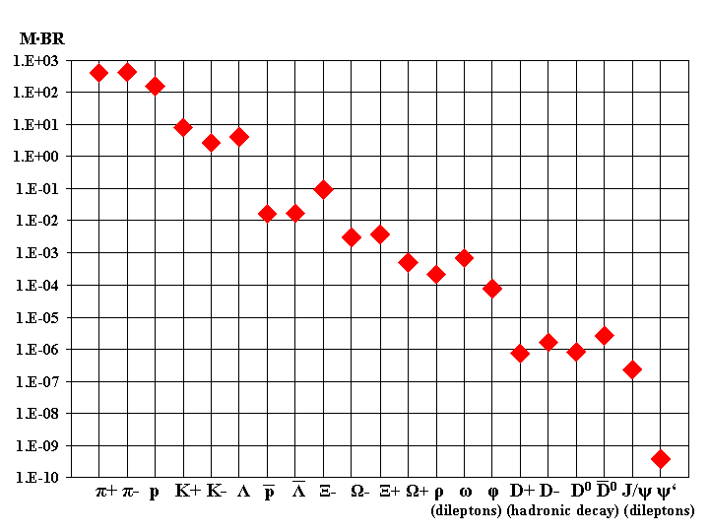
Rare Observables
Model predictions of particle multiplicities ( x branching ratio)
(central Au+Au, 25A GeV)
Some of the (most interesting) probes are extremely rare.
Decent measurement in reasonable time necessitates high interaction rates.
Current heavy-ion experiments run with very moderate rates (100 Hz - several kHz).
CBM targets for 10 MHz

Slide 5
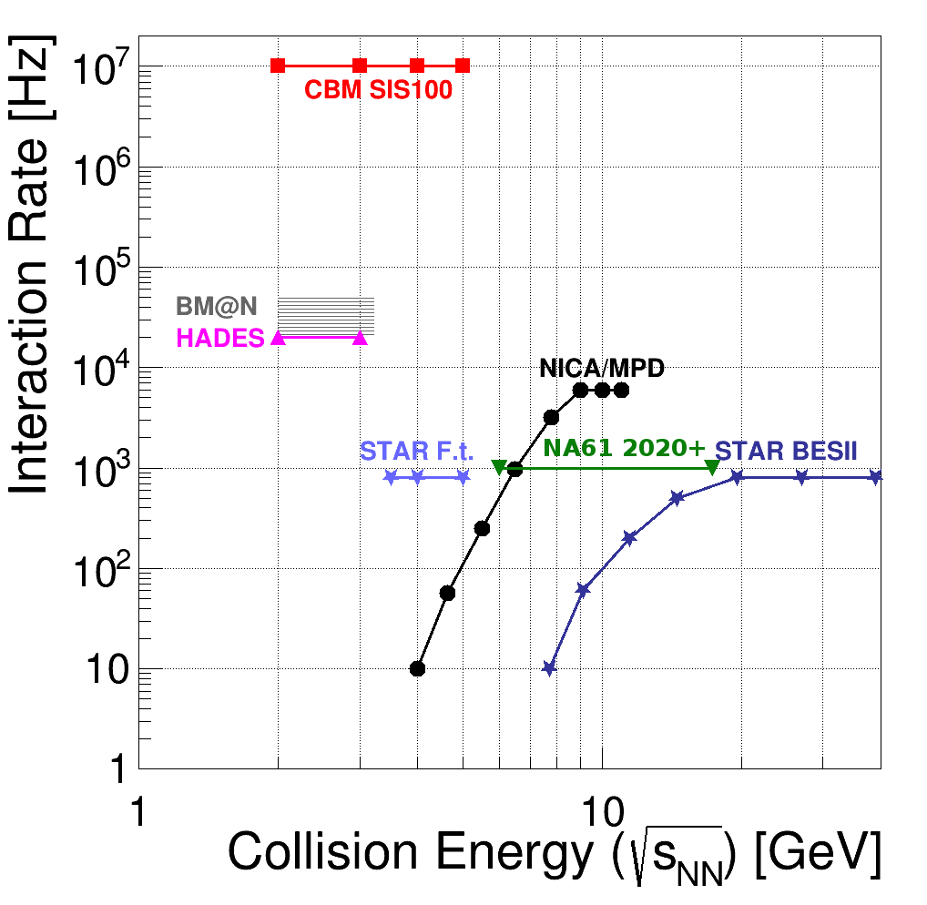
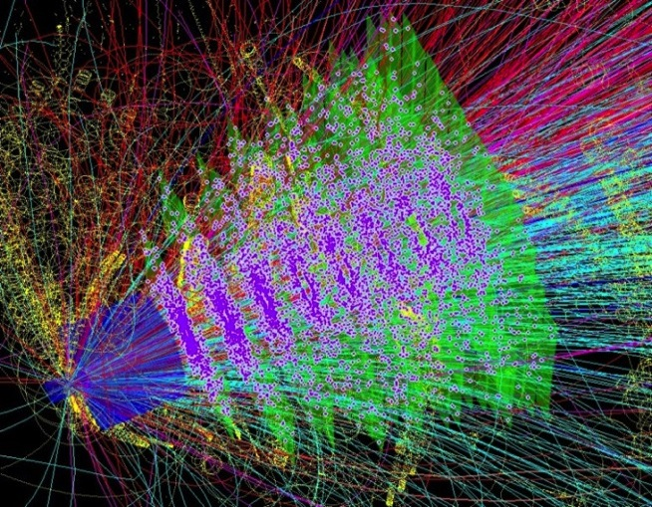
CBM in the experimental landscape
Uniqueness of CBM: very high rate capability
SIS300
x 10⁷/s !
Comes with huge challenges in terms of:
Speed and radiation hardness of detectors and read-out electronics
Data processing on- and offline

Slide 6
Data Rates
Raw data event size: 100 kB / min. bias event (Au+Au)
At 10 MHz event rate: raw data rate 1 TB/s
Archival rate:
  technologically possible are rates of 100 GB/s and above
  limiting factor are the storage costs
  typical runtime scenario 2 effective months / year (5 x 10⁶ s)
  At 1 GB/s: gives a storage volume of 5 PB/year
We aim at an data archival rate of a few GB/s, meaning that the raw data volume has to be suppressed online by factors 300 - 1000.

Slide 7
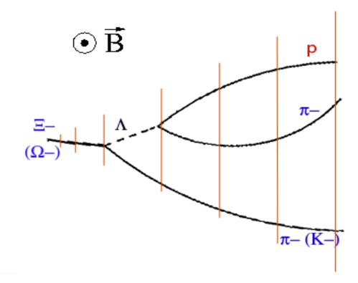
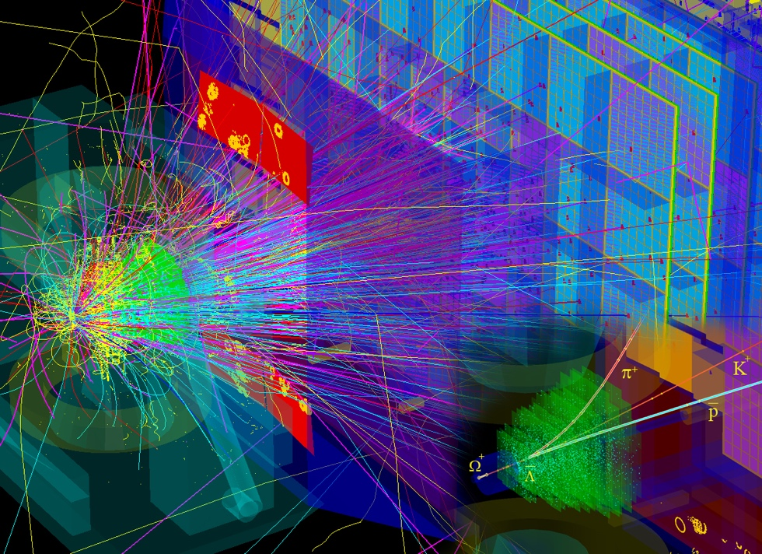
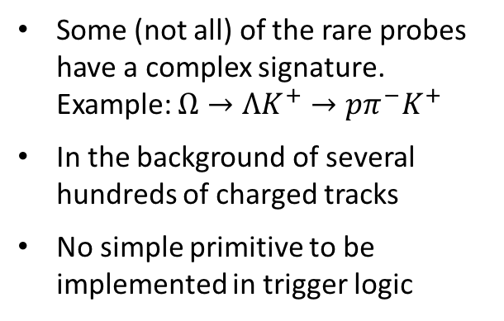
Selecting Data Online
Some (not all) of the rare probes have a complex signature.
Example: $Ω→ΛK^{+}→pπ^{−}K^{+}$
In the background of several hundreds of charged tracks
No simple primitive to be implemented in trigger logic

Slide 8
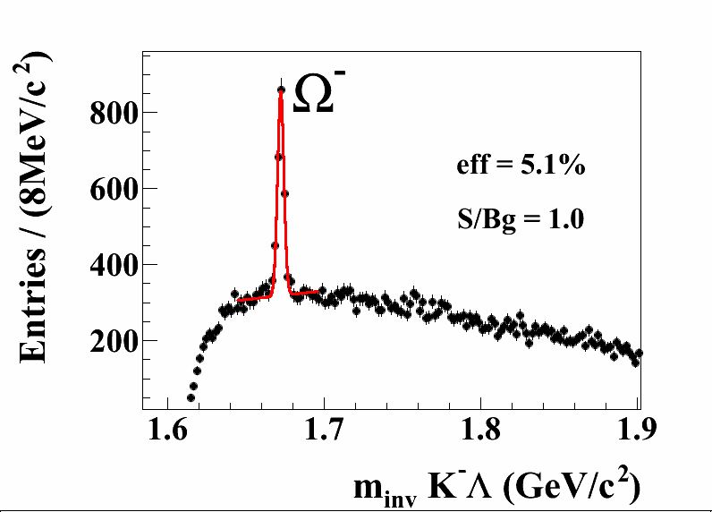
Selecting Data Online
Selection requires reconstruction of all tracks plus combinatorial search for two decay vertices: typical software task
Offline performance for Omega: S/B ~1
If realisable online: excellent software trigger
CBM simulation, central Au+Au, 10A GeV
Similar argument for many topology-based observables (hyper-nuclei, exotic strange objects, charm)
Simpler patterns e.g. for lepton pairs (J/ψ or low-mass)
R/O design must be based on the most challenging case

Slide 9
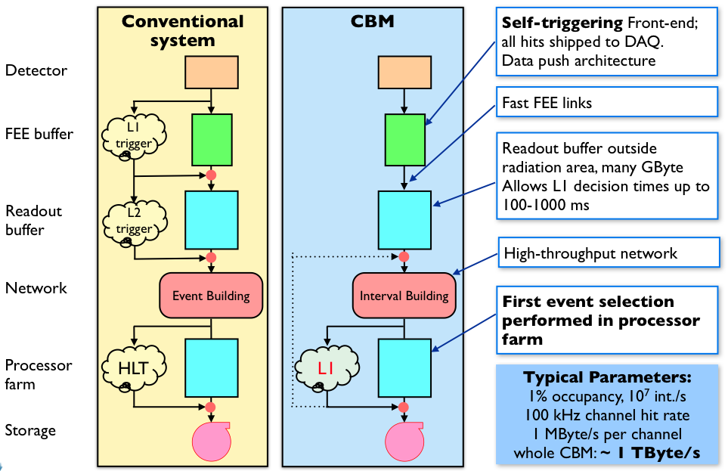
DAQ and Trigger Concept
No hardware trigger at all
Continuous readout by autonomous FEE
FEE sends data message on each signal above threshold
(“self-triggered”)
Hit message come with a time stamp; readout system is synchronised by a central clock
DAQ aggregates messages based on their time stamp into “time slices”
Time slices are delivered to the online computing farm (FLES)
Decision on data selection is done in the FLES (in software)

Slide 10








Triggered and Free-Running Readout
Hardware triggers: snapshots of the detectors
A trigger-less readout: a movie of the detector

Slide 11
Advantages
no latency issues; the system is limited by throughput
no buffers on FEE ASICS (inside radiation zone) needed
data selection is shifted to software
  in principle, everything which is usually done in the offline analysis can be implemented for online data selection
  very flexible: easy to switch between triggers, to use different triggers in parallel
  assessing the trigger efficiency is straightforward: no emulation of trigger logic needed
So, why was it not done before?
Requires an online compute farm powerful enough to process the entire data stream
Throughput is defined by the size of the compute farm and the speed of the algorithms.
CBM estimate: equivalent to ~10⁵ CPU cores needed
Some years ago, this was the entire LHCgrid
Nowadays (let alone in some years), feasible to finance and to host close to the experiment

Slide 12
Issues of a Trigger-less System
Noise from detectors and electronics
  tight threshold in order to suppress the contribution of noise to the total data rate
  good signal-to-noise ratios in detectors are needed in order not to lose signals
Example: fraction of noise from the STS
M.b. event rate | 10 MHz | 1 MHz | 100 kHz | 10 kHz
Threshold / noise = 3 | 40 % | 86 % | 98 % | 99.8 %
Threshold / noise = 3.5 | 11 % | 55 % | 92 % | 99.2 %
Threshold / noise = 4 | 2 % | 15 % | 65 % | 95 %
No events given to software
  Unlike in conventional HLTs, where events are build before by DAQ
  Online reconstruction starts from time-sorted data stream
  Algorithms have to take into account time coordinate (“4D reconstruction”)

Slide 13
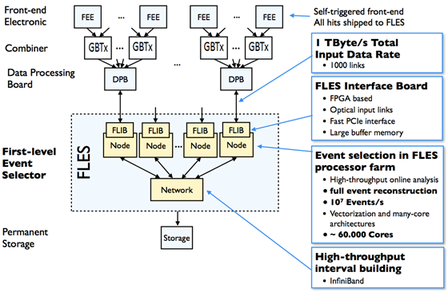
Read-out Scheme

Slide 14
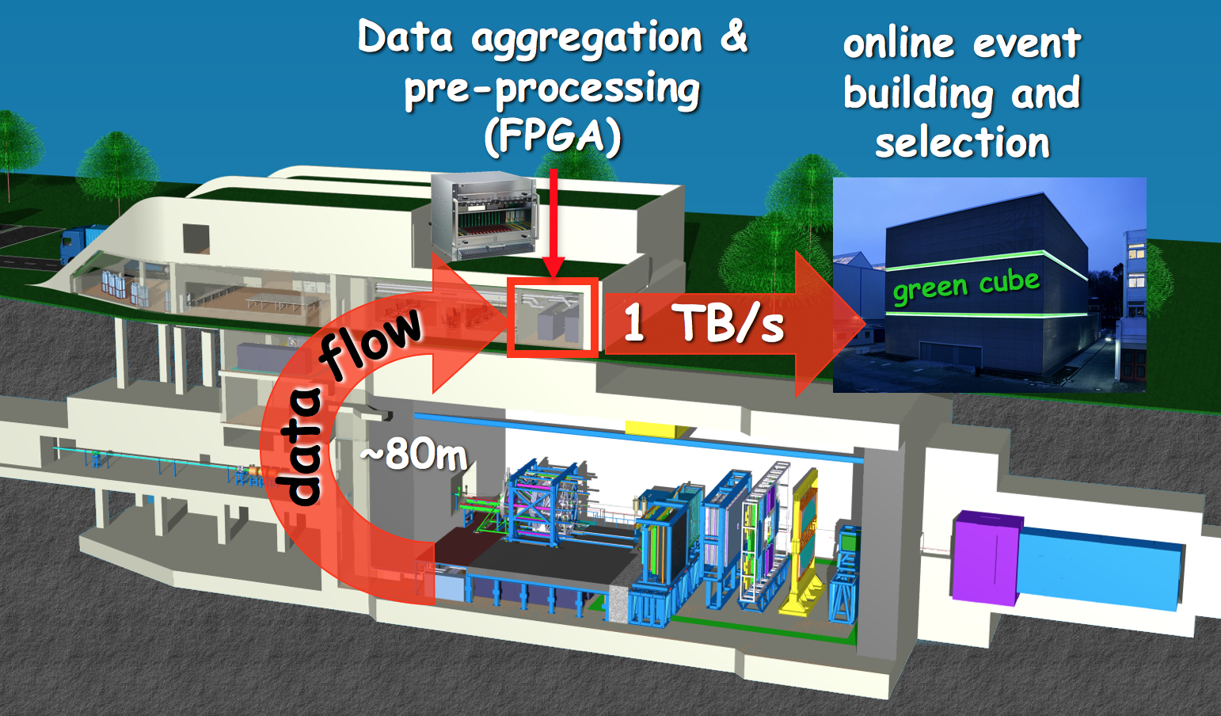
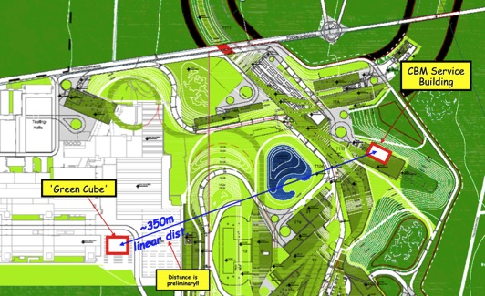
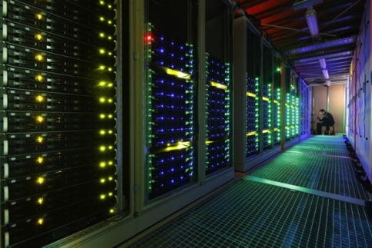
Online Data Flow
Green Cube, GSI

Slide 15
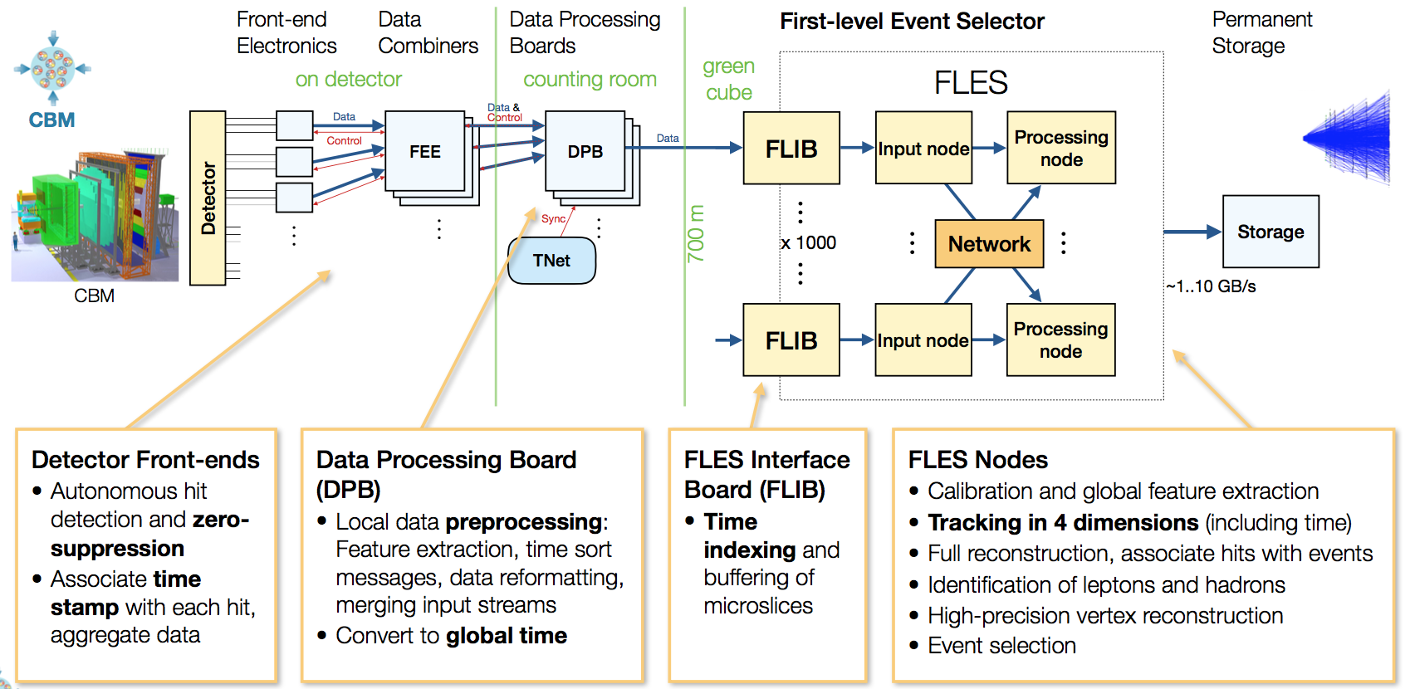
Readout Scheme

Slide 16
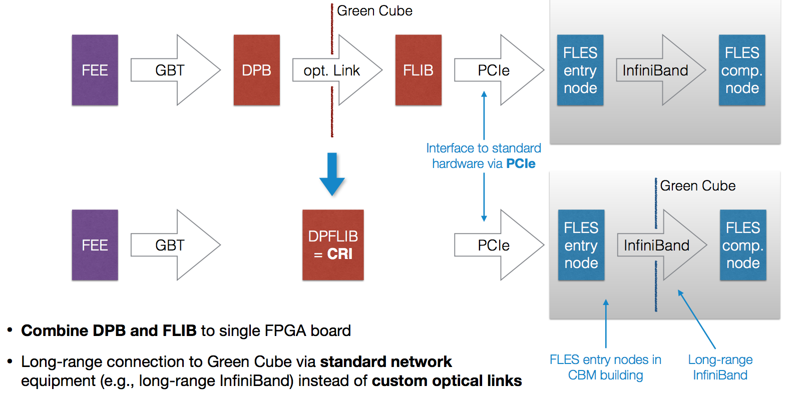
Towards the Final System
Transition to CRI mid-2019

Slide 17
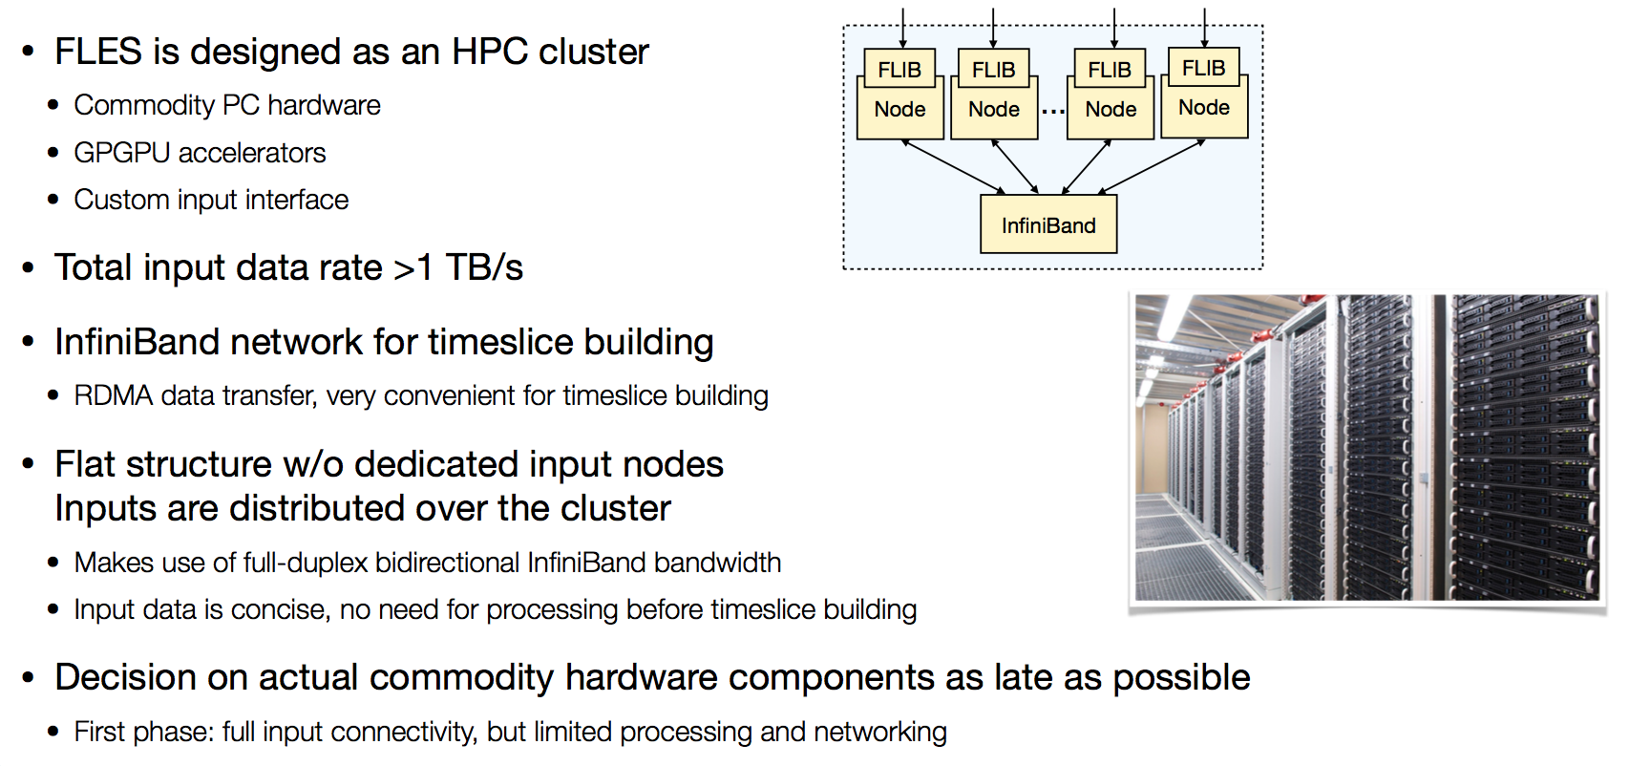
FLES Architecture

Slide 18
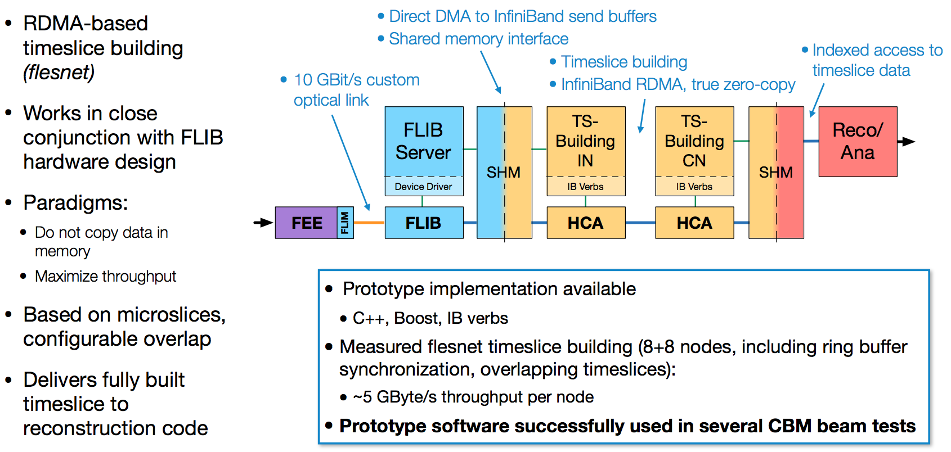
FLES Data Management

Slide 19
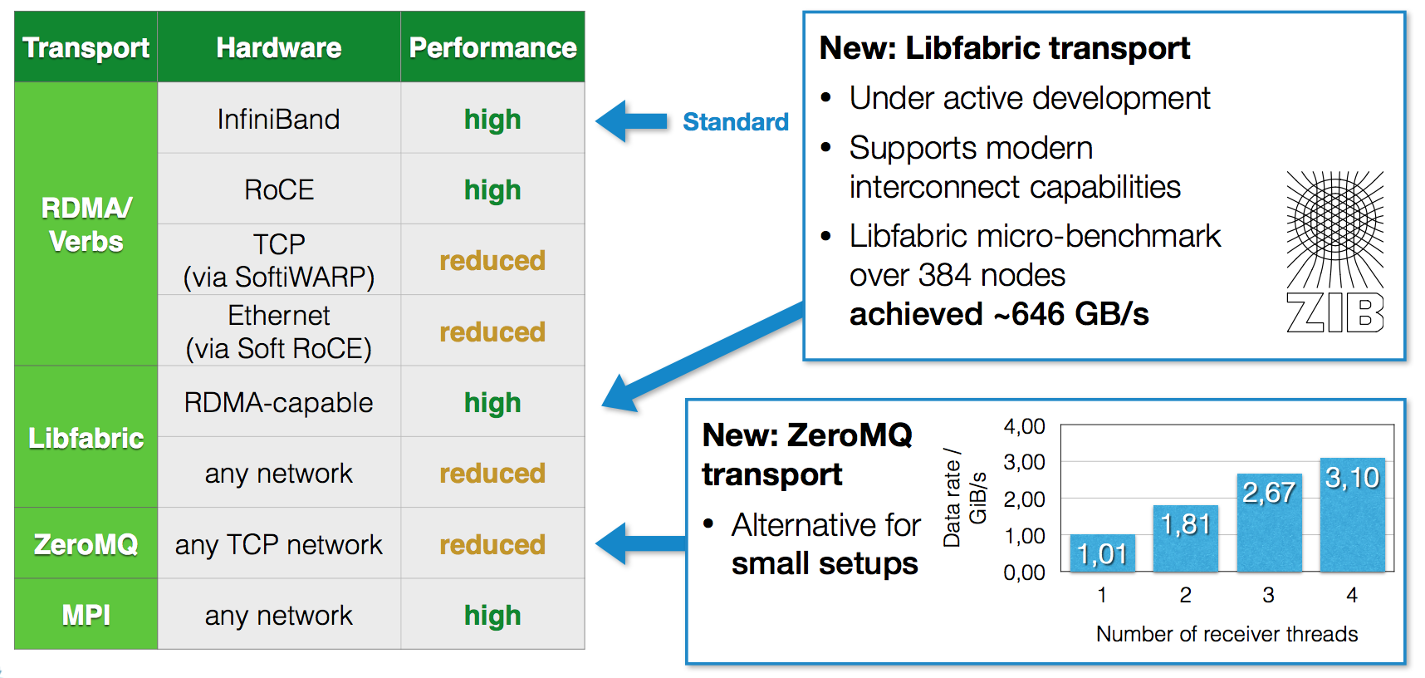
Data Transport

Slide 20
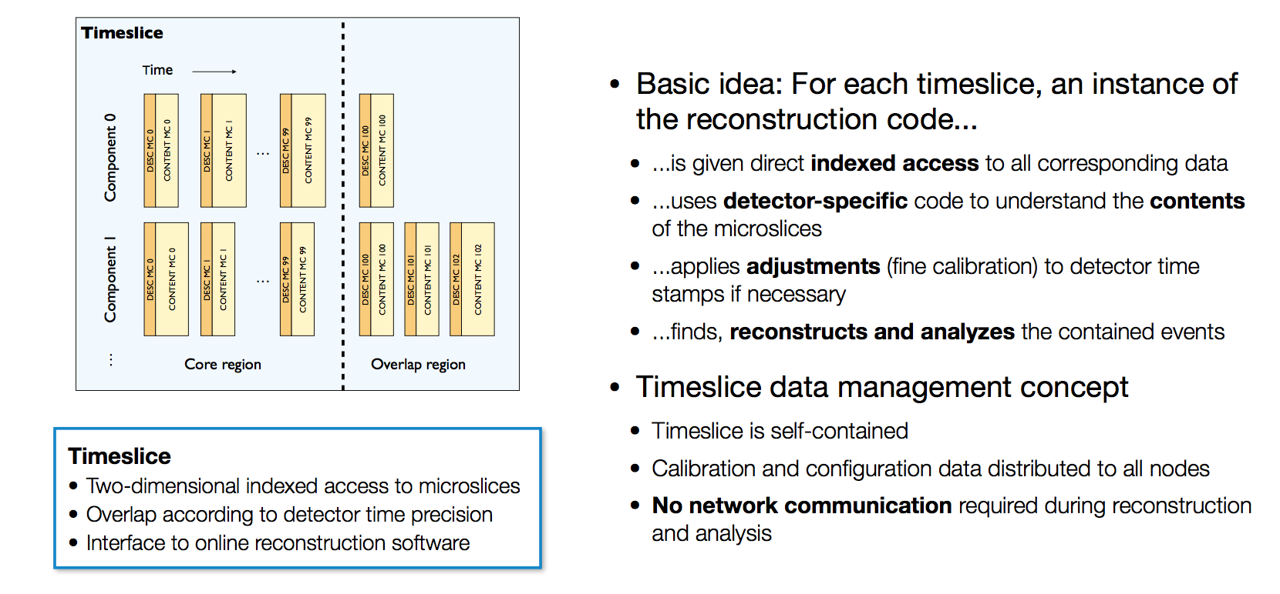
Time Slice: Interface to Online Reconstruction

Slide 21
Real-Time Reconstruction
In our concept, the task of online data selection is shifted from electronic engineering to software engineering.
For a given event / data rate, the speed of the algorithms determines the required size of the online compute farm.
For a given financial budget / size of the online farm, the speed of the algorithms determine the physics output of the experiment.
High-performance online software is a pre-requisite for the successful operation of CBM.
  Make optimal use of available parallel computer architectures: many-core, GPU, accelerators
  Be flexible to upcoming new architectures
Parallelism is the key word
  Data-level parallelism: one time slice per compute node
  Task-level and data-level parallelism within time slice

Slide 22
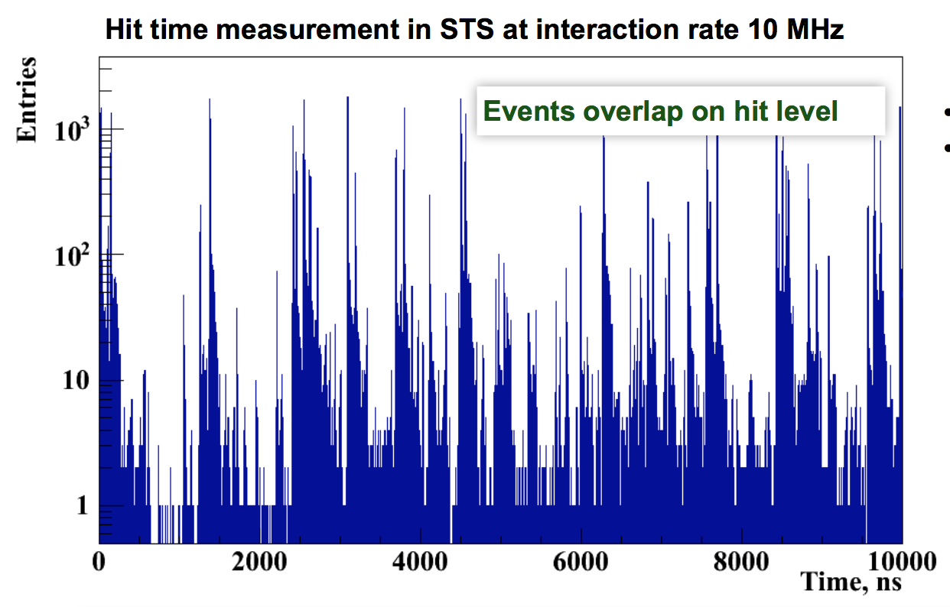
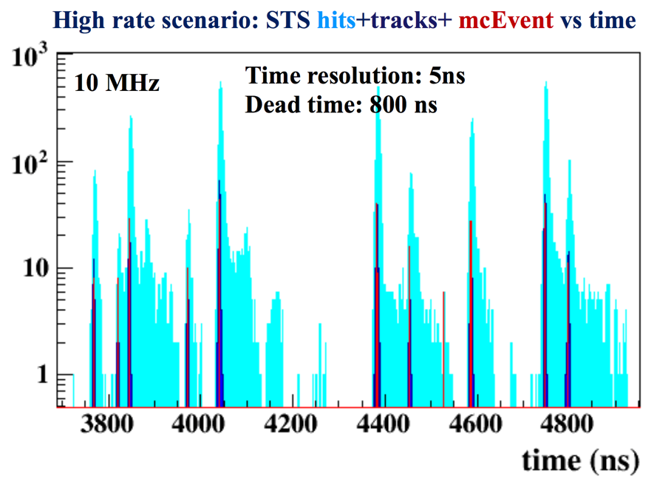
Track Finding
Usually, the most compute-intensive task in reconstruction
Approach: Cellular Automaton, operating on time-ordered stream of detector hits (no event association)
track finder
After track finding, events can be defined as time-clusters of tracks

Slide 23
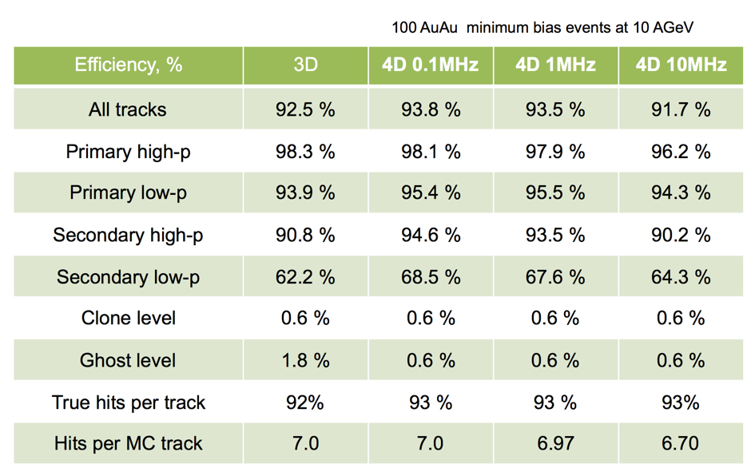
CA track finder: performance and scalability
High efficiency for primary tracks
Rate effects become visible above 1 MHz interaction rate
Good scaling behaviour: well suited for many-core systems

Slide 24
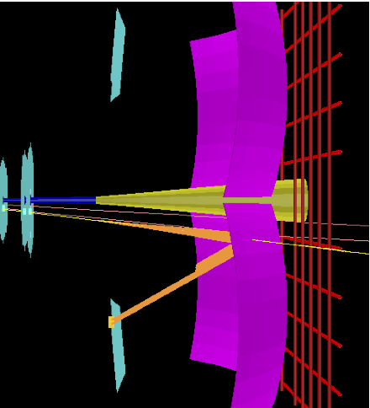
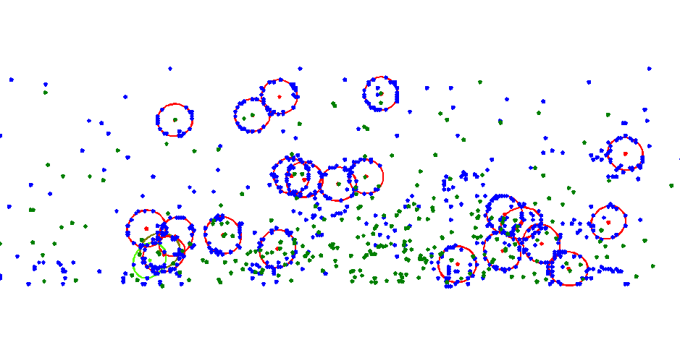
Another Example: Ring Finding in the RICH
Event Display
Problems:
High hit / ring density
Overlapping rings
Ring distortions
Cherenkov light emitted by electrons in the radiator is mirrored and focused into rings onto the photodetector plane.

Slide 25
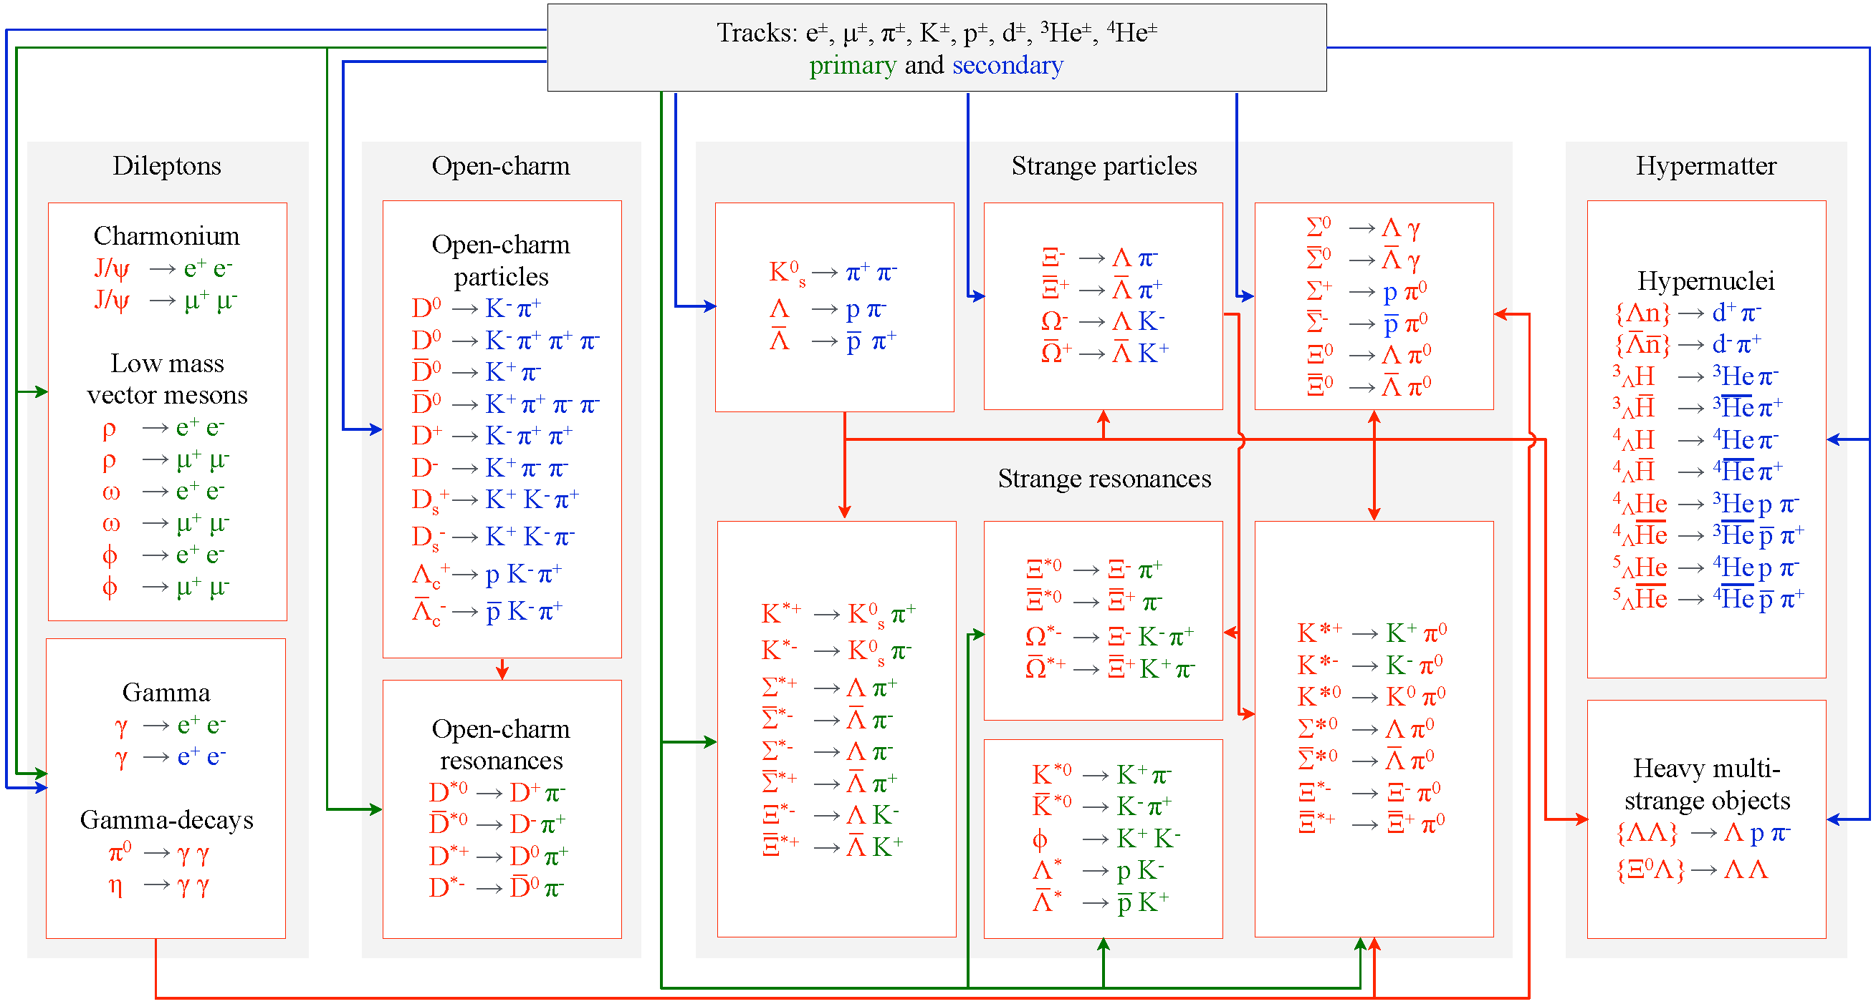
Particle Reconstruction in Real-Time
KFParticleFinder: Simultaneous access to multitude of particles
Real-time reconstruction allows online selection of rare probes.

Slide 26
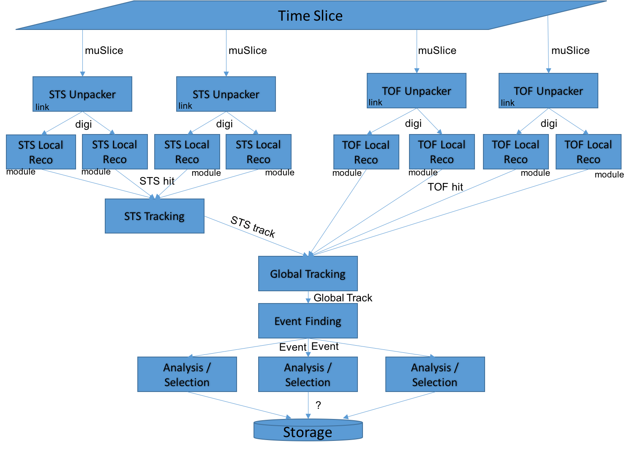
Example: Simple Process Graph (STS + TOF)

Slide 27
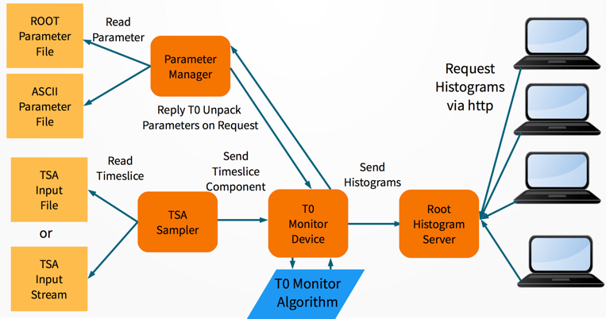
Data Processing Framework
Shortcoming of the current framework: linear task queue, no concurrency features -> not well suited for online data processing
Moving to message-queue-based system (FairMQ); intra-node and inter-node data transport possible
First deployment (proof-of-principle): online monitoring for mCBM

Slide 28
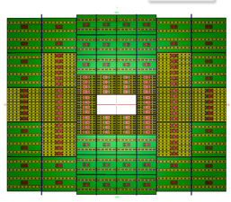
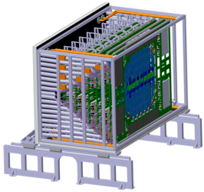
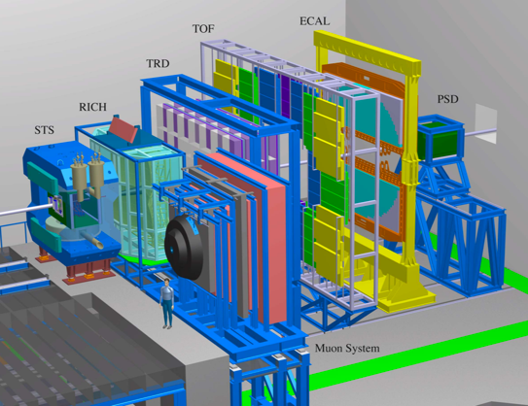
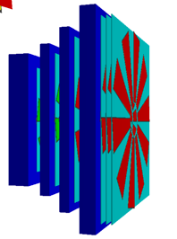
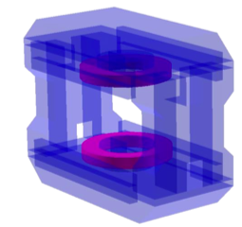
Simulation Software
Detector geometry model
  according to current technical planning
  comprising all relevant contributors to the material budget
  format: TGeo
  subject to continuous adjustments / improvements

Slide 29
Events and Time Slices
Time
Slice
Experiment
Collision
Detector
Event Model
Simulation
Event
Analysis
Reconstruction

Slide 30
Simulation Software
Example: STS
energy loss fluctuations (Urban model)
drift to readout surface in bias field
Lorentz shift
Thermal diffusion
Collection on read-out strips
Cross-talk
Detector response model:
  analogue response in sensitive detector elements
  digital response (R/O ASIC): free-streaming
    model timing response
    interference between different events
  thermal noise
DAQ emulation (time-slice building)
Goes far beyond conventional event-by-event simulation
  framework extensions implemented; full data stream can be simulated
    not yet in real (compressed) raw data format, but logically equivalent
    combining different sources at different rates (events, beam)
Simulated STS data (w/o thermal shielding),
Au+Au @ 10A GeV, beam rate 10⁹/s, event rate 10⁷/s

Slide 31
Summary
The online computing challenge for CBM (and PANDA) originates from the necessity to be selective w.r.t very rare observable in real-time.
The offline challenge is to efficiently analyse a huge amount of data by a geographically diverse scientific community.
Both challenges require the development and deployment of forefront computing technologies.

Slide 32
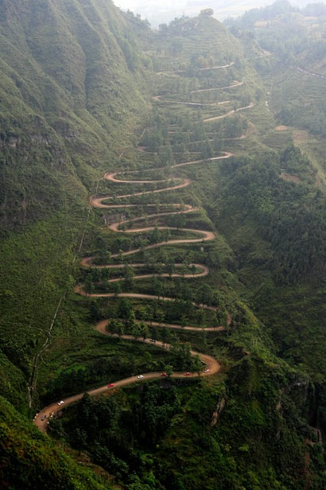
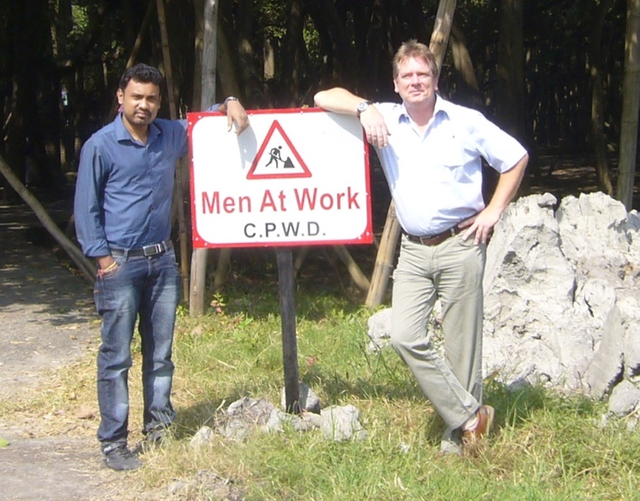
You Like Challenges?
Then CBM Computing might be of interest for you….welcome!

