Slide 1
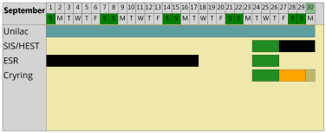
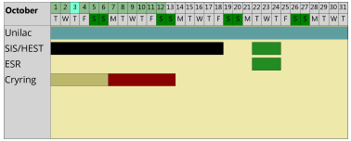
machine status
CRYRING@ESR & HITRAP
CRYRING@ESR
- electron cooler – not counting on operation in September
go to the last semi-successful state: 50% level as in July 2019
start to evaluate long-term alternatives
user wish: experiment beamtime still to proceed, also if the experiment installations are not 100% ready
venting done, preparing local baking system
- Water leak in YR12QS3 quadrupole magnet requires sizable extra effort and presents a risk to the start of the run end of Sep.
- ECR from Giessen: HV problem at the interface to CRYRING@ESR under investigation
HITRAP
no activity
C⁺

