Slide 1
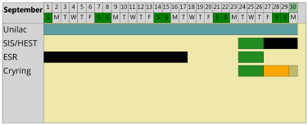
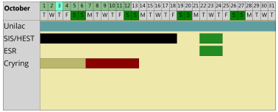
machine status
CRYRING@ESR & HITRAP
CRYRING@ESR
- electron cooler – not counting on operation in September
go to the last semi-successful state: 50% level as in July 2019
start to evaluate long-term alternatives
user wish: experiment beamtime still to proceed, also if the experiment installations are not 100% ready
venting done, preparing local baking system
XUV laser, scrapers, detector, etc. in implementation
- timing not available since one week is severely hindering preparations
HITRAP
laser spectr. in 09.2019
2 graduate students
in autumn confirmed
C⁺

