Slide 1
Compression and noise reduction of field maps
Xiaonan Du (PSU Department)
Phys. Rev. Accel. Beams 21 084601 (2018)

Slide 2
Outline
Introduction, eigen-values, transformation of base
Method of High Order Singular Value Decomposition
Example: 5D E-field map of 1st new Alvarez cavity
Benchmark: box-cavity solved analytically

Slide 3
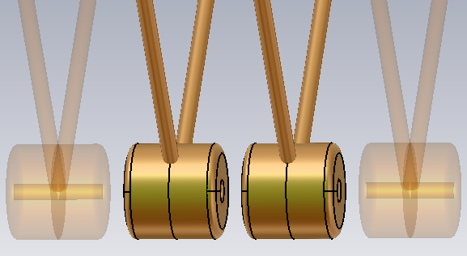
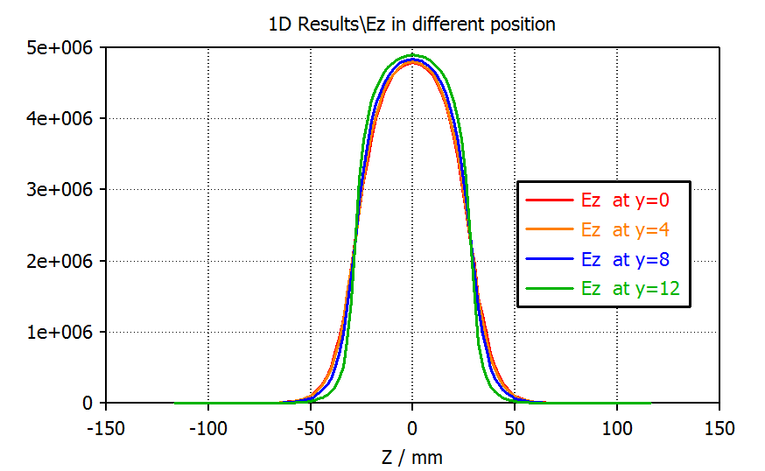
Why field data can be compressed?
simulated E-field distribution of one DTL cell
symmetry planes
smoothness (differentiable)
repeated patterns
continuity
lots of zeros
unwanted mesh noise
y
z
-120
0
120
-120
-120

Slide 4
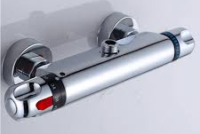
Application for transformation of data
height weight
body
scale
body
type
with matrix decomposition,
we find a better coordinate system.
$U_{1}$ and $U_{2}$ are orthonormal basis
Tom
Alice
Bob
…
$$\left[\begin{matrix}175 & 70 \\ 170 & 60 \\ 165 & 58 \\ ⋯ & ⋯ \\ 182 & 90 \\ 180 & 110\end{matrix}\right]$$
Tom
Alice
Bob
...
$$\left[\begin{matrix}188 & 6 \\ 179 & 15 \\ 174 & 15 \\ \text{...} & \text{...} \\ 203 & −7 \\ 209 & −26\end{matrix}\right]$$
$U_{1}$=[0.91,-0.41]
$U_{2}$=[0.41,0.91]
x
y
$x$: height of specific person
$y$: weight of specific person
$$U_{1}$$
$$U_{2}$$
$U_{1}$: statistical linear relation between human height and weight
$U_{2}$: offset from average for specific person
preferred
coordinates
Total
volume
Hot water
volume
Cold water
volume
Temperature
Signal Fourier Transform
Time domain:
amplitude, time
Frequency domain:
amplitude, frequency
preferred coordinates, remove high frequencies could achieve noise reduction

Slide 5
High Order Tensor Singular Value Decomposition
(HOSVD)
Tensor:
SVD:
train a set of orthonormal basis with original data (bunch of vectors or discrete 1D distributions), and project the data to them. Those basis are sorted according to it singular value. Elimination of bases with low singular-values can provide compression and noise reduction w/o loss of data essentials
$$\left[\begin{matrix}0.6 & 2 & −0.3\end{matrix}\right]$$
1st order tensor (vector)
$$\left[\begin{matrix}0.6 & 2 & −0.3 \\ 3 & 0 & 1.8\end{matrix}\right]$$
2nd order tensor (matrix)
SVD | Eigen decomposition | Fourier expansion
Singular values | Eigen values | Coefficients, spectral
Singular vectors | Eigen vector | Fourier basis
Sorted according to singular value | Sorted according to Eigen value | Sorted according to its wave length
3rd order tensor
(stack of matrices)
4th order tensor
(hard to draw ..)
HOSVD:
generalization of SVD, commonly applied to the extraction of relevant information from multi-way arrays (high order tensor).
A Multilinear Singular Value Decomposition
Lieven De Lathauwer, Bart De Moor, and Joos Vandewalle.
SIAM J. Matrix Anal. & Appl. 21-4 (2000), pp. 1253-1278

Slide 6
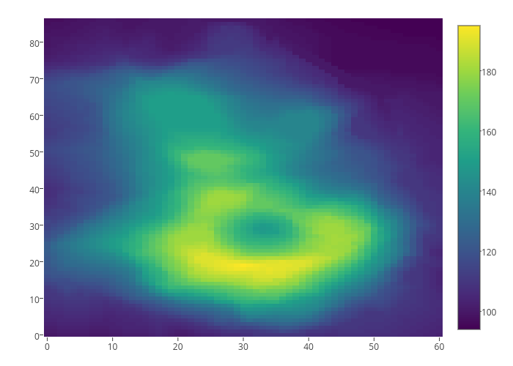
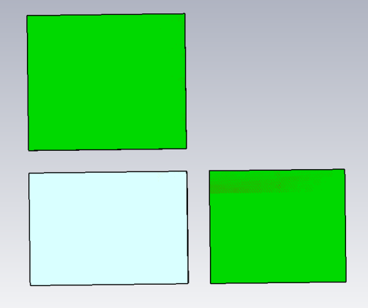
Example of 2nd order data SVD
2nd tensor,
matrix
2D heat map (matrix)
100 mesh steps
$$A=\left[\begin{matrix}0 & … & … & … & 0 \\ … & … & 111.13 & … & … \\ … & 55.1 & 79.1 & 16.12 & … \\ … & … & 192 & … & … \\ 0 & … & … & … & 0\end{matrix}\right]$$
heat map on
mesh grid (90,100):
90 mesh
steps
2D SVD, step by step:
$×_{1}$: treat row (1st dim) as vector to .......calculate inner product
$×_{2}$: treat column (2nd dim) as vector …….to calculate inner product
$×_{3}$: treat name? (3rd dim) as vector …….to calculate inner product
More familiar expressions:
(90,100)
$A=A^{′}×_{1}U^{\left(1\right)}$
$A=A^{′}U^{\left(1\right)}$
(90,100)
(100,100) a set of new bases
$$A^{′}=S×_{2}U^{\left(2\right)}$$
$${{A^{′}=(U}^{\left(2\right)})}^{T}S$$
(90,100)
(90,90)
Finally,
$A=S×_{2}U^{\left(2\right)}$ $×_{1}U^{\left(1\right)}$
$A={{(U}^{\left(2\right)})}^{T}$ $SU^{\left(1\right)}$
$U^{\left(1\right)}$
(100,100)
$$×_{1}$$
$$A$$
S
$$×_{2}$$
$U^{\left(2\right)}$
(90,100)
$$=$$
(90,100)
(90,90)
original data

Slide 7
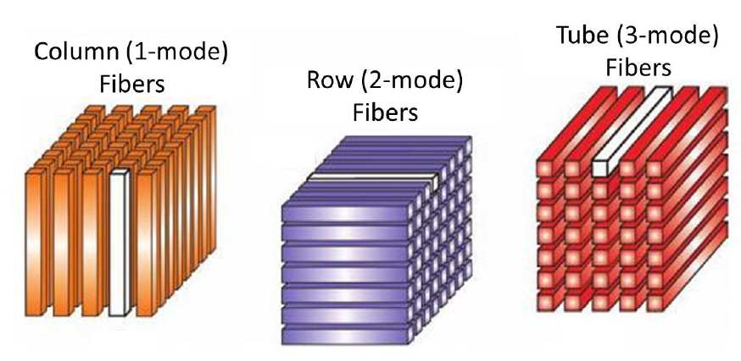
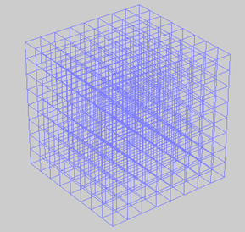
The $×_{n}$ operator:
discrete 3D distribution, e.g potential map, heat map, density map...
$$\left[\begin{matrix}1 & 2 \\ 3 & 4\end{matrix}\right]×_{1}\left[\begin{matrix}4 & 5 & 6 \\ 7 & 8 & 9\end{matrix}\right]×_{2}\left[\begin{matrix}1 & 4 & 2 & 3 \\ 2 & 1 & 0 & 1\end{matrix}\right]=\left[\begin{matrix}18 & 21 & 24 \\ 40 & 47 & 54\end{matrix}\right]×_{2}\left[\begin{matrix}1 & 4 & 2 & 3 \\ 2 & 1 & 0 & 1\end{matrix}\right]=\left[\begin{matrix}98 & 115 & 132 \\ 112 & 131 & 150 \\ 36 & 42 & 48 \\ 94 & 110 & 126\end{matrix}\right]$$
2X2 matrix is transformed to 4X3 matrix.
The process could be reversed if basis are orthonormal.

Slide 8
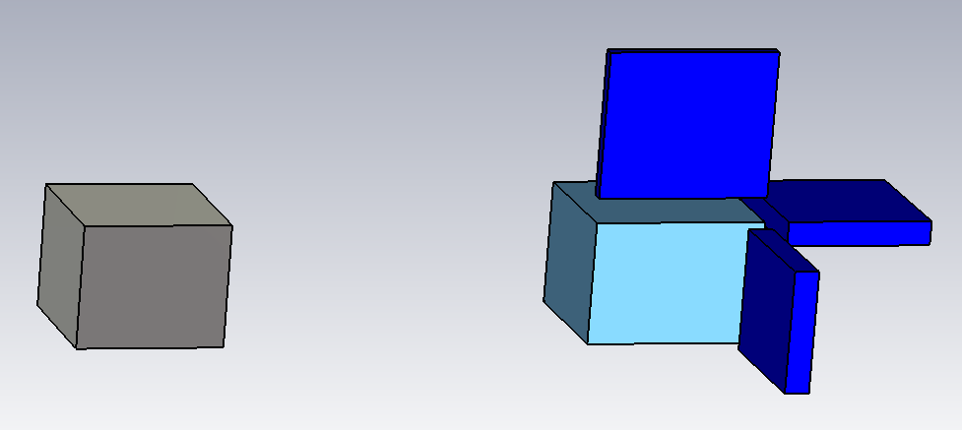
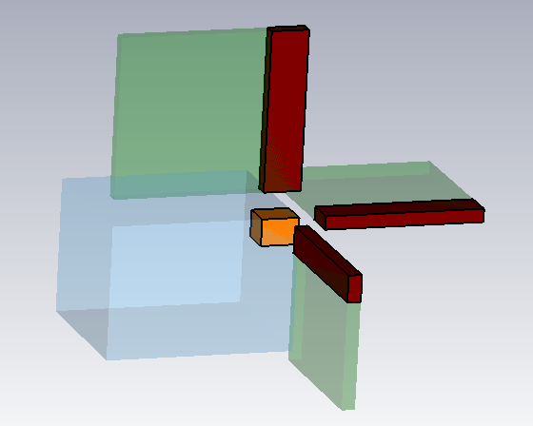
Example of 3rd order data SVD and compress
3 sets of singular vectors (square matrices)
$U^{\left(1\right)}$
(40,40)
A
(30,30)
HOSVD
(20,30,40)
S
$U^{\left(2\right)}$
(20,30,40)
(20,20)
$U^{\left(3\right)}$
3D heat map, with mesh grid 20*30*40 ($n_{z}$*$n_{y}$*$n_{x}$)
core tensor with shape (20,30,40)
$u^{\left(1\right)}$
$U^{\left(1\right)}$
(i, m)
finally, we get compressed data, a tensor with shape (2,3,4) and 3 sets of basis
dumped, because of too
small singular value
$U^{\left(2\right)}$
$A=S×_{3}U^{\left(3\right)}×_{2}U^{\left(2\right)}$ $×_{1}U^{\left(1\right)}$
Reduce
(i, j, k)
s
s
$u^{\left(2\right)}$
$A_{CR}=s×_{3}u^{\left(3\right)}×_{2}u^{\left(2\right)}$ $×_{1}u^{\left(1\right)}$
$S$
(j, n)
new core tensor
$u^{\left(3\right)}$
(k, p)
$U^{\left(3\right)}$
singular vectors with largest eigen-values
$A_{CR}$: compressed & recovered data
here: (2,3,4) components from new base were kept

Slide 9
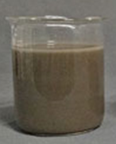
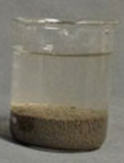
Generalize to tensor with $N^{th}$ order
Original data A is pre-stacked N^{th}-order tensor with shape($I_{1}, I_{2},…,I_{N}$), decomposition by HOSVD is
$$A=S×_{1}U^{(1)}×_{2}U^{(2)}⋯×_{N}U^{(N)}$$
where $A∈R^{I_{1}×I_{2}×…×I_{N}},$ $S∈R^{I_{1}×I_{2}×…×I_{N}}$, $U^{(N)}∈R^{I_{N}×I_{N}}$
=
data is represented by coefficient tensor S and basis ($U^{(n)}$, 1≤n≤N), then $U^{(n)}$ are cut to $u^{(n)}$ according to its singular value:
$\hat{A}=s×_{1}u^{(1)}×_{2}u^{(2)}⋯×_{N}u^{(N)}$
where $\hat{A}∈R^{I_{1}×I_{2}×…×I_{N}}$ , $\hat{A}≈A$, $s∈S$, $u^{(n)}∈U^{n}$
basis with high singular values (data essence) are preserved!
s and $u^{(n)}$ is compressed data, $\hat{A}$ is de-noised data.
≈

Slide 10
Data recovery /de-compress/ inquire
extract data value $f_{j_{1}j_{2}⋯j_{N}}$ on specific mesh node $j_{1}j_{2}⋯j_{N}$:
$$f_{j_{1}j_{2}⋯j_{n}}=s×_{1}{u_{j_{1}}^{}}^{(1)}×_{2}{u_{j_{2}}^{}}^{(2)}⋯×_{N}{u_{j_{N}}^{}}^{(N)}$$
where ${u_{j_{n}}^{}}^{(n)}$ is the $j_{n}$^{th} column of $u^{(n)}$
$\left[\begin{matrix}1 & 2 \\ 3 & 4\end{matrix}\right]×_{1}\left[\begin{matrix}4 & 5 & 6 \\ 7 & 8 & 9\end{matrix}\right]×_{2}\left[\begin{matrix}1 & 4 & 2 & 3 \\ 2 & 1 & 0 & 1\end{matrix}\right]=\left[\begin{matrix}21 \\ 47\end{matrix}\right]×_{2}\left[\begin{matrix}1 & 4 & 2 & 3 \\ 2 & 1 & 0 & 1\end{matrix}\right]=$ 42
$$s$$
$${u_{2}^{}}^{(1)}$$
$${u_{3}^{}}^{(2)}$$
$$f_{2,3}$$
use one column of each set of basis, the result will be scalar field value on specific mesh node.
Use complete basis that preserved, the result will be entire field map.
$u^{\left(1\right)}$
$U^{\left(1\right)}$
(i, m)
$U^{\left(2\right)}$
$S$
(i, j, k)
s
$u^{\left(2\right)}$
(j, n)
new core tensor
$u^{\left(3\right)}$
(k, p)
$U^{\left(3\right)}$

Slide 11
Advantage of transformed data
Much less data volume
Practically noise-free
High efficient data extraction: the extraction of de-noised data is done through multi-linear mapping rather than through time consuming memory search. The efficiency of beam dynamic simulation codes can by improved accordingly, if such compressed field map are used

Slide 12
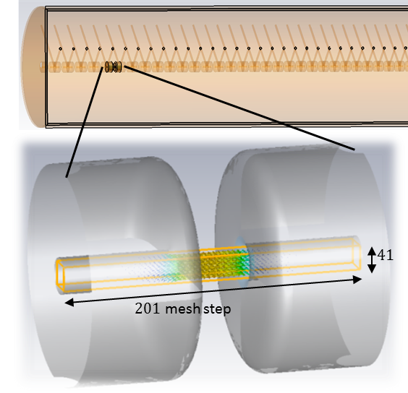
E-field map data of 1st cavity of new Alvarez-DTL
original field map is a 5th order tensor with shape (55, 201, 41, 41, 3), i.e.,
it comprises 55*201*41*41*3 = 5.5*10⁷ entries
tank1 comprises 55 cells
55 DTL cells
201 z-nodes per cell
41 x-nodes per cell
41 y-nodes per cell
3 field components per node: Ex,Ey,Ez
to “address“ a single field value, 5 infos needed, i.e., which:
cell, z-node, x-node, y-node, component
→
To each cell 201*41*41(long.*hor.*ver.)
mesh nodes are assigned.
3 field components on each mesh node.

Slide 13
Field map data set size after compression
after HOSVD and reduction:
(55, 201, 41, 41, 3)
shape of s: (3,8,4,4,3)
shape of $u^{\left(1\right)}$: (3,55)
shape of $u^{\left(2\right)}$: (8,201)
shape of $u^{\left(3\right)}$: (4,41)
shape of $u^{\left(4\right)}$: (4,41)
shape of $u^{\left(5\right)}$: (3,3) as no field component shall be lost !
total file size : 20 KB
dimension of original data -> fixed
from desired amount of compression ->
(to be shown later …)
compression factor ≈ 10000

Slide 14
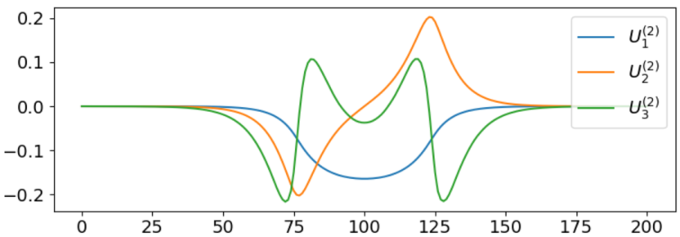
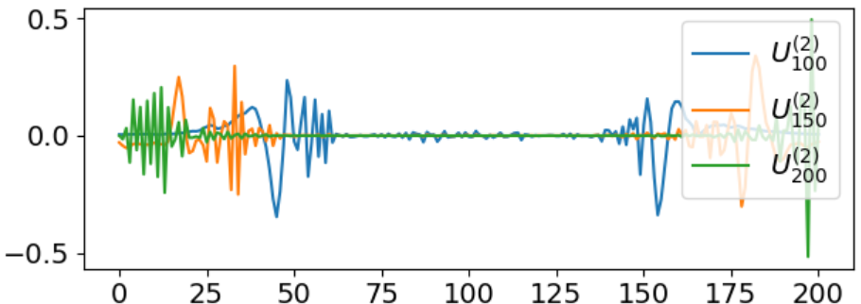
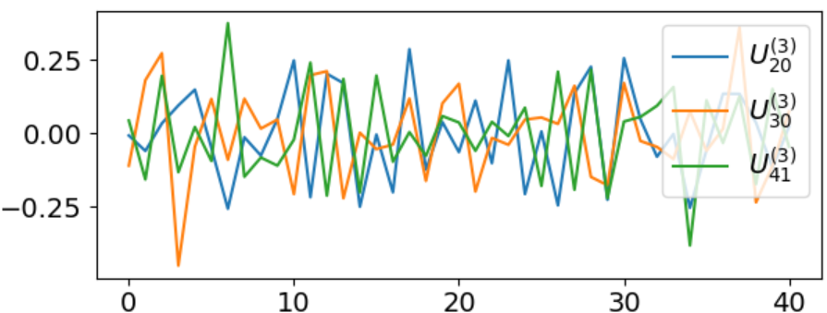
What the singular vectors looks like
high value singular vectors
low value singular vectors
z-node
z-node
distribution along z axis is linear
combination of ${U_{}^{(2)} }_{1\sim 8}$. The 1st singular vector is very similar to $E_{z}(z)$
noise-like, no physical meaning, should be cut
x-node
x-node
distribution along x axis is
linear combination of ${U_{}^{(3)} }_{1\sim 3}$
noise-like, no physical meaning, should be cut

Slide 15
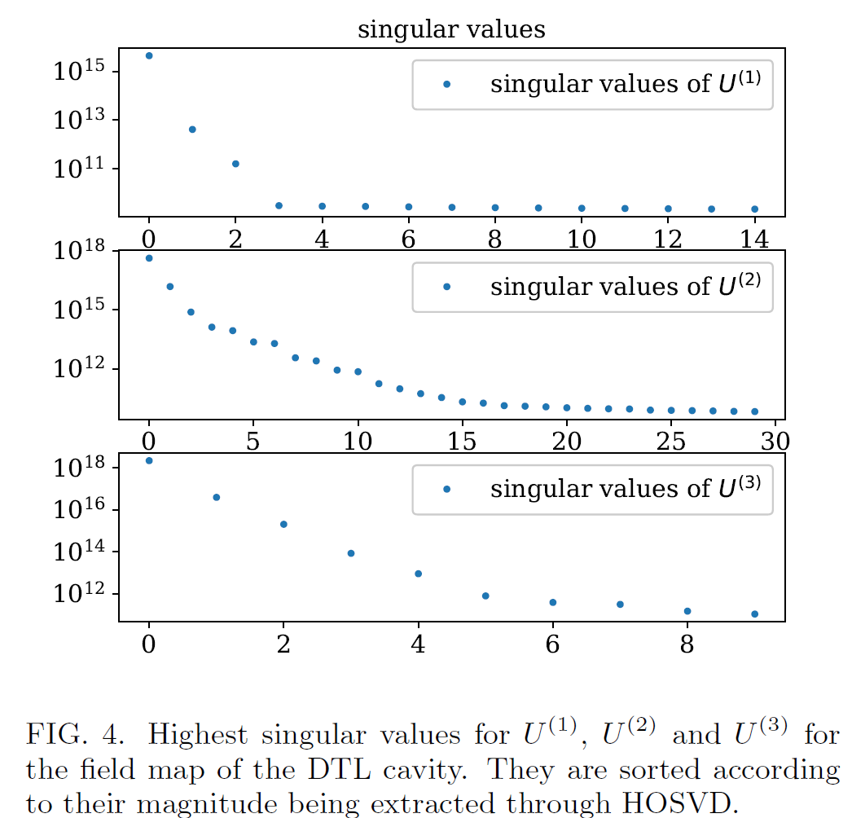
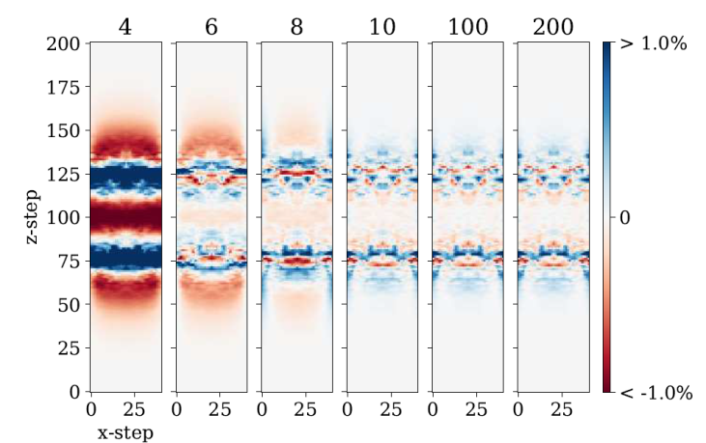
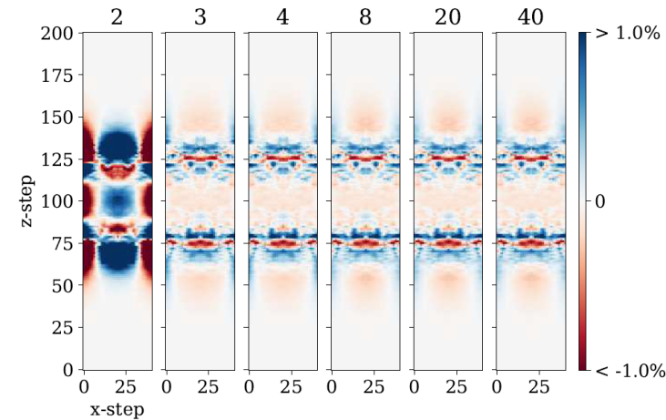
Determine number of base components to be kept, i.e., the compression factor
original: (55, 201, 41, 41, 3)
choice made as (3,8,4,4,3)
why not (5,15,8,8,3) or (3,3,3,3,3)?
change second index:
loss of essential data
too much useless
data
change third index:
Threshold is set to 1/10000 of the largest singular value, which is beyond expected accuracy of field map.
loss of essential data
too much useless
data
15

Slide 16
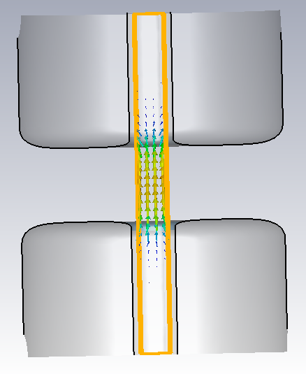
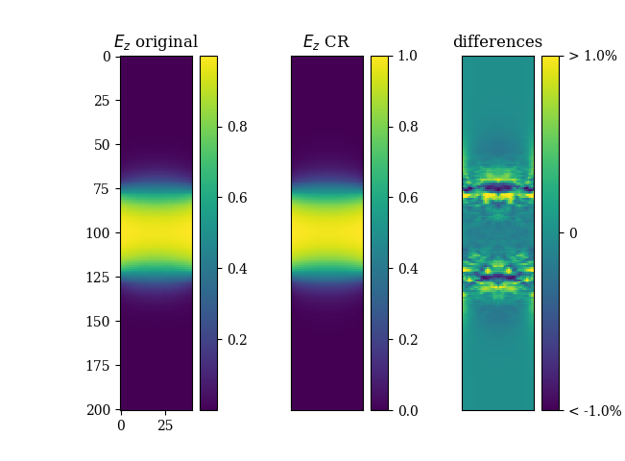
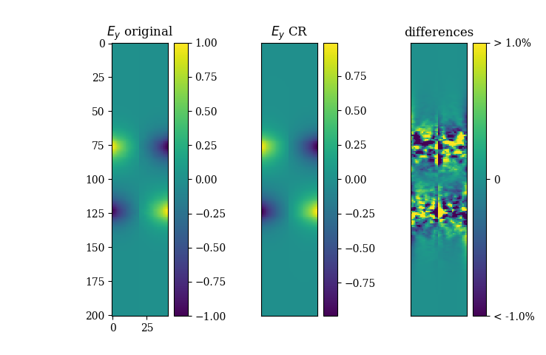
Quality of compressed field map data
z
y
x
comparing original data (55,201,41,41,3)
with compressed & recovered data (3,8,4,4,3)
CR: compressed and recovered
maybe CR data is worse because some “true information” is dumped
maybe CR data is better, because noise is dumped
check of quality ...

Slide 17
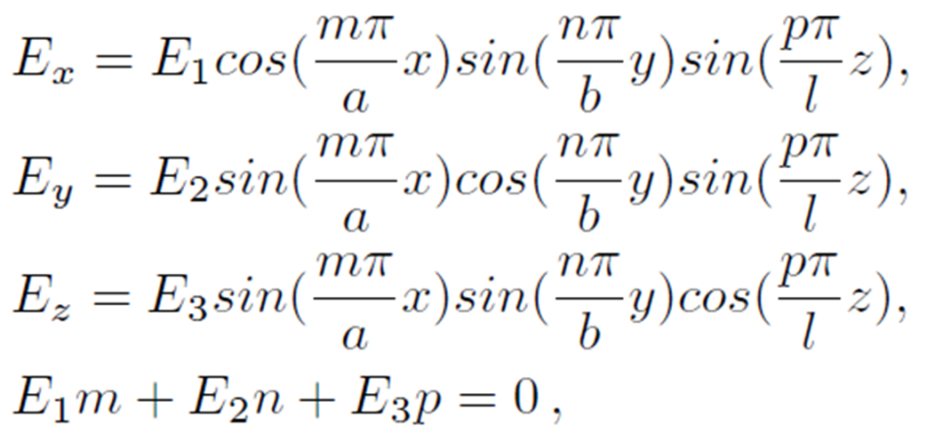
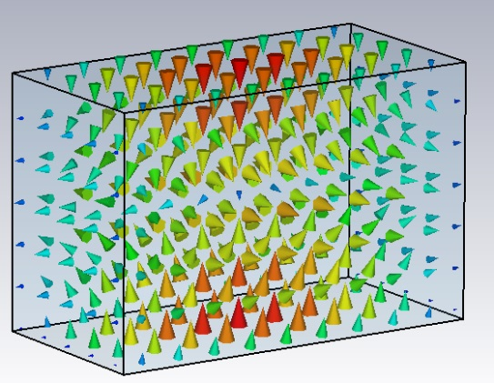
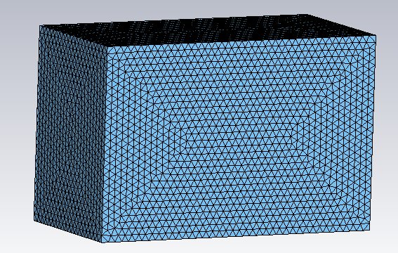
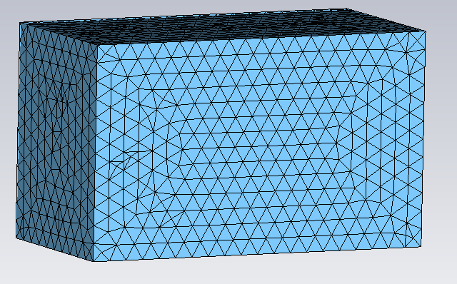
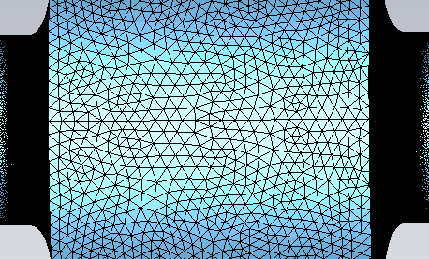
Example box cavity:
simulated and analytical field map
$$a$$
$$b$$
y
$$l$$
z
x
a = 100 mm; b = 130 mm; l = 200 mm;
m = 1; n = 1; p = 1
rf gap
good mesh
poor mesh
typical DT mesh

Slide 18
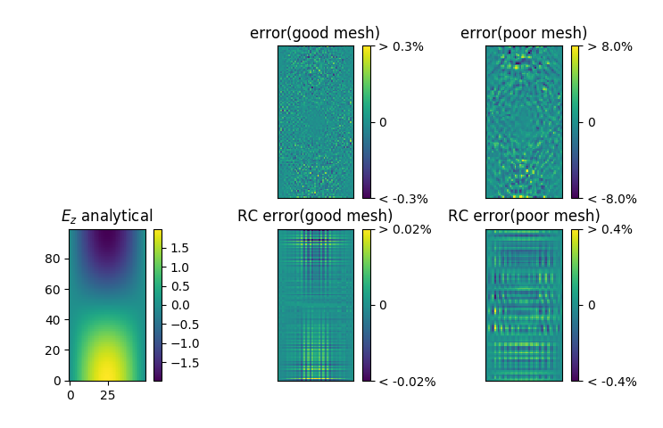
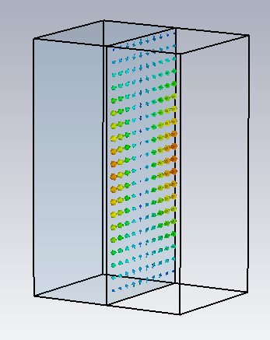
Check field distribution at arbitrary 2D slice :
deviation from “analytical“
z
x
y
Comparisons of originally simulated field map and of de-noised (RC) field map reveals that the algorithm reduces the amount of noise for both mesh types, and the analytical field values are reproduced. Additionally, the data volume to be stored is significantly reduced during field extraction

Slide 19
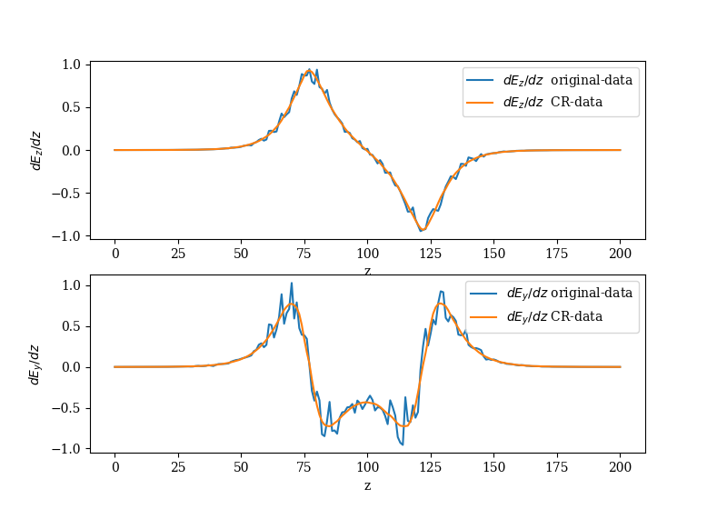
Analyzing field smoothness inside DTL gap
check field distribution at arbitrary off-axis position :
$\frac{dE_{z}}{dz}$ and $\frac{dE_{y}}{dz}$ along z axis, x=10, y=10 (node)
smoothness of E_{z} and E_{y} distribution is hard to see directly
smoothness of their derivatives d/dz is easy to see
CR-data is much smoother, hence with physical meaning (it is in fact much closer to analytical solution)
un-physical field ripples give kicks to particles in beam dynamics simulations
these kicks are not real and lead to artificial beam heating
this is of concern for circular machines (many passages through noisy field maps)

Slide 20
Summary
Data volume of the field map is compressed dramatically by four orders of magnitude
Compression also reduces field map noise caused by finite element method
Applicable to any kind of field maps
Paves way to develop a high efficiency particle simulation code that uses compressed field map
Details in
Thank you!
one more slide below for a frequently asked question.

Slide 21
Shortcut for calculation of n-mode SVD
$B∈R^{55∗201∗41∗3×41},$a bunch of 41-dimensional vectors, $V_{hijk}∈R^{41}$ is one of it’s elements
several ways to get right side singular vectors numerically.
Original way:
Eigen decomposition on $B^{T}B$ to get singular vectors.
it is announced that calculation of $B^{T}B$ is time consuming.
poor accuracy for low singular value part.
improved numerical methods:
iterative, save the effort of calculating $B^{T}B$ , more precise.
$$B^{T}B=\sum_{n=1}^{201∗55∗41∗41∗3}{{B_{n}}^{T}B_{n}}=\sum_{h=1}^{55}{\sum_{i=1}^{201}{\sum_{j=1}^{41}{\sum_{k=1}^{3}{{V_{hijk}}^{T}V_{hijk}}}}}=\sum_{i=1}^{201}{\sum_{j=1}^{41}{\sum_{k=1}^{3}{M_{ijk}{M_{ijk}}^{T}}}}$$
$$M_{ijk}{M_{ijk}}^{T}=\sum_{h=1}^{55}{{V_{hijk}}^{T}V_{hijk}}$$
$$M_{ijk}∈R^{55×41}$$
$B^{T}B$is mentioned as square-sum matrix C in the paper.
we already have pre-stacked data, not necessary to unfold to huge matrix B

