Slide 1
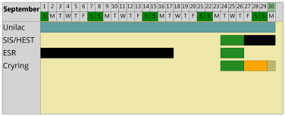
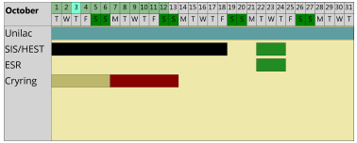
machine status
CRYRING@ESR & HITRAP
CRYRING@ESR
- electron cooler – still no success with the cryostat
further attempts are planned for September and later, but we do not count on the ecooler for the next beamtime
coordination with the user: Sept. beamtime still ongoing, also if the detectors & scrapers are not 100% ready
detectors partially arrived, the users are preparing them (ATP & Jena)
implement a local baking solution in YR09 (DEC team)
dipole - HF delay discussion, tests ongoing
HITRAP
possible graduate
students in autumn
C⁺

