Slide 1
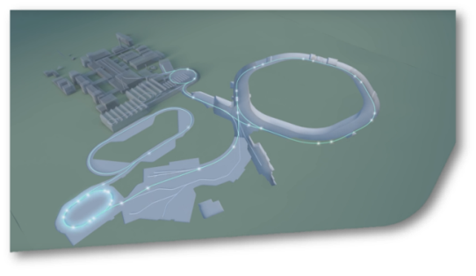
SIS18 Status Report KW33
SIS18
A high priority has been set to an immediate start of the procurement of a transformer which serves the SIS18 quadrupole power converter. The transformer has been identified as critical component. A process for advanced provision of budget for 2020 has been launched with the goal of an immediate start of the procurement process.
Negotiations for the design of the new extraction septum are ongoing.
The fixation of the coil of the TS1MU1 magnet is still under preparation. I first attempt in July could not be completed successfully. Further components have to be procured by the manufacturer DANFYSIK.
The beam pipe has been installed in the new micro spill structure cavity.

