Slide 1
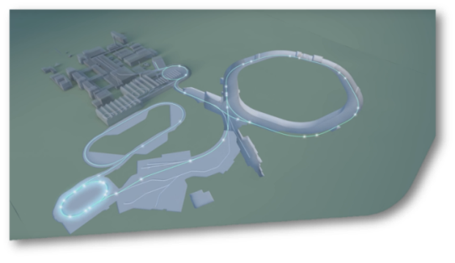
SIS18 Status Report KW32
SIS18
Assembly of new TK chopper system completed. A few thausend chopper pulses have been generated. The rise time is significantly shorter than with the old chopper system, leading to less uncontrolled beam loss.
One new offer has been received for the design of the new, prolongated SIS18 electrostatic extraction septum.
The new IPM power converters are connected to the IPM magnets. Power tests will be conducted as soon as the PSU controls system is operational (>A. Kainberger). After completion of the tests, the IPM system can be moved into the tunnel.
Visite of Darmstadt fire brigade. Inspection of the SIS18 tunnel to identify suitable attack routes.

