Slide 1
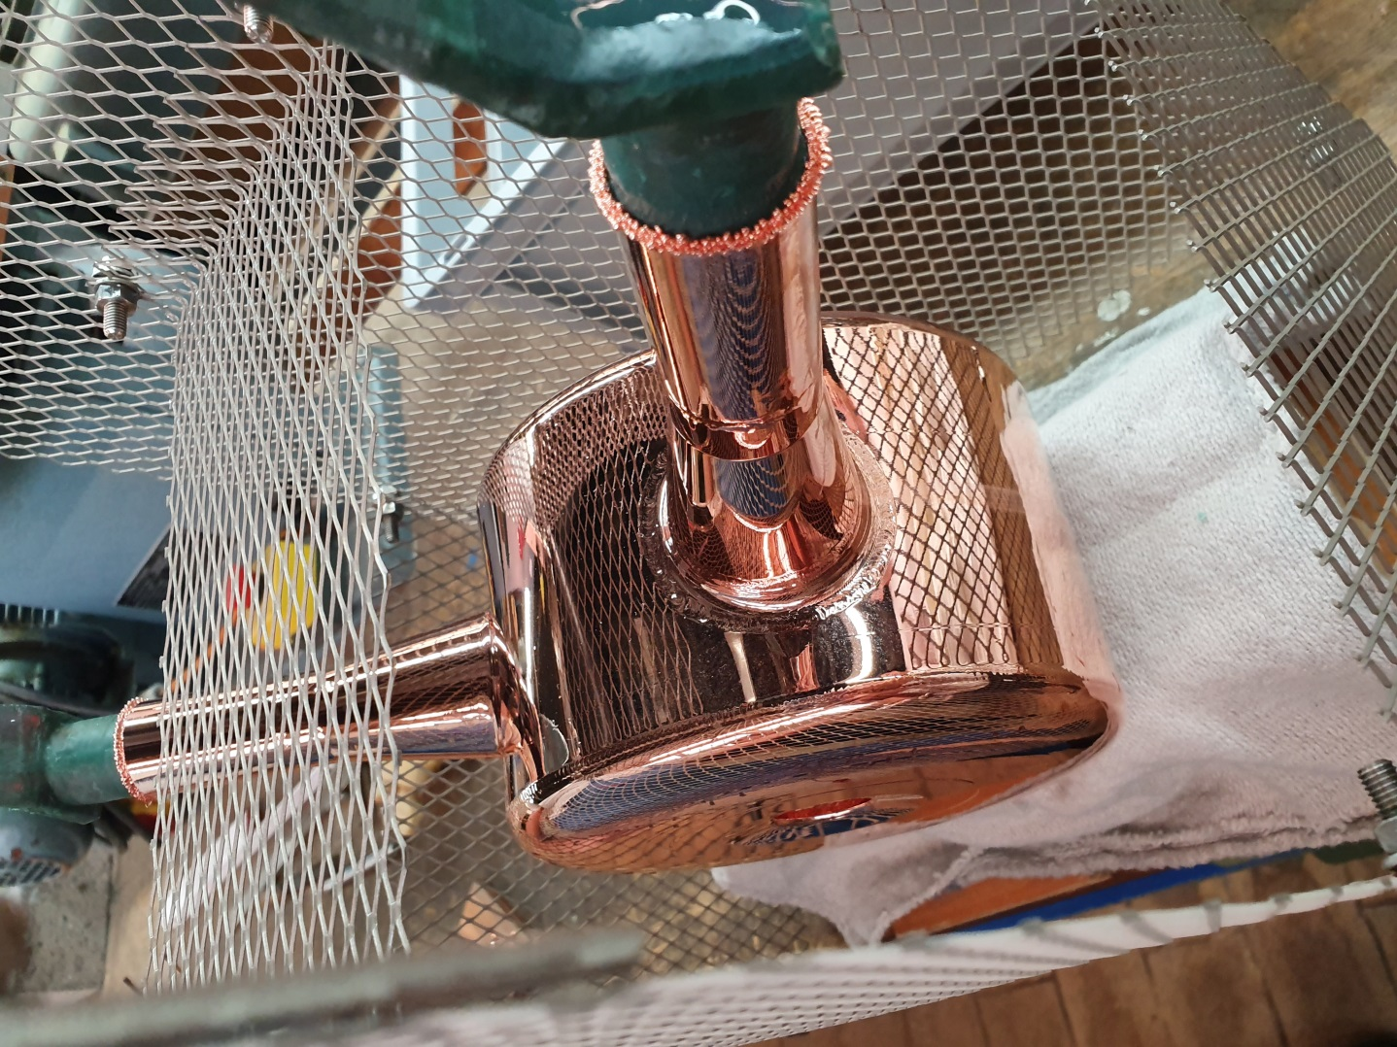
Milestone: successful Cu plating of the Alvarez demo cavity with new bath arrangement
Very high quality high-gloss
Cu layer of about 100 mikrons.
Anode geometry is optimized.
Chemical parameters adjusted
and fixed by laboratory
measurements.
Main parameter to be changed
is the current density which is
about 4 A/dm^2.
Lowering I is better for high-gloss, but enhances unwanted Cu growth near edges.
This effect can be minimized by
“dimming out”, i.e. inserting a
Cu wire nearby the edge. It must
be electrically connected to the
component, i.e. in this case the
wire takes major parts of the
current and therefore collects
the Cu ions on its surface.
Anode
lower current:
higher gloss vs.
Cu growth at edges

