Slide 1
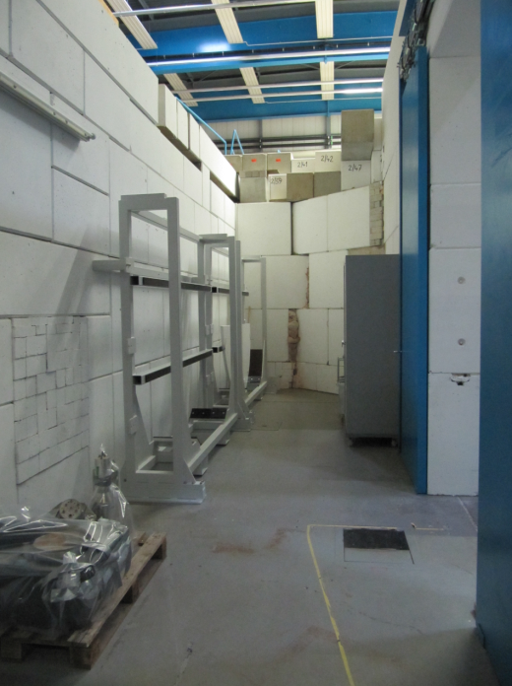
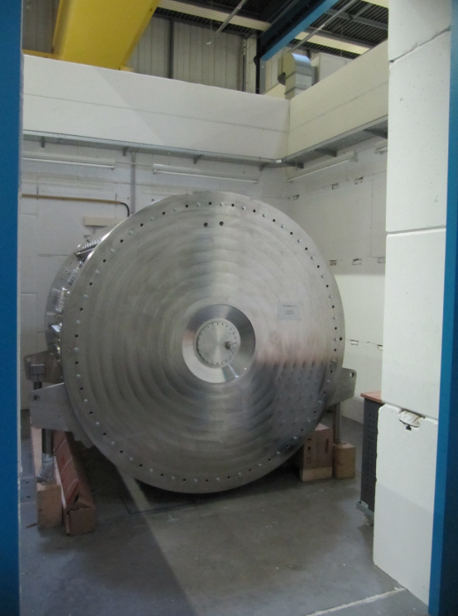
MM 06.08.2019 - PSU
Alvarez 2.0
FoS
Equip and prepare Z7 to continue SAT
Announcement

