Slide 1
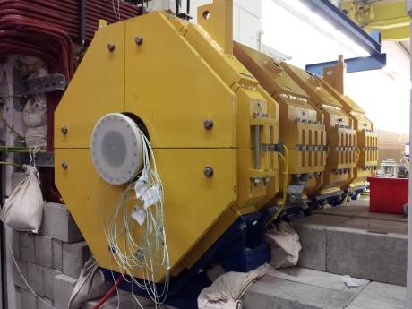
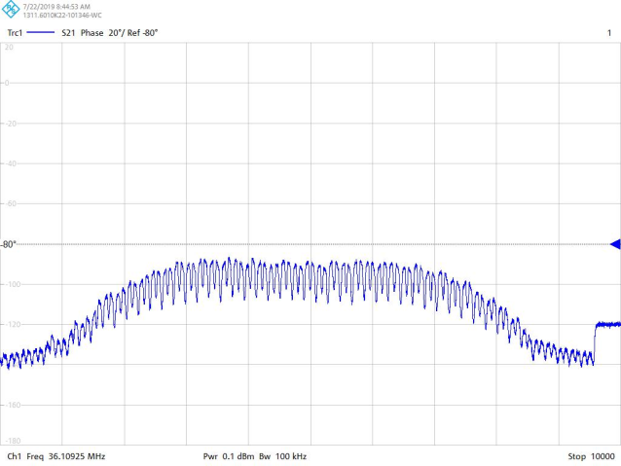
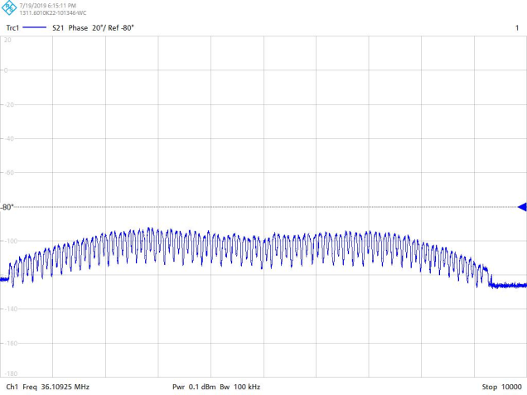
Machine meeting 16.7.19 - UNILAC
LEBT QQ beam pipe:
A-Tube: 2nd try for mounting the cooling jacket last week
Meeting 20. August for discussion of measurement results
HSI RFQ:
Setup for LLRF measurements completed
LLRF measurements started end of last week, RFQ looks good
Differences between some measurements not understood, so far no severe problem assumed
Vacuum controls upgrade
ongoing

Slide 2
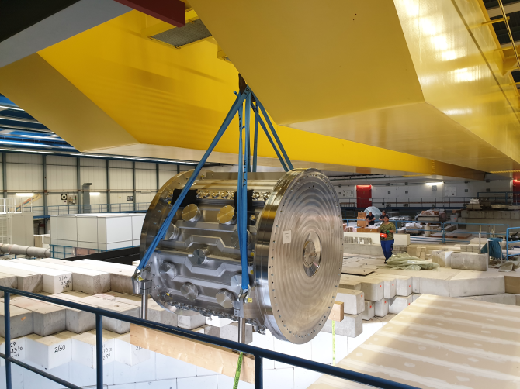
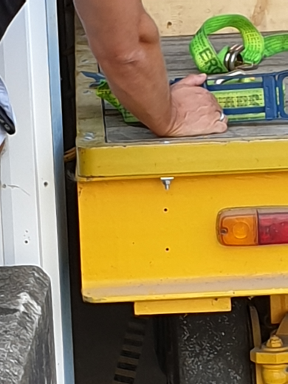
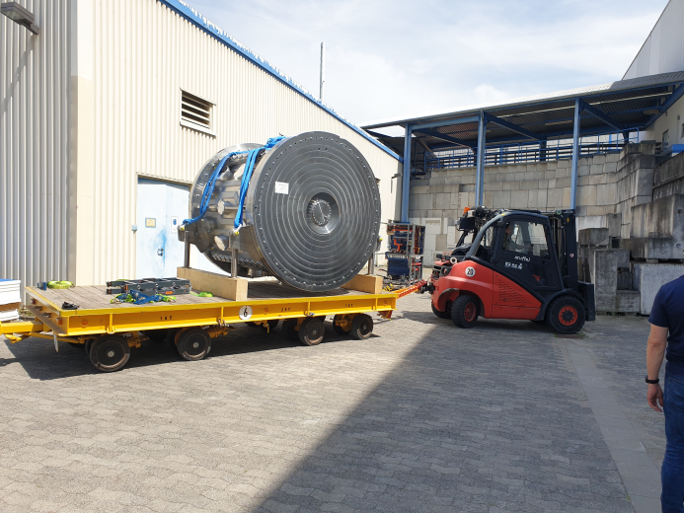
MM 23.07.2019 - PSU
Alvarez 2.0
FoS
Vacuum test successful (rubber sealed)
Yesterday: FoS is taken home (Z7)
next steps: SAT to be continued @Z7
Visit of BMBF (17.7.)
Mr Landvogt, “Controlling; Interne Prüfsysteme; Qualitätsmanagement”
immediately understanding for substitution, positive feedback
ROSE 4D emittance scanner:
SAT completed at HIT / Heidelberg
Further steps discussed with NTG
invitation to “contributed talk“ at IBIC 2019 (NTG, GSI)

