Slide 1
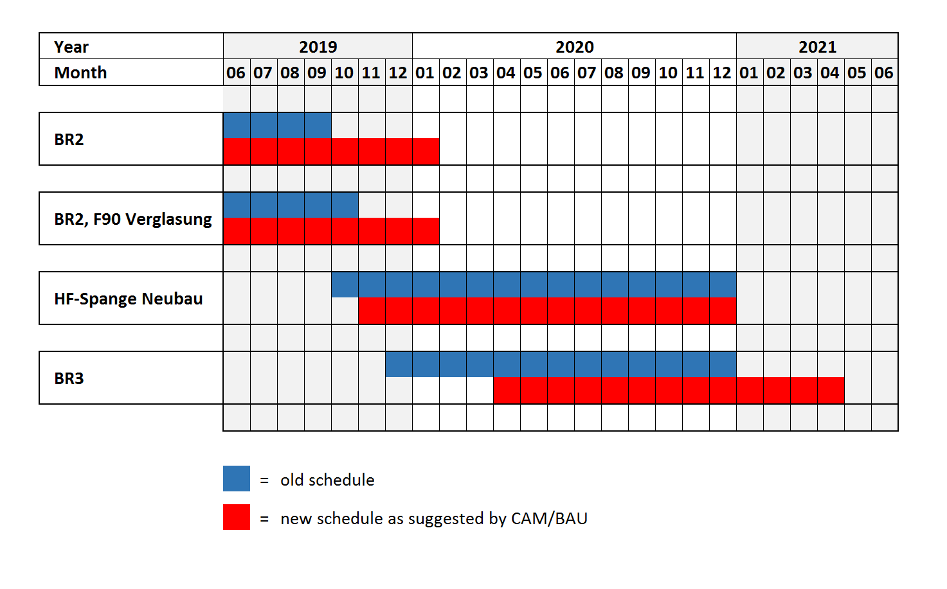
New schedules for BS&TGA renovation

Slide 2
Possible delay for the refurbishment of Großmontage
building permit for the replacement area in the „Testinghalle“ has yet not been granted
therefore, compliance with the original timetable (09/2019-12/2019) is uncertain
the time window for the replacement area in the „Testinghalle“ closes 01/2020!
COM/TRI is currently working on a plan B
implications for ACC operating and shutdown activities in 2020:
  ???? – must be discussed in detail

