Slide 1
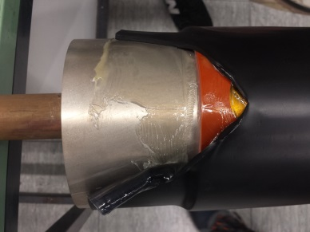
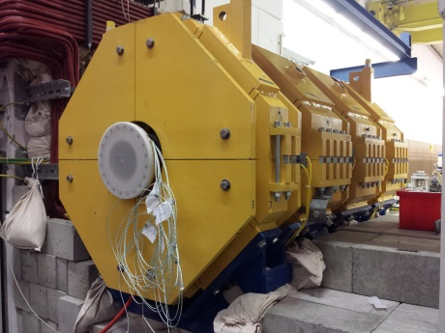
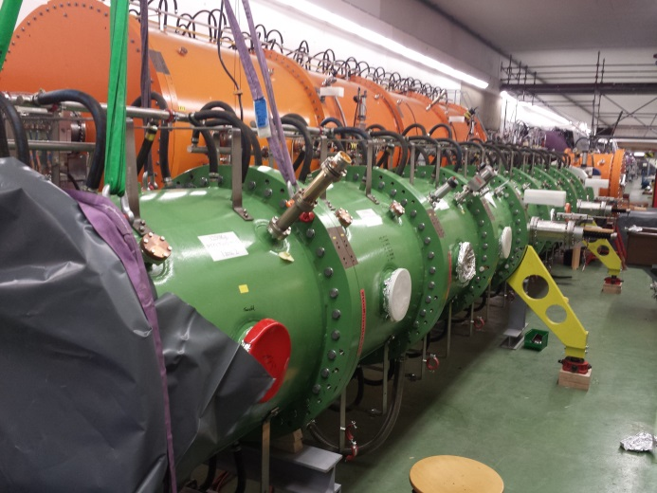
Machine meeting 16.7.19 - UNILAC
LEBT QQ beam pipe:
A-pipe: welding finished, leak tested, okay,
mounting of cooling jacket successful, but...
test with backup tube done (8th – 10th July)
test with unloaded magnet done (11th and 12th July)
HSI RFQ:
9 sections re-assembled
now working on 10th section
...for setup for LLRF measurements
Vacuum controls upgrade
connecting of contactor controllers continued

Slide 2
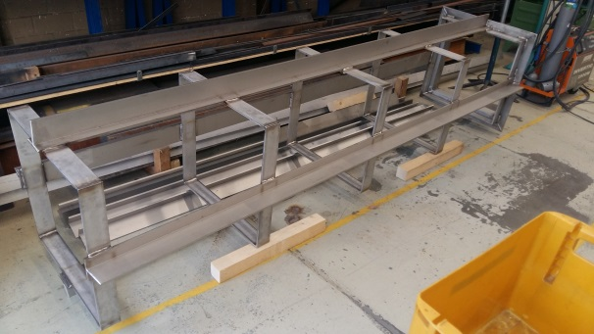
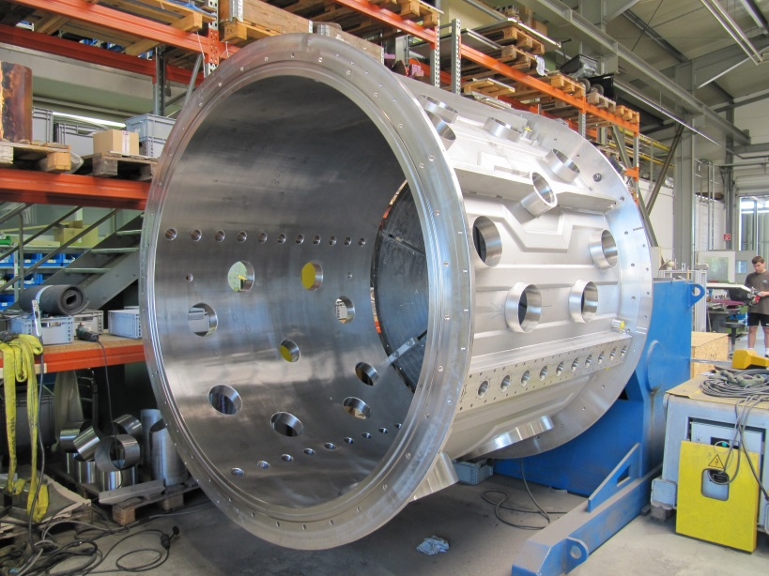
Machine meeting 2.7.19 - UNILAC
Vacuum controls upgrade:
LSB2: on schedule
Equipping and connecting of new racks in progress
connecting of contactor controllers continued
LSB4: on schedule
New racks in place
Mounting of contactor controllers continued
FoS:
ready for UHV FAT -> next Monday together with VAC
Cu cathode supports production proceeds well
drift tube with quadrupole ordered

