Slide 1
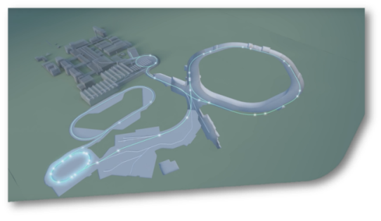
SIS18 Status Report KW29
SIS18
FAT and SAT of IPM and TS1MU1 power converters completed.
Revision of IPM vacuum chamber by Pfeiffer completed.
Details of SIS18 shut down activities discussed and scheduled with all involved technical departments. No resource issues communicated by technical departments (see minutes)
„Anlagenverantwortlicher“ for Nitrogen fire protection system assigned in dpt. GAT (A. Sachs).
Expertise finalized on mitigation options for the water leak (building) on top of the kicker room.
GAF work continues till 18th August. Authoritie‘s checks will start first week of September

