Slide 1
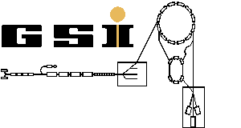

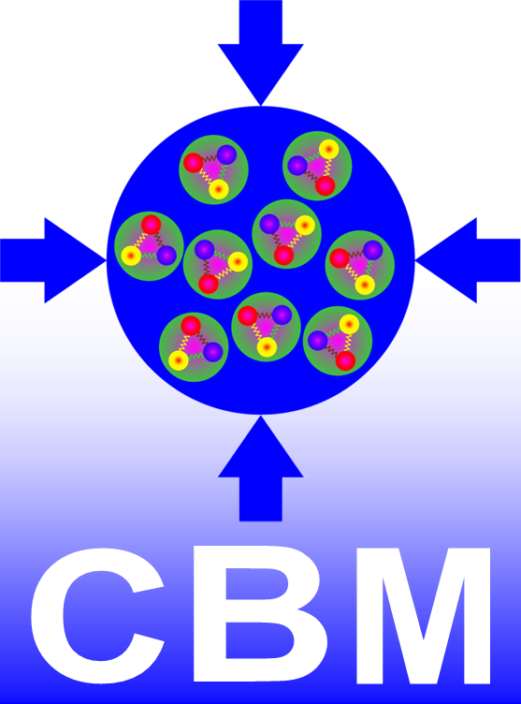
Event Reconstruction in the Tracking System of the CBM Experiment
Volker Friese
GSI Darmstadt
for the CBM Collaboration
International Conference on Mathematical Modelling and Computational Physics
Stara Lesna, 4 July 2019

Slide 2
Outline
Setting the stage
  FAIR and the CBM experiment
  The reconstruction task
Some selected reconstruction problems
  Cluster finding
  Cluster fitting
  Hit finding
  Track finding
  Event finding
Summary

Slide 3
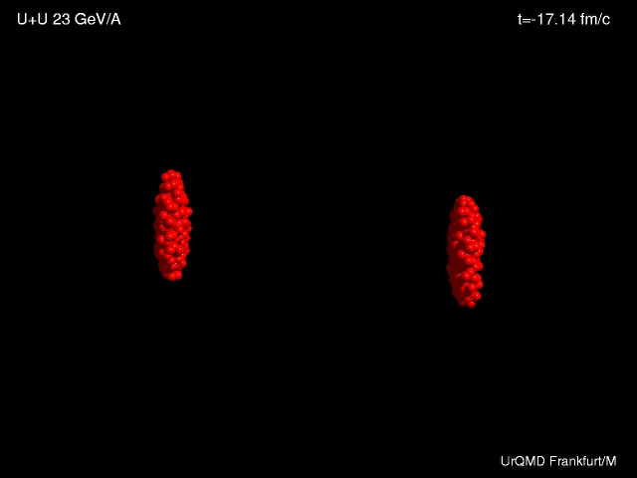
What we do in heavy-ion physics

Slide 4
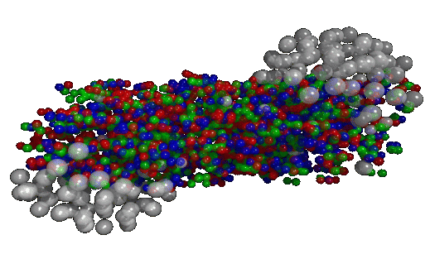
What we do in heavy-ion physics
The Hope:
Learn from the multitude of emitted particles (final state) about the state of the matter immediately after the collision (early state)
The Task:
Detect the final-state particles as completely as possible and characterise them w.r.t. momentum and identity (π, K. p, …)

Slide 5
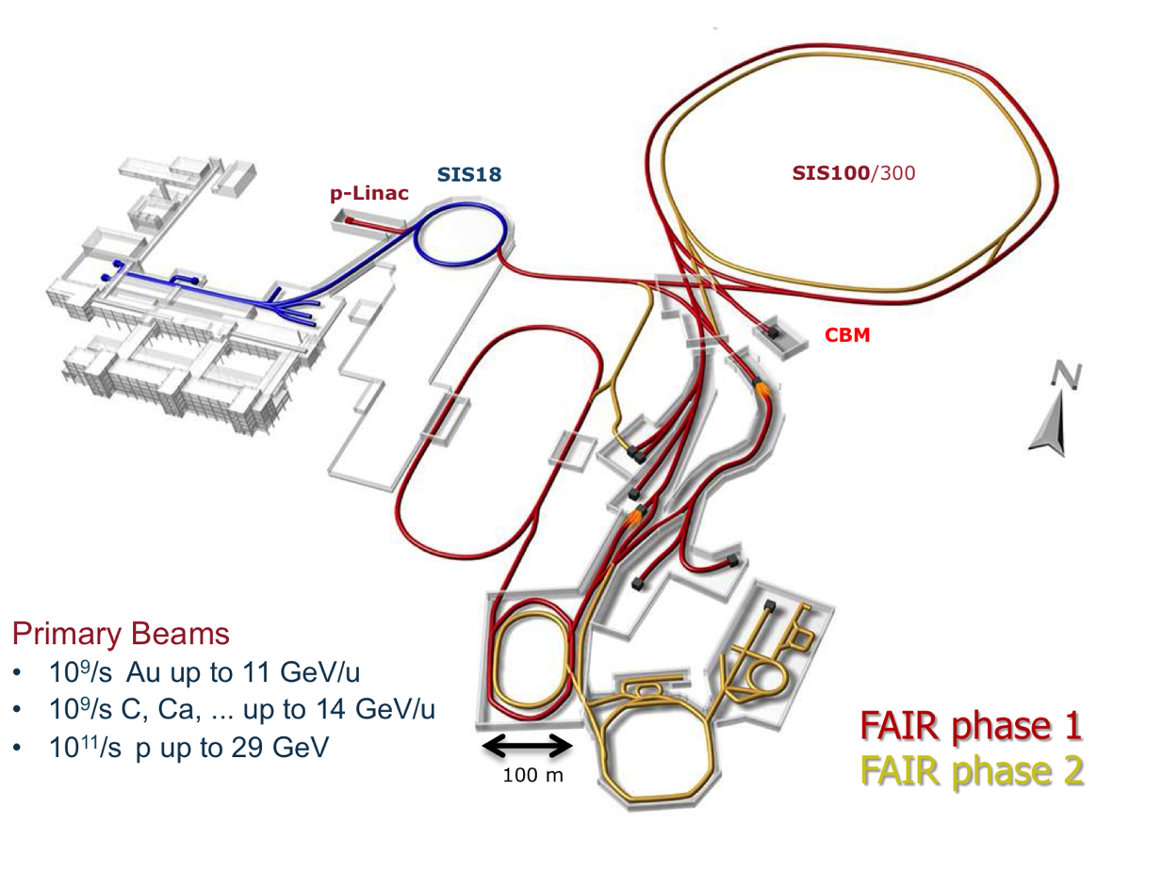
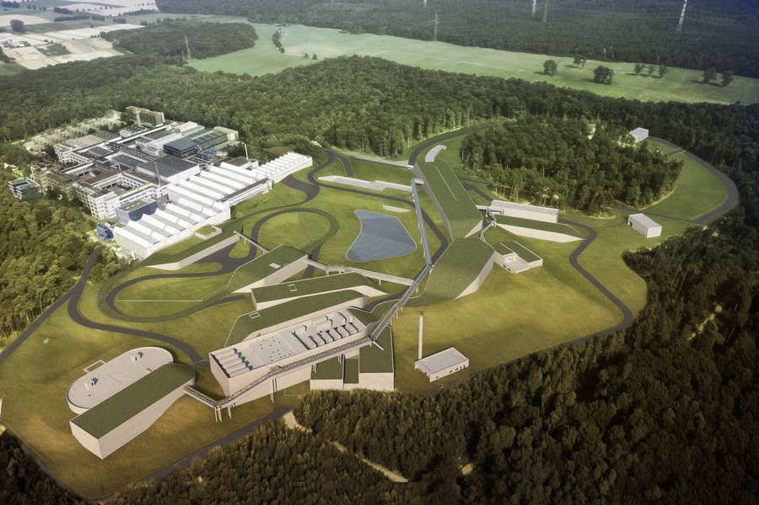
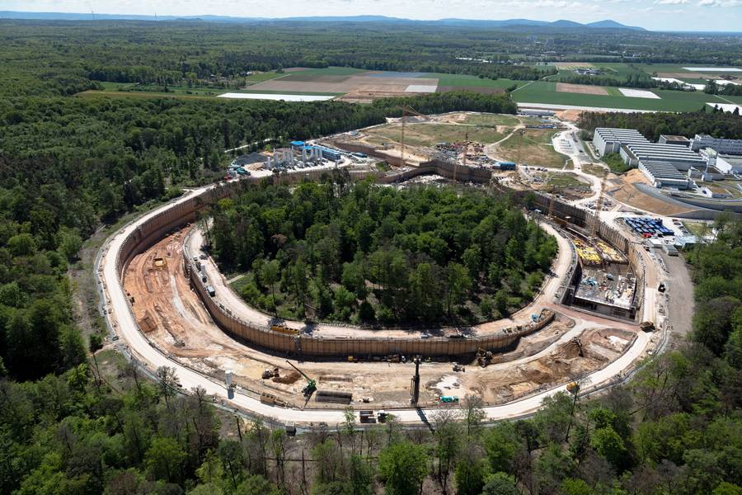
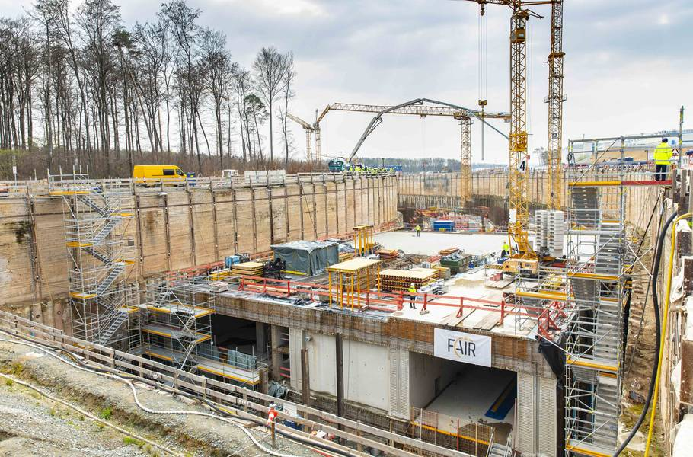
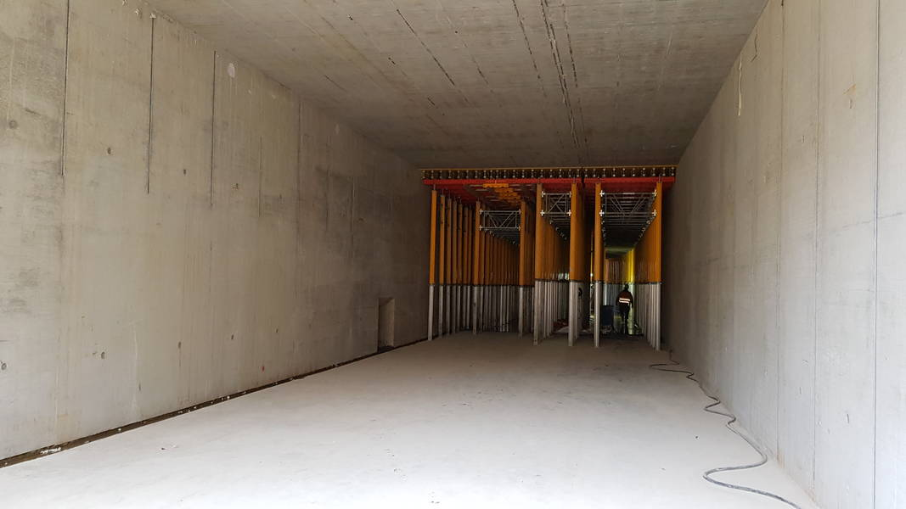
Facility for Antiproton and Ion Research (FAIR)
An accelerator-based research facility currently under construction in Darmstadt, Germany
Completion / start of operation in 2025

Slide 6
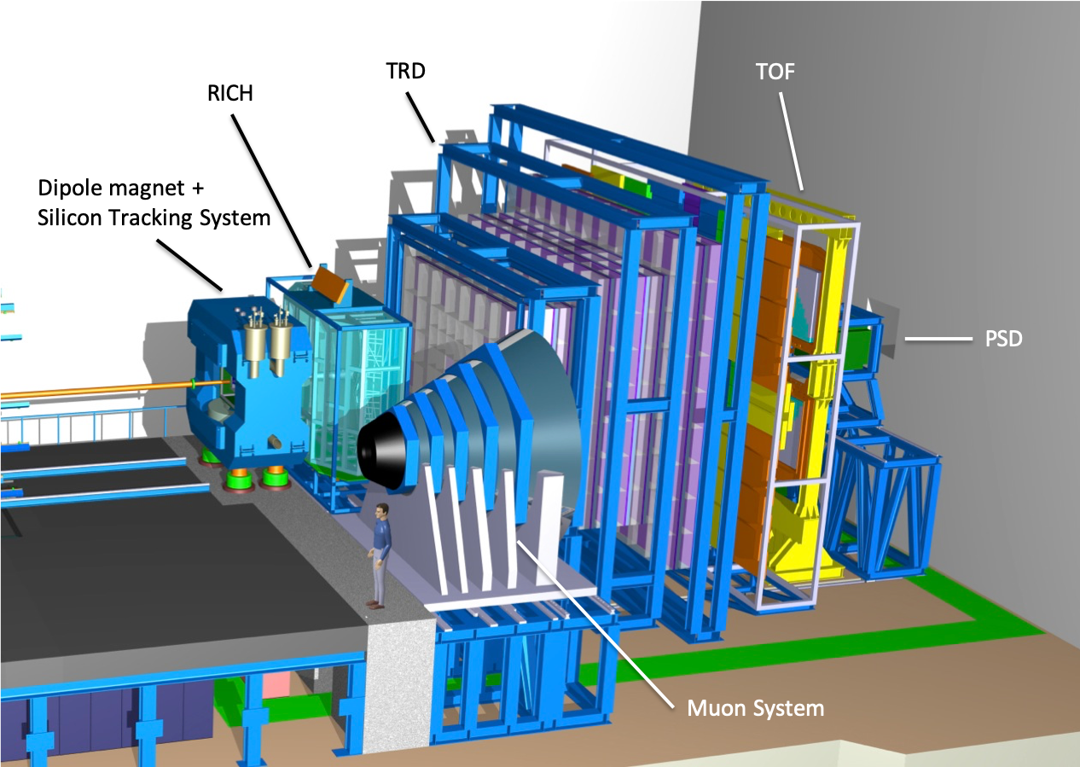
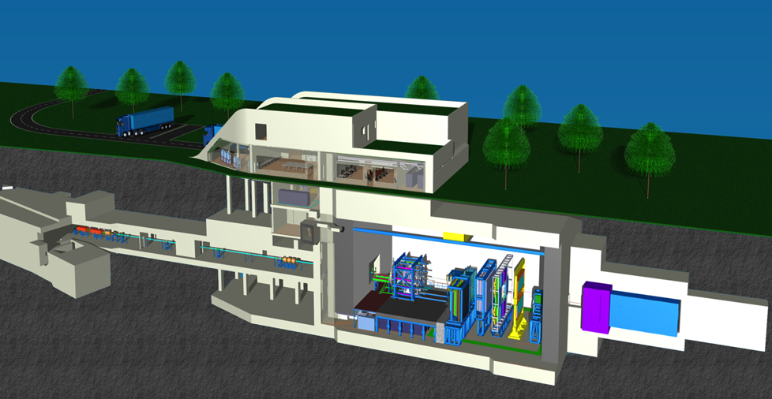
The CBM experiment
A large-acceptance, fixed-target experiment
Measuring nuclear collisions in the energy range 2 - 35 GeV/u
Identify hadrons, electrons and muons

Slide 7
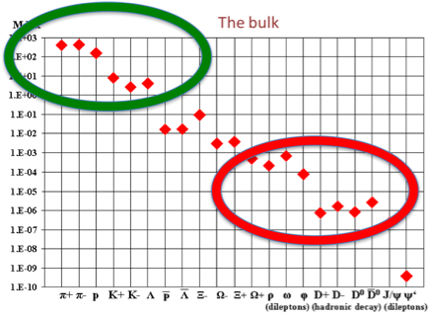
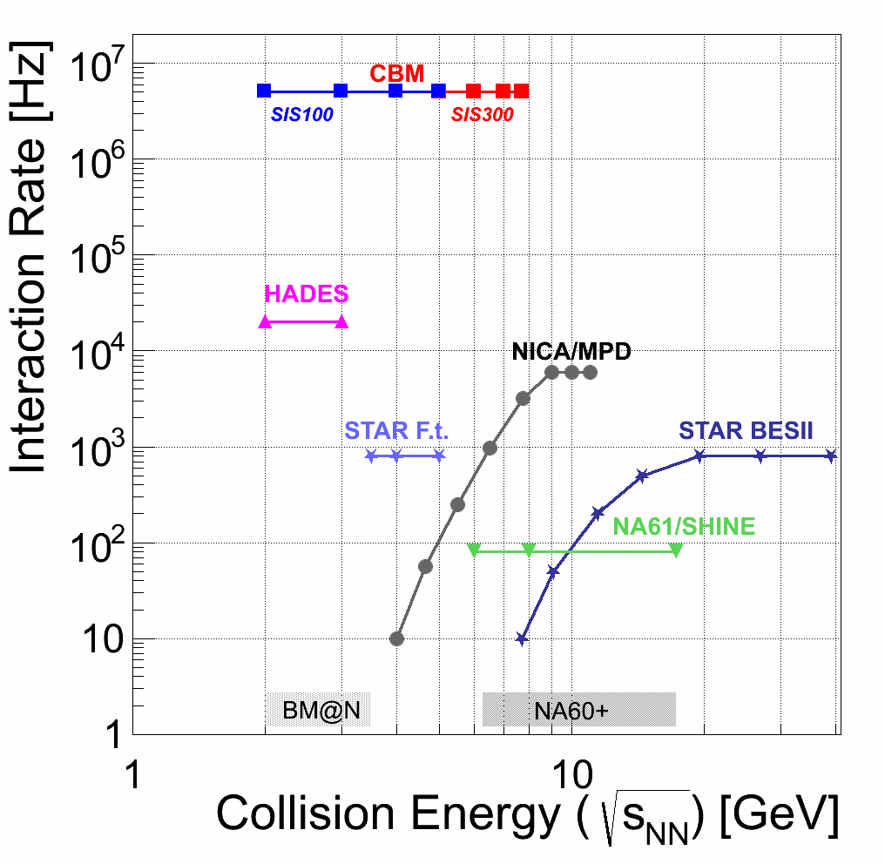
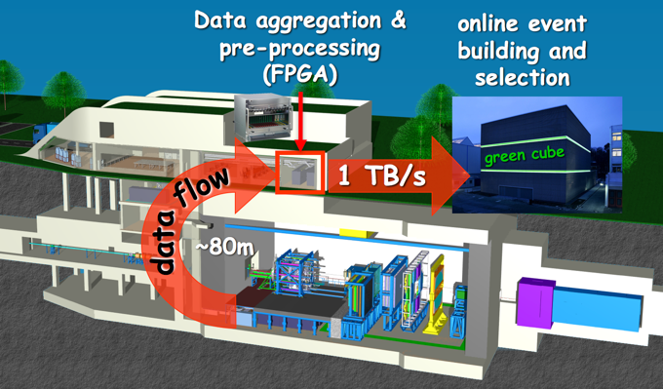
What’s particular in CBM?
Access to extremely rare observables
Requires very high interaction rates (> 1 MHz)
Novel readout concept:
No hardware trigger
Autonomous, self-triggered electronics
Inspection of the full data stream in software and selection in real-time.

Slide 8
What means “Reconstruction”?
Particles cross the detectors and deposit charge
Charge is collected and digitised in the read-out electronics (FEE)
The FEE sends messages to the data acquisition (DAQ)
The DAQ aggregates data and delivers them in packages (time-slices)
raw data (digis) = address, charge, time
Reconstruct trajectories and events from raw data
Common for all physics topics
Online
Real-time analysis and selection
Offline
Extraction of physics from events

Slide 9
Reconstruction: process graph
MVD
Hit finding
STS
cluster finding
RICH
ring finding
TRD
hit finding
TOF
hit finding
STS
Hit finding
STS + MVD
track finding
TRD
hit-track matching
TOF
Hit-track matching
RICH
ring-track matching
Global
Event Finding
PSD
Event characterisation

Slide 10
Reconstruction: process graph
MVD
Hit finding
STS
cluster finding
RICH
ring finding
TRD
hit finding
TOF
hit finding
STS
Hit finding
STS + MVD
track finding
TRD
hit-track matching
TOF
Hit-track matching
RICH
ring-track matching
Global
Event Finding
PSD
Event characterisation

Slide 11
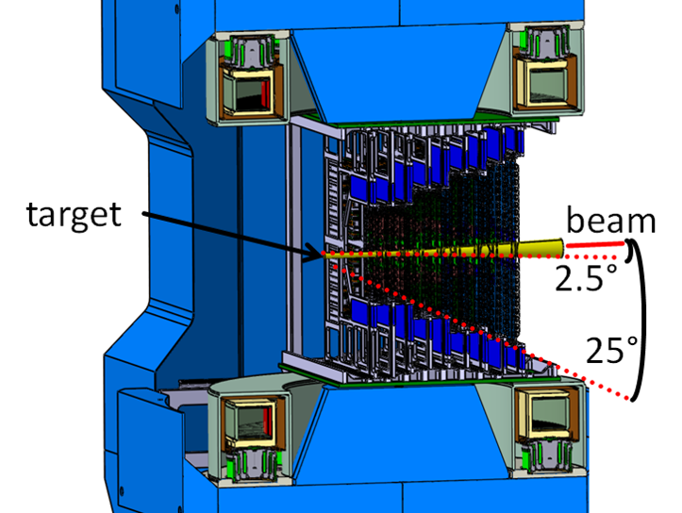
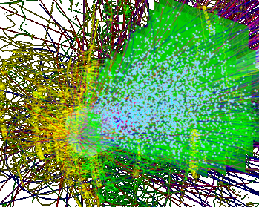
The CBM Silicon Tracking System (STS)
Arrangement of 900 low-mass, double-sided silicon strip sensors
Inside a magnetic dipole field
Task:
measure the trajectories of up to 700 charge particles per collision
reconstruct momentum from curvature
reconstruct secondary (weak) decays by topology

Slide 12
1. From digis to clusters
(a computational problem)

Slide 13
Clusters
particle
read-out strips
electrons
holes
sensor
A particle traversing the detector activates one strip or a group of strips.
Effects contributing to more than one strip being active:
track inclination (geometrical projection of trajectory to readout (strip) surface)
thermal transverse diffusion of electrons and holes
capacitive coupling of strips (cross-talk)
Task for reconstruction:
Identify clusters = groups of digis belonging to the same particle

Slide 14
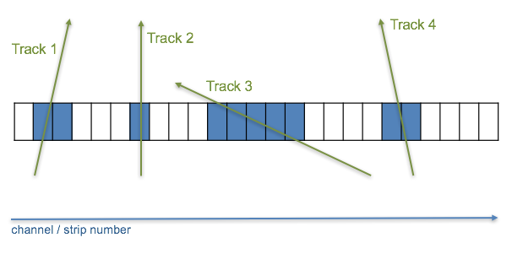
Cluster finding event-by-event
If digis were sorted into events (say, by a trigger), the task would be simple.
Define: two digis belong to a cluster if they are in neighbouring channels.
Sort digis in an array w.r.t. channel number
Loop over channels: register transitions inactive-active (cluster start) and active-inactive (cluster end)
Execution time: linear in number of channels; does not depend on number of data

Slide 15
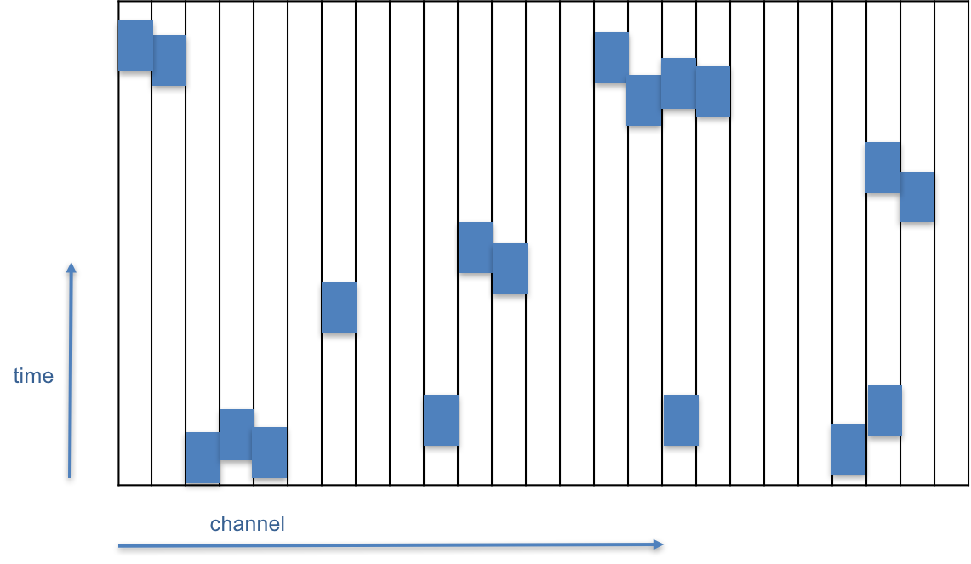
Cluster finding from free-streaming data
But we do not have a trigger and do not have events! Instead, what we get is something like
Define: two digis belong to a cluster if they are in neighbouring channels and their time difference is below a limit (gjven by the time resolution of the detector).
Possible approach: 2-d cluster finding
sort digis w.r.t. channel number; array of digis for each channel
discretise time axis into bins
double loops required: execution time is not linear in number of data

Slide 16
A “streaming” cluster finder
Idea:
keep track of the state of the detector (sensor)
  for each active channel: time of last digi and link to digi object
treat digis one after the other from the input stream
perform appropriate action depending on the state of the respective channel:
  update state
  release cluster (write to output or deliver to further processing)
Sole requirement: input stream must be time-sorted (for each sensor)
status buffer
channel (strip) number

Slide 17
Case 1
Neither the channel of the digi nor one of its neighbours is active
Add new digi to status buffer
next digi
status buffer
status buffer

Slide 18
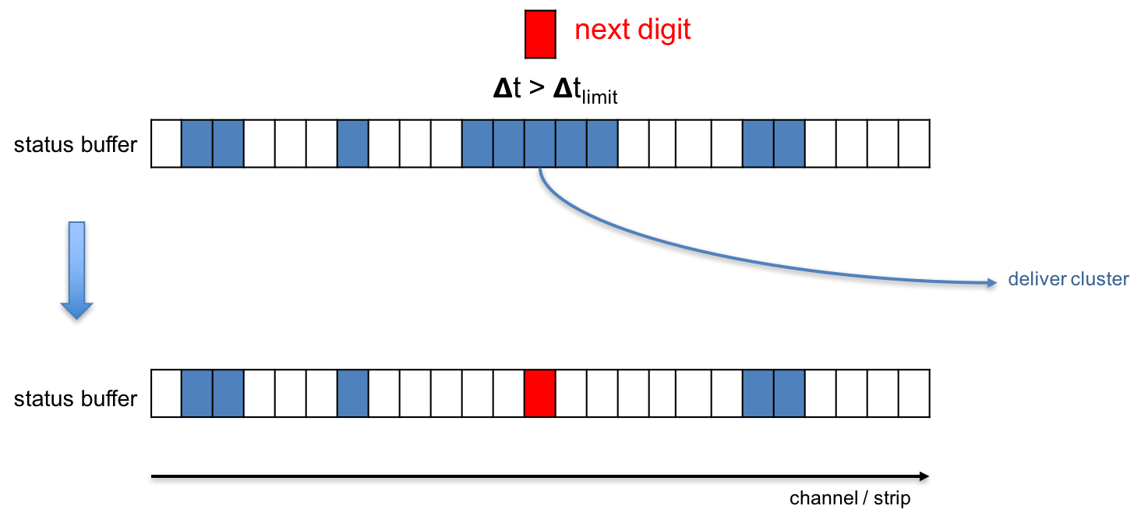
Case 2
The channel of the new digi is active:
Release corresponding cluster
Delete cluster digis from status buffer
Add new digi to status buffer

Slide 19
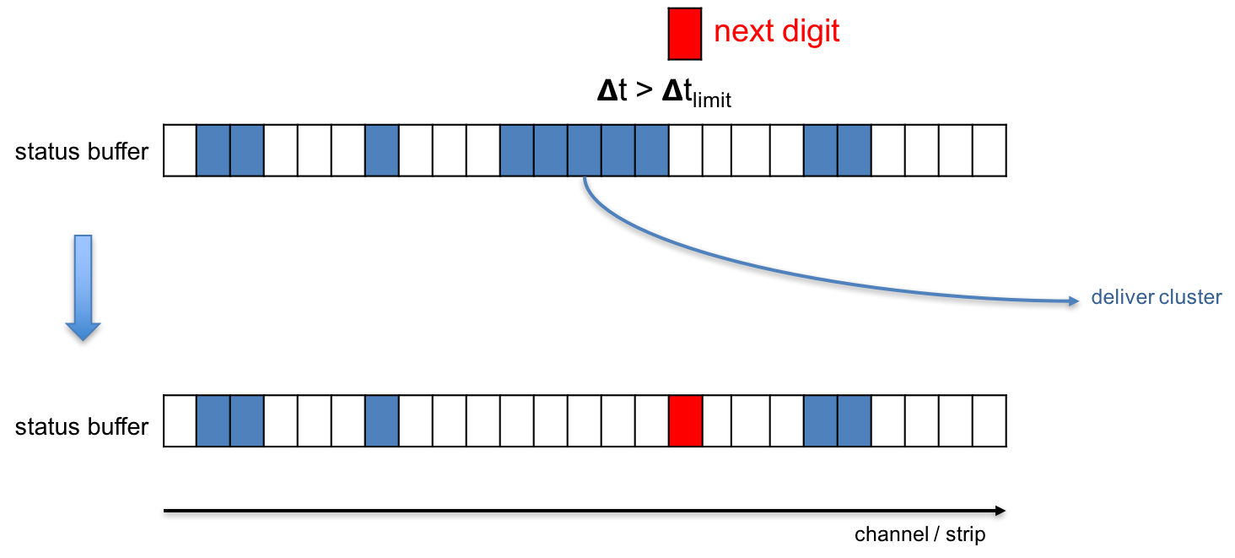
Case 3
A neighbouring channel (left or right) of the new digi is active. The time difference to the neighbour is above the time limit.
Release corresponding cluster
Delete cluster digis from status buffer
Add new digi to status buffer

Slide 20
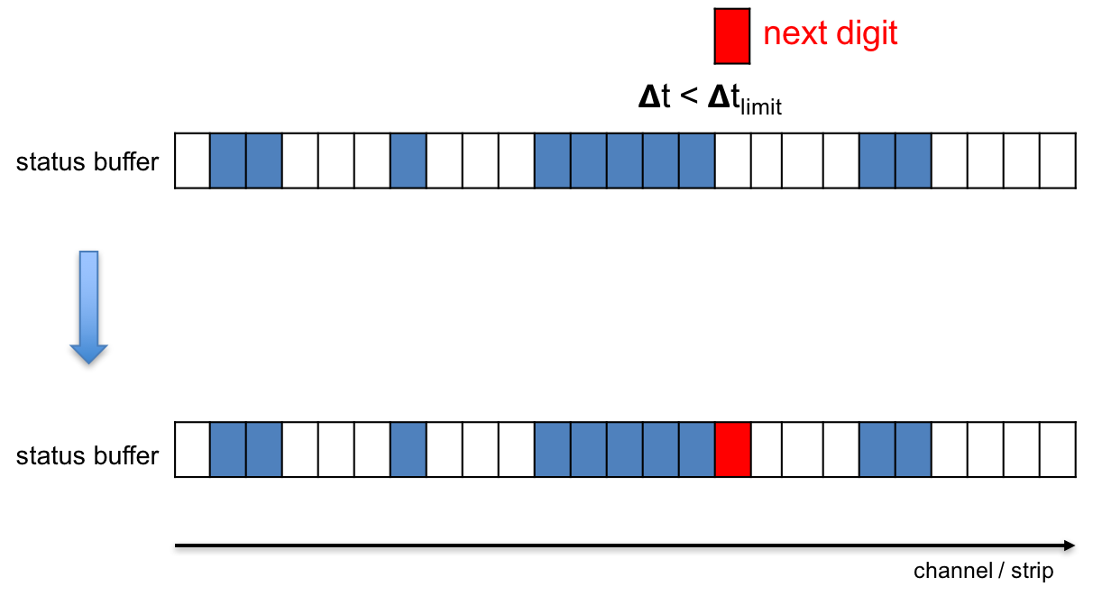
Case 4
A neighbouring channel (left or right) of the new digi is active. The time difference to the neighbour is smaller then the time limit.
Add new digi to status buffer

Slide 21
Performance
Faster than 2-d cluster finder even for small amount of data
Scales with the number of input data (events)
About 3 ms per event (5,500 digis, 1,700 clusters)
Cluster fit is included (takes about 55%)
Expense in memory: one double precision (time) and one integer (link to digi) per channel; about 2 M channels -> 25 MB

Slide 22
2. Determining the cluster position
(a mathematical problem)

Slide 23
The problem
There is a cluster of n measurements, each with a charge.
What is the proper cluster centre coordinate?
What is the error (precision of the measurement)?
  Knowledge is needed for track finding!
charge
q_{i}
q_{i+n}
i
i+n
strip
Strip pitch p = 58 mum for us
The “usual” answer is:
If there is only one strip, assign the strip centre as cluster centre. The error is p/sqrt(12)
If there is more than one strip, calculate the weighted mean (centre of gravity). The error is somewhat smaller than p/sqrt(12)

Slide 24
The generic problem
Generic formulation:
A continuous distribution q(x) is integrated in discrete bins (histogrammed): q(x) -> { q_{i} }
Determine the first moment of the distribution x₀ from the measurements { q_{i} }
If there is a prescription x_{c} = f({q_{i}}), what is its error (second moment of the residual distribution of x_{c} - x₀ ?

Slide 25
General considerations
There is no general answer for an arbitrary distribution q(x).
If the shape h(x) of q(x) is known: q(x) = Q h(x - x₀), x₀ can be reconstructed precisely.
Any measurement prescription x_{c} = f({q_{i}}) will have a deterministic residual 𝛿_{x} = x_{c}-x₀, which is a function only of the position of x₀ relative to the bin x₀ falls into: r = x₀ - x_{i}
We can define an error σ_{x}, if we assume r to be randomly (flatly) distributed. It is then the second moment of the distribution of 𝛿_{x}.
  N.b: : the error will not be Gaussian; CLT conditions are not fulfilled.
A good prescription f will be unbiased (the first moment of 𝛿_{x} vanishes), if 𝛿_{x}(r) = 𝛿_{x}(-r)
  This is in general not the case for the centre-of-gravity method!

Slide 26
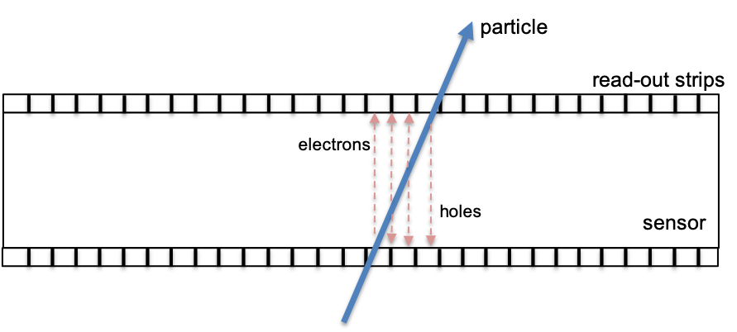
Application to our problem
Our case: constant distribution f(x) = Q 𝛳(Δ-|x-x₀|)
Half-width Δ given by track inclination (projection)
Assumes uniform ionisation along trajectory in sensor
Neglects: energy-loss fluctuations, diffusion, charge sharing
Procedure:
Assume r = x₀ - x_{i} to be flatly distributed (is fulfilled since the strip pitch is small)
For a given width Δ and cluster size n > 1, find the prescription x_{c} which reproduces x₀ exactly.
Assume a constant distribution of Δ and calculate the second moment of the residual x_{c} - x₀.
Three cases: n = 1, n = 2, n > 2

Slide 27
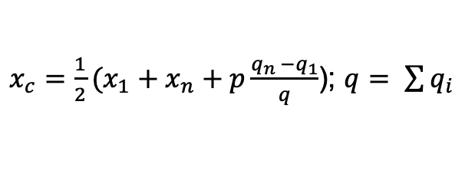
The easiest: n-strip clusters (n > 2)
For n > 2, the position can be exactly reconstructed (independent of Δ) from the charges in the first and the last bin:
$x_{c}=\frac{1}{2}(x_{1}+x_{n}+p\frac{q_{n }−q_{1}}{q}$); $q= \sum{q_{i}}$
The residual always vanishes : x_{c} = x₀ ; the measurement error is zero.

Slide 28
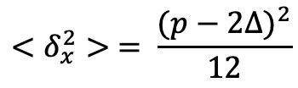

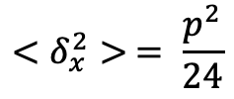
The least knowledge: 1-strip clusters
For n = 1, the only unbiased prescription for x_{c} is the strip centre: x_{c} = x₁
$$x_{c}=x_{1}$$
For a given Δ, the width of the residual is
$$<δ_{x}^{2}> = \frac{{(p−2Δ)}^{2}}{12}$$
For uniform distribution of Δ, the width of the residual is
$$<δ_{x}^{2}> = \frac{p^{2}}{24}$$
σ_{x} is smaller than p/sqrt(12)!
Reason: The fact that only one strip is activated restricts the possible true positions x₀.

Slide 29
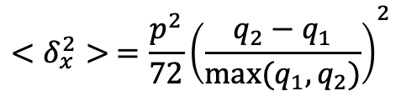
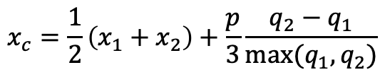
The trickiest: 2-strip clusters
For n = 2, astonishingly, the calculations are most involved. Sparing the details, we define
$$x_{c}=\frac{1}{2}\left(x_{1}+x_{2}\right)+\frac{p}{3}\frac{q_{2}−q_{1}}{max⁡(q_{1}, q_{2})}$$
which gives for a constant distribution of Δ
$$<δ_{x}^{2}> ={\frac{p^{2}}{72}\left(\frac{q_{2}−q_{1}}{max⁡(q_{1}, q_{2})}\right)}^{2}$$

Slide 30
3. From clusters to hits
(a geometrical problem)

Slide 31
General considerations
Clusters provide one-dimensional position information (perpendicular to the strip orientation).
The 2-d position is obtained by combining clusters from strips with different orientations (front and back side of the sensor).
Together with the z position of the sensor, we have a 3-d space point: a hit
Elementary trigonometry
fake hit
Note: within a sensor, each front-side cluster has to be combined with each back-side cluster: fake hits
Fake hits are minimised by small stereo angles (on expense of resolution in y direction)
true hit
true hit
fake hit

Slide 32
4. From hits to tracks
(a serious problem)

Slide 33
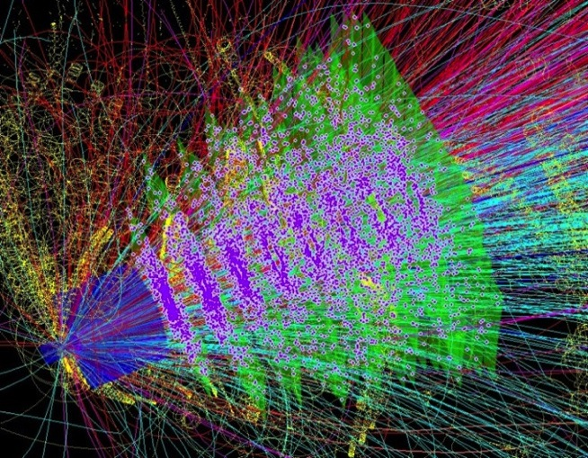
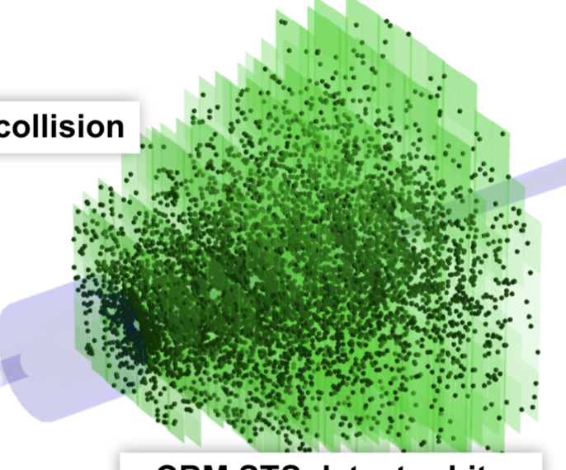
The track finding problem
one simulated collision
Tracks of produced particles
hits in the STS
Features:
About 700 charged tracks in the detector
High hit density in inner region
Fake (combinatorial) hits
Non-uniform magnetic field
Approaches:
Hough transform
Conformal mapping
Track following with Kalman Filter
Cellular Automaton

Slide 34
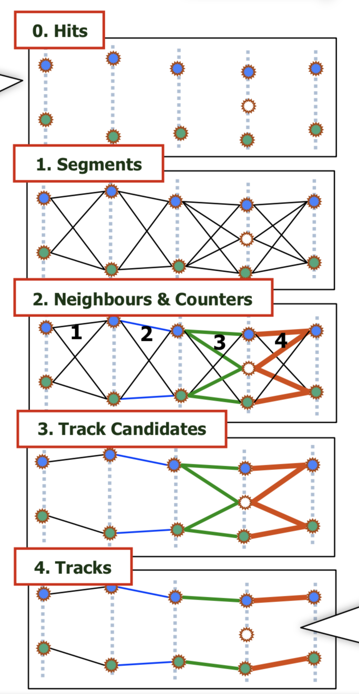
Cellular Automaton Track Finder: Principle
Connect hits to segments (cells) satisfying the track model
Find matching neighbouring cells according to track model
Estimate position of cell on track
Connect neighbouring cells to track candidates
Select best track candidates in case of competetion

Slide 35
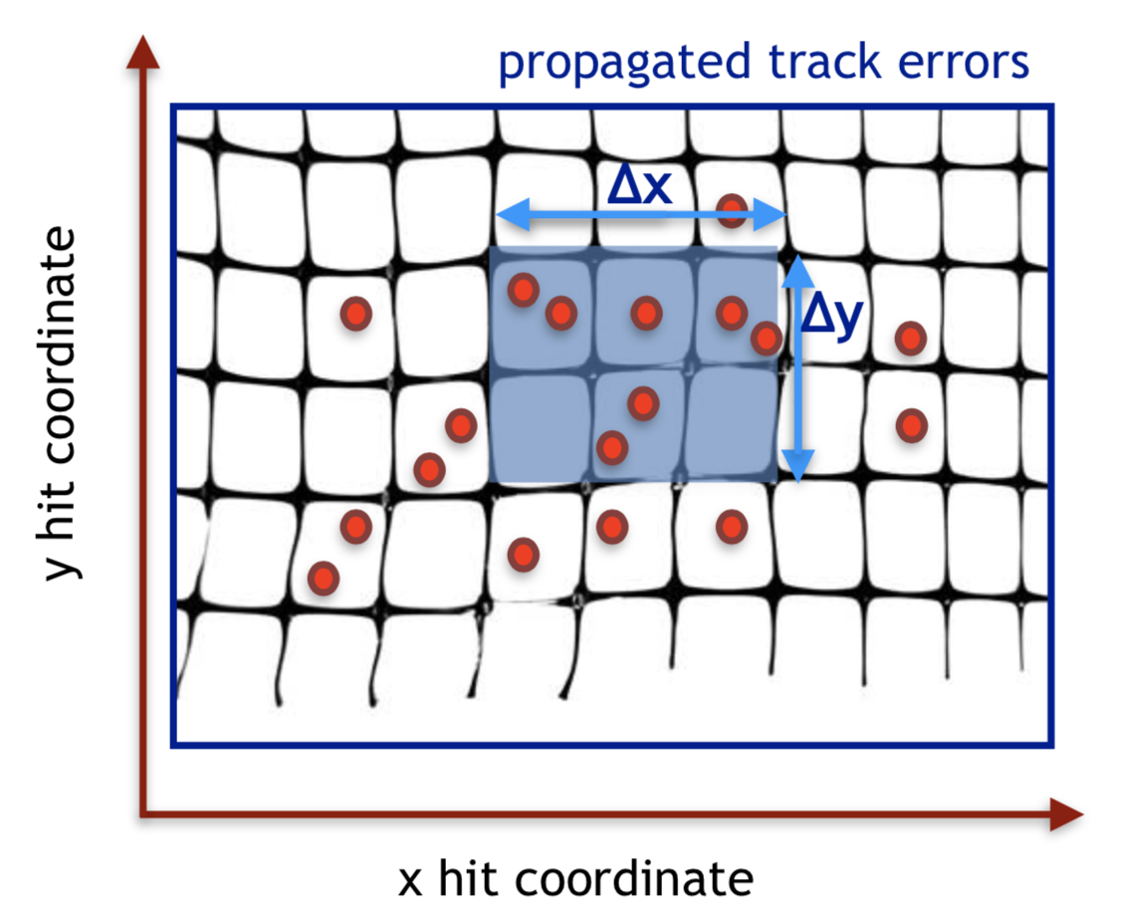
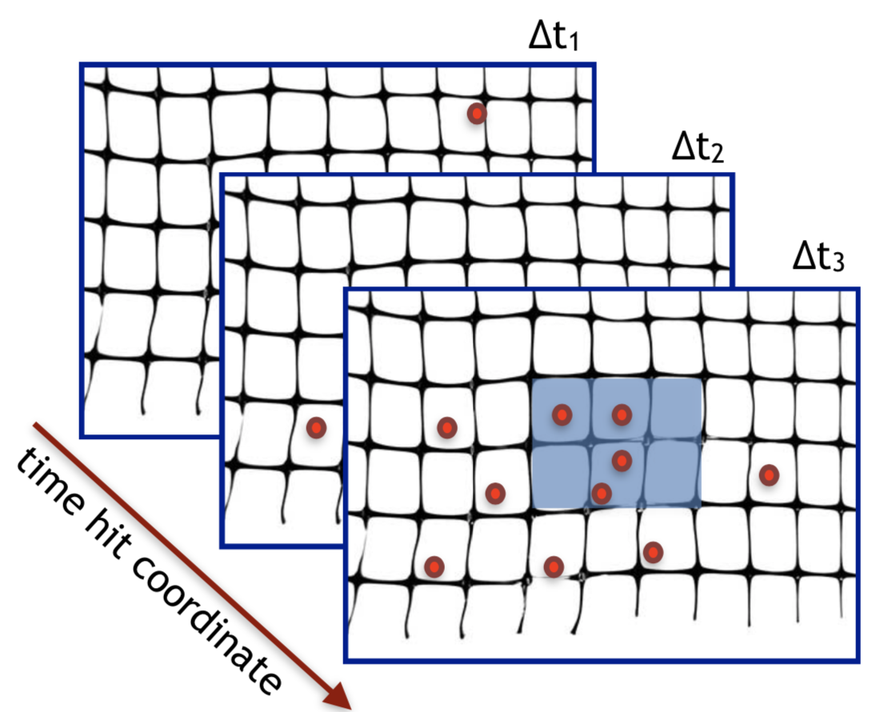
Time-based track finding
Input is a stream of hits, not sorted into events
Time is part of the track model: state vector: (x, y, t_{x}, t_{y}, q/p, t)
Key to fast execution is proper arrangement of data in memory: fast access, limited combinatorial search
Important: parametrise geometry and magnetic field; access from cache instead of from main memory.

Slide 36
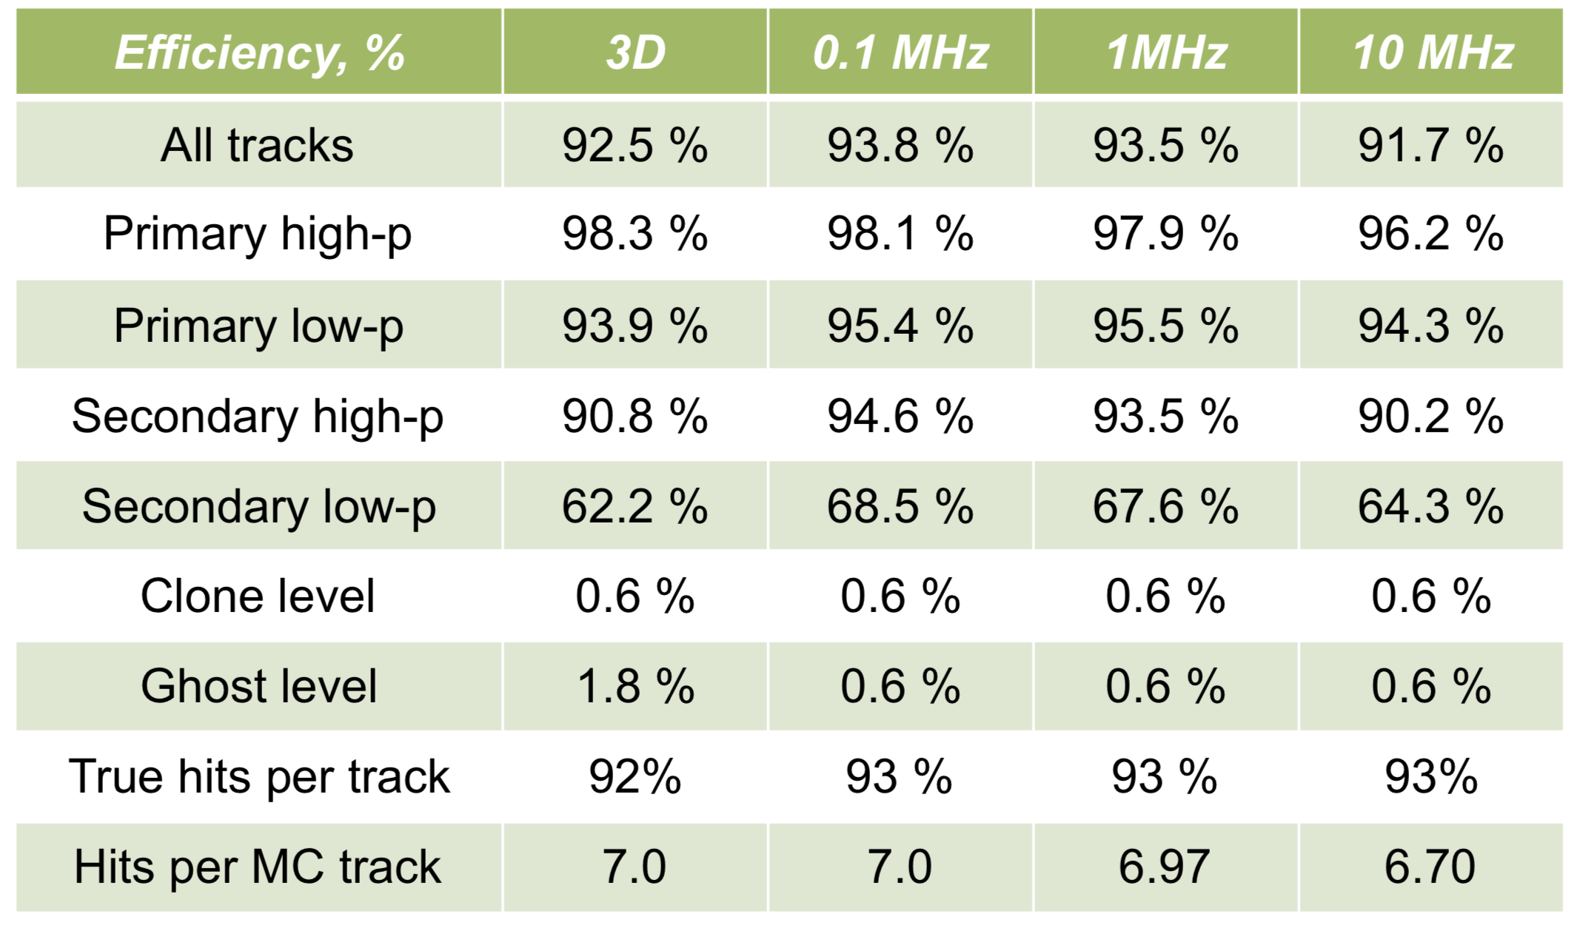
Track finding: performance
Good efficiency in particular for long tracks (8 hit measurements)
Rate effects are moderate even at 10 MHz.
Reconstruction time: 8.5 ms per event (single core)
Algorithm shows good scalability on many-core systems.

Slide 37
5. From tracks to events
(a straightforward problem ?)

Slide 38
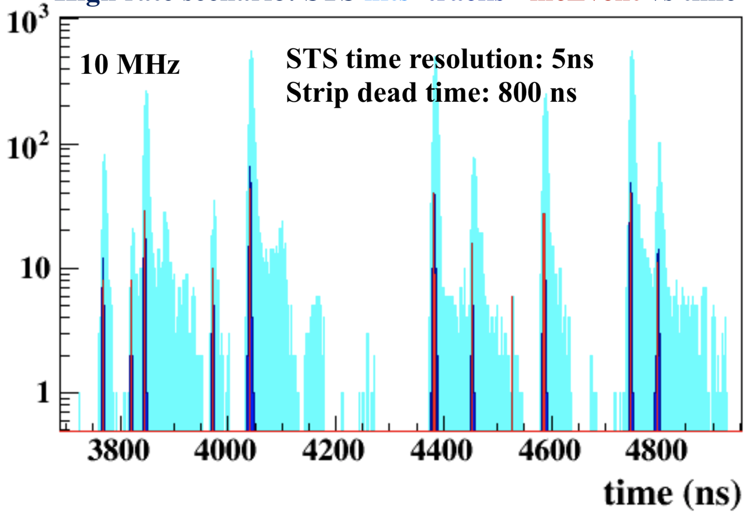
Event finding
hits
tracks
event time (MC truth)
Events can be defined as clusters of tracks in time.
Properly resolved events: 99% at 1 MHz interaction rate, 80% at 10 MHz

Slide 39
Summary
So, we are there: of an unintelligible set of raw data messages, we have obtained events, which can be subjected to higher-level analysis.
Shown were only some selected reconstruction tasks; there are many more.
The real challenge for CBM are fast algorithms for reconstruction of complex events in real-time.
Based on the current software, we estimate the size of the online computing farm to be 100 k HepSpec06 (about 60,000 nowadays CPU cores)
Work is ongoing to further accelerate the algorithms. Ideas and collaboration is welcome!

