Slide 1
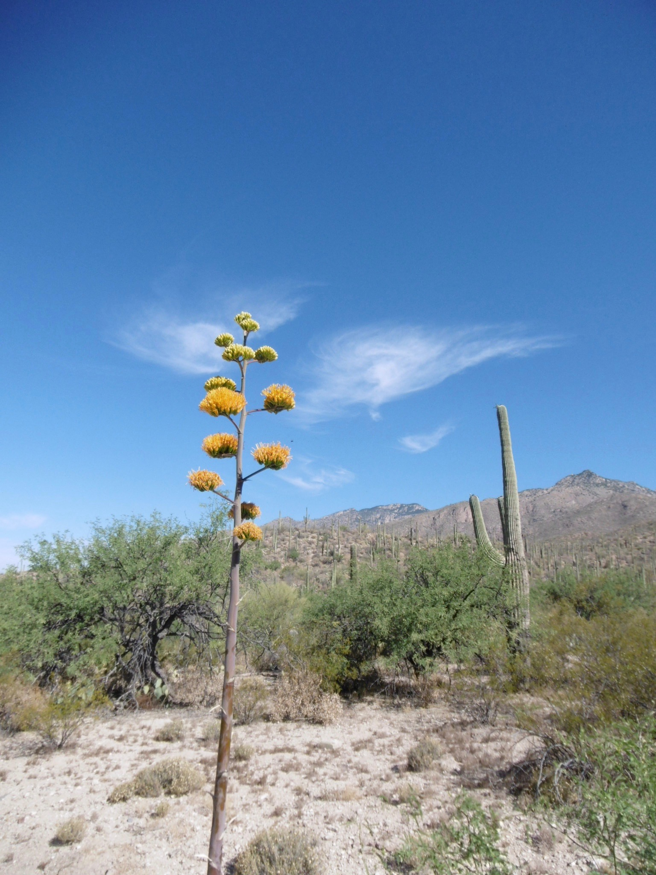
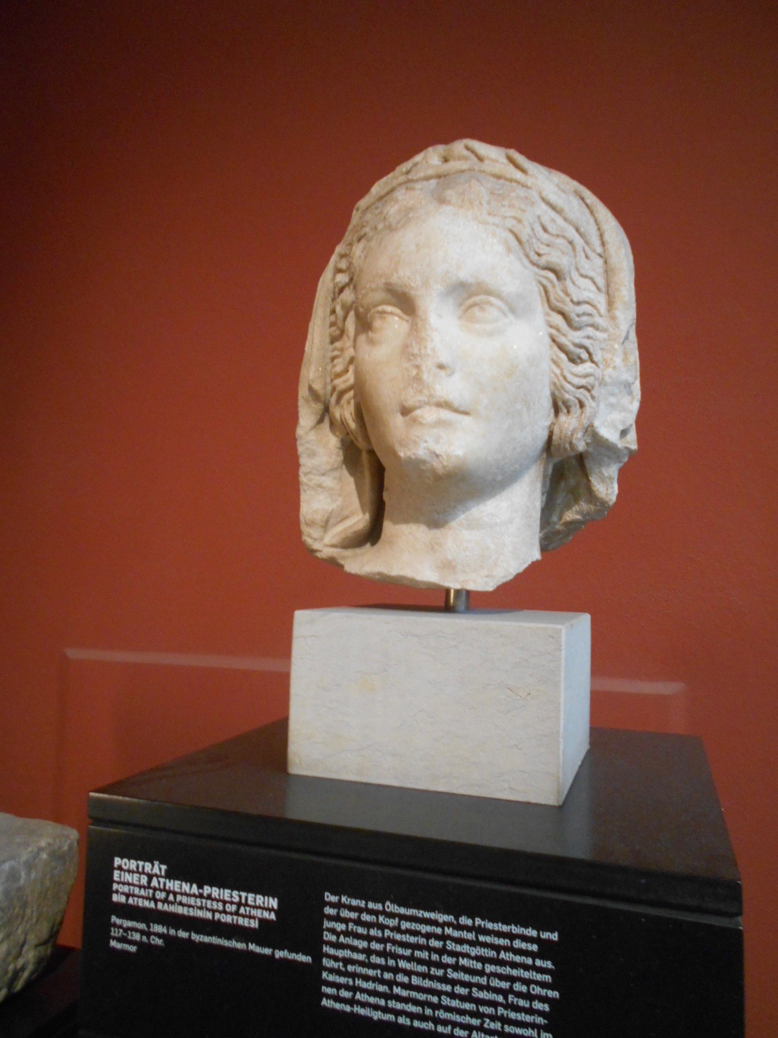
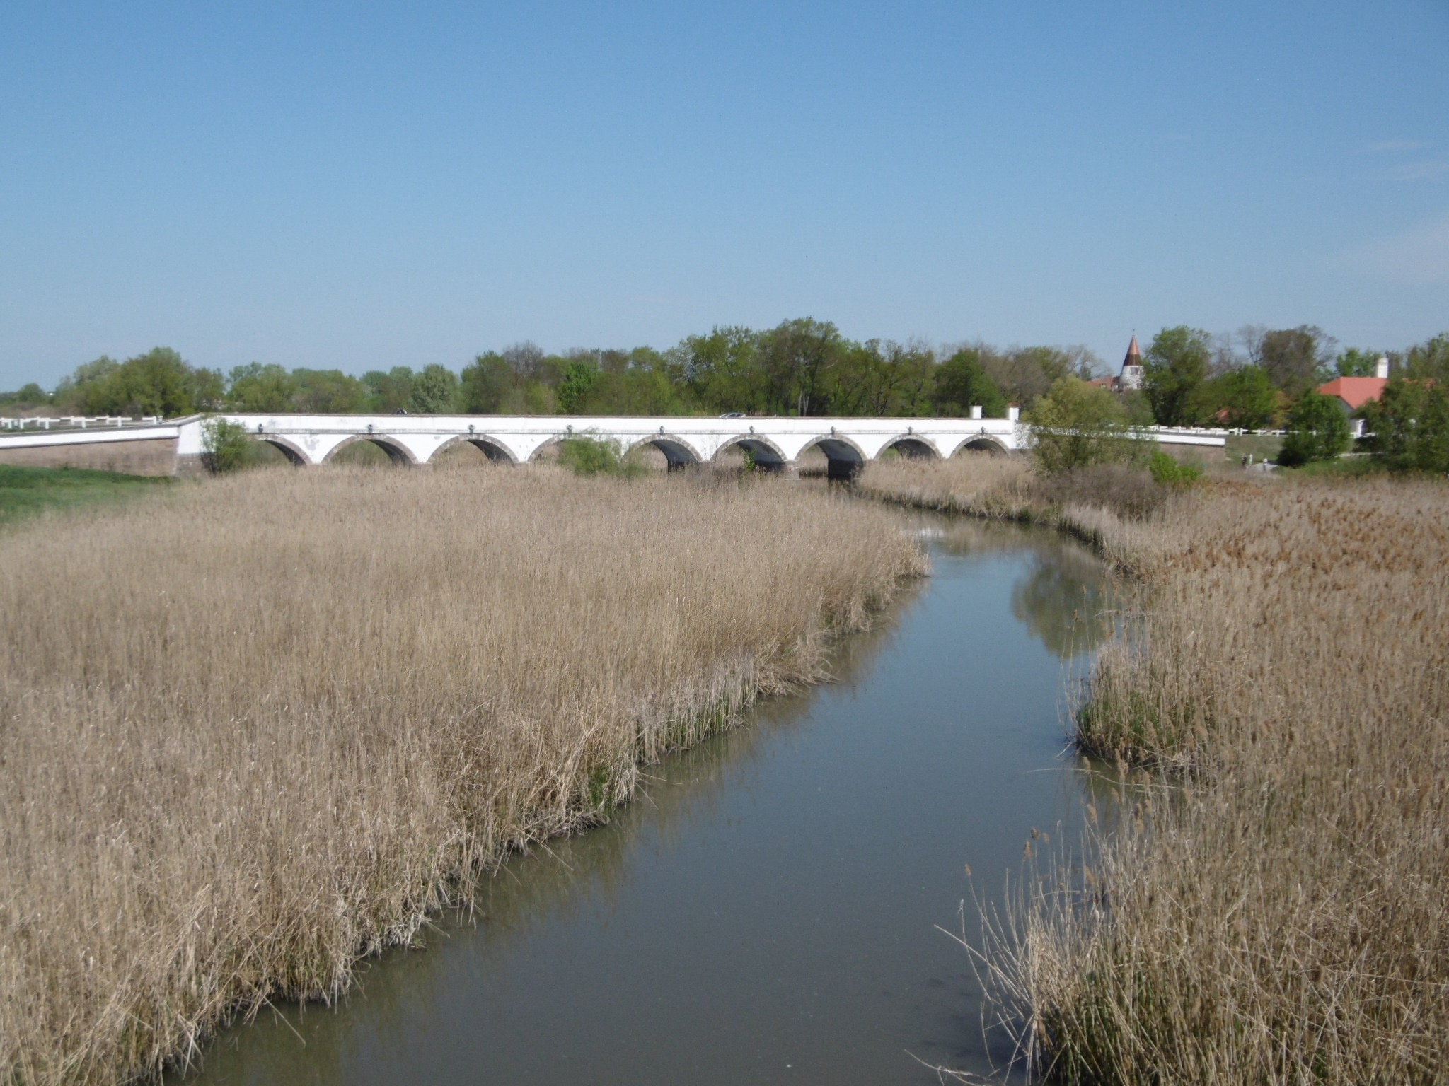



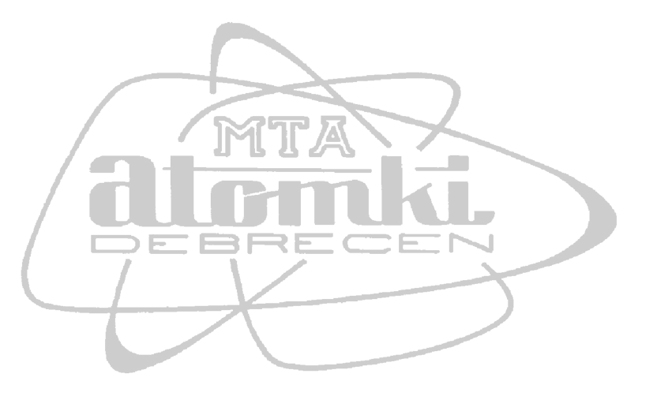
APPLICATIONS OF ACCELERATOR MASS SPECTROMETRY FOR HERITAGE STUDIES
A J Timothy Jull^{1,2,3}, M. Molnár¹, T. Varga¹, I. Hajdas⁴, G. Quarta⁵ and L. Calcagnile⁵.
1. Isotope Climatology and Environmental Research Centre, Institute for Nuclear Research, 4026 Debrecen, Hungary.
2. University of Arizona, Department of Geosciences, Tucson AZ 85721, USA
3. University of Arizona AMS Laboratory, Tucson, AZ 85721, USA
4. Laboratory of Ion Beam Physics, ETH-Zürich, 8092 Zürich, Switzerland.
5. Center of Applied Physics, Dating and Diagnostics (CEDAD), University of Salento, 73100 Lecce, Italy.

Slide 2
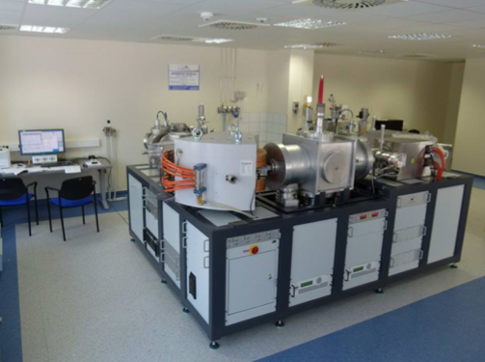
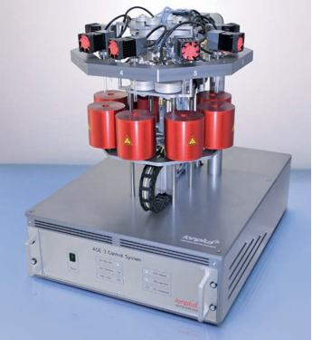
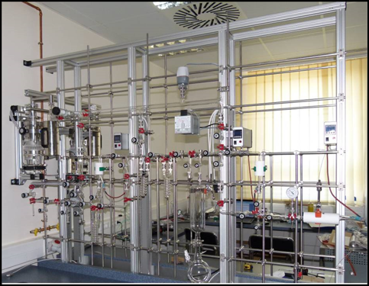
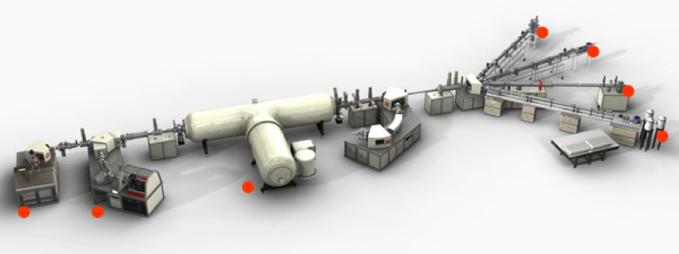
Accelerator Mass Spectrometry (AMS)
automated sample
preparation
200kV MICADAS
Debrecen
3 MV HVEE AMS, Lecce.
Sample preparation
Since the beginning of accelerator mass spectrometry (AMS) in 1977, its application to questions of cultural heritage studies has always been close to the forefront. The primarly application of AMS is to radiocarbon dating (t_{1/2} 5,700 yr), but in more recent times, the studies of other cosmogenic radionuclides can be applied to archaeological and heritage studies.
The great advantage of AMS is the small sample size of carbon required for radiocarbon dating, with <0.5mg C or even less required for a dating measurement.
New techniques allow as little at 0.05mg C.

Slide 3
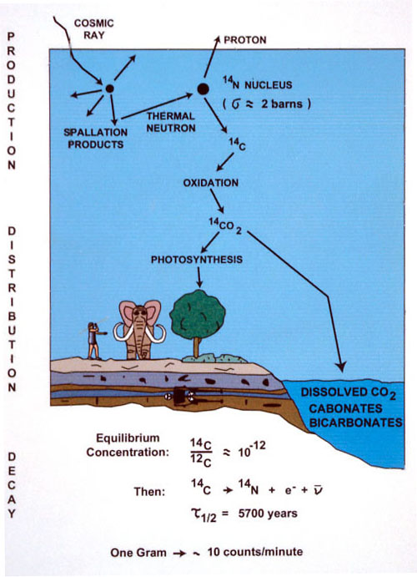
Radiocarbon dating
Basic assumption:
1. What we are dating was once in
Equilibrium with the atmosphere,
or
2. If not, it was earlier in equilibrium with
Another reservoir that we understand

Slide 4
Past cosmic ray intensity
Sun
Outside the solar system
Proton…
P, nuclides, gamma ray…
Earth Atmosphere
Produced secondary particles
(air shower)
Cosmogenic nuclides
Neutron capture reaction→ ¹⁴C
¹⁴N + n → ¹⁴C + p
¹⁰Be
¹⁴C
_{Aerosols}
¹⁴CO₂
As well as for dating, ¹⁴C and other cosmogenic
nuclides can give us
a record of past cosmic-ray intensities
Ice sheet

Slide 5
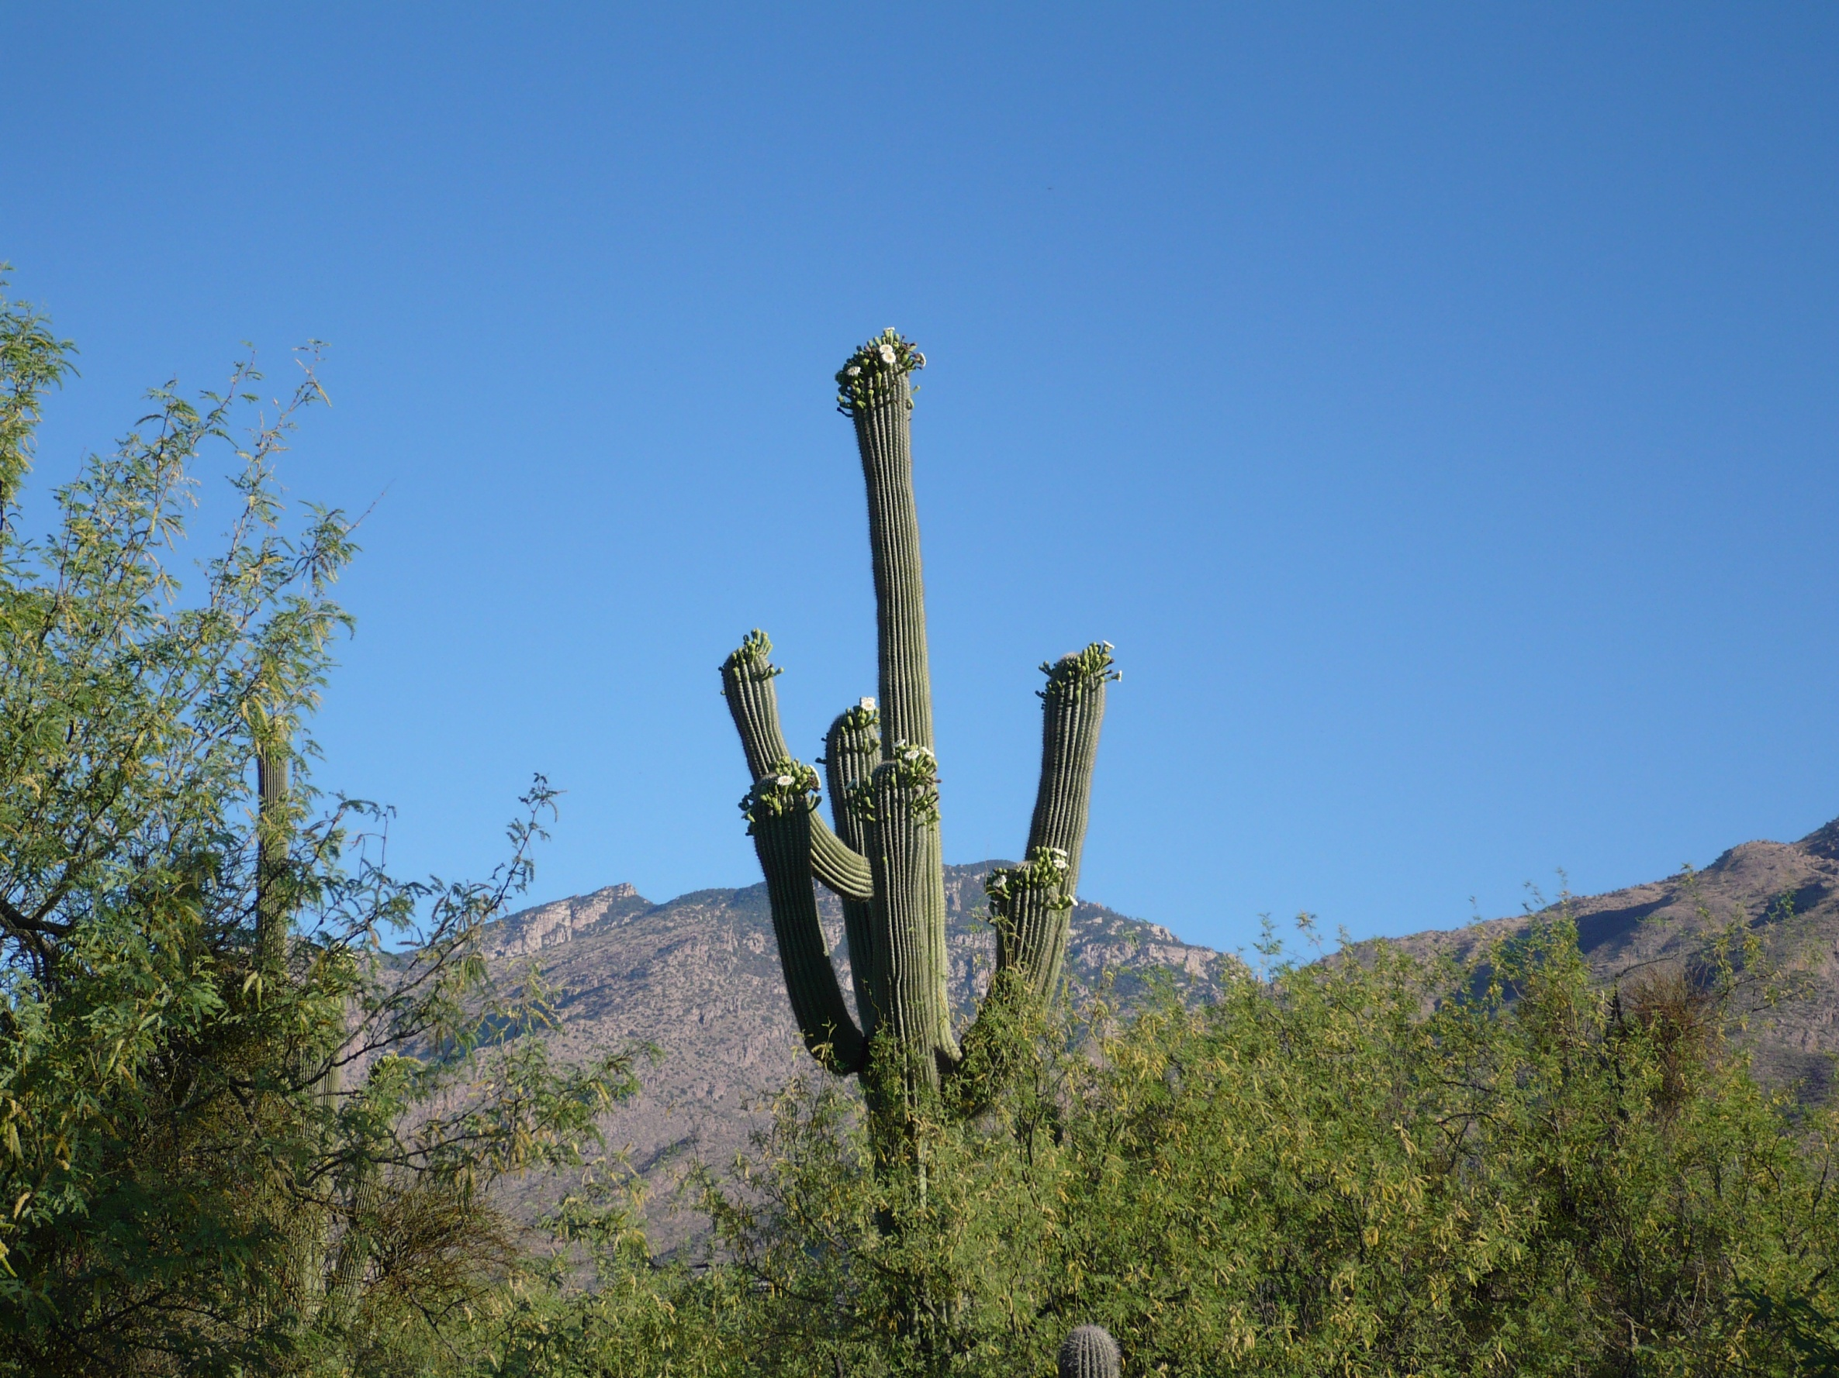
The atmospheric model
Atmospheric Production
Carbon-14 is produced in
The upper atmosphere by
¹⁴N(n,p)¹⁴C.
3. Atmospheric ¹⁴C is
Incorporated rapidly into
The bioshere
2. Cosmogenic:
¹⁴C (and other nuclides) are produced by
of cosmic ray production directly in rocks

Slide 6
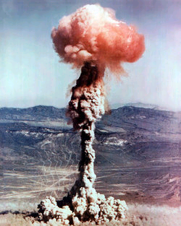
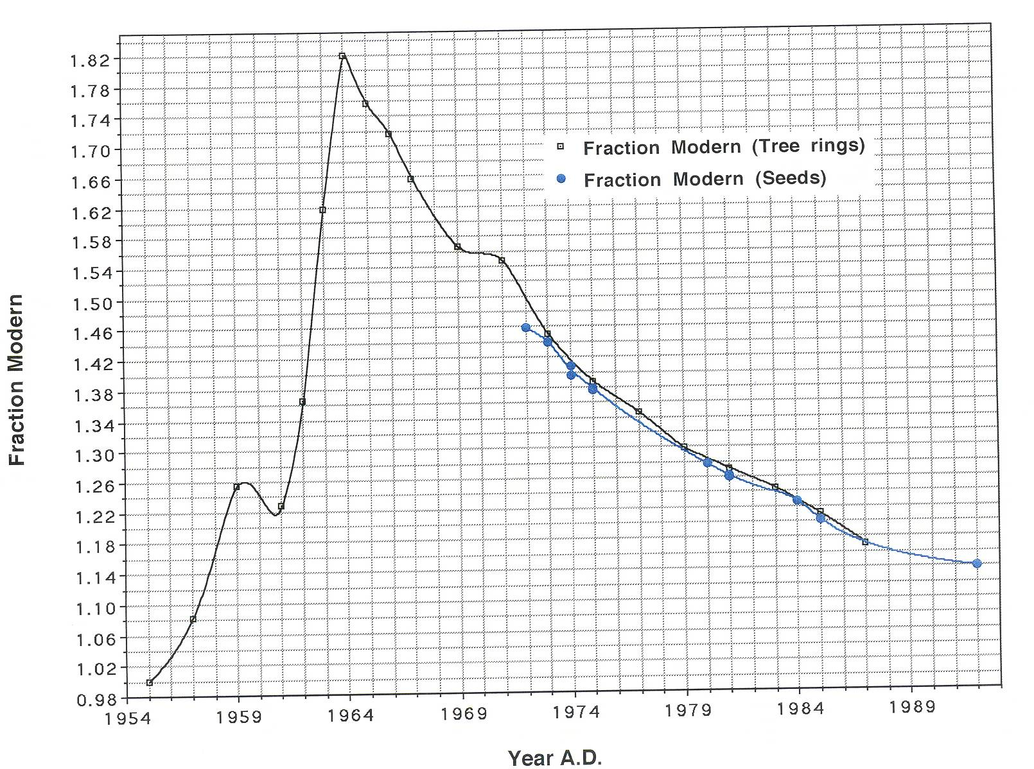
Since 1950AD, an additional source of ¹⁴C is from atmospheric nuclear testing.

Slide 8
Recent values of bomb ¹⁴C
Δ¹⁴C is excess above modern in parts per mil

Slide 9
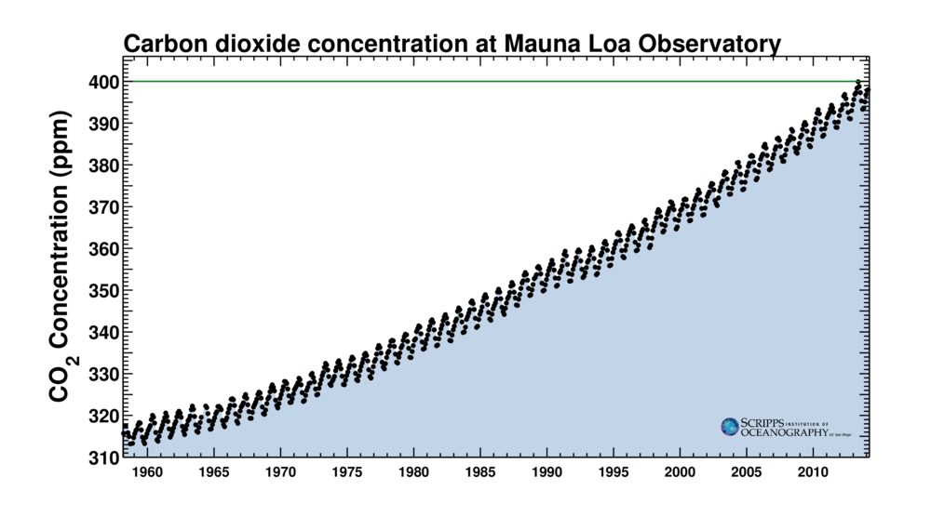
We have also been adding a lot of ¹⁴C-free CO₂ to the atmosphere

Slide 10
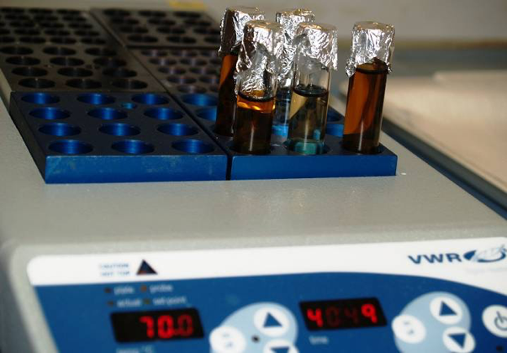
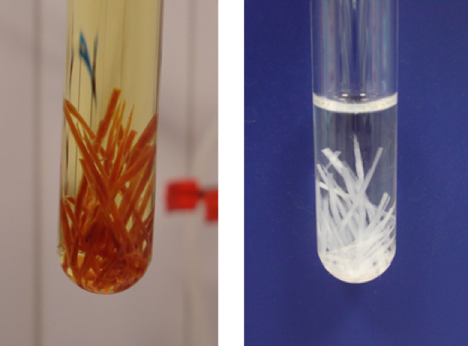
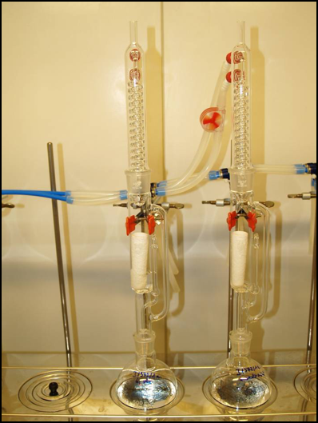
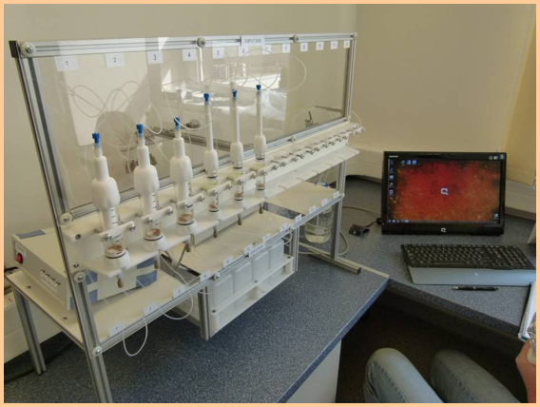
Sample Preparation: Methods development
Simple acid-base-acid
cleaning
Base-acid wash with bleaching
(BABAB) for cellulose
Soxhlet extractions
To remove organic
contaminants
Semi-automated bone chemistry
Graphite preparation

Slide 11
Definition of a ¹⁴C date
Stuiver and Polach, 1977
  The present year for radiocarbon dating is defined as 1950 AD. This date corresponds to the time when the radiocarbon technique was first developed. Radiocarbon dates are expressed in years before present (BP), or years before 1950.
  The half-life for a radiocarbon measurement is assumed to be 5568 years (the “Libby” half life).
  The original amount of radiocarbon in the atmosphere is assumed to be constant and known. This value is quantified using the National Institute of Standards and Technology (NIST - formerly National Bureau of Standards) Oxalic Acid I standard (NIST-SRM-4990B). Secondary standards used for analysis are adjusted to the original NIST Oxalic Acid I standard value.
  Radiocarbon measurements are normalized for isotopic fractionation by adjusting the measured activities, or carbon isotope ratios, to δ¹³C = - 25‰.

Slide 12
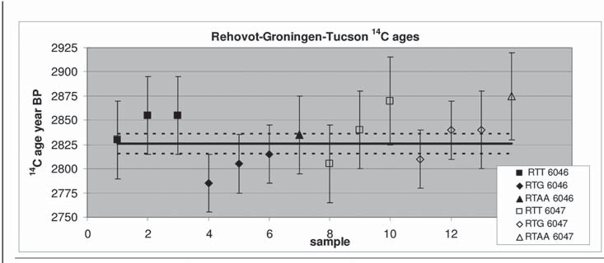
How well can we do?
Intercomparison between 3 labs
Distribution of the radiocarbon determinations for the two samples of Kadesh
Barnea Stratum 4. The weighted average ±1σ, 2826±10 14C year BP is represented by the three horizontal lines.
Note: this shows agreement between different labs on the SAME samples; yet Iron Age studies on different samples show deviations of 50-75 yr for different Iron I and II chronologies

Slide 13
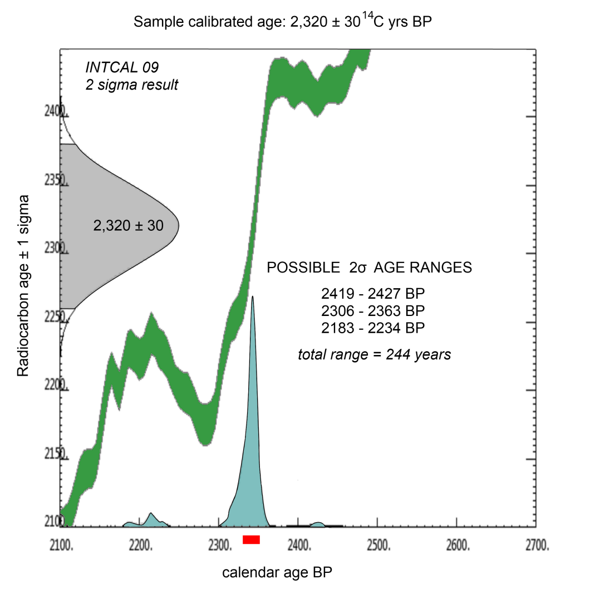
We need to calibrate the ¹⁴C age to get an absolute age estimate
www.calib.org

Slide 14
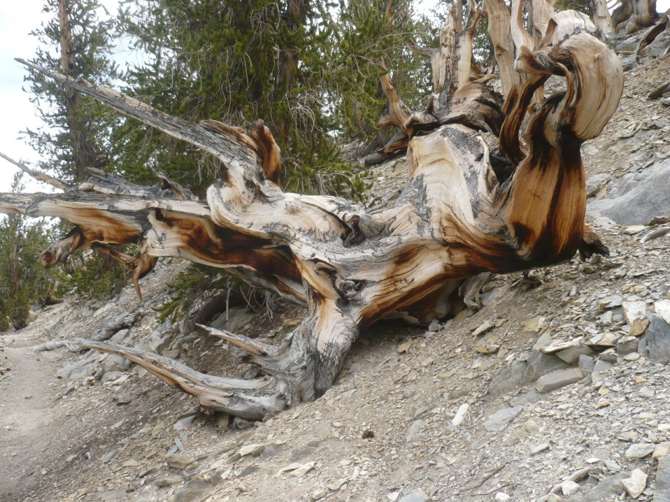
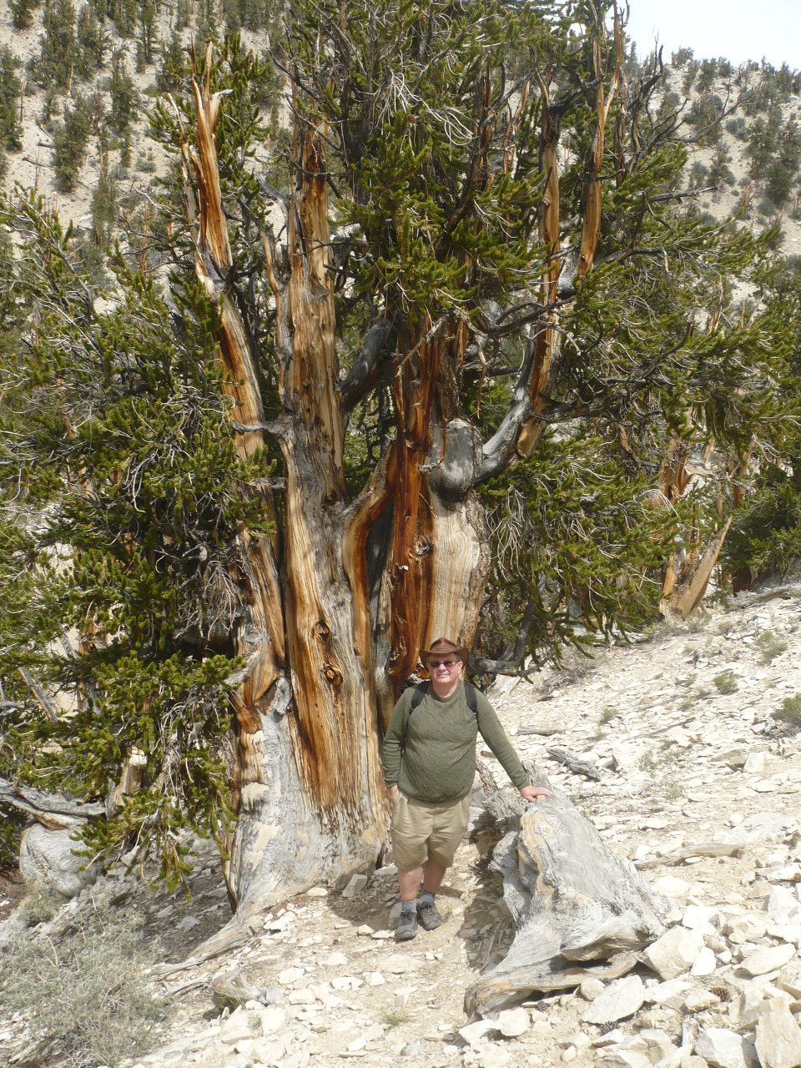
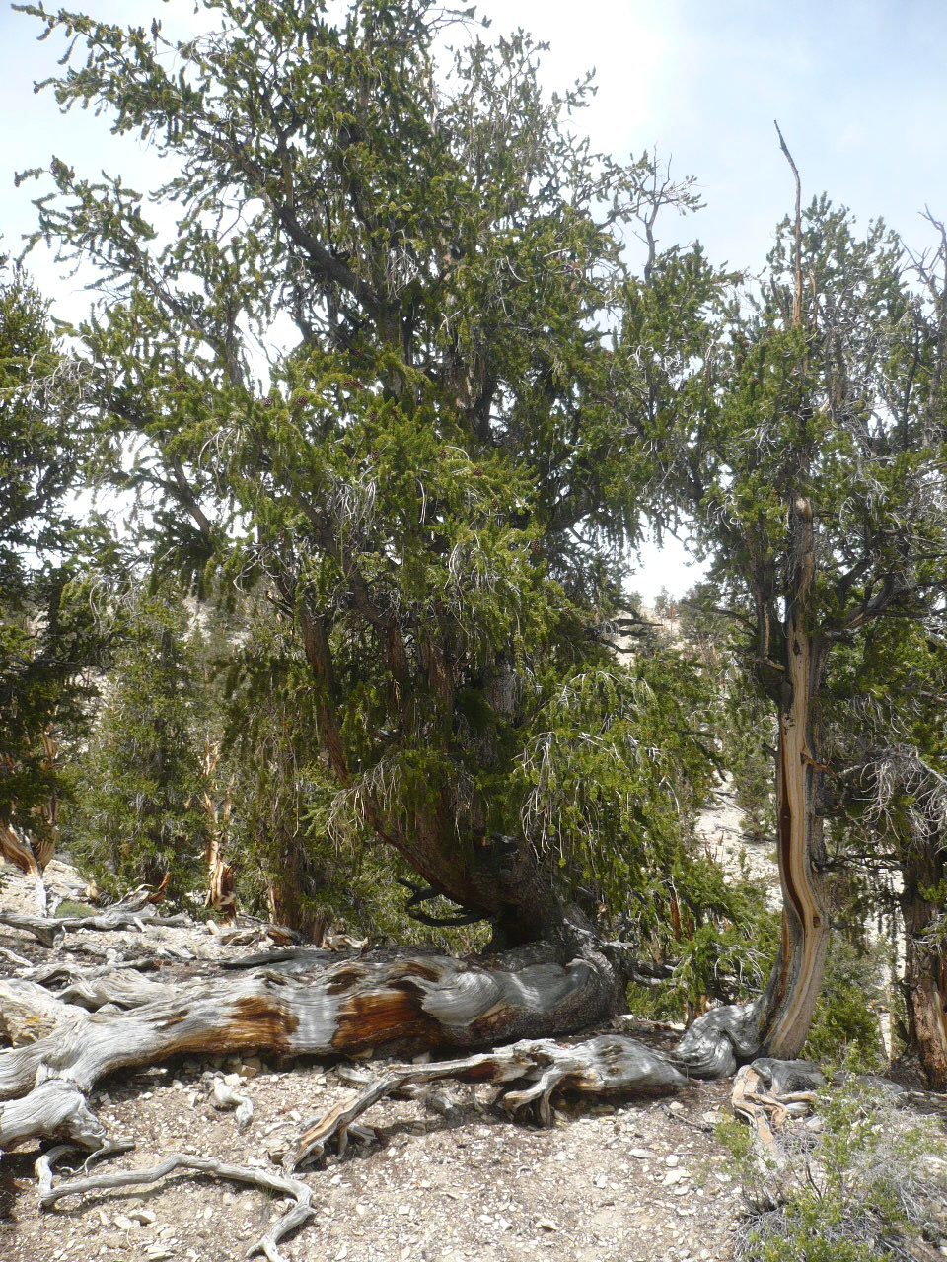
Recent work shows that an annual record of
¹⁴C is needed, not just a decadal record!

Slide 15
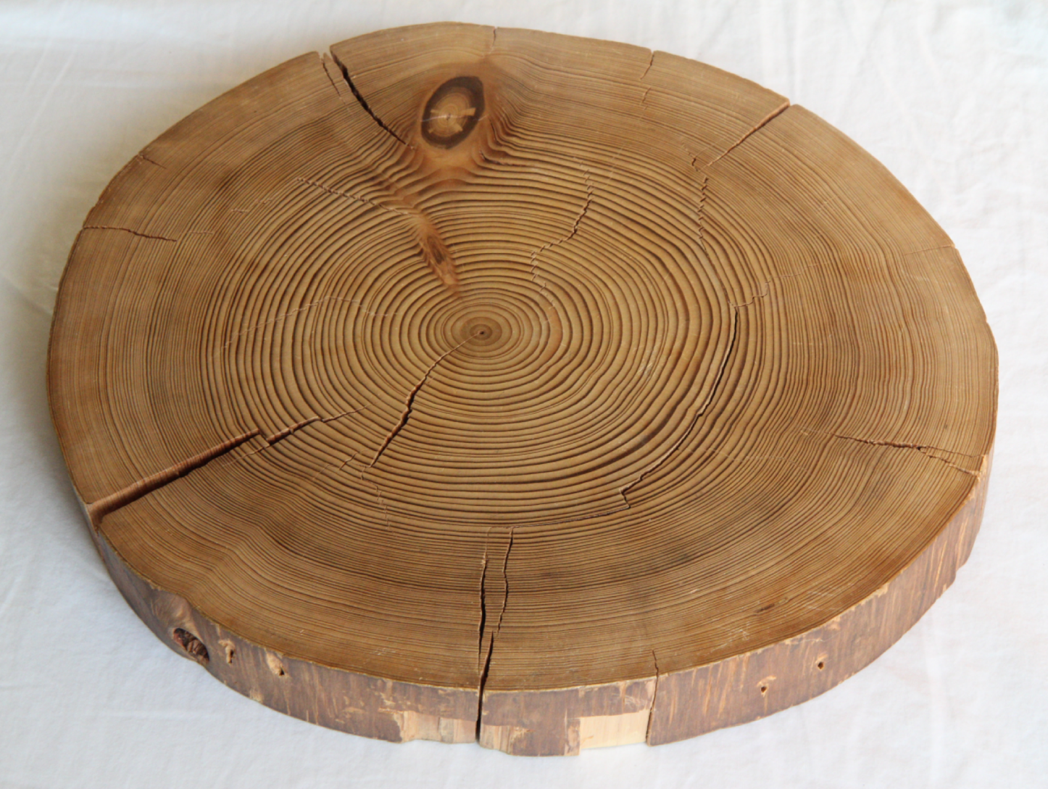
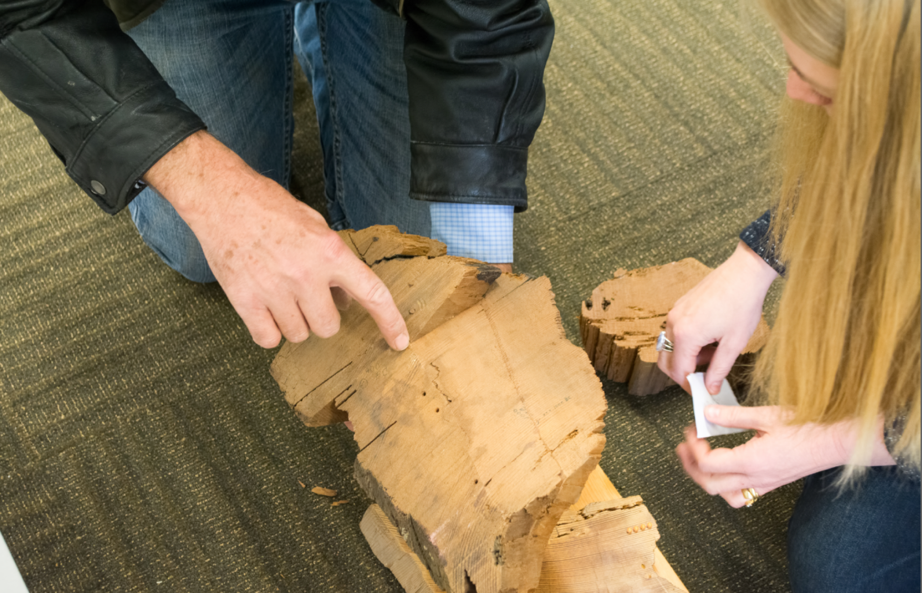
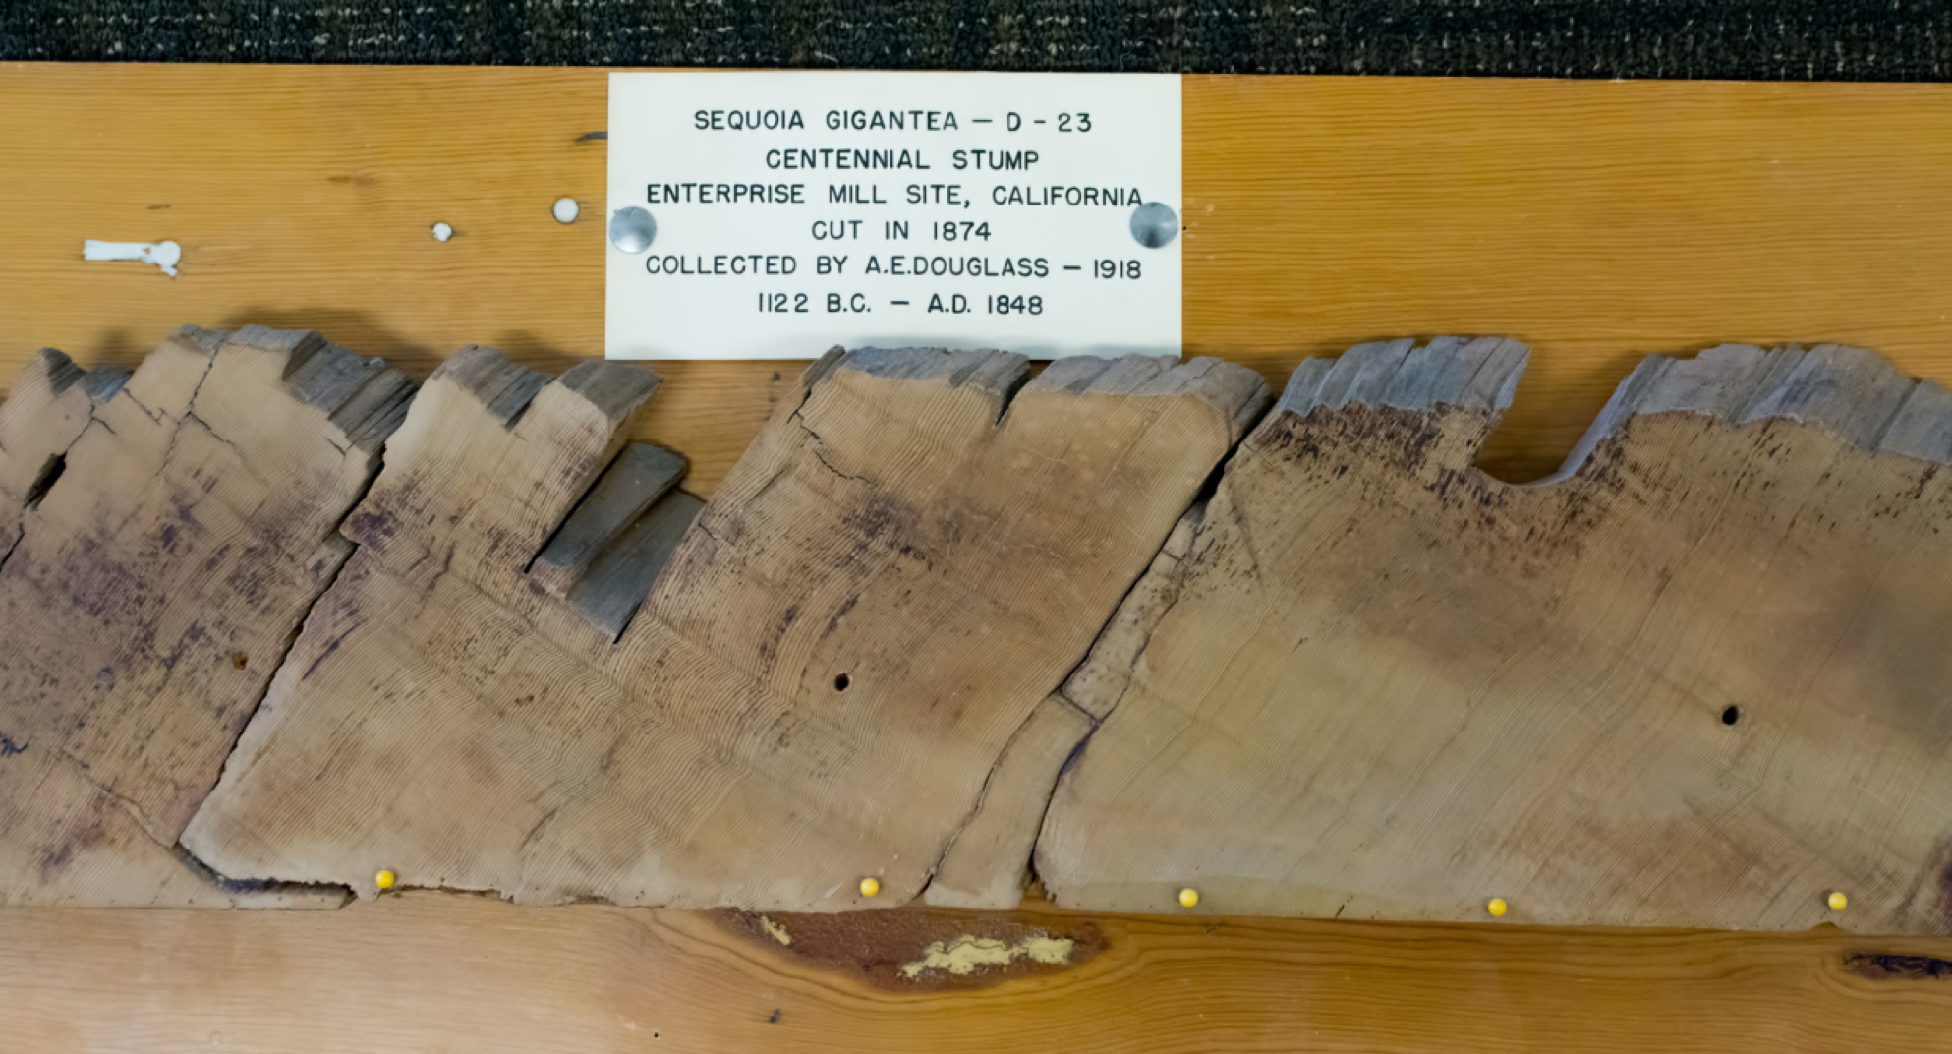
C-159 Centennial Stump
C-103 Broken Flute Cave.
Photo courtesy P. Brewer (LTRR)

Slide 16
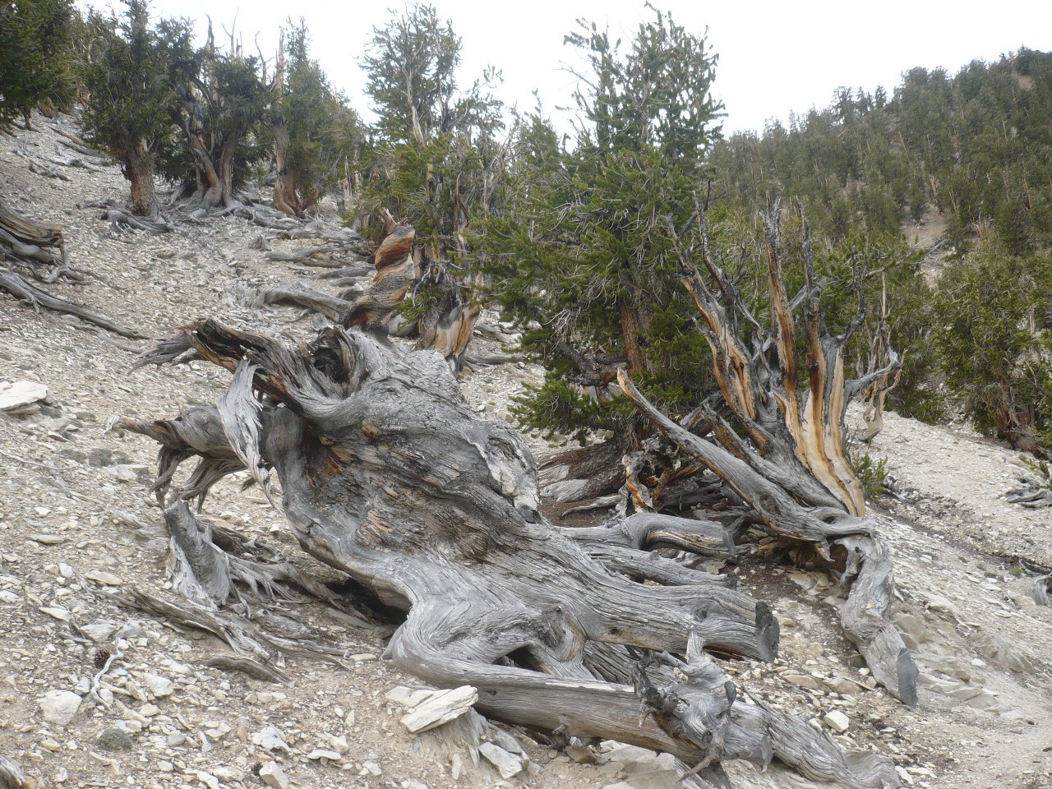
INTCAL13 Radiocarbon Calibration Curve
Reimer et al. (2013), Radiocarbon
55(4): 1869-1887.
New calibration curve in 2020!

Slide 17
What are the best kinds of samples?
Annual plants
Seeds
Wood, but can have “old wood” effect
Tissue
Plant Fibres
Bones, but can be problematic
Parchment

Slide 18
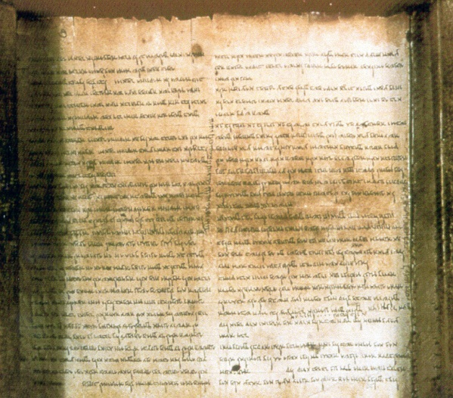
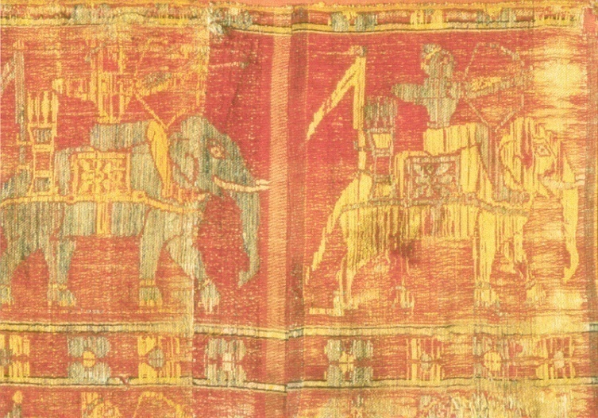
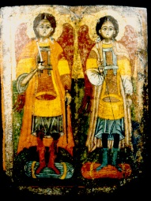
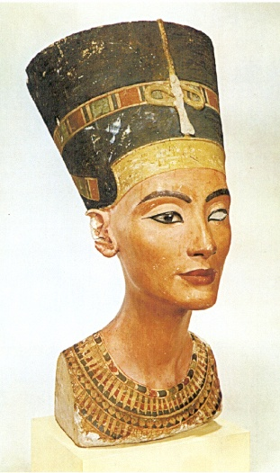
Interesting objects can be dated

Slide 19
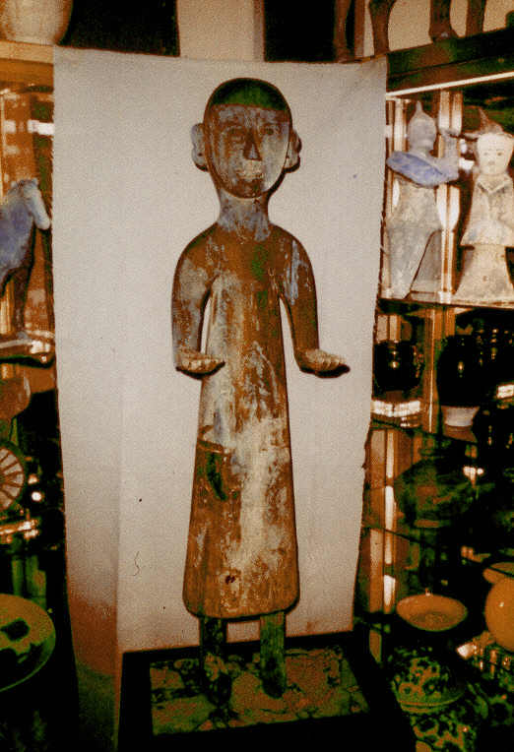
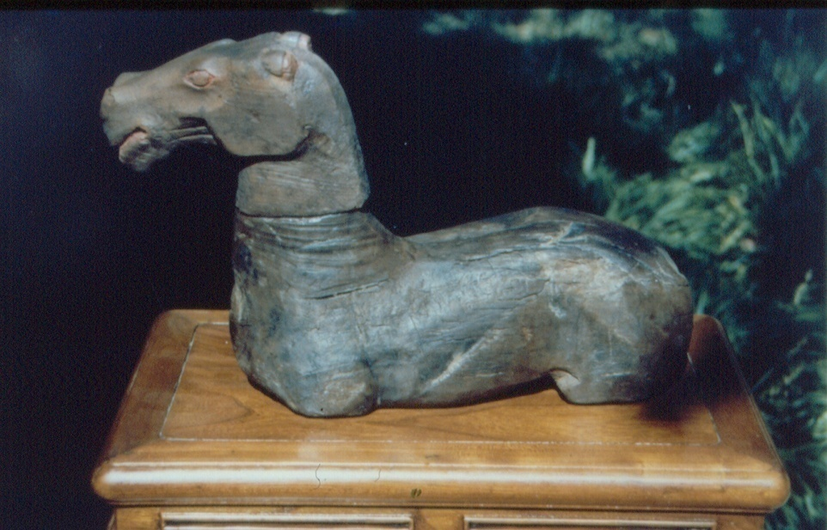
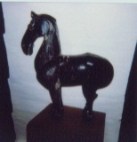
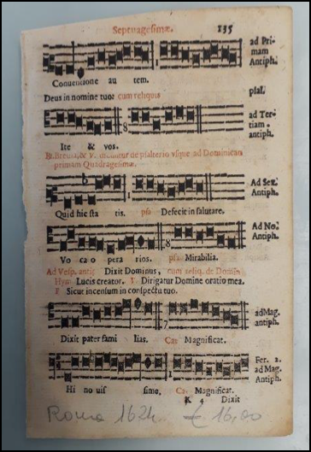
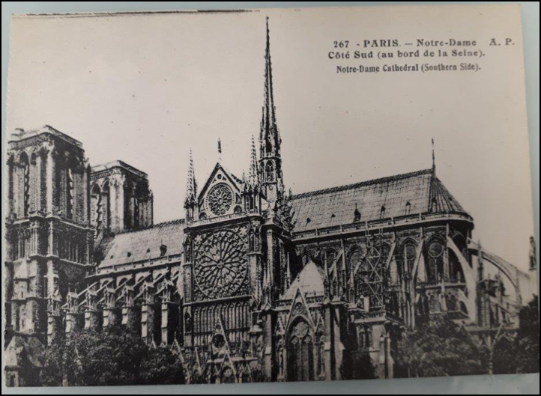
FAKE!
Han dynasty horse (~2000 yr old)
FAKE!

Slide 20
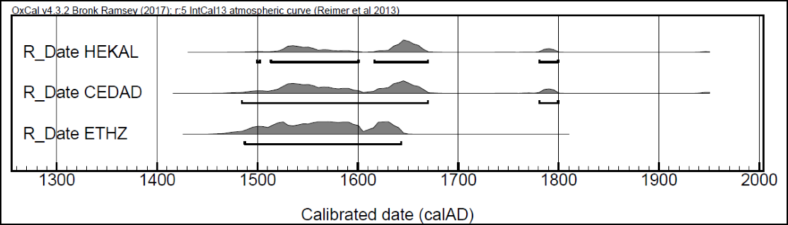
Music from the 17th century
Results from 3 different laboratories
Show consistent results.

Slide 21
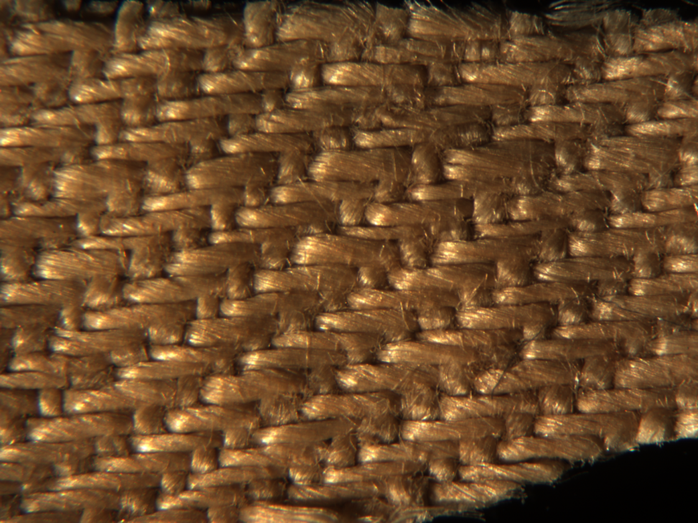
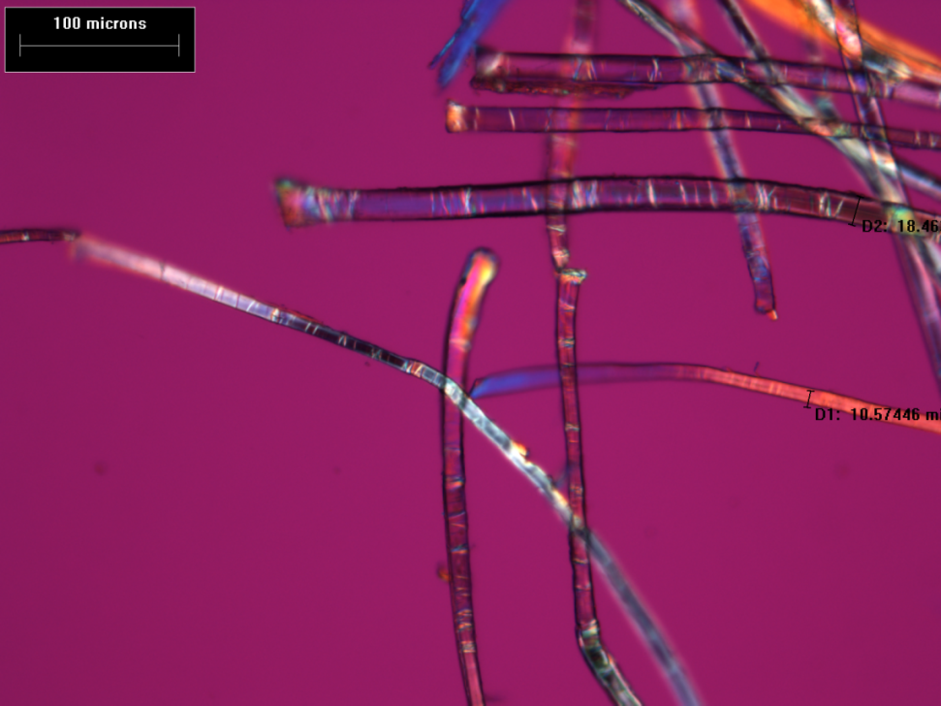
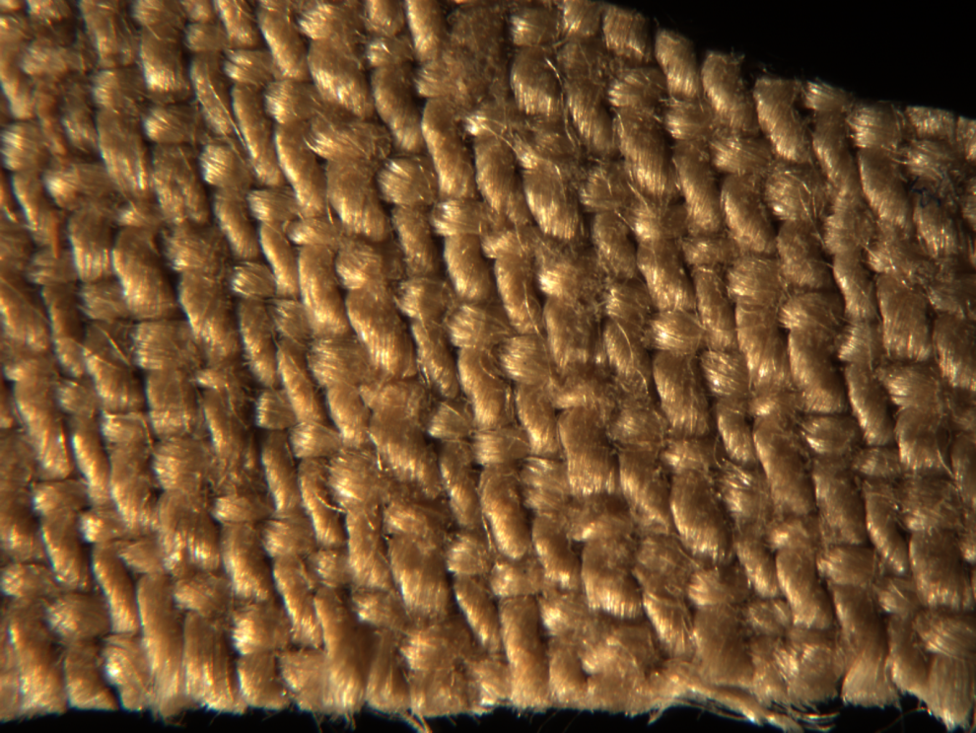
Most famous sample dated by ¹⁴C (1988)
The 3-1 or weft-float side
Warp side
A subsample of “Sample A-1”
received by Arizona
Flax fibres from Turin Shroud linen
Number of Google hits on this dating study:
>1,880,000

Slide 22

Dead Sea Scroll
2141±32 yr BP
(Arizona)
2128±38 yr BP
(ETH Zurich)
Calibrated age:
250-103BC
Paleography:
150-125BC
Book of Isaiah, on display in the Shrine of the Book, Jerusalem

Slide 23
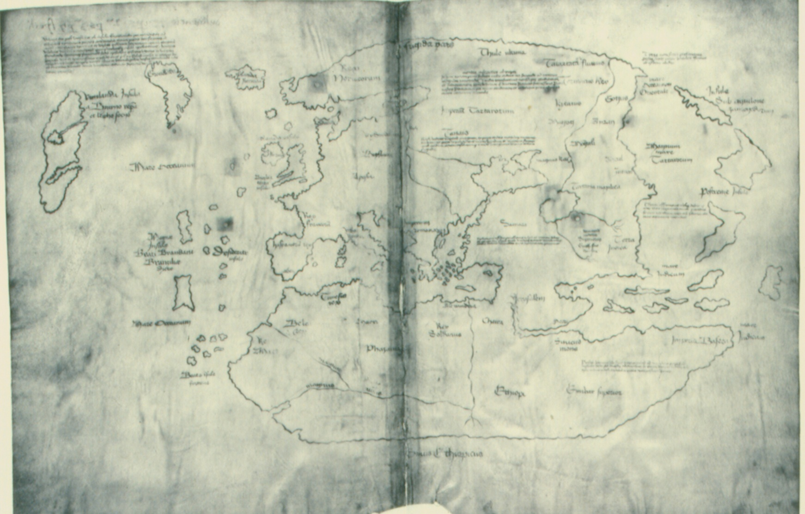
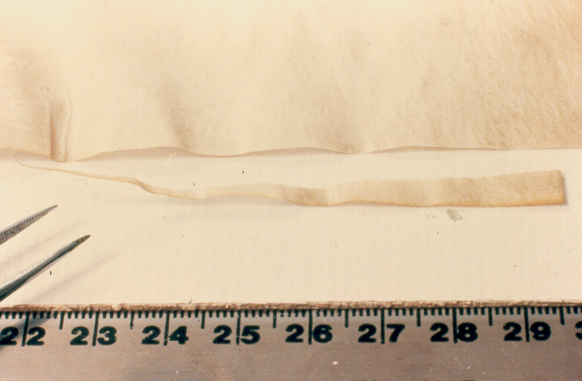
Vinland Map
Vinland Map: Old news in Scandinavia
      1423-1445 AD ( 1σ)
      1411-1468 AD (2σ)

Slide 24
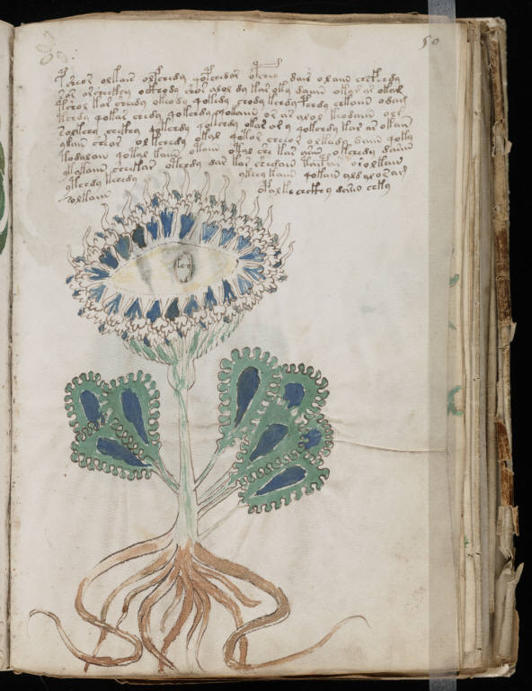
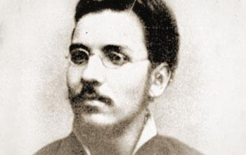
Voynich Manuscript
Current owner: Beineke Library, Yale University
Obtained from: Ethel Voynich, widow of Wilfred M. Voynich (1969).
Voynich had obtained the book from the Jesuit College in Frascati (1912)
which had the book since about 1666.
Known history:
Belonged to Emperor Rudolph II of Germany (Holy Roman Emperor, 1576-1612), who purchased it for 600 gold ducats and believed that it was the work of Roger Bacon.
It is very likely that Emperor Rudolph acquired the manuscript from the English astrologer John Dee (1527-1608).
Dee’s son noted that Dee owned:
"a booke...containing nothing butt Hieroglyphicks, which booke his father bestowed much time upon: but I could not heare that hee could make it out."

Slide 25
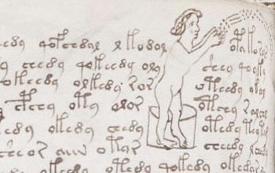
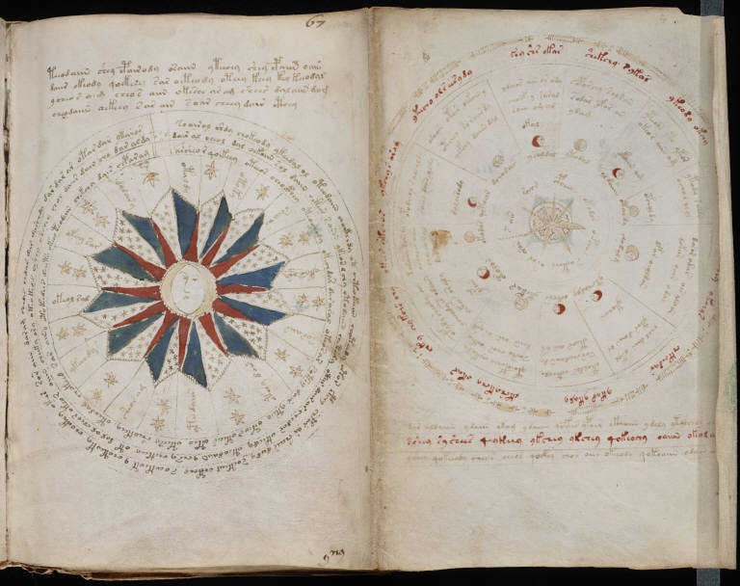
How old is it?
Radiocarbon dating shows the manuscript
Vellum is 1404-1438AD
Much older than known history.
Not old enough to be written by Roger Bacon
So, we are left with the puzzle:
Who wrote it and why?
What does the text mean?
What was the point in writing
something no-one can read,
or has the code?
Is it just some medieval joke?

Slide 26
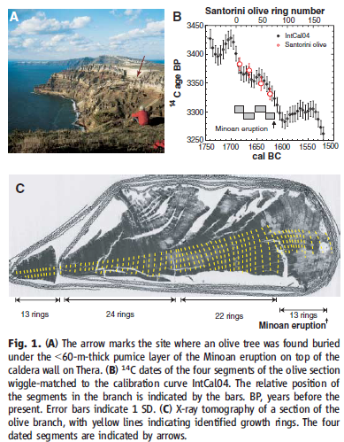
Friedrich et al (2006), Science 312: 548.

Slide 27
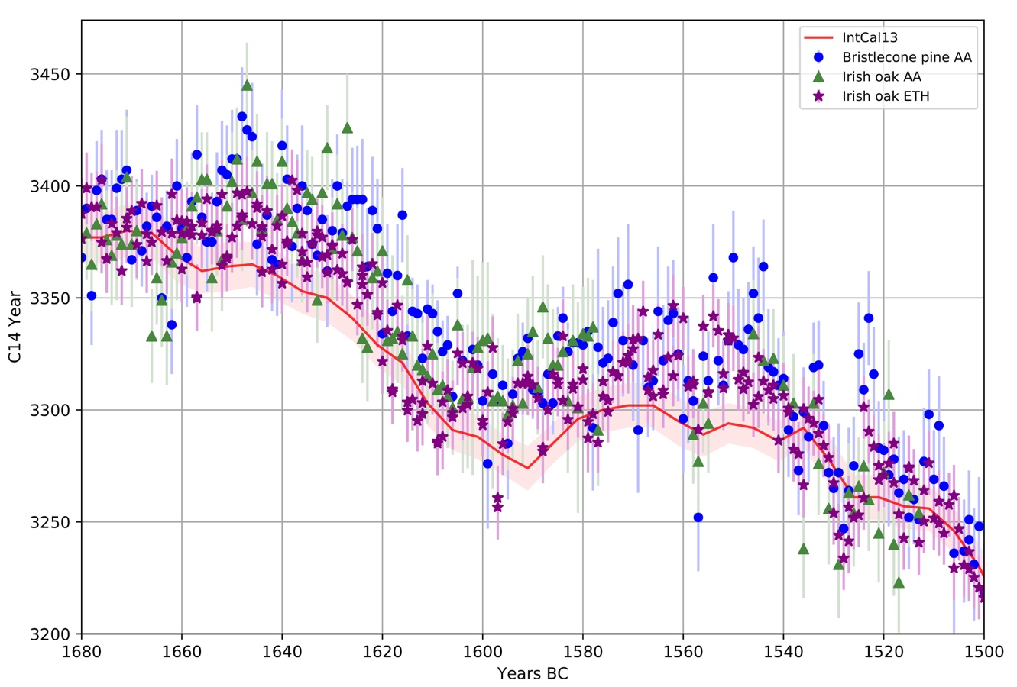
Comparison of 14C data from Bristlecone pine, measured at Arizona and
Irish Oak measured at ETH and Arizona.

Slide 28
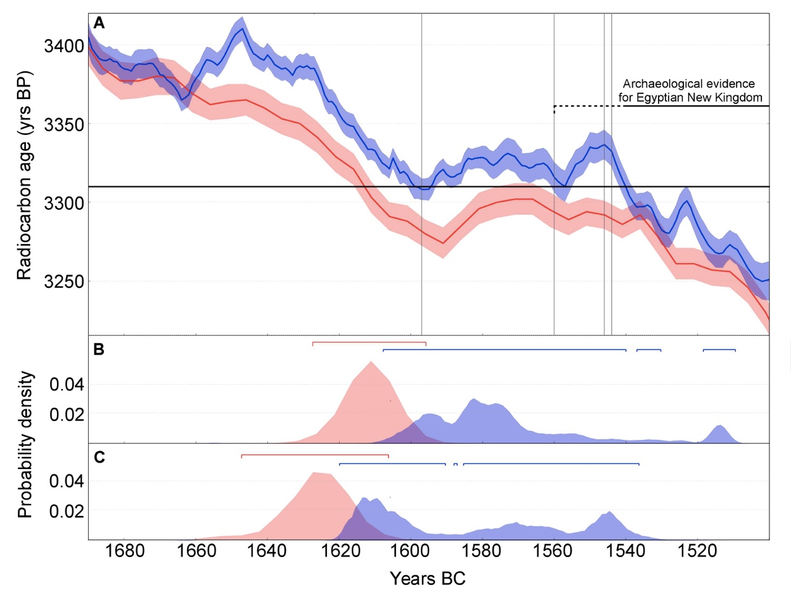
Effects on Middle Bronze Age dates (Santorini eruption)
Pearson et al. 2018. Science Advances

Slide 29
Rapid changes in ¹⁴C: Solar and other forcing?
There are periods where there are rapid changes in the 14C signal
Solar-flare related events: 774-775CE, 993-994CE, 660BCE
Not confirmed: 3372-3371BCE
Other events: 810BCE, 5480BCE
More events are likely.
Miyake et al. (2012) were the first
to recognize a very large event at AD774
from ¹⁴C in Japanese tree rings was likely
due to solar-flare effects.
Other possible effects:
Supernovae?
𝜸-ray bursts?
Carbon-cycle changes?
Fusa Miyake at Biosphere 2,
Oracle, Arizona in 2015.

Slide 30
The 774-775AD event is shown here. The right hand side shows the calibration curve during the same period.
Summary from Dee and Pope (2016), Proc. Roy. Soc. Lond. A472:20160263

Slide 31
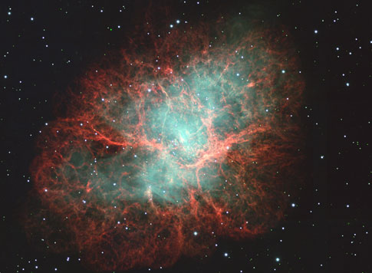
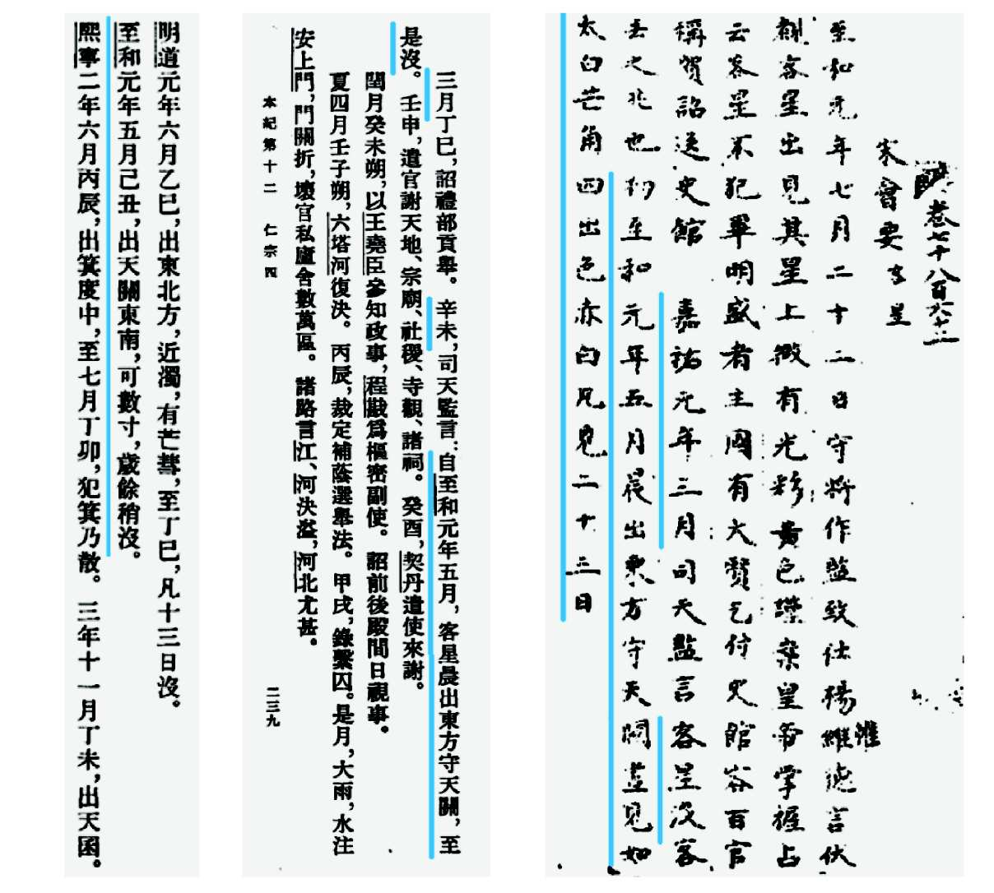
Is it possible to observe supernova as well
as cosmic-ray effects in tree rings?
Another talk….
Crab Nebula taken with Subaru Telescope
(Astronomy.com)

Slide 32
Acknowledgments
This is a contribution to the F11021 CRP (Coordinate Research Project) on “Enhancing Nuclear Analytical Techniques to Meet the Needs of Forensic Sciences” supported by the International Atomic Energy Agency. The research was also supported by the European Union and the State of Hungary, co-ﬁnanced by the European Regional Development Fund in the project of GINOP-2.3.2-15-2016-00009 ‘ICER’.

