Slide 1
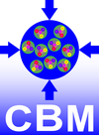



Application for testing CBM detectors
in beam at COSY in Q4/2019
Recent tests: (1) in mCBM (3/2019) (2) at COSY (4/2019)
Beamtime application at COSY for Q4/2019
Preview of medium-term plans at COSY 2020 – 2022
Johann M. Heuser
GSI Helmholtz Center for Heavy Ion Research GmbH, Darmstadt, Germany
for the CBM Collaboration
10th COSY Beamtime Advisory Committee Meeting,
IKP FZ Jülich, 1 July 2019

Slide 2

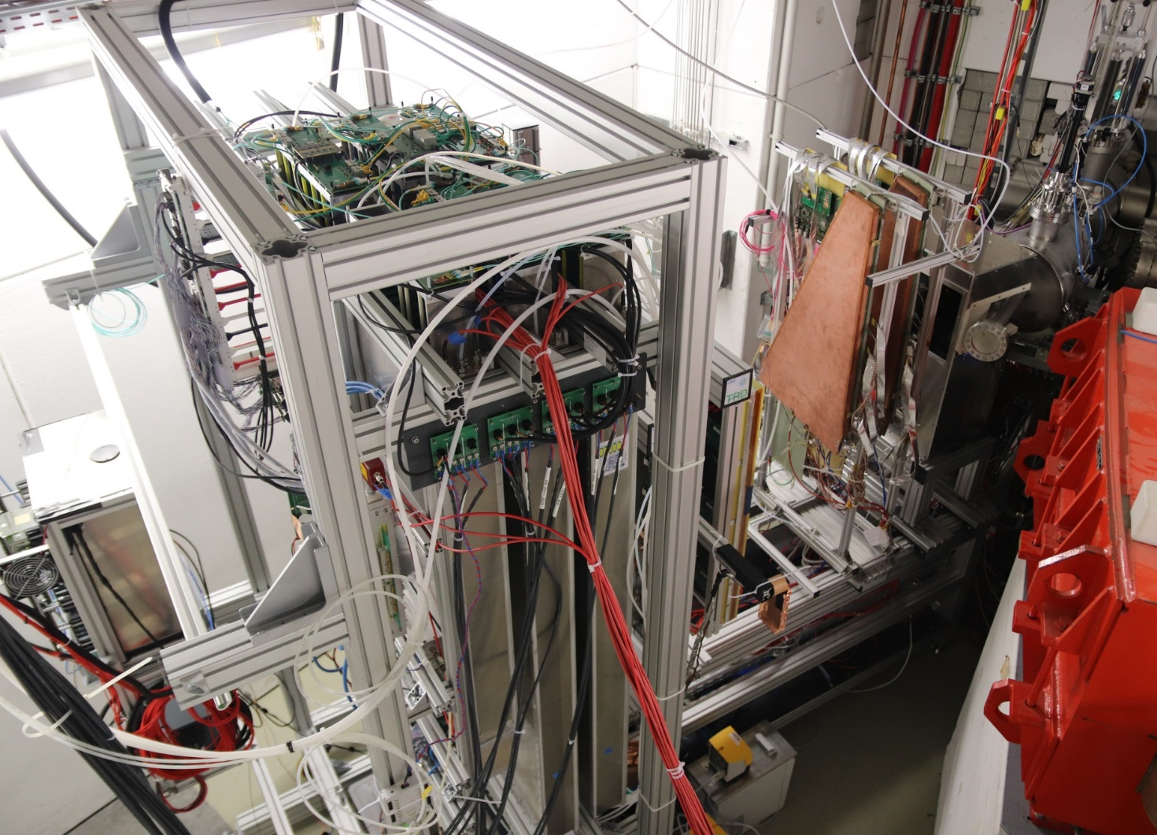
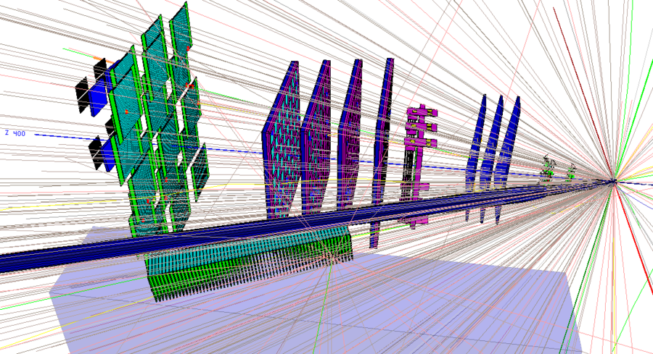
(1) Tests in mCBM@SIS18, 12/2018 and 3/2019
mCBM@SIS18 - a CBM full system test-setup
for high-rate nucleus-nucleus collisions at GSI/FAIR
mTOF
T0
diamond
mRICH
mSTS
mMUCH
first successful commissioning with beam 12/2018 and 3/2019
CBM prototype detector systems
free-streaming read-out and data transport to the mFLES
up to 10 MHz collision rate
online monitoring
event reconstruction and selection – offline now, on-line next
mTRD

Slide 3
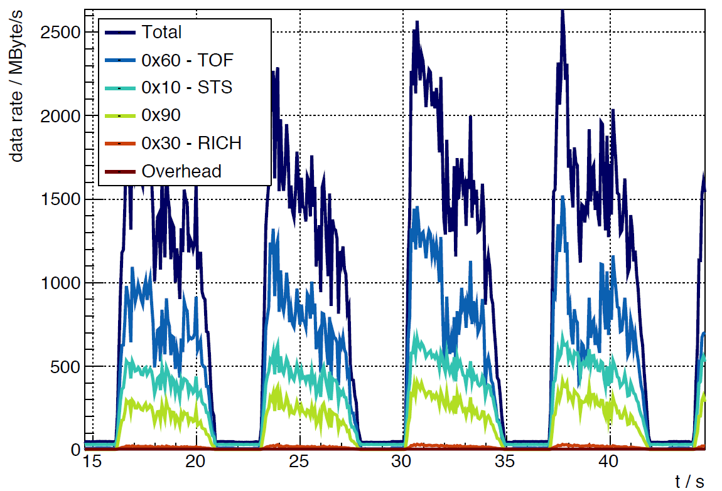
mCBM@SIS18 – combined data taking
x 10⁶
March 30, 2019 – run 175
(approx.) 10⁸ Ag ions/s (1.58 GeV/u) + Au (2.5 mm)
preliminary
T0 rate (Hz)
- T0
March 30, 2019:
beam intensity ≈ 10⁸ Ag ions / s
interaction rates 10⁶ … 10⁷ / s (preliminary)

Slide 4
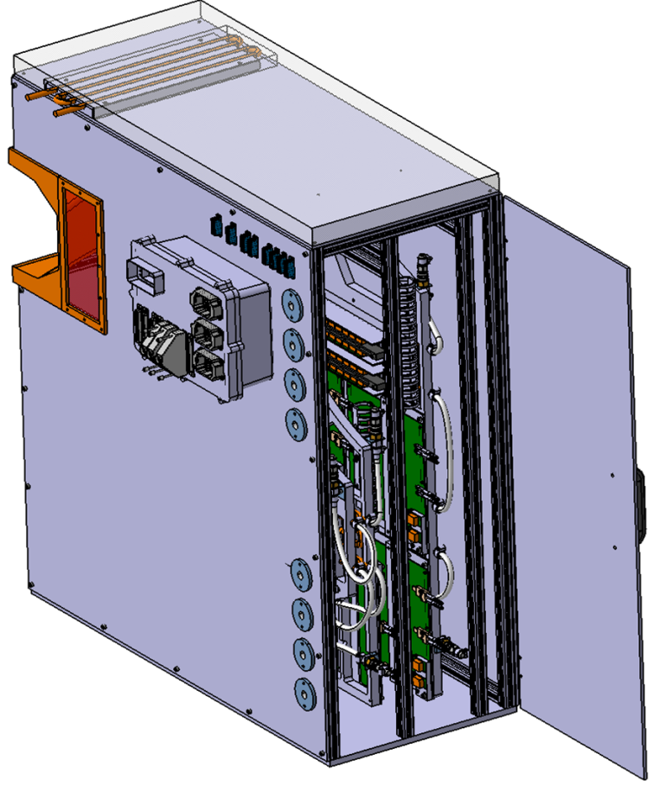
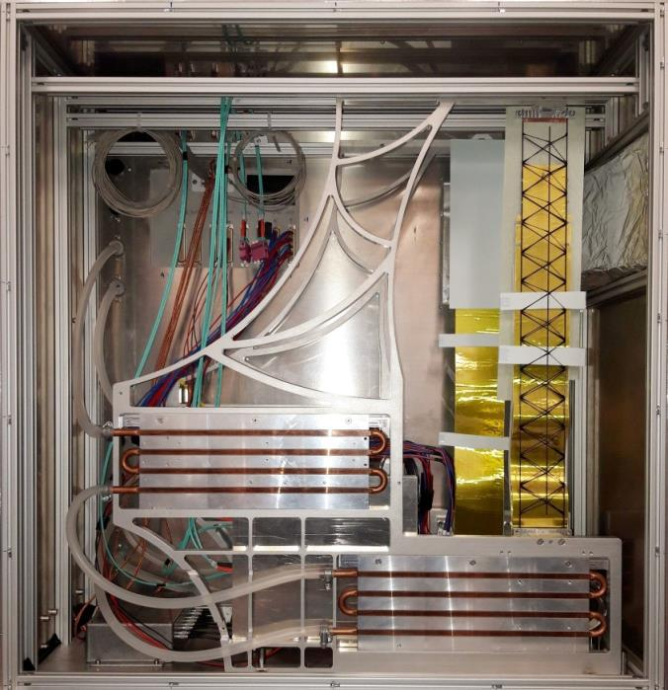

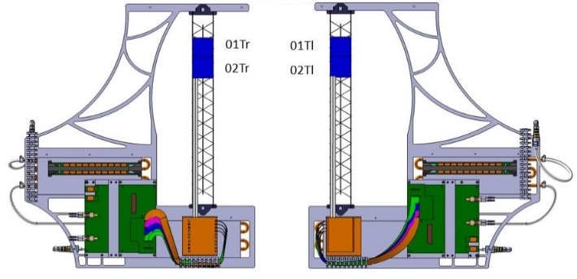
mSTS demonstrator
mSTS – demonstration of:
C-frame and ladder mounting mechanics
module and ladder assembly
LV + HV powering
liquid cooling of electronics (water)
module performance, data streaming
no sensor cooling, operation at “room” temperature
station #0
area 12 x 12 cm²
station #0: C-frames #0 and #1

Slide 5
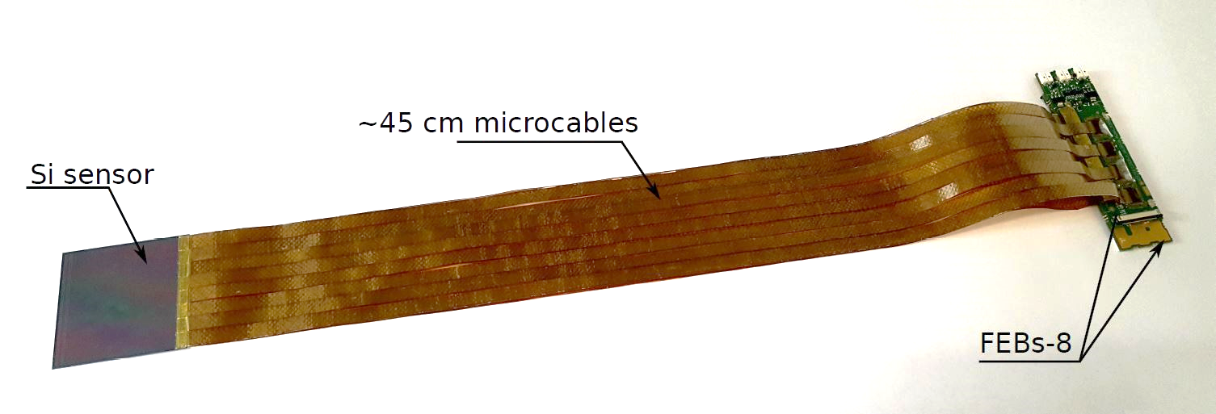
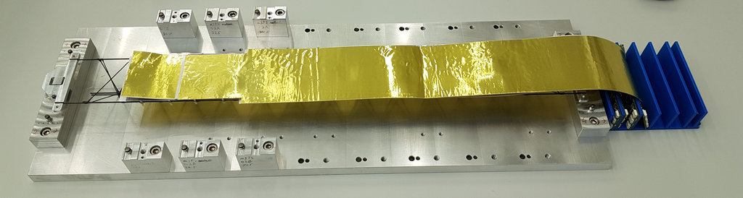
mSTS demonstrator
mSTS – demonstration of:
C-frame and ladder mounting mechanics
module and ladder assembly
LV + HV powering
liquid cooling of electronics (water)
module performance, data streaming
no sensor cooling, operation at ``room’’ temperature
station #0
area 12 x 12 cm²
module, longest STS variant
station #0: C-frames #0 and #1
half-ladder with 2 modules

Slide 6
mSTS achievements and findings
Achievements
Findings
module assembly
first full-size modules assembled
module assembly yield
all tested components used (sensors, microcables, ASICs)
microcable attachment yield high
FEB 8 assembly/operation yield
too low on the first prototypes
some modules fading away during (in-beam) operation
  under systematic study
  new FEB design, custom designed rad. tolerant LDO, …
ladder assembly
first half-ladders assembled
system integration
C-frame assembly
cooling plates
powering and read-out electronics
ladder installation
cabling
power supplies in “final” cave location
noise in longest modules too high
in test box: ≈ 1300 e OK
in mSTS: ≈ 3000 e ⇒ S/N ≈ 8-12
threshold high
  under systematic study
  power supplies, filtering
(preliminary)
read-out
data links stable
high-rate read-out achieved

Slide 7
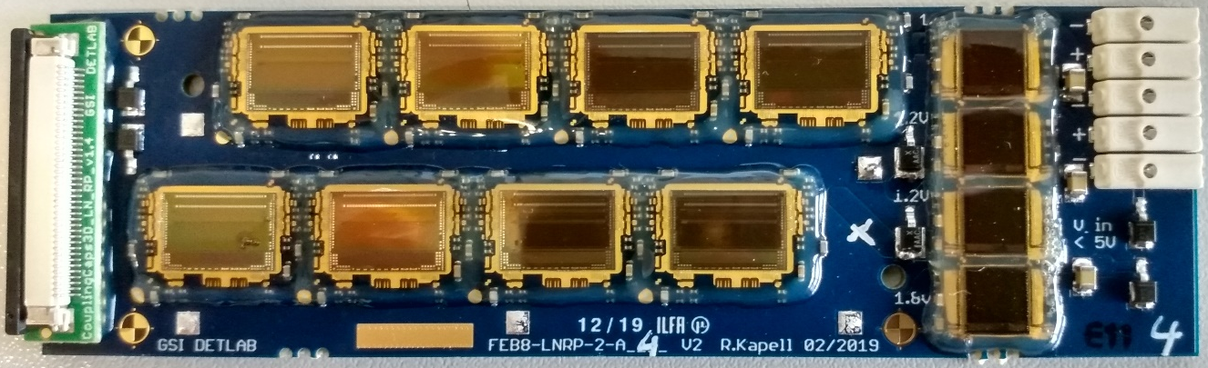
mSTS achievements and findings
preparations ongoing
Achievements
Findings
module assembly
first full-size modules assembled
module assembly yield
all tested components used (sensors, microcables, ASICs)
microcable attachment yield high
FEB 8 assembly/operation yield
too low on the first prototypes
some modules fading away during (in-beam) operation
  under systematic study
  new FEB design, custom designed rad. tolerant LDO, …
ladder assembly
first half-ladders assembled
approach:
in-detail check of module components, FEB-8 v2 and assembly procedure
assembly of new modules
systematic test in the STS lab
if successful, carry out in-beam test at COSY: module in reference fiber hodoscope tracking telescope (Q4/2019)
system integration
C-frame assembly
cooling plates
powering and read-out electronics
ladder installation
cabling
power supplies in “final” cave location
noise in longest modules too high
in test box: ≈ 1300 e OK
in mSTS: ≈ 3000 e ⇒ S/N ≈ 8-12
threshold high
  under systematic study
  power supplies, filtering
(preliminary)
read-out
data links stable
high-rate read-out achieved

Slide 8
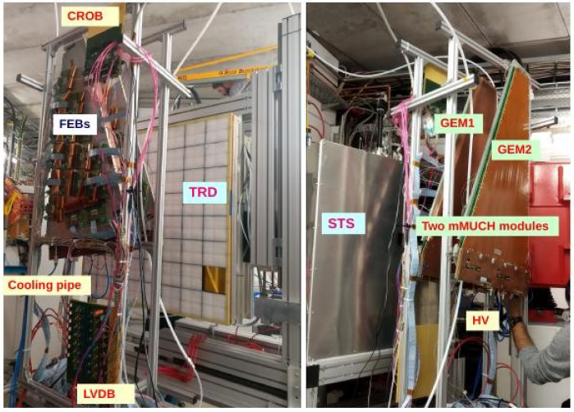
mMUCH demonstrator
~2200 pads, 18 FEBs per chamber
80 cm
current issues:
noise in one chamber
data synchronization in one chamber
modification in LV system for upcoming mCBM running

Slide 9
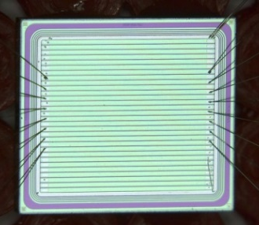
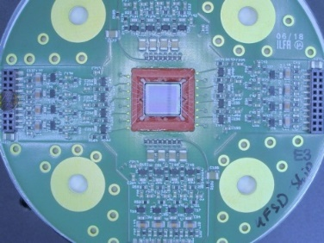
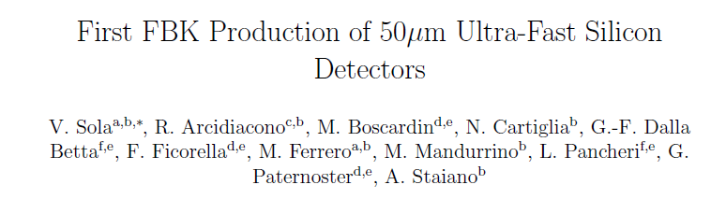
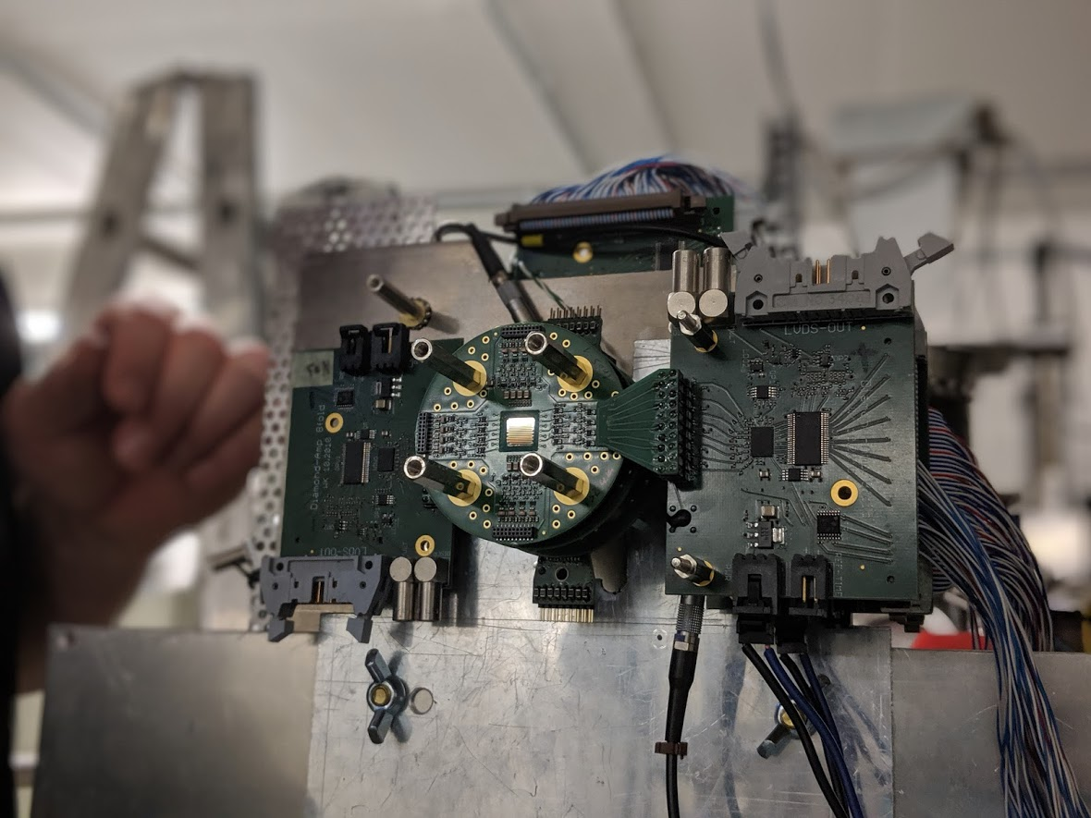
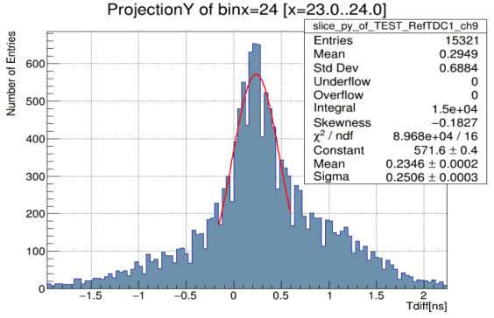
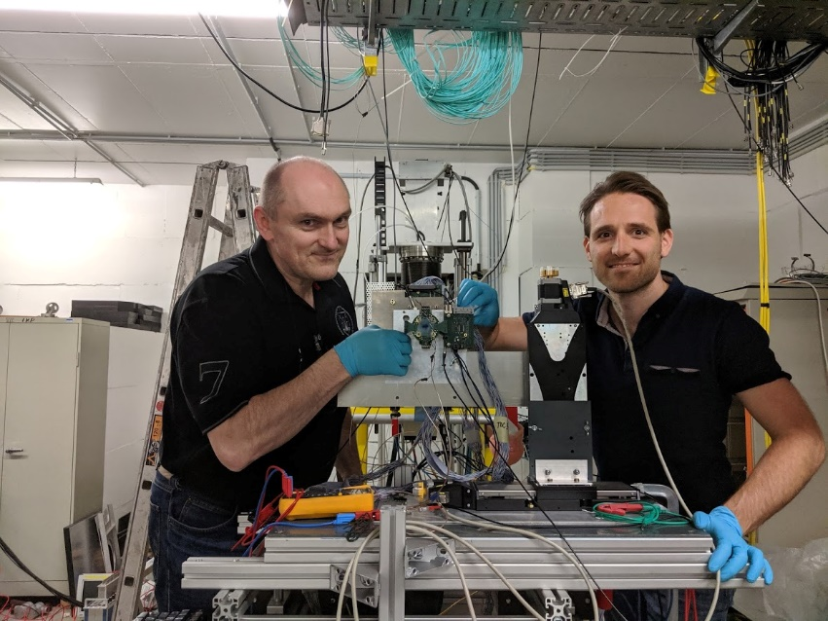
(2) UFSDs tested at COSY (4/2019) for HADES + CBM@FAIR
Ultra Fast Silicon Detectors:
A novel technology based on low-gain avalanche diode:
excellent timing properties, time precision below 100 ps
well established, cheap, production process
on-going R&D (ATLAS/CMS)
Sensors delivered from INFN Torino and FBK Trento
NIM A924 (2019) 360-368
Jerzy Pietraszko (GSI) et al.
scCVD diamond
Online results:
time precision 250 ps / 1.4 = 178 ps
detailed analysis on-going
further tests needed with improved detector stabilities
UFSD1
behind the holder
UFSD2

Slide 10
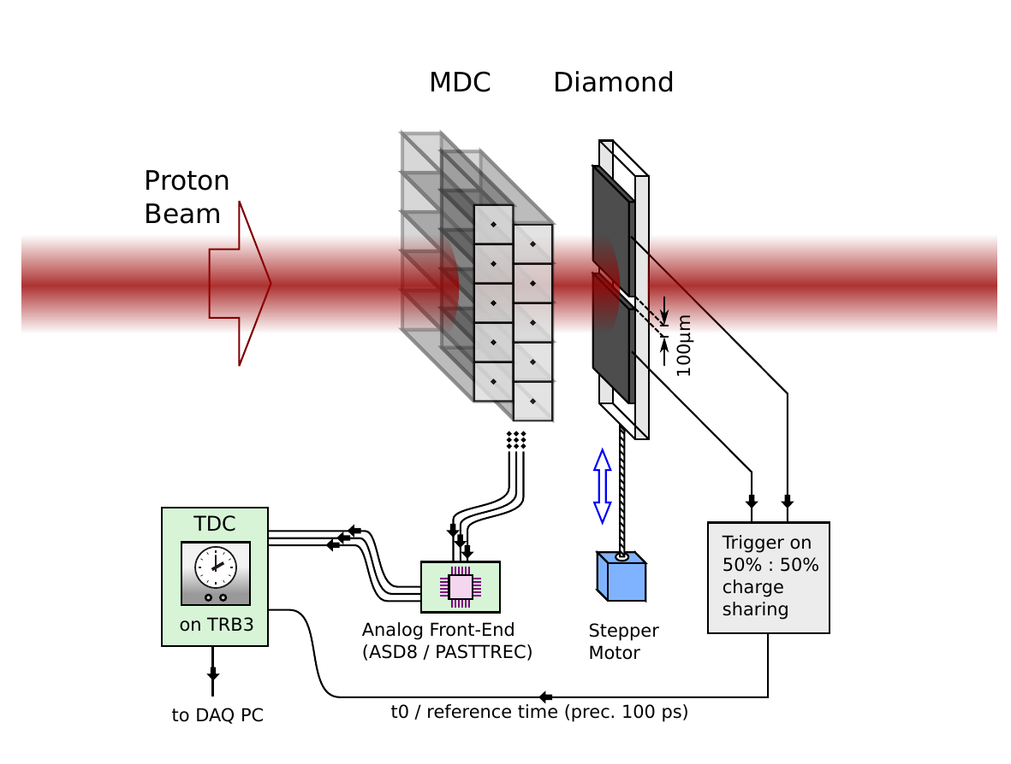
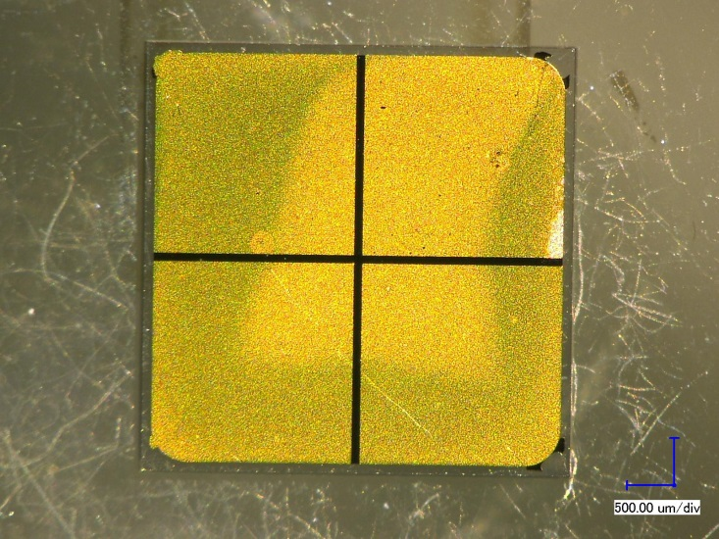
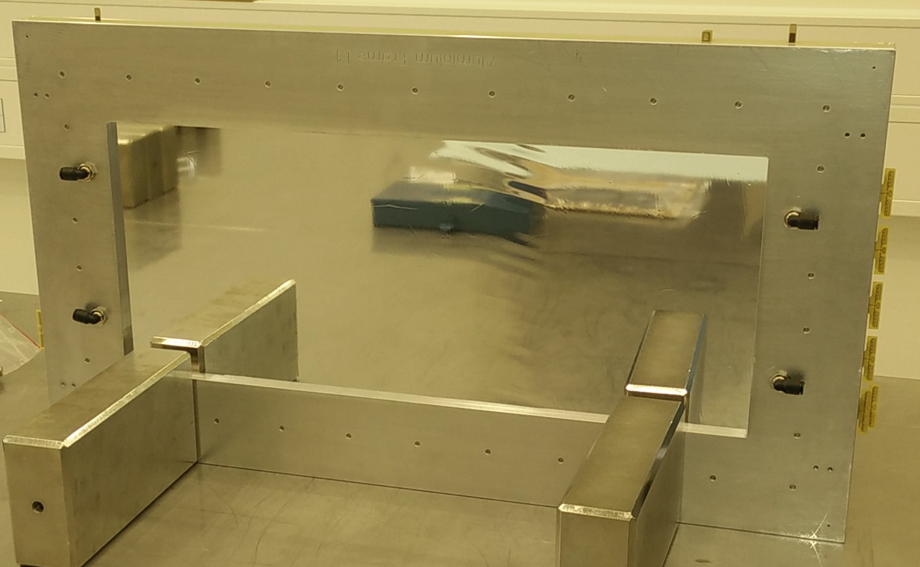
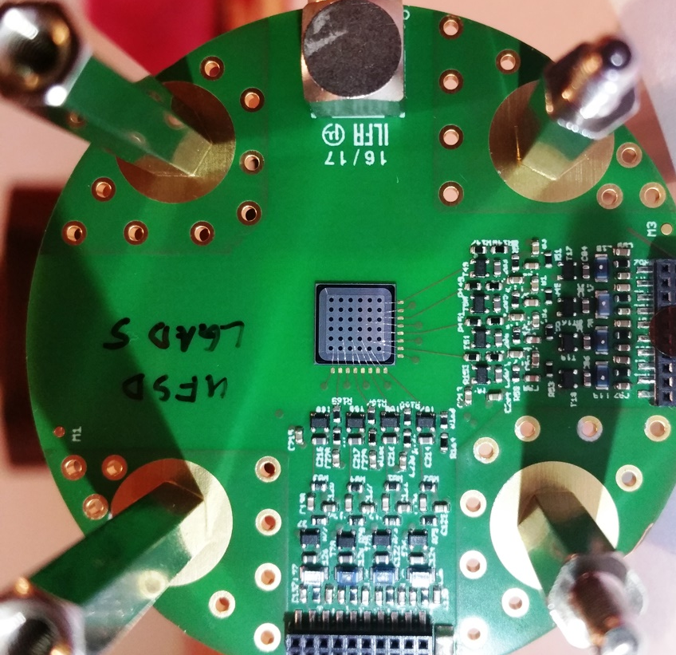
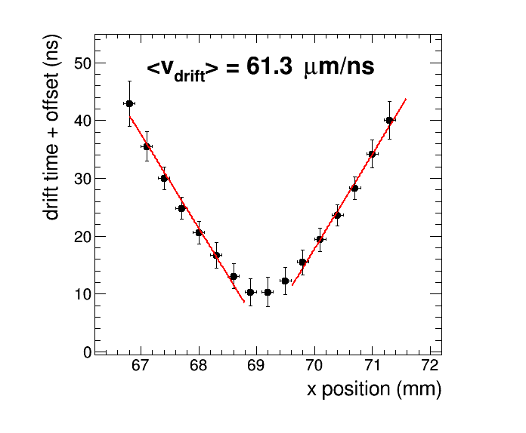
UFSDs: Further tests at COSY in Q4/2019
Goals:
Study drift velocity map inside drift cell, gas mixture dependency
Measure spatial resolution of new drift cell geometry (2.5 x 5 mm²)
Setup:
HADES Mini Drift Chamber (MDC)
  50 x 20 cm² active area
  2 drift cell layers, each 80 cells
reference / tracking by Silicon or Diamond detector:
  4 channels, 100 µm gap (diamond)
  36 pixels, active area: 4.5 x 4.5 mm²
  time precision < 100 ps
  movable (µm step precision)
scCVD
New technology
Ultra Fast Silicon Detectors
Mini Drift Chamber (MDC)
drift time inside a MDC prototypeV1
(5 x 5mm²) drift cell as function of perpendicular distance to sense wire (measured by same setup 2017 @ COSY)
set-up ready

Slide 11
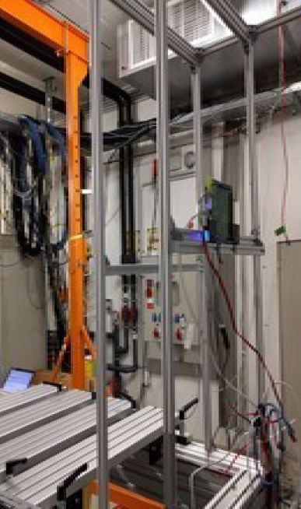

Fault Tolerant Local and Monitoring & Control
Reasons to develop FTLMC
SEE’s are problematic and can result in serious malfunctions
ARM produces intellectual property fault tolerant processors:
  Safety and redundancy:
  arm7v4 Cortex R5F
  Vendor that produces such a chip:
  TI- TMS570
  Task: Build a control board based on that chip: FTLMC
Robustness in detector environment
Test at COSY 2/2018:
Cortex-R chip (TI-TMS570)
exposed directly to beam during 13 hours
beam: 2 Gev Protons 10⁵ per bunch
total detected and corrected SEU’s:
  in Bank A: 718, in Bank B: 686
no unrecoverable errors
failure registers continuously monitored
database with error time-stamp
no errors during beam off times detected
To be tested at COSY Q4/2019:
new FTLMC board
set-up ready
Goethe Universität Frankfurt

Slide 12
Beamtime application at COSY for Q4/2019
Aim: Test CBM detectors equipped with new STS-XYTER v2.1 ASIC – shifted from Q2/2019
In order to exclude any potential risk regarding the qualification of the front-end electronics towards STS-XYTER Production Readiness, carry out further, dedicated test of the detectors:
STS module – in proton beam at COSY, allowing full characterization
[MUCH GEM chamber – better placed in mCBM environment for the DAQ support, power supply study]
Further aim:
refined tests of Ultra Fast Silicon Detectors
SEE stability tests of Fault Tolerant Local and Monitoring & Control board
Prototypes of the detectors/boards either are ready or will be ready.
One week of beamtime in JESSICA Cave will be sufficient to operate and to test the detectors.

Slide 13
Beamtime application at COSY for Q4/2019
Total number of particles and type of beam (p,d,polarization) | Momentum range (MeV/c) | Intensity or internal reaction rate (particles per second)
 |  | minimum needed | maximum useful
p | p ~ 3000 | ~ 10⁴ – 10⁶ | up to 10⁸
Experimental area | Safety aspects (if any) | Earliest date of installation | Total beam time (No.of shifts)
JESSICA Cave | None | one week at turn of Oct./Nov. 2019 (e.g week #45) | 7 days around the clock
to be tested:
(1) STS module, (2) MDC-UFS detector, (3) FTLMC board
Experimental set-up:
  JESSICA cave
  test beam table installed
  additional space in rack room close to the JESSICA door
  “Wasaquarium” as control room
During the tests, access to the cave will be required in order to reconfigure the set-up, days and nights. The participating teams will be of moderate size in personnel.
Delivery and installation of equipment during the week prior to the beam time could be helpful and efficient for the timely start of using the beam.

Slide 14
Preview of medium term plans for in-beam tests at COSY
First (parasitic) heavy-ion beam was delivered to mCBM in March 2019.
A first production run will take place in Spring 2020.
  technical tests in November 2019.
It is planned to extend running of mCBM further.
  Depending on how future beamtimes beyond 2020 may be realized within the FAIR-Phase 0 activity, CBM subsystem studies before series production of components and modules/sectors might need additional testing places, including COSY, in the foreseeable time 2020 – 2022.
Independent of the ongoing preparations for CBM, small test systems comprising new detector developments may be studied at COSY using the close-to-minimum ionizing protons in well focused beam.

