Slide 1
Status of FAIR
ECE and Scrutiny Group
4 November 2019
Karlheinz Langanke
FAIR GmbH | GSI GmbH

Slide 2
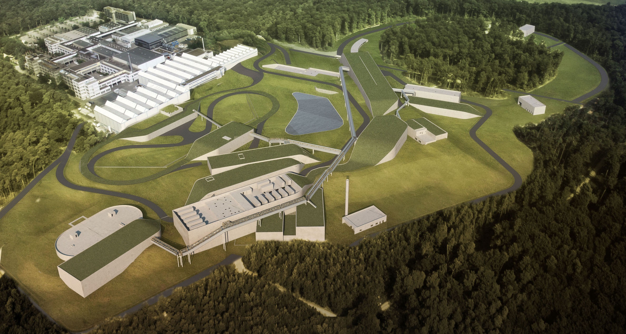
FAIR: Facility for Antiproton and Ion Research
– builds on Competence of GSI and the Community worldwide
ESFRI Landmark
Top priority for European
Nuclear Physics Community
Driver for Innovation in Science and Technology
2

Slide 3
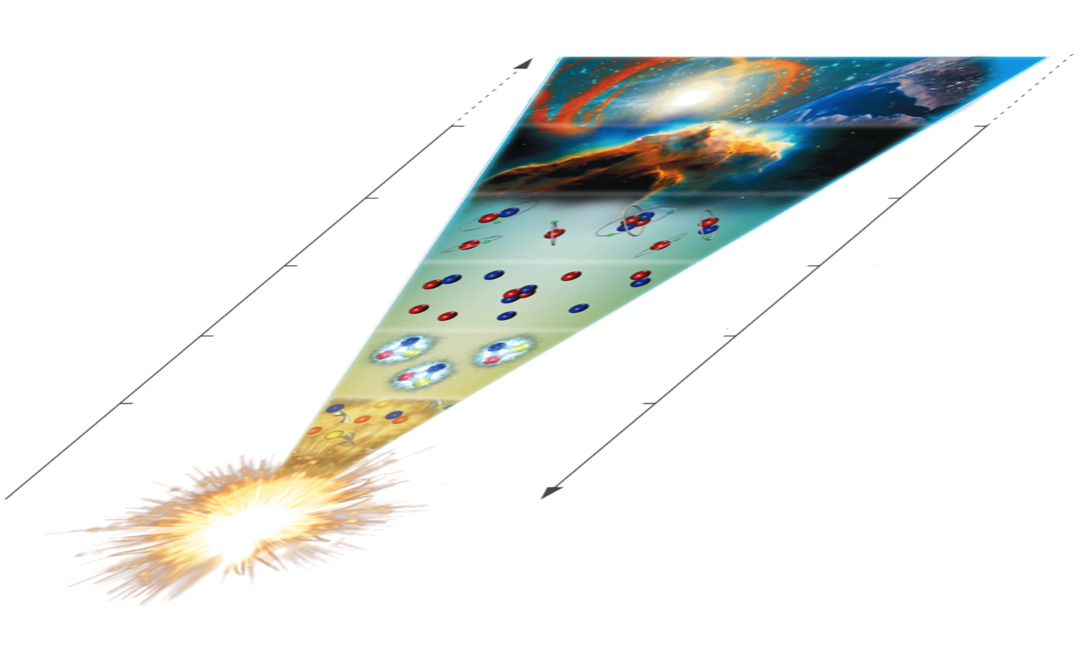
FAIR Science Sketch
time
Atomic, applied and
plasma physics - APPA
Astrophysics and
nuclear structure
- NUSTAR
Hadron structure
- PANDA
QCD phase transition - CBM
temperature
big bang

Slide 4
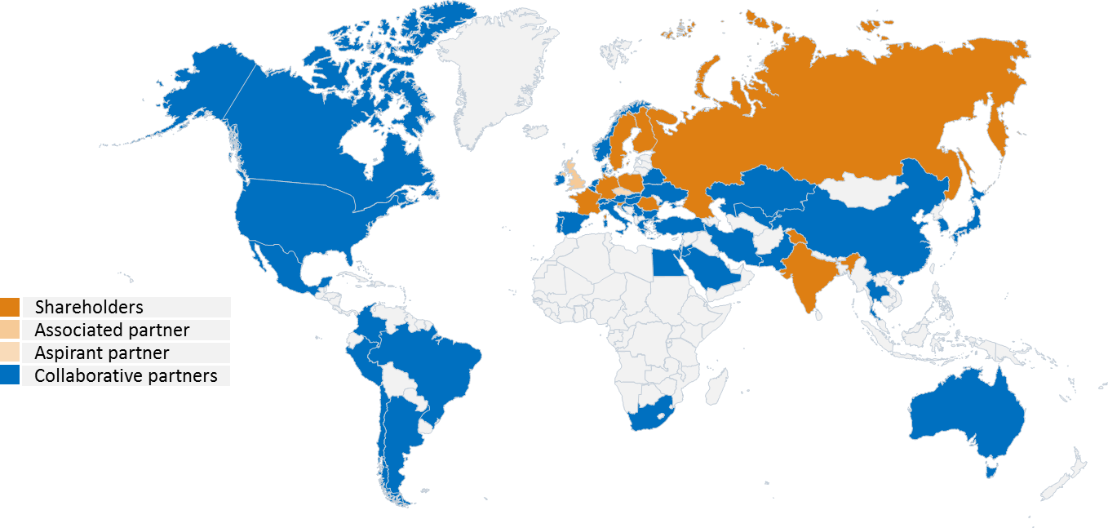
FAIR: International Co-operation
9 international FAIR Shareholders
1 Associated Partner (United Kingdom)
1 Aspirant Partner Czech Republic (Since 2018)
Participation of about 3.000 scientists

Slide 5
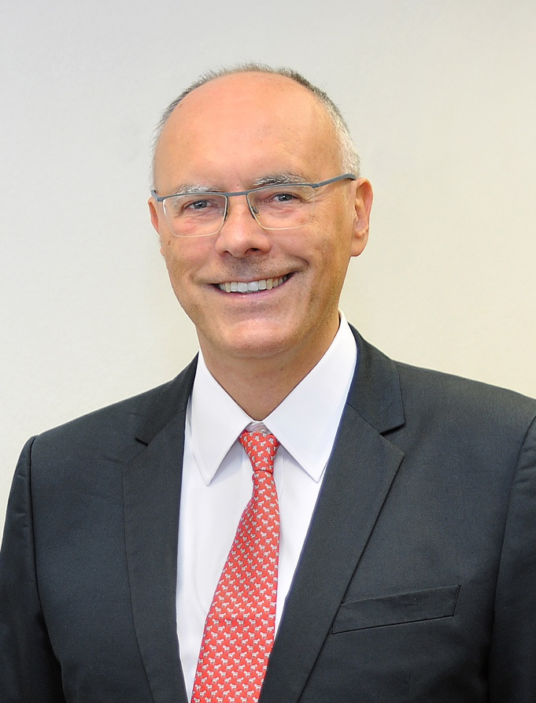
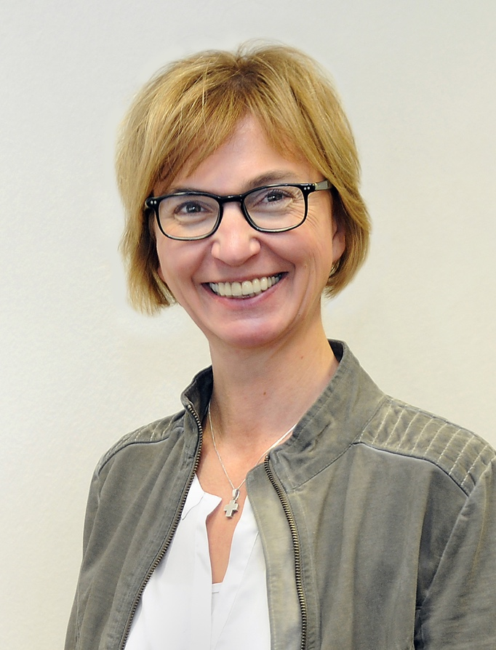
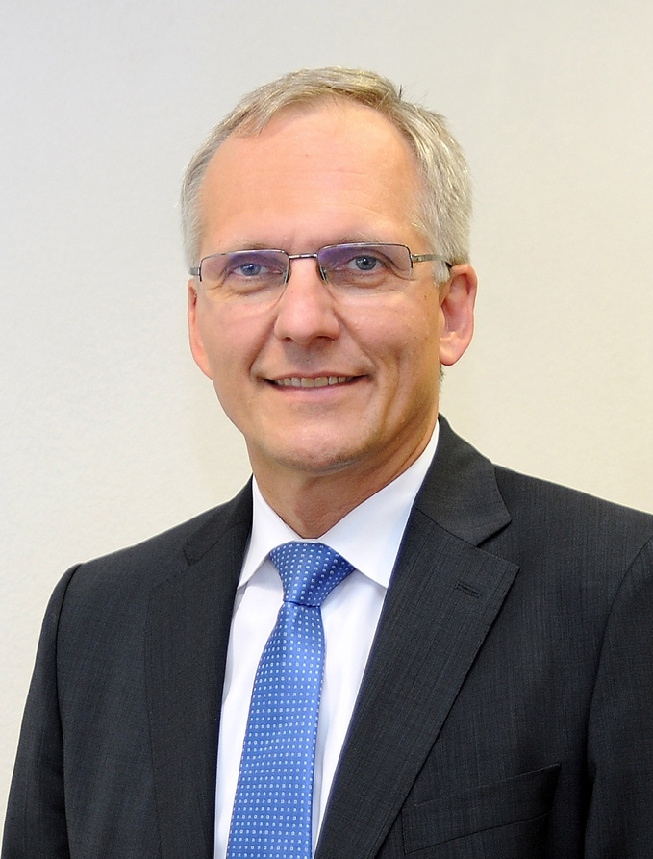
Common management
Paolo Giubellino
Scientific Managing Director
Ursula Weyrich
Administrative Managing Director
Jörg Blaurock
Technical Managing Director

Slide 6



Common strategy
Build FAIR and develop GSI for FAIR
Making FAIR a success requires:
    a strong host laboratory with world-
    class facilities and a leading role in
    the international scientific arena
    a vibrant scientific community, in
    particular young researchers,
    performing a first-class intermediate
    research program
    a modern campus with appropriate infrastructure for the employees and the international users
Construction
of FAIR
intermediate
research
program
Upgrade
of existing GSI
accelerators
Campus
development

Slide 7
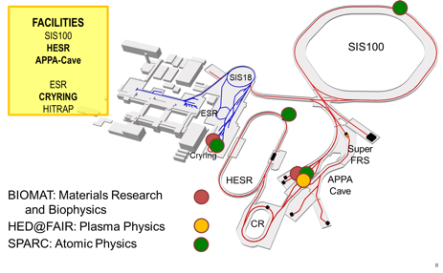
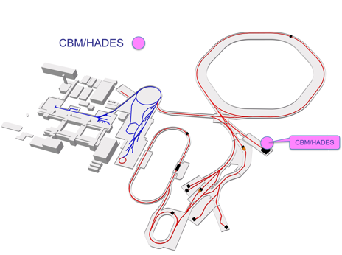
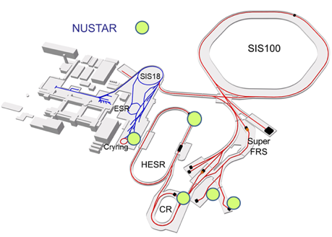

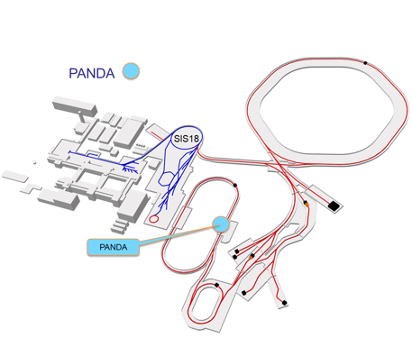
Schedule for FAIR Science
Working towards the completion of FAIR by 2025
Major thrust is on construction of FAIR accelerators and experiments.
At the same time staged approach to FAIR science and progressive commissioning of accelerators
and detectors:
    FAIR Phase-0 : start in 2019
    FAIR Day-1 configurations/ Phase-1 experiments with FAIR accelerators progressively approaching design parameters → 2024/25 …
    Full FAIR operation 2025+
APPA
CBM
NUSTAR
PANDA

Slide 8
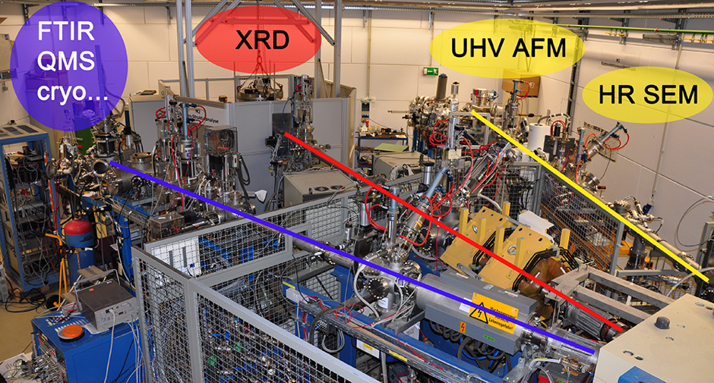
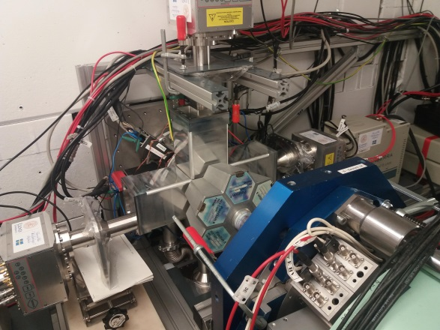
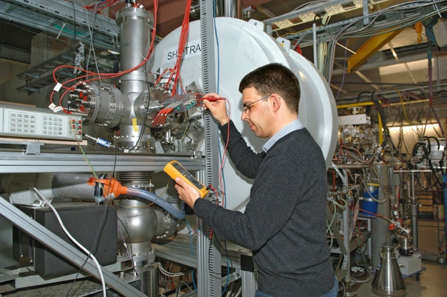

Phase-0 run 2018/19, Experiments at UNILAC
Biophysics and Materials research with a broad user program of approx. 50 proposals
UMAT C. Trautmann e.g. M-branch user facility
Super heavy elements (SHE)
SHE Physics
SHIPTRAP
U310 D. Rudolph “Spectroscopy of Flerovium”
U313 M. Laatiaoui “Laser spectroscopy of nobelium and lawrencium ”

Slide 9



SHIP/SHIPTRAP
Two-week beamtime campaign in June/July 2018
new / improved mass values for ^{251,251m,254,254m}No and ^{254,254m,255m,255,256}Lr
pinned down nuclear isomers with supreme resolving power of
novel PI-ICR technique of up to m/Δm = 10⁷
^{257g,m}Rf (Z=104) measurement at a rate of about 1 event per shift
10 hour measurement
1.2 s phase acc. time
m/Δm ≈ 10⁷
35 keV isomer resolved
10
²⁵⁵Lr
^{center}
PRELIMINARY
0
2.5 s
22 s
y-position [mm]
Φ
-10
^{255g}Lr
^{255m}Lr
-10
0
10
x-position [mm]
Notes:
PI-ICR stands for Phase Imaging Ion-Cyclotron-Resonance for short lived
A novel approach based on the projection of the Penning-trap ion motion onto a position-sensitive detector opens the door to very accurate mass measurements on the ppb level even for short-lived nuclides with half-lives well below a second. In addition to the accuracy boost, the new method provides a superior resolving power by which low-lying isomeric states with excitation energy on the 10-keV level can be easily separated from the ground state.
Determination of the cyclotron frequency of ion of charge q and mass m in a magnetic field B via the projection of the ion motion on a microchannel plate detector.
Groundstate 255Lr: Lebensdauer 22 s
Isomerer Zustand: 2.5 s (deshalb weisses Dreieck)
both alpha decay with a contribution of beta+

Slide 10
SHE Chemistry
Recommissiong of TASCA
Upgrades during 2017/18 shutdown:
new TASCA control system, integrated in GSI "control system" environment
relocation of TASCA control room due to renovation of SE building
upgraded shielding in cave X8 for improved background conditions
new quadrupole magnet power supplies
new TASCA detector chamber
→ more flexibility for focal plane detectors
det. systems, coupling chemical devices, ...
complete febex4-based digital DAQ for full focal plane detector
Beam commissioning (June 2018):
⁴⁸Ca/⁵⁰Ti+Yb / Au / Pb:
Ion optical performance verified
Control system and DAQ fully operational
Preliminary results obtained during TASCA Recommissioning 2018
Candidate events for new, most neutron-deficient Md isotope
(element 101) in ⁴⁸Ca + ¹⁹⁷Au reaction
Example of the ER-alpha correlations
²⁴⁵Md
Candidates
for ²⁴⁴Md
(new isotope)
(confirms known data)
SHE Chemistry, GSI/HIM

Slide 11
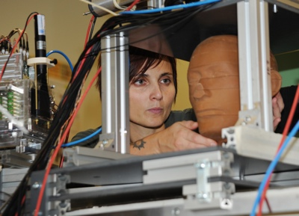
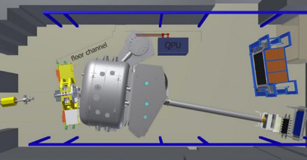
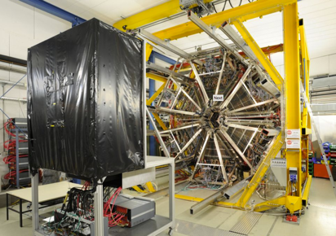
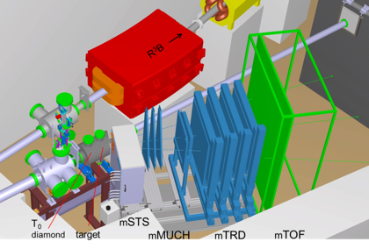
Phase-0 run 2018/19, Experiments at SIS18
Biophysics, ESA with a broad user program
Cave A and cave M tested with reference beam during the engineering run
Nustar / R3B
S444 R. Gernhäuser “R3B Commissioning”
S473 T. Aumann “Measurements of accurate cross sections with R3B”
S454 M. Heil “Studying the astrophysical reaction rate of 12C(a,g)16O”
Reference beam was tested during the engineering run
Hades S477 J. Stroth “Properties of hadron resonances and baryon rich matter“
Data taking Ag beam successfully completed
mCBM S471 N. Herrmann “mCBM commissioning”
Reference beam was tested during the engineering run

Slide 12

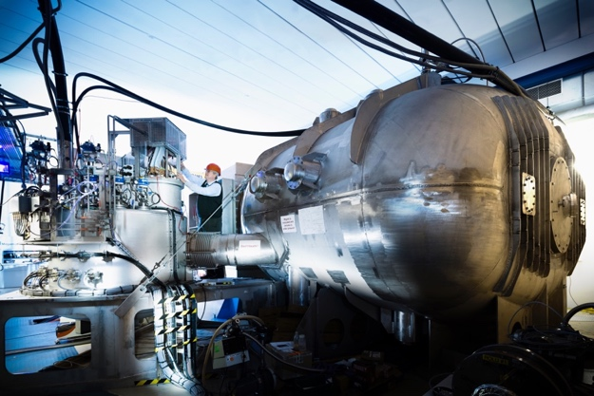
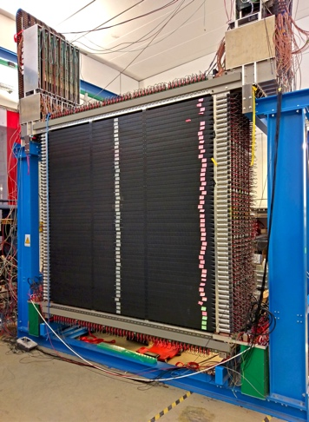
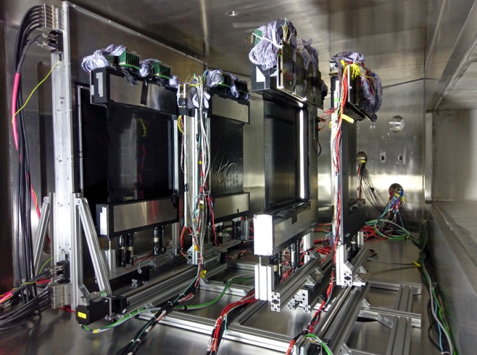
Phase-0 highlight: NUSTAR, R³B
Detector commissioning with beam
  All detection systems started up and performance checked with ¹²C beam
  Identification in new ToF wall demonstrated
  New and unique detection systems operated
Energy dependence measured
  Neutron-removal cross section of ¹²⁰Sn
Astrophysical reaction rate of ¹²C(α,γ)¹⁶O
  First data taken for the access of the experimentally challenging low energy regime
Fragments from ¹²C beam
Fragments from first pilot Sn beam identified

Slide 13
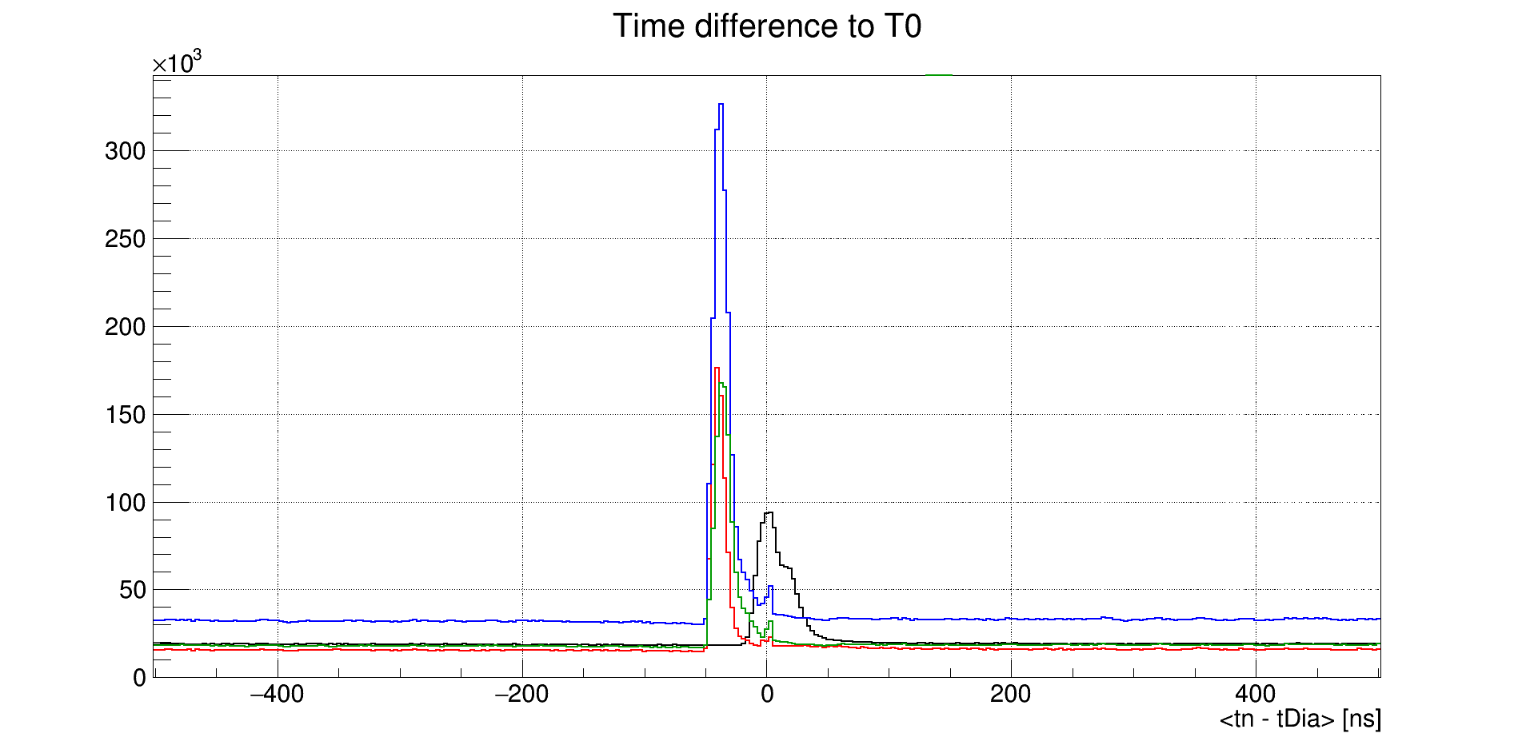
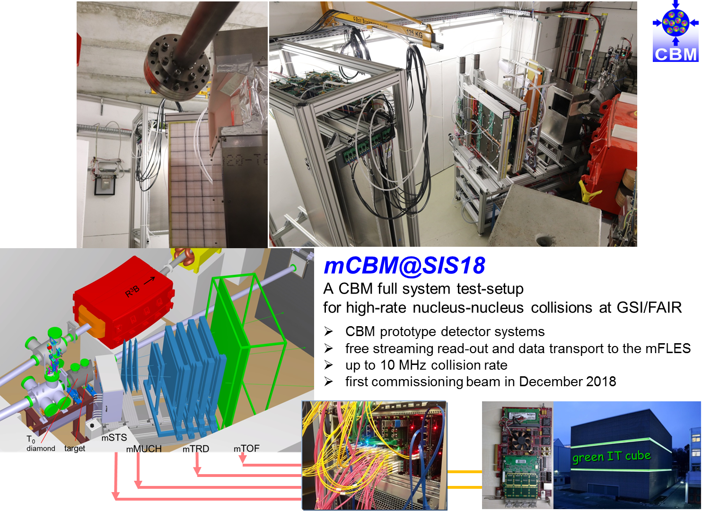
Phase-0 highlights: CBM, miniCBM@SIS18
A glimpse of actual beam-ready miniCBM setup which received beam on target.
Combining data from individual read-out chains of the subsystems mSTS, mMUCH and mTOF is possible.
Correlations for all detectors seen during commissioning

Slide 14
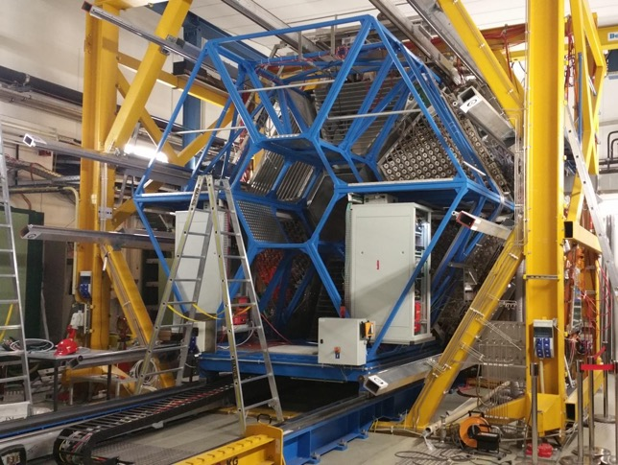
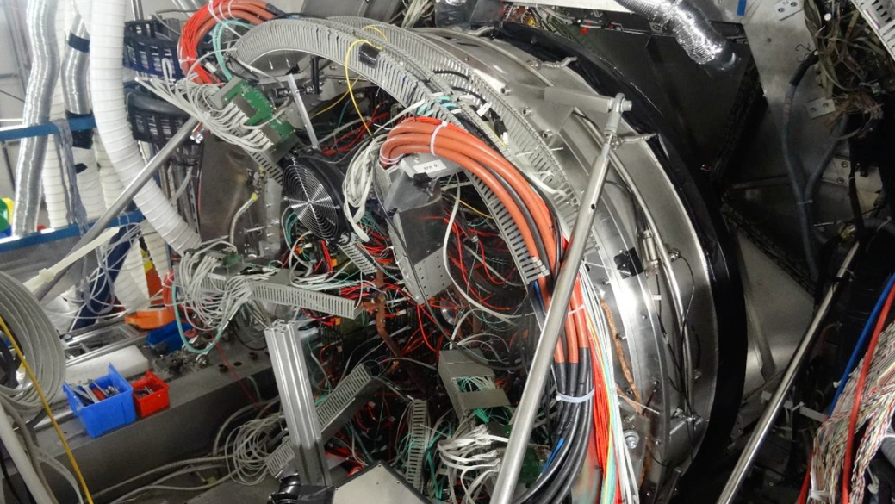


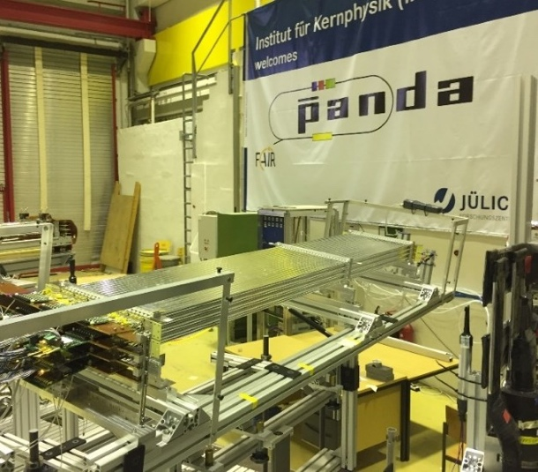

Phase-0 highlights: HADES (CBM, PANDA)
RICH upgrade: rings from particles observed
ECAL upgrade: 4 sectors tested with beam
First HADES beam data obtained in February
during commissioning of the beam on target
HADES production beam time 28 days in March
Unique studies of baryon-rich matter through 14 billion recorded events of Ag+Ag
HADES forward detection system to be complemented
this year utilising technology developed for and in close
cooperation with PANDA
Straw Tube Tracker

Slide 15
FAIR Phase-0: future beam times
Strategic decision:
Three months of beam time in each of the coming 3 years: 2020, 2021 and 2022 (preferably in spring)
Beam time plan 2020 published
Call for proposals to be published beginning of 2020 for the 2021 beam time
  Your proposals are most welcome!
Next GPAC meeting scheduled for June 2020

Slide 16
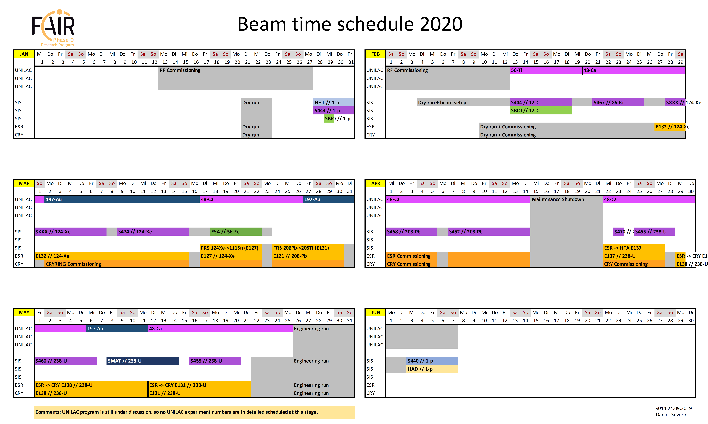
FAIR Phase-0: beam time 2020

Slide 17
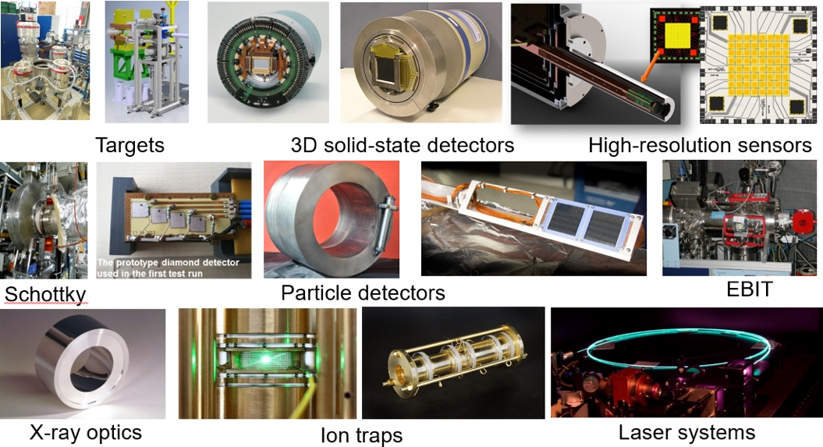
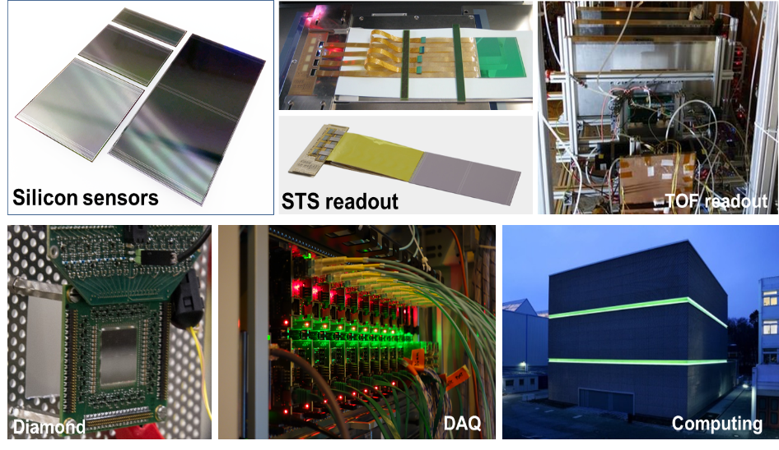
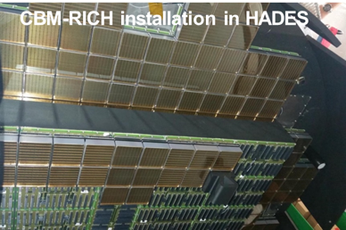
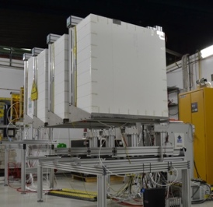
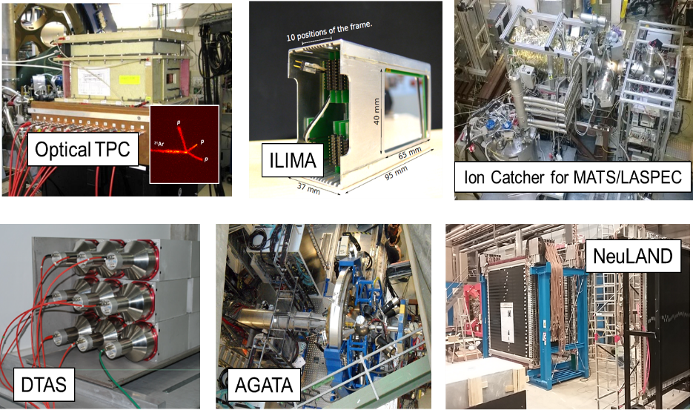
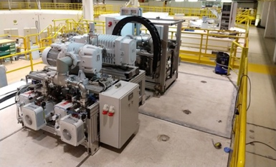
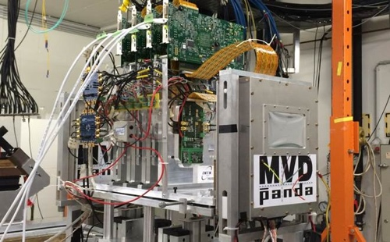
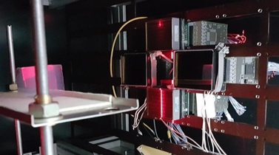
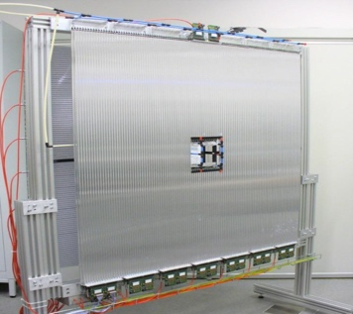
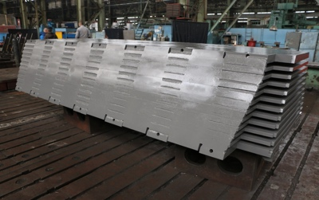
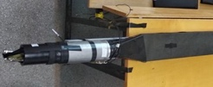
Detectors are constructed / being tested
A
P
P
A
C
B
M
TRD module test
at DESY
N
U
S
T
A
R
P
A
N
D
A
Micro-Vertex Detector
MUCH
Cluster-Jet target
TRD
Forward tracker
Solenoid yoke
17

Slide 18
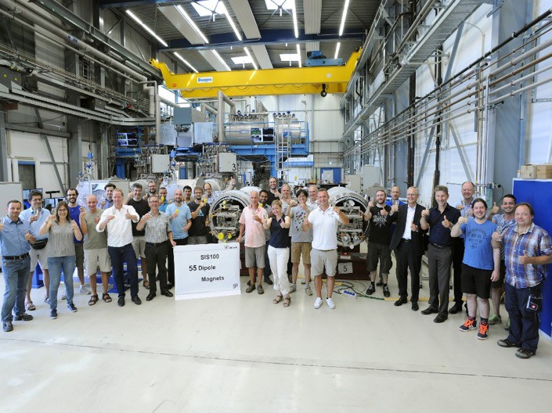
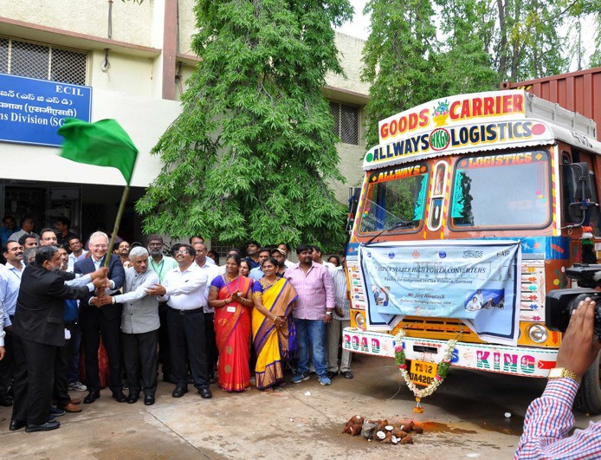
Some Recent Project Highlights (Part 1)
Celebration ceremony for testing of 55th SIS100 dipole magnet (50% of series) delivered by company BNG to GSI/FAIR
Ceremonial release to transport first batch of 67 pc. HEBT Power Converters from ECIL (India) to FAIR
18

Slide 19

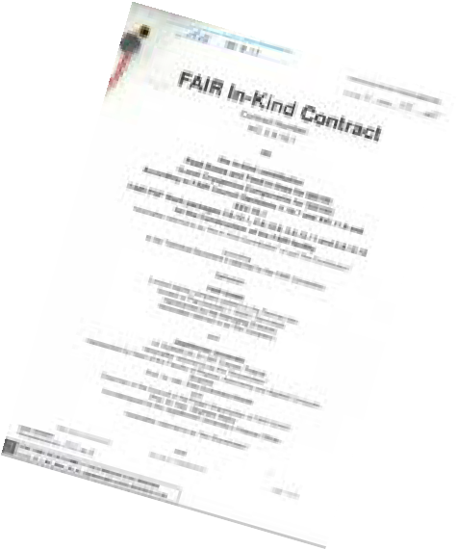

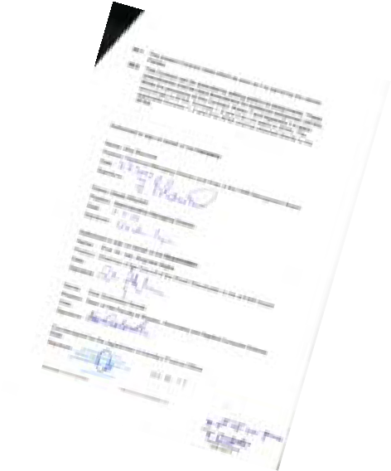
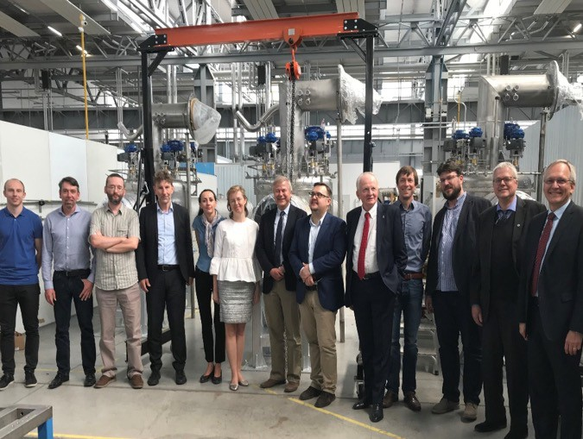
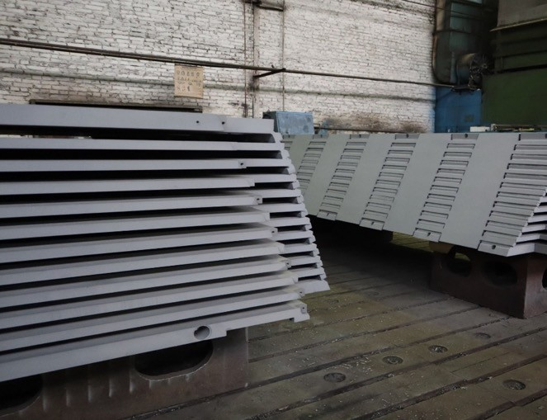
Some Recent Project Highlights (Part 2)
In-Kind Contracts signed for SIS100 Cryo Bypass Line and SIS100
Feedbox with WUST (Poland)
PANDA solenoid magnet:
Construction of all octants of the yoke completed at BINP (Russia)
19

Slide 20

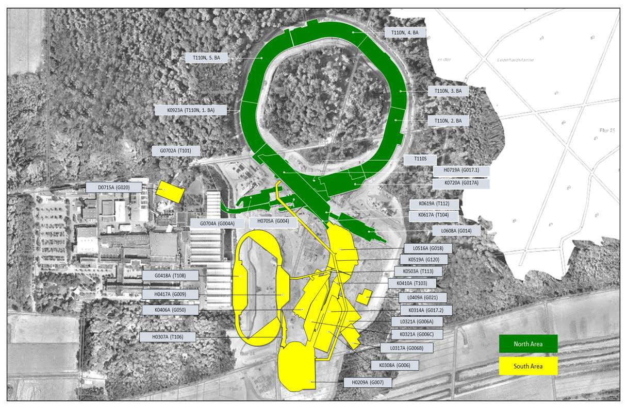

FAIR Project – Civil Construction
FAIR Site & Buildings
20

Slide 21
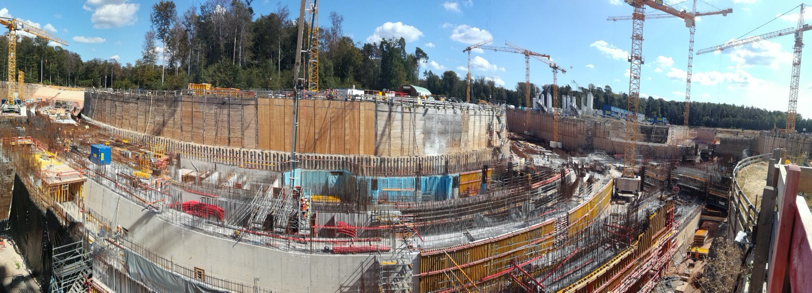
FAIR Project Progress – Civil Construction
Let me show you some impressions
…more films on www.fair-center.eu and the GSI Youtube channel

Slide 22
Civil Construction – Next Steps
Continuation of civil detailed design process
Continuation of civil works in area north
Award of civil works construction area south in Dec. 2019
Continue tender process for technical building installation packages (MEP) targeting at contract award mid 2020

Slide 23
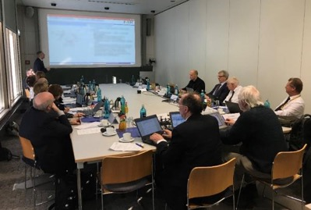
FAIR Progress and Cost Review - Report
See: www.gsi.de/en/start/news/details/2019/04/30/expertengruppe_abschlussbericht_zum_fair_projekt0.htm
...
...
The new management is now working very well.
...
...
Delaying or reducing part of the MSV’s scope is not recommended, for scientific and also cost reasons.
...
...
In summary, the FAIR Modularized Start Version (MSV) is to be constructed and completed in full as soon as possible. All else would be an extreme loss of science and waste of resources.

Slide 24
Council: Results of extr. meeting Oct 2019
The Council took note of the joint position paper by the German and the Russian Shareholder. The joint position paper sets the construction of the full Modularized Start Version (MSV) as final goal and states the will of the two countries to seek the additional funds needed to complete it.
The Council shared the opinion of Germany and Russia that the MSV is the goal to be realized.
The delegates will now start the consultations with their respective financial authorities in order to get a commitment on their further financial contribution to the realization of the MSV. The delegates will communicate the result of these consultations before the next Council meeting.

Slide 25


Council: Next steps
Decision regarding award of civil construction south in December 2019 by FAIR Council early December 2019
Further funding decisions regarding additional budget needs by FAIR Council early December 2019

Slide 26
Conclusions
FAIR will offer unique opportunities for scientific research in a wide range of fields
FAIR Phase-0 is now starting and research activities are coming back to the GSI/FAIR campus
The preparations for the FAIR MSV are in full swing
In particular civil – which had been a stumbling block for quite a while – is progressing very well and close to schedule
Despite the large funding needs, the shareholders have declared their wish to complete the FAIR MSV
Please consider joining us!

Slide 27
Topics for this meeting
Review of CBM
  Systems considered central/critical by collaboration: STS, DAQ
  Items planned to be financed via Common Fund
Review of NUSTAR
  Day-One configuration of the Super-FRS Experiments
  Systems considered central/critical by collaboration: DEGAS, R³B
  Plans for Common Funds
Review of TDRs
  1 TDR for PANDA (not Day-1) and 3 TDRs for NUSTAR in panels (see agenda)
  1 TDR for PANDA DCS and 1 TDR for SPARC require panel chairs
Next steps for the ECSG
which TDRs do you want to follow-up?
Replacement/prolongation of ECE members

Slide 28
Thank you very much
for your attention!

Slide 29
FAIR Phase-0
Interruption due to incident (transformer damage) on 13th July 2018
Engineering run: Nov – Dec 2018
  Established: basic operation conditions that are required for the physics programme in 2019, start ESR re-commissioning with beam.
  Experimental commissioning: mini-CBM
Physics run: Feb – April 2019
  Performed: approved experiments, which do not require highest intensities for very heavy ions
  Experimental commissioning: FRS, beam storage in ESR
Engineering run: Nov – Dec 2019
  1) to establish ESR storage mode 2) to establish deceleration in ESR 3) to complete the commissioning of CRYRING with ESR beam
Physics run: beginning of 2020
  Perform approved experiments, including the storage-ring based experiments.
Phase-0 to be continued until commissioning of FAIR accelerators
  Many detector and accelerator elements to be commissioned, while
  preparing know-how for FAIR
  Rich potential science programme

Slide 30
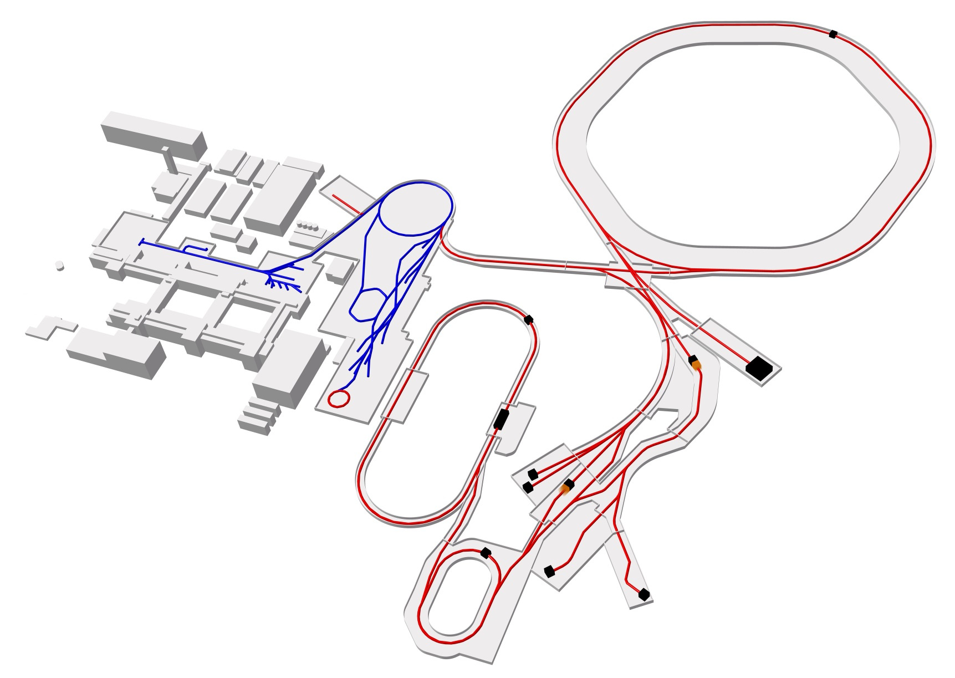
FAIR layout
SIS100
100 meters

Slide 31
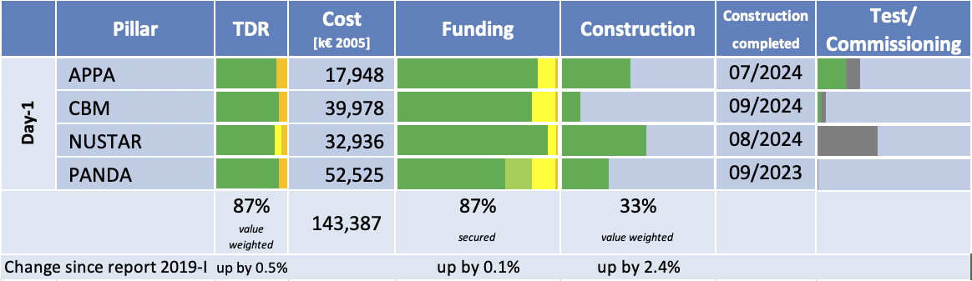
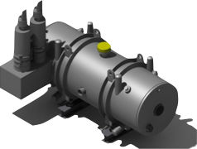
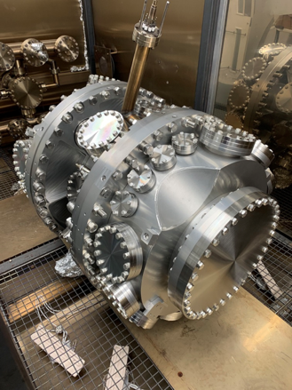
Status Overview Experiments
Preparations for the FAIR experiments progress

Slide 32
FAIR Committees
FAIR-Council
Administrative and Finance Committee (AFC)
In-Kind Review Board (IKRB)
Joint Scientific Council (JSC)
Machine Advisory Committee (MAC)
Expert Committee Experiments (ECE)
Resources Review Boards (RRBs)
Experiment Cost Scrutiny Group (ECSG)
Board of FAIR Collaborations (BFC)

