Slide 1
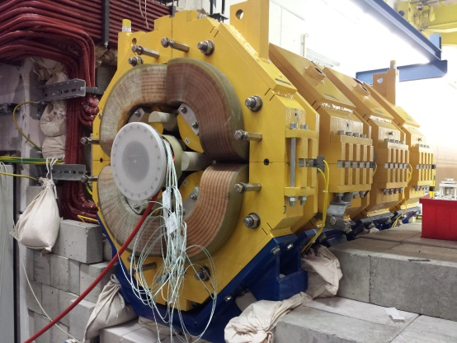
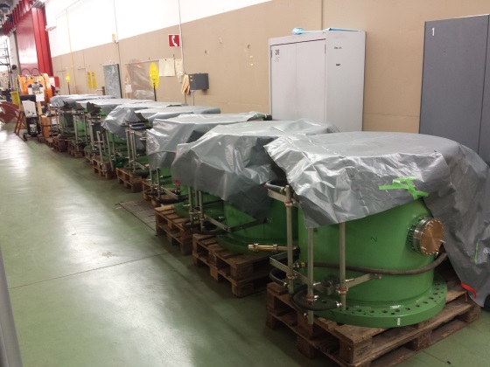
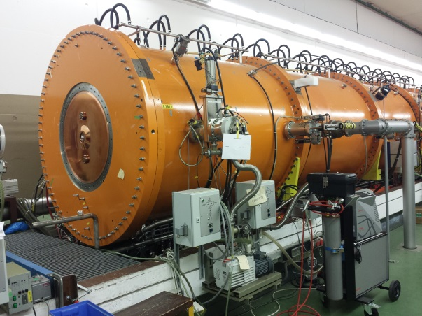
Machine meeting 2.7.19 - UNILAC
LEBT QQ beam pipe:
assembly of A-pipe: welding finished, leak testing and mounting of cooling jacket pending
next step on-site: test with backup pipe (inserted) & unloaded magnet
HSI RFQ:
All sections ready for re-assembly
Next: setup for LLRF measurements
HSI IH 1:
Electrical short repaired
End plate mounted, leak tested: okay. Not yet evacuated (Superlens cannot be installed before RFQ is back in beam line)

Slide 2
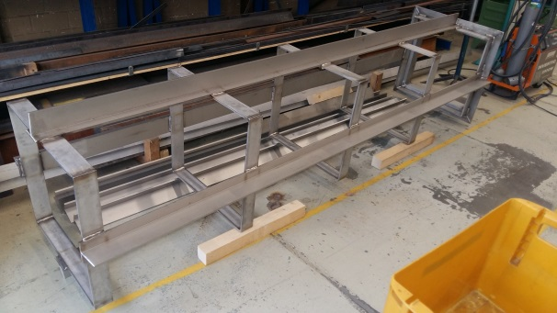
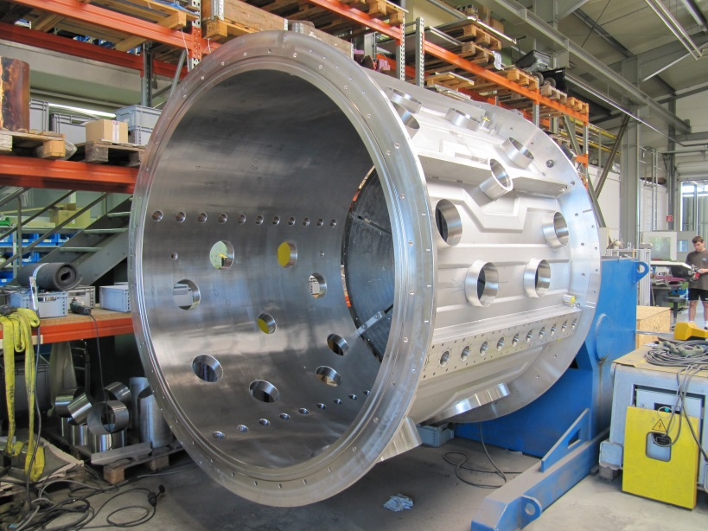
Machine meeting 2.7.19 - UNILAC
Vacuum controls upgrade:
LSB2: on schedule
Equipping and connecting of new racks in progress
connecting of contactor controllers continued
LSB4: on schedule
New racks in place
Mounting of contactor controllers continued
FoS:
ready for UHV FAT -> next Monday together with VAC
Cu cathode supports production proceeds well
drift tube with quadrupole ordered

