Slide 1
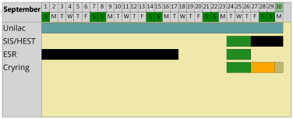
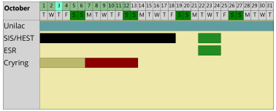
machine status
CRYRING@ESR & HITRAP
CRYRING@ESR
- electron cooler - the scheduled filling partially successful
larger flow with a phase separator, magnet superconducting, but no level reached
retry on July-09, if still no success schedule new meeting & new approaches
bake out of YR09/10 finished, attempt water cooling this week
detailed the UHV works in the Shutdown plan. Still no committment for execution.
preparation of ECR source for C⁺ run end of Sep. ongoing
ECR ion source construction
FESA and hardware under preparation
preparation of the CS for parallel local & ESR injection
HITRAP
no activities
C⁺

