Slide 1
GPUs for event reconstruction
1
MOHAMMAD AL-TURANY
GSI Darmstadt

Slide 2
Outline
2
FairRoot
Few words about GPU vs CPU
CUDA vs GPGPU
Why CUDA?
Examples :
  Runge-Kutta Track propagation
  Track and vertex fitting
Fermi (NVIDIA’s Next Generation CUDA Architecture)
Summary

Slide 3
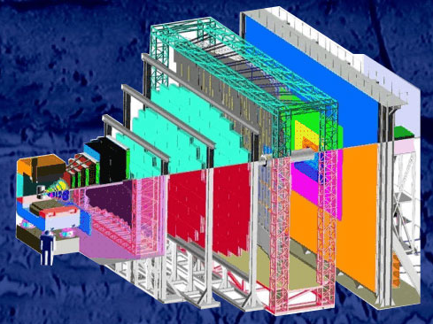
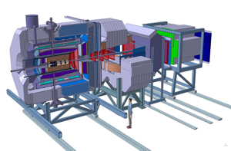
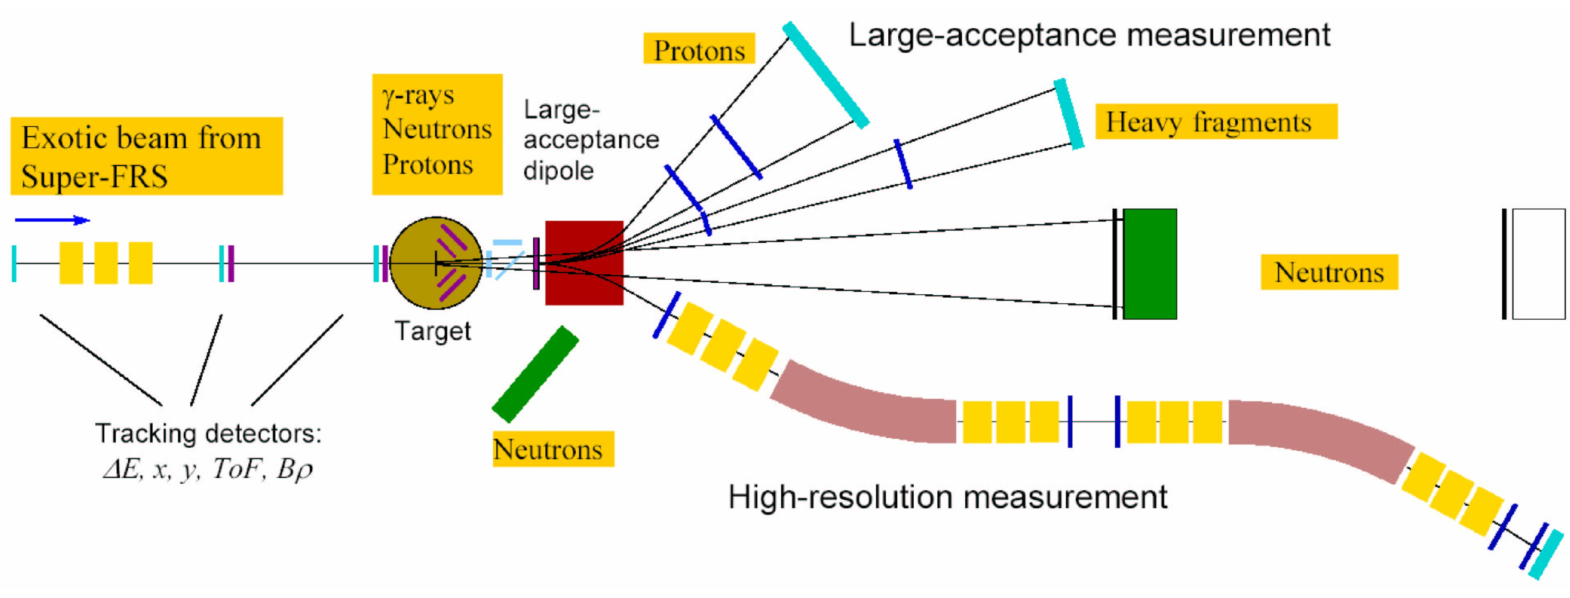
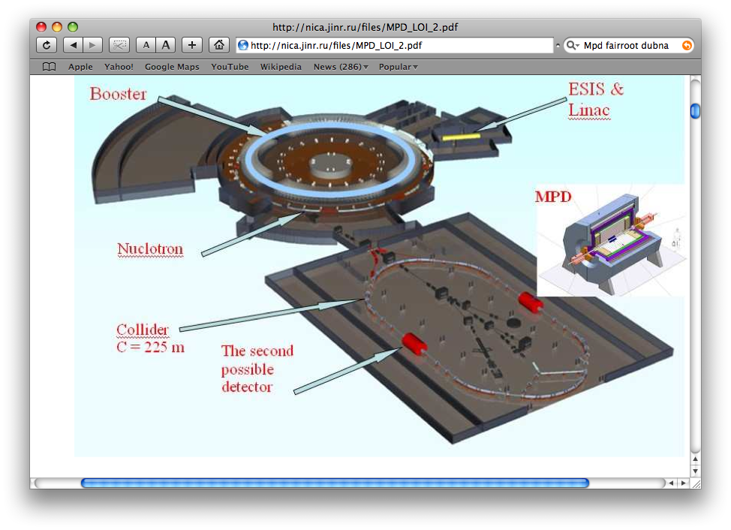
FairRoot
3
Mohammad Al-Turany
Denis Bertini
Florian Uhlig
Radek Karabowicz
CBM
PANDA
R3B
MPD
http://fairroot.gsi.de

Slide 4
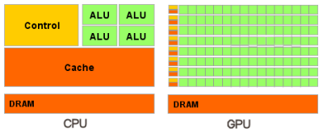
CPU and GPU
Processor | Intel Core 2 Extreme QX9650 | NVIDIA TESLA C1060 | NVIDIA FERMI
Transistors | 820 million | 1.4 billion | 3.0 billion
Processor clock | 3 GHz | 1.3 GHz | 1.15 GHz
Cores (Thread) | 4 | 240 | 512
Cache / Shared Memory | 6 MB x 2 | 16 KB x 30 | 16 or 48KB (configurable)
Threads executed per clock | 4 | 240 | 512
Hardware threads in flight | 4 | 30,720 | 24,576
Memory controllers | Off-die | 8 x 64-bit | 6 x 64 bit
Memory Bandwidth | 12.8 GBps | 102 GBps | 144 GBps

Slide 5
CPU vs. GPU
CPU
5
GPU
CPU is designed to execute one stream of instructions as fast as possible.
The CPU spends transistors on hardware features like instruction reorder buffers, reservation stations, branch prediction hardware, and large on-die cache.
GPU is designed to execute many parallel streams of instructions as fast as possible.
The GPU spends transistors in processor arrays, multithreading hardware, shared memory, and multiple memory controllers.
Mohammad Al-Turany, PANDA DAQT
16.04.2010

Slide 6
CPU vs. GPU
CPU
6
GPU
The CPU uses cache to improve performance by reducing the latency of memory accesses.
CPUs support one or two threads per core.
The GPU uses cache (or software-managed shared memory) to amplify bandwidth.
CUDA capable GPUs support up to 1024 threads per streaming multiprocessor. (1536 threads in FERMI)
Mohammad Al-Turany, PANDA DAQT
16.04.2010

Slide 7
CPU vs. GPU
CPU
7
GPU
The CPU handles memory latency by using large caches and branch prediction hardware. These take up a large deal of die-space and are often power hungry.
The cost of a CPU thread switch is hundreds of cycles.
The GPU handles latency by supporting thousands of threads in flight at once. If a particular thread is waiting for a load from memory, the GPU can switch to another thread with no delay.
GPUs have no cost in switching threads. GPUs typically switch threads every clock.
Mohammad Al-Turany, PANDA DAQT
16.04.2010

Slide 8
CPU vs. GPU
CPU
8
GPU
CPUs use SIMD (single instruction, multiple data) units for vector processing.
GPUs employ SIMT (single instruction multiple thread) for scalar thread processing. SIMT does not require the programmer to organize the data into vectors, and it permits arbitrary branching behavior for threads.
Mohammad Al-Turany, PANDA DAQT
16.04.2010

Slide 9
CUDA vs GPGPU
CUDA
9
GPGPU
work with familiar programming concepts (C language) while developing software that can run on a GPU
CUDA compile the code directly to the hardware (GPU assembly language, for instance), thereby providing great performance.
Trick the GPU into general-purpose
computing by casting problem as graphics
Turn data into images ("texture maps")
Turn algorithms into image synthesis ("rendering passes")
Drawback:
Tough learning curve
potentially high overhead of graphics API
highly constrained memory layout & access model
Mohammad Al-Turany, PANDA DAQT
16.04.2010

Slide 10
CUDA: Features
10
Standard C language for parallel application development on the GPU
Standard numerical libraries for FFT (Fast Fourier Transform) and BLAS (Basic Linear Algebra Subroutines)
Dedicated CUDA driver for computing with fast data transfer path between GPU and CPU
Mohammad Al-Turany, PANDA DAQT
16.04.2010

Slide 11
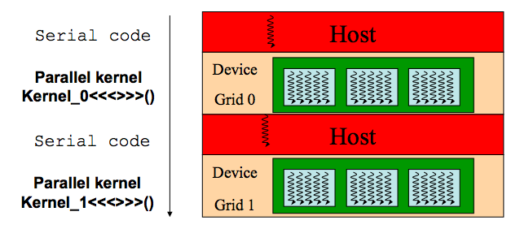
Why CUDA?
11
CUDA development tools work alongside the conventional C/C++ compiler, so one can mix GPU code with general-purpose code for the host CPU.
CUDA Automatically Manages Threads:
  It does NOT require explicit management for threads in the conventional sense, which greatly simplifies the programming model.
Stable, available (for free), documented and supported for windows, Linux and Mac OS
Low learning curve:
  Just a few extensions to C
  No knowledge of graphics is required
Mohammad Al-Turany, PANDA DAQT
16.04.2010

Slide 12
Cuda (2.3) Toolkit
12
NVCC C compiler
CUDA FFT and BLAS libraries for the GPU
CUDA-gdb hardware debugger
CUDA Visual Profiler
CUDA runtime driver (also available in the standard NVIDIA GPU driver)
CUDA programming manual
Mohammad Al-Turany, PANDA DAQT
16.04.2010

Slide 13
CUDA in FairRoot
13
FindCuda.cmake (Abe Stephens SCI Institute)
  Integrate CUDA into FairRoot very smoothly
CMake create shared libraries for CUDA part
FairCuda is a class which wraps CUDA implemented functions so that they can be used directly from ROOT CINT or compiled code
Mohammad Al-Turany, PANDA DAQT
16.04.2010

Slide 14
Reconstruction chain (PANDA )
14
.......
Hits
Track Finder
Track candidates
Track Fitter
Tracks
Task
CPU
Task
GPU
.......
Mohammad Al-Turany, PANDA DAQT
16.04.2010

Slide 15
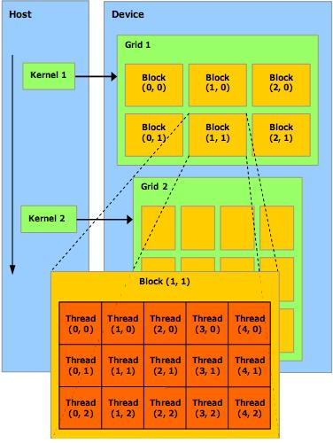
CUDA programming model
15
  Kernel:
    One kernel is executed at a time
    Kernel launches a grid of thread blocks
  Thread block:
    A batch of thread.
    Threads in a block cooperate together, efficiently share data.
    Thread/block have unique id
  Grid:
    A batch of thread blocks that execute the same kernel.
    Threads in different blocks in the same grid cannot directly communicate with each other
Mohammad Al-Turany, PANDA DAQT
16.04.2010

Slide 16
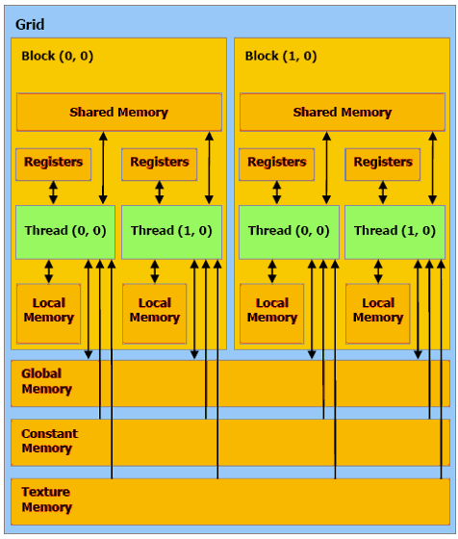
CUDA memory model
16
There is 6 different memory regions
Mohammad Al-Turany, PANDA DAQT
16.04.2010

Slide 17
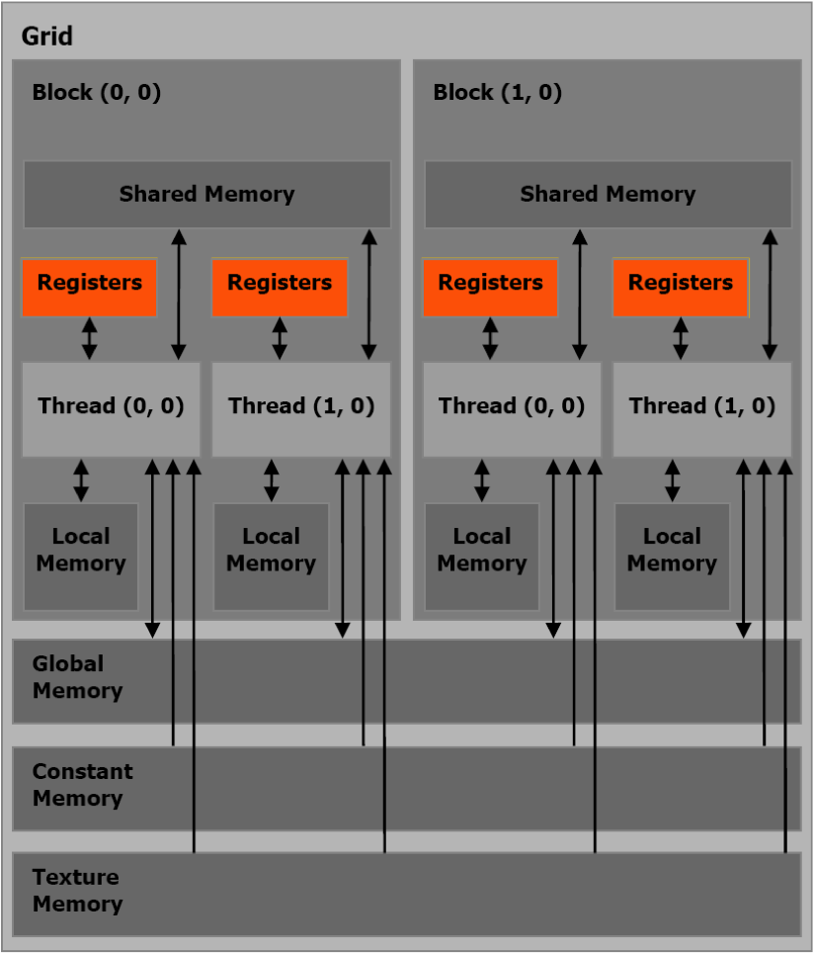
Register Memory
17
The fastest form of memory on the multi-processor.
Is only accessible by the thread.
Has the lifetime of the thread
Mohammad Al-Turany, PANDA DAQT
16.04.2010

Slide 18
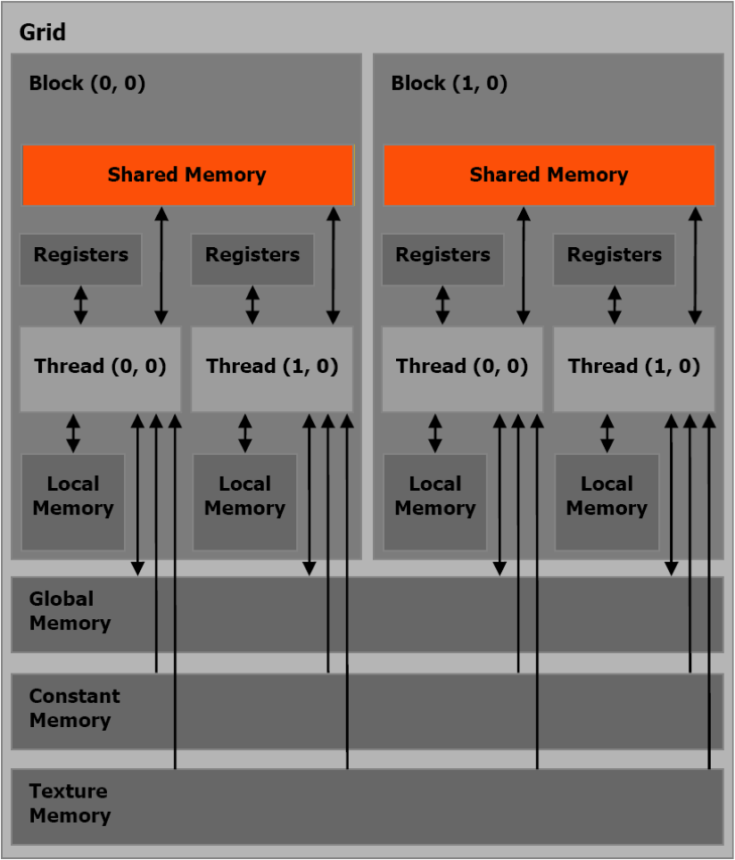
Shared Memory
18
Can be as fast as a register when there are no bank conflicts or when reading from the same address.
Accessible by any thread of the block from which it was created.
Has the lifetime of the block.
Mohammad Al-Turany, PANDA DAQT
16.04.2010

Slide 19
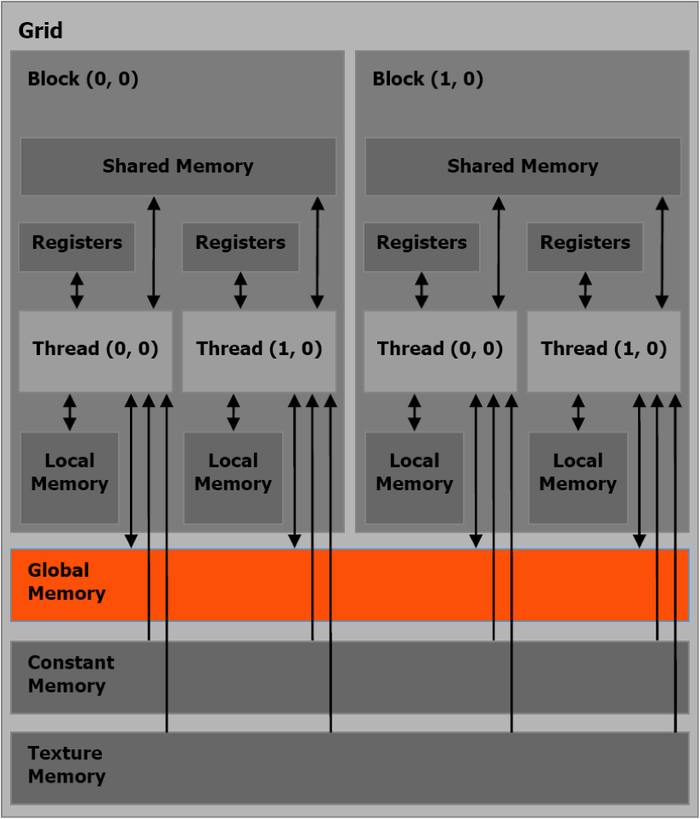
Global Memory
19
Potentially 150x slower than register or shared memory .
Accessible from either the host or device.
Has the lifetime of the application.
Mohammad Al-Turany, PANDA DAQT
16.04.2010

Slide 20
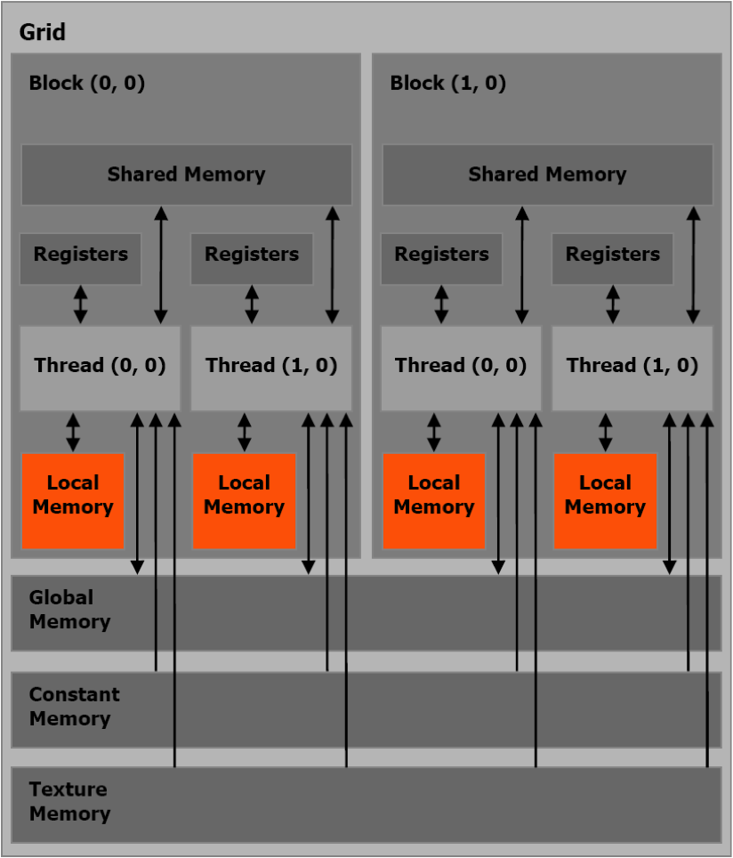
Local Memory
20
Resides in global memory and can be 150x slower than register or shared memory
Is only accessible by the thread
Has the lifetime of the thread.
Mohammad Al-Turany, PANDA DAQT
16.04.2010

Slide 21
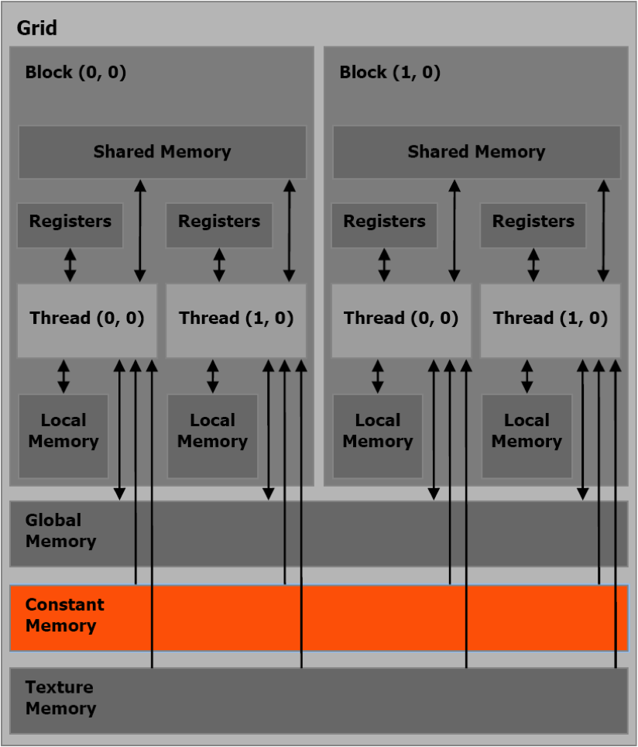
Constant Memory
21
in DRAM
cached
per grid
read-only
Mohammad Al-Turany, PANDA DAQT
16.04.2010

Slide 22
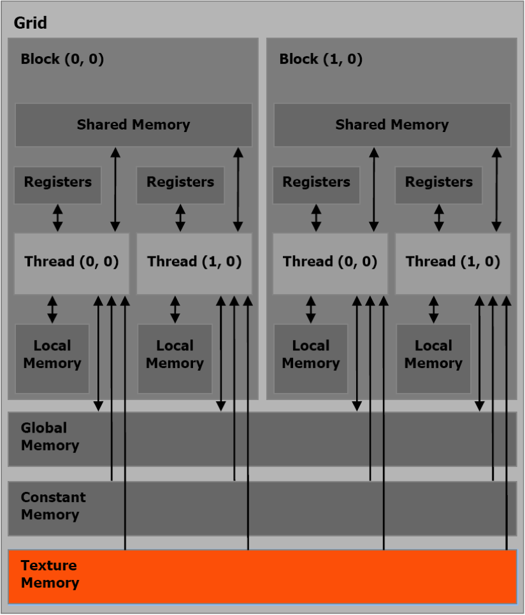
Texture Memory
22
in DRAM
cached
per grid
read-only
Mohammad Al-Turany, PANDA DAQT
16.04.2010

Slide 23
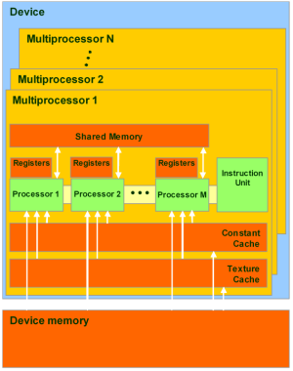
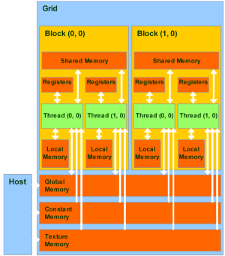
23
Global, local, texture, and constant memory are physically the same memory.
They differ only in caching algorithms and access models.
CPU can refresh and access only:
global, constant, and texture memory.
Mohammad Al-Turany, PANDA DAQT
16.04.2010

Slide 24
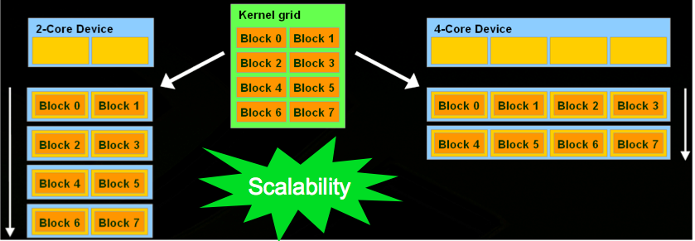
Scalability in CUDA
24
Mohammad Al-Turany, PANDA DAQT
16.04.2010

Slide 25
CUDA vs C program
CPU program
CUDA program
void inc_cpu(int *a, int N) {
int idx;
for (idx = 0; idx<N; idx++)
a[idx] = a[idx] + 1;}
int main() {
...
inc_cpu(a, N);
__global__
void inc_gpu(int *a, int N) {
int idx = blockIdx.x * blockDim.x +
threadIdx.x;if (idx < N)
a[idx] = a[idx] + 1;}
int main() {
...
dim3 dimBlock (blocksize);
dim3 dimGrid( ceil( N / (float)blocksize) );
inc_gpu<<<dimGrid, dimBlock>>>(a, N);

Slide 26
CPU vs GPU code (Runge-Kutta algorithm)
26
float h2, h4, f[4];
float xyzt[3], a, b, c, ph,ph2;
float secxs[4],secys[4],seczs[4],hxp[3];
float g1, g2, g3, g4, g5, g6, ang2, dxt, dyt, dzt;
float est, at, bt, ct, cba;
float f1, f2, f3, f4, rho, tet, hnorm, hp, rho1, sint, cost;
float x;
float y;
float z;
float xt;
float yt;
float zt;
float maxit = 10;
float maxcut = 11;
const float hmin = 1e-4;
const float kdlt = 1e-3;
…...
__shared__ float4 field;
float h2, h4, f[4];
float xyzt[3], a, b, c, ph,ph2;
float secxs[4],secys[4],seczs[4],hxp[3];
float g1, g2, g3, g4, g5, g6, ang2, dxt, dyt, dzt;
float est, at, bt, ct, cba;
float f1, f2, f3, f4, rho, tet, hnorm, hp, rho1, sint, cost;
float x;
float y;
float z;
float xt;
float yt;
float zt;
float maxit= 10;
float maxcut= 11;
__constant__ float hmin = 1e-4;
__constant__ float kdlt = 1e-3;
…..
Mohammad Al-Turany, PANDA DAQT
16.04.2010

Slide 27
CPU vs GPU code (Runge-Kutta algorithm)
27
do {
rest = step - tl;
if (TMath::Abs(h) > TMath::Abs(rest))
h = rest;
fMagField->GetFieldValue( vout, f);
f[0] = -f[0];
f[1] = -f[1];
f[2] = -f[2];
………..
if (step < 0.) rest = -rest;
if (rest < 1.e-5*TMath::Abs(step)) return;
} while(1);
do {
rest = step - tl;
if (fabs(h) > fabs(rest))
h = rest;
field=GetField(vout[0],vout[1],vout[2]);
f[0] = -field.x;
f[1] = -field.y;
f[2] = -field.z;
………..
if (step < 0.) rest = -rest;
if (rest < 1.e-5*fabs(step)) return;
} while(1);
Mohammad Al-Turany, PANDA DAQT
16.04.2010

Slide 28
Example (Texture Memory)
28
Using texture memory for field maps

Slide 29
Field Maps
29
Usually a three dimensional array (XYZ, Rθϕ, etc)
Used as a lockup table w ith some interpolation
For performance and multi-access issues, many people try to parameterize it.
Drawback:
  Specific for certain maps
  Hard to do with good accuracy
  Not possible for all maps
Mohammad Al-Turany, PANDA DAQT
16.04.2010

Slide 30
Texture Memory for field maps
30
Three dimensional arrays can be bind to texture directly
Accessible from all threads in a grid
Linear interpolation is done by dedicated hardware
Cashed and allow multiple random access
Ideal for field maps!
Mohammad Al-Turany, PANDA DAQT
16.04.2010

Slide 31
Runge-Kutta propagator
31
The Geant3 Runge-Kutta propagator was re-written inside a cuda kernel
  Runge-Kutta method for tracking a particle through a magnetic field. Uses Nystroem algorithm (See Handbook Nat. Bur. Of Standards, procedure 25.5.20)
The algorithm it self is hardly parallelizable, but one can propagate all tracks in an event in parallel
For each track, a block of 8 threads is created, the particle data is copied by all threads at once, then one thread do the propagation
Mohammad Al-Turany, PANDA DAQT
16.04.2010

Slide 32
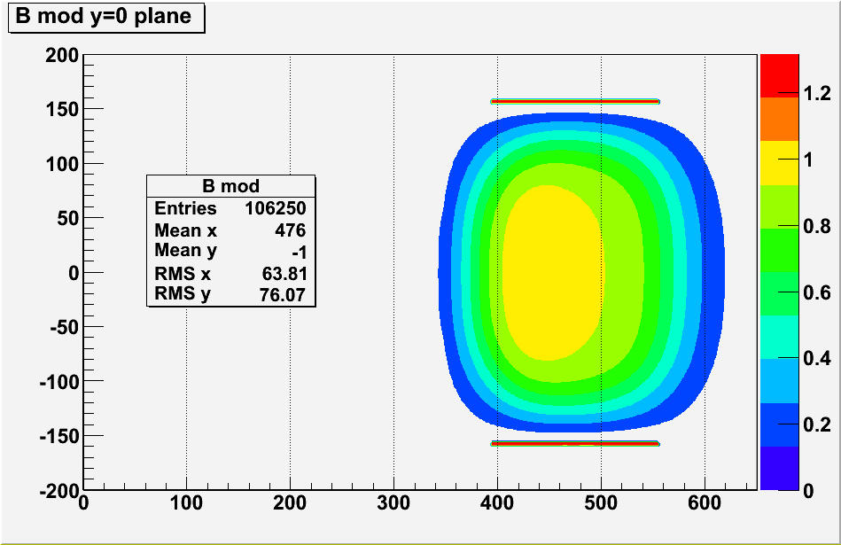
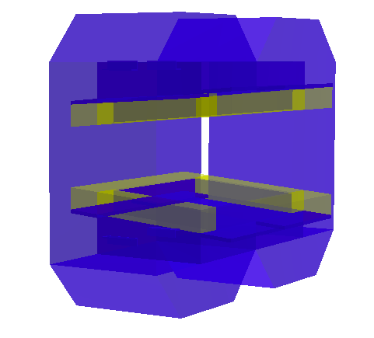
Magnet and Field
32
Mohammad Al-Turany, PANDA DAQT
16.04.2010

Slide 33
Cards used in this Test
33
 | Qaudro NVS 290 | GeForce 8400 GT | GeForce 8800 GT | Tesla C1060
CUDA cores | 16 (2 x 8) | 32 (4 x 8) | 112 (14 x 8) | 240 (30 x 8)
Memory (MB) | 256 | 128 | 512 | 4000
Frequency of processor cores (GHz) | 0.92 | 0.94 | 1.5 | 1.3
Compute capability | 1.1 | 1.1 | 1.1 | 1.3
Warps/Multiprocessor | 24 | 24 | 24 | 32
Max. No. of threads | 1536 | 3072 | 10752 | 30720
Max Power Consumption (W) | 21 | 71 | 105 | 200
Mohammad Al-Turany, PANDA DAQT
16.04.2010

Slide 34
Track Propagation (time per track)
34
Trk/Event | CPU | GPU emu | Quadro NVS 290 (16) | GeForce 8400GT (32) | GeForce 8800 GT (112) | Tesla C1060 (240)
10 | 240 | 190 | 90 | 80 | 70 | 40
50 | 220 | 140 | 50 | 36 | 20 | 8.0
100 | 210 | 160 | 44 | 29 | 17 | 5.0
200 | 210 | 125 | 45 | 28 | 15 | 4.3
500 | 208 | 172 | 46 | 26 | 11 | 2.6
1000 | 210 | 177 | 42 | 26 | 10 | 1.9
2000 | 206 | 178 | 41 | 26 | 10 | 1.5
5000 | 211 | 177 | 40 | 25 | 10 | 1.2
Time in μs needed to propagate one
track 1.5 m in a dipole field
Mohammad Al-Turany, PANDA DAQT
16.04.2010

Slide 35
Time needed to analyze one event in ms
Time (ms)
Tracks/Event

Slide 36
Gain for different cards
Trk/Event | GPU emu | NVS 290 | 8400 GT | 8800 GT | Tesla
10 | 1.30 | 3 | 3 | 3.5 | 6
50 | 1.60 | 4.4 | 6 | 11 | 28
100 | 1.30 | 4.8 | 7.3 | 12.3 | 47
200 | 1.70 | 4.8 | 7.5 | 14.5 | 49
500 | 1.20 | 4.5 | 7.9 | 18.5 | 80
1000 | 1.20 | 5 | 8.1 | 21 | 111
2000 | 1.10 | 5 | 8 | 21 | 137
5000 | 1.20 | 5 | 8.4 | 21 | 175
CPU/GPU time
Track/Event

Slide 37
Resource usage in this Test
37
 | Qaudro NVS 290 | GeForce 8400 GT | GeForce 8800 GT | Tesla C1060
Warps/Multiprocessor | 24 | 24 | 24 | 32
Occupancy | 33% | 33% | 33% | 25%
Active Threads | 128 | 256 | 896 | 1920
Limited by Max Warps / Multiprocessor | 8 | 8 | 8 | 8
Active threads = Warps x 32 x multiprocessor x occupancy
Active threads in Tesla = 8x32x30x0.25 =
1920
Mohammad Al-Turany, PANDA DAQT
16.04.2010

Slide 38

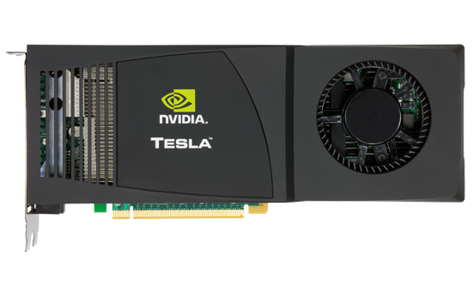
Parallelization on CPU/GPU
No. of Process | 50 Track/Event | 2000Track/Event
1 CPU | 1.7 E4 Track/s | 9.1 E2 Track/s
1 CPU + GPU (Tesla) | 5.0 E4 Track/s | 6.3 E5 Track/s
4 CPU + GPU (Tesla) | 1.2 E5 Track/s | 2.2 E6 Track/s

Slide 39
Using GPUs in HADES
39
Field Map is converted to XYZ map
Event where generated with 0.2-.0.8 GeV
Tracks are propagated from the first layer in the MDC1 to the sixth layer in MDC4
Mohammad Al-Turany, PANDA DAQT
16.04.2010

Slide 40
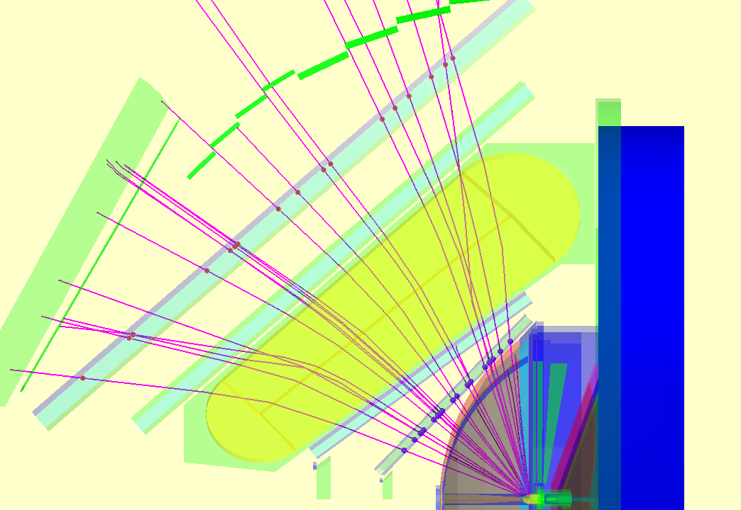
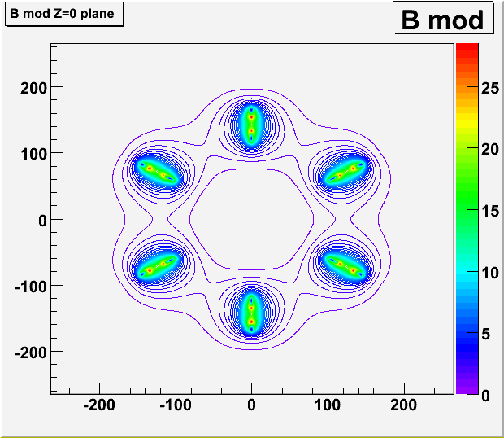
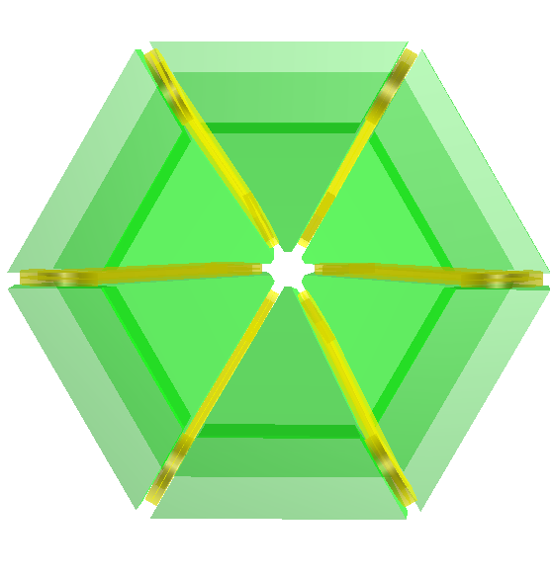
HADES

Slide 41
Track Propagation (Time per event)
41
Trk/Event | CPU | GPU emu | Tesla C1060 (240)
10 | 1.0 | 0.35 | 0.09
50 | 2.8 | 1.54 | 0.18
100 | 5.2 | 2.97 | 0.35
200 | 10.0 | 6.15 | 0.42
500 | 22.6 | 16.7 | 0.66
700 | 30.3 | 22.4 | 0.74
In HADES case the number of Tracks here should be taken as the number of propagations per events
(In HADES fitting each Track is propagated 6 times for each iteration in the fit)
Mohammad Al-Turany, PANDA DAQT
16.04.2010

Slide 42
Track Propagation ( μs/propagation)
Time in μs needed to propagate one
track from MDC1 layer1 to
MDC 4 layer 6
Speedup factors
Trk/Event | GPU emu | Tesla
10 | 2.9 | 11
50 | 1.9 | 15
100 | 1.8 | 15
200 | 1.6 | 24
500 | 1.4 | 34
700 | 1.4 | 41
Trk/Event | CPU | GPU emu | Tesla C1060 (240)
10 | 100 | 35 | 9.0
50 | 56 | 31 | 3.6
100 | 52 | 30 | 3.5
200 | 50 | 31 | 2.0
500 | 45 | 33 | 1.3
700 | 43 | 32 | 1.1
Mohammad Al-Turany, PANDA DAQT
16.04.2010

Slide 43
Example (Zero Copy)
43
Using the pinned (paged-locked) memory to make the data available to the GPU

Slide 44
Zero Copy
44
Zero copy was introduced in CUDA Toolkit 2.2
It enables GPU threads to directly access host memory, and it requires mapped pinned (non-pageable) memory
Zero copy can be used in place of streams because kernel-originated data transfers automatically overlap kernel execution without the overhead of setting up and determining the optimal number of streams
Mohammad Al-Turany, PANDA DAQT
16.04.2010

Slide 45
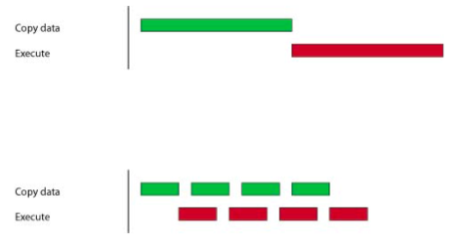
Track + vertex fitting on CPU and GPU
45
CPU Time/GPU Time
Track/Event | 50 | 100 | 1000 | 2000
GPU | 3.0 | 4.2 | 18 | 18
GPU (Zero Copy) | 15 | 13 | 22 | 20
Time needed per event (ms)
 | 50 | 100 | 1000 | 2000
CPU | 3.0 | 5.0 | 120 | 220
GPU | 1.0 | 1.2 | 6.5 | 12.5
GPU (Zero Copy) | 0.2 | 0.4 | 5.4 | 10.5

Slide 46
NVIDIA’s Next Generation CUDA Architecture
46
FERMI

Slide 47
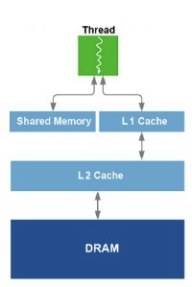
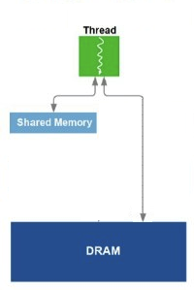
Features:
Support a true cache hierarchy in combination with on-chip shared memory
Improves bandwidth and reduces latency through L1 cache’s configurable shared memory
Fast, coherent data sharing across the GPU through unified L2 cache
Fermi
Tesla
http://www.behardware.com/art/imprimer/772/
Mohammad Al-Turany, PANDA DAQT
16.04.2010
47

Slide 48
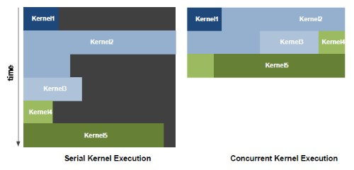
NVIDIA GigaThread™ Engine
Increased efficiency with concurrent kernel execution
Dedicated, bi-directional data transfer engines
Intelligently manage tens of thousands of threads
http://www.behardware.com/art/imprimer/772/
Mohammad Al-Turany, PANDA DAQT
16.04.2010
48

Slide 49
ECC Support
49
First GPU architecture to support ECC
Detects and corrects errors before system is affected
Protects register files, shared memories, L1 and L2 cache, and DRAM
Mohammad Al-Turany, PANDA DAQT
16.04.2010

Slide 50
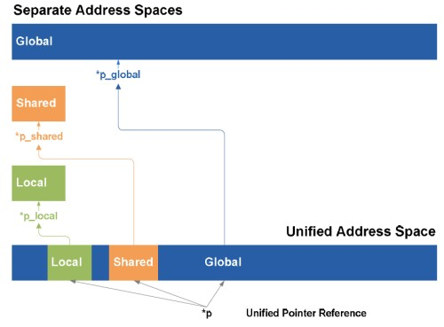
Unified address space
50
Groups local, shared and global memory in the same address space.
This unified address space means support for pointers and object references that are necessary for high-level languages such as C++.
http://www.behardware.com/art/imprimer/772/
Mohammad Al-Turany, PANDA DAQT
16.04.2010

Slide 51
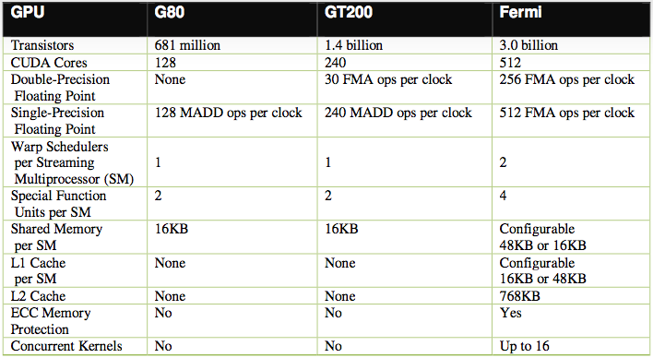
Comparison of NVIDIA’s three CUDA-capable GPU architectures
http://www.in-stat.com

Slide 52
Next Steps related to Online
In collaboration with the GSI EE, build a proto type for an online system
  Use the PEXOR card to get data to PC
  PEXOR driver allocate a buffer in PC memory and write the data to it
  The GPU uses the Zero copy to access the Data, analyze it and write the results

Slide 53
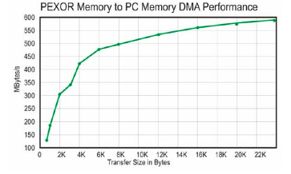
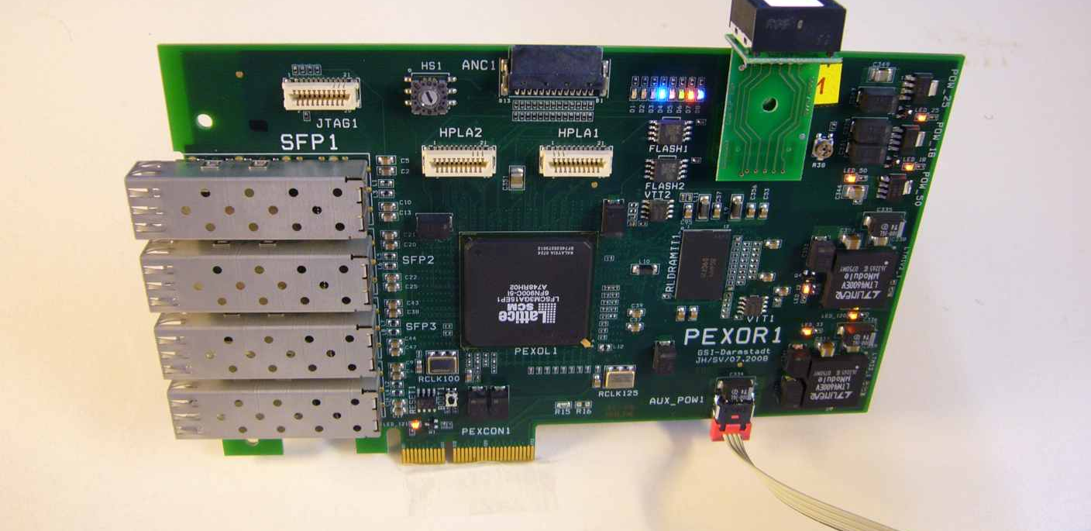
PEXOR
The GSI PEXOR is a PCI express card provides a complete development platform for designing and verifying applications based on the Lattice SCM FPGA family.
Serial gigabit transceiver interfaces (SERDES) provide connection to PCI Express x1 or x4 and four 2Gbit SFP optical transceivers

Slide 54
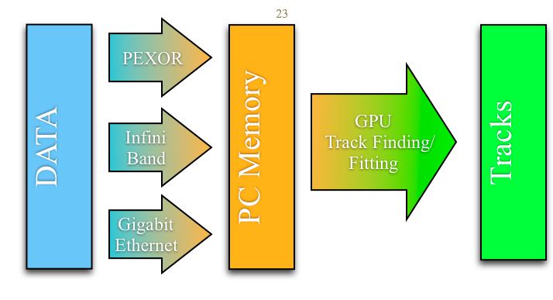
Configuration for test planned at the GSI

Slide 55
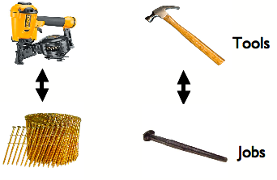
Summary
55
Cuda is an easy to learn and to use tool.
Cuda allows heterogeneous programming.
Depending on the use case one can win factors in performance compared to CPU
Texture memory can be used to solve problems that require lookup tables effectively
Pinned Memory simplify some problems, gives also better performance.
With Fermi we are getting towards the end of the distinction between CPUs and GPUs
  The GPU increasingly taking on the form of a massively parallel co-processor
Mohammad Al-Turany, PANDA DAQT
16.04.2010

Slide 56
Backup Slides
56

Slide 57
Emulation Mode
57
When running an application in device emulation mode, the programming model is emulated by the runtime. For each thread in a thread block, the runtime creates a thread on the host. The programmer needs to make sure that:
  The host is able to run up to the maximum number of threads per block, plus one for the master thread.
  Enough memory is available to run all threads, knowing that each thread gets 256 KB of stack.
Mohammad Al-Turany, PANDA DAQT
16.04.2010

Slide 58
Emulation Mode
58
In this example we have 8 threads per block
    Data is copied from global (or Host) Memory by 8 threads
    One thread perform the propagation
On 4 core machine the system can start 9 threads
In the CPU native code each time one get the field value we have to check for the boundary, but the GPU code do not need this check
  This explain the speed up in emulation mode against the native CPU code.
Mohammad Al-Turany, PANDA DAQT
16.04.2010

Slide 59
Texture Filtering
59
  CudaFilterModePoint: The returned value is the texel (Texture Element) whose texture coordinates are the closest to the input texture coordinates;
  CudaFilterModeLinear: The returned value is the linear interpolation of the two (for a one-dimensional texture), four (for a two-dimensional texture), or eight (for a three-dimensional texture) texels whose texture coordinates are the closest to the input texture coordinates
Mohammad Al-Turany, PANDA DAQT
16.04.2010

Slide 60
Texture Address Mode
60
How out-of-range texture coordinates are handled;
  Clamp: Out-of-range texture coordinates are clamped to the valid range. (Values below 0 are set to 0 and values greater or equal to N are set to N-1)
  Wrap: Out-of- range texture coordinates are wrapped to the valid range (only for normalized coordinates). Wrap addressing is usually used when the texture contains a periodic signal. It uses only the fractional part of the texture coordinate; for example, 1.25 is treated the same as 0.25 and -1.25 is treated the same as 0.75
Mohammad Al-Turany, PANDA DAQT
16.04.2010

Slide 61
Features available only in 1.3 computing capabilities
61
Support for atomic functions operating in shared memory and on 64-bit words in global memory (for 1.1 only 32-bit words)
Support for warp vote functions
The number of registers per multiprocessor is 16384 (8192 in 1.1)
The maximum number of active warps per multiprocessor is 32 (24 in 1.1)
The maximum number of active threads per multiprocessor is 1024 (768 in 1.1)
Support for double-precision floating-point numbers
Mohammad Al-Turany, PANDA DAQT
16.04.2010

Slide 62
Pinned Memory
62
On discrete GPUs, mapped pinned memory is advantageous only in certain cases. Because the data is not cached on the GPU, mapped pinned memory should be read or written only once, and the global loads and stores that read and write the memory should be coalesced.
On integrated GPUs, mapped pinned memory is always a performance gain because it avoids superfluous copies as integrated GPU and CPU memory are physically the same.
Mohammad Al-Turany, PANDA DAQT
16.04.2010

Slide 63
Track Propagation (time per event)
63
Trk/Event | CPU | GPU emu | Quadro NVS 290 (16) | GeForce 8400GT (32) | GeForce 8800 GT (112) | Tesla C1060 (240)
10 | 2.4 | 1.9 | 0.9 | 0.8 | 0.7 | 0.4
50 | 11 | 7 | 2.5 | 1.8 | 1.0 | 0.4
100 | 21 | 16 | 4.4 | 2.9 | 1.7 | 0.5
200 | 42 | 25 | 8.9 | 5.6 | 2.9 | 0.9
500 | 104 | 86 | 23 | 13.2 | 5.6 | 1.3
1000 | 210 | 177 | 42 | 25.7 | 10.1 | 1.9
2000 | 412 | 356 | 82 | 52.2 | 19.5 | 3.0
5000 | 1054 | 886 | 200 | 125 | 50.0 | 6.0
Time in ms needed to propagate all tracks in event
Mohammad Al-Turany, PANDA DAQT
16.04.2010

