Slide 1
System Integration Issues with the
Silicon Tracker of the CBM Experiment at FAIR
CBM experiment at FAIR
Silicon Tracking System
Integration: status and issues
Johann M. Heuser
GSI Helmholtz Center for Heavy Ion Research, Darmstadt, Germany
for the CBM Collaboration
Forum on Tracking Detector Mechanics 2019, Cornell University, Ithaca NY, USA

Slide 2
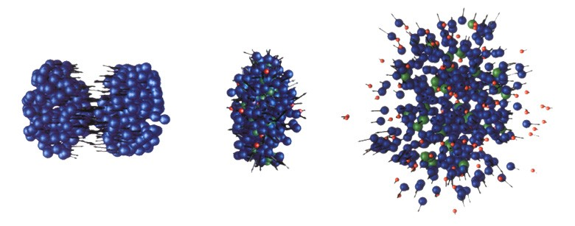
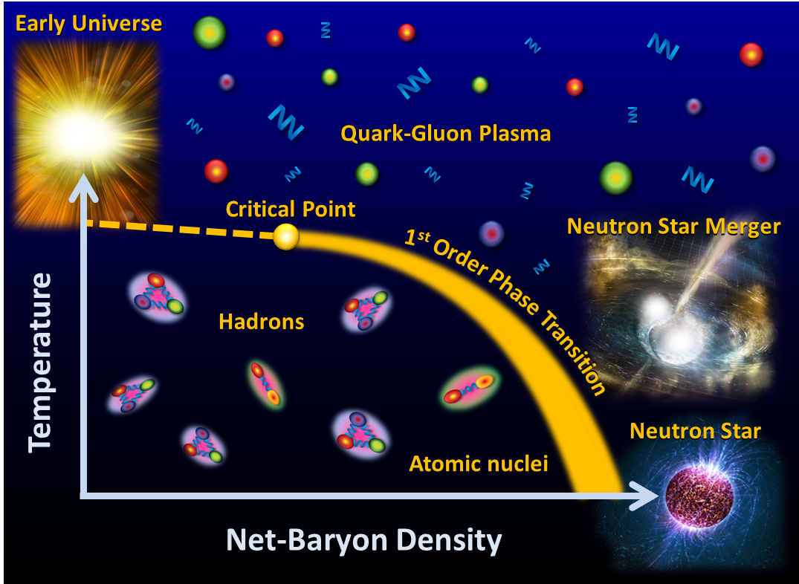

Compressed Baryonic Matter
The phase diagram of strongly interacting matter
⇒ focus on high-density matter:
Compressed Baryonic Matter
in the laboratory: nucleus-nucleus collisions
FAIR: the proper energy regime !
cartoon
Au + Au collision
model predictions, 10 GeV/u
temperature T < 120 MeV
density ρ > 8 ρ₀
reaction time t ~ 10⁻²³ s
8 ρ₀

Slide 3
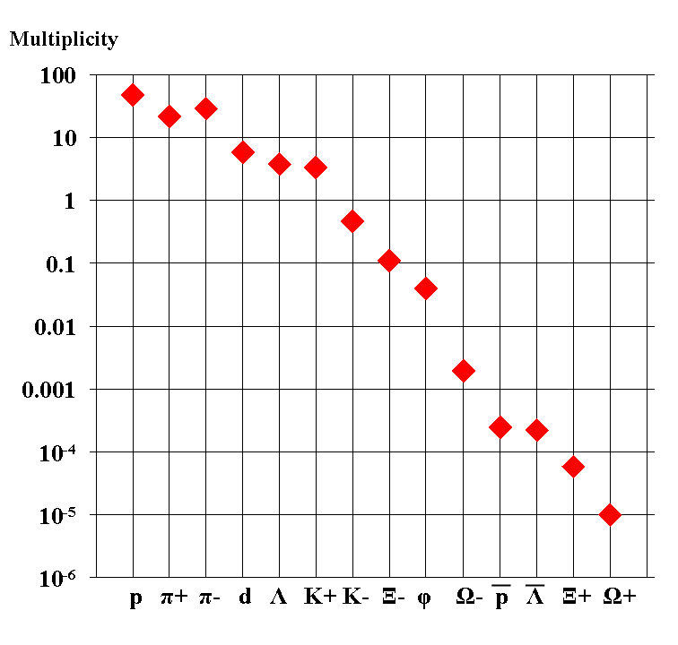
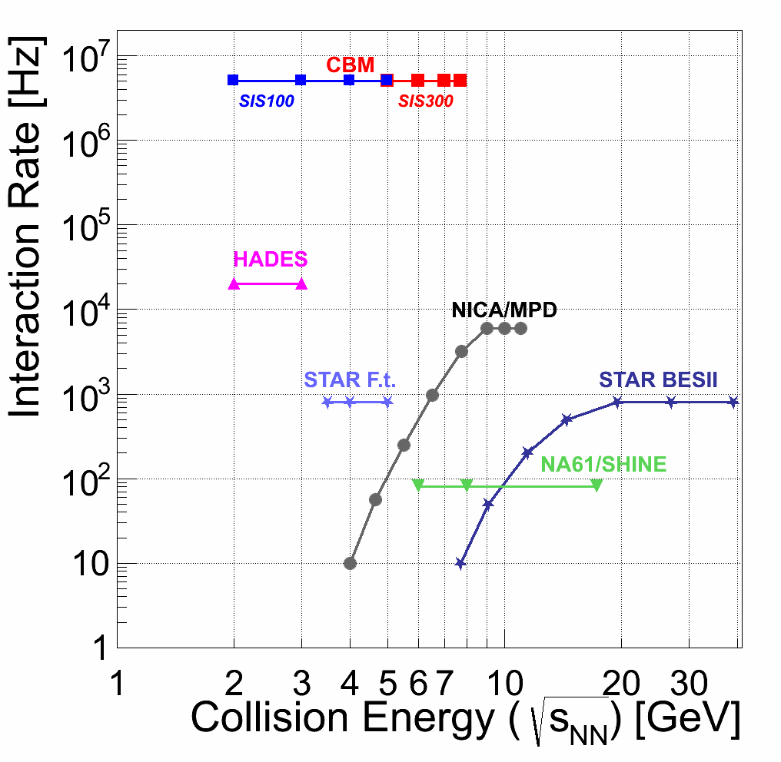
Compressed Baryonic Matter
high
net-baryon densities
Particle yields in central Au+Au 4 A GeV
Multiplicity × branching ratio
not measured with large statistics at high baryonic densities
rare probes:
⇒ high interaction rates

Slide 4


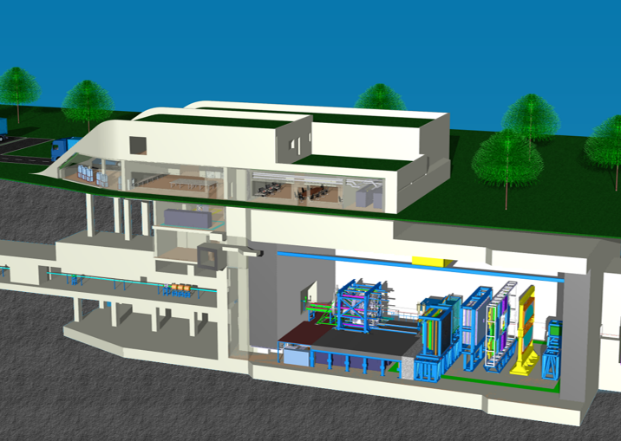


Facility for Antiproton and Ion Research
new international research laboratory to explore the nature and evolution of matter in the Universe
under construction, Darmstadt, Germany
p-Linac
SIS18
SIS100/300
CBM
(Compressed Baryonic Matter
experiment)
Helmholtz Center for Heavy Ion Research
CBM beams at SIS100:
ions: 10⁹/s, 2-14 GeV/u, √s_{NN}= 1.9 - 4.5 GeV
protons: 10¹¹/s up to 29 GeV
  target: typically 1% λ_{I}
FAIR phase 1
FAIR phase 2
100 m
current completion date, first beams: 2025

Slide 5
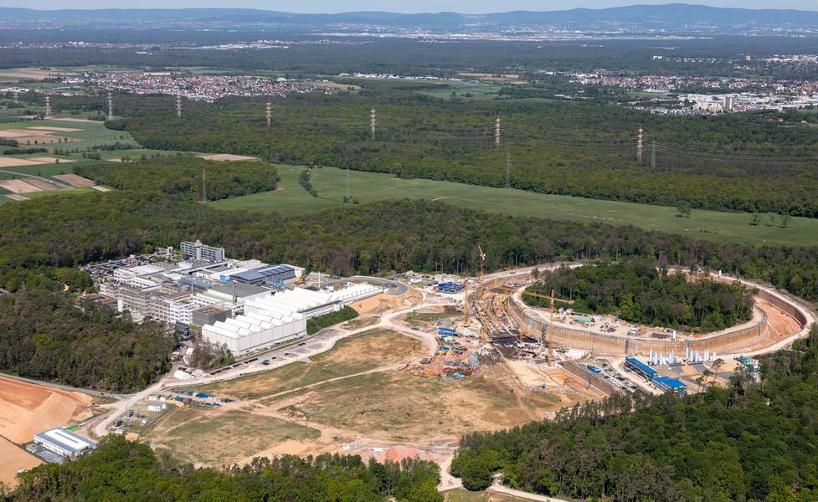
Facility for Antiproton and Ion Research
https://fair-center.eu/

Slide 6
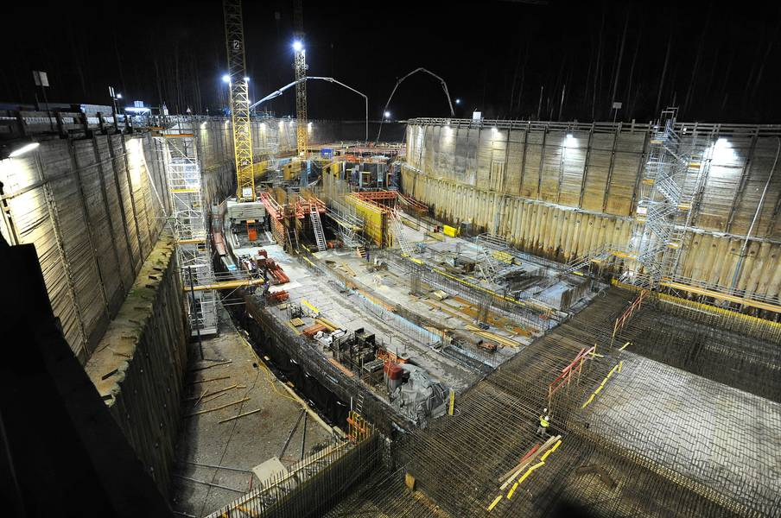
Facility for Antiproton and Ion Research
https://fair-center.eu/

Slide 7
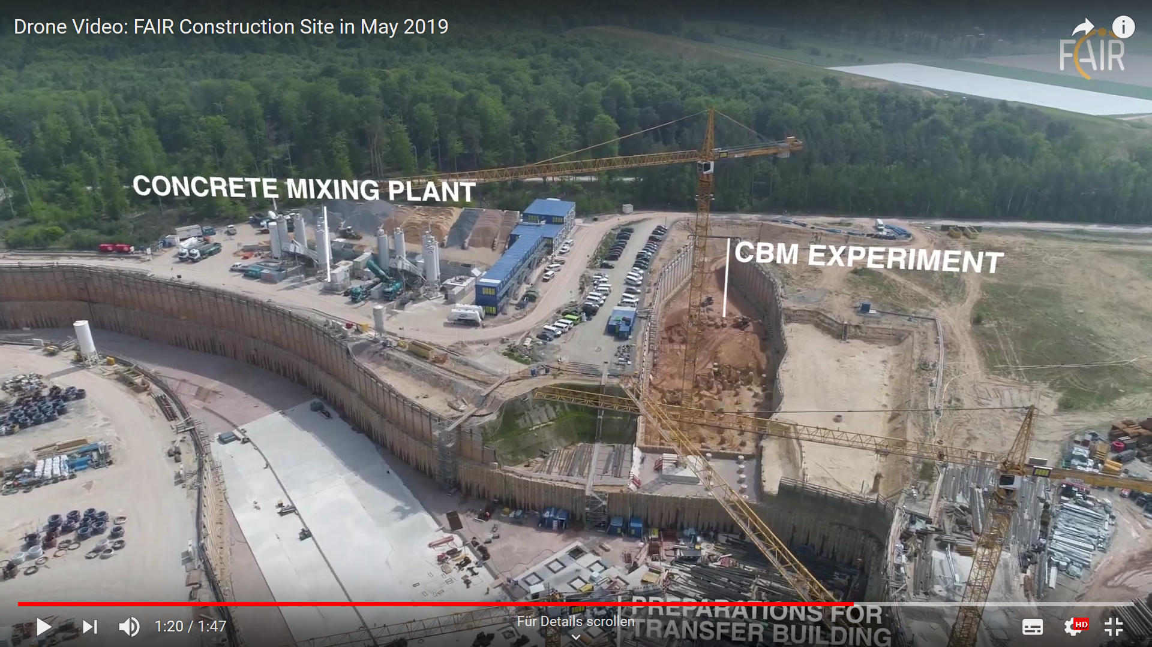
Facility for Antiproton and Ion Research
https://fair-center.eu/

Slide 8


Compressed Baryonic Matter Experiment
CBM cave + building

Slide 9

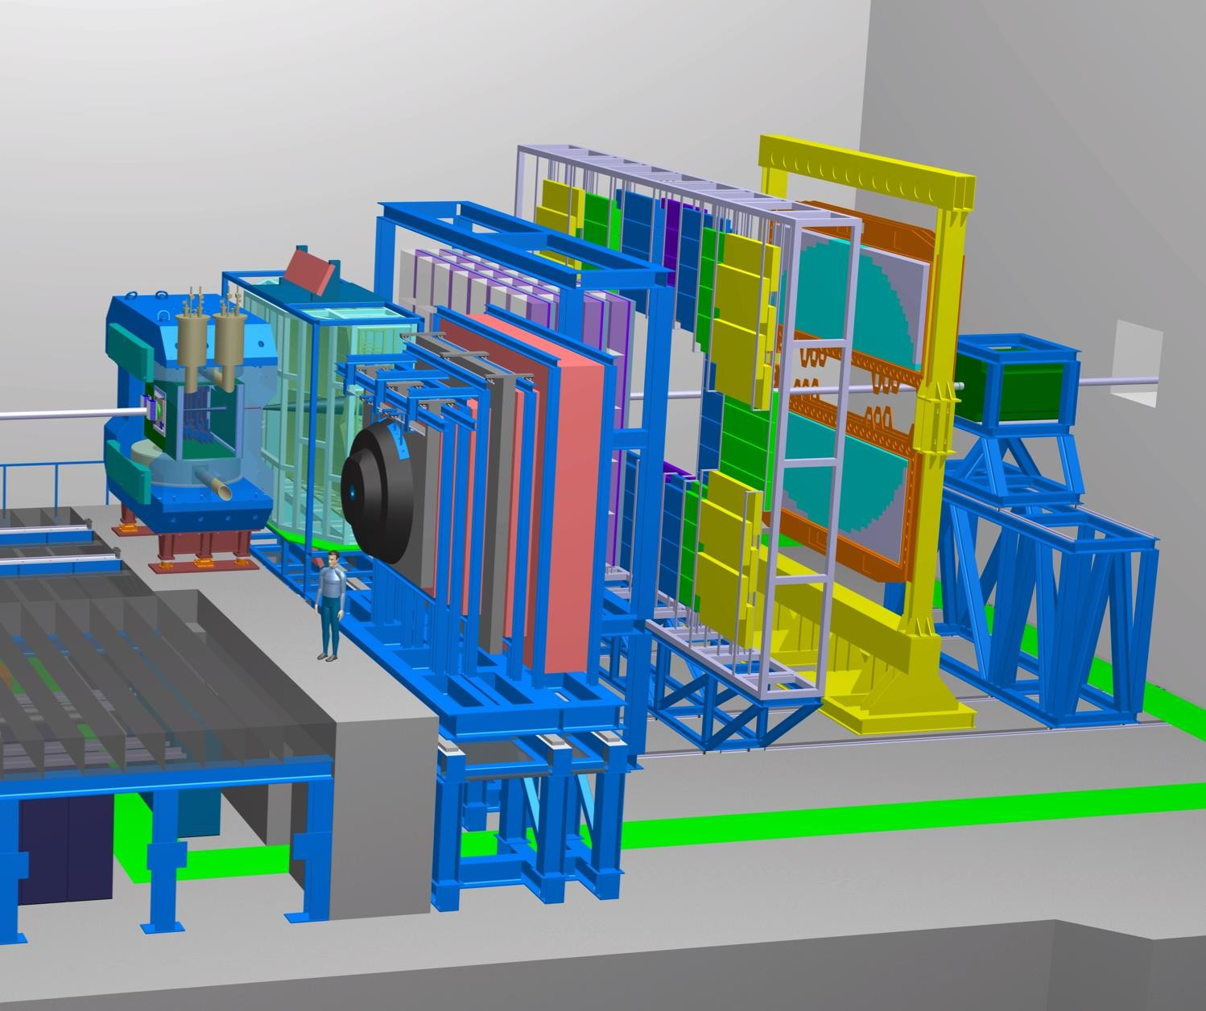


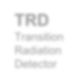
















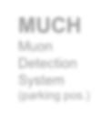

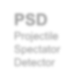






Compressed Baryonic Matter Experiment
Dipole Magnet
RICH
Ring Imaging Cherenkov
TRD
Transition Radiation Detector
TOF
Resistive Plate Chambers
Tracking acceptance:
$$2.5°< θ_{lab}<25°$$
Target
Beam
Free streaming DAQ
R_{int} = 10 MHz (Au+Au)
with
R_{int} (MVD) = 0.1 MHz
Software based event selection
MVD
Micro Vertex Detector
STS
Silicon Tracking System
MUCH
Muon Detection System (parking pos.)
ECAL
Electro- Magnetic Calorimeter
PSD
Projectile Spectator Detector

Slide 10

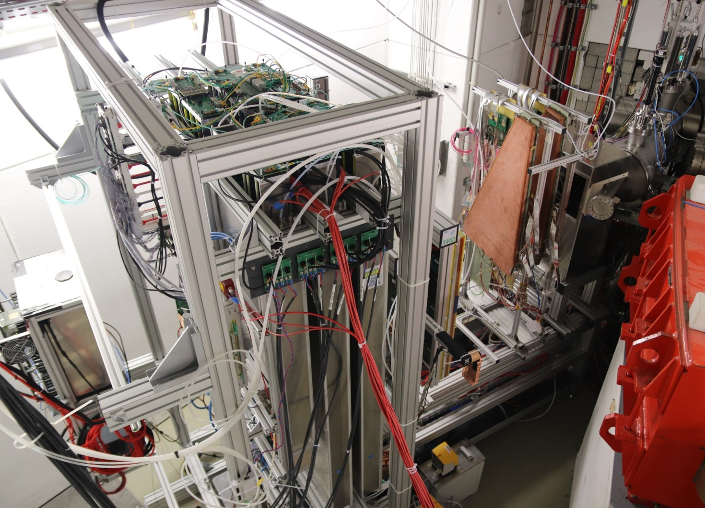
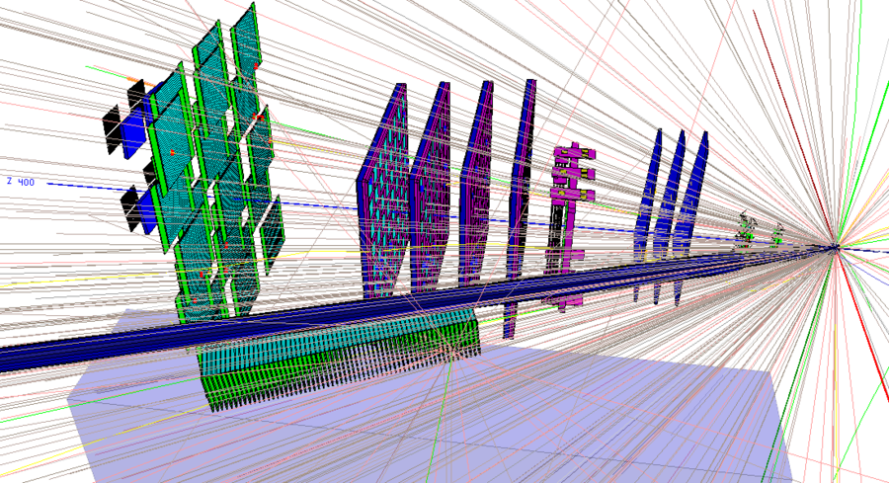
mCBM test experiment
mCBM@SIS18 - a CBM full system test-setup
for high-rate nucleus-nucleus collisions at GSI/FAIR
mTOF
T0
diamond
mRICH
mSTS
mMUCH
CBM prototype detector systems
free-streaming read-out and data transport to the mFLES
online event reconstruction and selection
up to 10 MHz collision rate
first successful commissioning with beam 12/2018 and 3/2019
mTRD

Slide 11
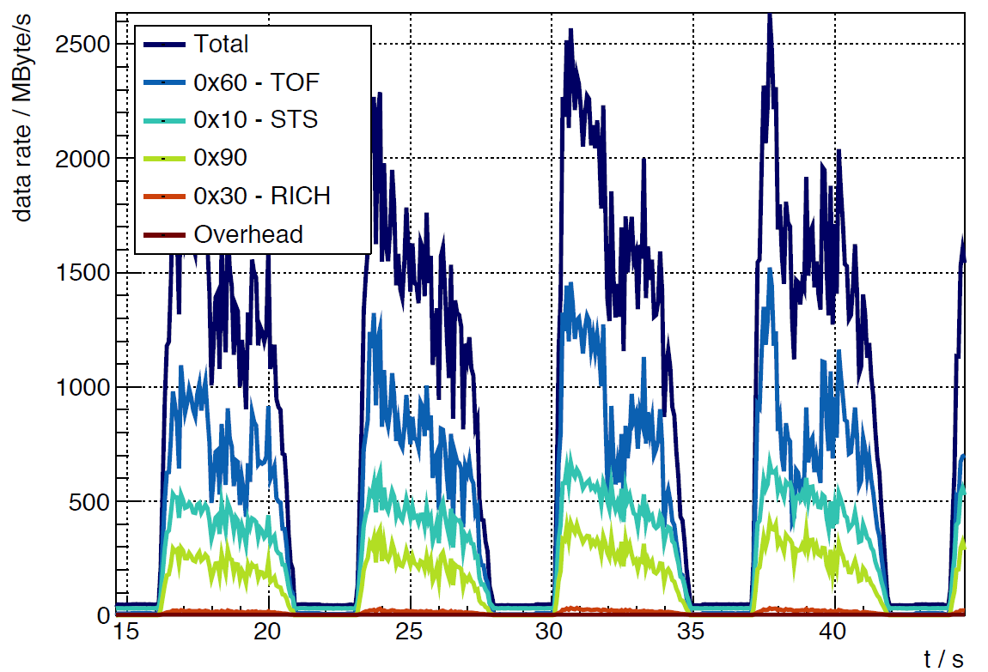
mCBM test experiment
x 10⁶
March 30, 2019 – run 175
(approx.) 10⁸ Ag ions/s (1.58 GeV/u) + Au (2.5mm)
preliminary
T0 rate (Hz)
T0
March 30, 2019:
beam intensity ≈ 10⁸ Ag ions / s
interaction rates 10⁶ … 10⁷ /s (preliminary)

Slide 12
Silicon Tracking System
Central CBM detector: charged-particle tracking + momentum measurement
Requirements/challenges:
up to ~ 700 charged particles per heavy-ion collision → high granularity
10⁵ − 10⁷ heavy-ion collisions per second → radiation tolerant
pile-up free streaming of hit data to online computing → fast electronics
mechanical precision: transversal to beam ≈ 100 µm, less along beam
Approach:
8 tracking stations, 0.3 – 1.0 m downstream target
  ≈ 4 m² area, ≈ 3.5 m³ volume,
  896 modules, 106 ladders, 1.8 M channels
double-sided silicon microstrip sensors
  hit spatial resolution ≈ 25 µm
  life time rad. tol. up to 10¹⁴ n/cm² (1 MeV eq.)
  operation at T < -10°C
self-triggering electronics
  time-stamp resolution ≈ 5 ns
  radiation tolerance > 30 Mrad
  power dissipation ~ 40 kW
low-mass detector modules/ladders:
  electronics/cooling outside physics aperture
  material budget per station: ≈ 0.3% – 2% X₀

Slide 13
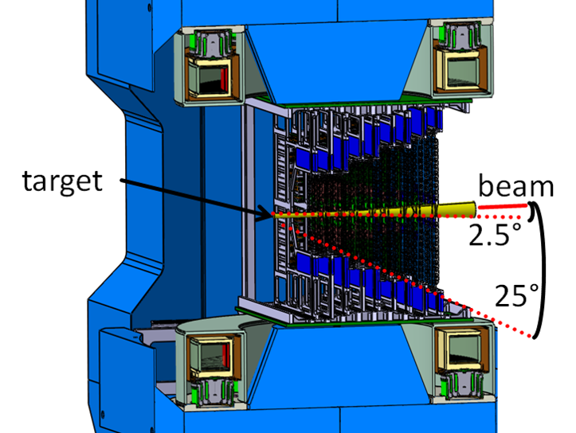
Silicon Tracking System
superconducting dipole magnet
[T]
field profile along beam
144 cm
distance from pole shoe center [mm]
[T]
field integral 1 Tm
distance from pole shoe center [mm]

Slide 14
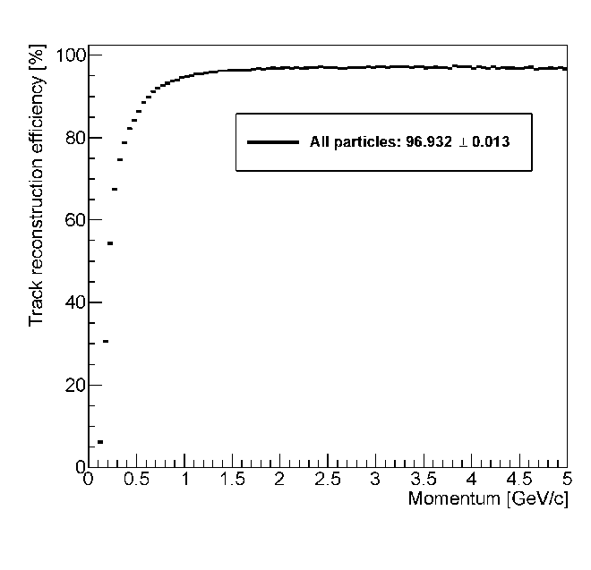
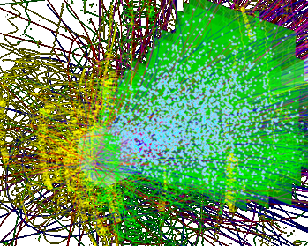
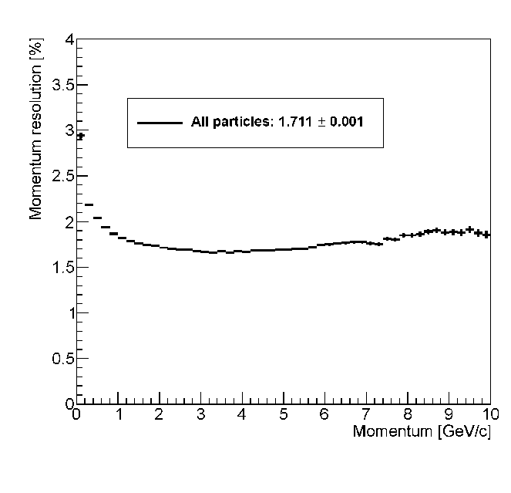
Silicon Tracking System
track reconstruction efficiency
central collision,
Au-Au, 10 GeV/u
700 charged
particles in
aperture
track reconstruct.
efficiency:
> 96 %
momentum resolution:
~ 2%
momentum resolution

Slide 15
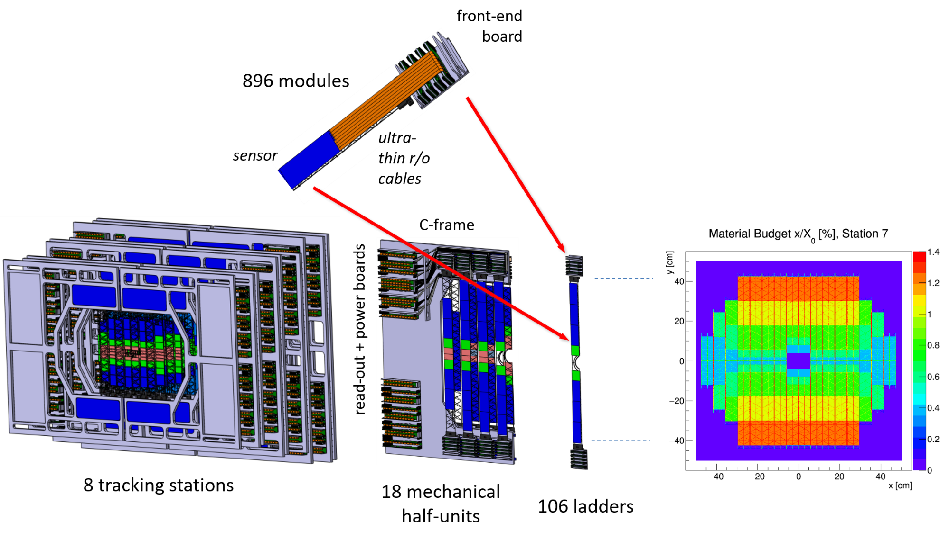
STS – composition
(18 variants)
(23 variants)

Slide 16
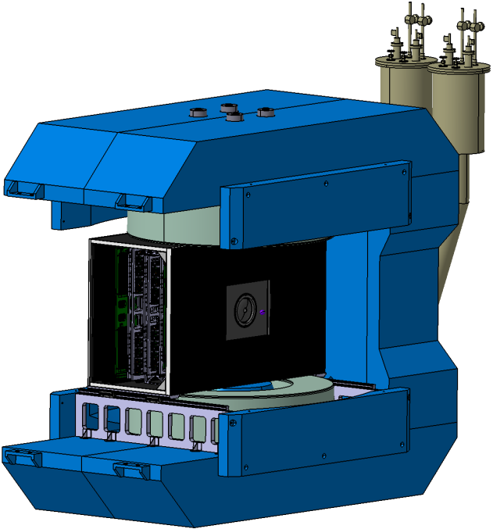
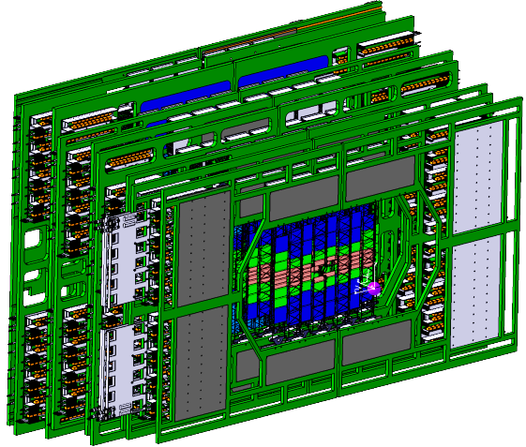
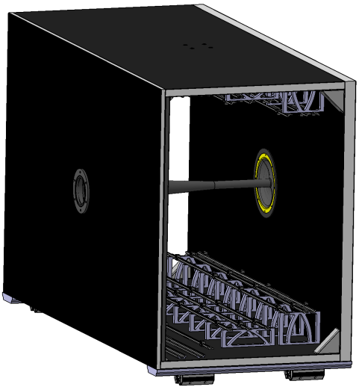
System engineering
details on construction in:
O. Vasylyev, FTDM 2017
Consistent design being detailed. Current issues:
Mechanical frames:
Material
Rail system
Positioning / adjustment
Cooling plate shape
Sensor cooling
Cabling
Thermal enclosure:
Sealing
Panel connections
Material budget rear panel
Overall stiffness
Service / support mechanics
Overall assembly procedure
Global system aspects:
STS services, rail supports and details of
  Cabling, patch panels
  Cooling
  Positioning
  Safety / emergency systems
  Integration upstream and downstream
  vibrations / structural analysis

Slide 17
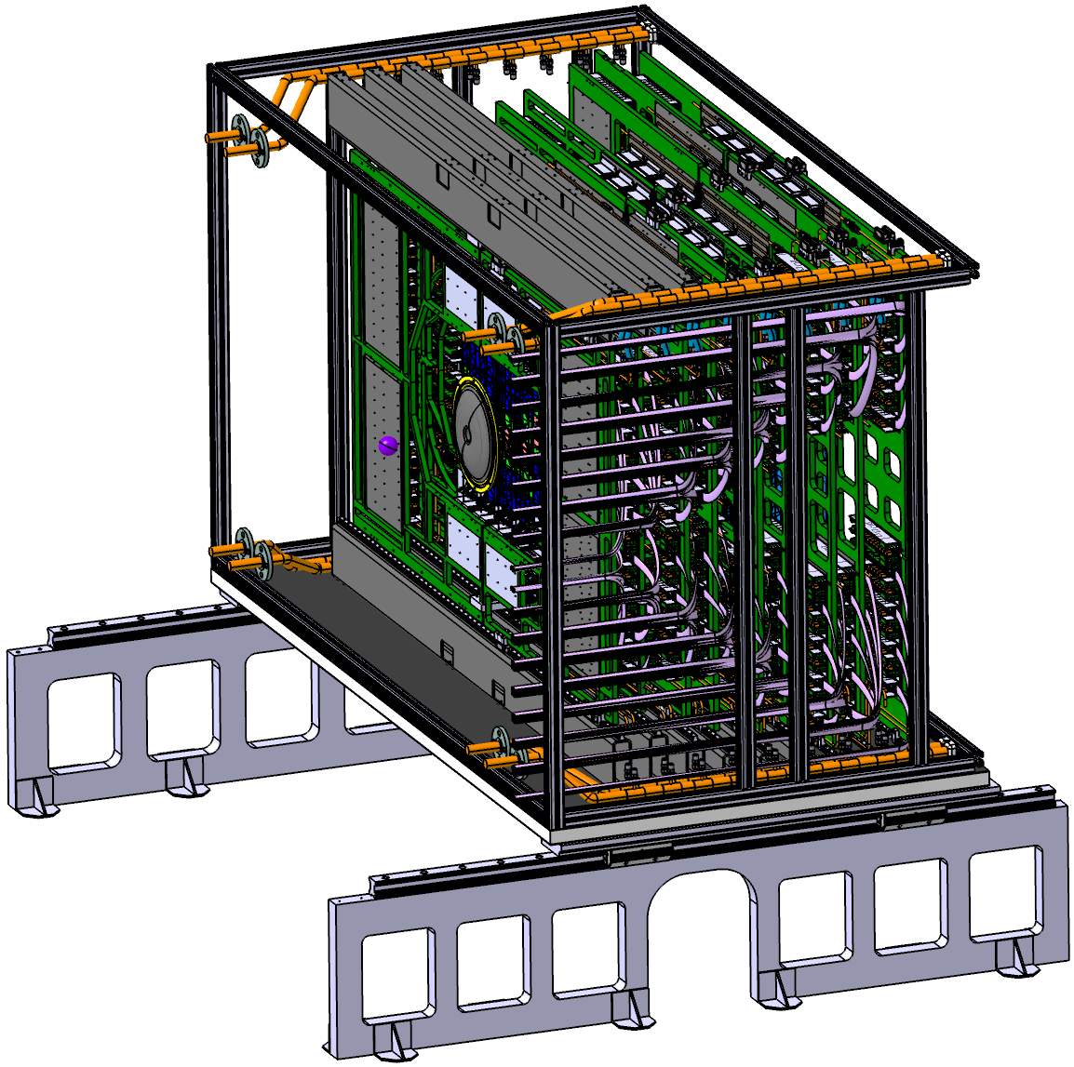
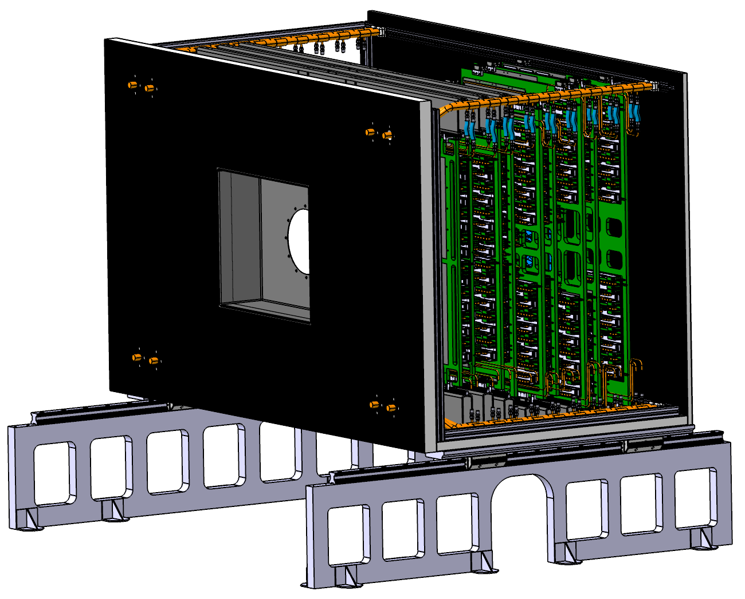
System engineering
full-scale mechanics demonstrator to be set-up

Slide 18
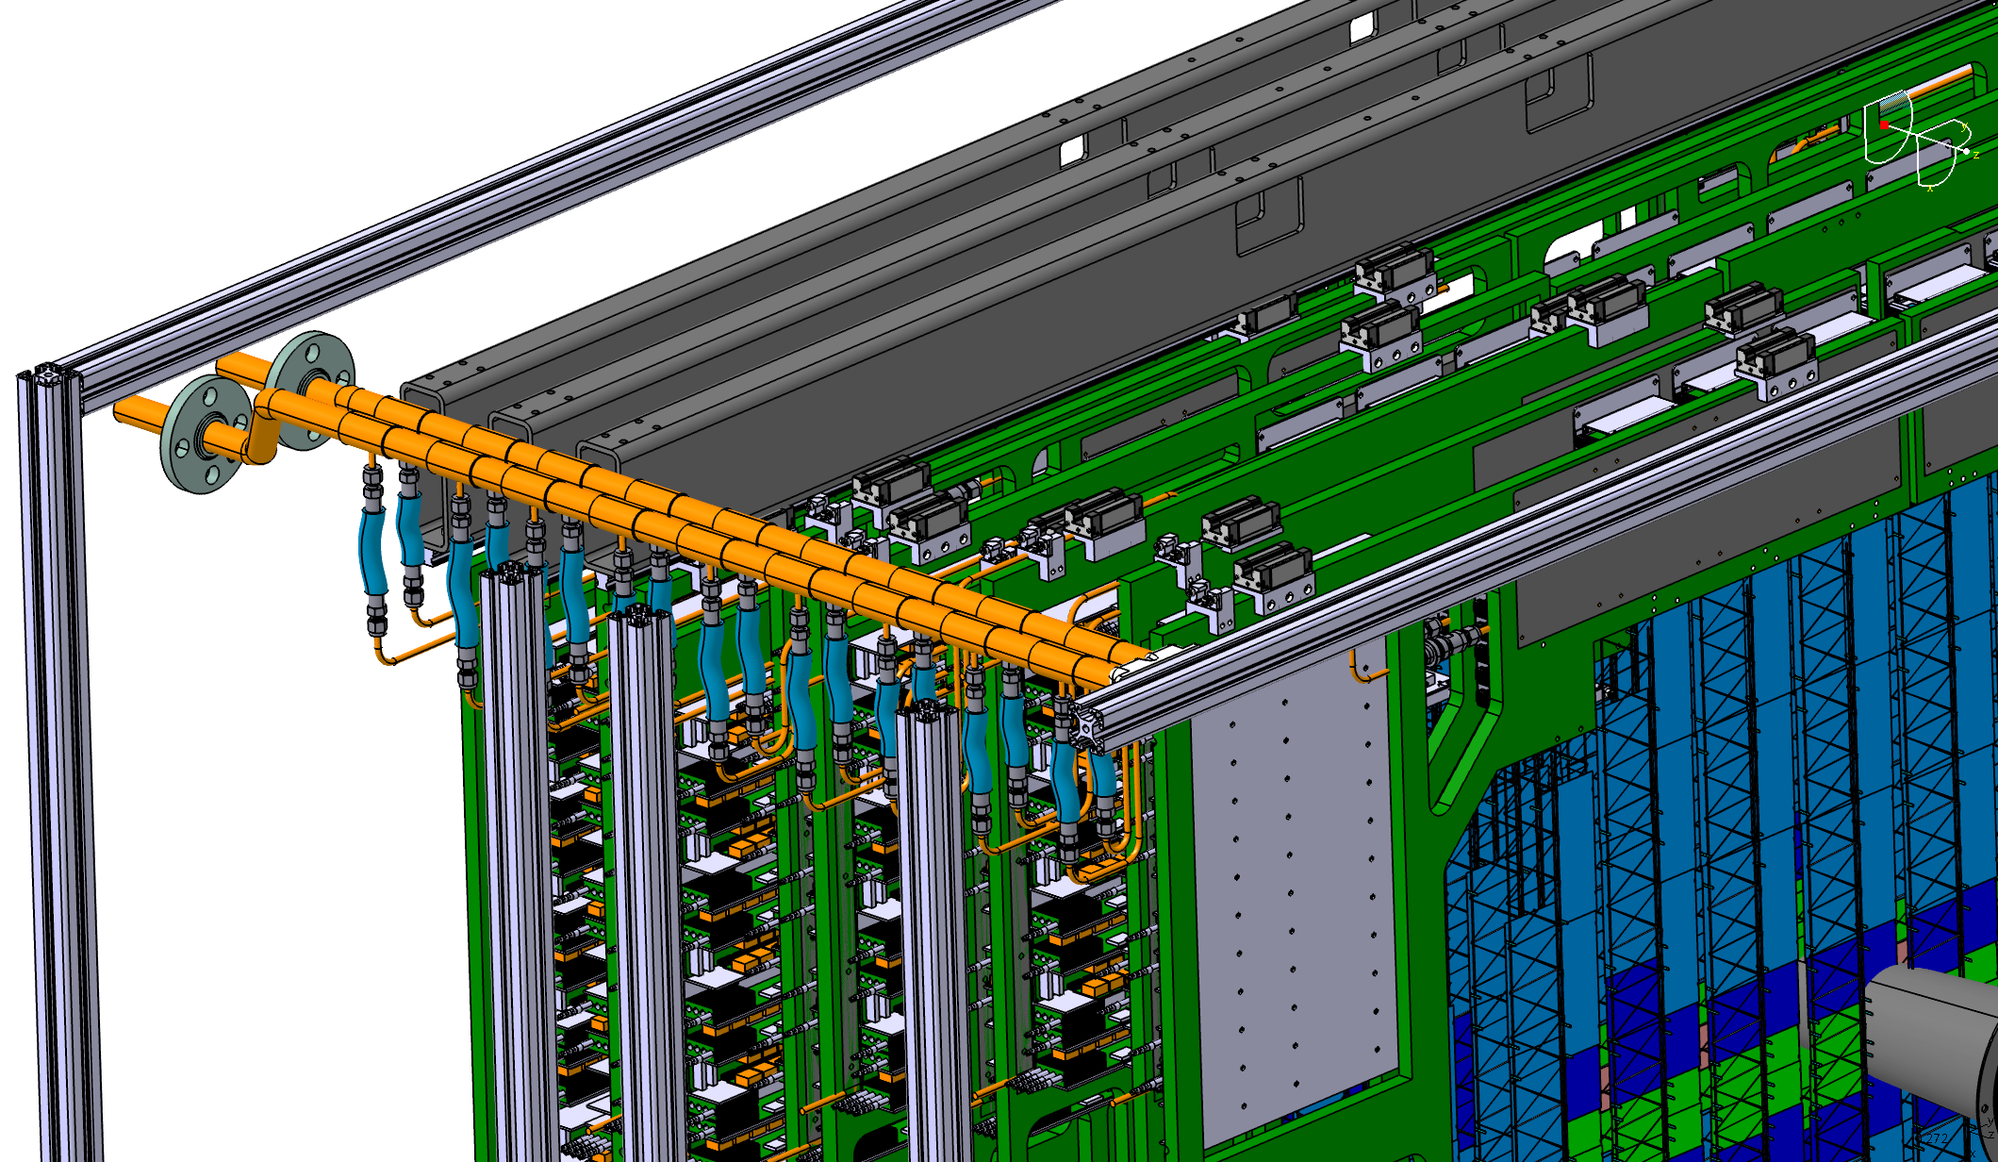
System engineering
cooling concept:
liquid distribution for electronics cooling
gas flow for sensor cooling
thermal demonstrator under set-up
details in:
K. Agarwar,
FTDM 2019

Slide 19
System engineering
cooling concept:
liquid distribution for electronics cooling
gas flow for sensor cooling
thermal demonstrator under set-up
details in:
K. Agarwal,
FTDM 2019

Slide 20
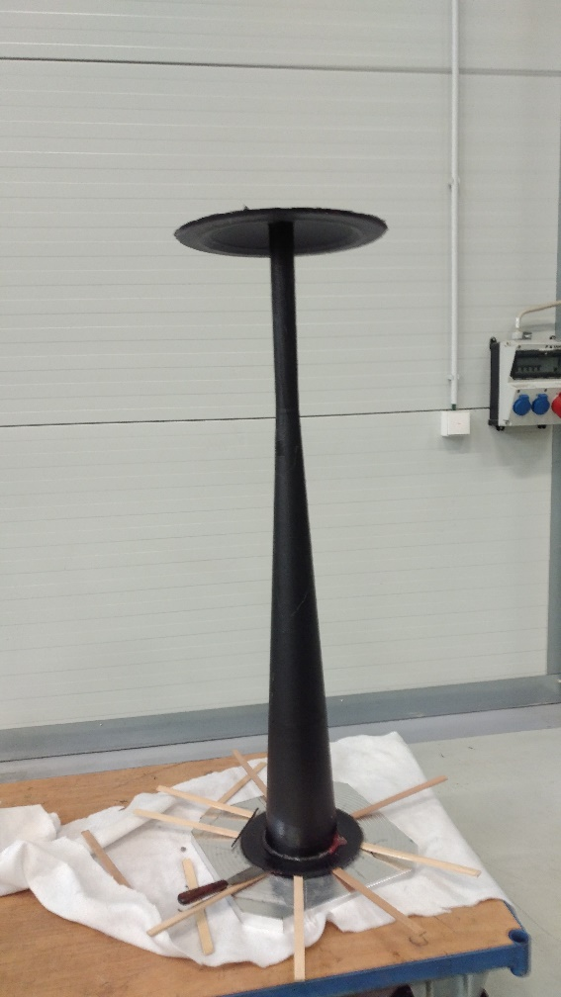
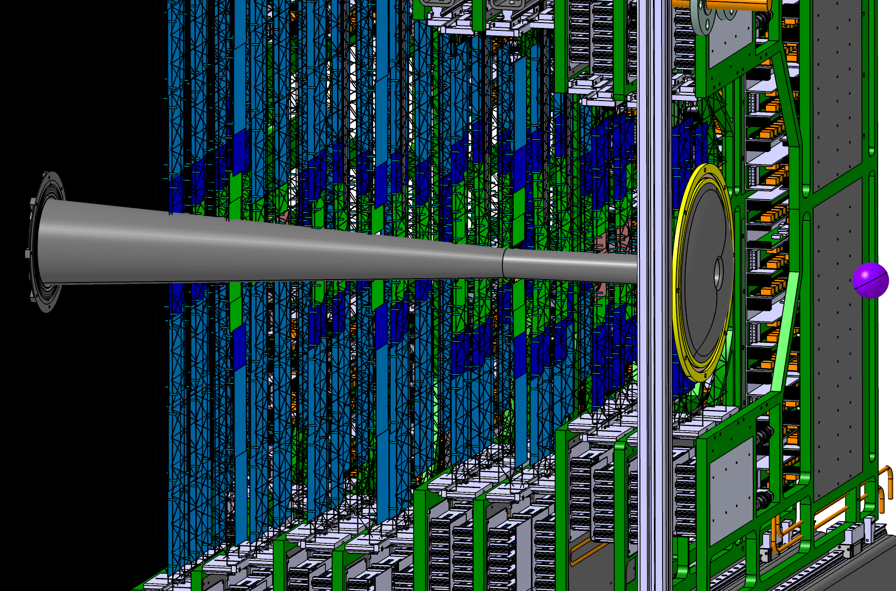
Beam pipe
0.5 mm carbon fiber prepreg on a hub, foil embedded
window to target vacuum
pipe
first prototype made in industry
vacuum stability test failed
collapse in transition area to conical part
new trial pending
thicker carbon fiber layer for pipe: 0.8 mm

Slide 21
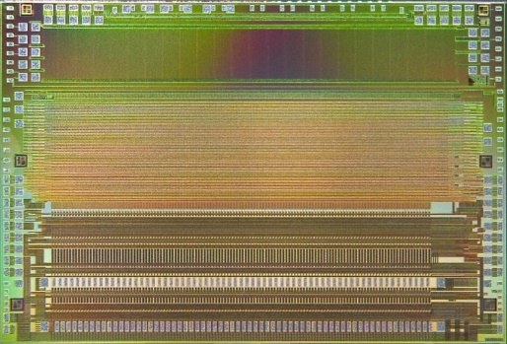
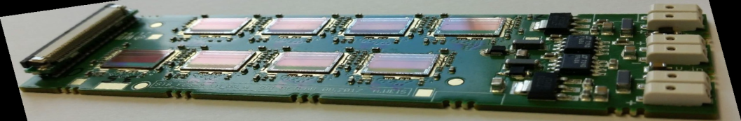
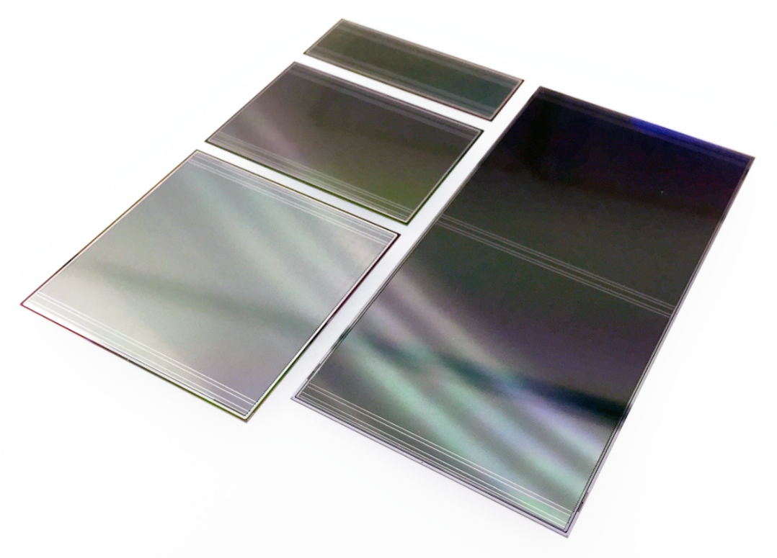
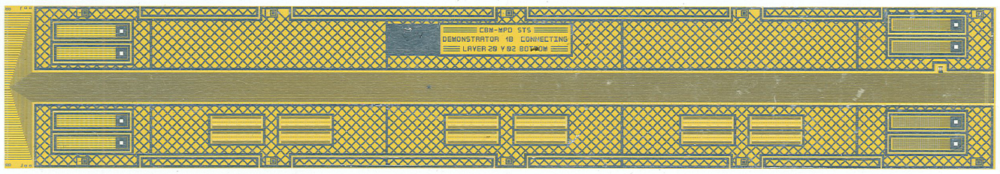
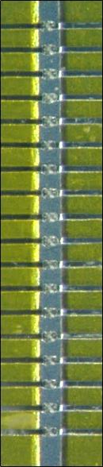
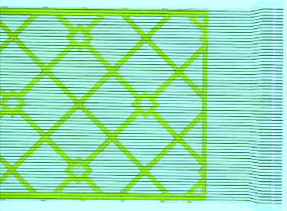

Module assembly
STS-XYTER v2.1
128 channels
self-triggering
5 bit ADC, time resolution < 5 ns
double-sided microstrip sensors
1024 strips of 58 µm pitch
320 µm thick
4 variants/strip lengths
Front-end electronics board FEB-8
signal layer:
64 Al lines of 116 µm pitch, 30 µm wide, 14 µm thick on 10 µm polyimide
TAB bonding
(Al width
45 µm) *⁾
trace lengths 5 - 55 cm
trace capacitance 0.45 pF/cm
cable stack: with shielding, spacers
thickness ~ 800 µm / 0.23% X₀
*⁾ alternative Cu cable/interconnect technology under study

Slide 22
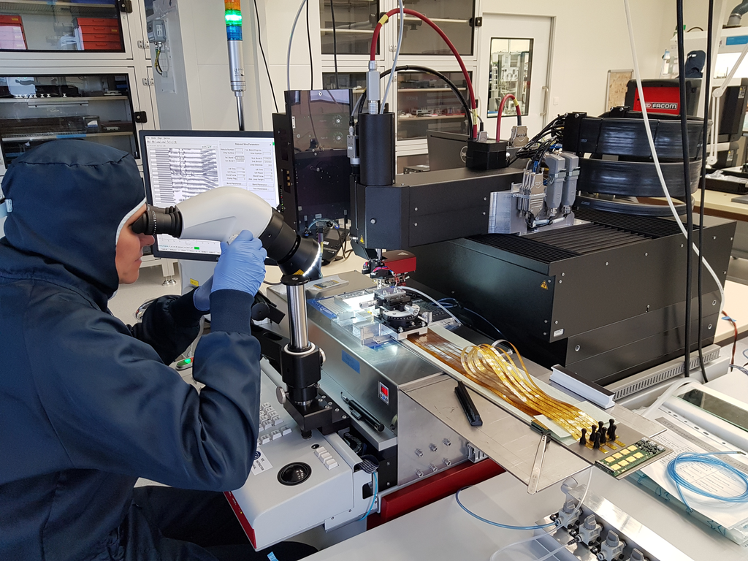
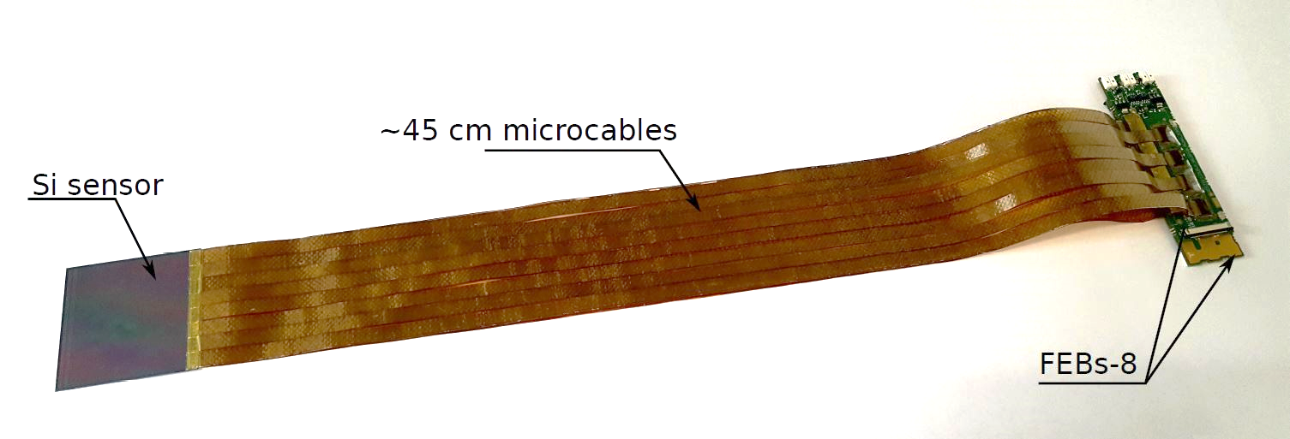
Module assembly
longest module variant
for mSTS

Slide 23
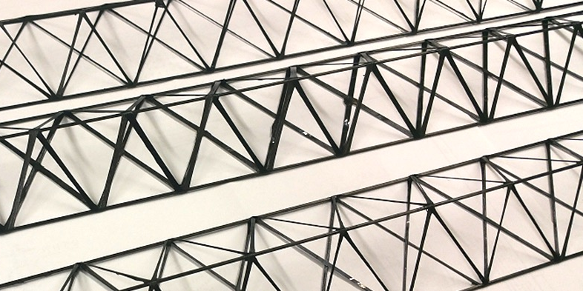
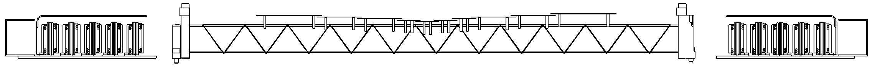
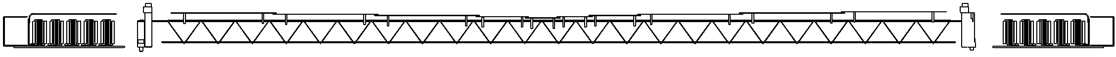
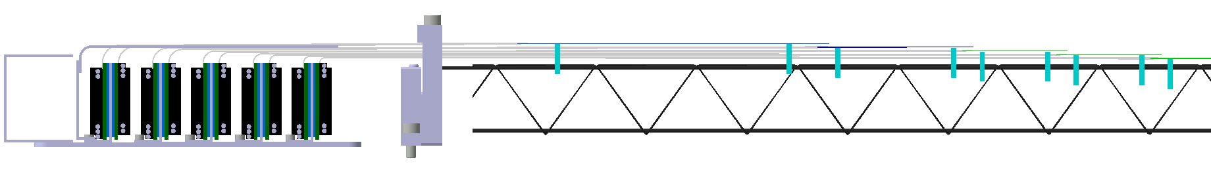
Ladder assembly
shortest ladder, 480mm
carbon fiber supports
longest ladder, 970mm
FEE box, microcable routing, sensor attachment
transition-fits:
pin to C-frame, pin to bearing

Slide 24
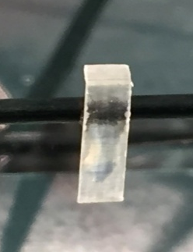
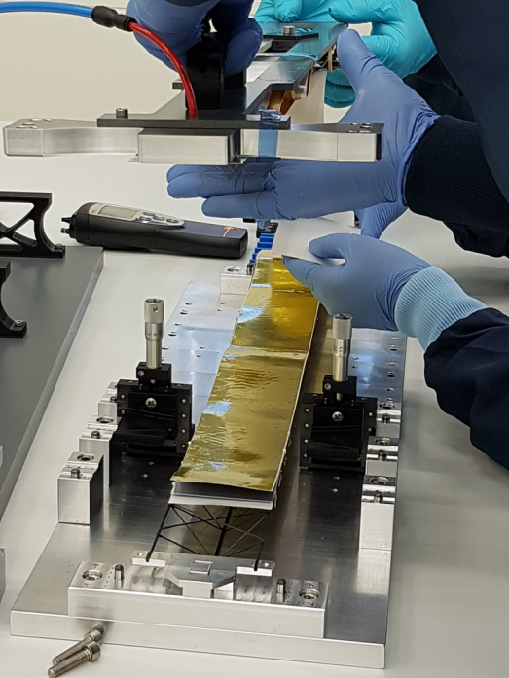
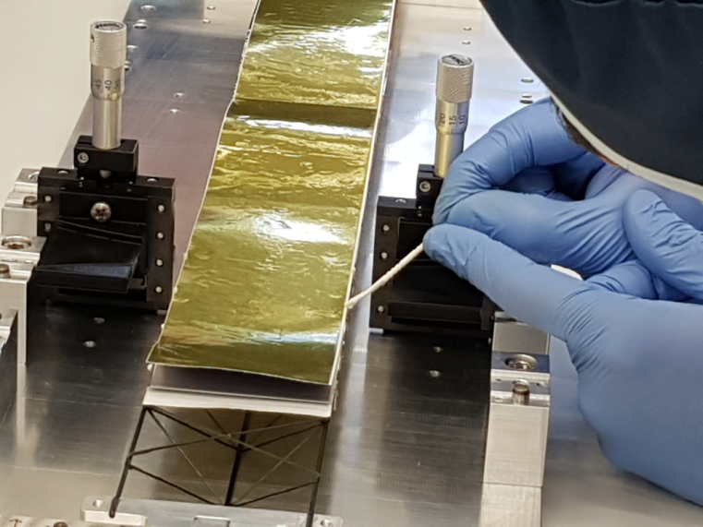
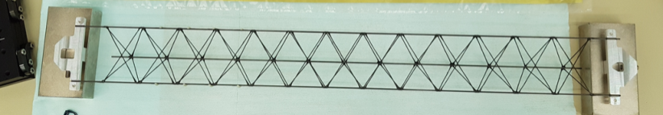
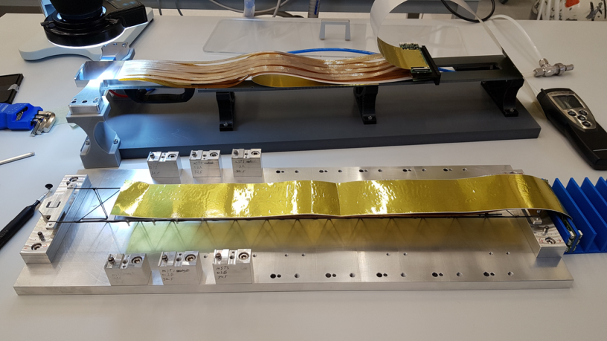
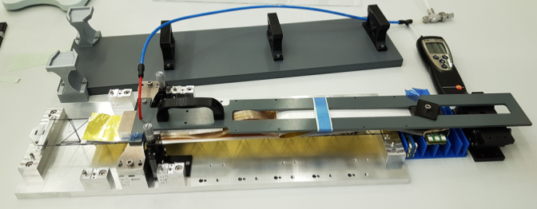
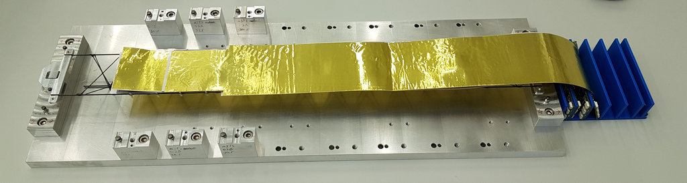
Ladder assembly
transfer of module #1 to ladder
half-ladder #0 for mSTS demonstrator
carbon fiber ladder with bearings
application of glue onto L-legs
module #0 installed on ladder;
module #1 on transfer tool
module #1 transferred, fixed during curing of glue

Slide 25
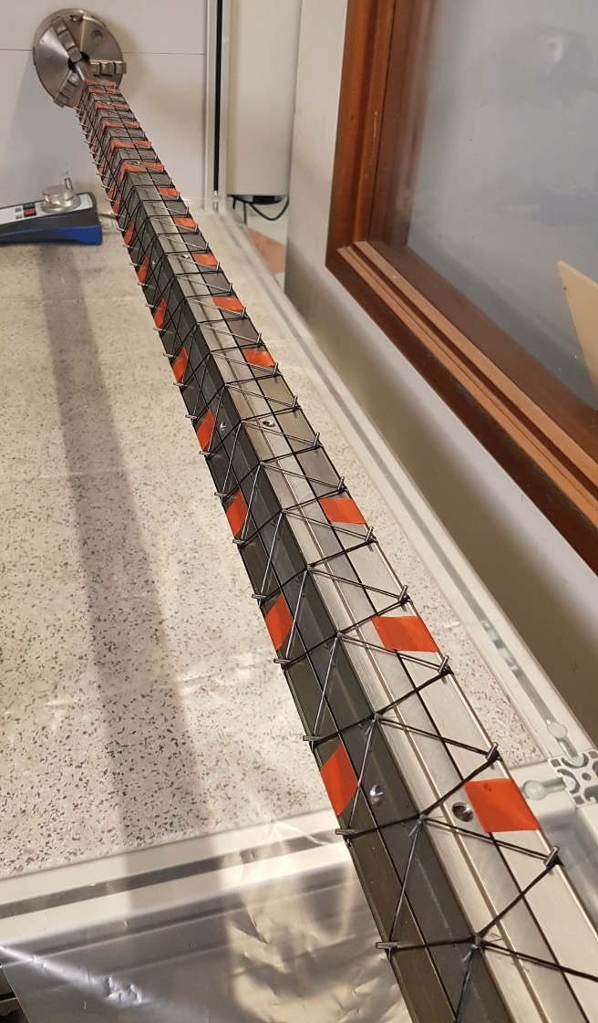
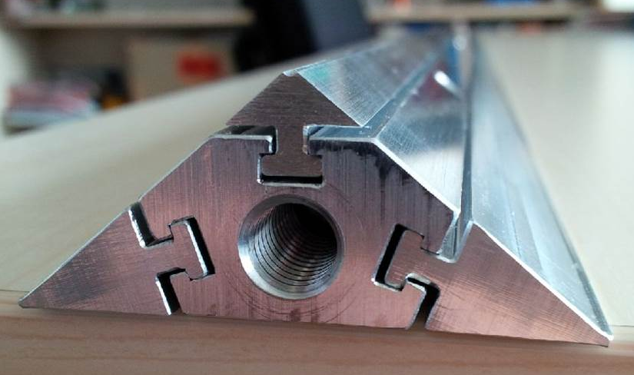
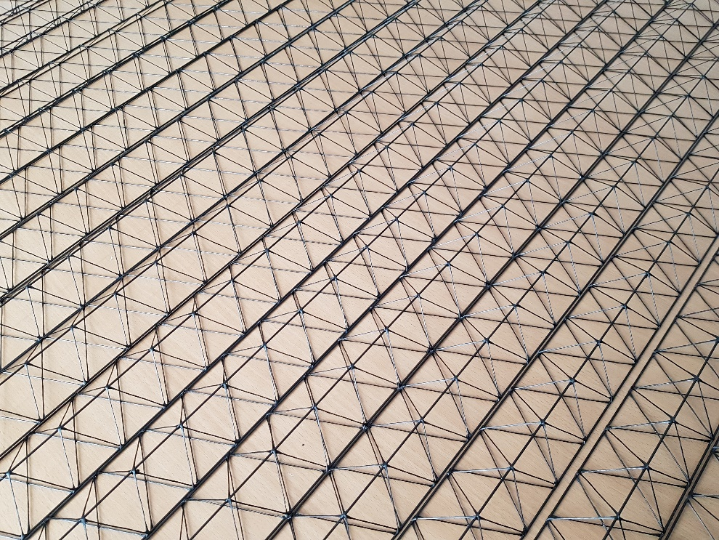
Carbon fiber ladders
derived from ALICE-ITS for production in a company
winding core (prototype – Al, final – steel)
carbon tube, 1.5/0.7mm ∅
carbon fiber,
Tenax, HTA40 E13, 3K, 200tex,
three rovings, twisted
EP resin
prototypes produced in company
length 120 cm, weight 14.8 g

Slide 26



Optical metrology
conceived for silicon microstrip QA,
adapted to ladder metrology:
fiducial marks on sensors
fiducial mark survey
focus:
surface height
edge detection
10 µm position resolution
mSTS mechanical dummy half-ladder
demonstration of assembly technique
sensor warp and other effects
module placement achieved within target
± 200 µm (z), 100 µm rms (xy)

Slide 27


Survey of carbon fiber ladders
* at simultaneous load;
with module mounting
starting from center of
ladder: expect ≈ 100 µm
ladder shapes – 16 prototypes
ladder sag under load
enlargement
300 µm*
quality uniform, slightly larger tolerances needed – longer L-legs
vibrational analysis ?

Slide 28


Central ladders
Concepts of modification to the carbon fiber ladders for the beam pipe intersection:
Hollow carbon fiber cone added to a ladder
(ALICE-ITS style frame).
Turned out presenting too much material in
CBM-STS geometrical arrangement.
Low-mass ribs in the cut-out. To be prototyped.

Slide 29




mSTS demonstrator
mSTS – demonstration of:
C-frame and ladder mounting mechanics
module and ladder assembly
LV + HV powering
liquid cooling of electronics (water)
module performance, data streaming
no sensor cooling, operation at ``room’’ temperature
station #0
area 12 x 12 cm²
station #0: C-frames #0 and #1

Slide 30



Issues seen with modules
module assembly yield
all tested components
microcable attachment yield high
FEB 8 assembly/operation yield
too low on the first prototypes
  under systematic study
  new FEB design, custom designed rad. tol. LDO, …
P-side, Vbias = 100V
noise in longest modules too high
in test box: ≈ 1300 e OK
in mSTS: ≈ 3000 e ⇒ S/N ≈ 8-12
threshold high
  under systematic study
  powering scheme, filtering
(preliminary)
N-side, Vbias = 100V

Slide 31

Issues with STS system integration summarized
modules:
understand and improve FEB assembly yield
improve with respect to final noise in system
ladders:
full length assembly to be done
central ladders to be prototyped
vibration analysis:
how to identify sources? cooling: N2 stream, liquid pump, …
apply to which components, measure? ladders, pipes, C-frames, …
beam pipe:
prototype based on carbon fiber, not yet approved
system integration:
optimization of FEB box design with respect to
cooling properties and space/cabling requirements

Slide 32
CBM-STS project teams
Germany
Helmholtz Center (GSI), Darmstadt
Karlsruhe Institute of Technology (KIT), Karlsruhe
Eberhard Karls University (EKU), Tübingen
Poland
University of Science and Technology (AGH), Krakow
Jagiellonian University (JU), Krakow
Warsaw University of Technology (WUT), Warsaw
Russia
Joint Institute for Nuclear Research (JINR), Dubna
Ukraine
Institute for Nuclear Research (KINR), Kiev
Japan
High Energy Accelerator Research Organization (KEK), Tsukuba (associate member)
STS timeline:
Construction: 2019 – 2024
Installation: 2025
First beams: in 2025

Slide 33
Backup

Slide 34

Module microcable stack
cable stack:
thickness ≈ 800 µm, 0.23% X₀
trace capacitance 0.45 pF/cm
trace lengths 5 - 55 cm
N-side read-out
P-side read-out

Slide 35


Read-out chain Front-end electronics

Slide 36

mSTS powering scheme
Floating LV supplies are referenced to the P- and N-side potentials.
Microcable shields are connected to the respective FEB grounds.
HV common return is not connected to the mSTS enclosure.
Enclosure is grounded at all times; electrically insulated from the mounting table

Slide 37

Detector signal path
Return path capacitor must be placed close to the FEBs.
Blocking resistors prevent signal “escape” into the filter and HV power supply.

