Slide 1
DEVELOPMENT OF COOLING DEMONSTRATOR FOR THE CBM SILICON TRACKING SYSTEM (STS)
K. Agarwal¹, R.M. Kapell², M. Kis², P. Koczon², P. Kuhl²,
U. Möller², H.R. Schmidt^{1,2}, J. Thaufelder², O. Vasylyev²
for the CBM Collaboration
¹ Eberhard Karls Universität Tübingen – Tübingen (DE)
² GSI Helmholtz Centre for Heavy Ion Research – Darmstadt (DE)
Forum on Tracking Detector Mechanics – Cornell University (Ithaca NY)
19/06/2019

Slide 2
INTRODUCTION TO CBM-STS

Slide 3
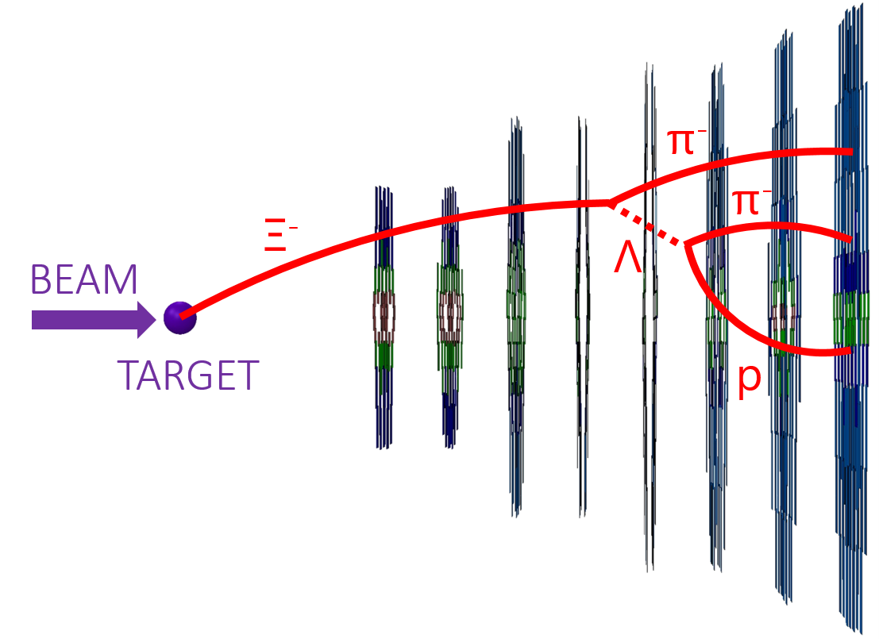
INTRODUCTION TO CBM-STS
STS Features:
8 layers → 896 silicon microstrip sensors
Track Reconstruction, ε ≥ 98%
Momentum Resolution, Δp/p ≈ 1.5%
y
x
z
Figure: Side-view of STS sensors with artistic illustration of a multi-strange hyperon (Ξ⁻) decay in STS
100 cm

Slide 4
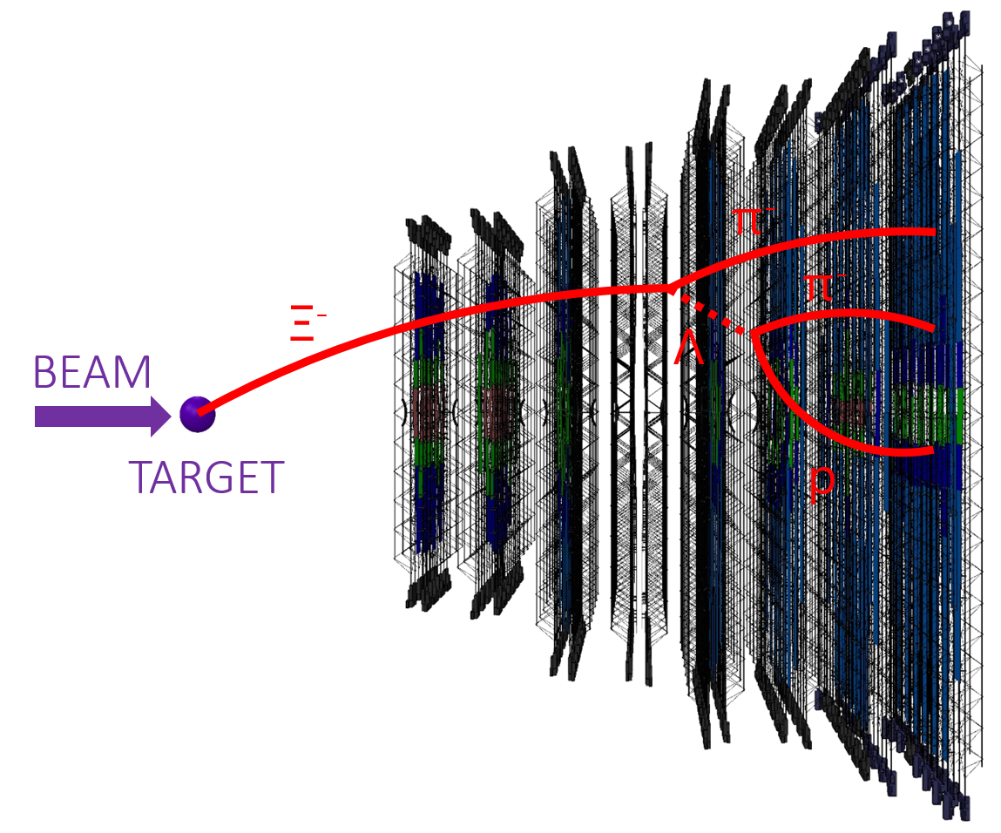
INTRODUCTION TO CBM-STS
STS Features:
8 layers → 896 silicon microstrip sensors
Track Reconstruction, ε ≥ 98%
Momentum Resolution, Δp/p ≈ 1.5%
Material Budget ∼ 1.5 % X₀ per layer
FEE and other detector infrastructure is placed outside detector acceptance
Sensors connected to the FEE via microcables
y
x
z
Figure: Side-view of STS sensors on ladders with artistic illustration of a multi-strange hyperon (Ξ⁻) decay in STS
100 cm

Slide 5
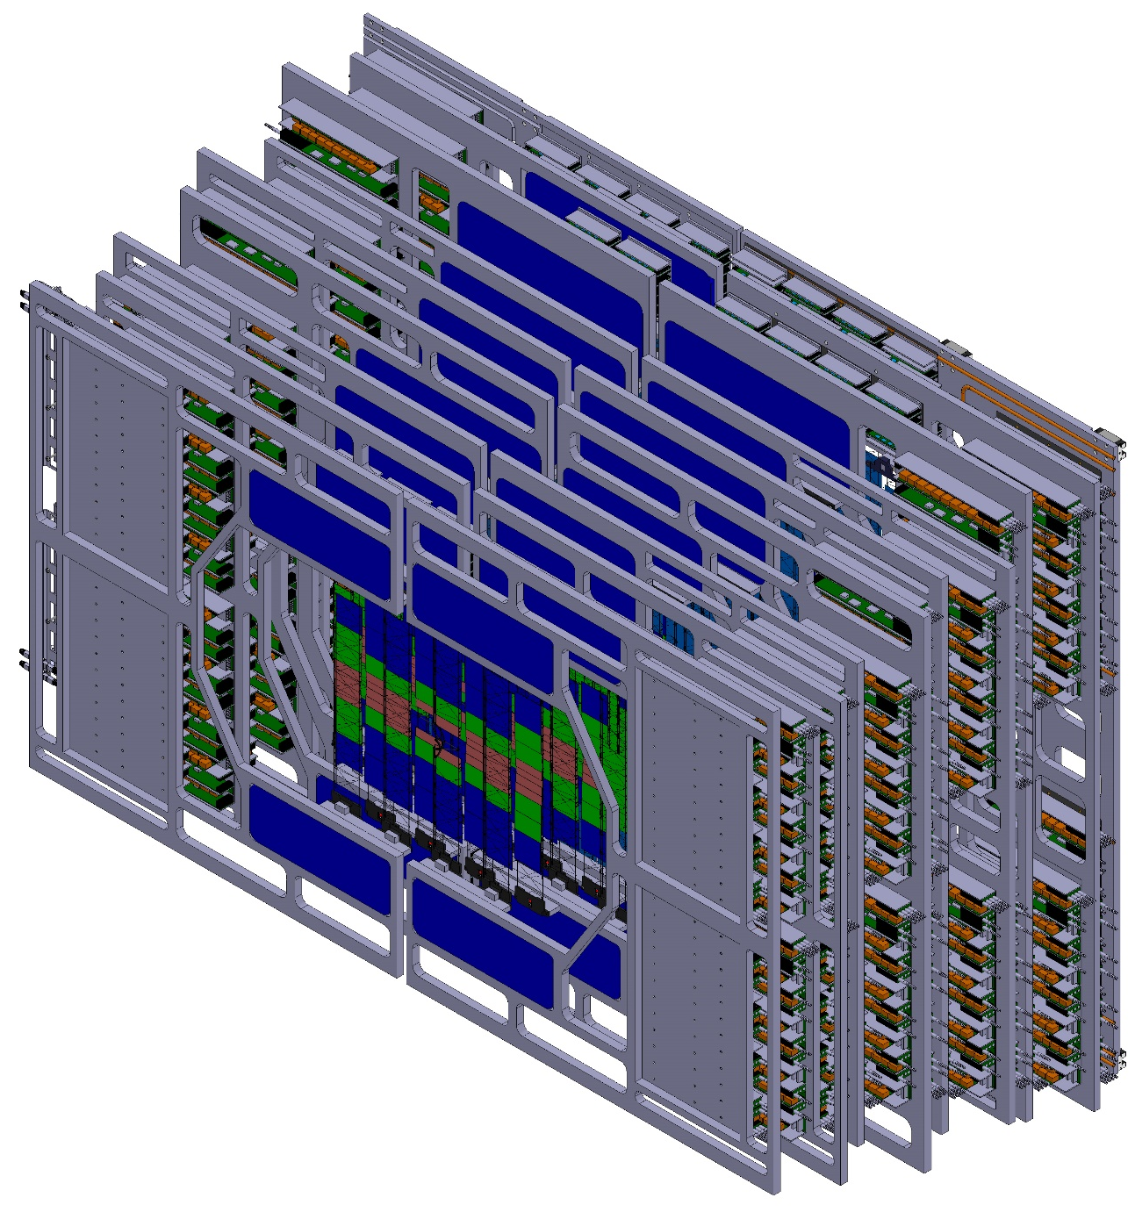
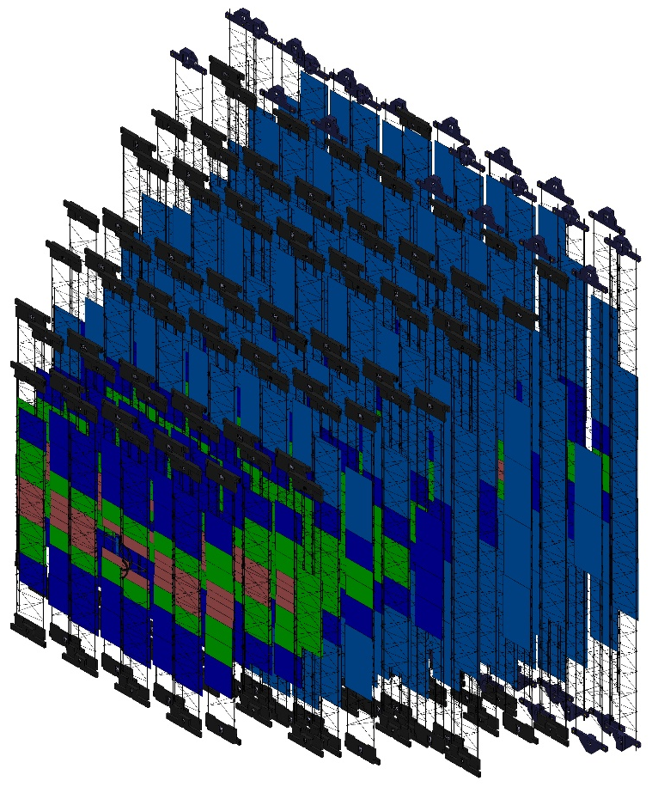
INTRODUCTION TO CBM-STS
y
x
z
Figure: Isometric-view of STS; Left – Sensors on ladders;
Right – Sensors with relevant infrastructure located at acceptance periphary

Slide 6
INTRODUCTION TO CBM-STS
More info on CBM-STS Integration:
Johann Heuser, FTDM 2019
Oleg Vasylyev, FTDM 2017
y
x
z
Figure: Isometric-view of STS; Left – Sensors on ladders;
Right – Sensors with relevant infrastructure located at acceptance periphary

Slide 7
THERMAL INTRODUCTION TO CBM-STS

Slide 8
(THERMAL) INTRODUCTION TO CBM-STS
y
x
z
Figure: Isometric-view of STS; Sensors with relevant infrastructure (i.e., FEE, cabling and cooling) located at acceptance periphary

Slide 9
(THERMAL) INTRODUCTION TO CBM-STS
Silicon Sensors:
Expected power dissipation ∼ 6 mW/cm² at -10°C at end-of-lifetime (fluence – 10¹⁴ n_{eq}(1 MeV)/cm²)
Target Temp. ≤ -10°C, by min. additional % X₀ per layer
Forced convective gas cooling
y
x
z

Slide 10
(THERMAL) INTRODUCTION TO CBM-STS
Silicon Sensors:
Expected power dissipation ∼ 6 mW/cm² at -10°C at end-of-lifetime (fluence – 10¹⁴ n_{eq}(1 MeV)/cm²)
Target Temp. ≤ -10°C, by min. additional % X₀ per layer
Forced convective gas cooling
Electronics and Power Cables:
Expected power dissipation ∼ 40kW in < 3.5 m³
Target Temp. ≤ -10°C, to avoid any heat transfer to silicon sensors (only 10 – 50 cm away)
Monophase NOVEC 649 cooling is the first choice
  GWP = 1 → Easier to obtain & longer operational lifetime
  Radiation hard → Safe to use in STS environment
Biphase CO₂ cooling as a backup
y
x
z

Slide 11
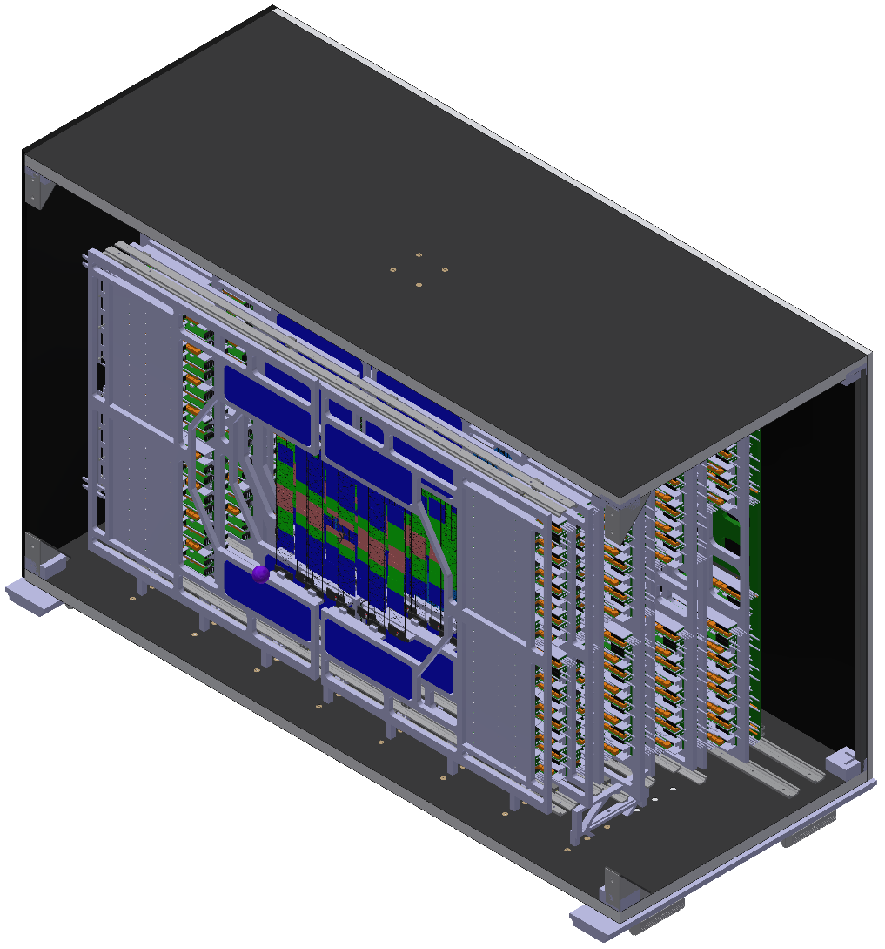
(THERMAL) INTRODUCTION TO CBM-STS
Silicon Sensors:
Expected power dissipation ∼ 6 mW/cm² at -10°C at end-of-lifetime (fluence – 10¹⁴ n_{eq}(1 MeV)/cm²)
Target Temp. ≤ -10°C, by min. additional % X₀ per layer
Forced convective gas cooling
Electronics and Power Cables:
Expected power dissipation ∼ 40kW in < 3.5 m³
Target Temp. ≤ -10°C, to avoid any heat transfer to silicon sensors (only 10 – 50 cm away)
Monophase NOVEC 649 cooling is the first choice
  GWP = 1 → Easier to obtain & longer operational lifetime
  Radiation hard → Safe to use in STS environment
Biphase CO₂ cooling as a backup
Thermal Enclosure:
CF sandwiched foam (∼ 20 mm) → Structural support
Thermal and moisture tight (RH < 0.5% at 20°C)
y
x
z

Slide 12
(THERMAL) INTRODUCTION TO CBM-STS
Silicon Sensors:
Expected power dissipation ∼ 6 mW/cm² at -10°C at end-of-lifetime (fluence – 10¹⁴ n_{eq}(1 MeV)/cm²)
Target Temp. ≤ -10°C, by min. additional % X₀ per layer
Forced convective gas cooling
COOLING DEMONSTRATOR
Experimental verification of all cooling concepts in a ‘realisitc’ setup with up to 3 half-layers (stations)
Electronics and Power Cables:
Expected power dissipation ∼ 40kW in < 3.5 m³
Target Temp. ≤ -10°C, to avoid any heat transfer to silicon sensors (only 10 – 50 cm away)
Monophase NOVEC 649 cooling is the first choice
  GWP = 1 → Easier to obtain & longer operational lifetime
  Radiation hard → Safe to use in STS environment
Biphase CO₂ cooling as a backup
Thermal Enclosure:
CF sandwiched foam (∼ 20 mm) → Structural support
Thermal and moisture tight (RH < 0.5% at 20°C)
y
x
z

Slide 13
COMPUTATIONAL CHARACTERISATION OF FRONT-END ELECTRONICS BOARD (FEB) COOLING
Aim: To know the expected temp. profile on STS-FEB setup to optimise operational parameters (eg. cooling line dimensions, mass flow, pressure drop etc), by simulating the complex behaviour of the coolants (NOVEC 649 and biphase CO₂)

Slide 14
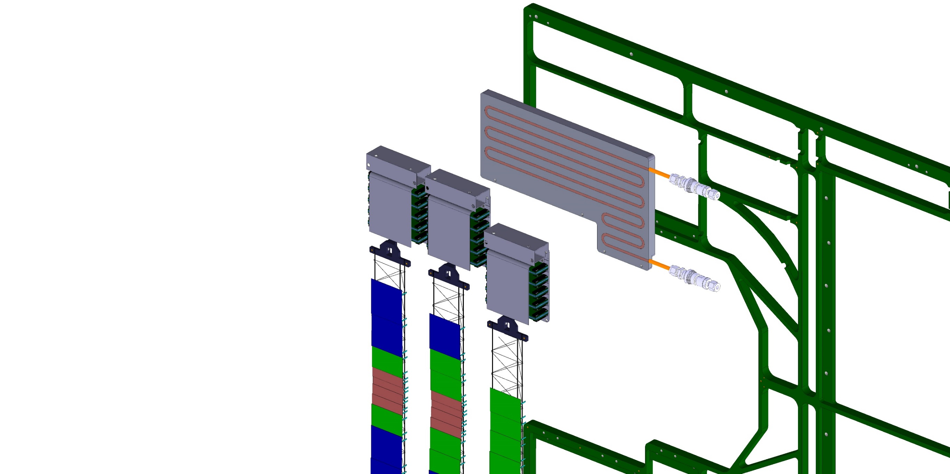
FRONT-END ELECTRONICS BOARD (FEB) COOLING
C-Frame (support structure) to hold the cooling plates and sensors mounted on ladders
Cooling Plates (press-fitted tube channels) with Monophase NOVEC 649 or Biphase CO₂ coolant
Front-End Electronics Boxes (FEB Boxes) holding the FEBs
Silicon Sensors mounted on CF Ladders
Figure: Each FEB Box housing FEE derives it cooling from a cooling plate attached on the C-Frame

Slide 15
CHOICE OF COOLANT
Monophase NOVEC
  Relatively lower performance
    higher mass flow
    higher pressure drop
    larger tubes
    non-uniform temperature
  To-be-used at LHCb-SciFi
  Easier commercial manufacturing (LAUDA-type chillers)
Biphase CO₂ (2PACL cycle)
  Great performance
    less mass flow
    low pressure drop
    smaller tubes
    uniform temperature
  In-use at ATLAS-IBL, CMS-Pixel, LHCb-VELO
  Potentially difficult for commercial manufacturing
  Vapor compression systems (with oil), though commercial, could possibly be an issue even at STS radiation (???)
  FIRST CHOICE COOLANT FOR STS-FEB
  BACKUP CHOICE FOR STS-FEB

Slide 16
MONOPHASE NOVEC 649 – COMPUTATIONAL FLUID DYNAMICS (CFD)
SolidWorks Flow Simulation Module
Definition of any new fluid (in this case NOVEC) possible by importing necessary fluid properties from datasheet/REFPROP
Electronics chips (silicon) defined as volumetric heat sources
Further possibility to include thermal interfaces (as thermal resistances), convection and radiation to make more precise calculations
Simulation Goal: Max. FEB Temp. < -10°C

Slide 17

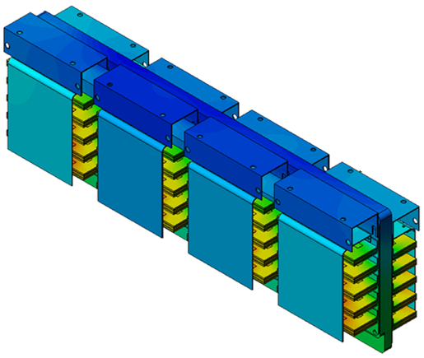
MONOPHASE NOVEC 649 – COMPUTATIONAL FLUID DYNAMICS (CFD)
SolidWorks Flow Simulation Module
Definition of any new fluid (in this case NOVEC) possible by importing necessary fluid properties from datasheet/REFPROP
Electronics chips (silicon) defined as volumetric heat sources
Further possibility to include thermal interfaces (as thermal resistances), convection and radiation to make more precise calculations
Simulation Goal: Max. FEB Temp. < -10°C
Example Case with min. temp. and max. load
Coolant Temp. = -40°C
Heat Load = 1080 W
Tube ID = 5.4 mm
Tube Length = 2.7 m
Mass Flow = 150 g/s
Pressure Drop = 1.25 bar

Slide 18
MONOPHASE NOVEC 649 – COMPUTATIONAL FLUID DYNAMICS (CFD)
SolidWorks Flow Simulation Module
Definition of any new fluid (in this case NOVEC) possible by importing necessary fluid properties from datasheet/REFPROP
Electronics chips (silicon) defined as volumetric heat sources
Further possibility to include thermal interfaces (as thermal resistances), convection and radiation to make more precise calculations
Simulation Goal: Max. FEB Temp. < -10°C
Example Case with min. temp. and max. load
Coolant Temp. = -40°C
Heat Load = 1080 W
Tube ID = 5.4 mm
Tube Length = 2.7 m
Mass Flow = 150 g/s
Pressure Drop = 1.25 bar
  Fair amount of flexibility is available
  Tests to check feasibility ongoing
  Commercial manufacturing (via Lauda or Huber etc. is foreseen)
  Experiences of LHCb-SciFi and their recommendations are crucial (special thanks to O. Crespo-Lopez and M. Doubek – CERN EN-CV)

Slide 19
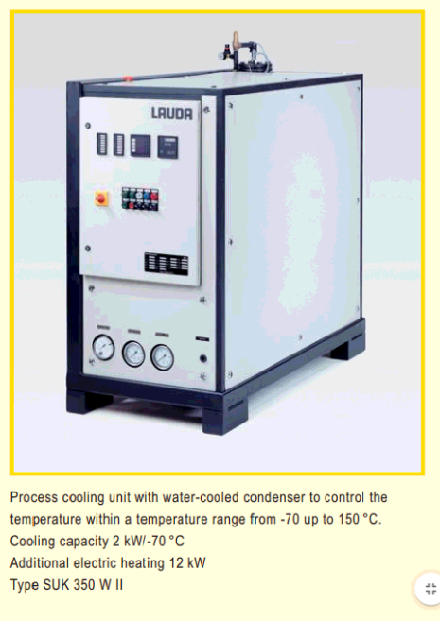
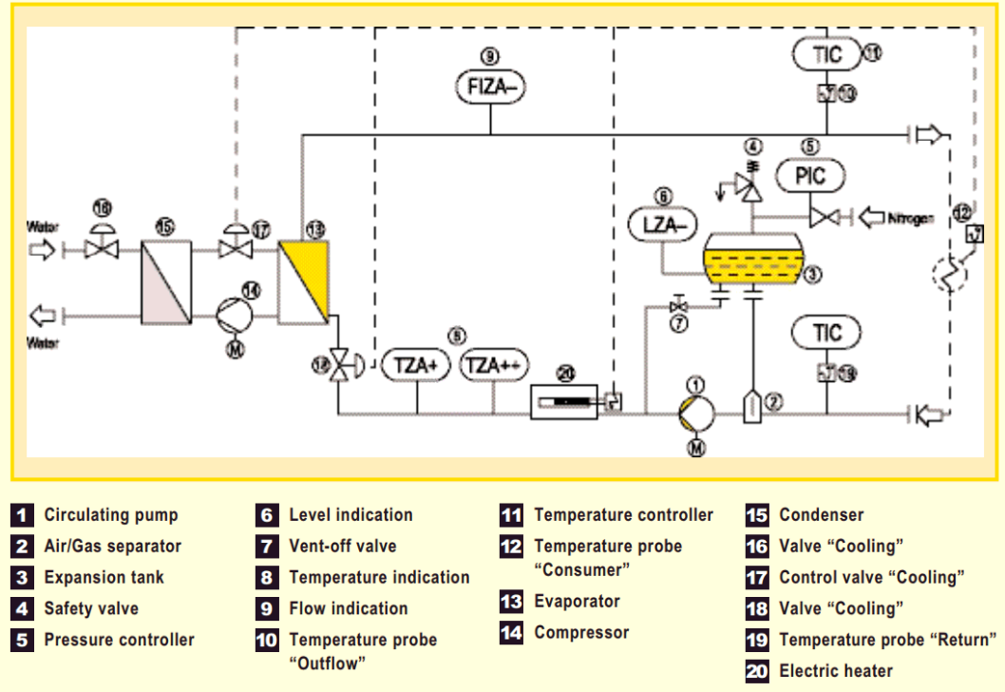
MONOPHASE NOVEC 649 – COMMERCIAL MANUFACTURING
Figures: Process Cooling Units – LAUDA (P&ID and unit sample)
www.lauda.de/en/individual-temperature-control-systems/industrial-heating-and-cooling-systems/process-cooling-systems.html

Slide 20
BIPHASE CO₂ – SEMI-EMPERICAL BOILING MODEL + THERMAL FEA
Calculations in MATLAB with a Semi-Emperical Flow Boiling Model done based on Thome et al (EPFL)
Useful estimates of Heat Transfer Coefficient (HTC), Pressure Drop and Dry-Out onset
Direct determination of cooling line dimensions and mass flow required in 2PACL and Vap. Comp. cycle!
Inspired from the work done by B. Verlat, Z. Zhang for CoBRA
Importing the HTC and fluid temp. in SolidWorks Thermal FEA allows to obtain temp. profile of the FEB setup
Further possibility to include thermal interfaces (as thermal resistances), convection and radiation to make more precise calculations
Simulation Goal: Max. FEB Temp. < -10°C

Slide 21
BIPHASE CO₂ – SEMI-EMPERICAL BOILING MODEL + THERMAL FEA
Calculations in MATLAB with a Semi-Emperical Flow Boiling Model done based on Thome et al (EPFL)
Useful estimates of Heat Transfer Coefficient (HTC), Pressure Drop and Dry-Out onset
Direct determination of cooling line dimensions and mass flow required in 2PACL and Vap. Comp. cycle!
Inspired from the work done by B. Verlat, Z. Zhang for CoBRA
Importing the HTC and fluid temp. in SolidWorks Thermal FEA allows to obtain temp. profile of the FEB setup
Further possibility to include thermal interfaces (as thermal resistances), convection and radiation to make more precise calculations
Simulation Goal: Max. FEB Temp. < -10°C
Example Case (Vapor Compression Cycle)
Coolant Temp. = -30°C
Subcooled coolant = 10°C
Heat Load = 594 W
Tube ID = 3.6 mm
Tube Length = 2 m
Mass Flow = 10 g/s
Pressure Drop = 0.67 bar
Dryout margin = 8%

Slide 22
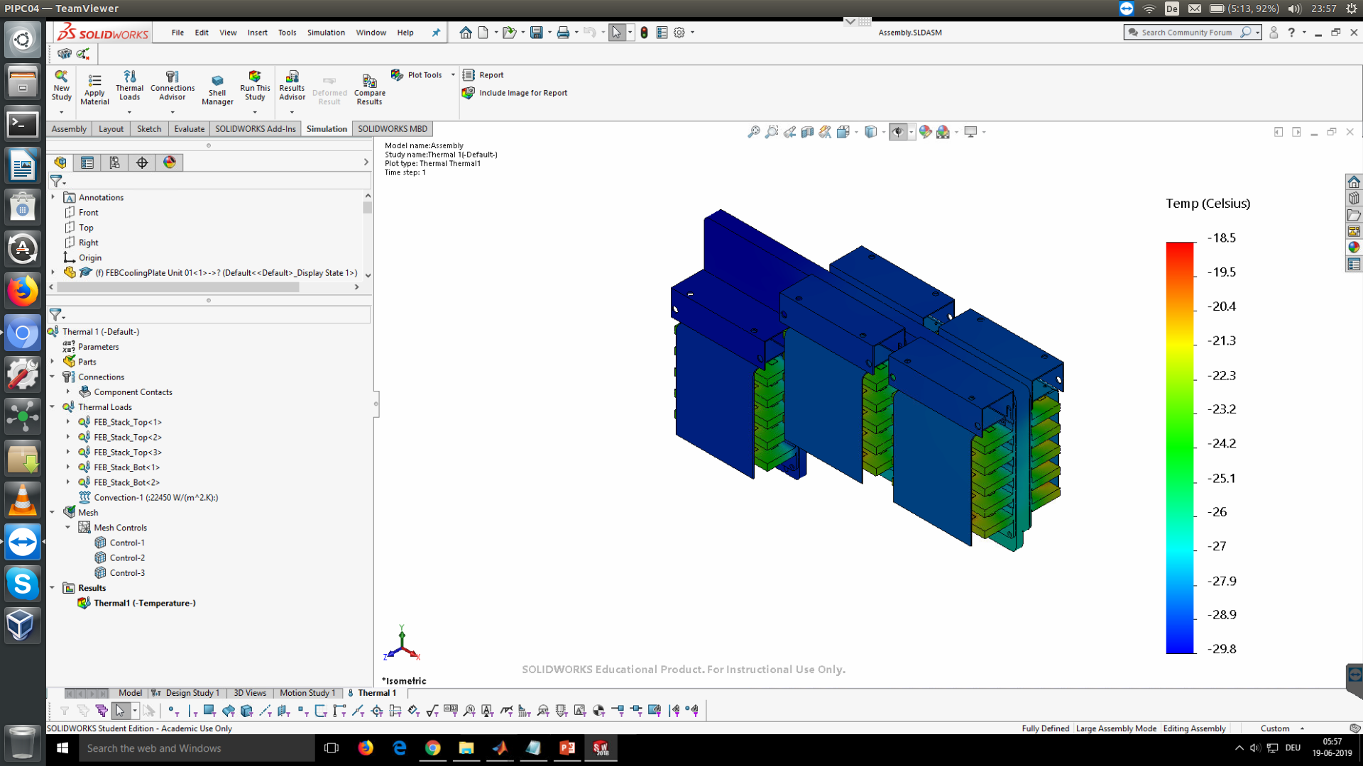
BIPHASE CO₂ – SEMI-EMPERICAL BOILING MODEL + THERMAL FEA
Calculations in MATLAB with a Semi-Emperical Flow Boiling Model done based on Thome et al (EPFL)
Useful estimates of Heat Transfer Coefficient (HTC), Pressure Drop and Dry-Out onset
Direct determination of cooling line dimensions and mass flow required in 2PACL and Vap. Comp. cycle!
Inspired from the work done by B. Verlat, Z. Zhang for CoBRA
Importing the HTC and fluid temp. in SolidWorks Thermal FEA allows to obtain temp. profile of the FEB setup
Further possibility to include thermal interfaces (as thermal resistances), convection and radiation to make more precise calculations
Simulation Goal: Max. FEB Temp. < -10°C
Example Case (Vapor Compression Cycle)
Coolant Temp. = -30°C
Subcooled coolant = 10°C
Heat Load = 594 W
Tube ID = 3.6 mm
Tube Length = 2 m
Mass Flow = 10 g/s
Pressure Drop = 0.67 bar
Dryout margin = 8%

Slide 23
BIPHASE CO₂ – SEMI-EMPERICAL BOILING MODEL + THERMAL FEA
Calculations in MATLAB with a Semi-Emperical Flow Boiling Model done based on Thome et al (EPFL)
Useful estimates of Heat Transfer Coefficient (HTC), Pressure Drop and Dry-Out onset
Direct determination of cooling line dimensions and mass flow required in 2PACL and Vap. Comp. cycle!
Inspired from the work done by B. Verlat, Z. Zhang for CoBRA
Importing the HTC and fluid temp. in SolidWorks Thermal FEA allows to obtain temp. profile of the FEB setup
Further possibility to include thermal interfaces (as thermal resistances), convection and radiation to make more precise calculations
Simulation Goal: Max. FEB Temp. < -10°C
Example Case (Vapor Compression Cycle)
Coolant Temp. = -30°C
Subcooled coolant = 10°C
Heat Load = 594 W
Tube ID = 3.6 mm
Tube Length = 2 m
Mass Flow = 10 g/s
Pressure Drop = 0.67 bar
Dryout margin = 8%
  Commercial manufacturing for a 2PACL-type 40kW system is potentially difficult
  Vapor compression cycle is the backup option (no use of capillaries in relatively less severe STS radiation environment)

Slide 24
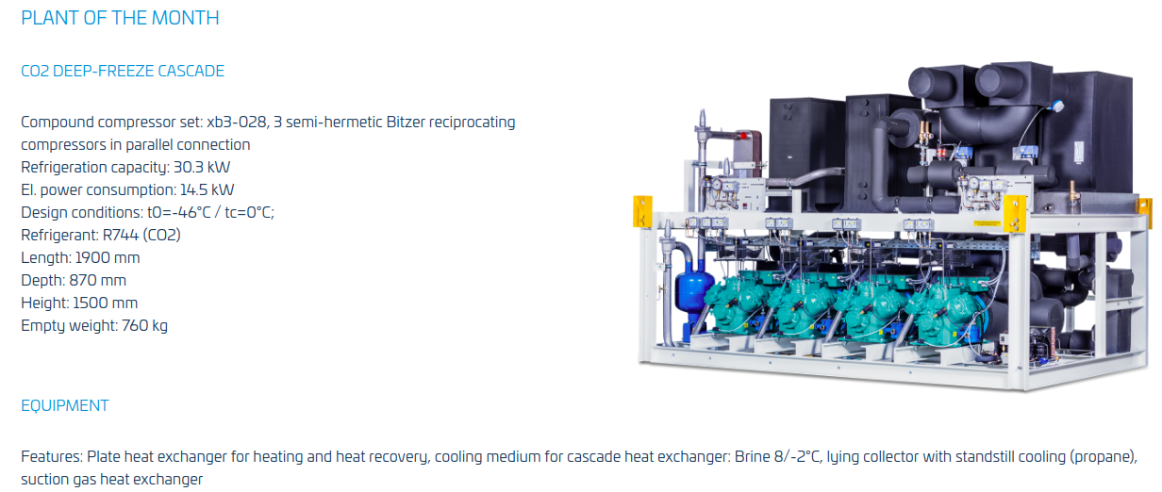

BIPHASE CO₂ (VAPOR COMPRESSION) – COMMERCIAL MANUFACTURING
www.compact-kaeltetechnik.de/en/
and many many options available!

Slide 25
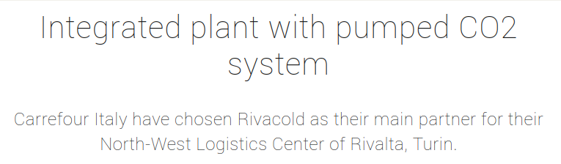

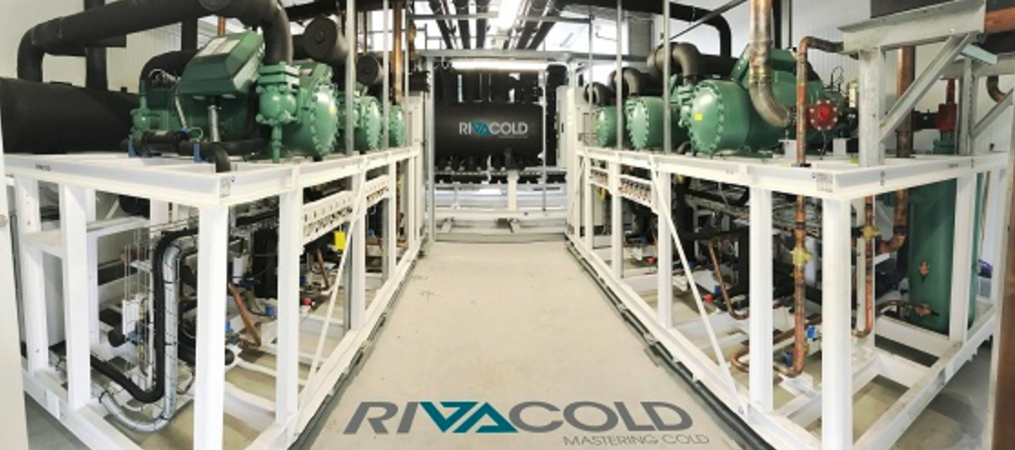
BIPHASE CO₂ (2PACL) – COMMERCIAL MANUFACTURING (?)
800 kW !!!
www.rivacold.com/ww/en/integrated-plant-with-pumped-co2-system

Slide 26
OTHER IDEAS AND ONGOING R&D FOR
THE STS THERMAL DEMONSTRAOR

Slide 27
STS-FEB COOLING DISTRIBUTION SYSTEM
Distance b/w the distribution system and STS is approx. 30 m
Higher tube diameters for individual transfer lines (total up to 72) could reduce the pressure drop, but means larger feedthroughs ☹

Slide 28
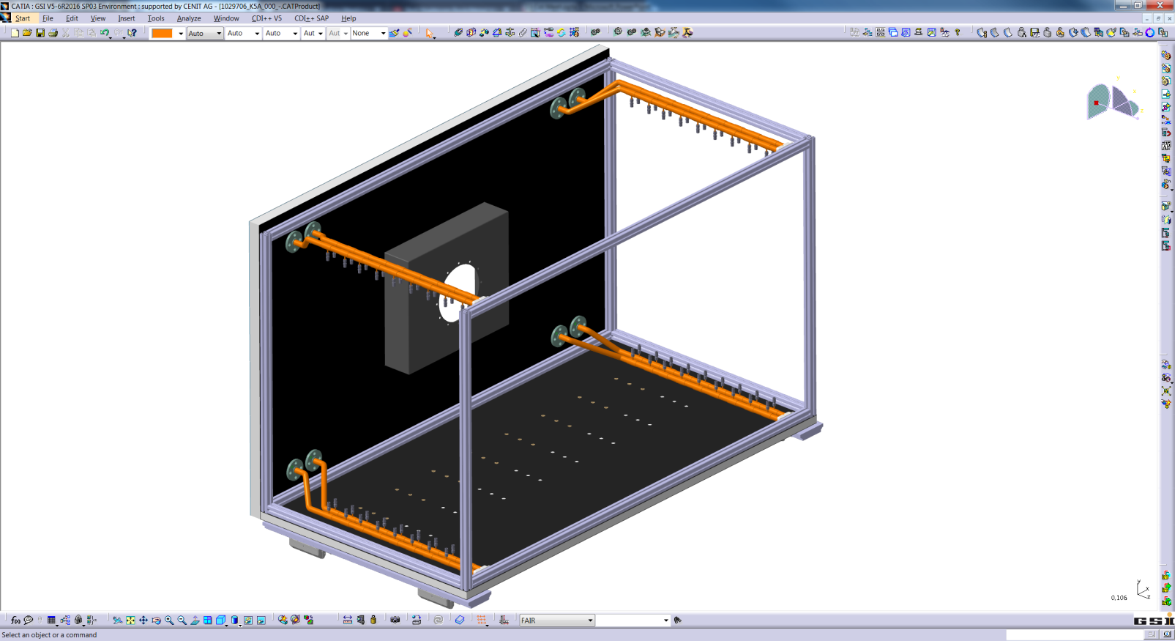
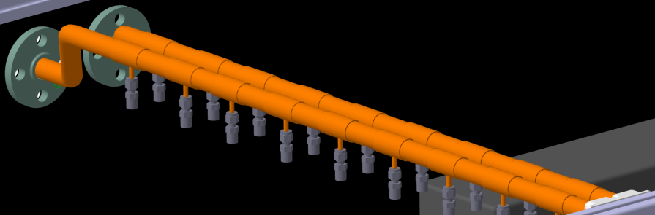
STS-FEB COOLING DISTRIBUTION SYSTEM
Distance b/w the distribution system and STS is approx. 30 mts
Higher tube diameters for individual transfer lines (total up to 72) could reduce the pressure drop, but means larger feedthroughs, especially for NOVEC ☹
Cooling manifolds
LHCb-VELO like distribution scheme is a promising way to bypass these issues!
Issue: Unequal flow distribution, no control on individual lines
Solution: Inducing additional pressure drops by using flow restrictors in individual lines for flow balancing
  Ref: Wiktor Byczynski, FTDM 2017 & 2018
Given that pressure drops could be upto 10 bars for securing 90% flow balance, suitable pumps have to be used
Front flange
Out manifold
In manifold
Rear holder

Slide 29
STS-FEB COOLING DISTRIBUTION SYSTEM
Distance b/w the distribution system and STS is approx. 30 mts
Higher tube diameters for individual transfer lines (total up to 72) could reduce the pressure drop, but means larger feedthroughs, especially for NOVEC ☹
Cooling manifolds
LHCb-VELO like distribution scheme is a promising way to bypass these issues!
Issue: Unequal flow distribution, no control on individual lines
Solution: Inducing additional pressure drops by using flow restrictors in individual lines for flow balancing
  Ref: Wiktor Byczynski, FTDM 2017 & 2018
Given that pressure drops could be upto 10 bars for securing 90% flow balance, suitable pumps have to be used
Front flange
Out manifold
In manifold
Rear holder
  Flow balancing tests with orifices (2.5 – 3 mm ID) have to be verified experimentally!

Slide 30
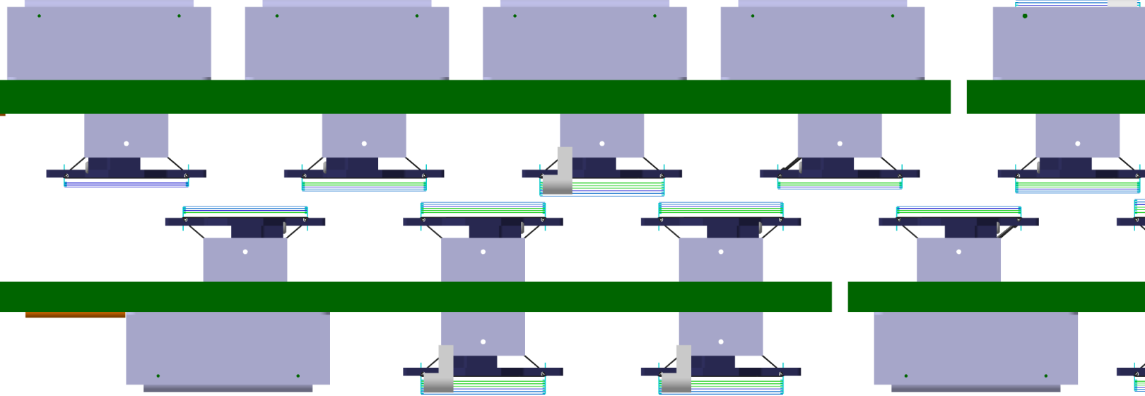
SILICON SENSOR COOLING
Visible sensor surface
C - Frames
Ladders with hidden FEB Boxes
Figure (left): Sensor cooling concept of STS (Top-view)
Cooling
Element
Cooling
Element
Cooling
Element
Cooling
Element
z
Cooling
Element
Cooling
Element
Cooling
Element
Cooling
Element
Cooling
Element
x
Visible sensor surface

Slide 31
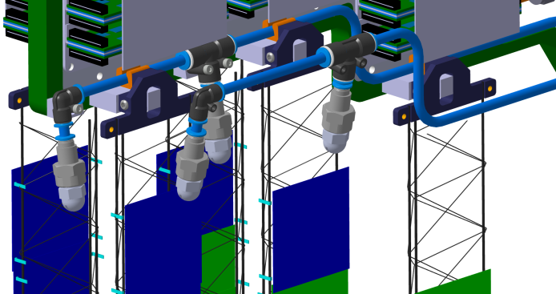
SILICON SENSOR COOLING
Visible sensor surface
C - Frames
Ladders with hidden FEB Boxes
Figure (left): Sensor cooling concept of STS (Top-view)
Cooling
Element
Cooling
Element
Cooling
Element
Cooling
Element
z
Cooling
Element
Cooling
Element
Cooling
Element
Cooling
Element
Cooling
Element
x
Visible sensor surface
Figure (bottom): Flat air-nozzles mounted on top of ladders for cooling the sensors
Nozzles (as an working example) to blow cold air directly on exposed sensor surface
Space is available for mounting outside acceptance
Low velocity flow targeted (< 1 m/s)
Other possibility is to use perforated CF-tubes in parallel to the sensors (Belle 2 - PXD)
Nozzles

Slide 32
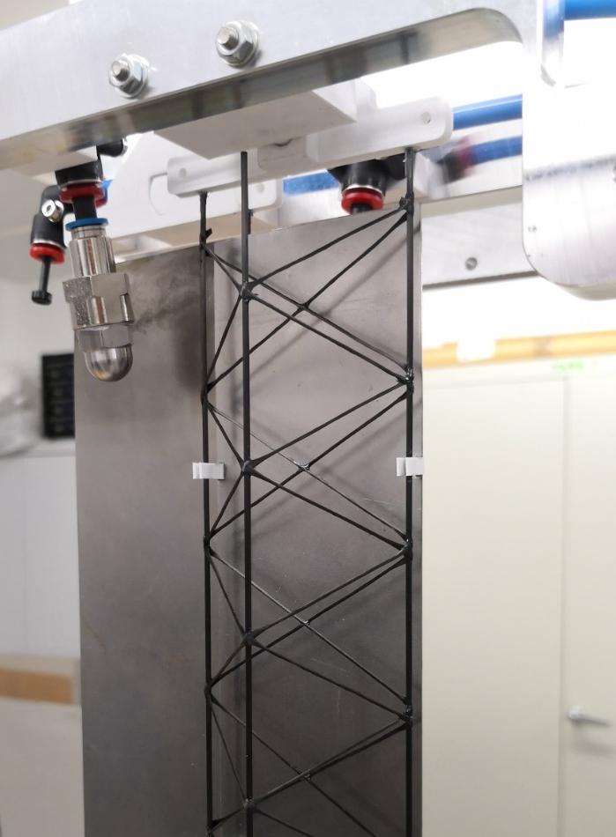
SILICON SENSOR COOLING
Visible sensor surface
C - Frames
Ladders with hidden FEB Boxes
Figure (left): Sensor cooling concept of STS (Top-view)
Cooling
Element
Cooling
Element
Cooling
Element
Cooling
Element
z
Cooling
Element
Cooling
Element
Cooling
Element
Cooling
Element
Cooling
Element
x
Visible sensor surface
Nozzles (as an working example) to blow cold air directly on exposed sensor surface
Space is available for mounting outside acceptance
Low velocity flow targeted (< 1 m/s)
Other possibility is to use perforated CF-tubes in parallel to the sensors (Belle 2 - PXD)
Nozzles
Exposed ‘sensor’ surface

Slide 33
SILICON SENSOR COOLING
Visible sensor surface
C - Frames
Ladders with hidden FEB Boxes
Figure (left): Sensor cooling concept of STS (Top-view)
Cooling
Element
Cooling
Element
Cooling
Element
Cooling
Element
z
Cooling
Element
Cooling
Element
Cooling
Element
Cooling
Element
Cooling
Element
x
Visible sensor surface
Nozzles
Nozzles (as an working example) to blow cold air directly on exposed sensor surface
Space is available for mounting outside acceptance
Low velocity flow targeted (< 1 m/s)
Other possibility is to use perforated CF-tubes in parallel to the sensors (Belle 2 - PXD)
Exposed ‘sensor’ surface
  Temp. and flow profile measurements along the ladder are underway
  Vibrations? T/RH sensors in radiation? Etc?

Slide 34
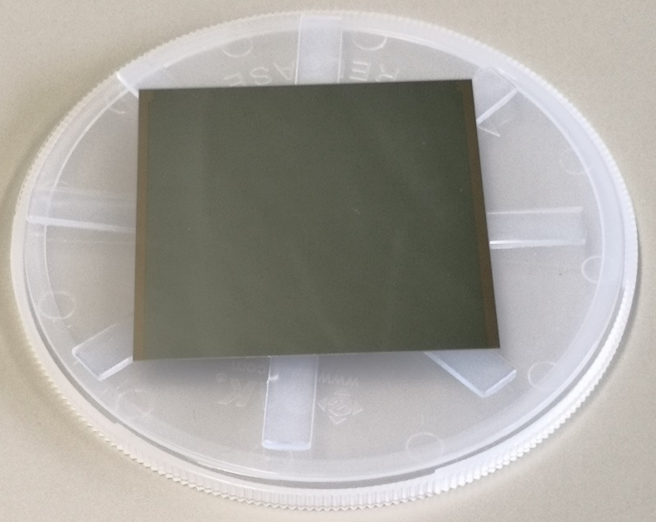
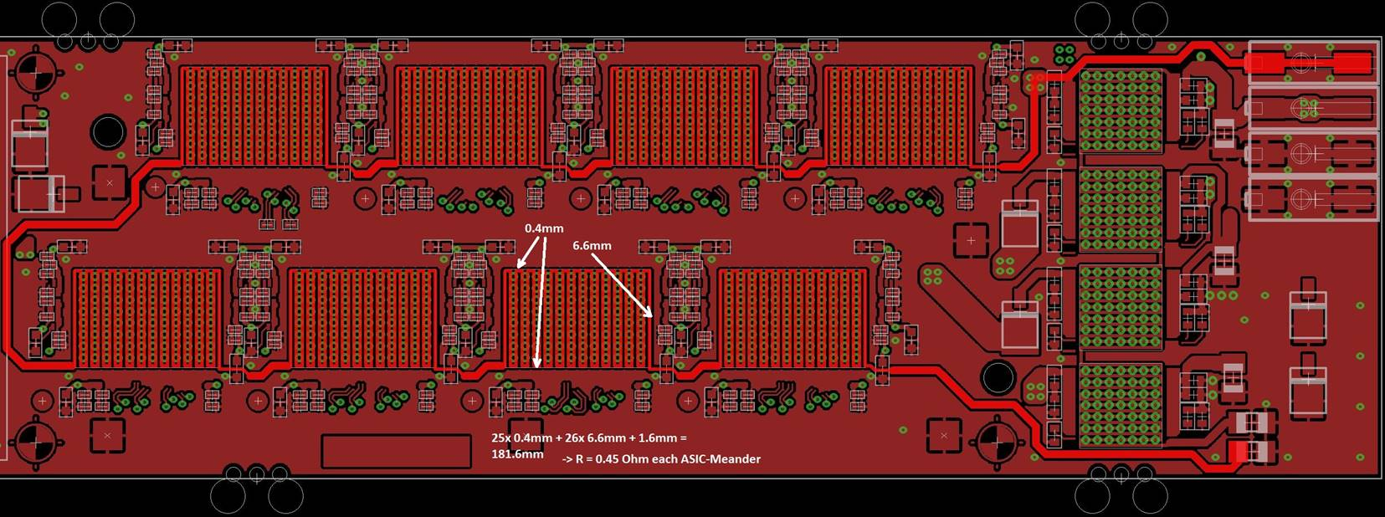
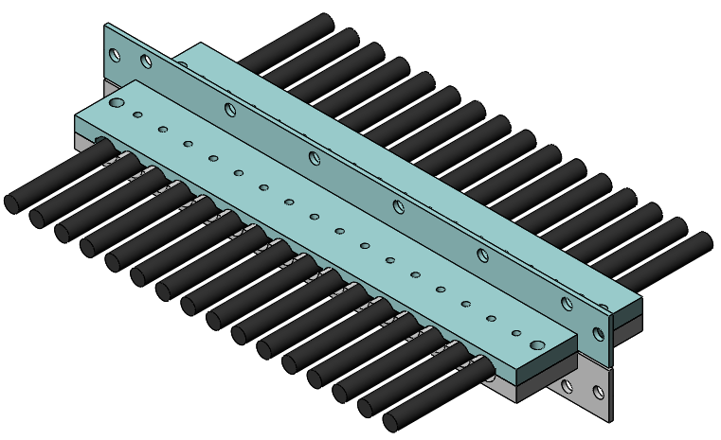
MISCELLANEOUS ACTIVITIES
  Dummy Silicon Sensor
  Inconel layer deposited on silicon wafer
  (Ref: E. Petit, FTDM 2017)
  Feedthroughs
  Service cables bundled and moulded in silicone
  Further insertion and sealing
  (Ref: P. Petagna, Eng. Forum 2008)
  Dummy Front-End Electronics Board
  Copper meander mimicing silicon chips

Slide 35
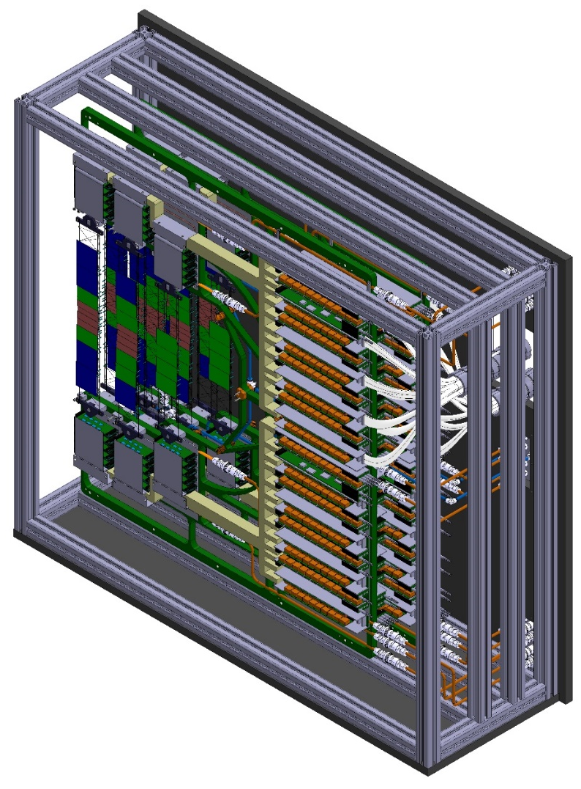

CONCLUSIONS & OUTLOOK
Silicon Sensor Cooling
  Power dissipation of 6 mW/cm² at -10°C
  Forced gas convection via nozzles or perforated CF tube
  To be tested with heat-producing dummy sensors ...
  Vibrations to be studied!
  T/Rh measurements – FOS sensors?
Front-End Electronics Cooling
  Power dissipation of 40 kW in < 3.5 m³
  Monophase NOVEC 649 cooling (biphase CO₂ is backup)
  Aluminium cooling plates based on copper press-fitted tube channels technology
  Compuational characterisation done to understand the setup better
  Manifold based distribution system (VELO type)
  Dummy electronics boards in design phase
  To be tested experimentally ...
Thermal enclosure
  20 mm CF-foam sandwich
  Feedthroughs still an open issue!
  Potential for cabling testing
Cooling Demonstrator to potentially answer most of the questions in a ‘realisitc’ setup with up to 3 half-stations

Slide 36
THANKS A LOT FOR YOUR ATTENTION ☺
QUESTIONS ? SUGGESTIONS ?

Slide 37
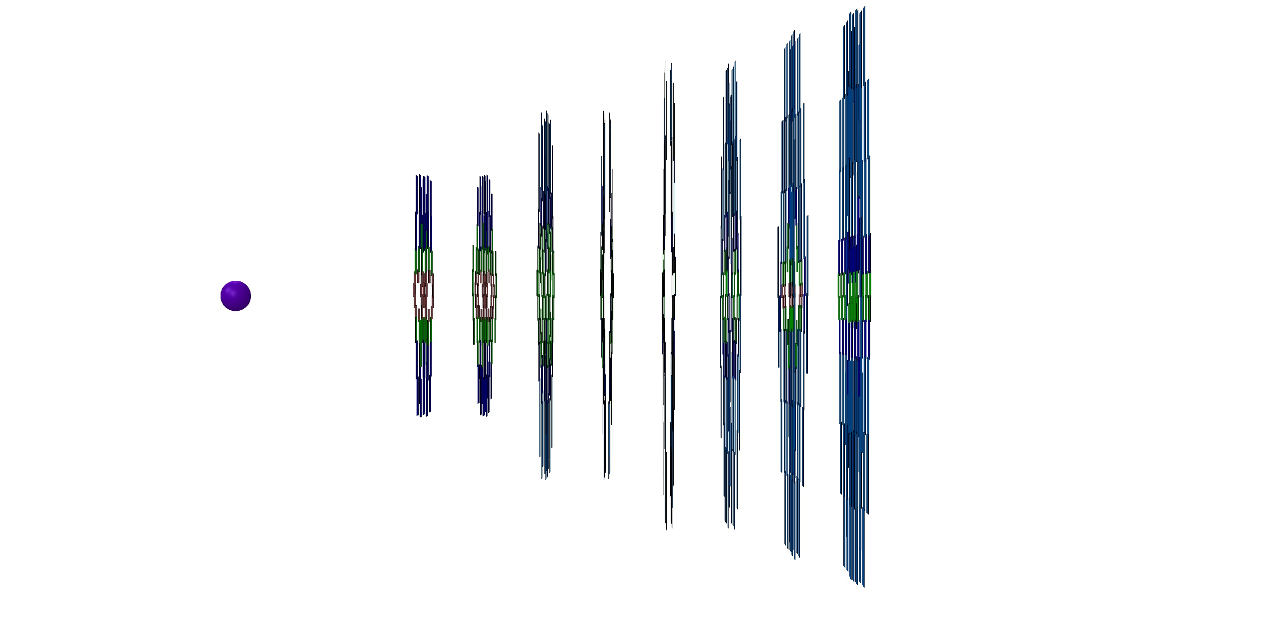
STS Features:
π⁻
π⁻
Ξ⁻
Λ
BEAM
TARGET
p

Slide 38
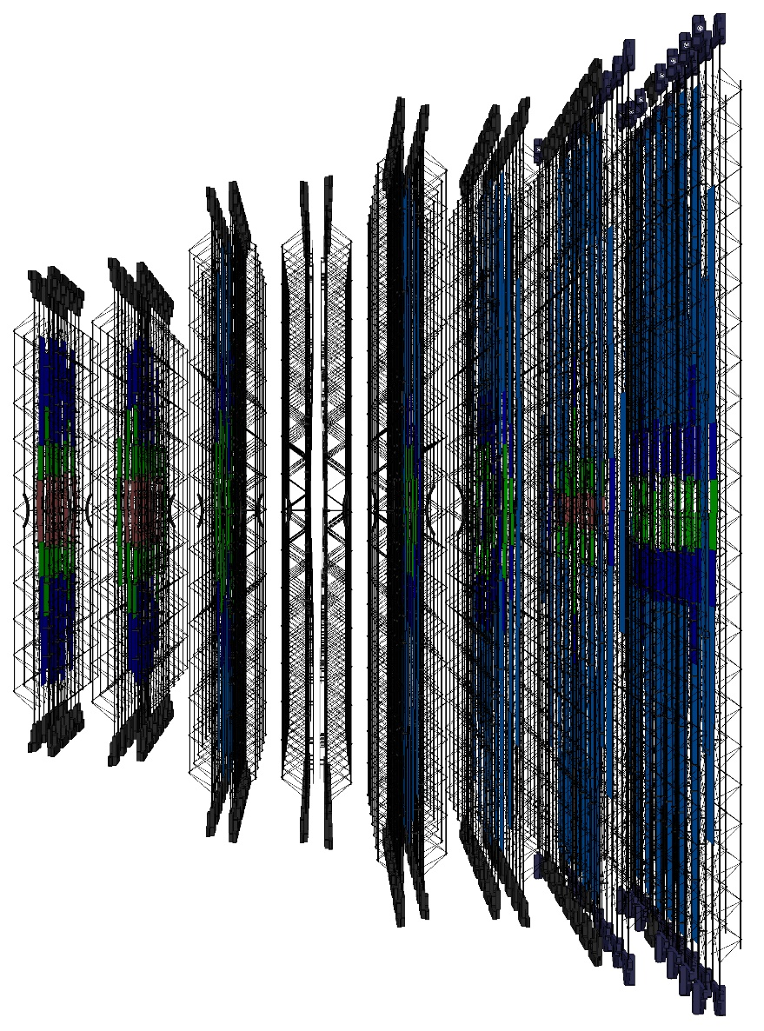
π⁻
π⁻
Ξ⁻
Λ
BEAM
TARGET
p

Slide 39
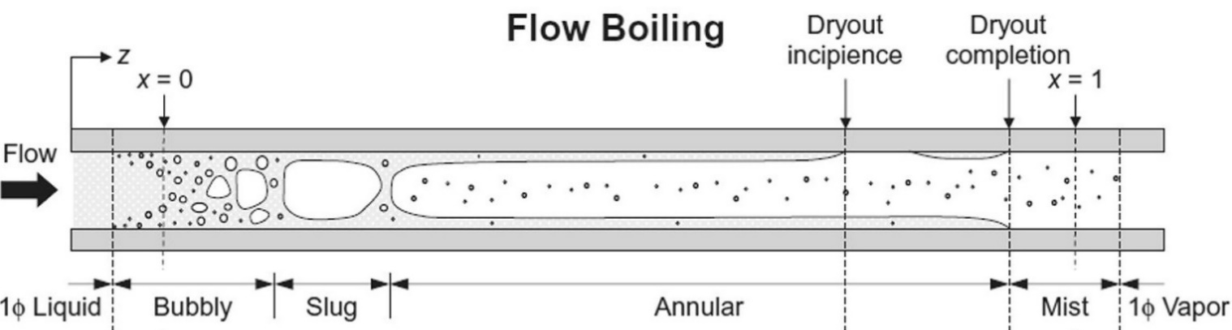

THERMAL SIMULATIONS OF FEE – BIPHASE CO₂
Semi-emperical boiling flow model
  Heat Transfer Coefficient
  Pressure Drop
  Dry-out onset
↓
  Cooling line dimensioning
  Mass flow estimation
1. Set boundary conditions
(power dissipated, tube dimensions, initial fluid conditions)
....................................................................
2. Break it down into small elements
3. Calculate thermodynamical properties for 1st element
P_{i+1} , HTC_{i}
H_{i+1}
T_{i+1} , x_{i+1} = f(T_{i+1} , x_{i+1})
................
4. Repeat till the end
Emperical Model ΔP, HTC

Slide 40

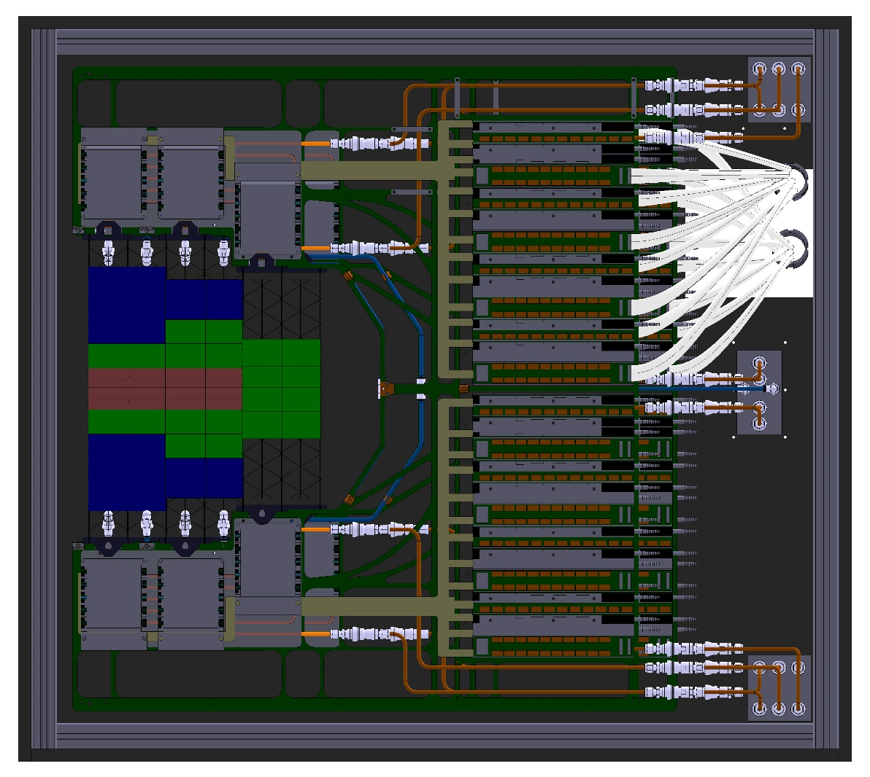
STS COOLING DEMONSTRATOR
Figure: CAD Front-view (Left) and Isometric-view (Right) of the upcoming STS Cooling Demonstrator (still in progress)

Slide 41
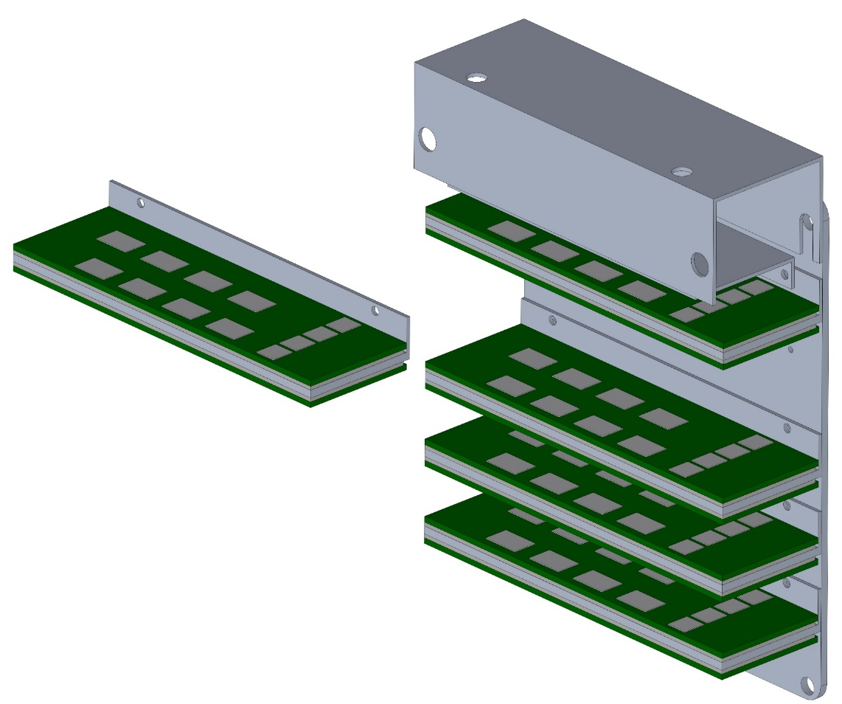
ELECTRONICS COOLING
1. Pair of Front-end Electronics Boards (FEBs)
[Readout for 1 silicon sensor]
3. Each FEB Box derives it cooling from a cooling plate
attached on the C-Frame
2. Series of FEBs assembled together: FEB Box
[Readout for 5 sensors = ½ ladder]

Slide 42
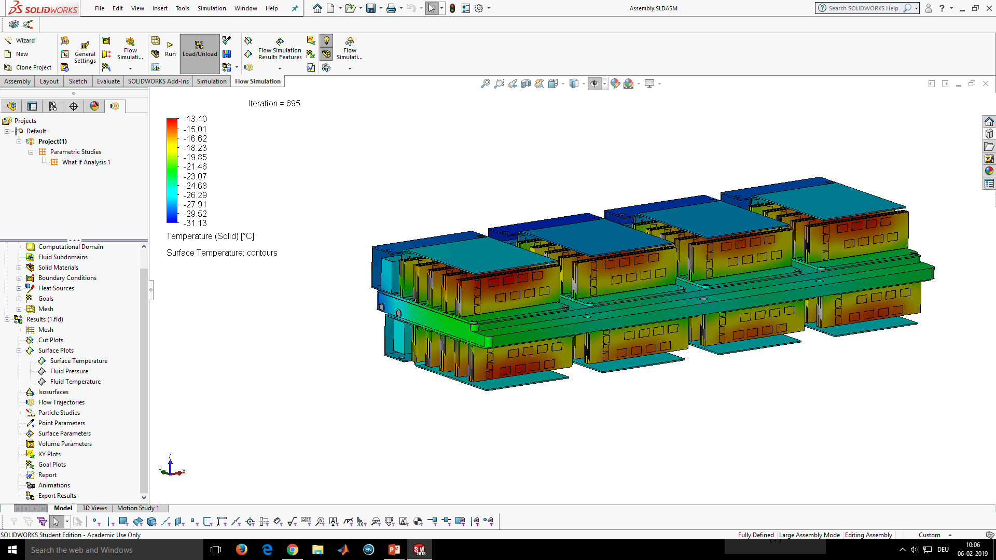
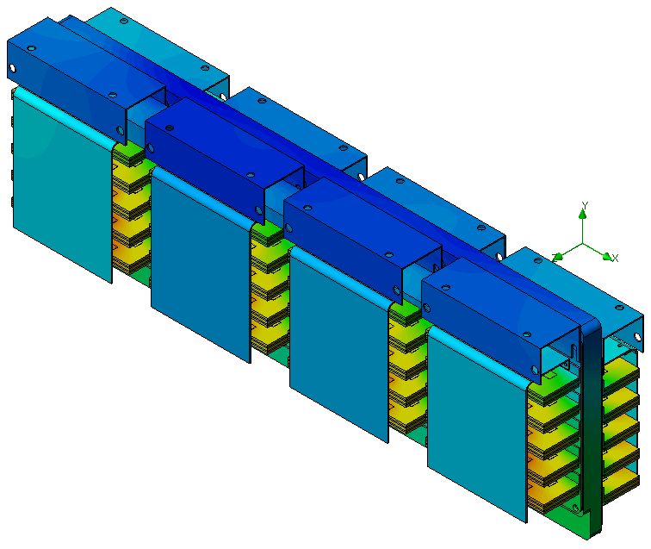
I. FEE COOLING – SOLIDWORKS CFD SIMULATION
Total Power Dissipated = 1080 W
NOVEC temp. = - 40°C
  Mass Flow = 150 g/s
  Pressure Drop = 1.25 bar
  Max. Temp. = -13.40°C
In principle, temp. control could be done by lowering the temp. or my increasing the mass flow
Input Temperature [°C] | -40 | -40 | -45 | -45
Mass Flow Rate [g/s] | 150 | 200 | 150 | 200
Maximum Temperature [°C] | -13.40 | -16.80 | -17.66 | -21.20
Pressure Drop [bar] | 1.25 | 2.09 | 1.27 | 2.13
Assumptions:
  No Thermal Interface Material
  No Radiation
  No Convection
  No Cable Heat
Practical Limit
(Specially for Mass Flow)

Slide 43
II. DISTRIBUTION SYSTEM – ENSURING BALANCED FLOW
LONG PATH
FLOW
RESTRICTORS
INLET
SHORT PATH
OUTLET
Fluid preferentially takes the easy path, i.e., the shorter path
  Flow (short path) > Flow (long path)
  Head loss (short path) = Head loss (long path)
Adding additional presure drop in the system could balance the flow in multiple branches
Idea currently used in LHCb VELO with calibrated gaskets/orifices and other commercial hydraulic plants

Slide 44
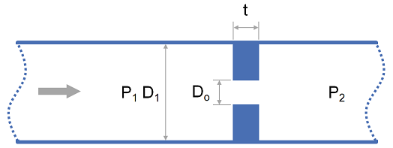
II. DISTRIBUTION SYSTEM – ENSURING BALANCED FLOW
Balanced flow could be achieved at an expense of high pressure drop via inlet orifice in the system
Approx. 10 bar pressure drop in the manifold could be set as a limit (but highly dependent on cooling plant capabilities) → Determines orifice diameter
Target is to achieve > 90% flow balance in all branches for the operational mass flow = 150 – 200 g/s (from CFD)
Pressure Drop [bar] across a sharp-edged orifice for Novec 649 (D₁ = 6 mm)
 | 150 g/s | 200 g/s
2.0 mm | 15.52 | 27.53
2.5 mm | 5.72 | 10.14
3.0 mm | 2.4 | 4.26
Ref: www.pressure-drop.mobi/0902.html

Slide 45
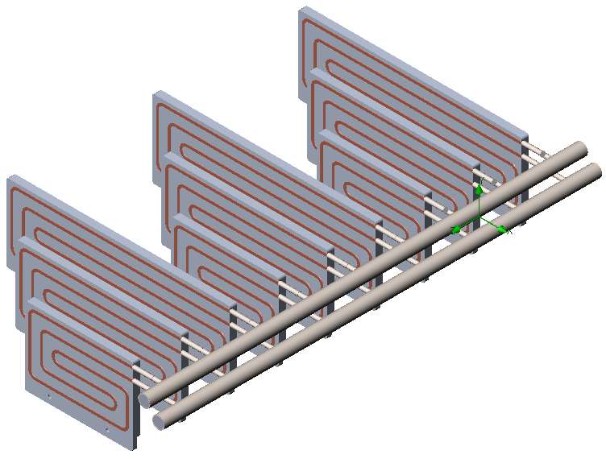
II. DISTRIBUTION SYSTEM – ENSURING BALANCED FLOW
SolidWorks CFD results with different flow rates and orifice diameters
 | 150 g/s |  | 200 g/s
 | Flow Balance | Pressure Drop | Flow Balance | Pressure Drop
2.0 mm | 92.76 % | 19.02 bar | 93.57 % | 33.76
2.5 mm | 90.12 % | 6.73 bar | 90.23 % | 11.87
3.0 mm | 88.85 % | 3.62 bar | 89.15 % | 6.33
Note: Flow Balance is defined as the ratio of min. and max. flow in the all lines
Orifice diameter of 2.5 mm or 3 mm could be good trade-off between flow balance and pressure drop

Slide 46
GLOBAL VIEW OF STS FEE COOLING PLANT
Performance ✔
Implementation ✘
Coolant
Performance ✘
Implementation ✔
Bi-phase CO₂
Mono-phase NOVEC 649
Pumped Liquid System (e.g. TRACI-XL)
Vapor Compression System (e.g. Fridge)
Oil-free compressors
Oil compressors
Testing rad. hardness of oils (POE)
Using rad. hard oil (Krytox)

Slide 47
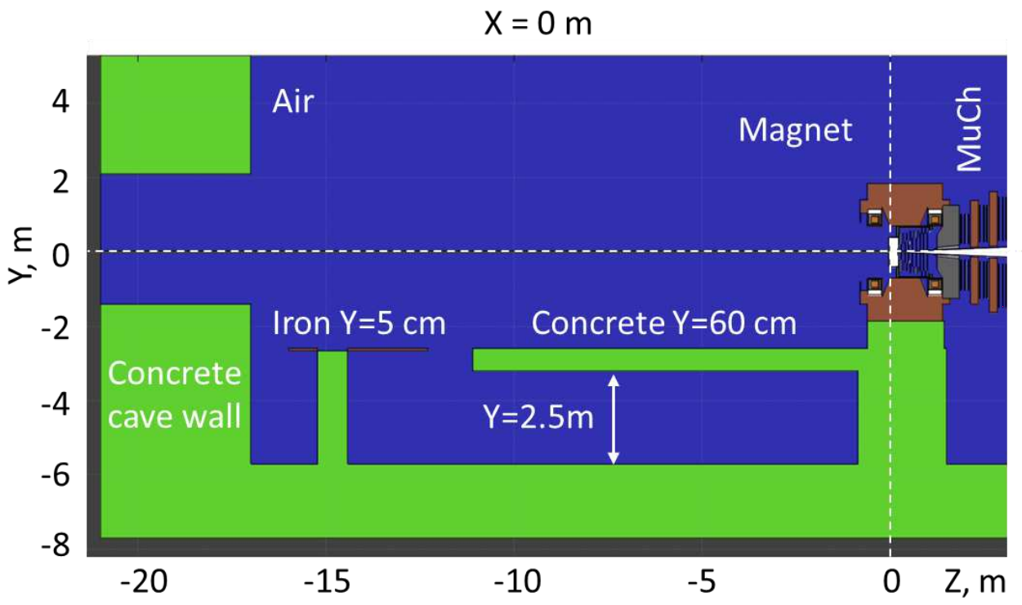
TOPICS COVERED IN THIS TALK
Cooling Plant
FEE
Distribution System

Slide 48
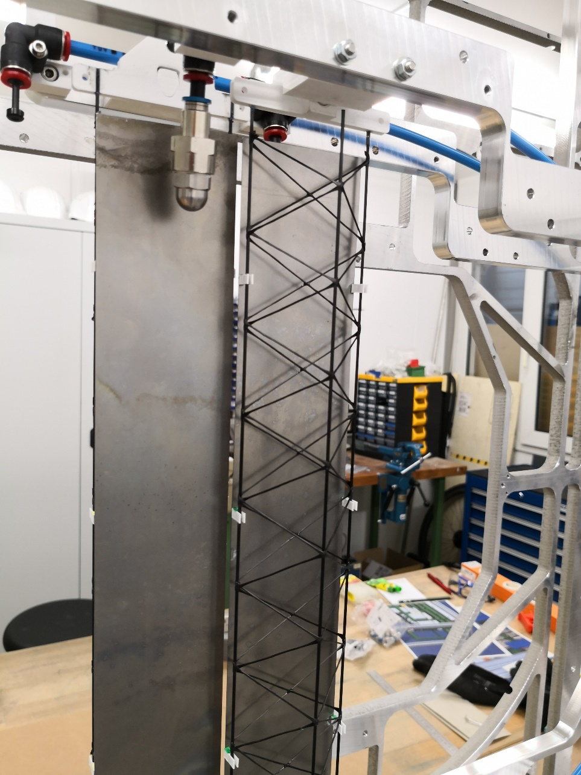
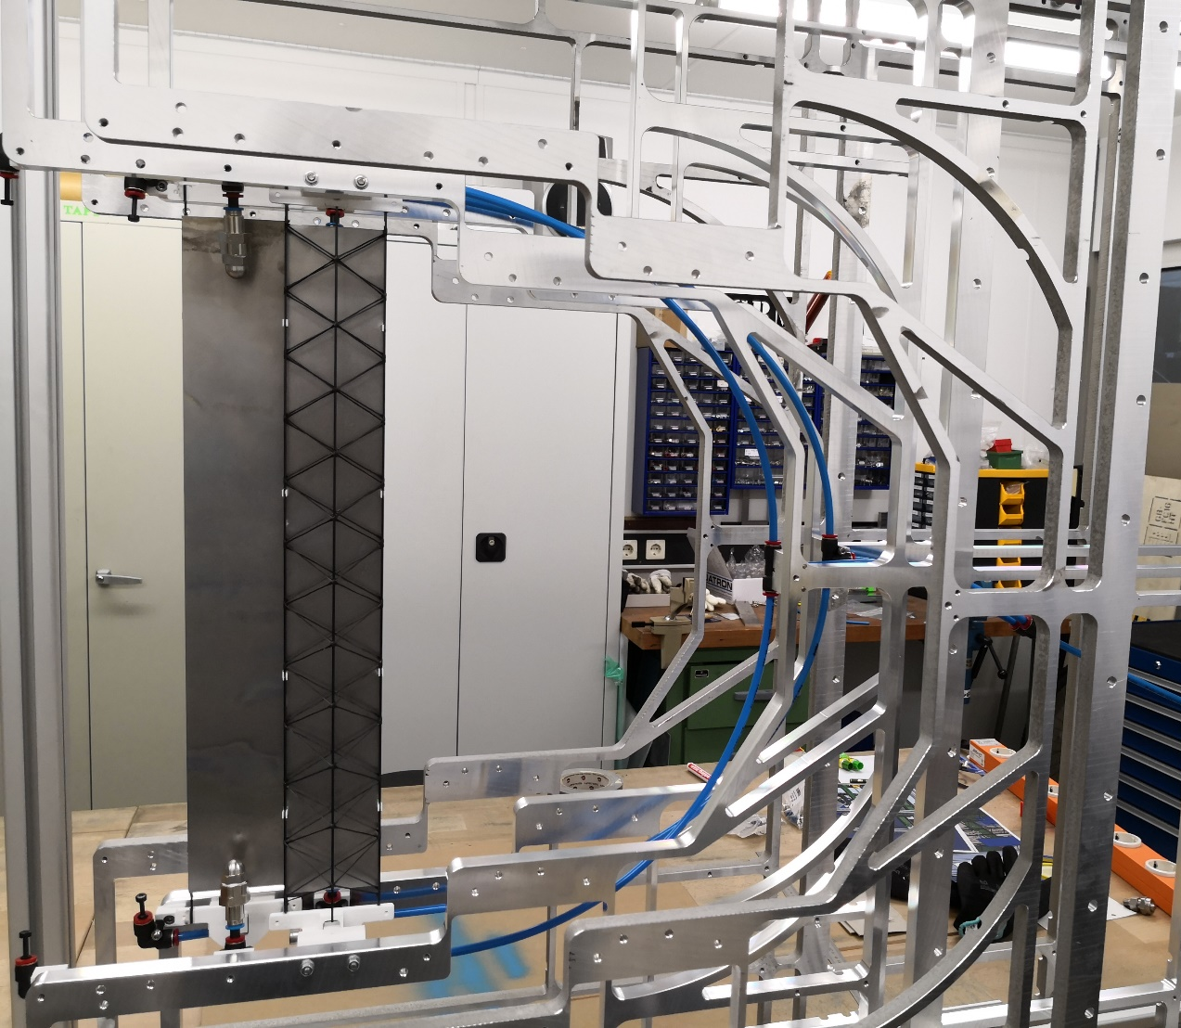

Slide 49
