Slide 1
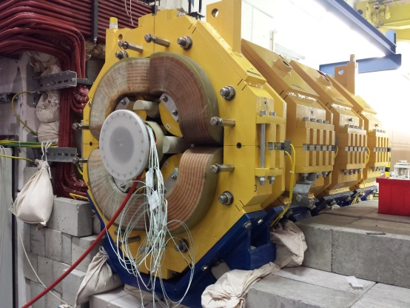
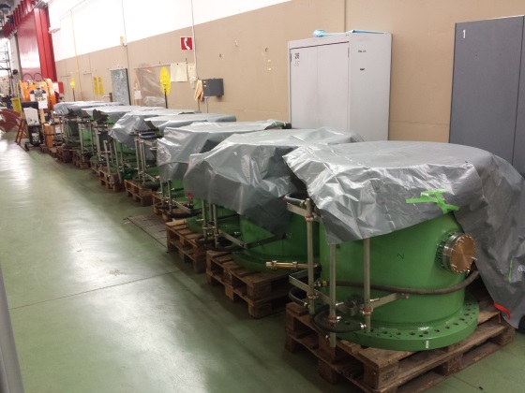
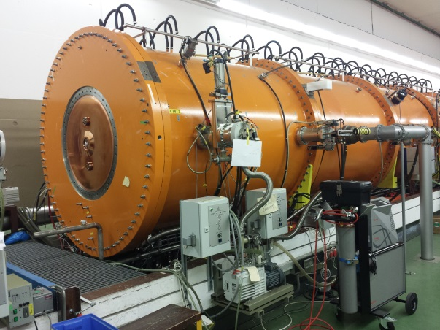
Machine meeting 9.7.19 - UNILAC
LEBT QQ beam pipe:
assembly of A-pipe: welding finished, leak tested, okay; mounting of cooling jacket pending
today on-site: test with backup pipe (inserted)
next: test with unloaded magnet
HSI RFQ:
3 sections almost re-assembled
...for setup for LLRF measurements
HSI IH 1:
Electrical short repaired
End plate mounted, leak tested: okay. Not yet evacuated (Superlens cannot be installed before RFQ is back in beam line)

Slide 2
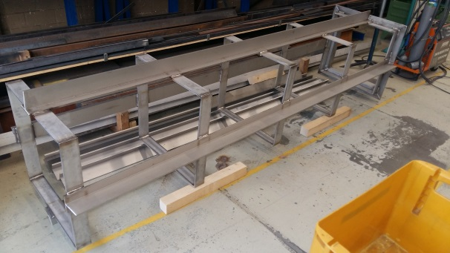
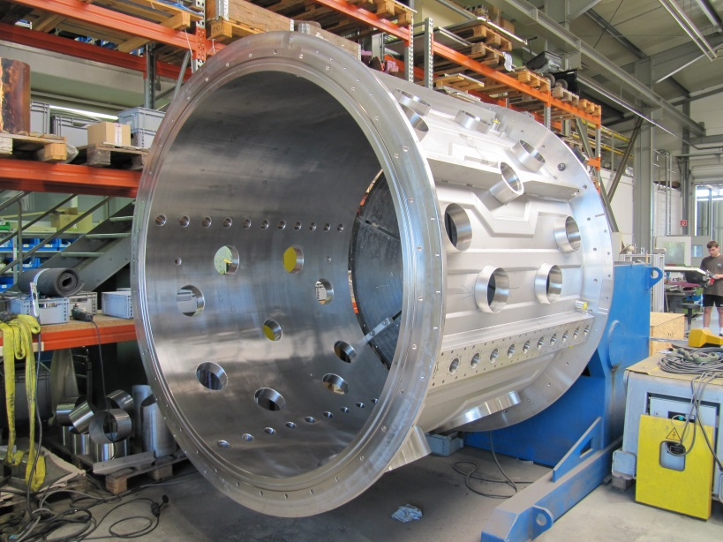
Machine meeting 2.7.19 - UNILAC
Vacuum controls upgrade:
LSB2: on schedule
Equipping and connecting of new racks in progress
connecting of contactor controllers continued
LSB4: on schedule
New racks in place
Mounting of contactor controllers continued
FoS:
ready for UHV FAT -> next Monday together with VAC
Cu cathode supports production proceeds well
drift tube with quadrupole ordered

