Slide 1
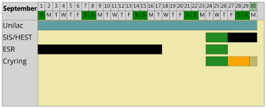
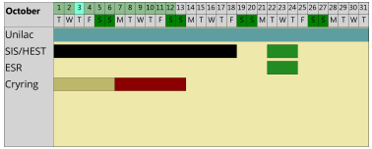
machine status
CRYRING@ESR & HITRAP
CRYRING@ESR
- electron cooler – a new filling attempt ongoing this week
larger flow with a phase separator, magnet superconducting, but no level reached
if still no success schedule new meeting & new approaches
agreed to implement a local baking solution in YR09 (DEC team) if the detectors for the Spetember beamtime are delivered in July
looking for a long term solution for vacuum controls
preparation of ECR source for C⁺ run ongoing
FESA and hardware under preparation
coordination meeting for storage ring mode and parallel operation
report 2018 submitted
HITRAP
no activities
C⁺

