Slide 1
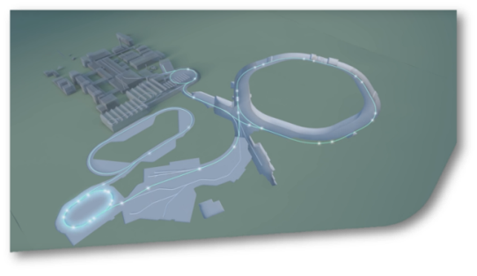
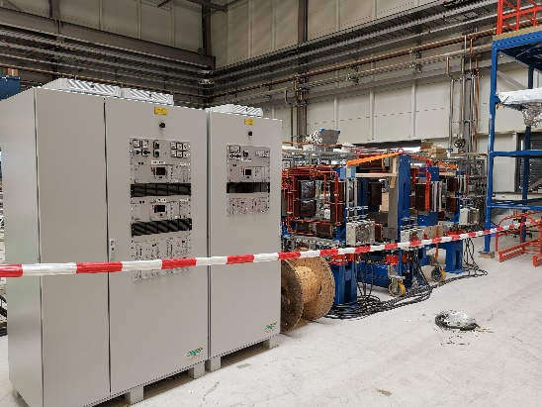
SIS18 Status Report KW26
SIS18
Shipment of all parts for SIS18/SIS100 IPM system completed (PC, chamber, magnets etc.). Presently SAT for IPM power converter running with IPM magnet system in testing hall.
Manufacturing of new transfer channel (TK) chopper system
completed by AURION and accepted by GSI. Installation is running.
Commissioning-test of new SIS18 fire prevention system
successfully executed. No damage of machine components.
No commercially acceptable offer received for new E-septum design.
First software for GUI and data processing of digitized SIS18 BI signals in development (digital Schottky mesaurement)
Planning of „machine experiments“ (November) started.

