Slide 1
Machine meeting 25.06.19 - UNILAC
LEBT QQ beam pipe:
assembly of A-pipe: welding and annealing (partly) finished, mounting of cooling jacket pending
next step on-site: test with backup pipe & unloaded magnet
HSI RFQ:
All sections new electrodes implemented, cleanded & checked
Waiting for setup for LLRF measurements
HSI IH 1:
Electrical short fixed, drift tube and all other components inside tank in place
Ready for mounting of end plate

Slide 2
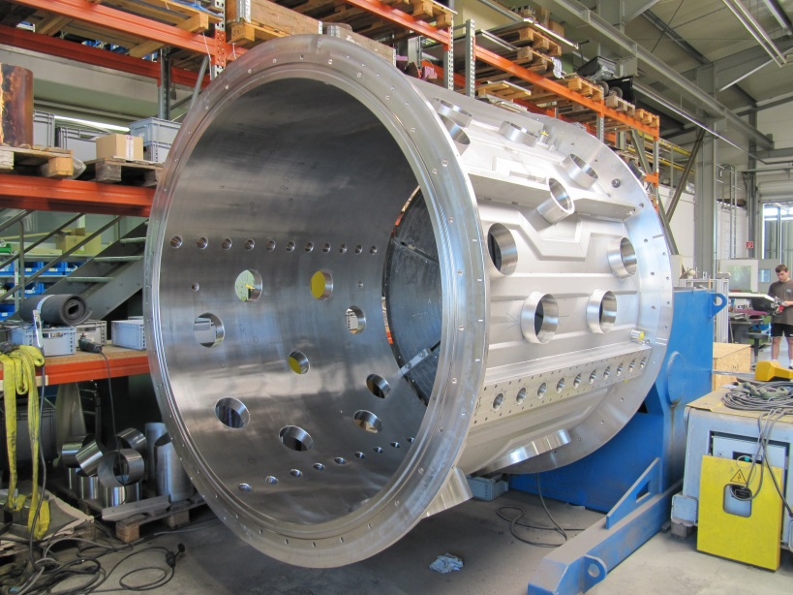
Machine meeting 25.06.19 - UNILAC
Vacuum controls upgrade:
LSB2: on schedule
Equipping and connecting of new racks in progress
connecting of contactor controllers continued
LSB4: on schedule
New racks in place
Mounting of contactor controllers continued
FoS:
FoS FAT at VA-TEC last week (mantle and endplates):
dimensions ok
surfaces better than expected, however small defects spotted which will be fixed easily
FAT w.r.t. UHV within next days
some flange-welding proc. to be re-defined
Cu cathode supports production proceeds well
drift tubes with stems ready for transport to bunker
drift tube with quadrupole to be ordered soon

