Slide 1
CERN-FAIR
Steering Committee
José Miguel Jimenez

Slide 2
Outline
Status report on the S-FRS Magnet test bench
Review of existing (formal) collaborations
CERN-GSI Workshop, Geneva – July 2019

Slide 3
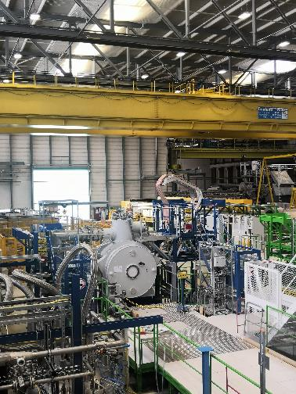
Status report on the S-FRS Magnet test bench
Test plan status
Test organisation
Resources
S. Russenschuck and L. van den Boogaard
Many thanks to A. Chiuchiolo (GSI).

Slide 4
Status report on the S-FRS Magnet test bench
Schedule
New facility
New magnet
New instrumentation
New team….
Courtesy of A. Chiuchiolo

Slide 5
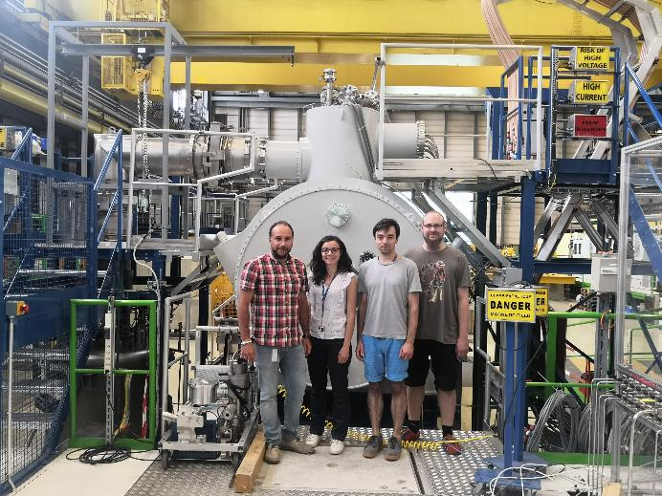
Status report on the S-FRS Magnet test bench
GSI team @ CERN

Slide 6
Status report on the S-FRS Magnet test bench
Status
Deployment of the GSI personnel (4 FTEs) was completed by beginning of February 2019.
First Short multiplet arrived in Feb 2019.
Numerous non-conformities, and adaptations to do related to both multiplet and test station.
Installation of GSI Instrument Panel and Electrical Cabinet
  Software needs to work correctly before cool down can start
  Expert from GSI coming this week.

Slide 7
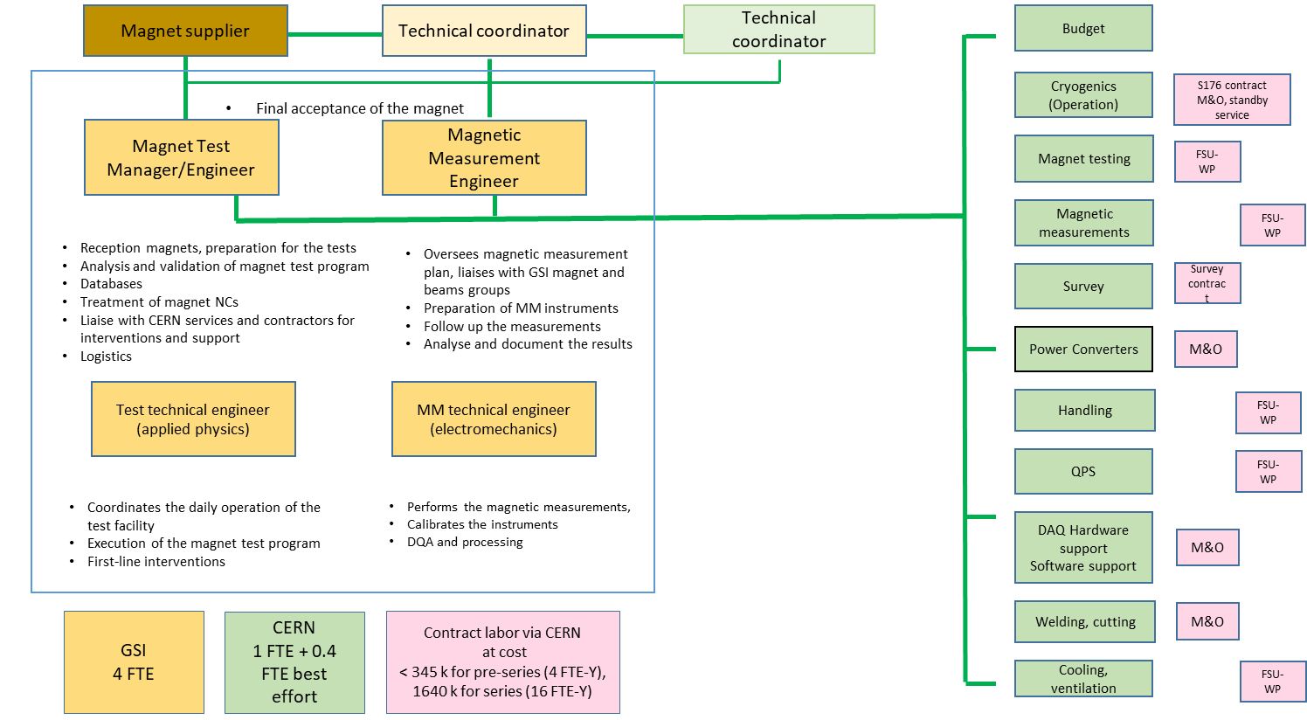
Status report on the S-FRS Magnet test bench
Organisation – status July’19

Slide 8
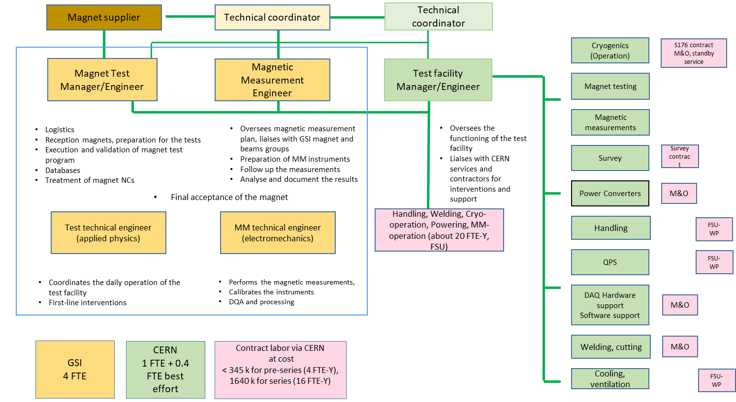
Status report on the S-FRS Magnet test bench
Organisation – status May’19 (series)

Slide 9
Status report on the S-FRS Magnet test bench
Budget overview for installation phase - July’19
Contribution GSI
8 MCHF on materials
  5.6 MCHF on cryogenics infrastructure
  1.1 MCFH Magnetic measurements
  0.8 MCHF platforms, interlocks, QPS
  0.4 MCHF power converters
  0.1 MCHF survey
Contribution CERN
3.2 MCHF on materials
4.9 MCHF on personnel (32 FTE.y)

Slide 10
Status report on the S-FRS Magnet test bench
Points that need attention
Instrument panel and electrical cabinet (GSI)
  People that made the decisions and design left...
  Nobody came so far to help with critical software problems. This week for the review people will come.
  Without an operational software, the magnet cannot be cooled down.
CERN committed to do things in a cost efficient way
  No people hired, no additional FSU.
  But at some point CERN may have to do so in anticipation of the series testing.
  Visibility on schedule delivery become crucial.
Magnet transport from CERN
  Who will do the wrapping – transport responsibility of ASG...?
  Work permits for contractors that are not CERN’s ones…?

Slide 11
Review of existing (formal) collaborations (1)
Beam Physics
  Simulations of intense beam and machine optimization (synchrotrons). On-going.
  Space charge and collective effects studies (linacs/synchrotrons) – workshops. On-going.
  FCC-hh beam stability, collective effects – In the framework of EuroCirCol. Financing?
  Advanced Landau Damping – joint PhD student. Agreed.
Beam Instrumentation
  Production of 180 ionisation chambers for FAIR BLM. Completed.
  Development of a cryogenic current comparator for high precision beam current measurements. Completed.
  Delivery of a Luminescence Profile Monitor prototype with a Gas Jet Target as part of Work-package 13 of HL-LHC Project. Completed.
  ARIES collaborations (WP8 Advanced accelerator diagnostics and WP16 Intense RF modulated e-beams). On-going.

Slide 12
Review of existing (formal) collaborations (2)
Control’s systems. On-going without new frame contract.
  LHC software Architecture.
  FESA (Front-end Software Architecture).
  Timing system.
  CMW (controls middlewhare)/RBAC Role based access control.
  SILECS (Software infrastructure for low level equipment controllers).
  FESA classes for PicoScope digitisers.
Industrial Controls. On-going without frame contract.
  GSI is using the CERN Industrial Control Frameworks, thus JCOP and UNICOS, for their cryogenics and vacuum controls.
  Develop a PLC based interlock system for the Super-FRS magnet test bench.

Slide 13
Review of existing (formal) collaborations (3)
Absorbers, collimators and beam dumps
  Proposal made for absorbers and beam dumps. Contacts, proposal but no follow-up.
Mechanical engineering of collimators
  ARIES, collaborating with GSI for WP17 (Materials for Collimators and Thermal management applications). CERN carried out irradiation experiment at UNILAC M-branch. On-going.
Injection and extraction systems
  Design of the pulsed generator for the AD magnetic horn similar installation will be built for FAIR. On-going.
  Work on CosTheta superconducting septum: Overall the effort was limited to exchange of information and visit by CERN DOCT (now graduated) to GSI for some weeks. Financing?
  ARIES, Slow Extraction spill improvement. Agreed.

Slide 14
Review of existing (formal) collaborations (4)
RF feedback systems
  Broadband transverse feedback systems (synchrotrons). Contacts but no follow-up.
Machine protection. On-going without frame contract.
  Simulation of Transient Effects in the SIS100 Superconducting Magnet and Busbar Systems.
  Developing a prototype system for the GSI-FAIR Personal Safety System.
  Quench detection systems (uQDS) for FAIR.
Vacuum systems. Contacts but no follow-up.
  Insulation vacuum system and its control.
  Adapting CERN standards of controls for GSI and future FAIR.

Slide 15
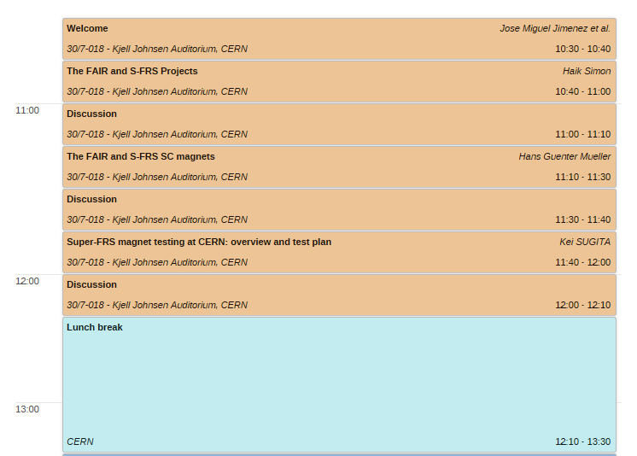
CERN-GSI superFRS kick-off meeting
Wednesday 3rd July – Morning session
https://indico.cern.ch/event/828084/timetable/#20190703.detailed

Slide 16
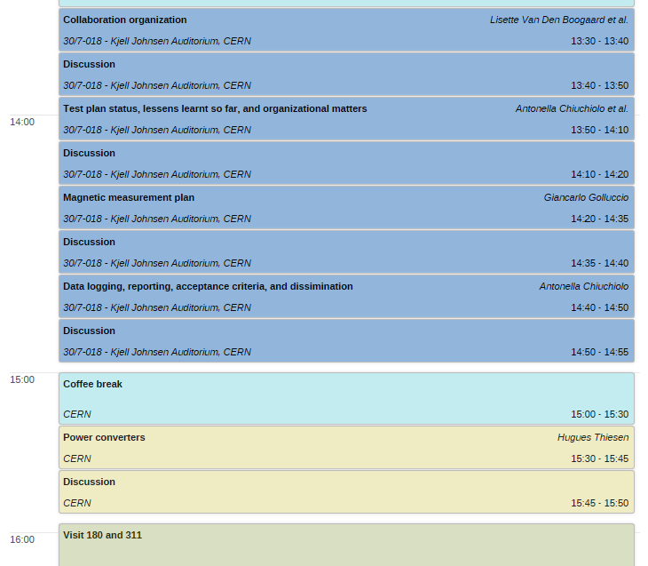
CERN-GSI superFRS kick-off meeting
Wednesday 3rd July – Afternoon session
https://indico.cern.ch/event/828084/timetable/#20190703.detailed

Slide 17
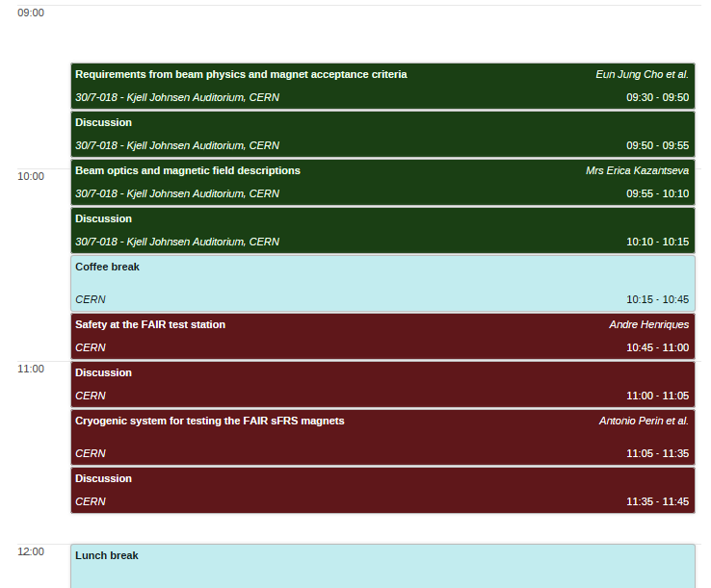
CERN-GSI superFRS kick-off meeting
Thursday 4th July - Morning session
https://indico.cern.ch/event/828084/timetable/#20190703.detailed

Slide 18
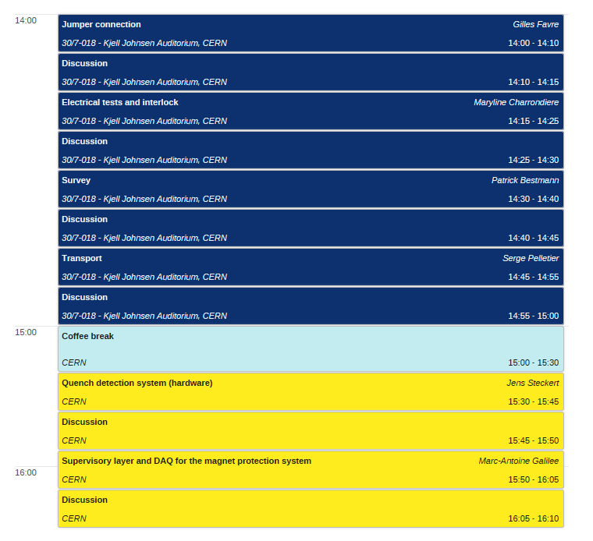
CERN-GSI superFRS kick-off meeting
Thursday 4th July - Afternoon session
https://indico.cern.ch/event/828084/timetable/#20190703.detailed

Slide 20
Status report on the S-FRS Magnet test bench
Test organization – @ Preparation Area
FoS Activities
CERN resources
GSI resources
Issues
Transport
Unpacking
Commissioning racks and electrical tests
Temporary support
Feet mounting
EN-HE-HH
FSU
TE-MSC-TF
EN-HE-HH
EN-HE-HH +
FSU
EN-HE-HH
GSI team
GSI team
ggg
GSI team
Debugging system
Cherry picker
Safety trainings
Non conformity

Slide 21
Status report on the S-FRS Magnet test bench
Test organization – on Test bench/ Warm
FoS activities
CERN resources
GSI resources
Issues
Transport
Feet Alignment
Installation safety valve
Jumper alignment
Welding jumper
Insulation vacuum pumping
Cold mass survey
Removal transport rods
Leak test (Jumper, IV, LHe vessel + IP)
Purging
Electrical tests
EN-HE-HH
FSU
TE-CRG-ME + FSU
EN-MME-FW
EN-MME-FW
Contractor TE VSC TE-
sveyMSM)
FSU
Contractor TE-VSC sda
TE-CRG-ML
TE-MSC-TF
EN-HE-HH
GSI team
TE-CRG-ME + FSU
GSI Cryo
EN-MME-FW
GSI team
GSI surveyMSC-
GSI team
Contractor TE-VSC sda
GSI team
GSI team
Non conformity
Non conformity
From remote
Non conformity
Missing info?
Not optimized

Slide 22
Status report on the S-FRS Magnet test bench
Test organization – on Test bench/ Warm
Bench activities
CERN resources
GSI resources
Issues
Removal platforms
Spacers/marks position
Install brackets
Piping for current leads
Cabling IP and EC
HSE inspection
QDS cables integrity
Commissioning facility
Commissioning EC and IP
EN-HE-HH + FSU
EN-SMM-ASG dsakdjsajd
EN-ACE-COS
External Contractor
NN
HSE-OHS-IB
TE-MSC-MM
TE-MPE-EP
TE-MPE- MS/MSC-TF/EPC-MPC
xxxx
EN-HE-HH + FSU
EN-SMM-ASG dsakdjsajd
EN-ACE-COS
External Contractor
GSI Team
HSE-OHS-IB
TE-MSC-MM
TE-MPE-EP
TE-MPE- MS/MSC-TF/EPC-MPC
GSI team + GSI control
Not stable

Slide 23
Status report on the S-FRS Magnet test bench
Test organization – on Test bench/ Cold
Activities
CERN resources
GSI resources
Issues
Cooldown
Commissioning at cold
Installation MM devices
MM measurements
Gabriella+ cryo Operation+ cryo Control
Maryline….PC,QDS,EE, Hubert
GSI control + GSI cryo+ GSI team
GSI team
?

