Slide 1

CERN-GSI Collaborations on Beam Instrumentation
M. Schwickert,
GSI Beam Instrumentation Department

Slide 2
Outline
Since many years fruitful collaborations on many Beam Instrumentation (BI)
topics exists at both BI departments at CERN and GSI.
Collaboration Activities in the past
  Support to CERN by Project Associates from GSI (FESA software development)
  Purchase and beam tests of LHC-type Beam-Loss Monitors
Ongoing Collaboration Topics
  Collaborative support for Cryogenic Current Comparators for AD and ELENA
  Electron Lense: GSI support to CERN e-lense studies
  Ionization Profile Monitor: mutual technical exchange based on ARIES programme
Proposal for Future Collaborations
  Common developments on FESA integration of beam diagnostic devices (HW + SW)
  FESA integration of Bunch Structure Monitor (Feshenko-type)
  SEM-Grid: Detector and Readout

Slide 3
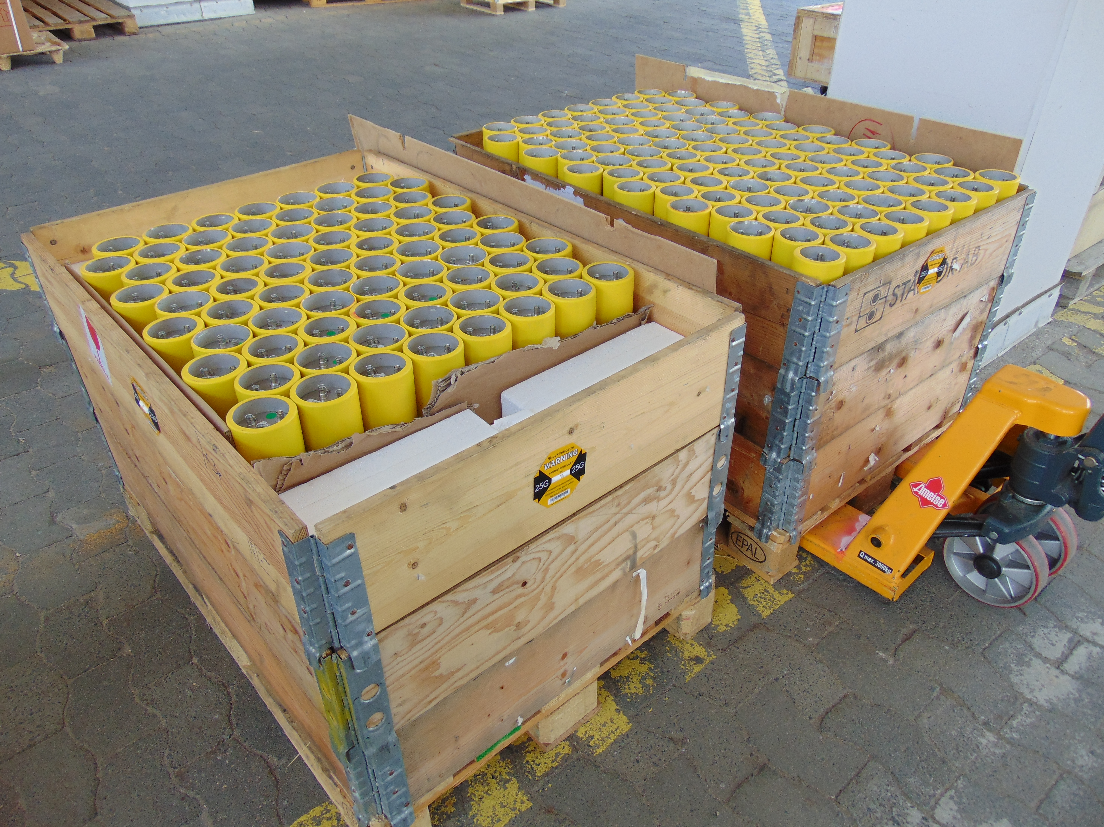
Past: Project Associate /
Beam-Loss Monitor Purchase
Project Associate of GSI BI-Team:
Tobias Hoffmann (DAQ-Expert)
01.10.2006 – 31.03.2007
Topic „Design, implementation, deployment and testing equipment software“
Full-time work at CERN for former AB-CO Department
Important starting point for the FESA development teams inside GSI‘s Controls and Beam Instrumentation departments
Purchase of LHC-type Beam-Loss Monitors (CERN/Protvino)
Common manufacture, initiated by Bernd Dehning (CERN-BI) in 2011, S. Grishin
Delivered and tested: 5 pcs. (2007), 40 pcs. (2013), 180 pcs. (2017)
additional request for 8 pcs. LIC for pBar-Target

Slide 4
Ongoing: Cryogenic Current Comparator (CCC)
→ Non-intercepting beam current measurement with pA resolution
CCC detector developed by U Jena / HIM / GSI, now installed in CERN-AD
Amendment to existing CERN-GSI collaboration agreement
CERN:
J. Tan, L. Soby, M. Wendt,
M. Fernandes, R. Johnes
GSI:
T. Sieber, D. Haider, F. Kurian, H. Reeg,
P. Kowina, M. Schwickert
+ U Jena + Helmholtz Insititute Jena
+ TU Darmstadt
Successfully accomplished:
GSI+Partners: CCC prototype, improvement of CCC detector, e-m simulation of magnetic shield, flux concentrator, SQUID system and readout electronics
CERN: development, installation and commissioning of CCC for AD
Future topics: (collaboration workshop at CERN last week!)
  CERN: development of CCC for ELENA
  GSI: manufacture and installation of CCC for Cryring
  Manufacture and installation of 5 CCCs for FAIR (German In-Kind)
CERN-built CCC cryostat for AD; CCC
now standard tool for AD
operation

Slide 5
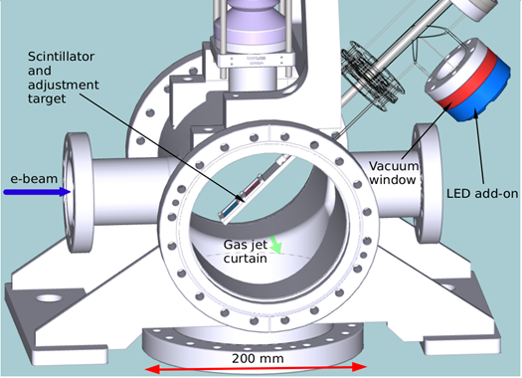
Ongoing: E-Lense for HL-LHC
In the past:
Addendum No. 10: „Delivery of a lumines-cence profile monitor for observing the interaction of a proton and electron beam with a gas jet target for the High Luminosity Large Hadron Collider“
1 Postdoc @ GSI financed by CERN
CERN: R. Veness, R. Johnes
GSI: P. Forck, S. Udrea, D. Vilsmeier
→ Status: accomplished.
Ongoing:
  Significant support and consulting for the development
  of the HL-LHC e-lense luminescence monitor
  Support for e-lense experiments at Cockcroft (UK), GSI: P. Forck, (S. Udrea)
Hollow electron lens (e-lens) presently under development as part of collimation upgrade for LHC high-lumi upgrade of LHC.
For effective operation very precise alignment between ion beam and electron beam required
Beam diagnostics set-up based on intersecting gas sheet and observation of beam induced fluorescence under development within a collaboration between CERN, Cockcroft Institute and GSI.
E-Lense Test Setup
Next step: define goals and milestones for a new collaboration agreement

Slide 6
Desired: Common FESA-Developments for BI
Cern and GSI are the only research facilities using FESA software environment → close collaboration is natural, exists since many years, also with CERN controls team
Synergies exist for the development of FESA-based data acquisition for operations
Important: to maximize synergies possibilities to use identical data acquisition hardware at both, CERN and GSI, should be studied for specific instruments
Possible common developments:
  Resonant Transformer for FAIR-HEBT, 14-bit ADC in FMC form factor, open hardware µTCA carrier (AFC), eg. BE-CO-HAT section could contribute with firmware and driver
  Fast Current Transformer: development of advanced GUIs, possibly including only tomography
  SEM-Grid readout: FESA software and readout electronics (see next slide)
Next steps: find and define common FESA projects, organize kick-off meeting, enhance existing technical exchange

Slide 7
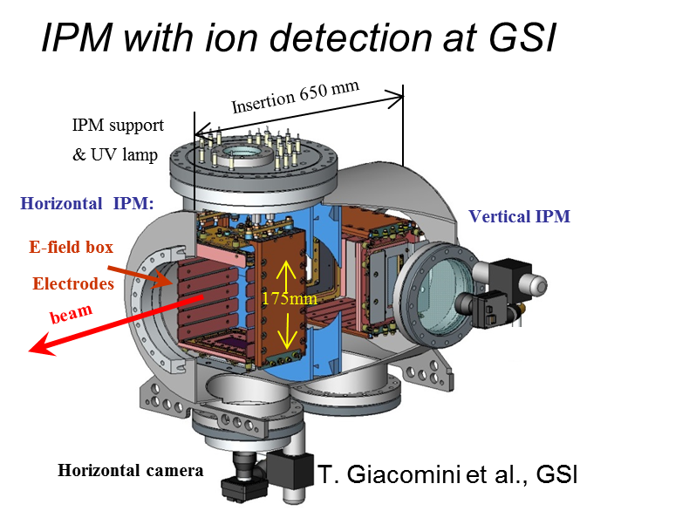
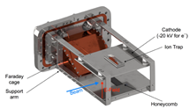
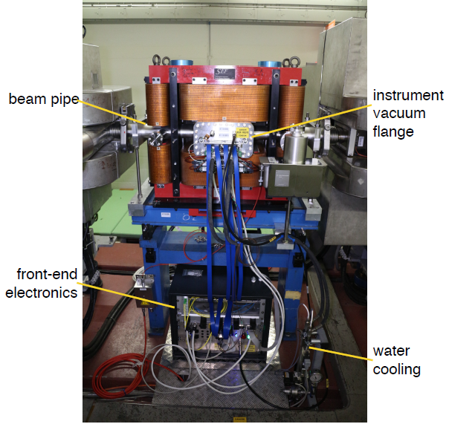
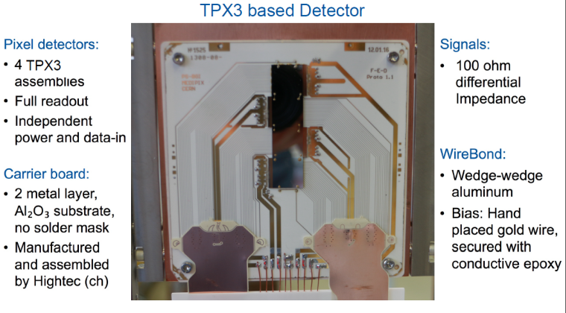
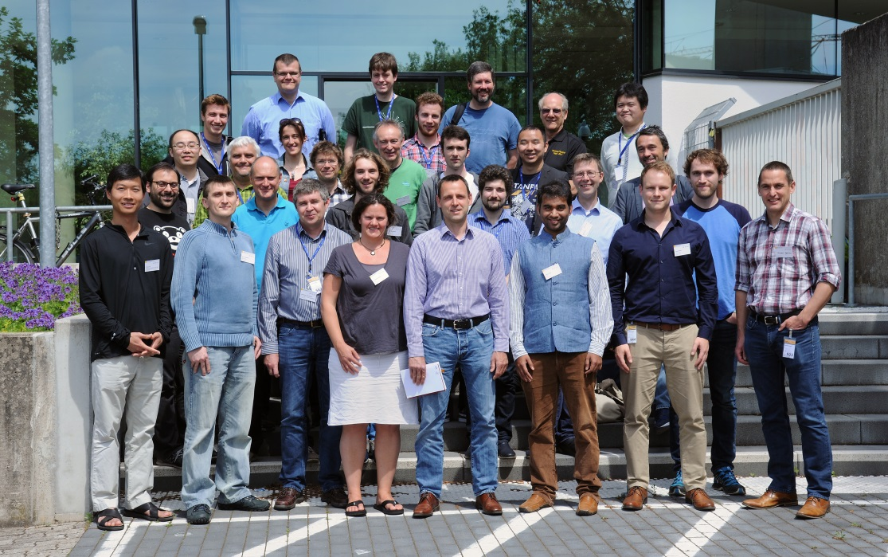
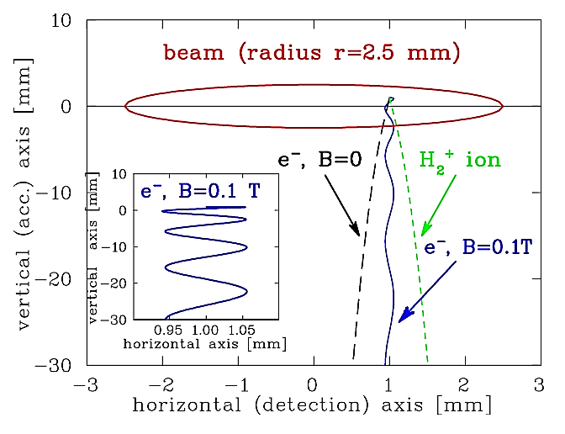
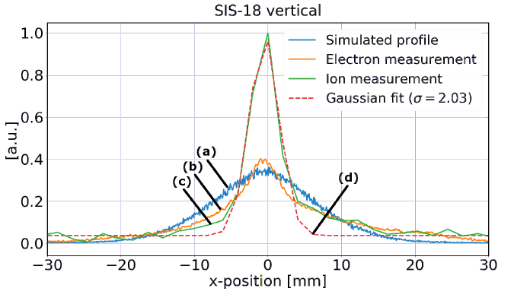
Ongoing: Ionization Profile Monitor
ARIES Workshop on ‘Simulation,
Design & Operation’ (May 2017)
at GSI
General compilation on IPM realization
at LINACs and synchrotrons
New detector technologies and experiences
Exchange of novel ideas
Code development for image reconstruction
Detector, magnet & compensation at CERN PS
J. Storey et al. CERN
D. Vilsmeier et al. GSI
for discussion: enhance existing technical exchange with formal collaboration agreement

Slide 8
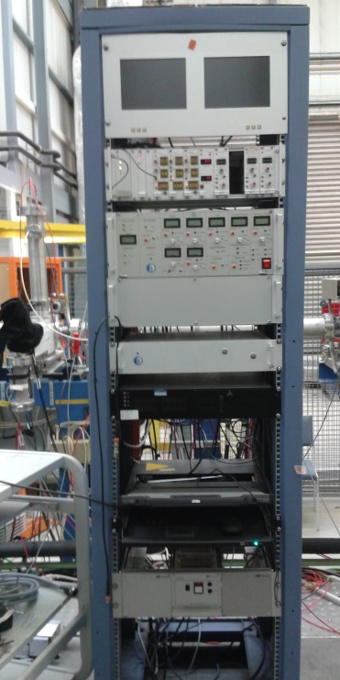
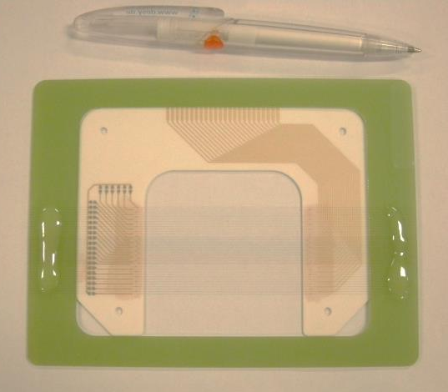
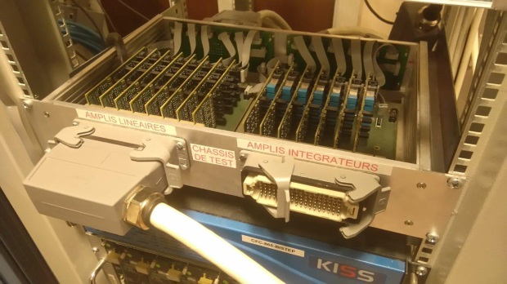
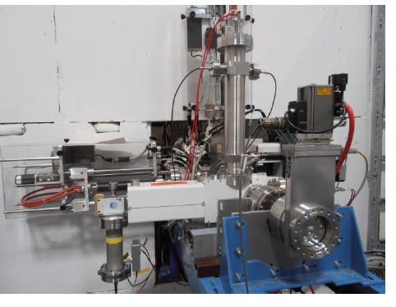
Desired: Collaboration on pLINAC Diagnostics
Bunch Shape Monitor for GSI & pLINAC
Turn-key system from Russian INR purchased
Functionality well proven at GSI & other institutes CERN, SNS, FRIB ...
Control of complex monitor by INR standards using LabVIEW
At CERN: migration to FESA and GUI finished
Collaboration: Adaption of CERN system
Additionally: Advanced reconstruction
data analysis
Advantage: Usage of identical HW allows
common FESA implementation (CERN/GSI)
Contact at engineering level is well established !
SEM-Grid for profile and emittance
measurement at pLINAC
pLINAC: smaller beam than at UNILAC
smaller wire distance of 0.5 mm required
→ GSI: readout not achievable with GSI technology
Analog front-end electronics (‘I to U amplifier’)
→ GSI: no FESA compatible version available
Collaboration: Adaption of CERN system
Advantage: usage of common HW & FESA implementation
Contact at engineering level well established !
Next step: discuss collaboration agreement for pLinac diagnostics (both topics)

