Slide 1
High intensity beams
Oliver Boine-Frankenheim, Accelerator Physics
CERN-GSI collaboration meeting

Slide 2


Ongoing: Regular GSI-CERN workshops
Collective effects and intensity limitations
Collective Effects: Coordination of Theory and Experiments, GSI, March 2006
Organisers: F. Ruggiero (CERN), I. Hofmann
Fokus: GSI/FAIR Synchrotrons and LHC Injectors
To be continued (next workshop Nov 2019) !
H. Bartosik, F. Schmidt, E. Metral, G. Rumolo (CERN)

Slide 3
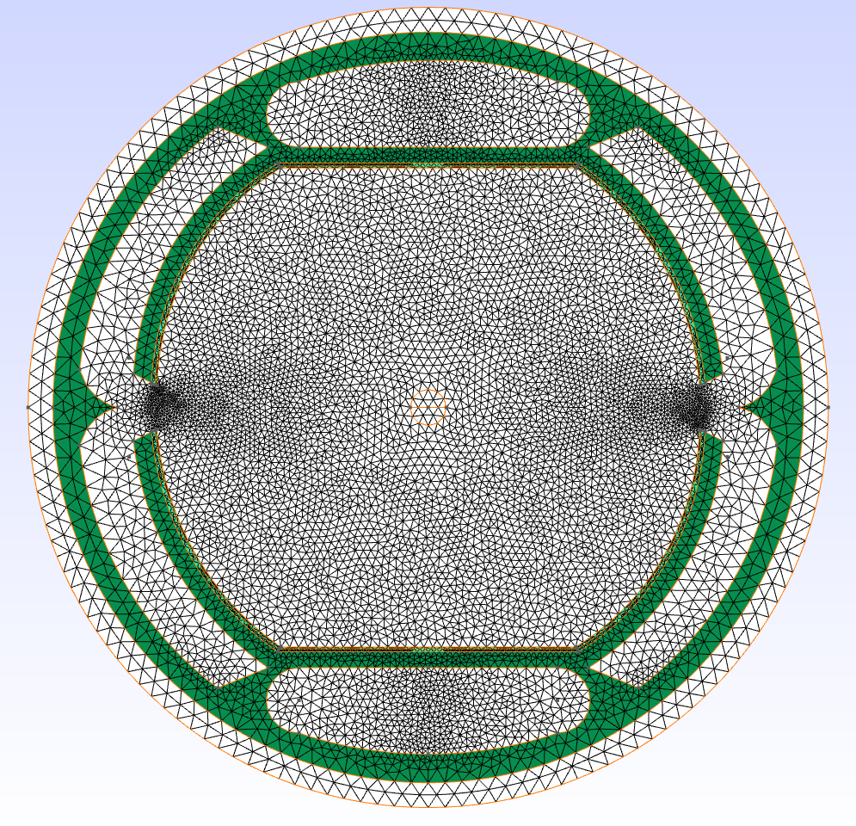
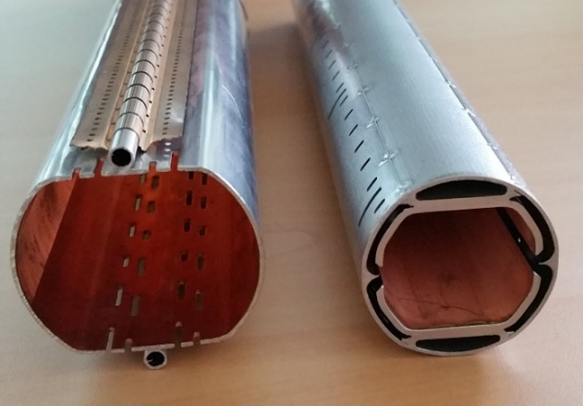
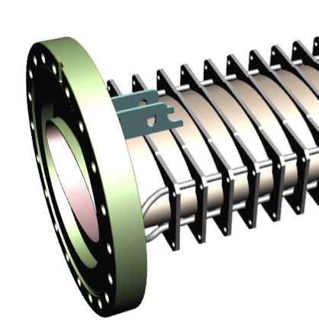
Ongoing: Beam and EM Field simulations
Beam screen impedances: FCC-hh vs LHC
LHC
FCC-hh
or AC
SIS100
Since 2016: Impedance and beam instability simulations for
SIS100 and FCC, using the same simulation tools.
Next: Continue/Improve FCC-hh CDR, Eddy current simulations
D. Schulte (CERN)
EuroCirCol / WP 2.4: Beam stability (GSI/TU Darmstadt)

Slide 4
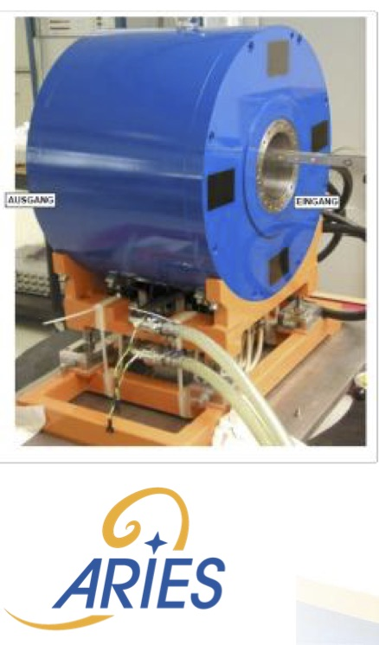
Ongoing: Beam intensity effects mitgation
1) Advanced Landau damping for LHC/FCC and FAIR
Beyond octupoles: (Pulsed) electron lenses with optimised profiles, RF quadrupoles
Joint BMBF funded research / PhD thesis**
E. Metral (CERN)
2) Pulsed electron lens development
Gun development
Joint CERN-GSI teststand
ARIES WP 16: D. Ondreka (GSI)
3) Transverse Feedback Systems (TFS)
Regular exchange, closer collaboration desired
SIS100 and CERN PS TFS have similar specs !
W. Höfle (CERN)
Remark:
FCC-hh would need
7² x 168 LHC-type
octupoles.
E-lens gun
solenoid
** Joint PhD students are a good way for collaboration !
On the average 2-3 /year CERN students receive their
PhD from the Darmstadt/Frankfurt universities.

Slide 5
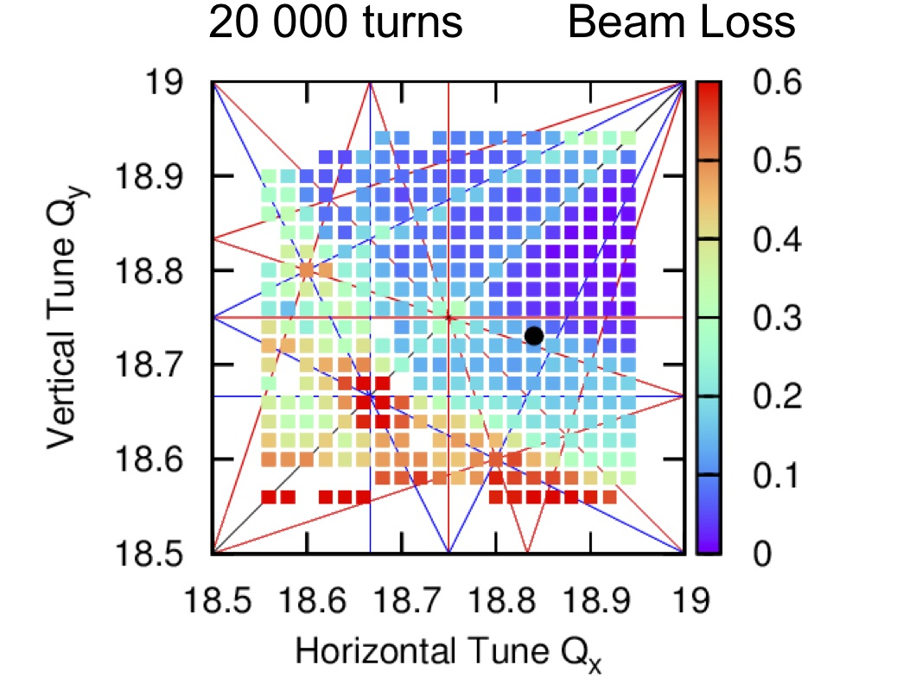
Just started:
High performance simulation tools
Goal: Optimise working points and corrections for minimum loss/emittance growth based on realistic beam dynamics simulations for the LHC injector chain (CERN) and SIS18/100 (FAIR)
Joint development of high-performance
GPU simulation tools
Jan 2019: kick-off meeting for openlab at CERN
with E4 and NVIDIA GPU engineers
May 2019: SixTrackLib shows factor 2000 speed-up vs. MAD-X for 1 Mio macro-particles over 1s.
Next: Full SIS100 + SPS simulations and verifications, experimental validations
A. Oeftiger (GSI), Y. Papaphilippou (CERN)

Slide 6
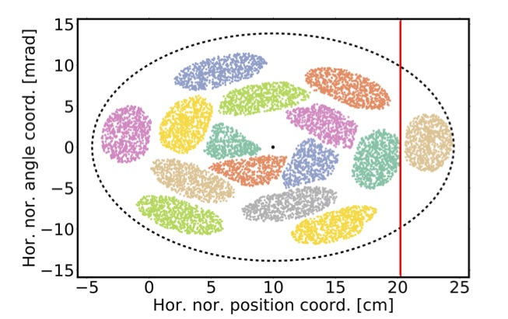
Perspectives:
Advanced Optimisation and ML
Automatic performance optimization plays an increasing role at many accelerator labs.
Recent sucessfull cooperation of S. Appel (GSI) with V. Kain and S. Hirlander (CERN) on gradient-independent methods for LEIR injection
-> „game changer for performance, ease of operation and reproducibility“
Possible joint project: Automatized performance optimization of the CERN and GSI/FAIR accelerators using gradient-independent methods
Example: Optimized injection (simulation)
Future perspectives:
Machine Learning, with training data from simulations codes or machines.
Will play an increasing role in beam diagnostic (for high intensity).
-> Larger cooperation project and bilateral
exchange / workshops

