Slide 1
Collaboration CERN – GSI/FAIR superconducting magnets
C. Roux for
Department of Superconducting Magnets
GSI Darmstadt, 02.07.2019

Slide 2
overview
CERN-GSI/FAIR collaborations: superconducting magnets
all collaborations in the framework of the 2010 agreement K1727/DG
TITLE/SCOPE | Machine | Status | Addendum | Date
Magnetic-field measurement systems for the SIS100 superconducting dipoles | SIS100 | active | Annex to #2 #9, KR2984/TE | 2014 2016
Cryogenic testing of the superconducting magnets for the Super-FRS | Super-FRS | active | #2 #4 #5 #12, KR3912 | 2012 2014 2016 2018
Simulation of transient effects in the SIS100 main busbar system | SIS100 | in preparation
Superconducting high-field septa | Future accelerators | proposed

Slide 3
SIS100: magnetic-field measurement system (dipoles)
K1727/DG (2010), Annex to addendum #2, Addendum #9: active collaboration
purpose
design and procurement of a magnetic field measurement system for the SIS100 series dipoles:
five shafts to be operated at 4 K in vacuum (first time), based on CERN design of tangential coils
five segments of rotating coils within dipole
MRU
contribution
Add. | GSI |  |  | CERN
#2 | Development of rotating feedthrough |  |  | Loan of measurement system
#9 | Design of the shaft Layout of the patch panel Procurement of MRUs mechanical components tooling Costs up to 55.000 CHF for personnel (calibration) up to 143.000 CHF for material (integrators, racks, …) | open |  | Expertise in coil design Drawing of coils and MRUs Procurement of integrators cabinets for controllers Winding and calibration of the coils Assembly of the segments | 15 segments delivered 10 expected in 09.2019
compensation of effort: three MRUs delivered to CERN in 2017
Responsible: S. Russenschuck | A. Szwangruber

Slide 4
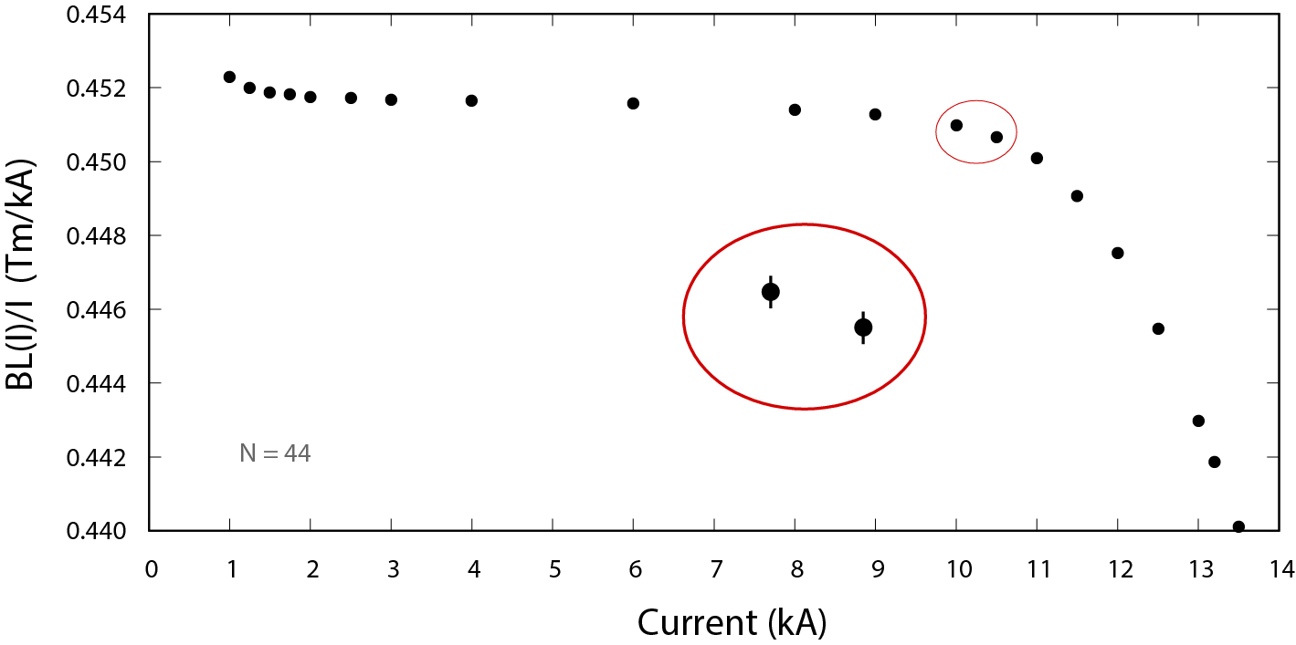
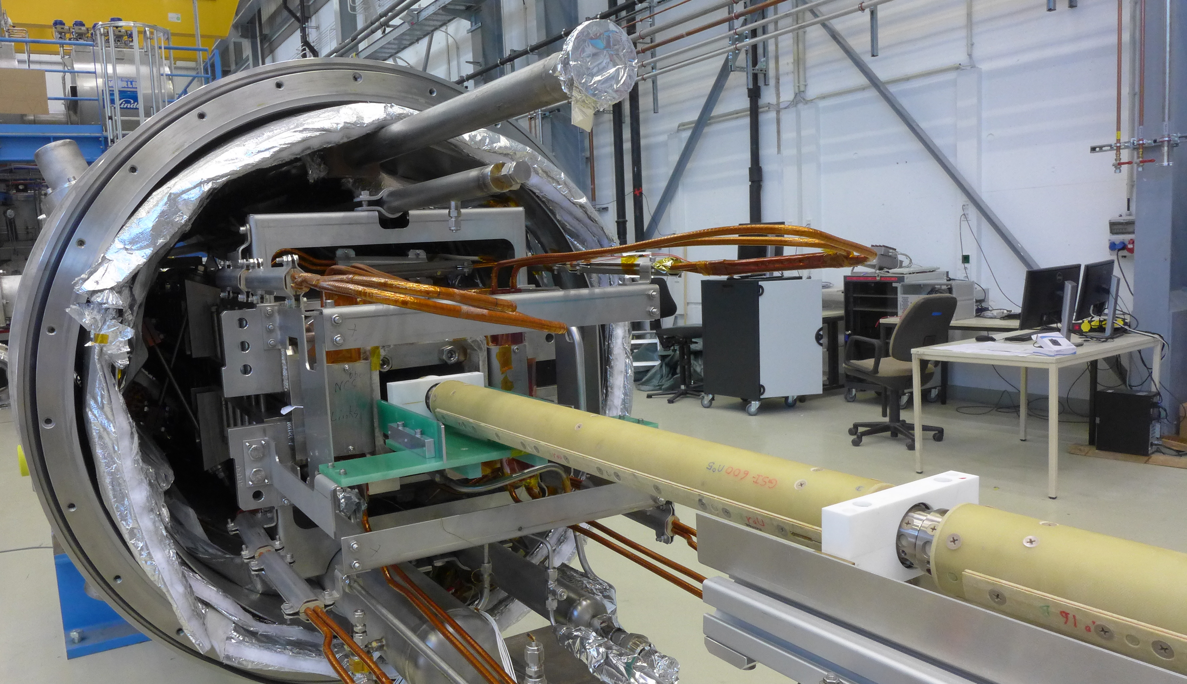
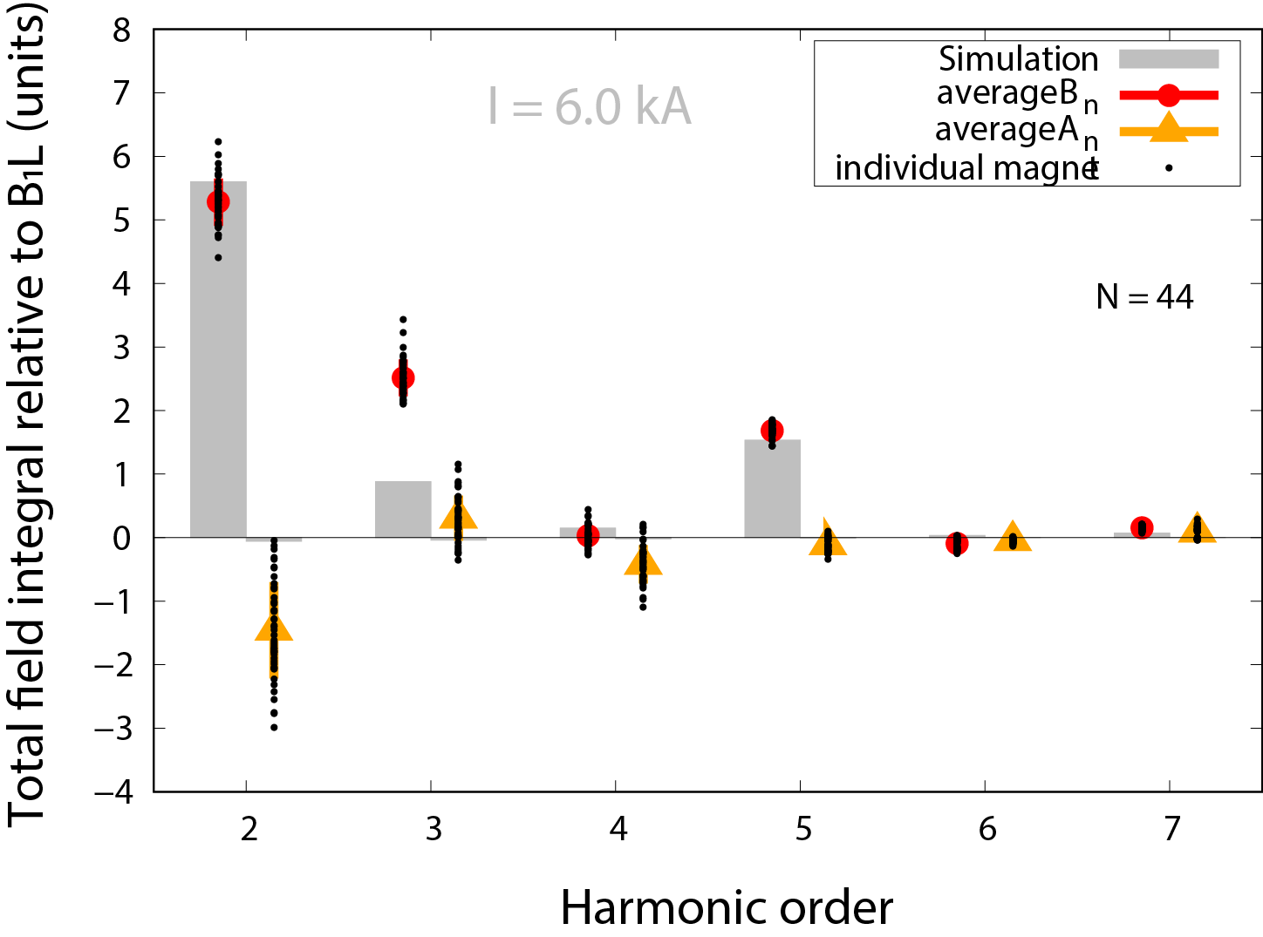
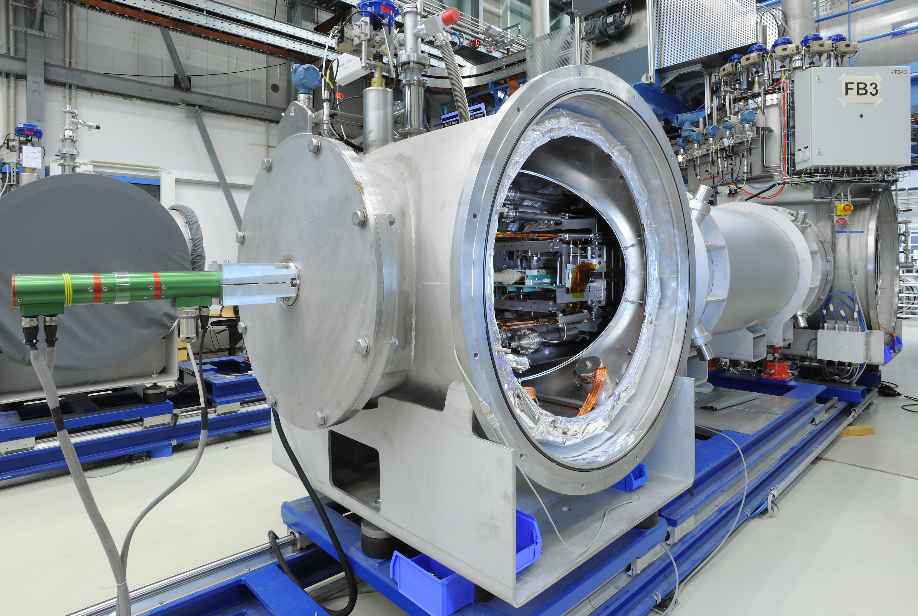
SIS100: magnetic-field measurement system (dipoles)
K1727/DG (2010), Annex to addendum #2, Addendum #9: active collaboration
status: active, close to completion
SAT results: magnetic-field properties
three shafts at full operation at the series test facility for the SIS100 superconducting dipoles performing SAT.
at STF/GSI:
ΔBL/BL = 4.1 ×10⁻⁴
Excellent measurement system reveals excellent magnet properties
proof of principle for operation at cold + vacuum
Responsible: S. Russenschuck | A. Szwangruber

Slide 5
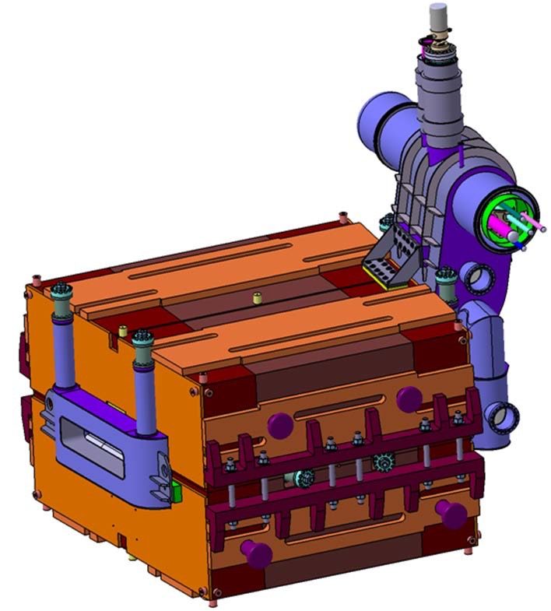
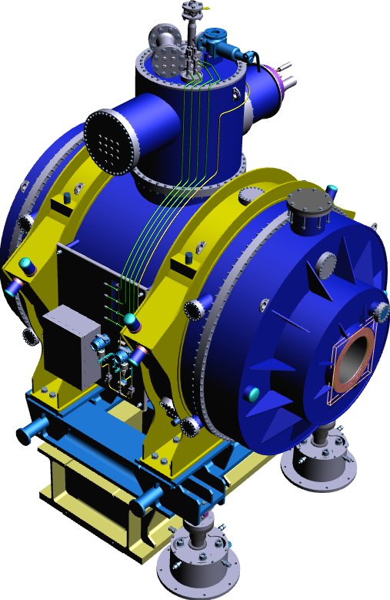
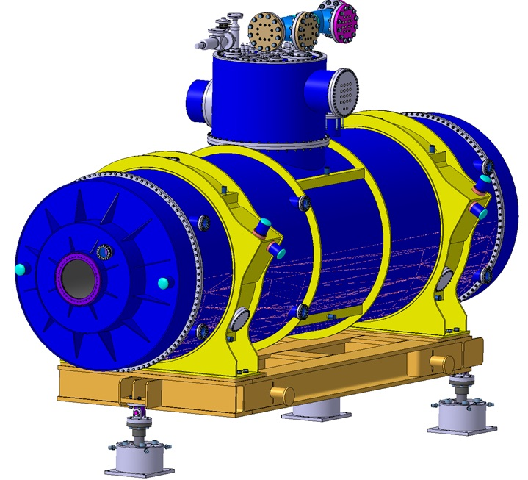
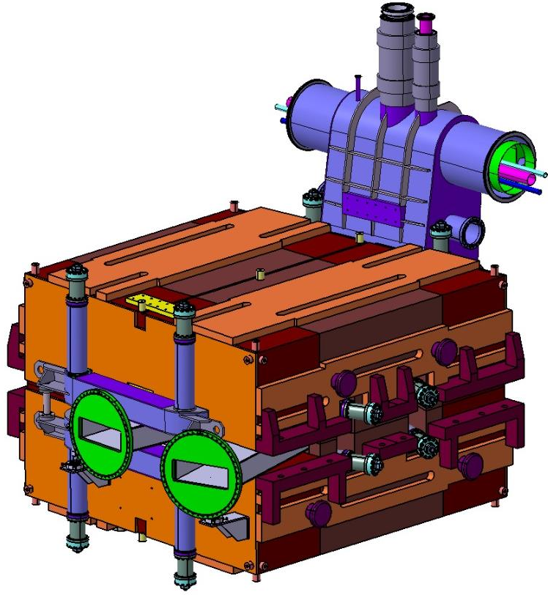
Super-FRS: testing of sc. magnets
K1727/DG (2010); Addendum #2 (2012), #4 (2014), #5 (2016) for infrastructure refurbishment + #12 (2018) for testing phase: active
purpose
testing of all superconducting magnets for the Super-FRS depicting the SAT for acceptance.
refurbishment and adaption of the cryogenic test facility at B180/CERN.
32 multipletts
24 dipoles
contribution
Add. | GSI |  |  | CERN
#2 | 5.000.000 € |  |  | Refurbishment of test facility B180
#4 | 1.860.000 CHF |  |  | Procurement of pre-cooler, QD-system, survey tooling
#5 | 210.000 CHF |  |  | Integration work, modification of cryo lines Implementation of preparation test bench and control room
#12 | Testing of the magnets 4 FTEs Further personnel if required Experts of survey at pre-series testing Cost-recovery for operational services | ongoing tbd ongoing ongoing |  | 1 FTE: test engineer to oversee functioning of test facility 0.4 FTE: support of equipment groups on best-effort basis Energy costs (no cryogenics) Office space and infrastructure | See kick-off See kick-off ongoing
facility will be made available for similar testing after Super-FRS activities
Responsible: L. Van den Boogard/S. Russenschuck | K. Sugita

Slide 6
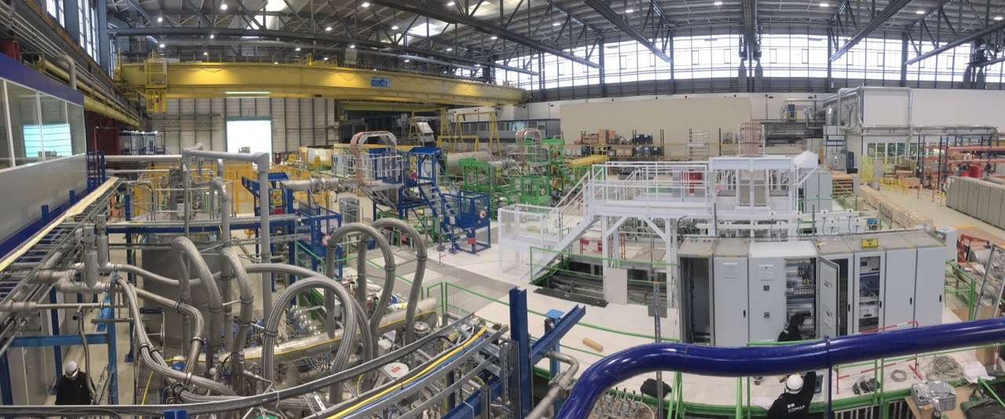
Super-FRS: testing of sc. magnets
K1727/DG (2010); Addendum #2 (2012), #4 (2014), #5 (2016) for infrastructure refurbishment + #12 (2018) for testing phase: active
status: test facility
B180 refurbished and operational
Measurement systems available
GSI contributions on campus
32 multipletts
24 dipoles
test facility at B180:
infrastructure and measurement systems ready
for full commissioning/testing phase
Responsible: L. Van den Boogard/S. Russenschuck | K. Sugita

Slide 7
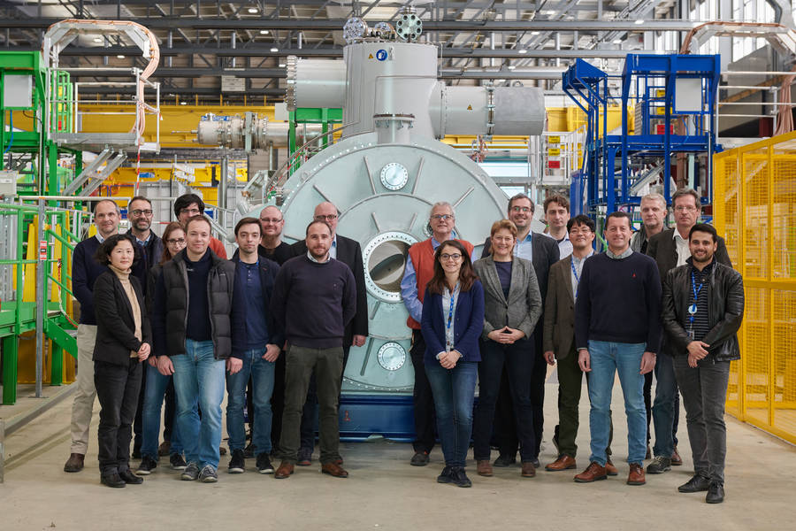
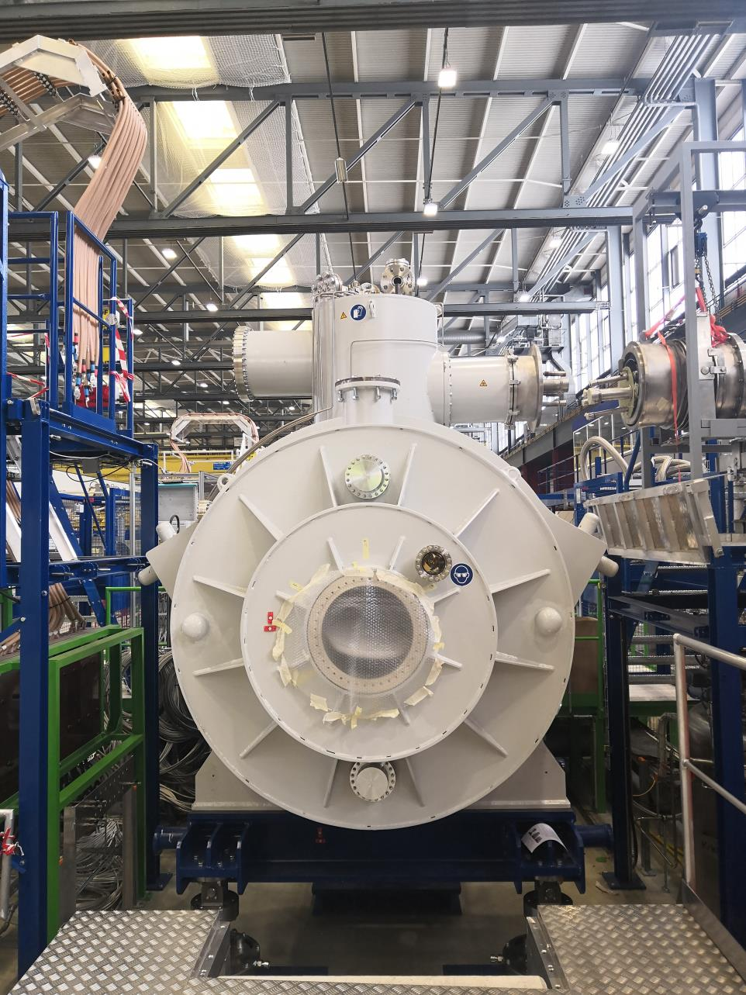
Super-FRS: testing of sc. magnets
K1727/DG (2010); Addendum #2 (2012), #4 (2014), #5 (2016) for infrastructure refurbishment + #12 (2018) for testing phase: active
status: testing
first multiplett delivered
pre-series testing started
commissioning of the test facility (simultaneously)
FIRST cool down planned in week 27
Kick-off meeting at 03.07-04.07: organisation/personnel
32 multipletts
24 dipoles
delivery of pre-series multilplett
at test bench
testing phase in progress
(1.5 y for pre-series, 4 y for series magnets)
Responsible: L. Van den Boogard/S. Russenschuck | K. Sugita

Slide 8
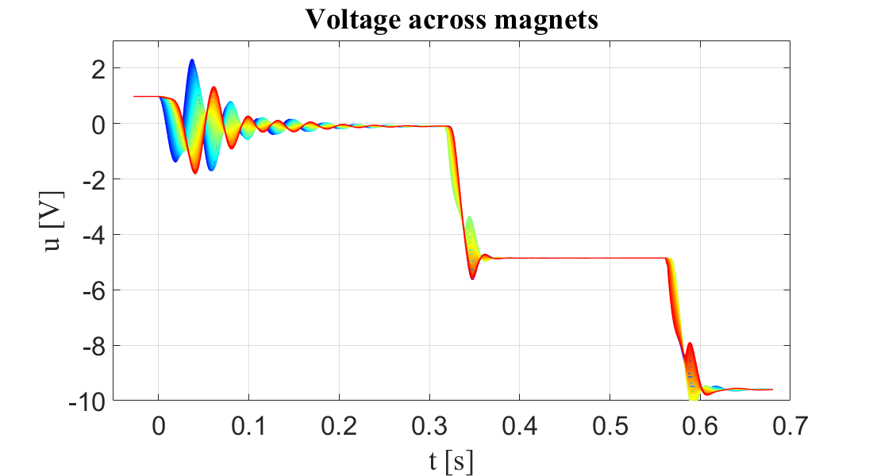
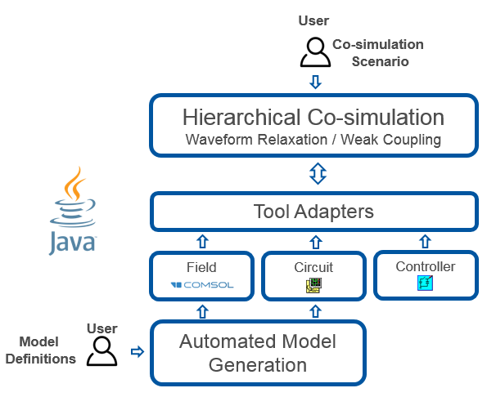
SIS100: transient effects in the main busbar system
in preparation: contract ready for signature (soon)
purpose/benefit
simulation of transient effects in the SIS100 sc. magnet system with CERN software tools:
Reveal dynamical electrical behaviour at operation of complex cryomagnetic system.
courtesy of CERN
fast power abort in LHC dipole
contribution
Add. | GSI |  | CERN
#x | Input data of components and operation (magnet circuits, power converter, QD system, cycling details, 3D models) Delegation of GSI staff member (PhD student) Personell costs for CERN experts supervision first year: 0.35 FTE afterwards: 0.1 FTE |  | Simulation strategy and STEAM code Manpower for supervision and code adaption Guide and training of PhD student Cross-check of simulation results
assumed effort: 3 years
dynamical and collective behaviour of SIS100 cryomagnets
use of STEAM in non-CERN application: valuable feedback
Responsible: A. Verwej | P. Szwangruber

Slide 9
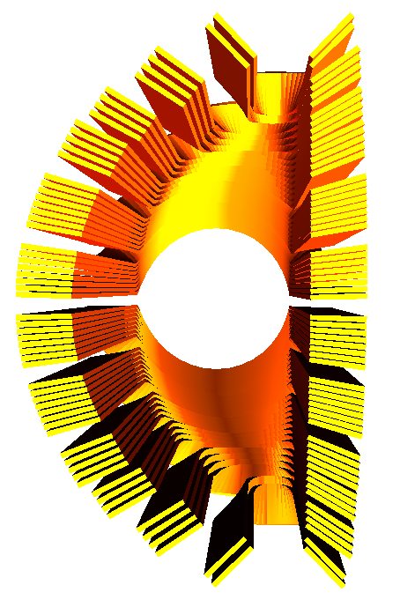
high-field superconducting septa: magnet development
proposed
purpose/benefit
conventional iron-dominated septa are limited to 2 T field strength. At GSI a cosine-theta septa magnet concept was developed enabling much higher field strength.
superconducting cosine-theta septa might be used at future accelerators (e.g. FCC, medical, …). For feasibility studies the concept must be transferred to an engineering design.
septa magnetic field
cosine-theta type coil
contribution
Add. | GSI |  | CERN
#x | septa concept |  | Consine-theta expertise (Rutherford cable)
 | Design studies: electromagnetic, cryogenic, mechanical R&D of critical parts Prototyping and testing
high interest from both sides (application in future projects)
benefit from complementary expertise
Responsible: J. Borburgh | K. Sugita

Slide 10
Collaboration CERN-GSI/FAIR superconducting magnets
thank you

Slide 11
bonus slides

Slide 12
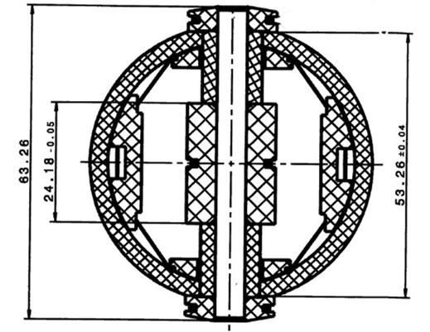
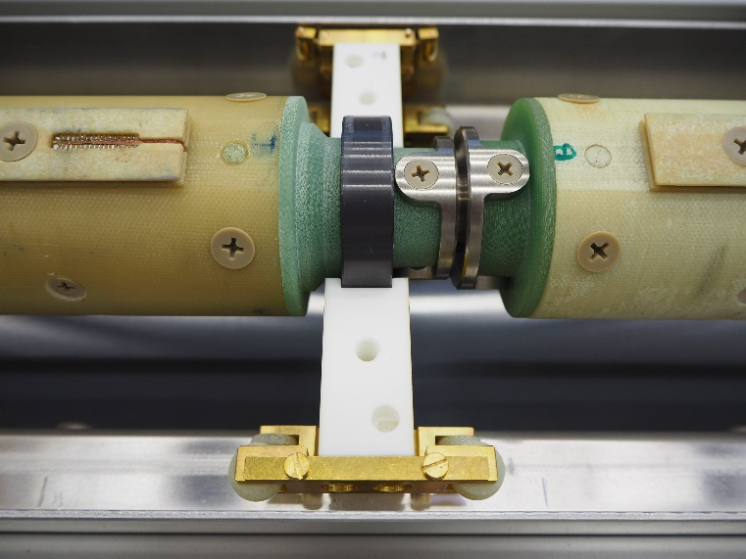
magnetic field measurements
3600 mm
System for magnetic field measurements
5 measuring heads – tangential coils
3 pick up coils per head, 600 mm length
effective surface 1.67 m²
Ti-alloy bellows – interconnection between segments and to align the heads along the beam axis
SiN ball bearings for rotation motion
ceramic supporting blocks for transverse positioning in the gap
measuring head
supporting block
620 mm
SiN ball bearing
Ti bellow
24.18 -0.05
53.26 ±0.04
63.26
cross section of the measuring head (3 tangentinal coils)
Field measurements in vacuum @ 4.5K
rotated ferro fluidic feed througth
motor unit
The measuring probe is designed and built in collaboration with CERN

Slide 13
SIS100: magnetic-field measurement system (dipoles)
K1727/DG (2010), Addendum #9 + Annex to addendum #2
purpose
status
design and procurement of a magnetic field measurement system for the SIS100 series dipoles:
five shafts to be operated at 4 K, based on CERN design of tangential coils
GSI:
6 MRU‘s were produced at GSI during 2015 -2017
3 MRU‘s delivered to CERN in 2017
mechanical design of the measuring probe finalised in Q2/2017
all mechanical components for 5 measuring probes (5 shafts build up of 5 segments each) are procured and delivered to CERN
CERN:
3 electronic cabinets for control of the measuring system and DAQ delivered to GSI in 2017
fabrication of all coils (winding, calibration, sorting) is finished
15 out of 25 segments delivered ( 2017, 2018, 2019)
remaining 10 segments are under assembly and calibration. Expected delivery Sept. 2019
contribution
GSI | CERN
Design of the shaft Layout of the patch panel Procurement of MRUs mechanical components tooling Costs up to 55.000 CHF for personnel (calibration) up to 143.000 CHF for material (integrators, racks, …) | Expertise in coil design Drawing of Coils and MRUs Procurement of Integrators Cabinets for controllers Winding and calibration of the Coils Assebly and calibration of the segments
compensation of CERN’s effort: three MRUs

Slide 14
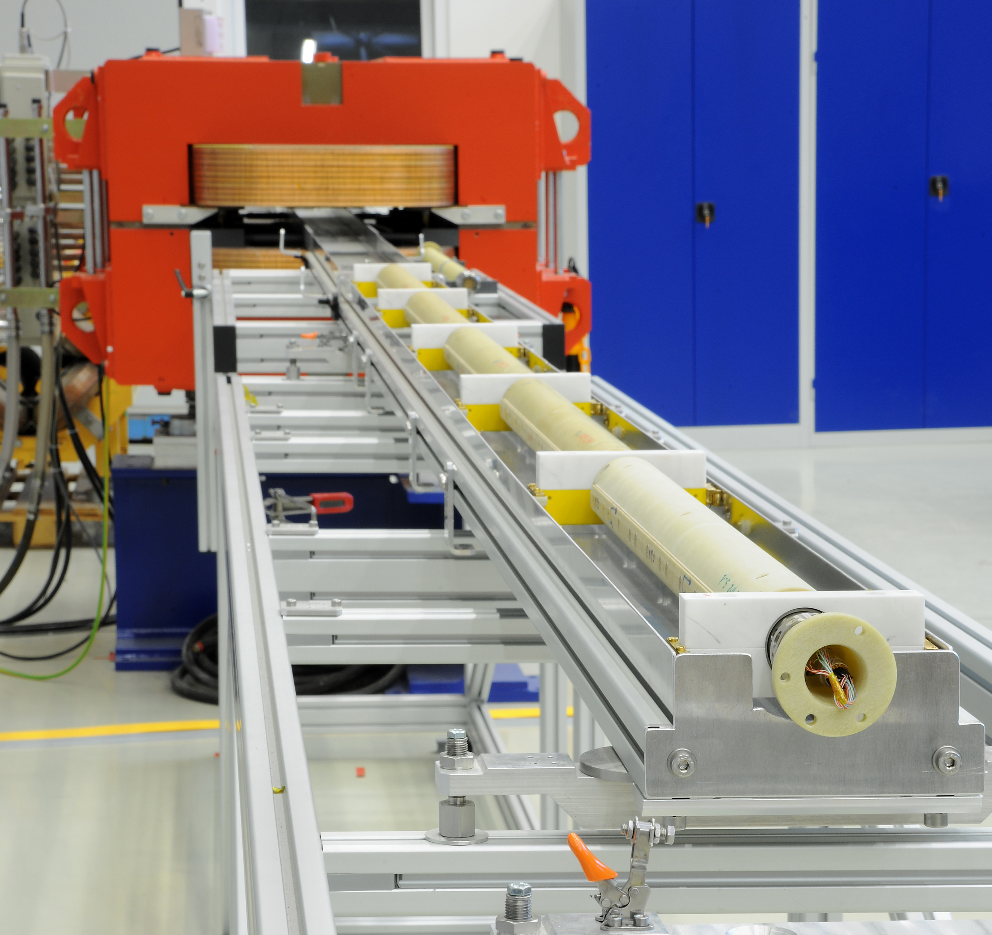
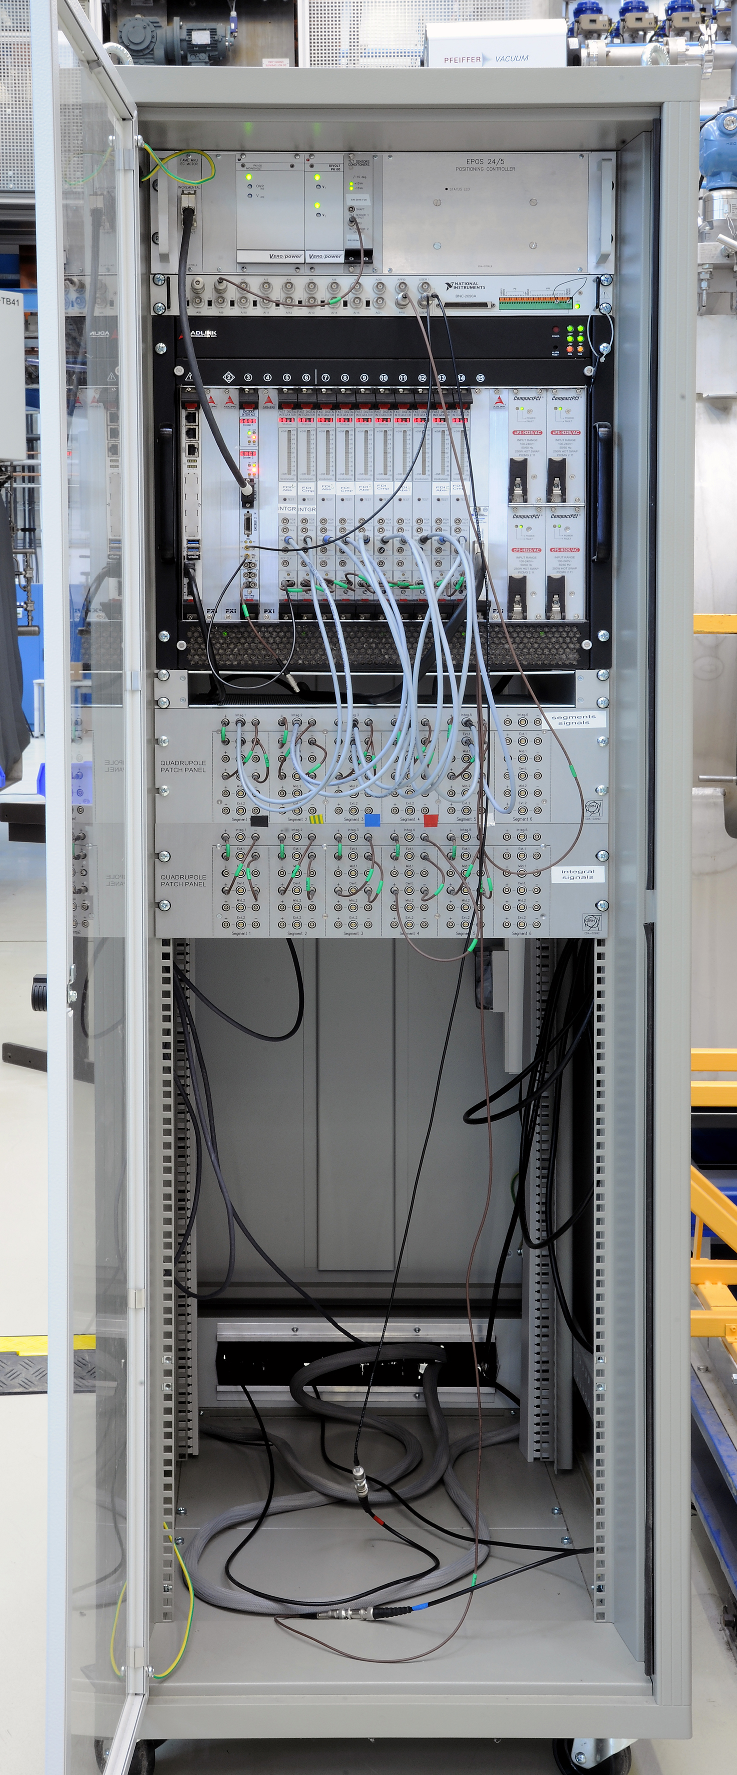
SIS100: magnetic-field measurement system (dipoles)
K1727/DG (2010), Addendum #9 + Annex to addendum #2
4
installation of the shaft into the series dipole magnet
5
1
1
3
2
2
5
1 – shaft of 5 rotating coils
2 – motor unit (MRU) for MFMS
3 – electronic cabinet for MFMS
4 – calibration magnet
5 – series dipole magnet for SIS100
series dipole magnet with installed MFMS at the test bench

Slide 15
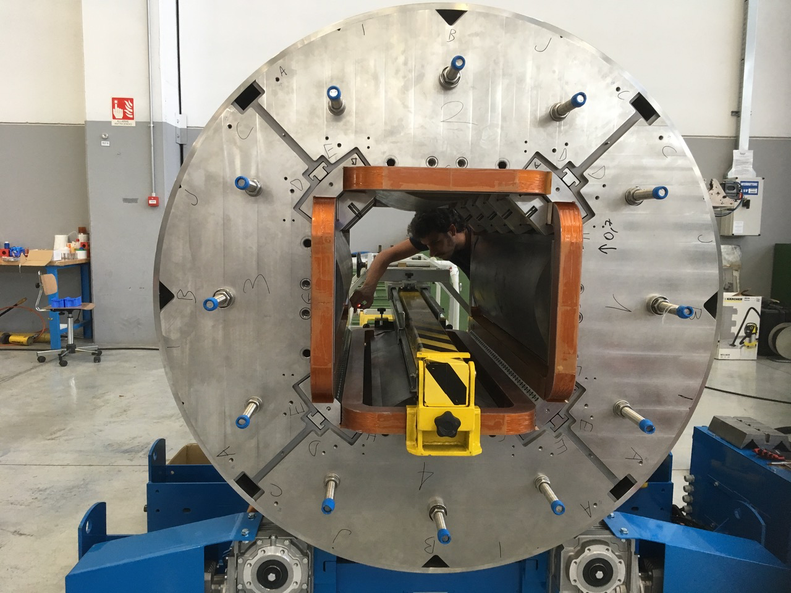
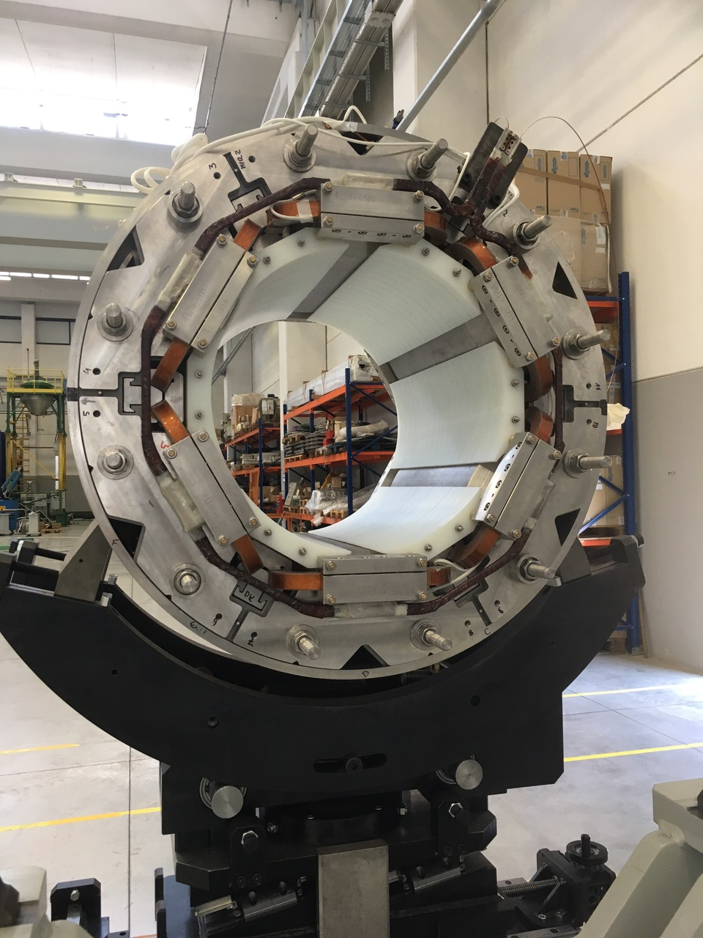
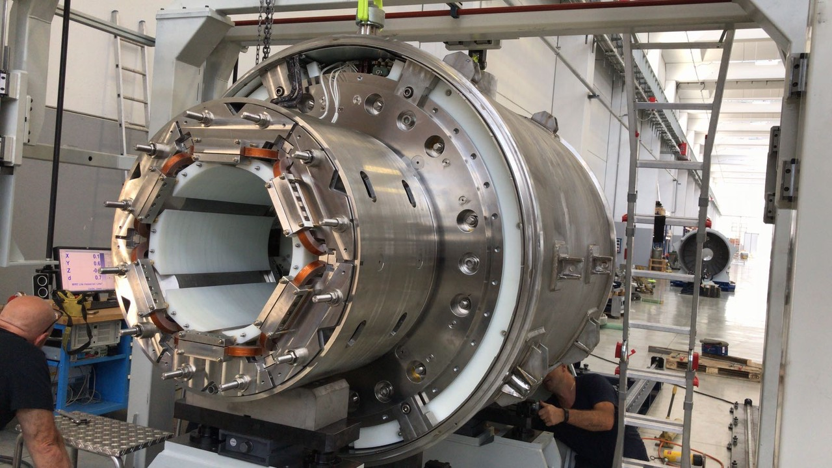

Slide 16
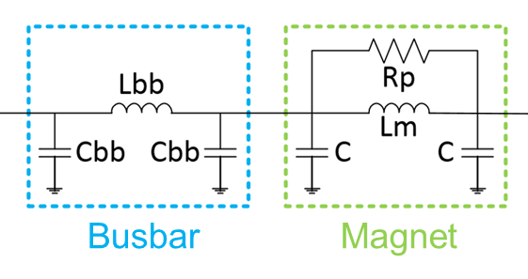
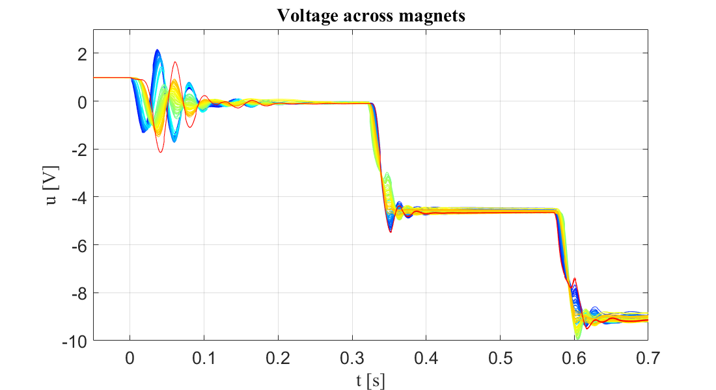
Transient Effects in the SIS100 Main Bus Bar System
CERN simulation tools: Simulation of Transient Effects in Accelerator Magnets (STEAM)
Example of a fast power abort in LHC dipole circuit @ 10kA, 10A/s
Simulations:
Electrical (netlist based)
Mechanical
Magnetic
Thermal
Quench
Simulation
Measurements
courtesy of CERN

Slide 17
SIS100: magnetic-field measurement system (dipoles)
K1727/DG (2010), Annex to addendum #2, Addendum #9
purpose
design and procurement of a magnetic field measurement system for the SIS100 series dipoles:
five shafts to be operated at 4 K, based on CERN design of tangential coils
SiN ball bearings
Ti bellows
600 mm
refurbishment and adaption of the cryogenic test facility at B180/CERN (add. #2, #4, #5).
refurbishment and adaption of the cryogenic test facility at B180/CERN (add. #2, #4, #5).
53.26 ±0.04
measuring head with tangential coils
interconnections
rotated ferro fluidic
feed througth
motor rotating
unit (MRU)
~ 3 m
SIS100 dipole with magnetic field measurement system

Slide 18
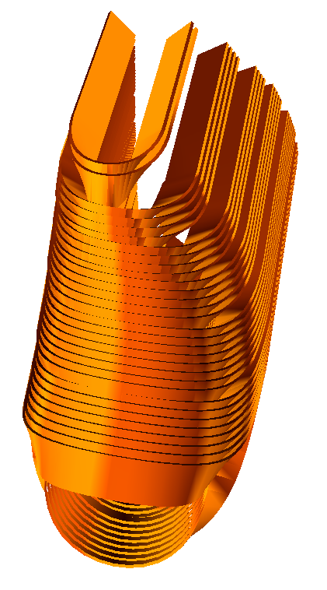
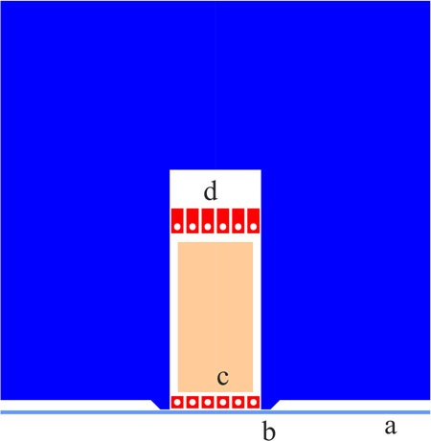
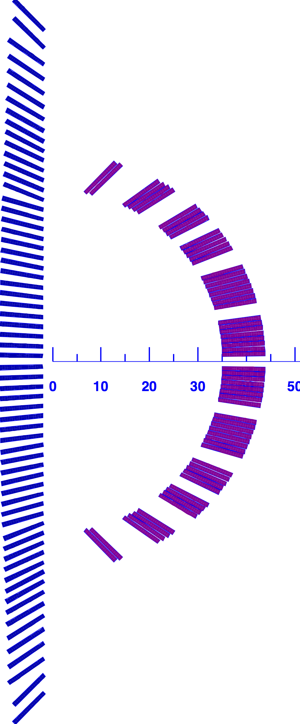
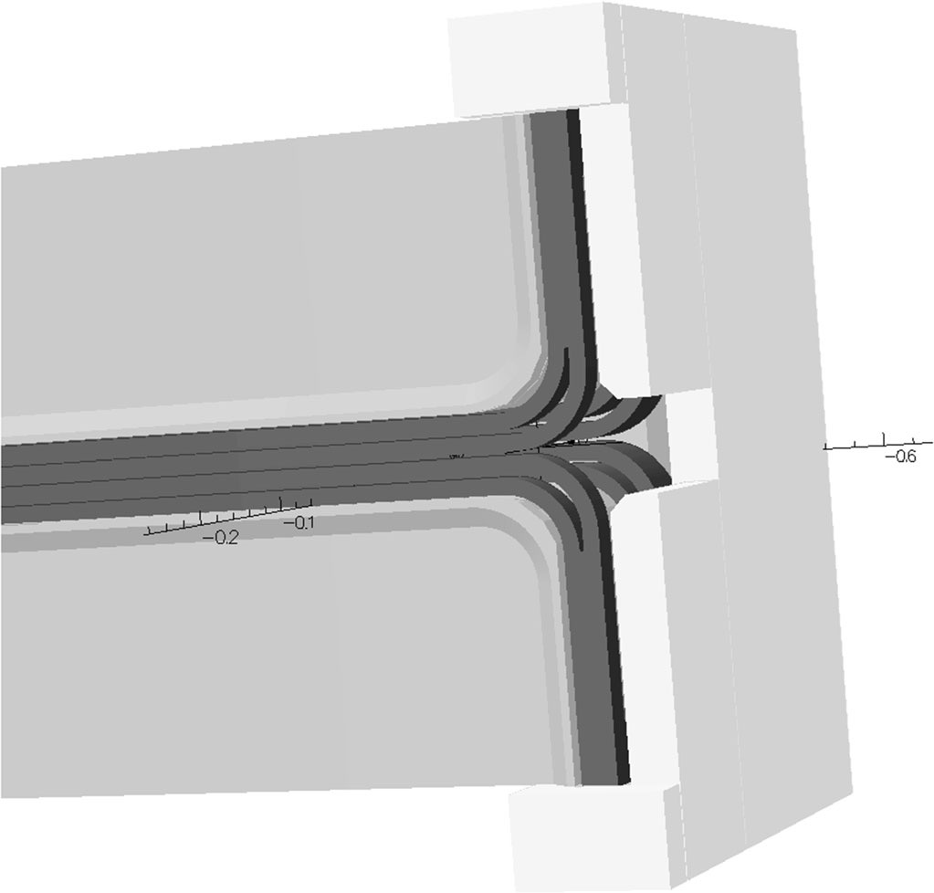
High field septum magnet with truncated cosine-theta concept
Conventional septum magnet
< 2T
Iron yoke
Iron yoke
Stray field / Main field
(Preliminary optimisation)
SIS100
septum magnet

Slide 19
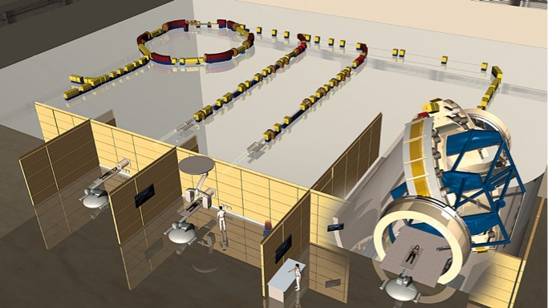
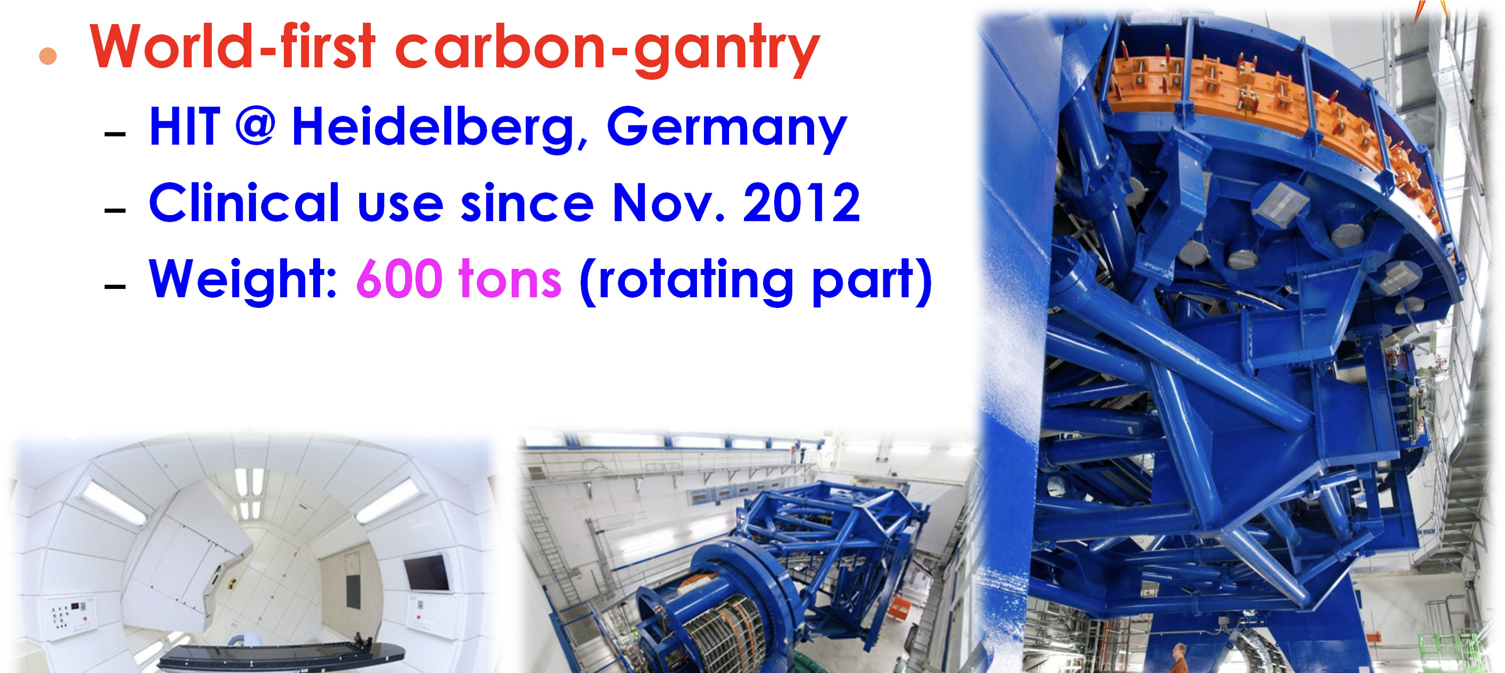
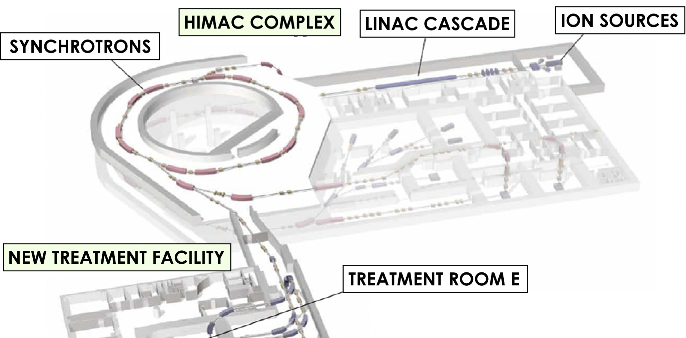
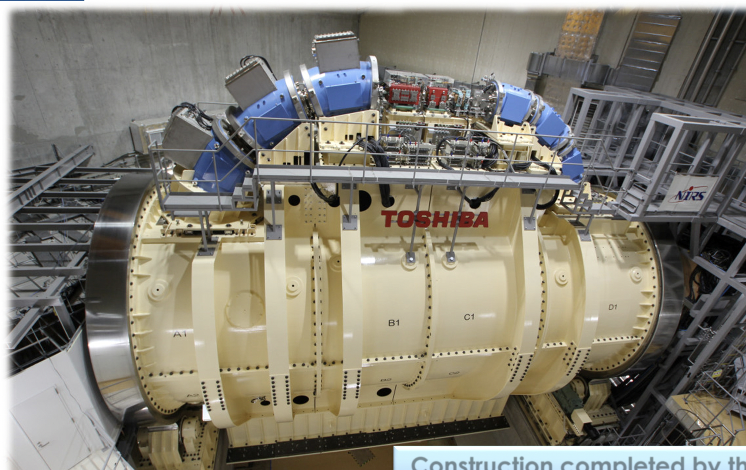
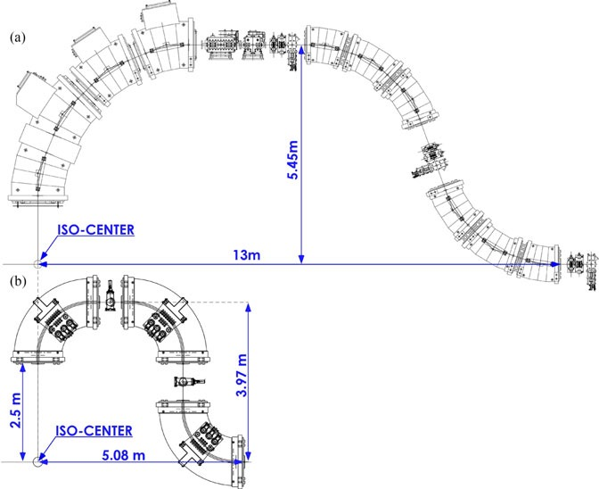
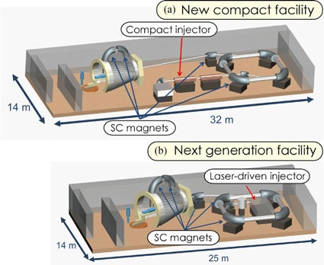
Medical machine
Heidelberg, Germany
Normal conducting gantry
600 ton
NIRS, Japan
Superconducting gantry
1st generation
300 ton
2nd generation
compact and light weight
1st generation
Shorter straight section in the ring (injection, extraction) is important for further compact medical facility.
Therefore high field sc septum magnet is a key technology for further developments.
2nd generation
Collaboration Meeting CERN - GSI/SCM | C. Roux for SCM

