Slide 1
Overview GSI / FAIR Status
Collaboration Meeting: CERN – GSI/FAIR
Darmstadt - 2nd July 2019
Jörg Blaurock
Technical Managing Director FAIR GmbH & GSI GmbH

Slide 2
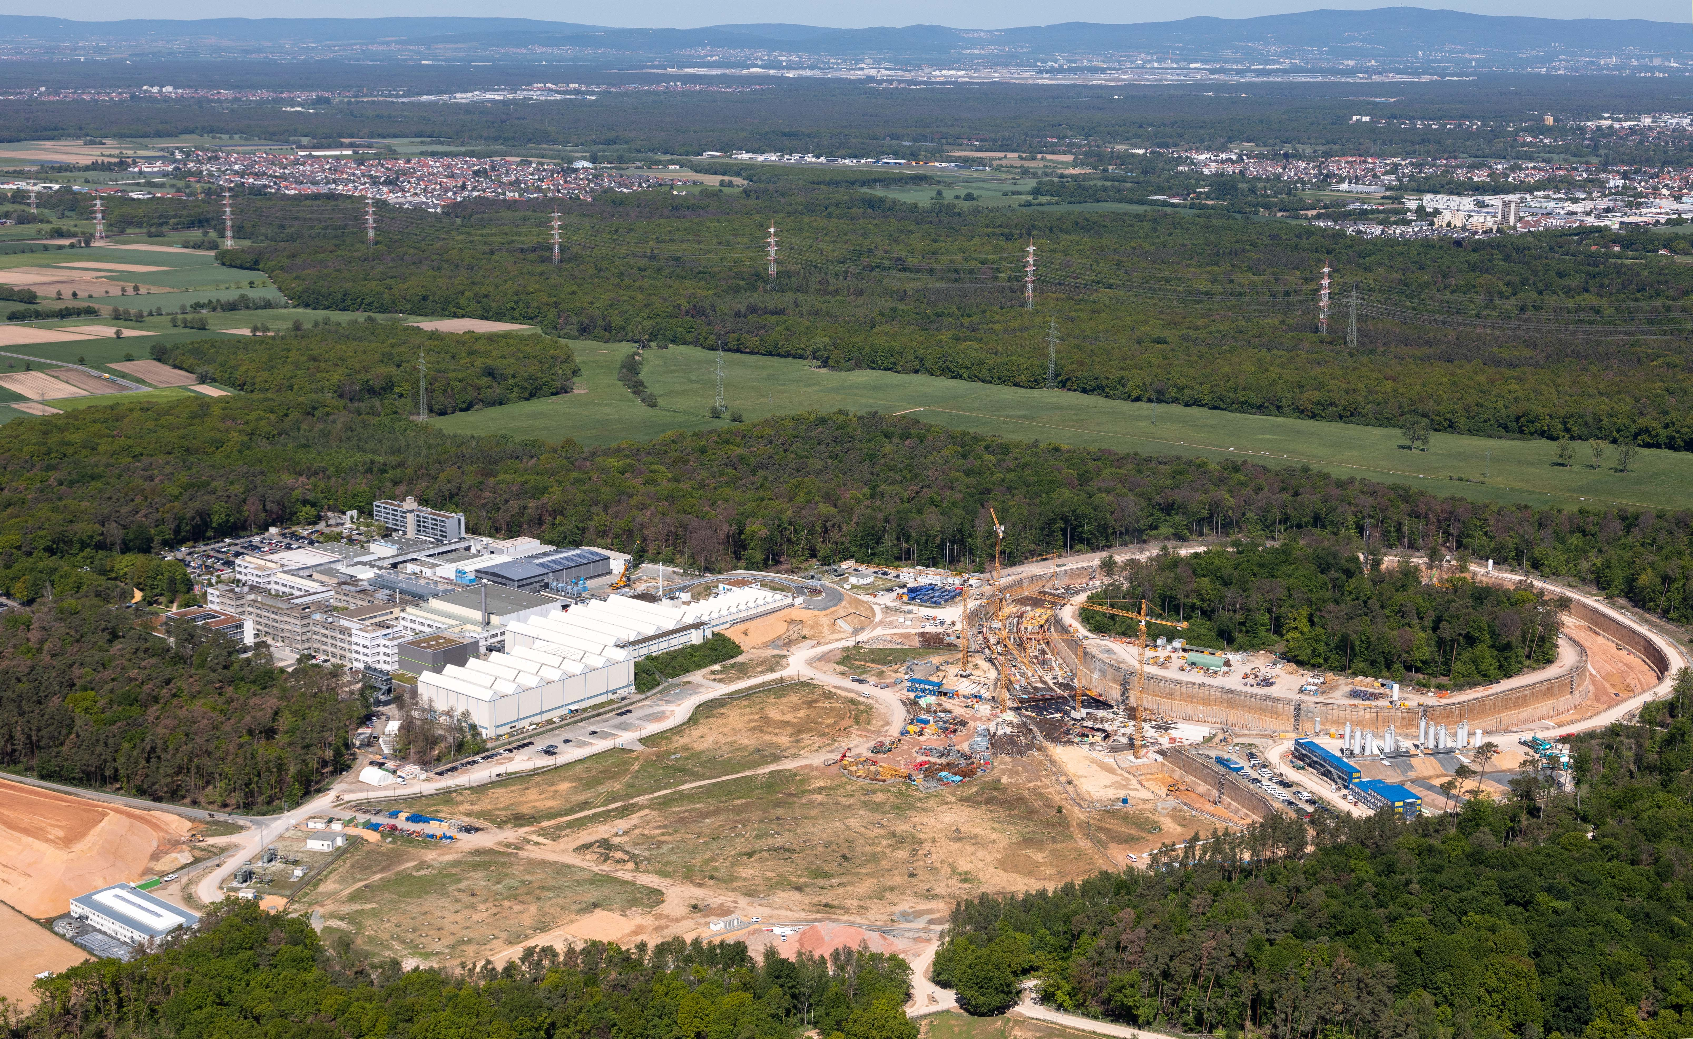
FAIR & GSI Darmstadt
Status: May 2019
Notes:
Hintergrundbild: aktueller Bildausschnitt der GSI mit neuen Gebäuden

Slide 3
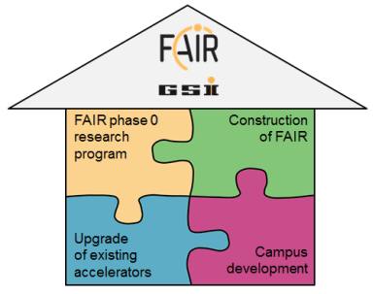
Agenda
FAIR & GSI – Strategy
GSI GmbH & FAIR GmbH Organisation
GSI Operation
GSI Campus
FAIR Project
Collaboration CERN – GSI/FAIR

Slide 4
FAIR & GSI – Strategy
Our 4 strategic priorities
Construction of FAIR
FAIR phase 0 research program
Upgrade of existing accelerators
Campus development

Slide 5
Agenda
FAIR & GSI – Strategy
GSI GmbH & FAIR GmbH Organisation
GSI Operation
GSI Campus
FAIR Project
Collaboration CERN – GSI/FAIR

Slide 6
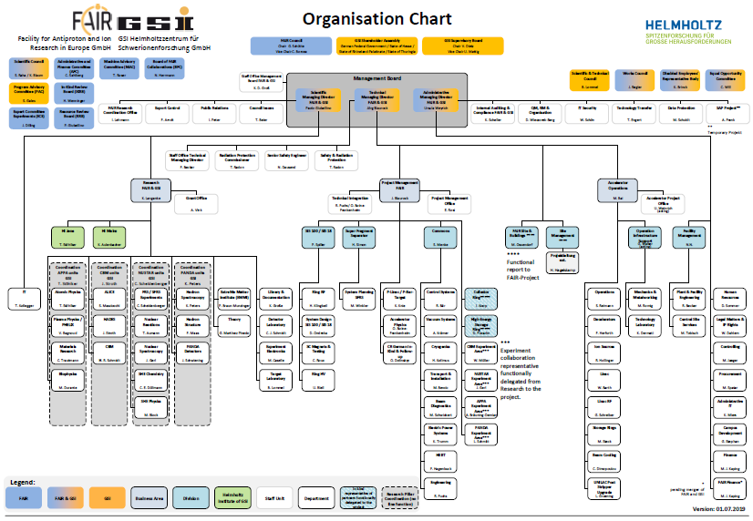
GSI GmbH & FAIR GmbH Organisation

Slide 7
Agenda
FAIR & GSI – Strategy
GSI GmbH & FAIR GmbH Organisation
GSI Operation
GSI Campus
FAIR Project
Collaboration CERN – GSI/FAIR

Slide 8
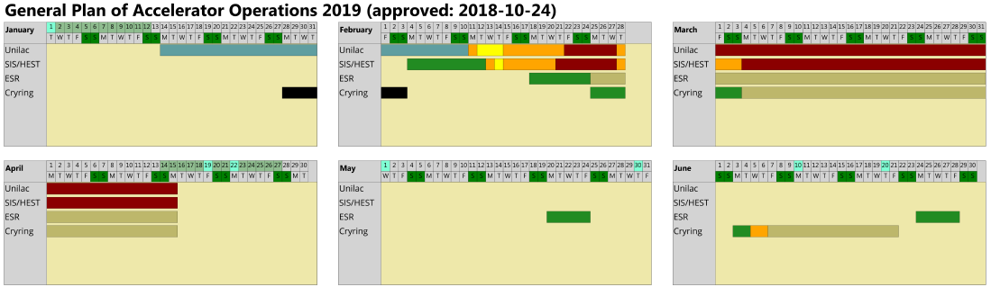
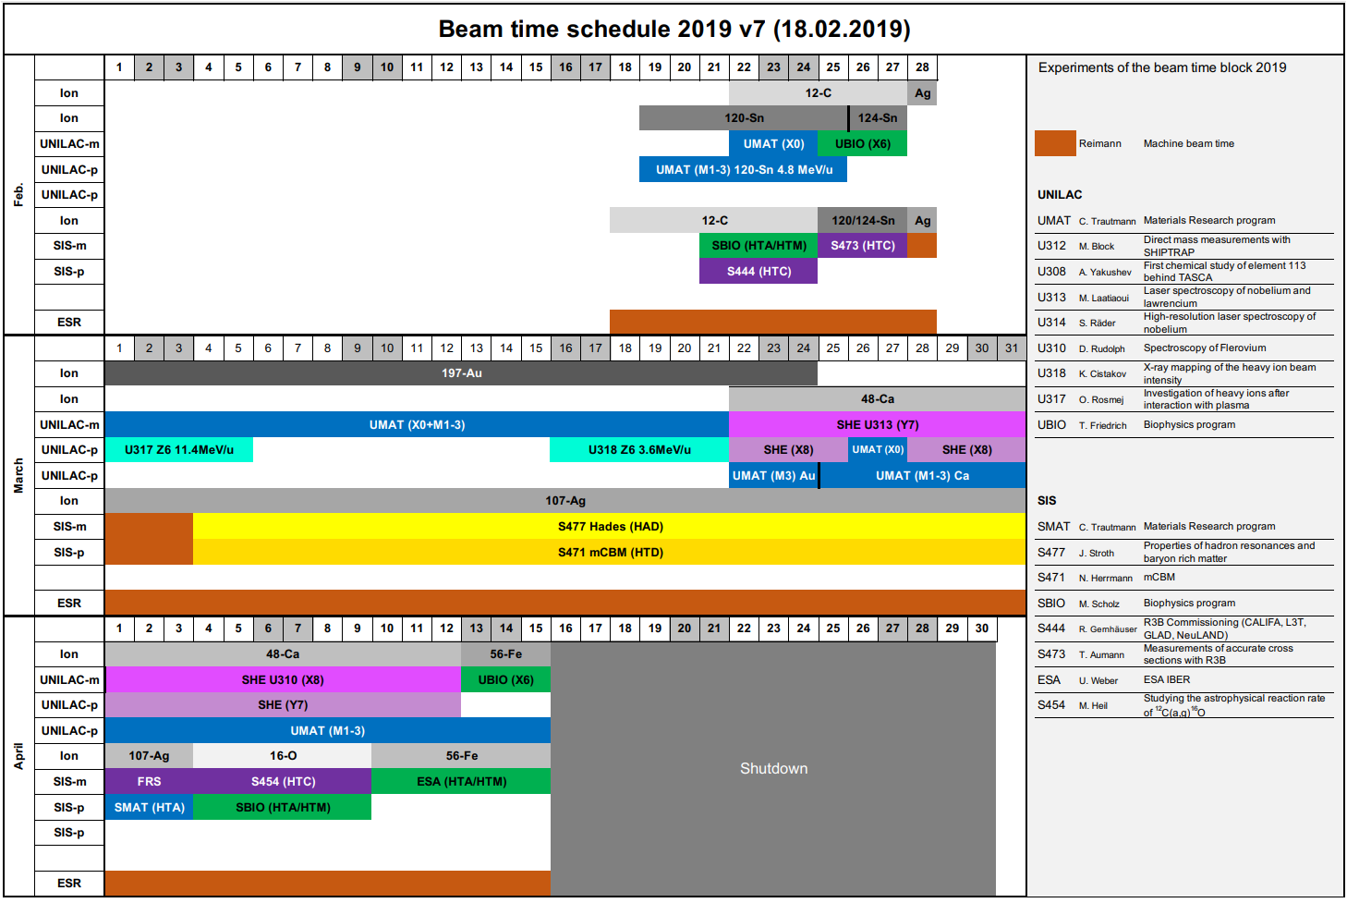
GSI Operation - Beam time 2019 Q1

Slide 9
GIS Operation
Physics run: 10/02/2019 – 15/04/2019
Carry out scheduled Physics program from Feb. 28 to April 15
Continue the ESR and CRYRING commissioning
Physics run plan:
  A total of 17 experiments:
    9 UNILAC, 8 SIS18 fix target
    Requested ions: 12-C, Sn, Ag, 48-Ca, Au, 16-O, 56-Fe
  ESR commissioning as synchrotron
  CRYRING commissioning and user operation as stand alone mode
Status quo so far
  Done, all carried out with requested ion species. BeamOnTgt: ~80%!
    Highlight: HADES with significant improved spill quality by modulating quadrupoles
    Further improvement: R3B beam setup. Can benefit from steady operation
  Carried out with very limited time, a total of 15 shifts over the 2.5 month
    Achieved: deceleration Ag45+ from 260MeV/u to 110 MeV/u
    Decelerated Fe25+ was stored and cooled at 120MeV/u
  To be carried out: storage ring mode in the Fall of 2019
  Carried out with excellent stability w.o e-cooler, which has broken cryo system

Slide 10
Agenda
FAIR & GSI – Strategy
GSI GmbH & FAIR GmbH Organisation
GSI Operation
GSI Campus
FAIR Project
Collaboration CERN – GSI/FAIR

Slide 11
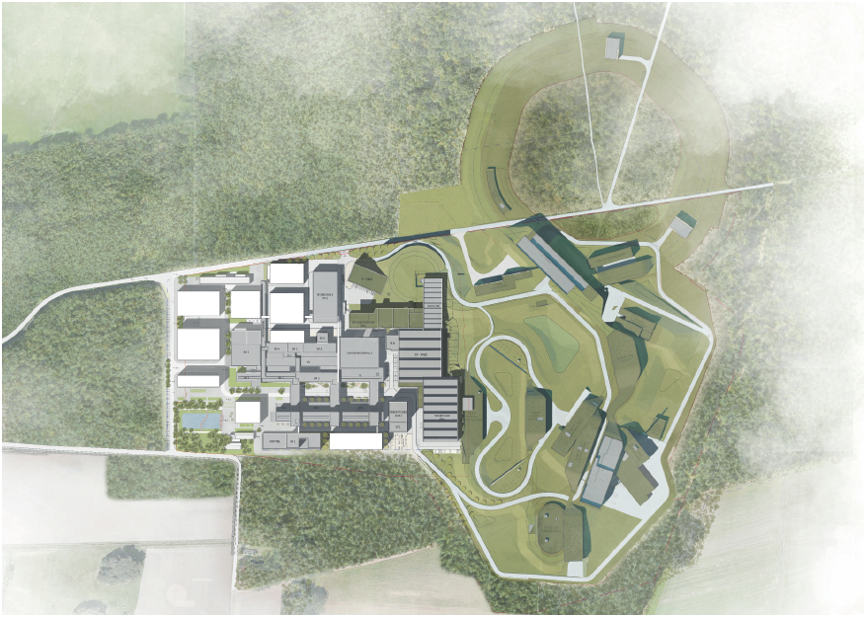
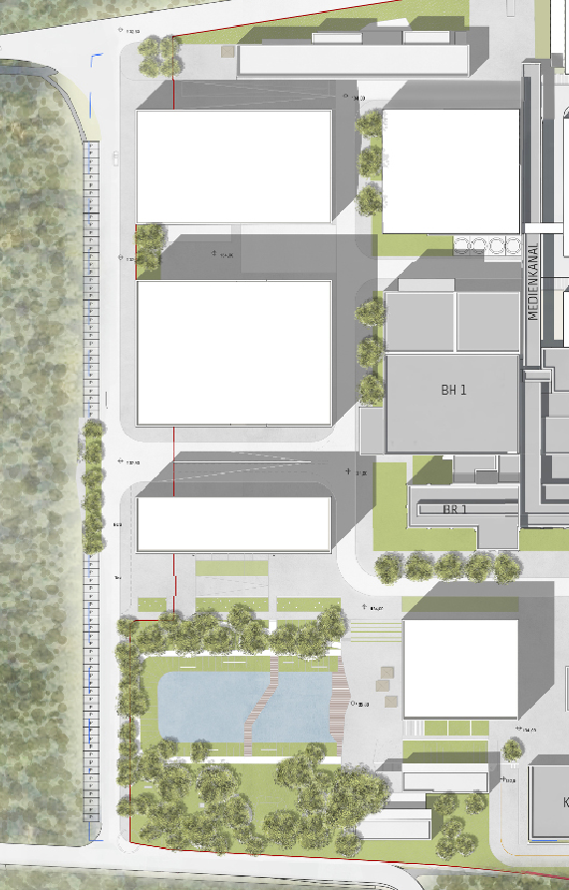
GSI Campus Development - Masterplan
KBW
Car park
Entrance building
FAIR & GSI Campus Development - 1st Phase
FAIR Control center (FCC)
Multi storey car park
Entrance building
Refurbishment of existing buildings
FCC

Slide 12
Agenda
FAIR & GSI – Strategy
GSI GmbH & FAIR GmbH Organisation
GSI Operation
GSI Campus
FAIR Project
Collaboration CERN – GSI/FAIR

Slide 13
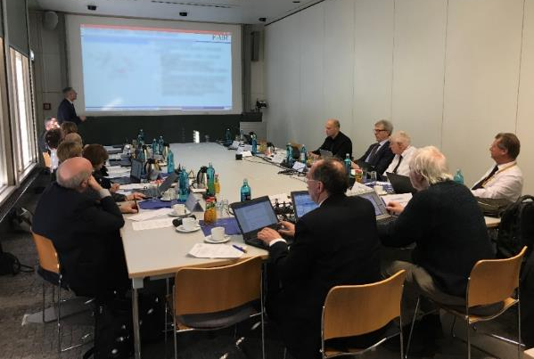
FAIR Project - International Review 2019
International Project Review completed and conclusions presented to 26th Extraordinary FAIR Council on 29th April 2019

Slide 14
FAIR Project - International Review 2019
Conclusions of the Review Panel
  Science case of FAIR MSV as world class science confirmed
  First experiments are expected end 2025
  FAIR project execution works are recognized as very good
  Full scope of civil works should be executed at once
  Solutions for providing the necessary additional funding should be implemented shortly to allow full continuation of project execution works
Next Steps
  Discussion in 27th (3.&4. July 2019) and 28th (5.&6. Dec. 2019) FAIR Council where proposed decisions need to be taken.

Slide 15
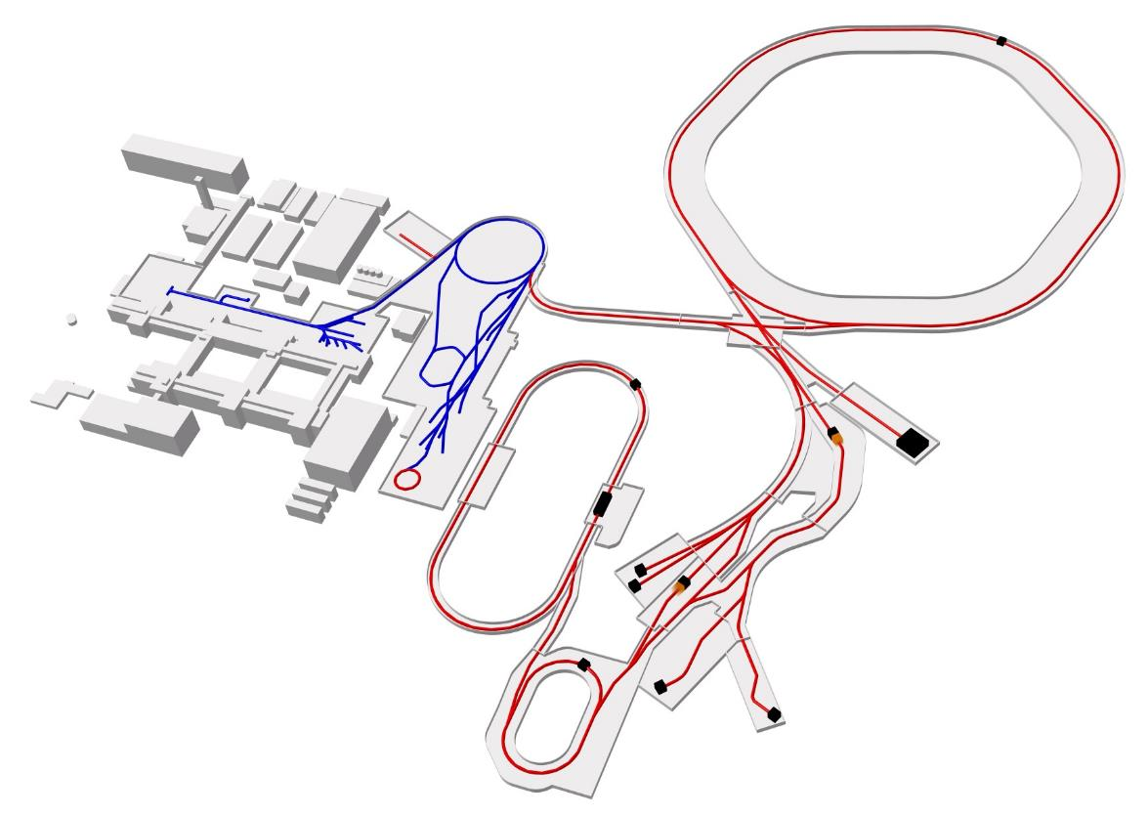
FAIR Project – The Facility
Ring
accelerator
Ring accelerator SIS100
Linear
accelerator
Production of new atomic nuclei
Antiproton
ring
Production of antiprotons
100 meters
Existing facility
Planned facility
Experiments
Collector
ring

Slide 16
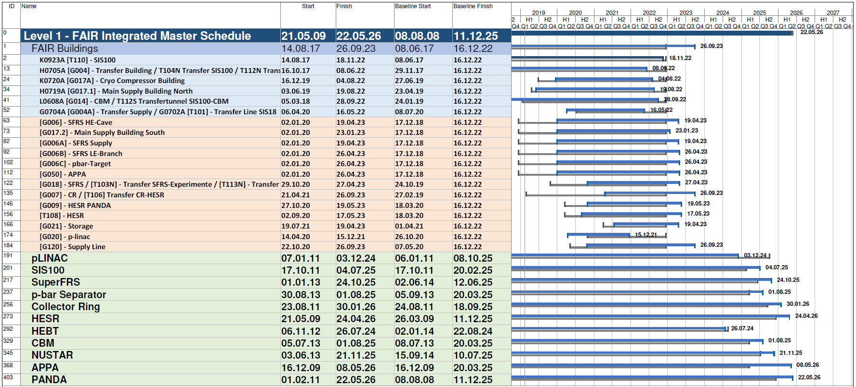
FAIR Project - Master Time Schedule
New Baseline as February 2019
Baseline Dates 2016
New Baseline Dates
Early Science in second half of 2025
Completion of full FAIR MSV scheduled until mid 2026

Slide 17
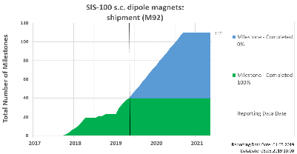
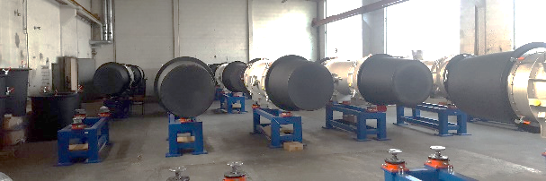
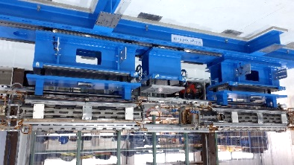
FAIR Project – ACC
SIS100
  Integration of FOS quadrupole module started at BNG
  41 sc dipole modules delivered, 36 dipole modules successfully tested and accepted
  Contract for series testing of the integrated modules with INFN (Salerno, Italy) signed
  Series production released for thin wall dipole- and for thin wall quadrupole chambers with LHe cooling.
  Manufacturing of series of bunch compression cavities at Aurion completed
  Integration of series of bunch compressor power converters at OCEM almost completed
  Production of injection septum magnets and power converters completed
  Series production of cryo-adsorption pumps completed by ILK.
  Tender launched for main dipole- and quadrupole power converters and for extraction kicker system.
  Decision taken for technical solution of quench detection system based on GSI-inhouse developments.
sc dipole modules in GSI storage area
FOS QP module integration @ BNG
Bunch compression cavities at AURION

Slide 18
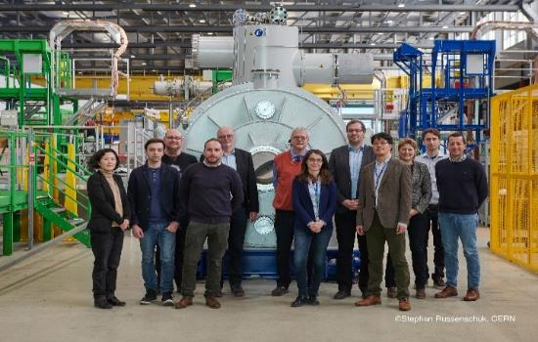
FAIR Project – ACC
Super- FRS
  Kick-off meeting at CERN of the testing facility for SC magnets performed
  Successful FAT of First-of-Series SC Multiplet; Multiplet shipped to CERN for testing
  SC branched dipoles specifications ready. Award of tender expected for Q4-19 / Q1-20
  Local cryogenics specification released in January 2019
  Contracts status with BINP:
      NC dipoles and diagnostic vacuum chambers signed
      Contract finalised for SC dipoles vacuum chambers
      Negotiation ongoing for NC multipoles, NC magnet chambers, other vacuum elements and BPM detectors
  Production contract for the special radiation hard cable as supplementary material (MIC cable) for NC dipoles signed in January 2019
  In-kind contract with Sweden for SEM-grid detectors signed in February 2019. Kick-off done on 04/04/2019
  India expressed interest to provide the laterally part of iron shield. Decision required soon.
Kick-off of testing facility at CERN
Notes:
Negotitation ongoing streichen?

Slide 19
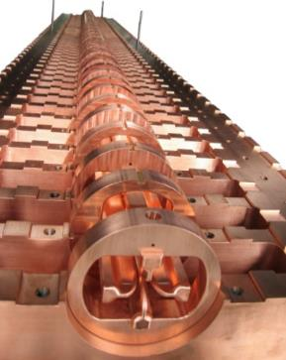
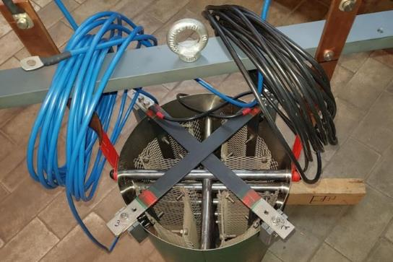
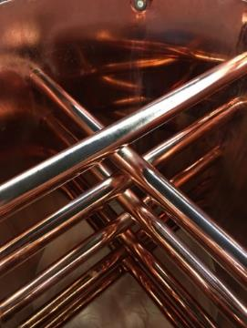
FAIR Project – ACC
pLinac/ pbar Target
  Commissioning of ion source at CEA in progress. Beam shape improved
  Ladder-RFQ (fig. 1) opened and machined to final geometry after first low level RF tests and succeeding simulations. Very good agreement with expected resonace frequency, quality factor and flatness
  Copper Plating tests for first CCH cavity started. Promising results with dummy cavity (see fig. 2 and 3)

Slide 20
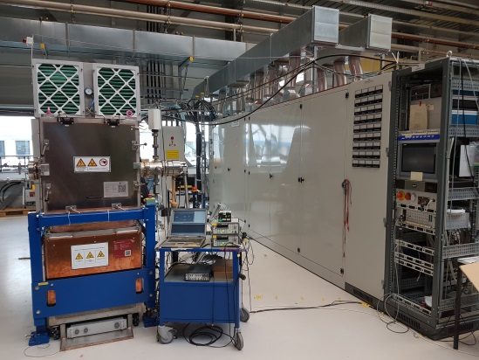
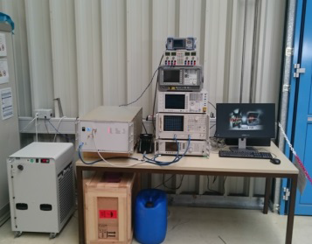
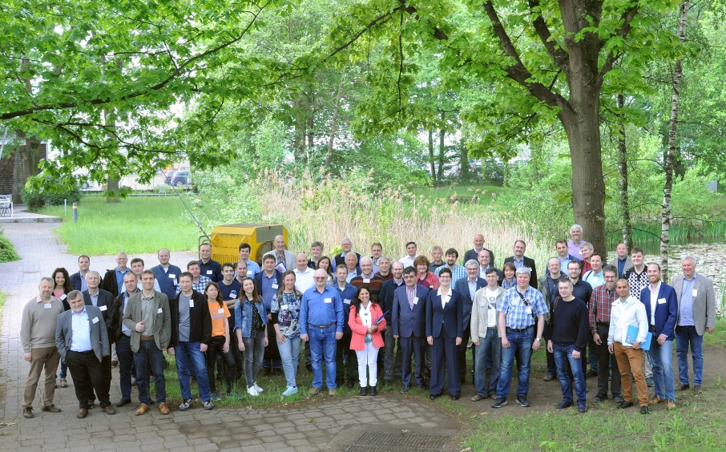
FAIR Project – ACC
Collector Ring
  Series production of RF – debunchers has been finished. SAT is under preparation at GSI
  Series production of Power amplifiers for Stochastic Cooling is in progress
  2nd BINP - FAIR Coordination Workshop performed covering aspects of all subprojects in Darmstadt at GSI from 20th – 24th May 2019
RF-debuncher
Power amplifiers for Stochastic Cooling
FAIR-BINP Coordination Workshop May 2019

Slide 21
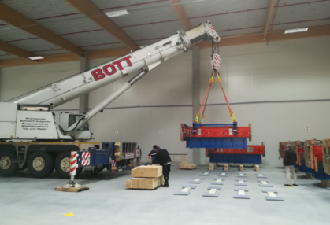
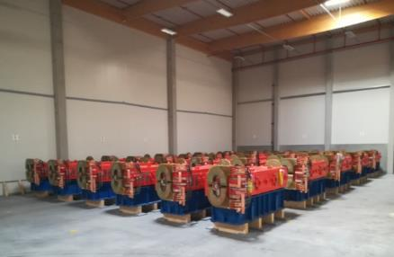
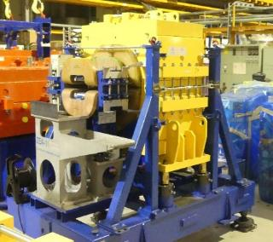
FAIR Project – ACC
HESR
  All Dipoles are produced and are in Jülich, 78% are delivered to FAIR
  All Quadrupoles are produced and are in Jülich
  Sextupoles, steerers and their power converters are in production (Romania), magnets arriving continuously in Jülich
  Nearly all other power converters are produced and are in Jülich.
  RF equipment mechanical design is finished, production has started.
  Stochastic cooling equipment, beam diagnostics and injection kickers are in production

Slide 22
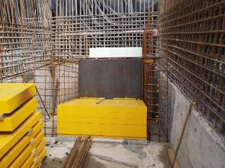
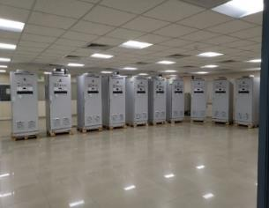
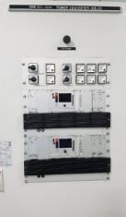
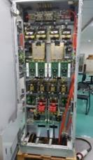
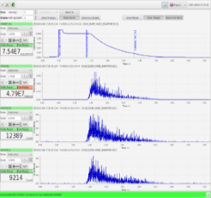
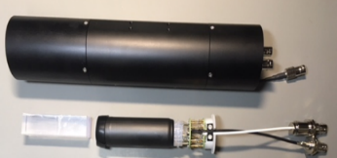
FAIR Project – ACC
  Installation of first beam dump in HEBT transfer building in April 2019
  HEBT Power Converter:
      Detailed Specifications of all HEBT Power Converter types released
      FAT of main series (67 pcs.) HEBT Quadrupole Power Converter completed at ECIL, India in June 2019
  HEBT Beam Instrumentation:
      Beam tests of FAIR-type Beam-Loss Monitors successfully tested with beam at HADES
      Acceptance tests of LIBERA readout system performed
COMMONS
Installation of HEBT beam dump
HEBT PC during FAT at ECIL
Inspection of prototype HEBT Steerer PC at ECIL
New Beam-Loss Monitor
designed & produced by GSI

Slide 23
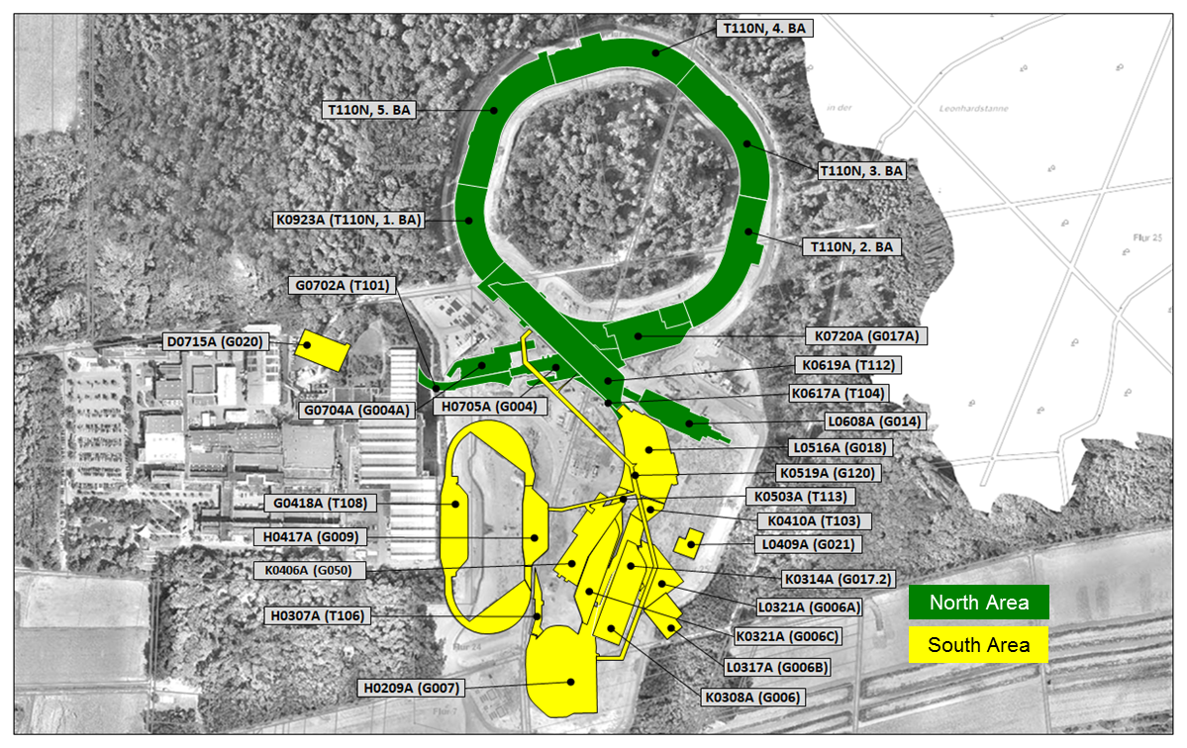
FAIR Project - Civil Construction
FAIR Site & Buildings

Slide 24
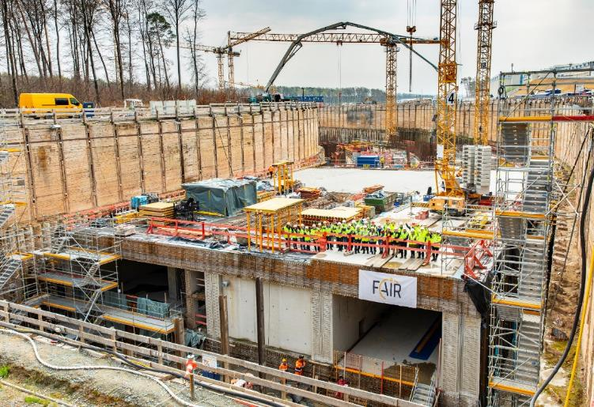
FAIR Project - Civil Construction
1st SIS100 tunnel segment
concreting completed in April 2019
Groundbreaking ceremony
on 3rd July 2017

Slide 25
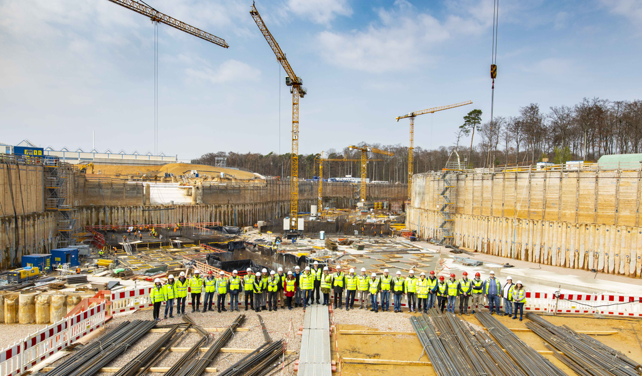
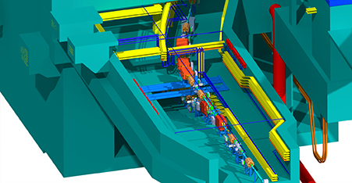
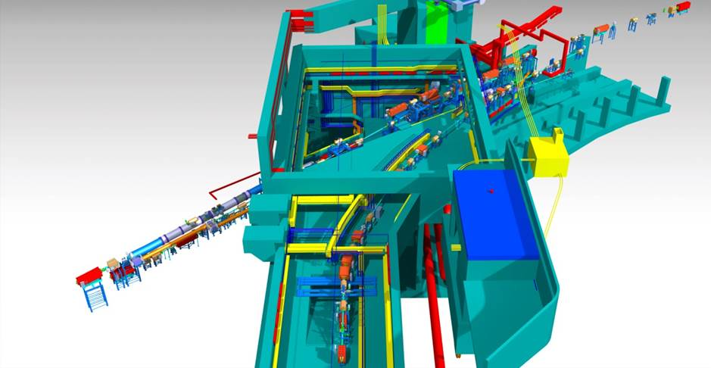
FAIR Project - Civil Construction
Ground slab of transfer building under execution in April 2019
Complex design of very large transfer building

Slide 26
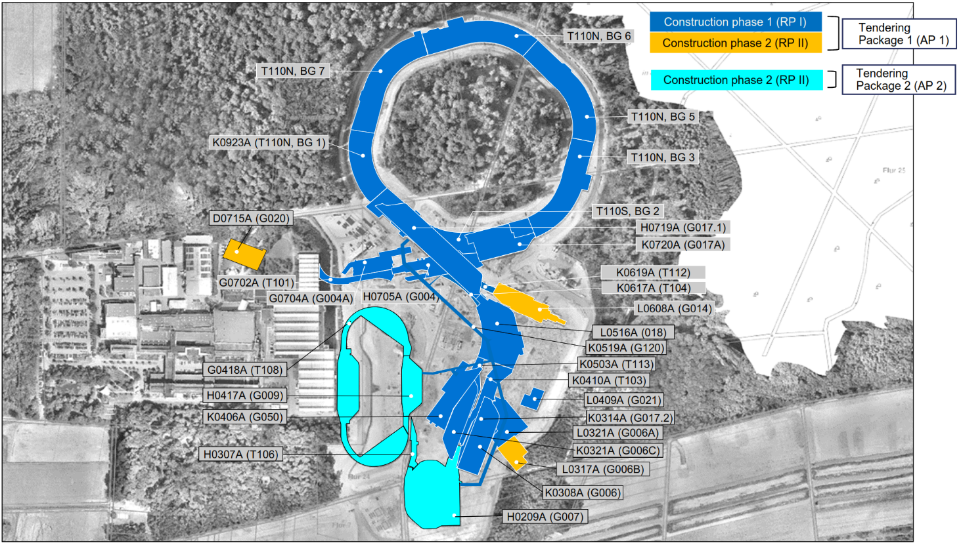
FAIR Project - Civil Construction
- Contracting strategy for Technical building Installations

Slide 27
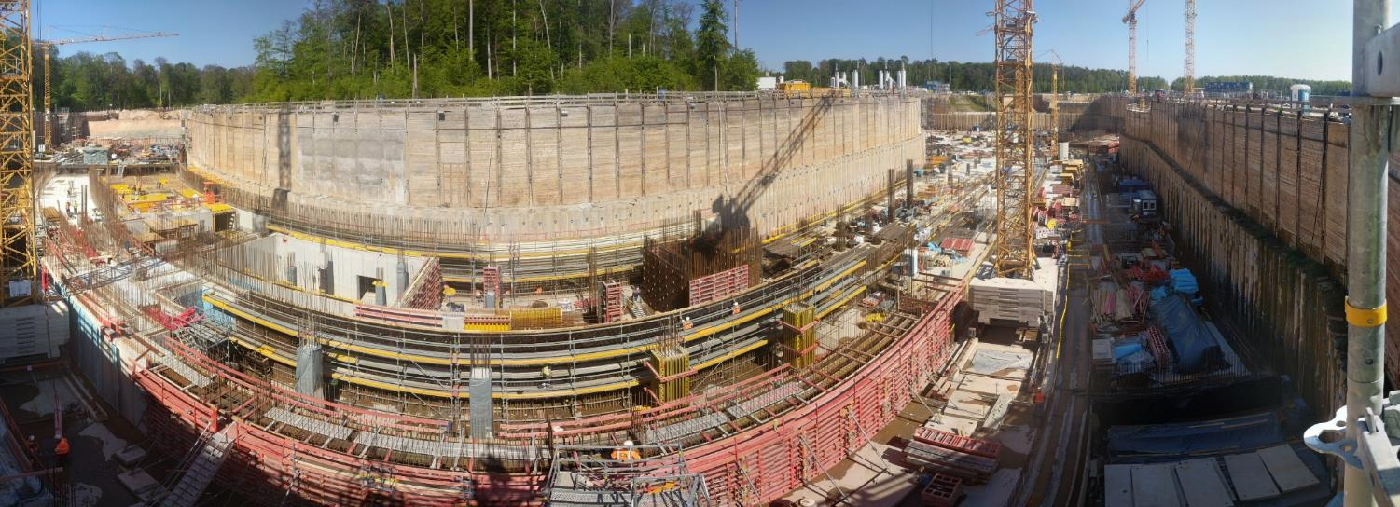
FAIR Project - Civil Construction
- Next Steps
Continuation civil detailed design process and civil work in the field
Awarding of construction area south in full in Q4 2019
Continue tendering for technical building installation (MEP) and award in 2020

Slide 28
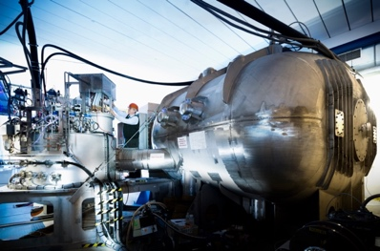
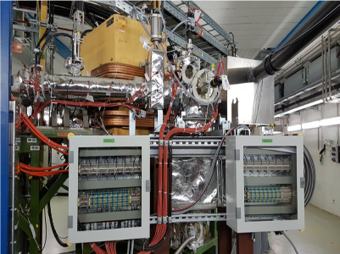
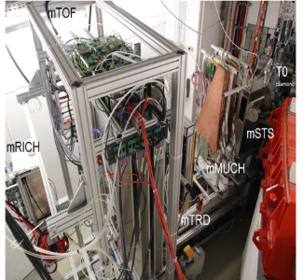
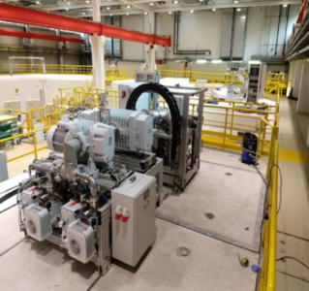
FAIR Project - Experiments
Main Achievements
Day 1 configurations vetted technically and scientifically by Expert Committee Experiments and Joint Scientific Council.
Experiments utilizing beams from SIS18 within the FAIR Phase-0 program have started.
First test experiments of the NUSTAR-R3B collaboration were performed with the fully operational GLAD magnet, a large German-French contribution to the experiments.

Slide 29
Agenda
FAIR & GSI – Strategy
GSI GmbH & FAIR GmbH Organisation
GSI Operation
GSI Campus
FAIR Project
Collaboration CERN – GSI/FAIR

Slide 30
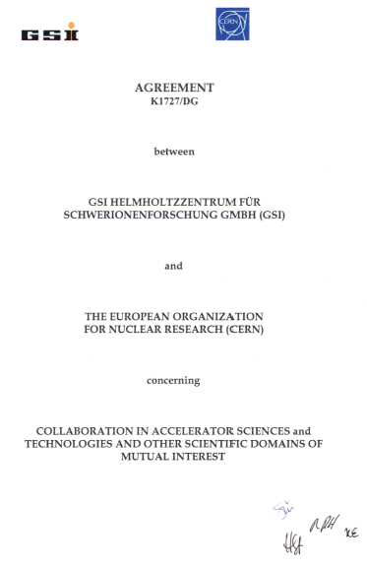
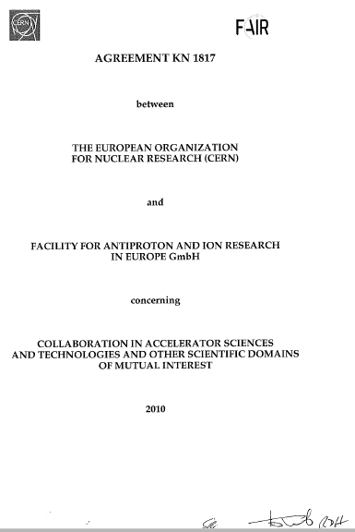
Collaboration CERN – GSI/FAIR
CERN and GSI/FAIR have an excellent and longlasting collaboration over many decades.
We appreciate very much that you are visiting GSI/FAIR Campus.
We are looking forward to fruitful discussions to intensify collaboration activities on proposed selected topics with special focus on FAIR.

Slide 31
Thank you for your attention !

