Slide 1
Photonis 2150 Part 2, Afterglowing and DiRICH
Merlin Böhm, A. Lehmann, D. Miehling,
M. Pfaffinger

Slide 2
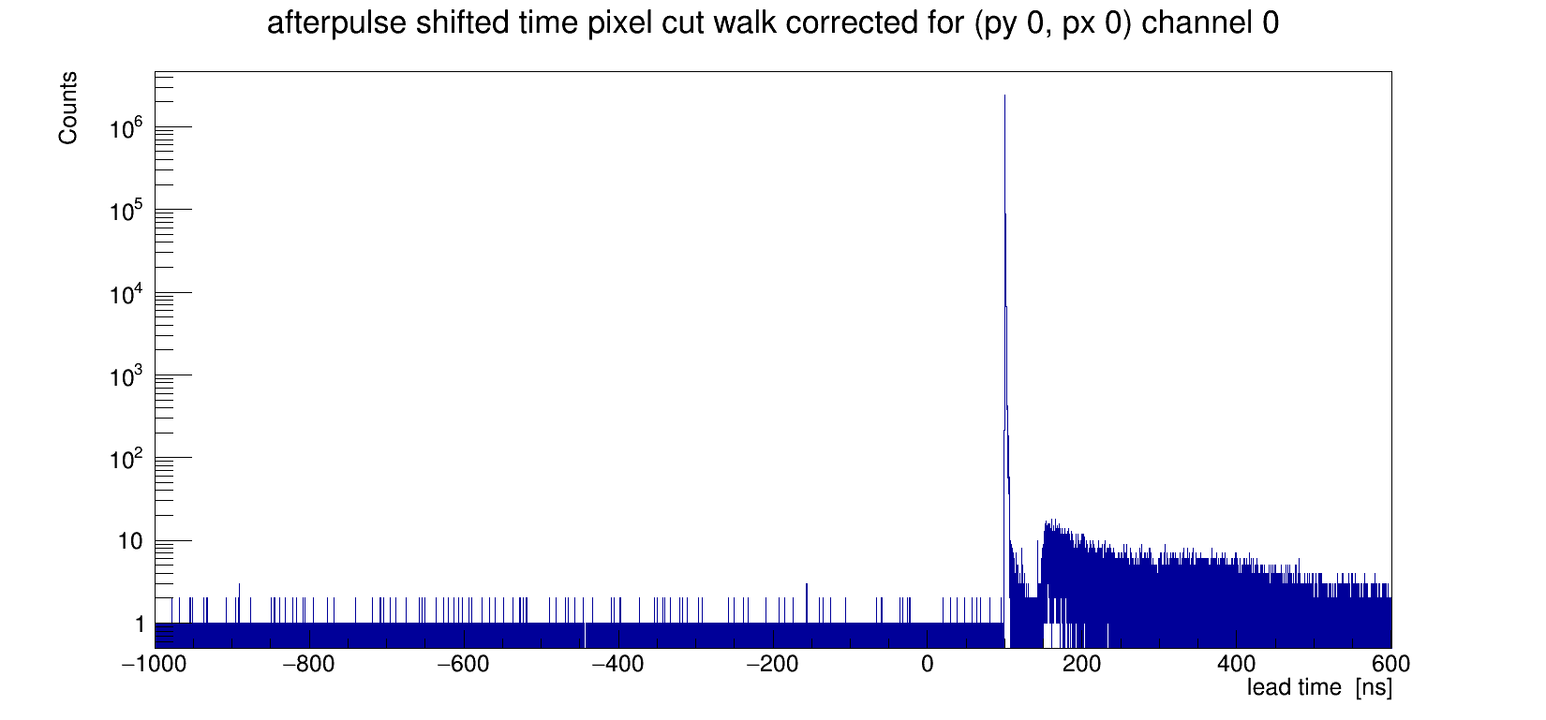
TRB measurements – Time spectrum
Sum of all events
Laser pulse
Afterpulses +
Dark counts
Dark counts
Measured time delay between laser pulse and pixel response

Slide 3
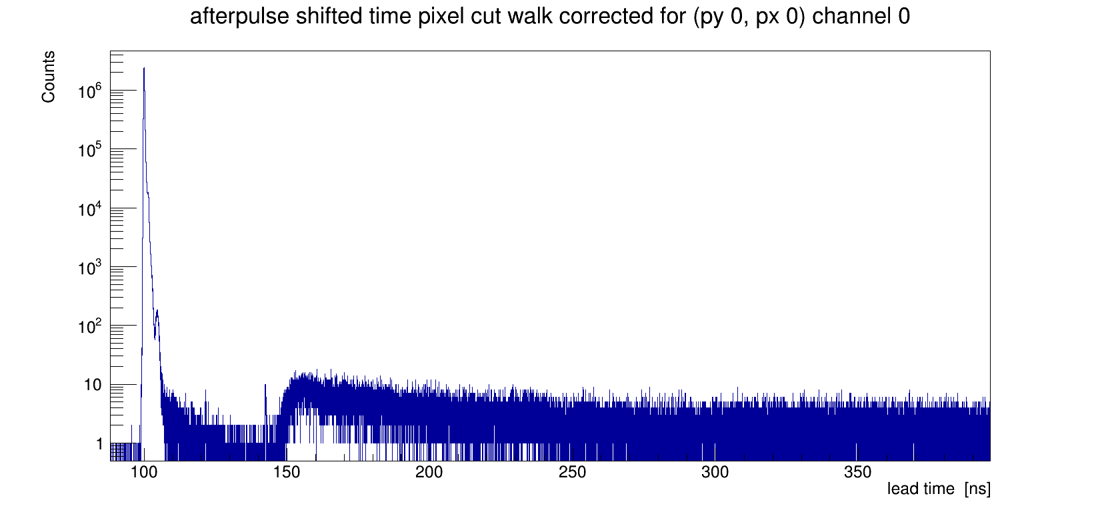
TRB measurements – Time spectrum zoomed
Sum of all events
Laser pulse
Afterpulses +
Dark counts
Dark counts
Measured time delay between laser pulse and pixel response

Slide 4
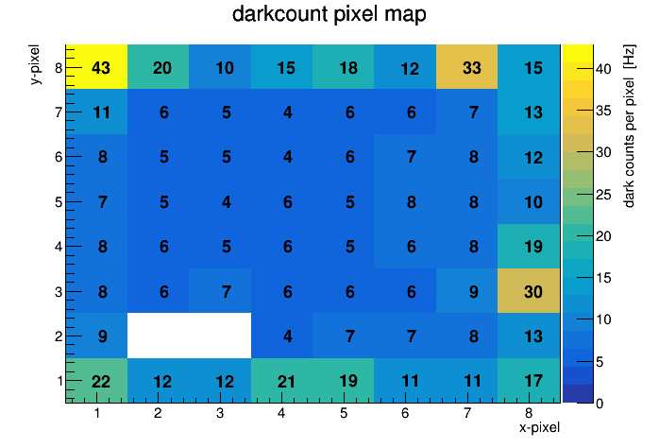
TRB measurements – dark count rate
Photonis
9002150
Threshold set to 0.1 p.e. (low noise background) at 2200V (0.7e6 gain)
Whole Sensor 649 Hz, per Pixel average 10 Hz

Slide 5
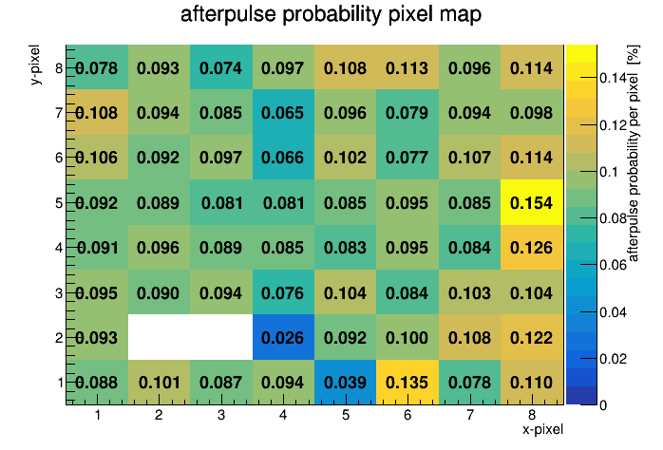
TRB measurements – Afterpulse probability
Photonis
9002150
Threshold set to 0.1 p.e. (low noise background) at 2200V (0.7e6 gain)
Whole sensor average afterpulse fraction 0.093%

Slide 6
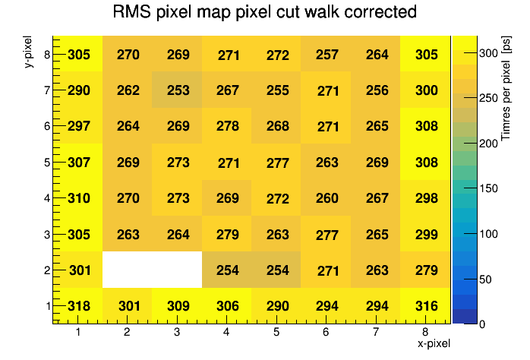
TRB measurements – RMS time resolution
Photonis
9002150
Threshold set to 0.1 p.e. (low noise background) at 2200V (0.7e6 gain)
Time window 90-110 ns
Average time resolution of 280 ps dominated by readout electronics

Slide 7
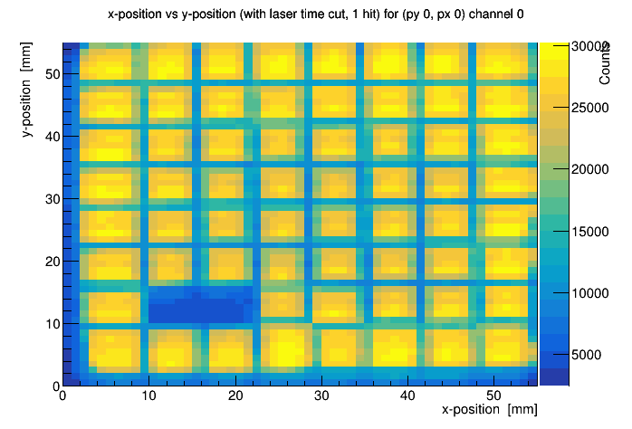
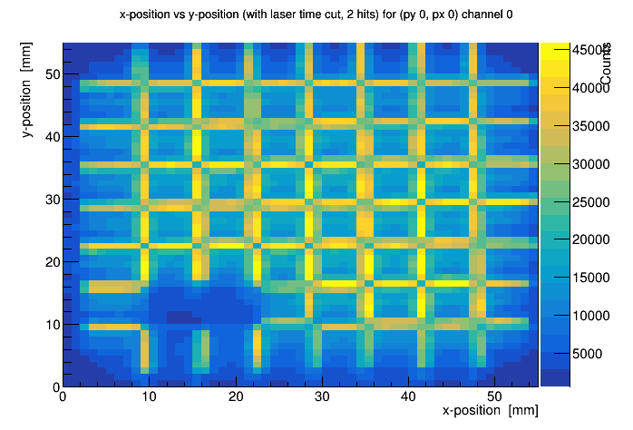
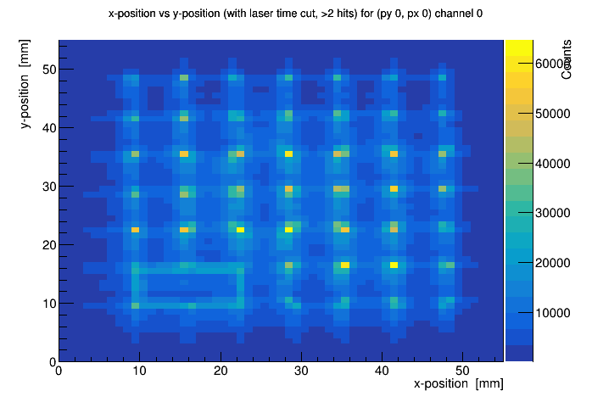
TRB measurements – Crosstalk
1 Hit
2 Hits
3 Hits
Narrow time window of 1.5 ns, at 2200V (0.7e6 gain)
2 Pixels simultaneously hit reveals charge cloud width
Charge cloud width ~1.6 mm FWHM
3 Pixels simultaneously hit reveals edge of pixels

Slide 8
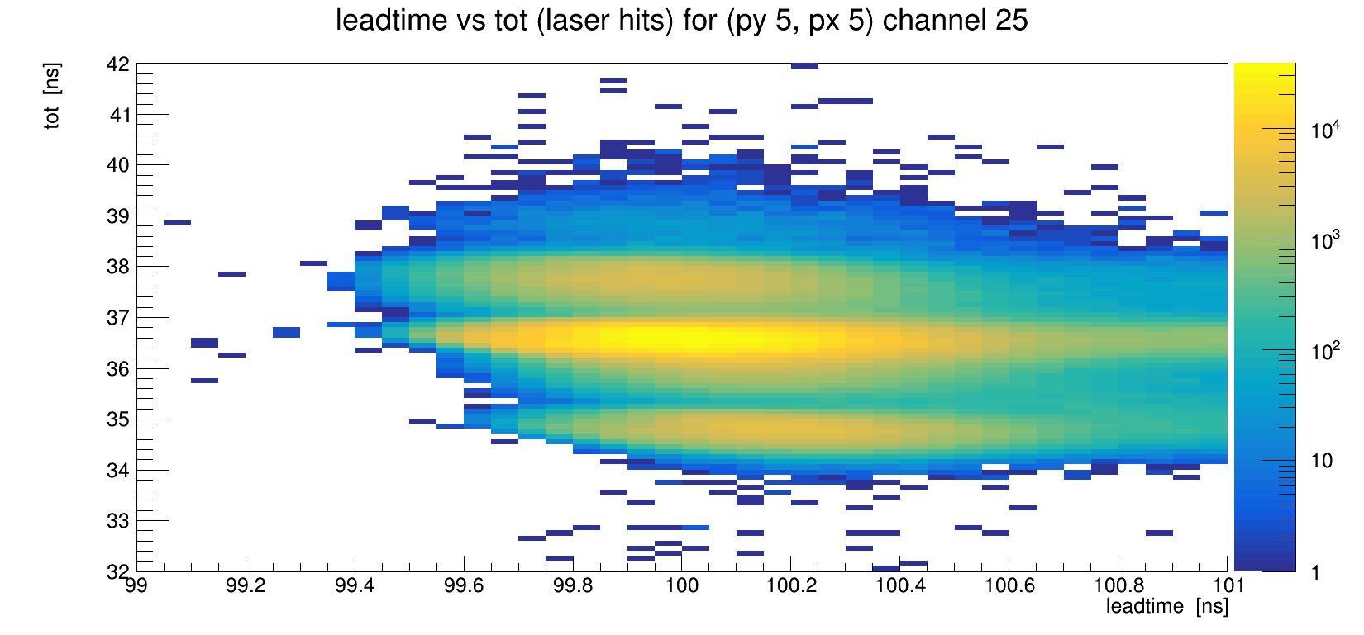
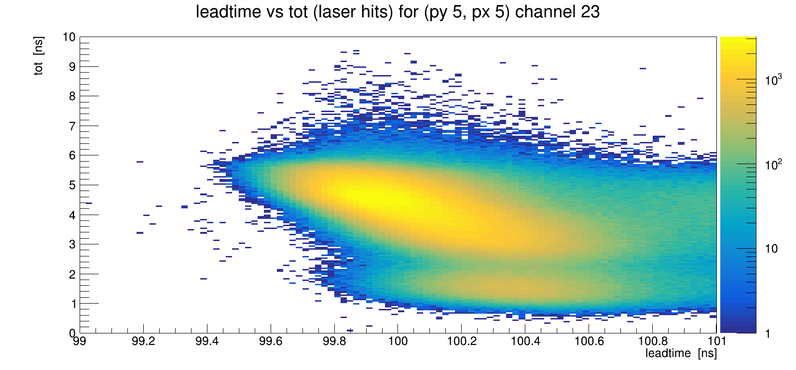
TRB measurements – Ringing behavior
Monitoring the time over threshold (tot) during scans
Adding 50 Ohm parallel between signal and ground in the past showed less ringing (or much higher frequency) and no multiple peaks in tot spectra
Photonis countermeasure: adding 75 Ohm, is effective, too
2108 (no countermeasure)
2150 (75 Ohm on Backplane)
Multiple peaks
Continuous spectrum

Slide 9
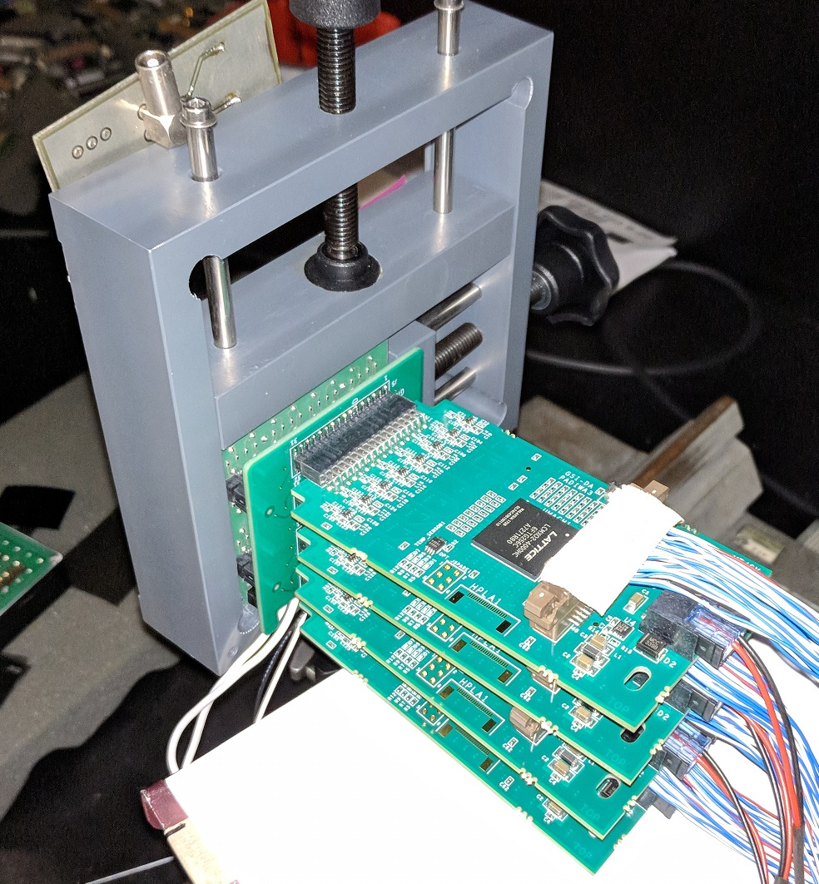
TRB measurements – Crosstalk behavior
MCP-PMT
Adapter PCB
Cover half of the MCP-PMT and look at the number of simultaneous hits in a 15 ns window around the laser peak on the covered and open side at different thresholds
Adjust ND-Filter to get ~1 p.e./Pixel (${\overline{n}}_{pe}$)
Adjust the voltage to get the same signal height distribution
Discriminator boards (PADIWA)

Slide 10
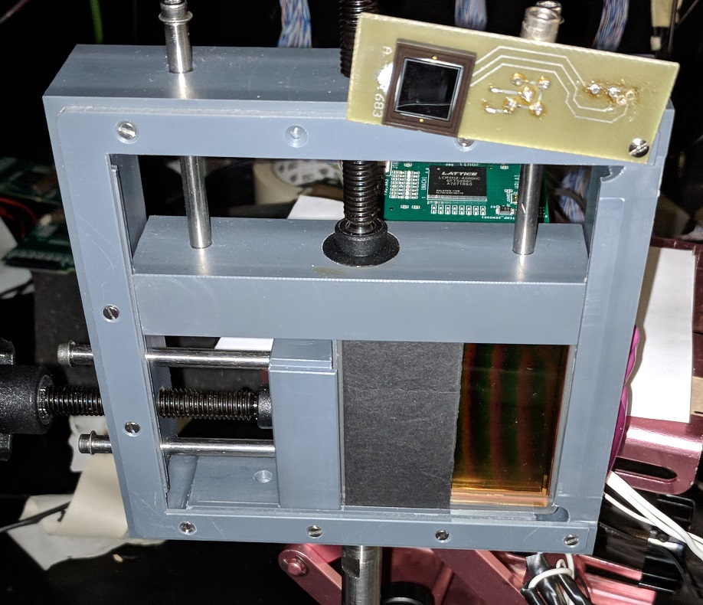
TRB measurements – Crosstalk behavior
Reading out only the 3 most left and right rows so partially covered pixels don’t distort the result
On the covered half only crosstalk from oscillation should be seen
Illuminated half: 18 pixels * (1-P(0)) = 12 hits expected (P(0) = exp(-${\overline{n}}_{pe}$) with ${\overline{n}}_{pe}$= 1)
On 2108 crosstalk events with up to 18 Hits/Laser pulse at low threshold can be observed, on 2150 only 2 hits
Crosstalk signal height also 25% smaller on 2150 compared to 2108
Photonis countermeasures against crosstalk seem to be effective
Covered half
Open half

Slide 11
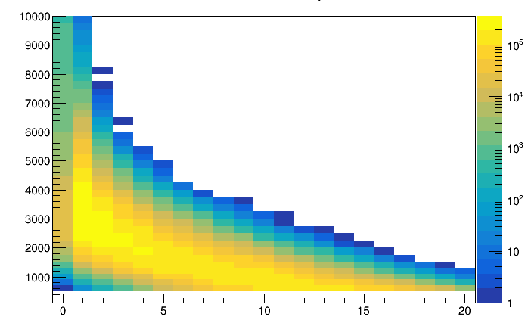
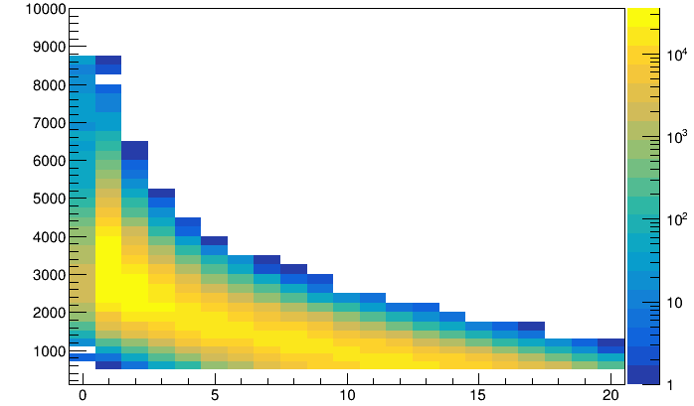
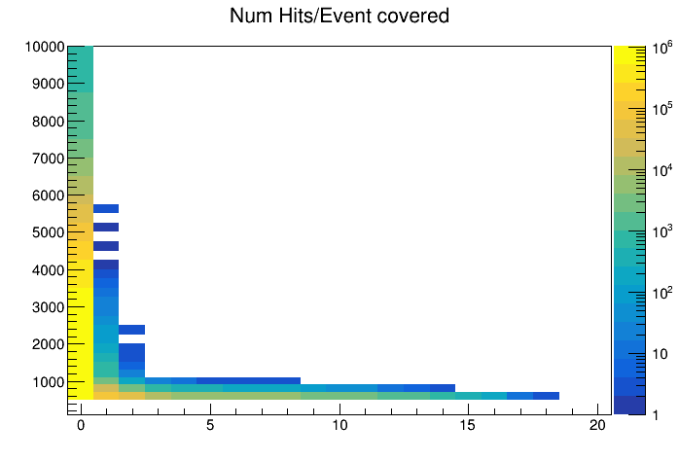
TRB measurements – Crosstalk behavior
2108 open half
2150 open half
Threshold
Threshold
Expected 12 Hits
Expected 12 Hits
2108 covered half
2150 covered half
Less “fake hits” at covered half of 2150
Number of Hits/Event
Number of Hits/Event

Slide 12
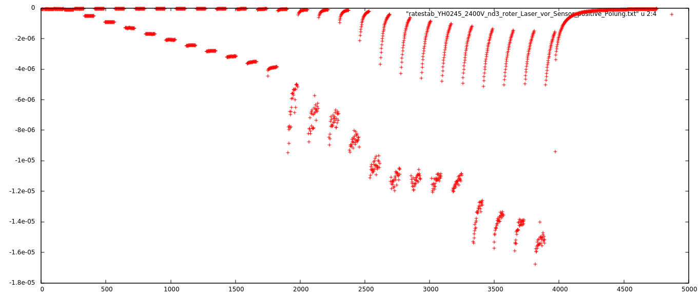
New feature: afterglowing?
After illuminating MCP-PMTs with high intensity light the darkcount rate is significantly increased
The count rate decays within several seconds
This effect can also be observed during our rate stability measurements:
YH0245
Laser off
Current [A]
Laser on
Time [s]

Slide 13
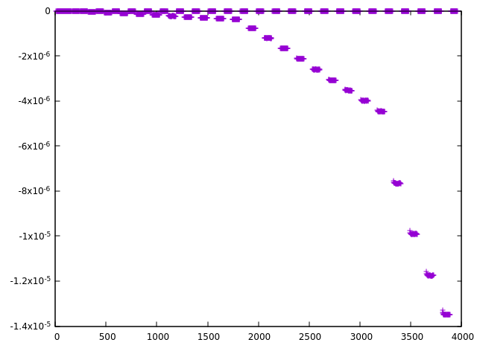
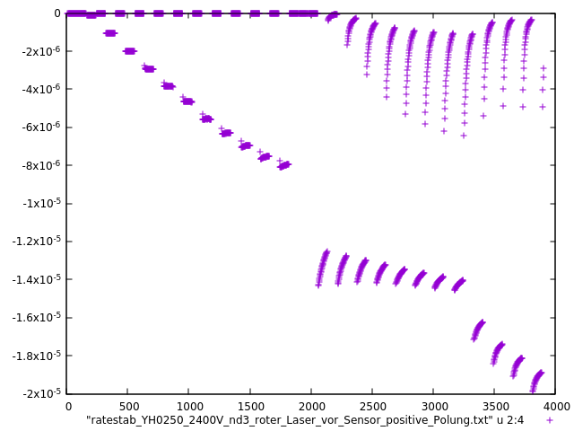
New feature: afterglowing?
left: Photonis 9001393-URD
right: Hamamatsu YH0250
red line corresponds to 2MHz photonrate per cm²
anode current in A
anode current in A
time in s
time in s

Slide 14
New feature: afterglowing?
With current measurements: this feature seems to occur with both Photonis and Hamamatsu tubes and affects only ALD-tubes
no effect: Photonis 9001341 (non-ALD tube)
almost no or a small effect: Photonis 9001393 (two-ALD), 9001394 (ALD), 9002108 (ALD), 9002150 (ALD); Hamamatsu JS0026 (ALD?, Gießen), JS0035 (ALD)
a strong effect:
Hamamatsu YH0245 (ALD?, Gießen), YH0250 (ALD)

Slide 15
New feature: afterglowing?
comment: the summary on the last slide is preliminary since (most of) the data is from old ratestability measurements and only „bycatch“
more investigations needed with both current measurements and PADIWA and/or DiRiCH

Slide 16
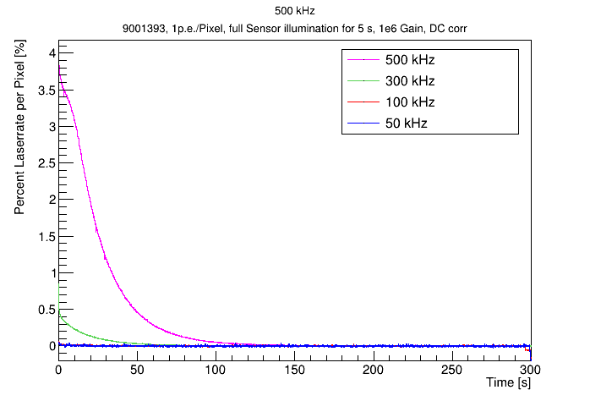
Afterglowing – further investigations with 9001393 with TRB
Illuminating the full MCP-PMT PC for 5s with 1p.e./Pixel, then turn off the laser and measure the count rate
Higher illumination intensity results in more afterglow
Observed up to 10% afterglow events compared to the laser rate

Slide 17
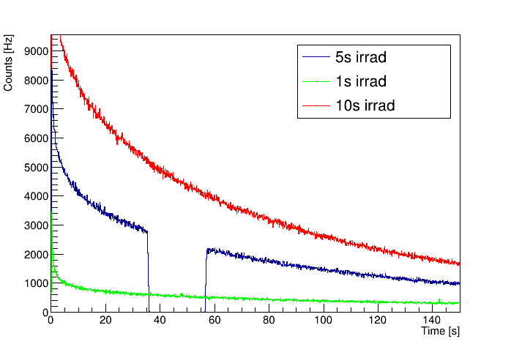
Afterglowing – further investigations with 9001393 with TRB
Illuminating the full MCP-PMT PC for different amount of time with 1p.e./Pixel, then turn off the laser and measure the count rate
Longer illumination intensity results in more afterglow
Turning off the HV has no effect on the decay
HV off

Slide 18
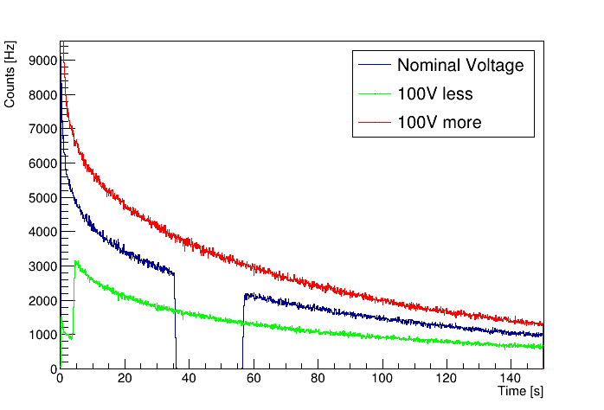
Afterglowing – further investigations with 9001393 with TRB
Illuminating the full MCP-PMT PC for 5s with 1p.e./Pixel and altered HV, then turn off the laser and measure the count rate
Amount of afterglow is gain dependent
Turning off the HV has no effect on the decay
HV off

Slide 19
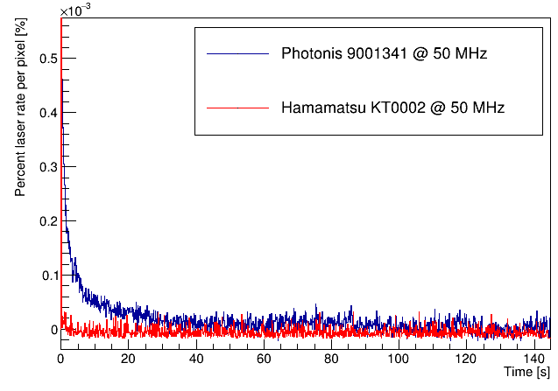
Afterglowing – further investigations
Further observations:
Afterglowing must be an effect of the ALD-Layer because:
Only MCP-PMTs with ALD-Layer affected
No afterglow when turning on only the PC bias voltage on during illumination
Higher MCP resistance leads to more afterglow
Photonis as well as Hamamatsu MCP-PMTs are affected

Slide 20
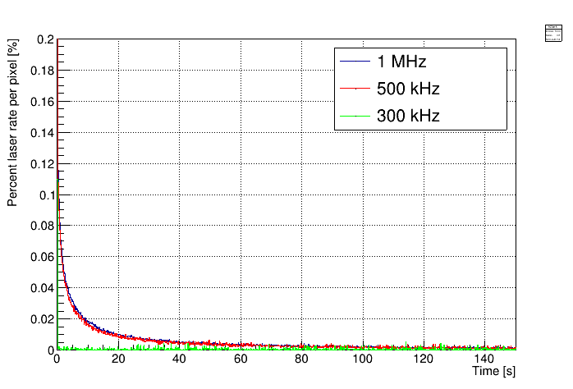
Afterglowing – further investigations
Further observations:
Afterglowing must be an effect of the ALD-Layer because:
Only MCP-PMTs with ALD-Layer affected
No afterglow when turning on only the PC bias voltage on during illumination
Higher MCP resistance leads to more afterglow
Photonis as well as Hamamatsu MCP-PMTs are affected
Hamamatsu YH0250

Slide 21
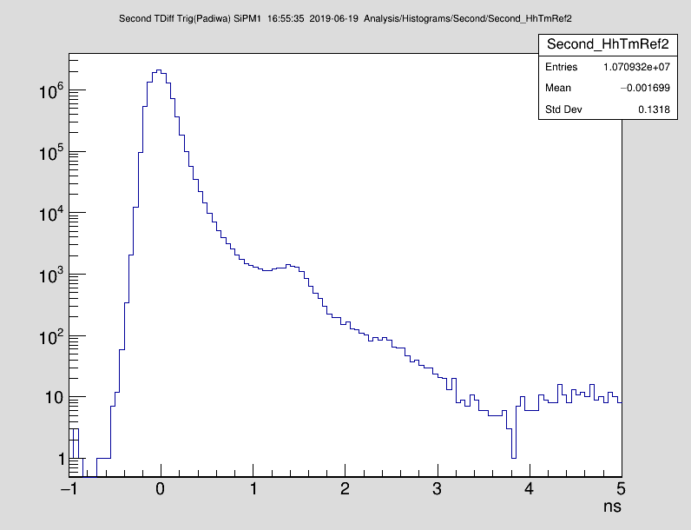
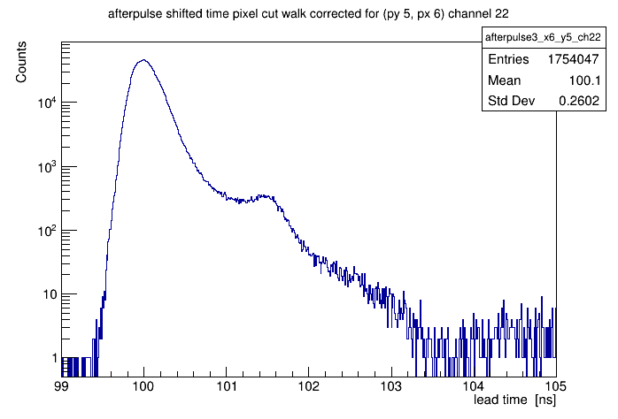
First DiRICH measurements
Got a DiRICH system to test different input configurations of the DiRICH
Time resolution measured with MCP-PMTs significantly better than Padiwa/TRB3
Photonis 2150
DiRICH
132 ps RMS
Padiwa3
260 ps RMS

Slide 22
Summary
Photonis 2150: Time resolution RMS of 171ps (scope) and ~279ps (PADIWA/TRB), but 132 ps with DiRich
low darkcount rate and low afterpulse probability
crosstalk behavior compared to 9002108 much better
better ringing behaviour than former 9002108 tube
MCP-PMT afterglowing after heavy illumination, is rate, duration, gain and MCP resistance dependent, investigation ongoing
First DiRICH measurement very promising, but investigation ongoing

