Slide 1
Beam time schedule 2020
Ideas, questions, first draft…

Slide 2
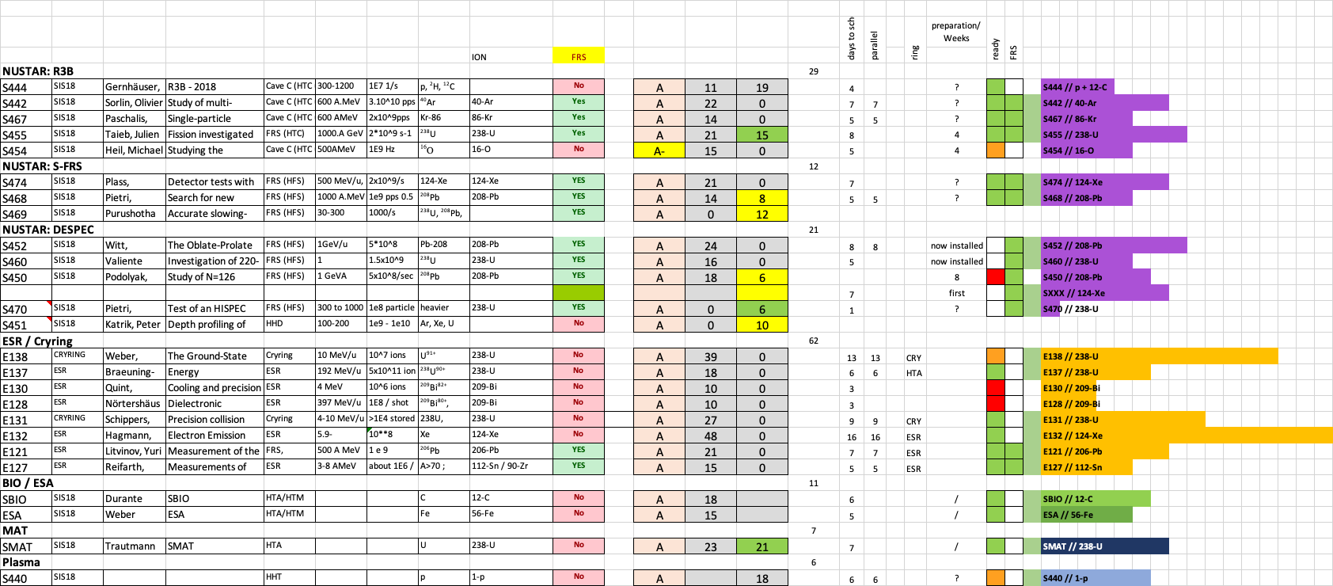
Open proposals for 2020

Slide 3
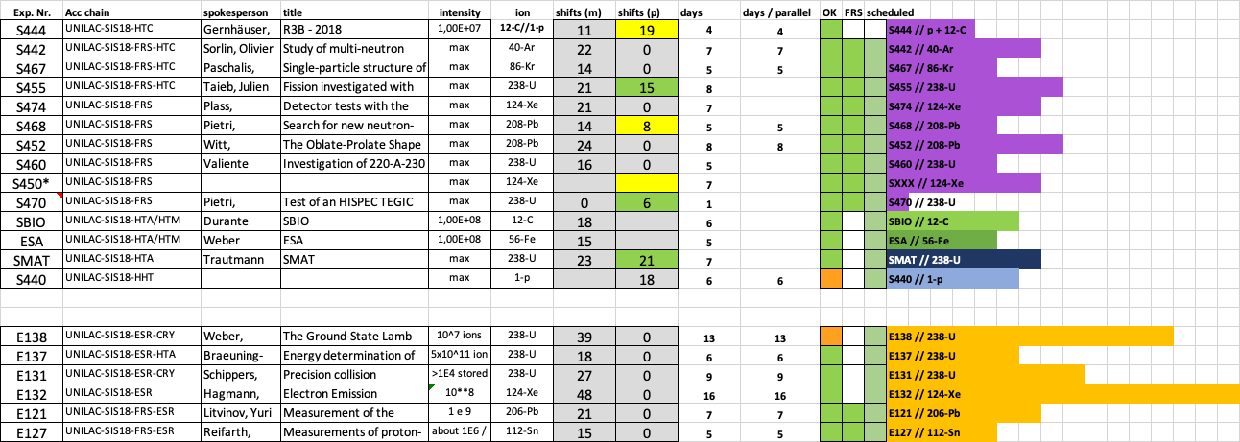
Open proposals for 2020

Slide 4
Open questions
UNILAC operation: Ti beam at the beginning
Au / Ca beam alternating
Fe and C for SIS/Bio -> 3 beams in the machine
p in the beginning and end
….

