Slide 1
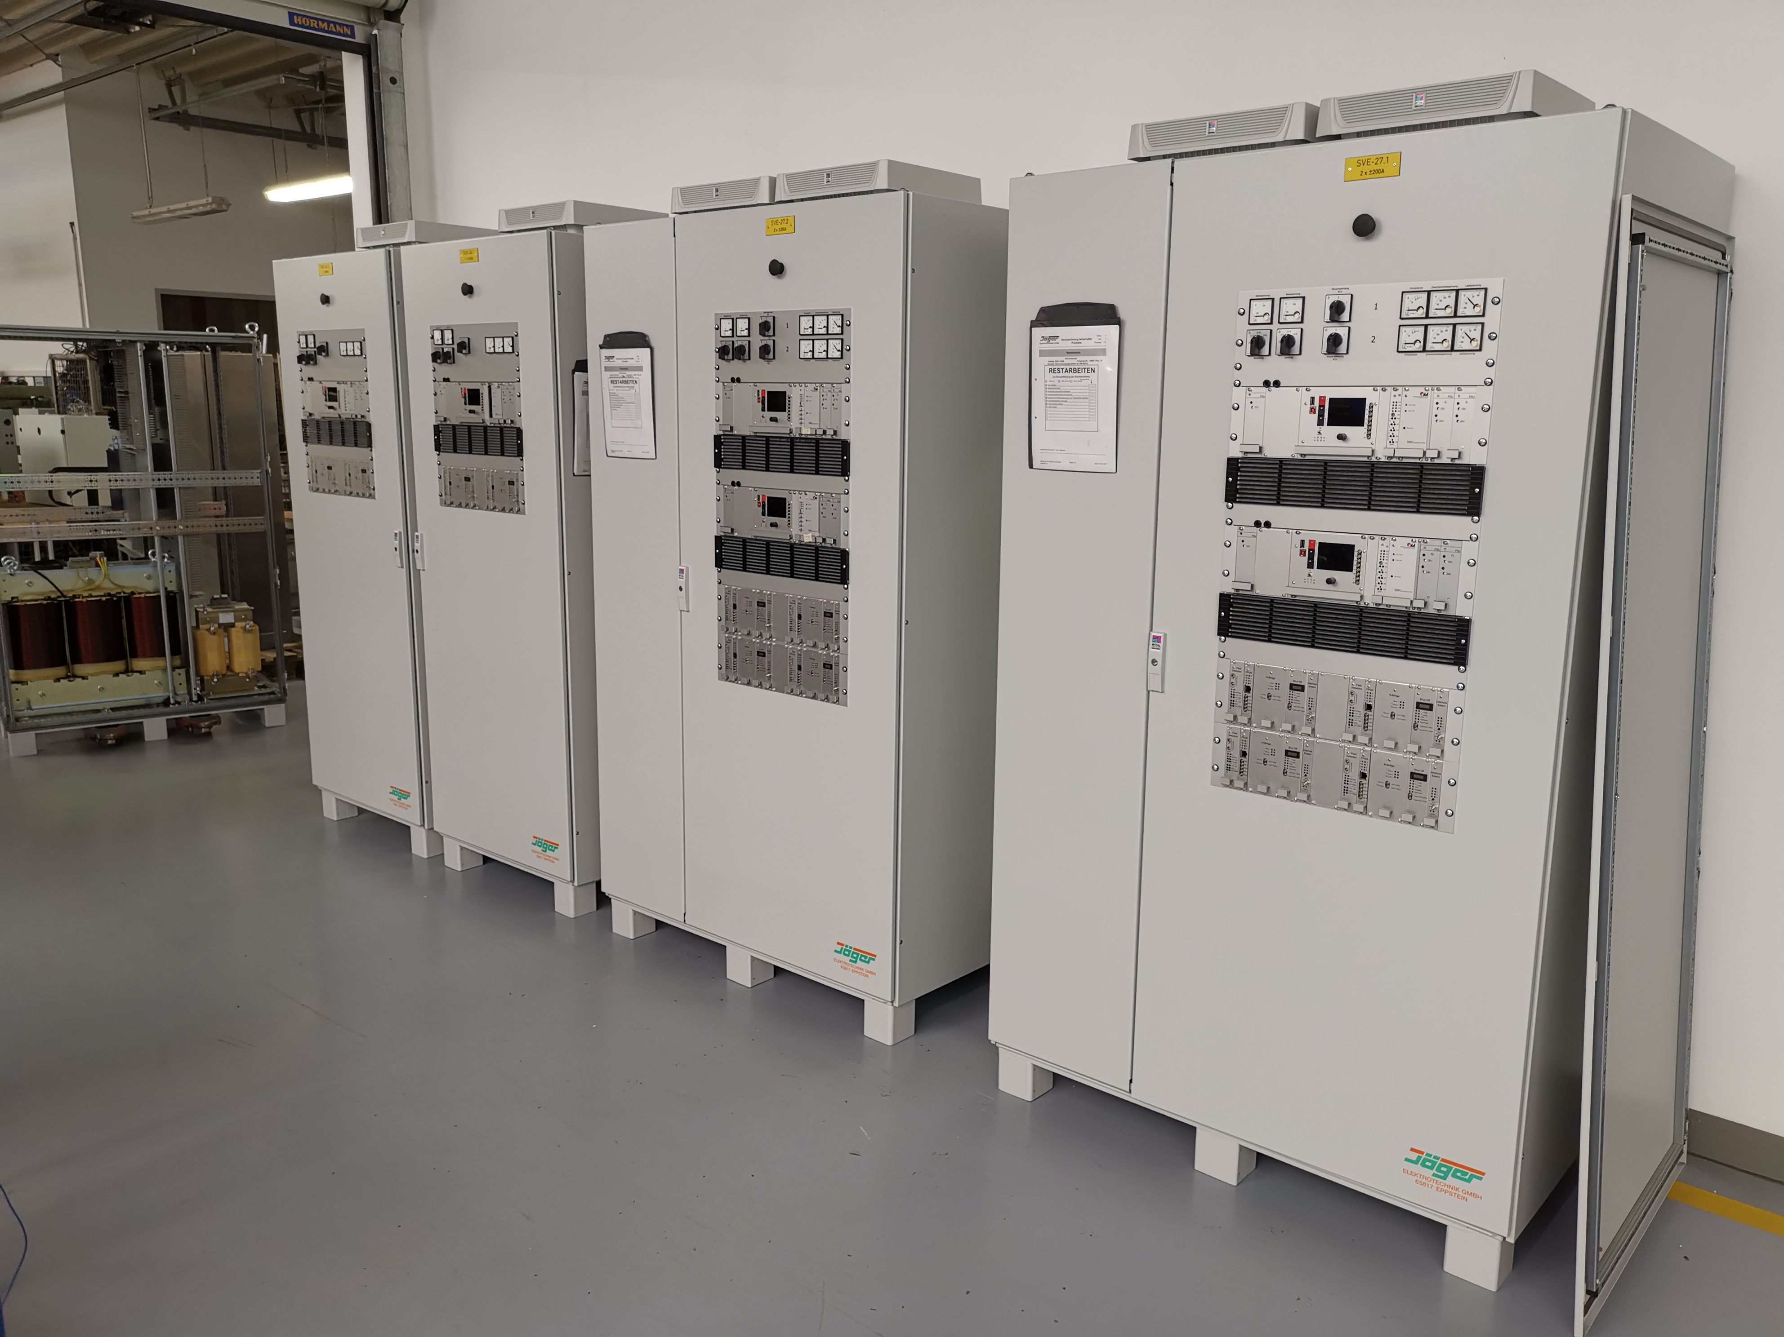
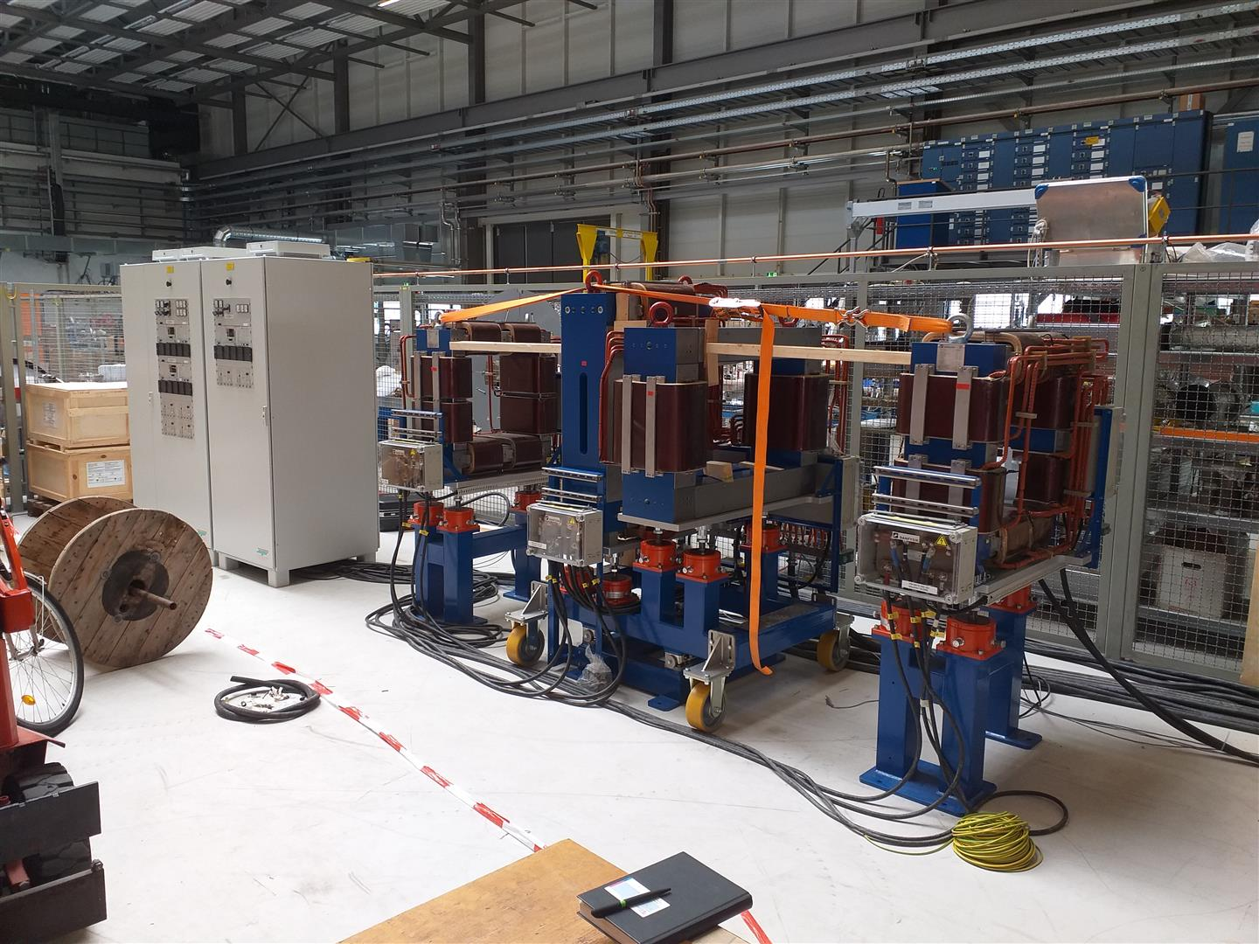
SIS18 Status Report KW23
Technical solution for the fixation of the (moving) coil of the TS1MU1 dipole magnet agreed with DANFYSIK.
Power converter for TS1MU1 magnet after modifications back at GSI and accepted after SAT.
SIS18 IPM magnet power converter installed in testing hall together with IPM magnets. Ready for power tests (SAT).
Check of radiation hardness of SIS18 septum wires started. Evtl. application of reduced cross section wire in new septum.
Preparation of commissioning test for Nitrogen fire protection system. Foil for dust protection of SIS18 arrived. Installation will start in present week.
Delivered: SIS18 and SIS100 IPM power converter
IPM power converter with IPM magnets at SAT in testing hall

