Slide 1
Machine meeting 04.06.19 - UNILAC
LEBT QQ beam pipe:
all parts in house, assembly of A-pipe pending
tests with todays pipe completed, cross-checked
next step: removal of pipe, test with unloaded magnet
Vacuum controls upgrade:
LSB2: Equipping and connecting of new racks in progress
LSB4: New racks in place, electric and air connection pending
Installation of new hardware in progress

Slide 2
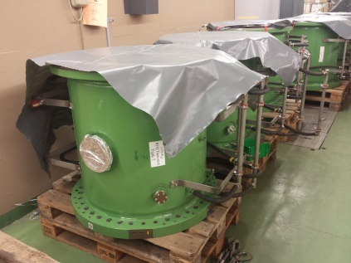
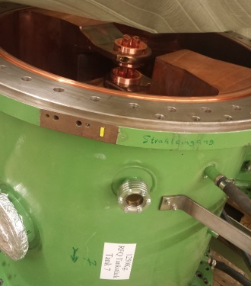
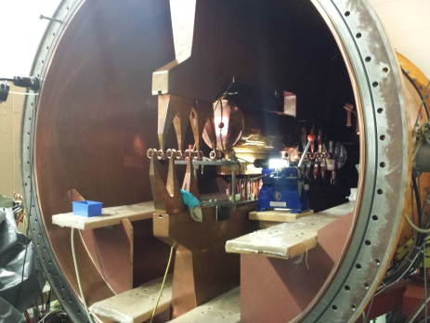
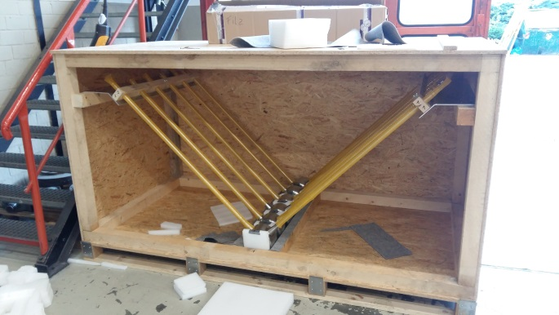
Machine meeting 04.06.19 - UNILAC
HSI RFQ:
section 1-7: new electrodes implemented
HSI IH 1:
leak repaired, metal seals for re-assembly prepared
electrical short checked, right now higher resistance ⇒ re-check after DT is in place
FoS:
drift tubes with stems ready for shipping
FoS delivery in June
PO for DT with quadrupole in July (yesterday good meeting with DANFYSIK)
Cu cathode supports under production
positive feedback from last MAC

