Slide 1
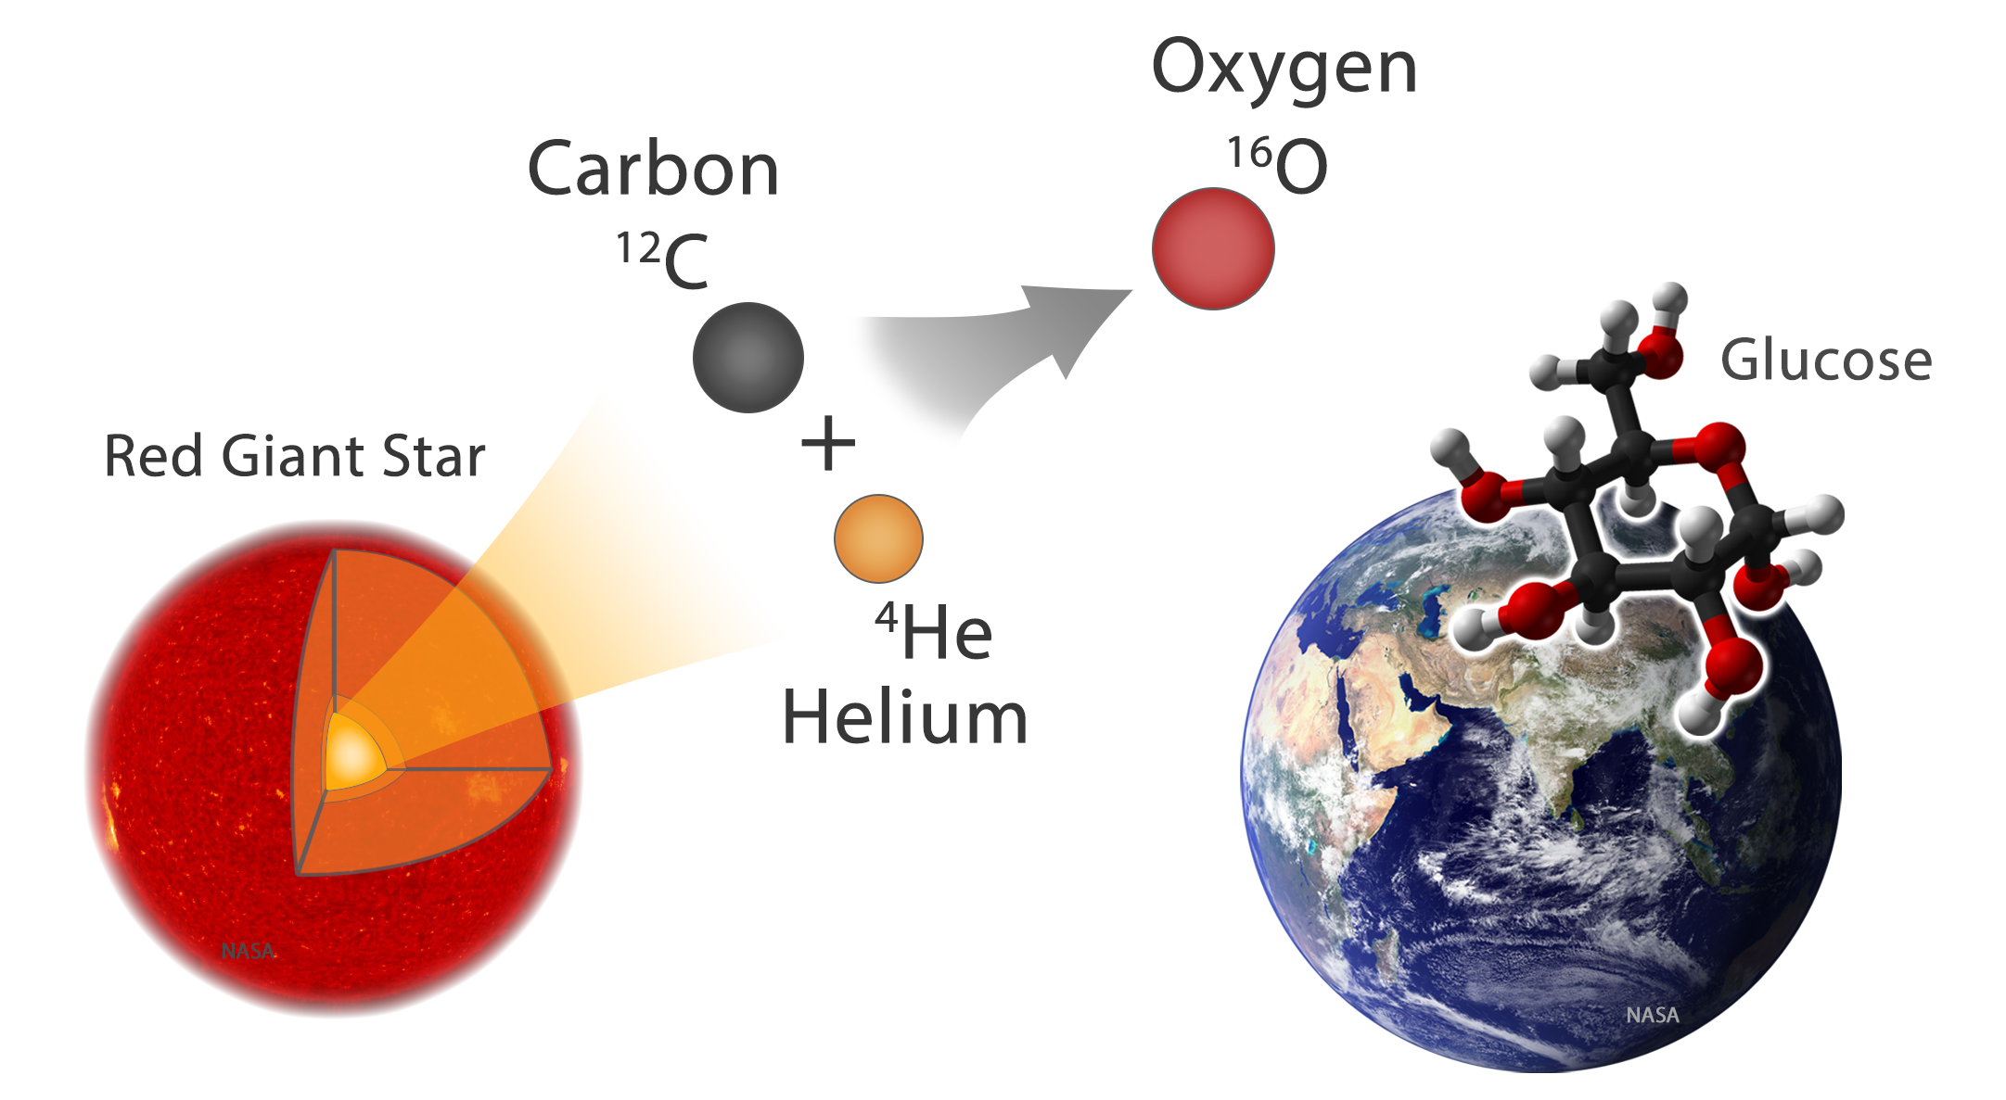

High rate experiments at Cave-C
Spill structure issue @ Phase-0 experiments
Investigating Helium burning in massive stars by measuring Coulomb dissociation of ¹⁶O into ¹²C and ⁴He
Spokesperson: Michael Heil, Kathrin Göbel, René Reifarth
s454 - April 4th to 10th 2019

Slide 2
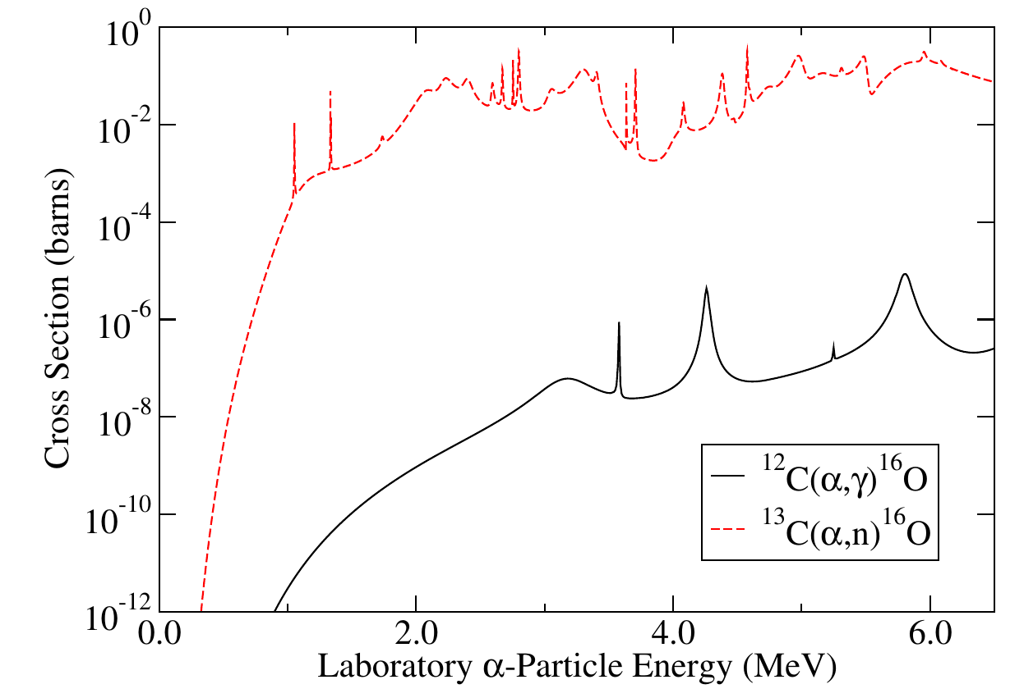
Fusion reactions during stellar burning
Extremely small cross sections
Extremely low energies
Background from impurities ...
De Boer et al, Rev. Mod. Physics 89 (2017)

Slide 3
Fusion reactions during stellar burning
Experimental range so far:
E_{cm} > 1 MeV, E_{lab} > 1.3 MeV
De Boer et al, Rev. Mod. Physics 89 (2017)

Slide 4
Fusion reactions during stellar burning
Energy range relevant in stars:
E_{cm} = 0.3 MeV, E_{lab} = 0.4 MeV
Experimental range so far:
E_{cm} > 1 MeV, E_{lab} > 1.3 MeV
De Boer et al, Rev. Mod. Physics 89 (2017)

Slide 5
s454 – the experiment
Coulomb dissociation of ¹⁶O on ²⁰⁸Pb
Advantages:
  high intensity of ¹⁶O beam
  large number of virtual photons
  large (γ,α) cross section
¹⁶O + ²⁰⁸Pb → ⁴He + ¹²C + ²⁰⁸Pb (CD)

Slide 6
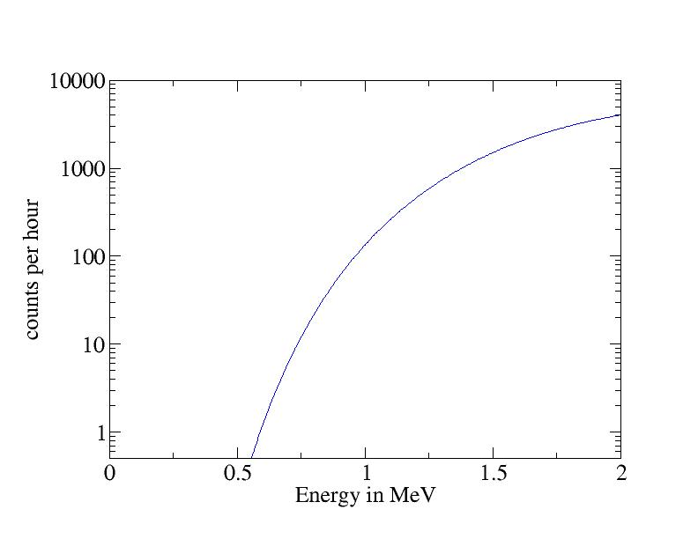
s454 – the experiment
Coulomb dissociation of ¹⁶O on ²⁰⁸Pb
Advantages:
  high intensity of ¹⁶O beam
  large number of virtual photons
  large (γ,α) cross section
We will be able to reach
about 800 keV,
200 keV lower than all
previous measurements!!!
¹⁶O + ²⁰⁸Pb → ⁴He + ¹²C + ²⁰⁸Pb (CD)
Pb target 50 mg/cm²
5E9 Hz incoming beam
beam energy of 500 AMeV
E2
20 per hour
at 0.8 MeV
140 per hour
at 1 MeV
CD (E2) yield calculated with code CDXSP from Stefan Typel

Slide 7
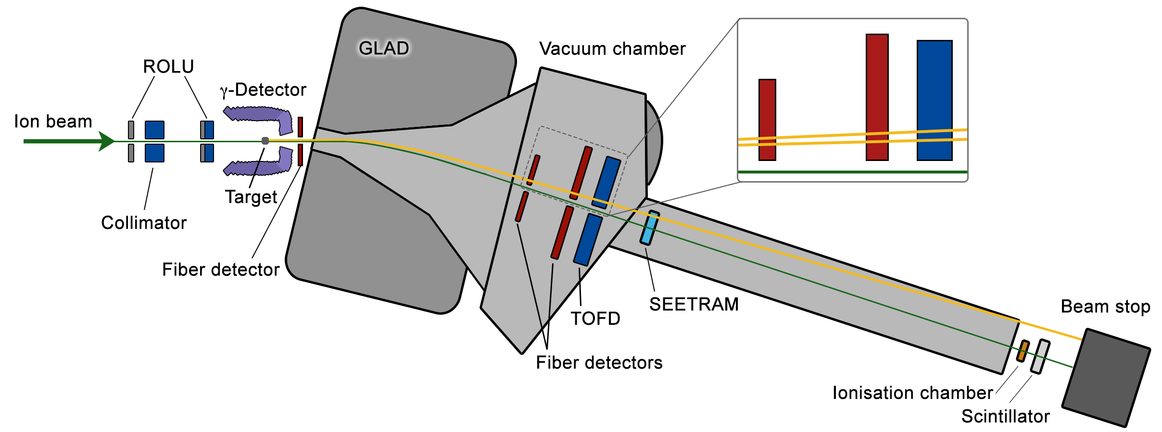
s454 – a unique setup
¹²C
⁴He
¹⁶O
10⁹/spill
High rate experiment, perfectly suited to study DAQ/detector limits

Slide 8
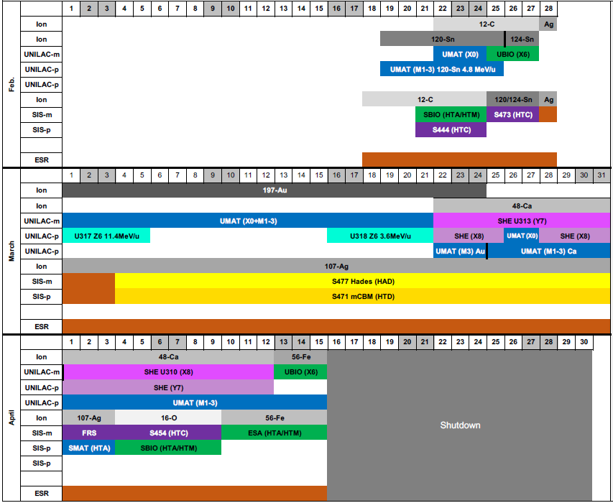
Commissioning
Only a few days of running!
prepared settings in engineering runs (12C)
limited setup time!
issues with spill structure diagnosed
(firmware active since several years)
Experiment

Slide 9
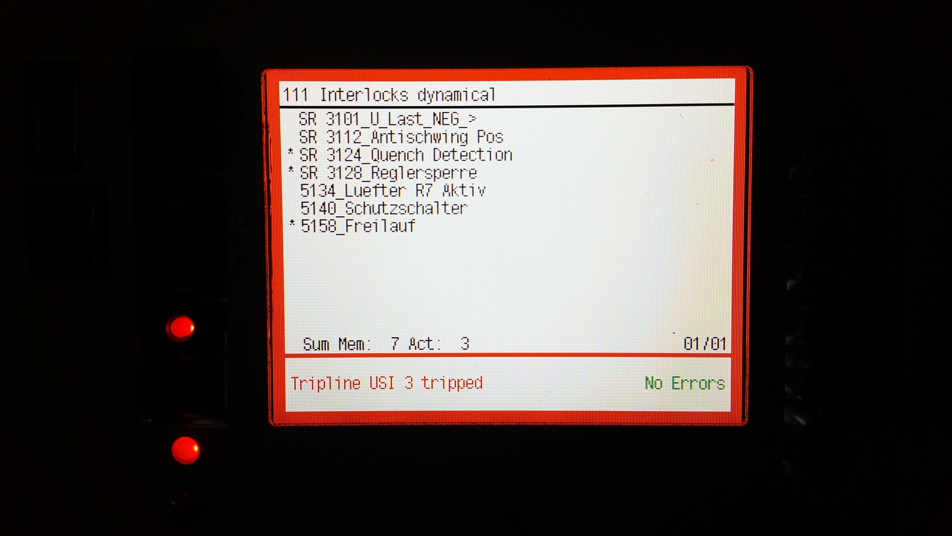
20190225 5:12 Quench @2800A !!!
Quench while ramping up earlier (directly after comm.)
Analysis: just a bad contact
Recovery within 48h !!!

Slide 10
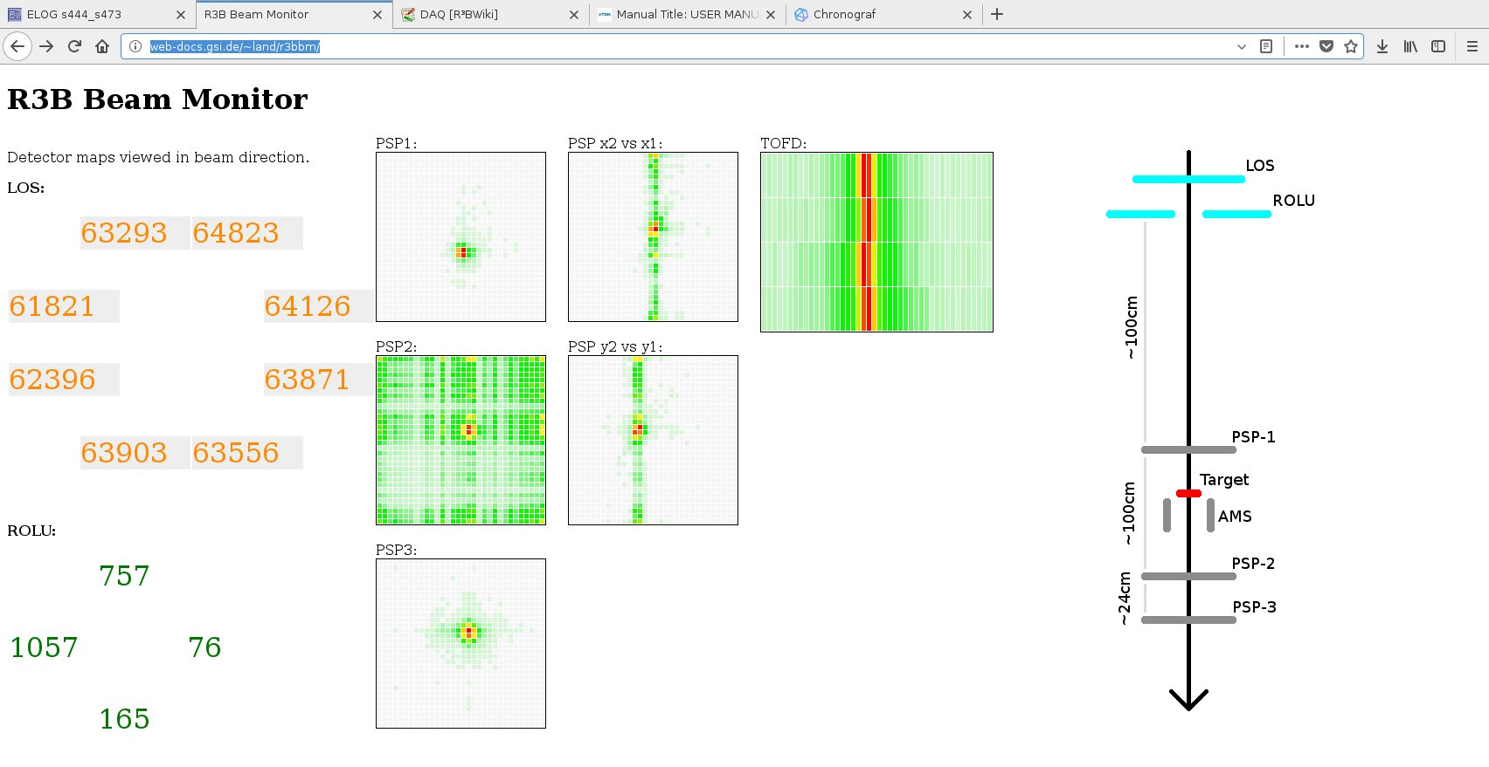
Commissioning experiment
➔ online tools developed

Slide 11
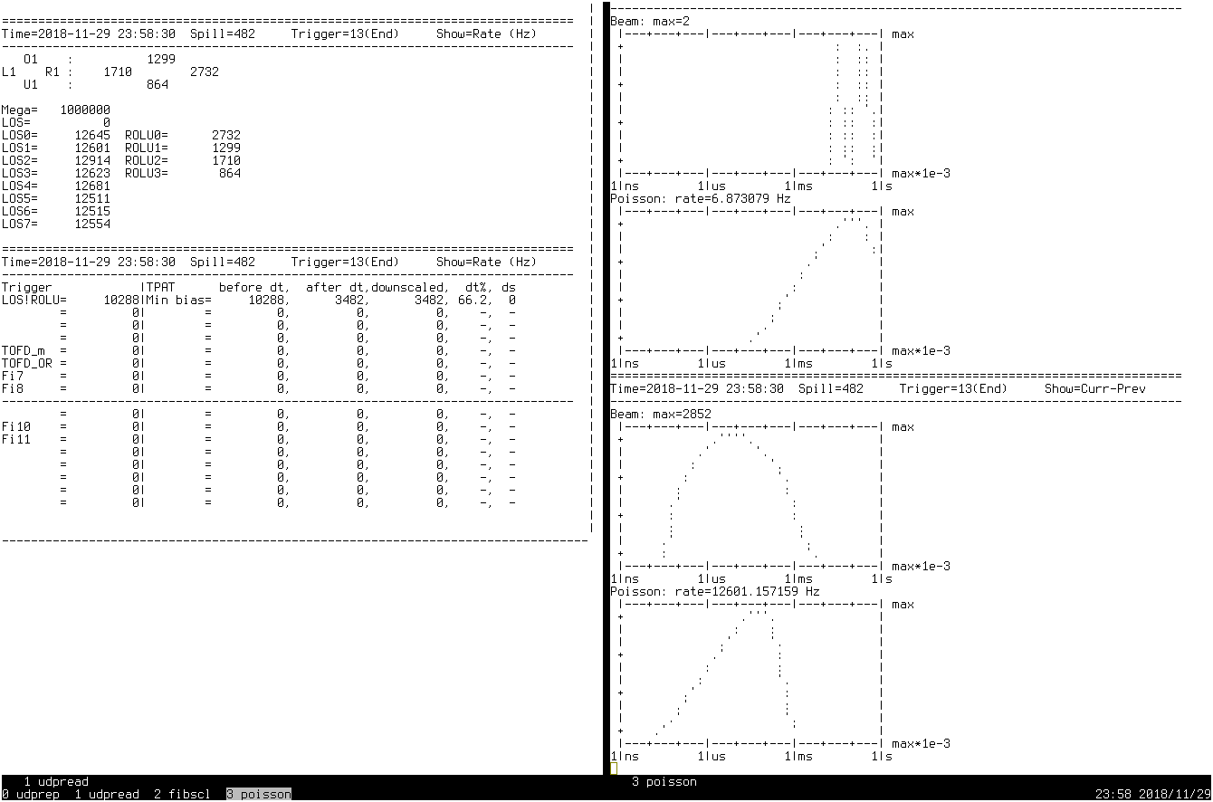
R³B – Eng. Run 2018 - Measured timing between
ions (LOS scintillating plastic „start“ detector)
B. Löher (NUSTAR DAQ)
Multi-hit TDC measures arrival time of every ion in Cave C
Beam intensity: (only) 12 kHz (measured rate, meas.dead time large!)
Measured distribution does not match the theoretical Poisson distribution for this event rate (online, trigger module)
Measured distribution is shifted to shorter intervals
  ions not randomly distributed
  ions come in tighter bunches
Poisson maximum is at 90-100 us
Measured maximum is at 10 us
➔ Further optimization of SIS extraction
direct feedback possible.

Slide 12
Time structure below 10µs observed (on-line)
close to spectroscopic shaping time ➔ pile up !
non recoverable (only via segmentation/separation of channels)!
comparison to Poisson statistics
(optimal case, flat top, poisson distributed events)

Slide 13
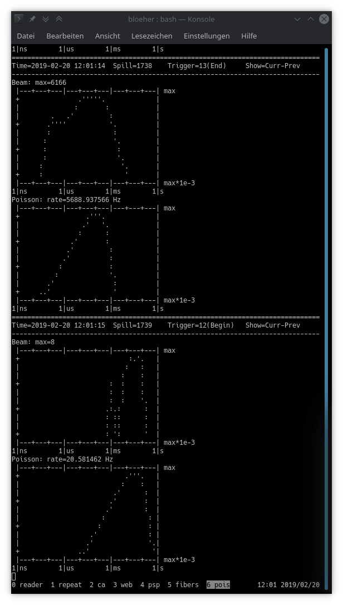

Without quadrupole
excitation
With quadrupole
excitation
No immediate effect but same time many other issues

Slide 14
Strong effect on acceptable DAQ rate!
running at 20µs dead time (i.e. close to pure detector limits)
free running (random (!) pulser) 40 kHz
with beam ~8 kHz
i.e. effectively intensity is reduced by factor 5 !
N.B. shorter shaping is used e.g. at HADES for MIPS tracking
pushing the limit there

Slide 15
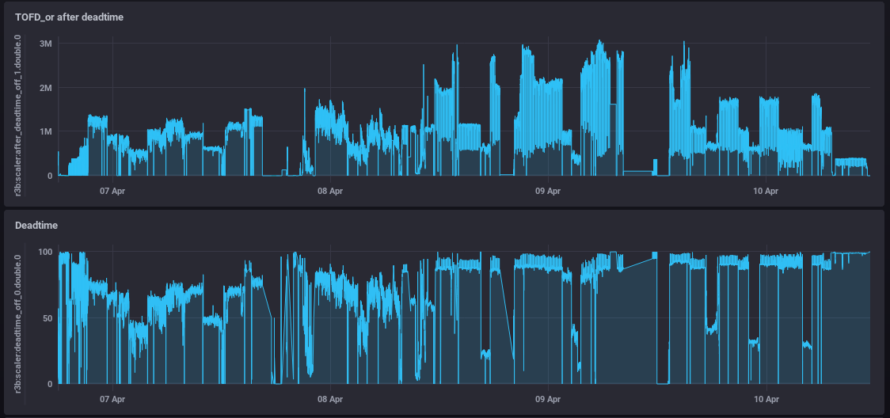
Smaller dead time is related to empty target runs! (unfortunately)
i.e. spill structure similarly „bad“ always

Slide 16
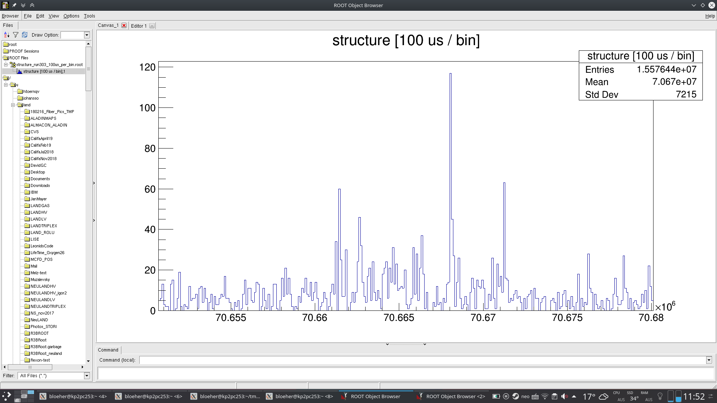
spikes
(factor 10!)

Slide 17
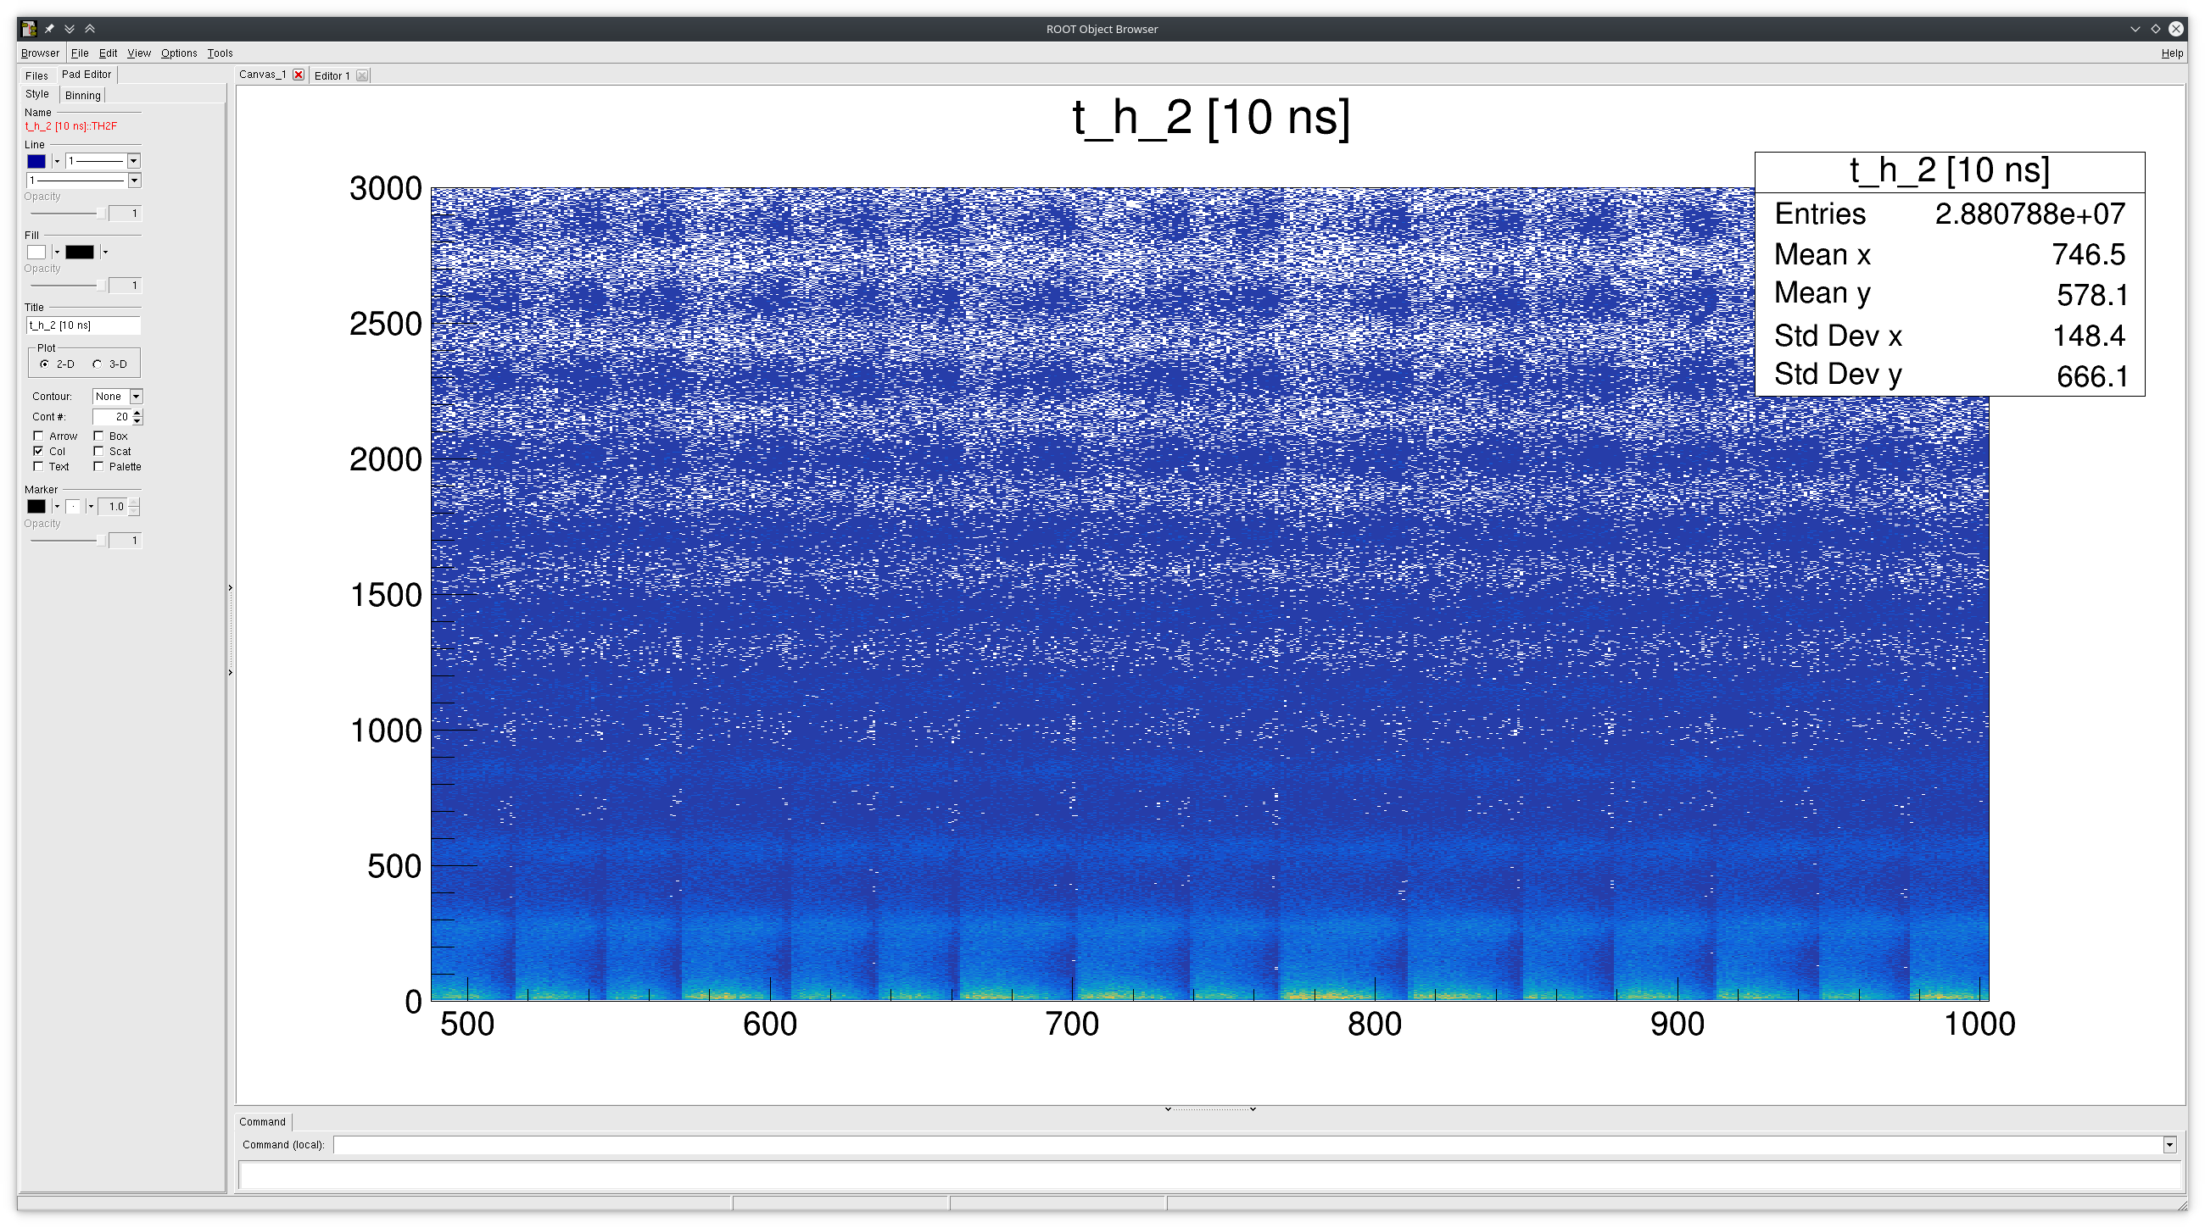

Slide 18
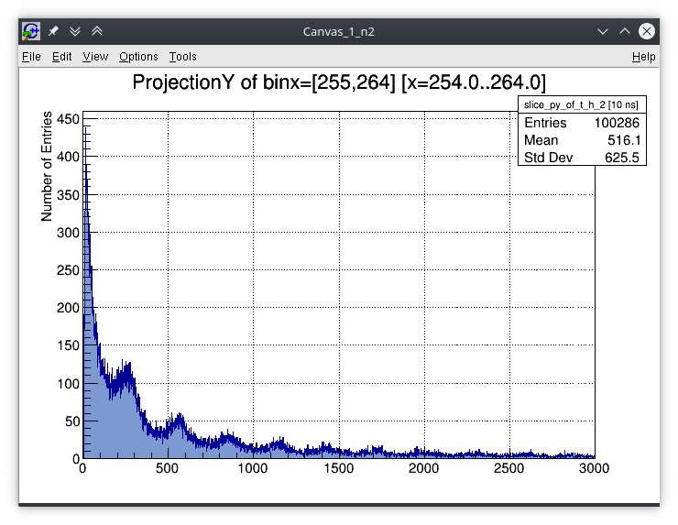
Begin of spill
3µs

Slide 19
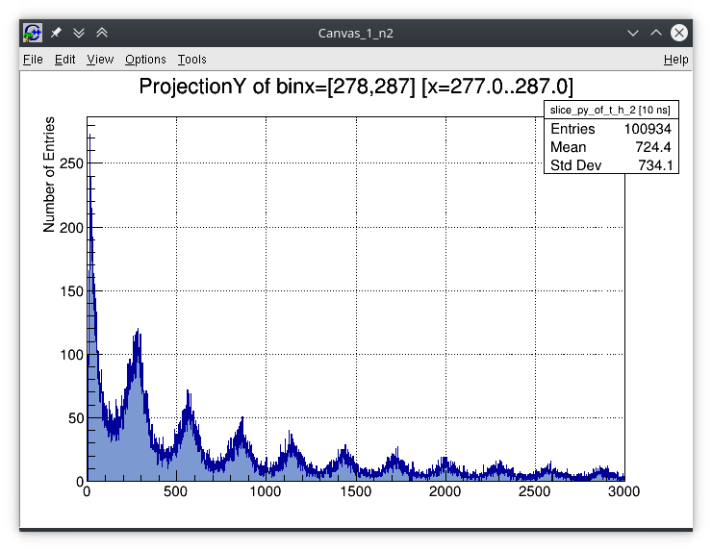
End (!) of spill
3µs

Slide 20
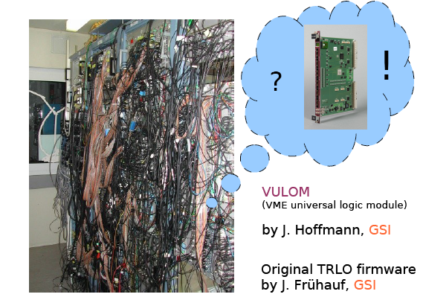
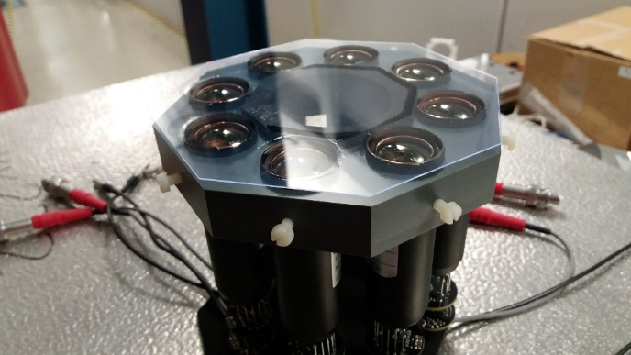
For all this (online) analysis just a plastic detector and a
Vulom module are needed
Own firmware running since2012

Slide 21
Summary
Spill structure issue seems not yet solved (at least cannot be
removed on ‘daily’ basis
Short Setup times are key for NUSTAR experimental program
(many short experiments)
Simple test equipment exists since years (beam time retreats)
and can readily be used (on line) i.e. no specialities needed
Detailed analysis of previous runs ongoing ...

Slide 23
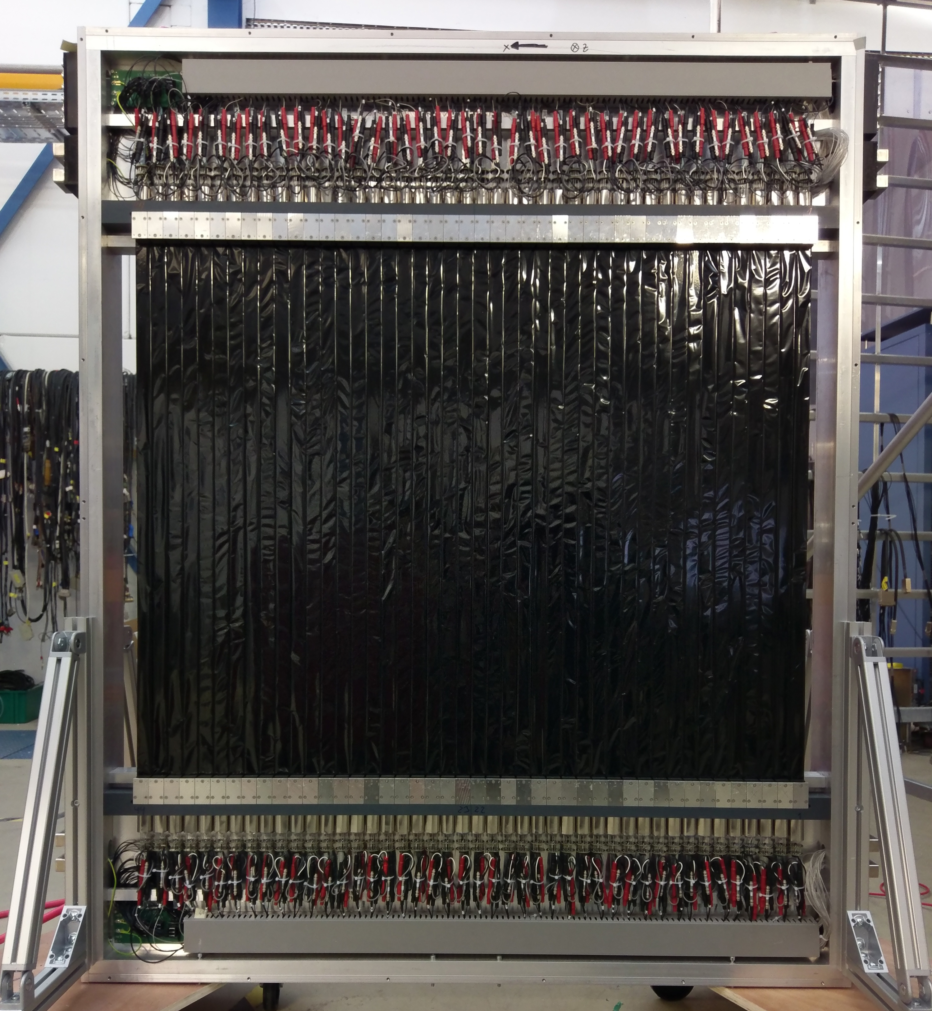
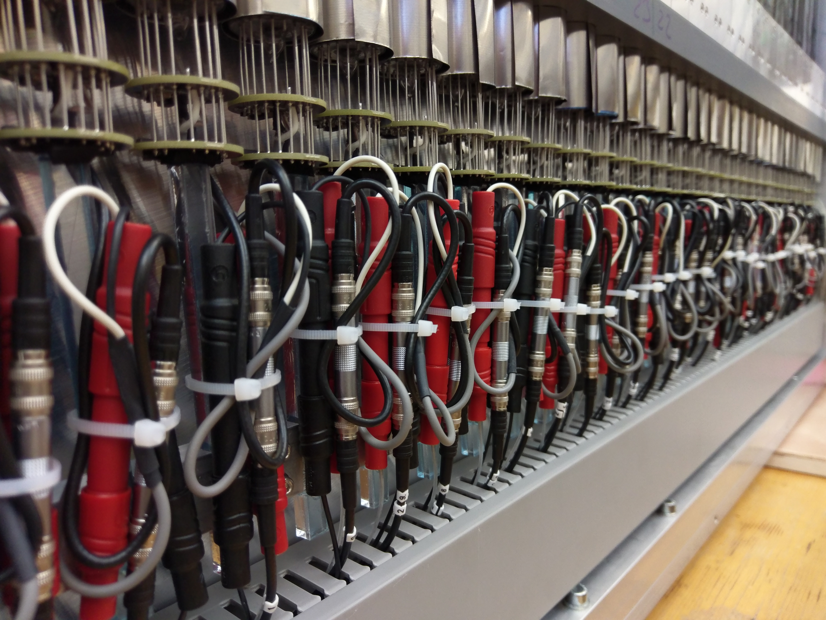
s454 – a unique setup
Time-of-flight detector ToFD
Build at GSI

