Slide 1

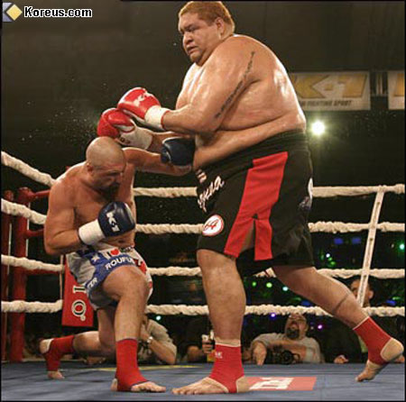
INFN-LNF - SPAS
- SUMMARY -
“- Cables & Gas-Pipes Structure” VS “EMC Backward”.
GSI - March 2010 - D. Orecchini

Slide 2
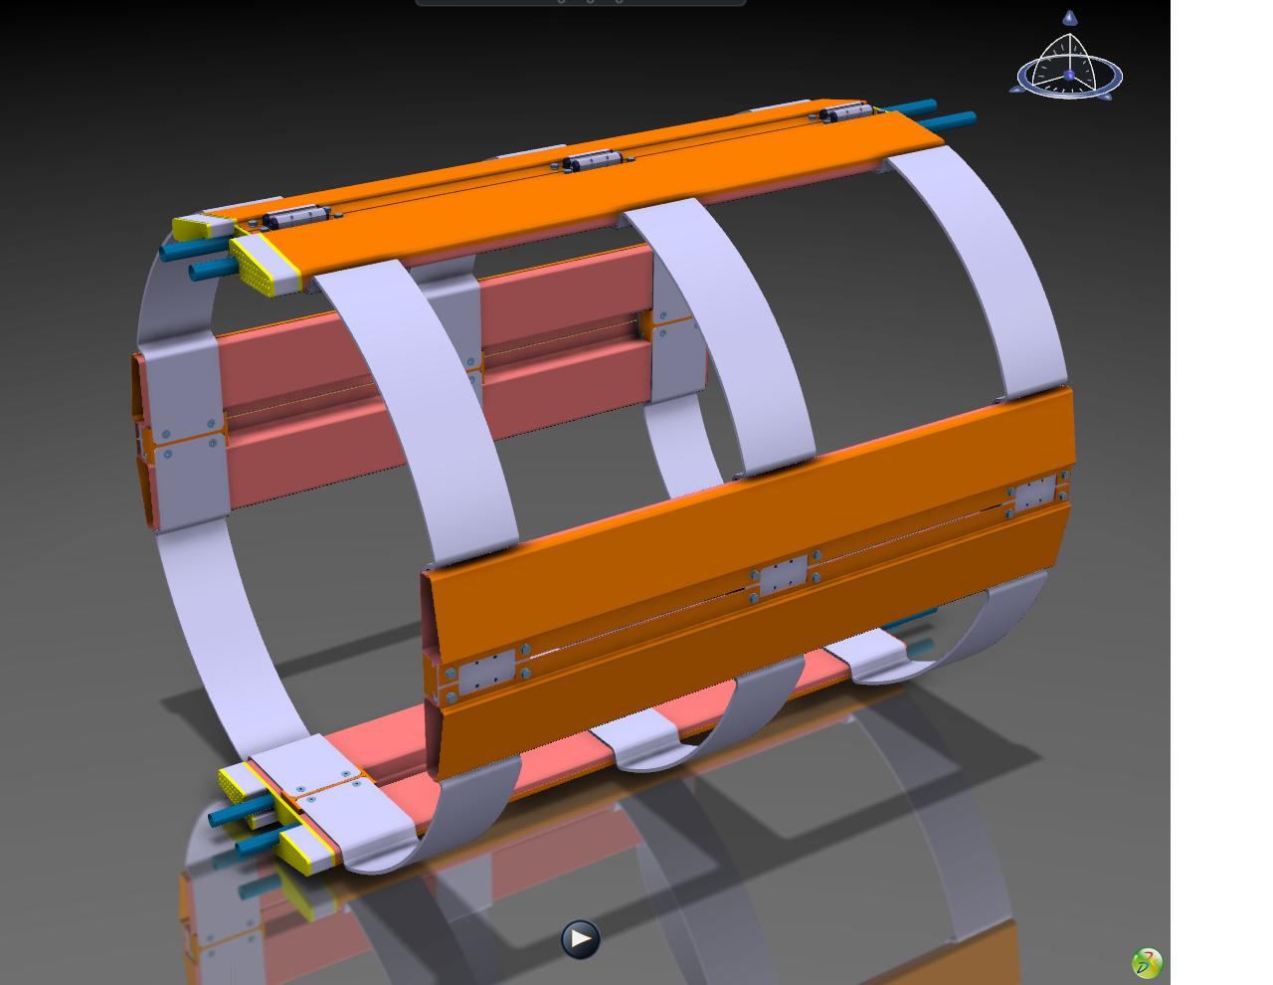
INFN-LNF - SPAS
Cables & Gas-Pipes Support Structure -“Pictorial View”-
Support Skates
Patch Panels
Support Structure
Gas Pipes
Cables Route
GSI - March 2010 - D. Orecchini

Slide 3
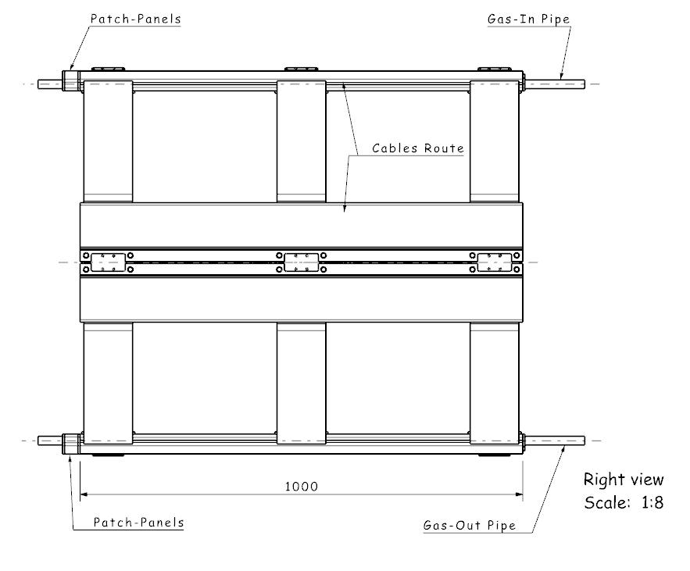
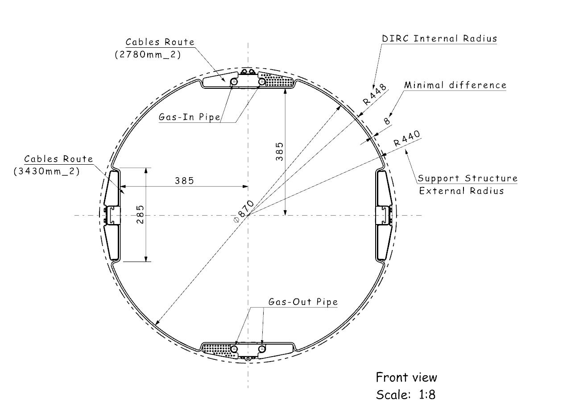
INFN-LNF - SPAS
Cables & Gas-Pipes Structure “Main Dimensions”
Solution main characteristics:
Reduced four points for cables routing;
the structure has been placed on the
external perimeter as much as possible;
all the spaces have been minimized;
this solution can accomodate either “STT”
and “TPC” cables.
GSI - March 2010 - D. Orecchini

Slide 4
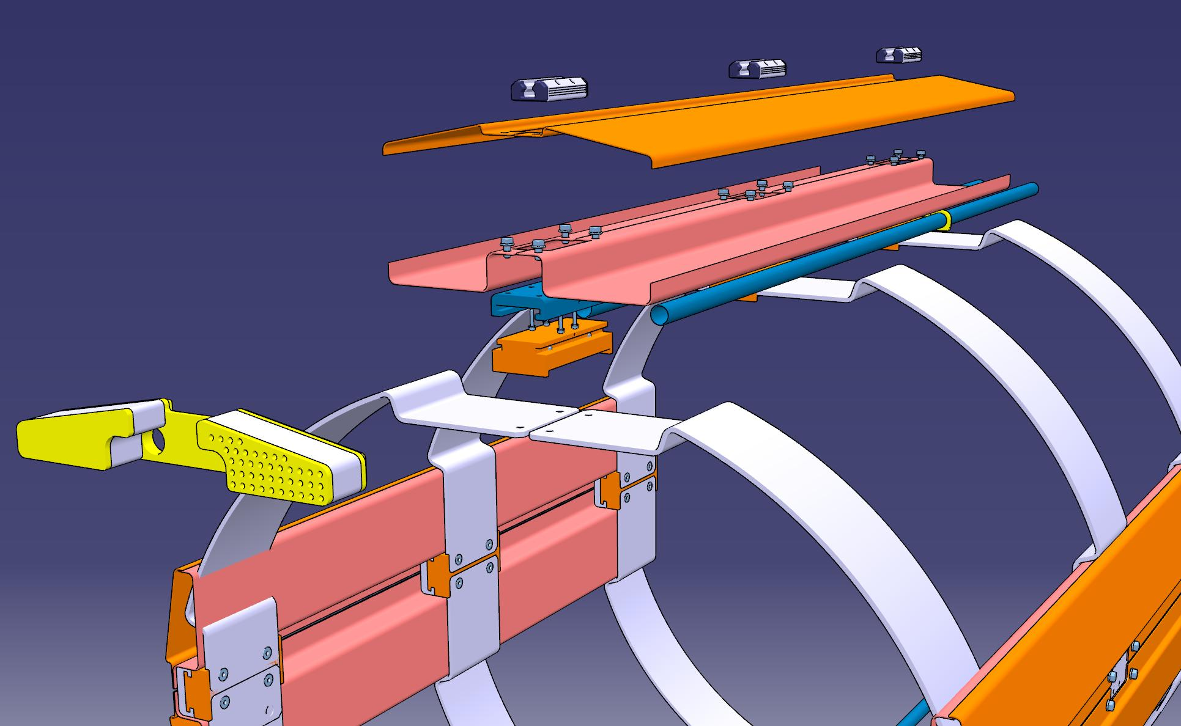
INFN-LNF - SPAS
Cables & Gas-Pipes Structure details
In this solution the four “routings” are connected by a series of shaped profiles, and all components are kept together by a modular system.
The “patch panel” (for now) is just an attempt to suggest a possible solution to develope.
The real connectors are not defined yet.
GSI - March 2010 - D. Orecchini

Slide 5
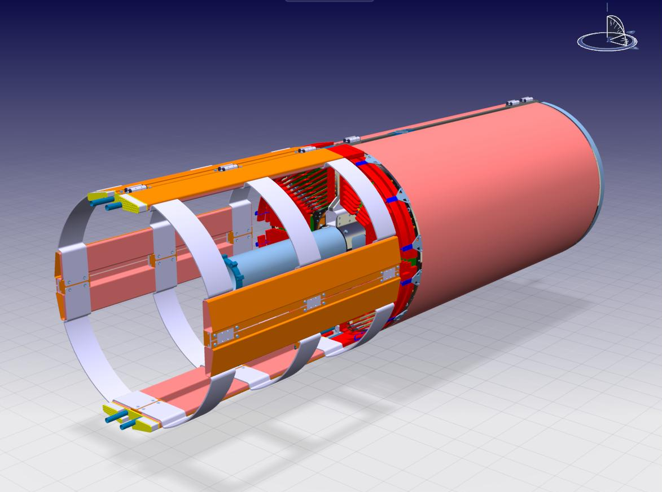
INFN-LNF - SPAS
Cables & Gas-Pipes Structure with Straw Tracker -“Pictorial View”-
General view of the tracking system with all the supplies assembled (electronics, gas ,cables,....).
GSI - March 2010 - D. Orecchini

Slide 6
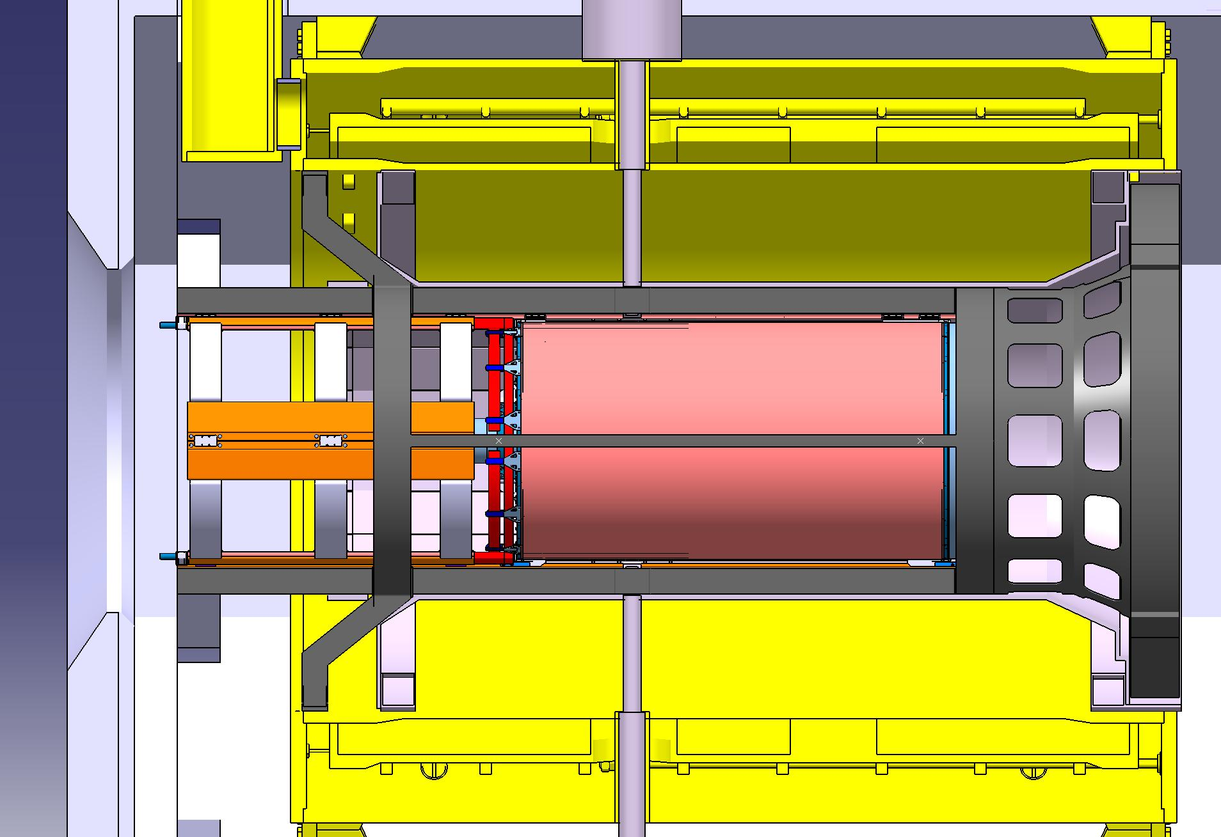
INFN-LNF - SPAS
Cables & Gas-Pipes Structure inside the Magnet
Magnet End-Cap
Magnet Front
Electronics Space
Straw-Tracker
Cables & Gas-Pipes Structure
Patch-panels
All the Tracker cables and gas–pipes, must be disconnected here, before the extraction of the detector.
GSI - March 2010 - D. Orecchini

Slide 7
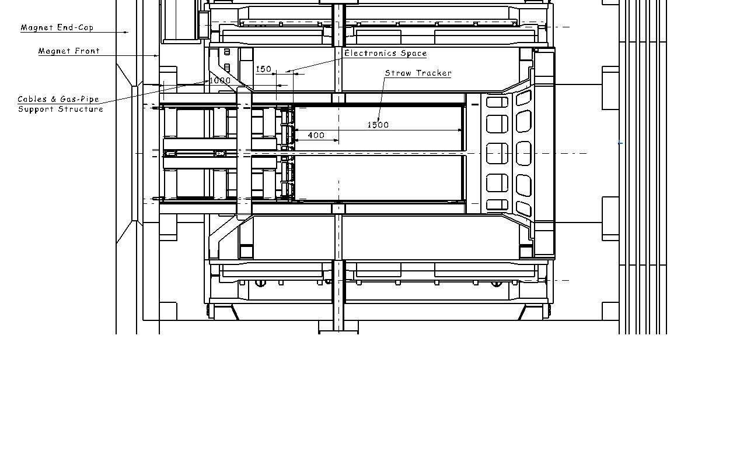
INFN-LNF - SPAS
Cables & Gas-Pipes Structure encumbrances inside the Magnet
GSI - March 2010 - D. Orecchini

Slide 8
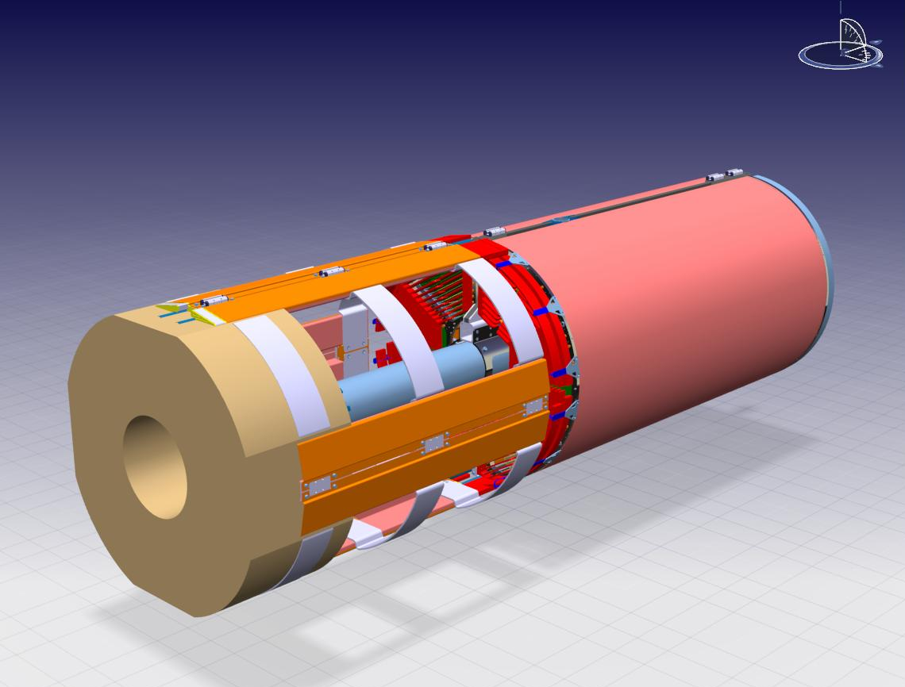
INFN-LNF - SPAS
Cables & Gas-Pipes Structure VS “EMC Backward” –”Pictorial View”-
Cables & Gas-Pipes
structure is fully interfeering with the “EMC”
GSI - March 2010 - D. Orecchini

Slide 9
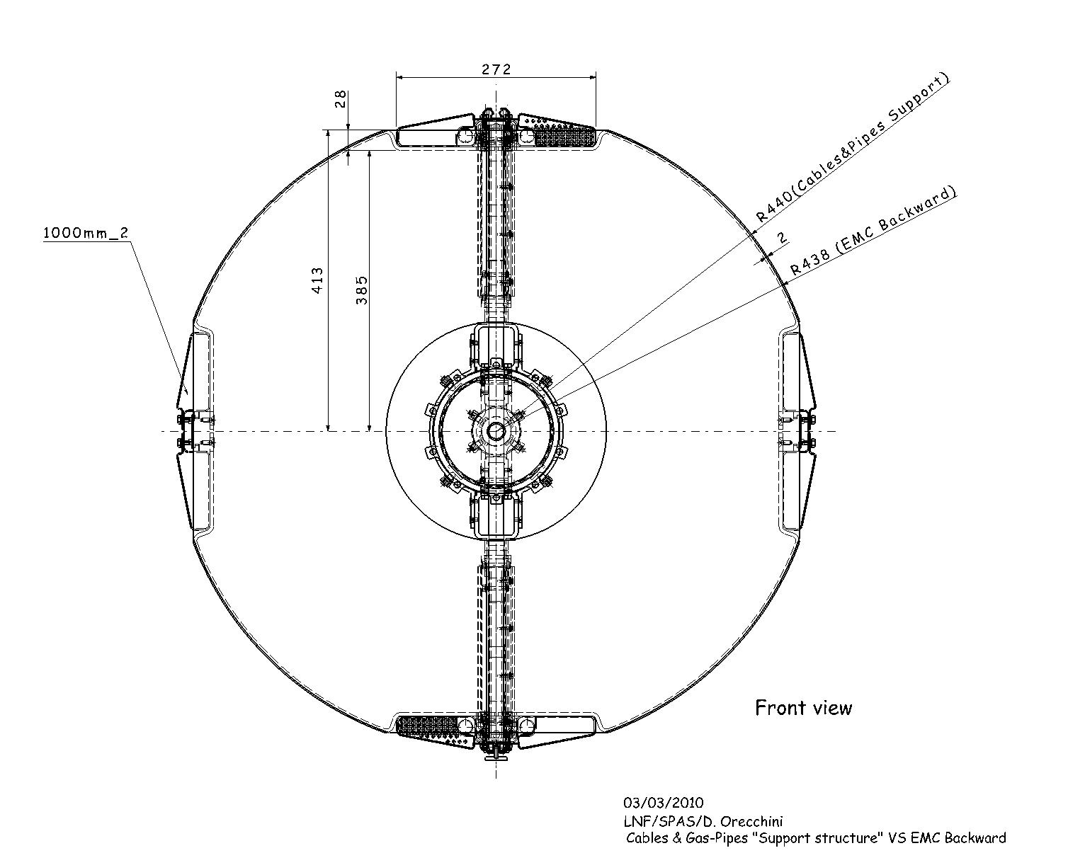
INFN-LNF - SPAS
Cables & Gas-Pipes Structure VS “EMC Backward” -Main Dimension-
Residual space for Cables & Gas-Pipes
No space at all for the “Support Structure”.
(Is also necessary to leave at least 5mm or more, between the “Support Structure” e the “EMC”)
WARNING
Up to now is really difficult to estimate how much space will need.
So, is dangerous minimize so much the devoted space.
GSI - March 2010 - D. Orecchini

Slide 10
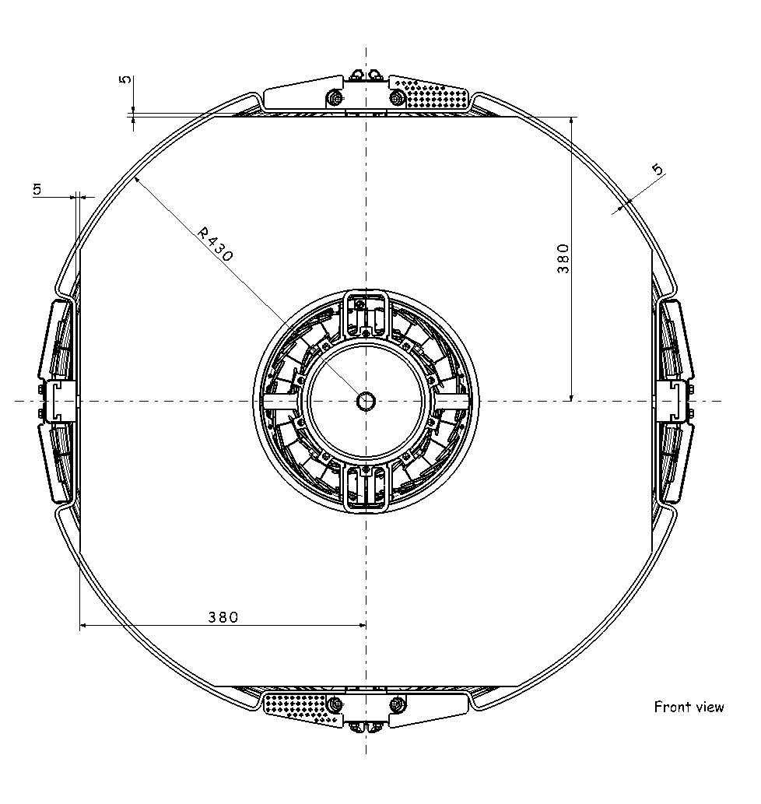
INFN-LNF - SPAS
Cables & Gas-Pipes Structure VS “EMC Backward” -Main Dimension-
Free space
“EMC” suggested external dimensions.
GSI - March 2010 - D. Orecchini

Slide 11
INFN-LNF - SPAS
Final considerations.
A prototype of the “Cables & Gas Pipes” structure can be realized in Frascati Lab (next mounths), but before starting, an approval must be necessary.
This prototype could be assembled on the “Central Tracker -parking and inserting structure-” actually under construction in Frascati Lab.
GSI - March 2010 - D. Orecchini

