Slide 1
EC H2020 Project focused on 100 km
Frontier Circular Collider Infrastructure Implementation and ee Collider Design
Michael Benedikt, Johannes Gutleber
25 June 2019

Slide 2
H2020 Infrastructure Design Study call
Design Studies INFRADEV-01-2019-2020
Opening Date 25 July 2019
Deadline Date: 12 November 2019, single stage
contribution from the EU of between EUR 1 and 3 million

Slide 3

EC H2020 Project Call Scope
Resources &
Environment
Scientific User Collaboration
Open Data
Coherently Integrate Europe
Plans for constru-ction including re-source efficiency & environmental impacts
Ensure that a scientific user community is built up to exploit the facility from the start on
Plans to organize access to research data
Coherently inte-grate the infra-structure in the European re-search landscape
Call requests tackling the key questions of the feasibility of the new facility

Slide 4
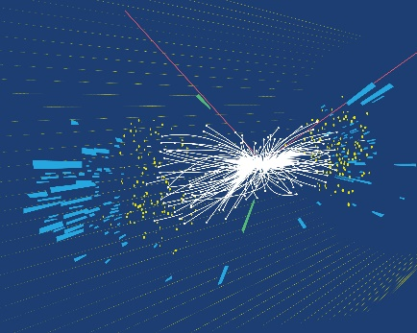
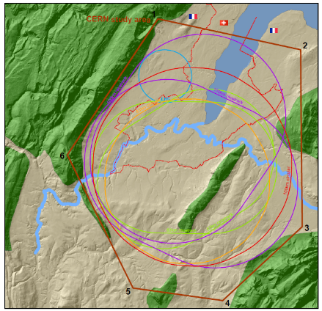
EC H2020 Project Call Scope
Construction & Operation
Governance and Organisation
Research Services
Site Selection
Construction & operation budget and funding strategy including in-kind strategies
Governance structure, processes, resources, set-up
Research services to be provided at international level
Site selection, placement and implementation, work with host states

Slide 5
Design Study Project for Circular Lepton Collider
Goal: Carry out the technical design study for a 100 km long luminosity frontier circular collider infrastructure at CERN that will extend Europe’s leadership in the domain of fundamental physics research until the end of the 21st century.
The study focuses on the high priority topics to prepare the ground for a construction project by 2026:
optimisation of the particle collider design, which leads to the invariants of the infrastructure project,
planning and necessary investigations for a sustainable civil engineering construction project including the requirements of a circular economy,
implementation and public participation processes in France and Switzerland (CERN host states) including transnational topics such as environmental impact assessment, management of excavation materials and access to shared resources (electricity, water, communication, transport),
definition and implementation of a project exploitation plan considering the need to create a committed user community that exploits the RI from the beginning onwards and to engage every member of the society,
Socio-economic impact assessment with a plan to design the facility for impact creation, including the regional impacts and potential synergies for all participating stakeholders in Europe.

Slide 6
Work Packages
KEK (Japan)
Terra Mater (AT)
CERN
CSIL (IT)

Slide 7
Participants and Budget
NOTE: 50% cofounding by participating institutes.
# | Organisation | Country | EU Funding | Matching (>50%) | Total
1 | CERN | IEIO |  |  | Admin + tech support + conferences
2 | CEA | FR
3 | INFN | IT |  |  | Impedance, coll. Effects, MDI+Sapienza
4 | U. Leoben | AT |  |  | Matex
5 | KEK | JP |  |  | Optics design
6 | KIT | DE
7 | NBI | DK
8 | PSI | CH |  |  | Injection, contribution funded by CHART
9 | CNRS | FR |  |  | Regional development, physics workshops
10 | BINP | RU |  |  | Collider parameters and layout
11 | DESY | DE |  |  | Optics, emittance tuning
12 | Springer/Nature | DE/NL (tbc) |  |  | Publishing workflow, CDR, socio-economic
13 | Terra Mater FS | AT |  |  | Engagement & comm. strat./plan
14 | CSIL | IT |  |  | Socio-economic
15 | U. Santiago | ES |  |  | Socio-economic (person at CERN)
16 | Cerema | FR |  |  | Regional implementation France
17 | CETU | FR |  |  | Matex, tunnel safety, legal evolution
18 | LD | CH |  |  | Regional implementation Switzerland, architecture design of 1 site, EIA framework
 |  | TOTALS | 3'000'000 € | 5‘000‘000 € | 8‘000‘000 €

Slide 8
WP 1 – Management and Coordination
Lead beneficiary: CERN
Description: Management of the action, establishment of a governance and management structure for the preparatory phase, considerations on establishment of collaborations for particle physics experiment. Develop a funding strategy and plan.

Slide 9
WP 2 – Particle collider design
Description: Focus on optics and beam dynamics, machine performance optimisation, number of interaction points, MDI, technical descriptions of the equipment
The work does not include design of an experiment and detector technologies. The project will, however, include a task on the establishment of a collaboration for that purpose (in another WP).
Lead beneficiary: KEK, Japan
Deputy: CERN
Key beneficiaries: DESY (DE), KIT (DE), NBI (DK), INFN LNF + Sapienza (IT), CEA (FR), BINP (RU)

Slide 10
WP 3 – Integrate Europe
Description: Development of a feasible layout and implantation of the collider in the region in cooperation with other WPs. Set up of transnational environmental impact assessment framework. Development of excavated materials management and re-use. Preparation of administrative processes, preparation of public hearing processes in France and Switzerland.
Lead institute: CERN
Key beneficiaries: Cerema (FR), C (FR), LD (CH), MUL (AT)
Partners: GESDEC, SGAR Lyon, Canton of Geneva (if they agree), Setec (FR)

Slide 11
WP 4 – Sustainable impact
Description: Document the cost estimates, carry out socio-economic impact assessment for the collider+experiments+infrastructure (design, construction, 15 years operation), develop the regional impacts due to the development in a global project, develop financing and in-kind strategy, design for sustainable RI operation (create user community, proto collaborations)
Lead beneficiary: CSIL (IT)
Deputy: CERN
Beneficiaries: U. Santiago (ES), CNRS/IN2P3/LAPP (F)
Partners: UNIMI (IT)

Slide 12
WP 5 – Leverage and engage
Description: Develop a communication strategy and plan in cooperation with external partners focusing on the host states, develop collaborative workflow from concept to scientific publication using a toolkit (Springer/Overleaf cooperation), produce CDR and proceedings, journal articles, develop citizen science/societal engagement project and impact plan, develop industrial exploitation plans.
Lead beneficiary: Terra Mater (AT)
Deputy: CERN
Beneficiaries: Springer/Nature (DE)
Partners: Overleaf (UK)

Slide 13
Design for Industrial Innovation WP
Identified challenge: What is the potential for industrial spillovers that technology R&D and high-tech of an FCC-ee can generate?
Solution: High-density Solid-State Power Amplifiers (SSPA) are a promising technology to flood the commodity and industrial RF power market on the FCC-ee construction timescale. Per module, the power will remain constant or may decrease, meaning that for an accelerator a scalable and fault-tolerant design needs to be found to achieve MW of power. Industry also needs those solutions for cheap and resilient power applications.

Slide 14
Solid-State RF Energy Applications
Plasma applications
(cutting, surface engineering,
Cosmetics, chemical processes)
Heating
(Food processing,
drying, pasteurization)
Lighting
(Airports, events,
large spaces)
Cooking
(High capacity
Cooking and defrosting)
Radio applications
(Beacons, navigation
transmitters, positioning)
RADAR
(weather, telecom,
imaging)
Propulsion
(Satellites, deep
space exploration)
Heat Treatment
(Hyperthermia
and ablation)

Slide 15
Design for Industrial Innovation WP
Problem: limited EC funding and already large consortium involving a significant level of administration make it difficult to define and manage another WP on industrial cooperation
Action needed: Find 3 to 5 meuro for a separate co-innovation project with industry to be able to show some level of relevant results and generate impact.
  The proposed Design Study project can only document in a milestone or deliverable that impact potentials exist, but no concrete work is foreseen to drive them forward

