Slide 1
Status of ARIES
TIARA Meeting
GSI, 1 July 2019
Maurizio Vretenar, CERN, Project Coordinator
Notes:
Why do we need ARIES

Slide 2
Outline
ARIES has just passed the mid/project point (start 1 May 2017, end 30 April 2021).
Work is progressing according to plans (see situation Milestones and Deliverables), with only minor delays in some Milestones.
Periodic Report 1 (first 18 months) was completed on time and approved by the EC on 27 February, including the financial part. The corresponding budget has been received and is distributed to partners accordingly to the rules defined by the Governing Board.
ARIES has been selected as a success story for the December 2018 communication campaign of DG/RTD.
Only one concern: the low level of Transnational Access achieved so far, because of facilities that are still in construction or not attracting enough users.

Slide 3
Mid Term Review
Agreement with the EC Officer Patricia Postigo: «light» review, no special documents to be prepared.
The Review will take place in Brussels on 25 September 2019.
Reviewers: Patricia Postigo (EC Officer) and Katherine Harkay (Argonne APS).
ARIES represented by: Maurizio Vretenar, Brigitte Cros, Alessandro Bertarelli.
Programme:
- Introduction to ARIES (Goals, structure, situation at mid-term) – M. Vretenar, 20’
- The ARIES Networks, status at mid-term – M. Vretenar, 20’
- The ARIES WPs on New Acceleration Technologies (Network, TA, JRA) – B. Cros, 20’
- The ARIES Transnational Access, status at mid-term – M. Vretenar, 20’
- The ARIES Material studies, TA and JRA – A. Bertarelli, 20’
- The ARIES JRAs on Innovation, thin films and electron lenses – M. Vretenar, 20’

Slide 4
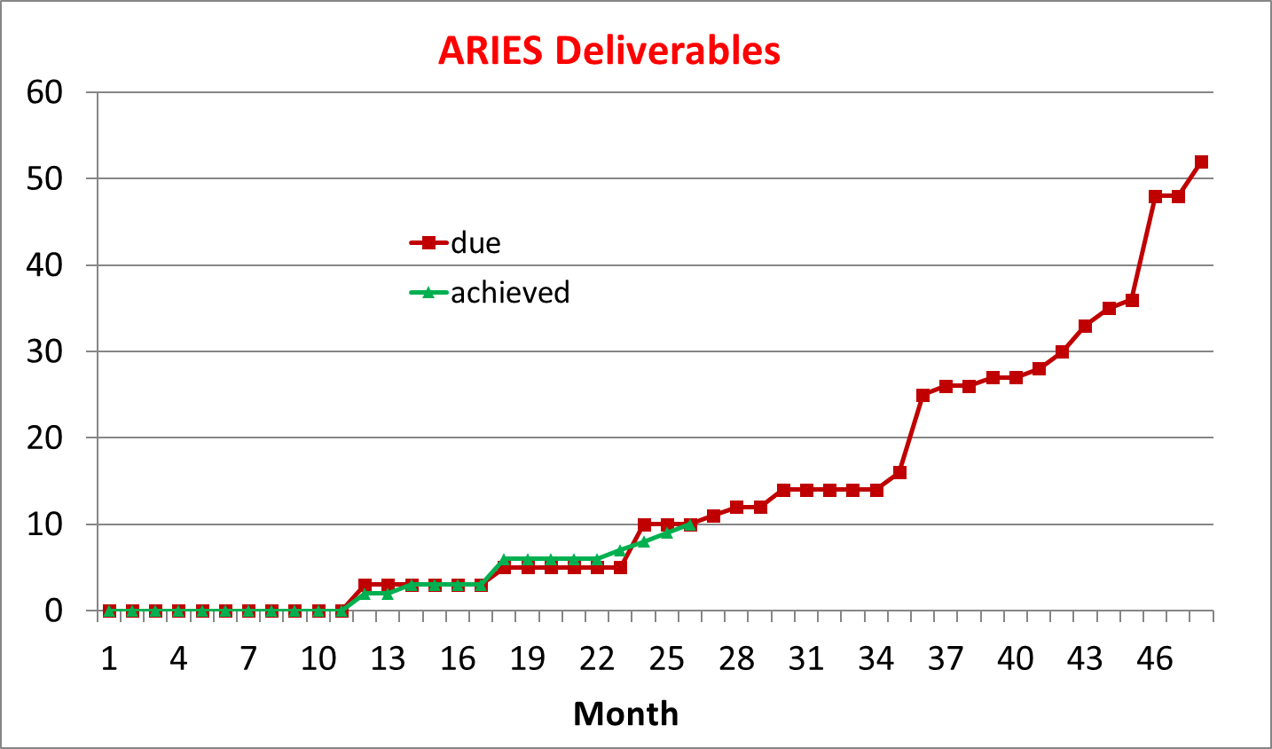
Status of Deliverables
10/10 Deliverables submitted
1 Deliverable (D16.1) delayed due to external events (delay accepted by the EC Officer)
1 Deliverable submitted in advance

Slide 5
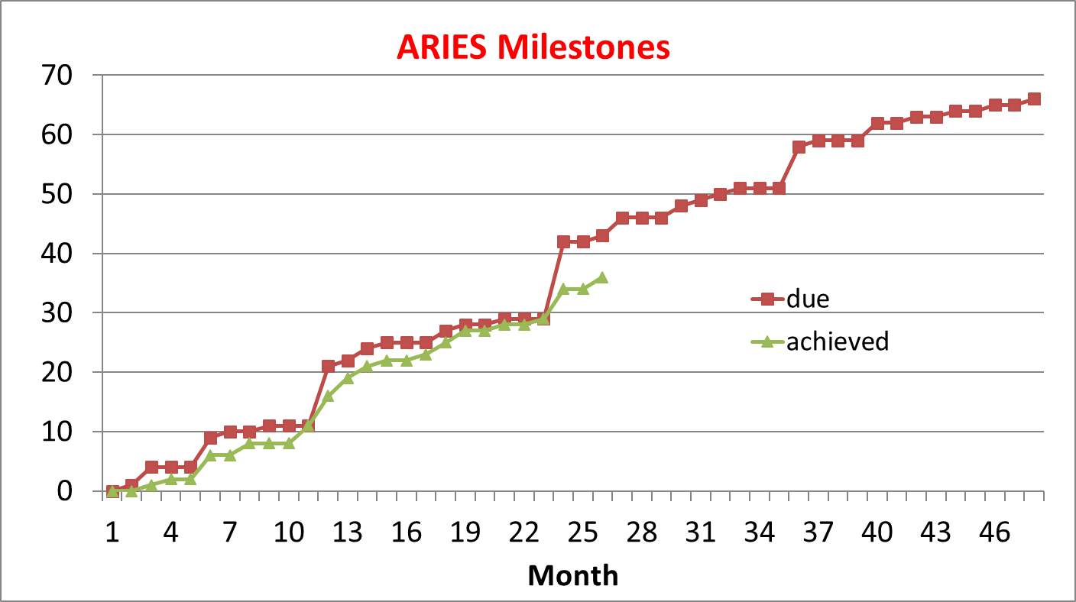
Status of Milestones
Achieved 36 / 43
7 late Milestones for various reasons
1 workshop delayed
1 no news
1 delayed Mid Term review
2 minor delay
2 delayed for maternity leave

Slide 6
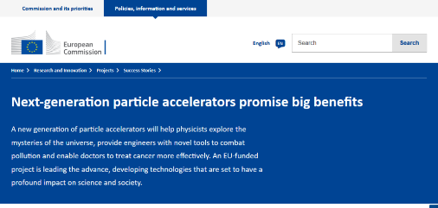
ARIES features in December 2018 EC communication campaign
Article on ARIES in the December 2018 list of «success stories» of EC Research and Innovation Projects, for general public.
Based on a written interview to the coordinator by a UK journalist.
Excellent article, but the journalist has picked up almost exclusively the applications of accelerators (and the muon collider…)
Officially on-line on December 5th, preview at http://ec.europa.eu/research/infocentre/article_en.cfm?artid=49808
Text for social media
(89k followers)
A new generation of particle accelerators, more powerful, more efficient and more affordable than their predecessors, will help physicists explore the mysteries of the universe, provide engineers with novel tools to combat pollution and enable doctors to more effectively treat cancer. The #EUfunded ARIES project is leading the advance, developing technologies that are set to have a profound impact on science and society. #H2020
New version of the ARIES video

Slide 7
Transnational access summary at M24
14 facilities: only 7 are correctly progressing
4 did not start yet, after 2 years of project
3 have low or very low access

Slide 8
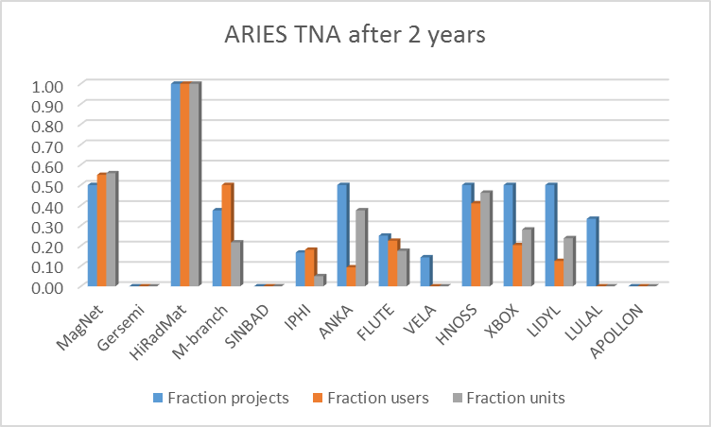
TNA graph

Slide 9
Budget of underperforming TNAs
WP | name | Access budget | Operation budget
9 | Gersemi | 115’685
11 | Sinbad | 147’000
11 | IPHI | 133’572 | 115’052
11 | FLUTE | 24’505 | 42’240
11 | VELA | 99’400 | 97’140
13 | Apollon | 173’864 | 66’250
13 | Lund | 116’850
 | TOTAL | 810’876 | 320’682

