Slide 1
HITRI
Heavy Ion Therapy Research Infrastructure
Project Proposal: INFRADEV-01-2019-2020
1st July 2019
HITRI means ’quick’ or ‘fast’
in languages in the SEE region
Nicholas Sammut

Slide 2
Ion Therapy Machine Design Study
- a general European design study that can be used by anyone including SEEIIST but not excluding other new European initiatives
- a general next design for Europe
- we hope to merge all research agendas in a unified front to avoid duplication of effort, maximize resources, maximize knowhow & create a disruptive technology base

Slide 3
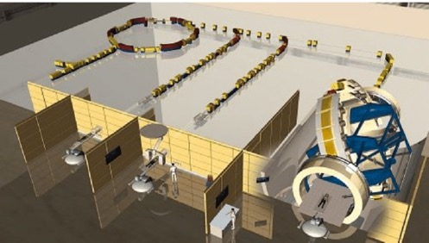
Goals
A) Research
- Facility R&D
- Applied R&D
- Clinical treatment
B) Treatment Facility
CNAO
MedAustron
HIT

Slide 4
Goals for Increased Market Penetration
A) Accelerator
- Reduced Capital Cost (~120M€)
- Reduced Footprint (~1000m²)
- Higher beam Intensities (10¹⁰ppp)
- Lower running costs
B) Delivery
- Fast Dose Delivery (possibly with 3D feedback)
- Equipped with rotating gantry
- Using multiple ions
- With range calibration and diagnostics online

Slide 5
General Scheme
WP1: Project Management and Technical Coordination - Nicholas Sammut (UniMalta - Coordinator), Marco Durante (GSI – Deputy Coordinator); Maurizio Vretenar (CERN – Deputy Coordinator)
WP2: User Community, Dissemination and Outreach – Manjit Dosanjh (CERN)
WP3: Accelerator Design – Maurizio Vretenar (CERN) - (D-Coord)
WP4: Magnet Design – Lucio Rossi (INFN)
WP5: Gantry Design – Sandro Rossi (CNAO)
WP6: Medical Biophysics and Imaging – Christian Graeff (GSI)
WP7: Infrastructure, Diagnostics and Safety Systems – To be announced
?

Slide 6
Scientific Advisory Committee
Sanja Damjanovic (Chair SEEIIST Steering Committee, Minister of Science Montenegro)
Herwig Schopper (Ex DG CERN)
Hans Specht (ex DG GSI)
Jurgen Debus (Medical Director HIT)
Jay Flanz (Chair Particle Therapy Co-Operative Group)
More to be added…
?
?

Slide 7
WP1 – Project Management & Technical Coordination
Participants: Uni Malta, GSI, CERN, SEEIIST
Description of Work
Task 1.1: Governance and coordination of contractual, financial and administrative aspects of the Design Study
Task 1.2: Scientific & Technical management
Task 1.3: Coordination of participants, communication & meeting organization
Task 1.4: Cost Benefit Analysis
Task 1.5: ITRI Business Plan
Task 1.6: Innovation Management and Technology Transfer
Task 1.7: ITRI Governance Model and Criteria for Site Selection
Task 1.8: Ethical Considerations

Slide 8
WP1 – Project Management & Technical Coordination
Deliverables:
D1.1: 1st Progress Report – M12
D1.2: 2nd Progress Report – M24
D1.3: Final Progress Report – M36
D1.4: Ion Therapy Research Infrastructure Design Study Monograph – M36
D1.5: Cost Benefit Analysis – M18
D1.6: Business Plan – M6
D1.7: Innovation Management and Technology Transfer Plan – M12
D1.8: Governance model report – M18
D1.9: Site selection criteria report – M18
D1.10: Ethical considerations report – M8

Slide 9
WP2 – User Community, Dissemination and Outreach
Participants: CERN, CNAO, Clinical Centre of Montenegro, Skopje University, ENLIGHT, (EORTC/ESTRO)
Description of work:
Task 2.1: Establishing a communication and outreach plan including social media
Task 2.2: Establish and strengthen a multidisciplinary user community by leveraging the ENLIGHT platform
Task 2.3: Promoting and raising awareness of Hadron Therapy and importance of HITRI
Task 2.4: Identify and organise of training linked to HITRI with a special focus on SEE and build capacitance
Task 2.5: Joint Sponsored Annual meeting with ENLIGHT
Task 2.6: Develop a common collaborative platform for data sharing including epidemiological data
Task 2.7: Animation and video etc for promoting HITRI in final year of project

Slide 10
WP2 – User Community, Dissemination and Outreach
Deliverables
D2.1: Set up and maintain internal and external project website – M2
D2.2: Communication and outreach strategy – M2
D2.3: Report on ENLIGHT meeting outcomes with user community – M24
D2.4: Project Flyer for international distribution – M6
D2.5: Report on outreach activities and material – M24, 36
D2.6: Project final brochure for dissemination of R&D results – M36
D2.7: International dissemination of scientific papers throughout the project – M12, 24, 36
D2.8: Develop a common collaborative platform for data sharing– M24
D2.9: Showcase final report and animation/video – M36

Slide 11
WP3 – Accelerator Design
Participants: CERN, TERA/SEEIIST, CNAO, Uni Melbourne, IAP Frankfurt,
Uni Sarjevo, CIEMAT, INFN, Elettra
Description of work:
Task 1.1: Synchrotron design
Design and optimise an ion research and therapy synchrotron with resistive magnets, with energy 450 MeV/u and intensity 10¹⁰ ions per pulse, with multi-turn injection and dual slow-fast extraction.
Design and optimise an ion research and therapy synchrotron with superconducting magnets as specified by WP4, with energy 450 MeV/u and intensity 10¹⁰ ions per pulse, with multi-turn injection and dual slow-fast extraction.

Slide 12
WP3 – Accelerator Design
Task 1.2: Injector linac design
Design and optimise a new 8 MeV injector linac for ion research and therapy synchrotrons, in the frequency range 300-400 MHz.
Identify suitable ion sources for the synchrotron.
Build and characterise a low-power scaled prototype of the key linac accelerating structure.
Task 1.3: High-Frequency linac design
Design and optimise a 3 GHz linear accelerator at 430 MeV/u for ion research and therapy.
Identify the optimum accelerating structures for the linac.
Define the layout of the RF system for the linac.

Slide 13
WP3 – Accelerator Design
Deliverables:
D3.1: Technical design of optimised synchrotron with resistive magnets – M12
D3.2: Advanced conceptual design of optimized synchrotron with superconducting magnets – M36
D3.3: Technical design of new injector linac – M12
D3.4: Technical Design of high-frequency linac – M36

Slide 14
WP4 – Magnet Design
Participants: INFN, CEA, CERN, CIEMAT, PSI, (LBNL), (Uni Kyoto)
Description of Work
Task 4.1: review of accelerator magnets types and suitability for «fast» cycling operation.
How fast? Can trade-off between other parameters (aperture) make the cycling slower? A strong support from Optics (task in the accelerator design)
Matrix SC Materials-Magnet configuration-Field reach-Ramp rate
Task 4.2: Review of gantry magnets
Driver parameters of fa gantry: field, compactness, weight. Movable vs. Fixed (connection with WP Gantry)
Connection to synchrotron magnets design: advantage (or not relevance) of using the same technology)

Slide 15
WP4 – Magnet Design
Task 4.3 & 4.4: evaluation (technical and financial) of various superconductors for synchrotron magnet (task 3) and gantry magnet (task4)
Resistive magnet (as a calibration to compare)
LTS (NbTi and Nb3Sn)
MgB2 (probably only for accelerators)
HTS (YBCO and/or Bi-2212 and Bi-2223); use for 10-30 K operation.
Task 4.5: Design(s) of a synchrotron magnet
Conceptual design (various options)
Engineering design of proposed baseline for SEEIIST (one)
Task 4.6: Design(s) of a gantry magnet
Conceptual design (various options)
Engineering design of proposed baseline for SEEIIST (one)

Slide 16
WP4 – Magnet Design
Deliverables:
D4.1: Report on existing accelerator magnet types, suitable for fast SC synchrotron and for SC gantry and preliminary evaluation - M12
D4.2: Workshop with Magnet Industry - M24
D4.3: Coil winding of the real SC magnet with reduced size prototype and magnetic measurements results - M30
D4.4: Final report on Magnet design for SC synchrotron and SC gantry, with indication of time, cost and TRA (technology readiness assessment) - M34

Slide 17
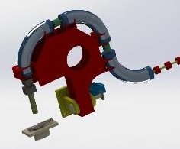
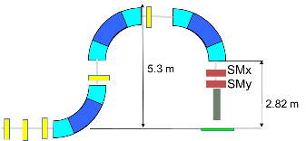
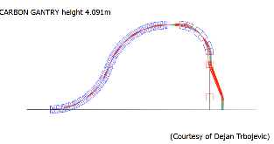
WP5 – Gantry Design
Participants: CNAO, PSI, CERN, Cockcroft Institute, Uni Melbourne
Description of Work
Task 5.1: Compact Synchrotron Gantry Design Based on new mechanical design and Canted Cosine Theta Magnets (small aperture, 30mm) - (TERA concept merged with PSI concept)
Task 5.2: Toroidal Magnet Gantry Design (L. Bottura GaToroid) (to develop magnet, beam optics, kicker, mechanics
Task 5.3: Large Energy Acceptance Linac Gantry (special optics need to be developed)
For the 3 options, to be studied:
Beam optics design
Integration in the beam delivery line
Mechanical support

Slide 18
WP5 – Gantry Design
Deliverables
D5.1: Compact Synchrotron Gantry Beam Delivery Design – M36
D5.2: Toroidal Magnet Gantry Design – M36
D5.3: Large Energy Acceptance LINAC Design – M36

Slide 19
WP6 – Medical Biophysics and Imaging
Participants: GSI, CNAO
Description of Work
Task 1.1: Fast dose delivery through improved real time control and detectors
Upgrade the CNAO dose delivery system for very short spot durations
Incorporate novel detectors, dynamic intensity control and multi-energy operation
Task 1.2: Conformal motion mitigation through synchronized delivery
Realise treatment plan libraries and dynamic switching between plans
Tailor plan parameters to enable delivery of one IES per breathing cycle
Task 1.3: Gantry-free delivery enabling arc therapy for high-dose rates
Design study for a gantry-free system enabling multiple beam angles
Treatment planning study exploiting the system for particle arc & FLASH therapy

Slide 20
WP6 – Medical Biophysics and Imaging
Deliverables
D6.1: Motion-synchronised delivery of one beam energy per breathold in phantoms – M24
D6.2: Implemented treatment planning strategy for gantry-free arc therapy – M36
D6.3: Demonstration of arc therapy in an animal model with orthotopic tumours – M36

Slide 21
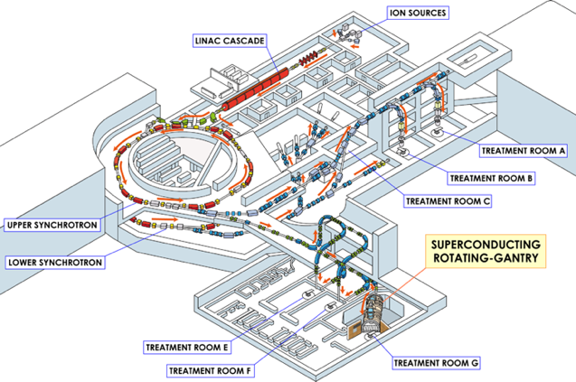
WP7 – Infrastructure, Diagnostics and Safety Systems
Participants: Cosylab, Uni Malta
Description of Work
7.1: Machine infrastructure requirements
7.2: Machine controls, instrumentation and diagnostics design
7.3: General machine safety systems
7.4: Patient safety systems
7.5: Patient environment and positioning system
7.6: Environmental and climate change considerations
HIMAC Chiba Japan

Slide 22
WP7 – Infrastructure, Diagnostics and Safety Systems
Deliverables
D7.1: Machine Infrastructure report – M36
D7.2: General machine safety controls, instrumentation, diagnostics and systems report - M24
D7.3: Patient safety systems report – M30
D7.4: Patient environment and positioning design report – M8
D7.5: Environmental and climate change considerations report – M8

Slide 23
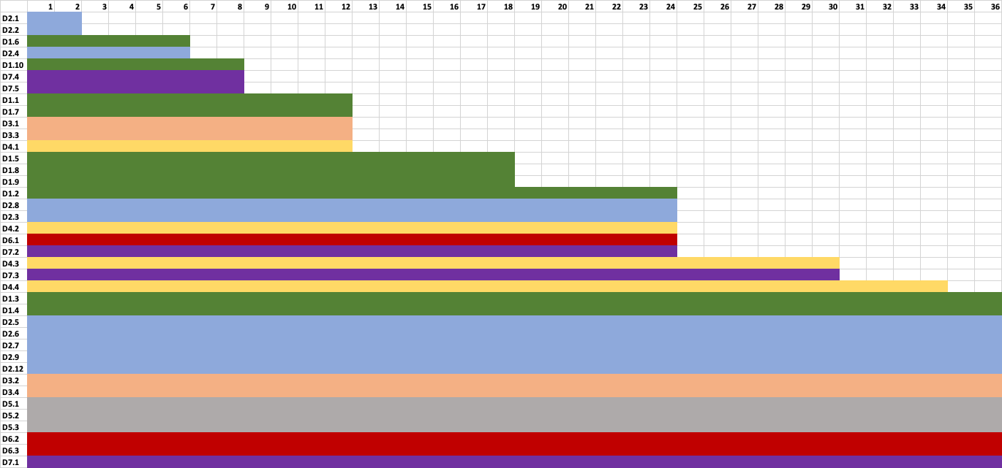
Project Timeline

Slide 24
Proposal Timeline to Submission
- end of July - all main participants and work package leaders confirmed
- end of August - all Balkan region participants confirmed
- end of August - 1st draft of proposal
- end of August - 2nd face-to-face meeting of all participants at CERN
- end of September – all administrative paper work settled & checked
- end of September – budgeting confirmed
- 5th November - submission

Slide 25
20+ Project Participants

