Slide 1
AFT: Why was it invented?
Accelerator Fault Tracking
For CERN’s Accelerator Complex
May 2019
A. Apollonio (TE-MPE)
C. Roderick (BE-CO)

Slide 2
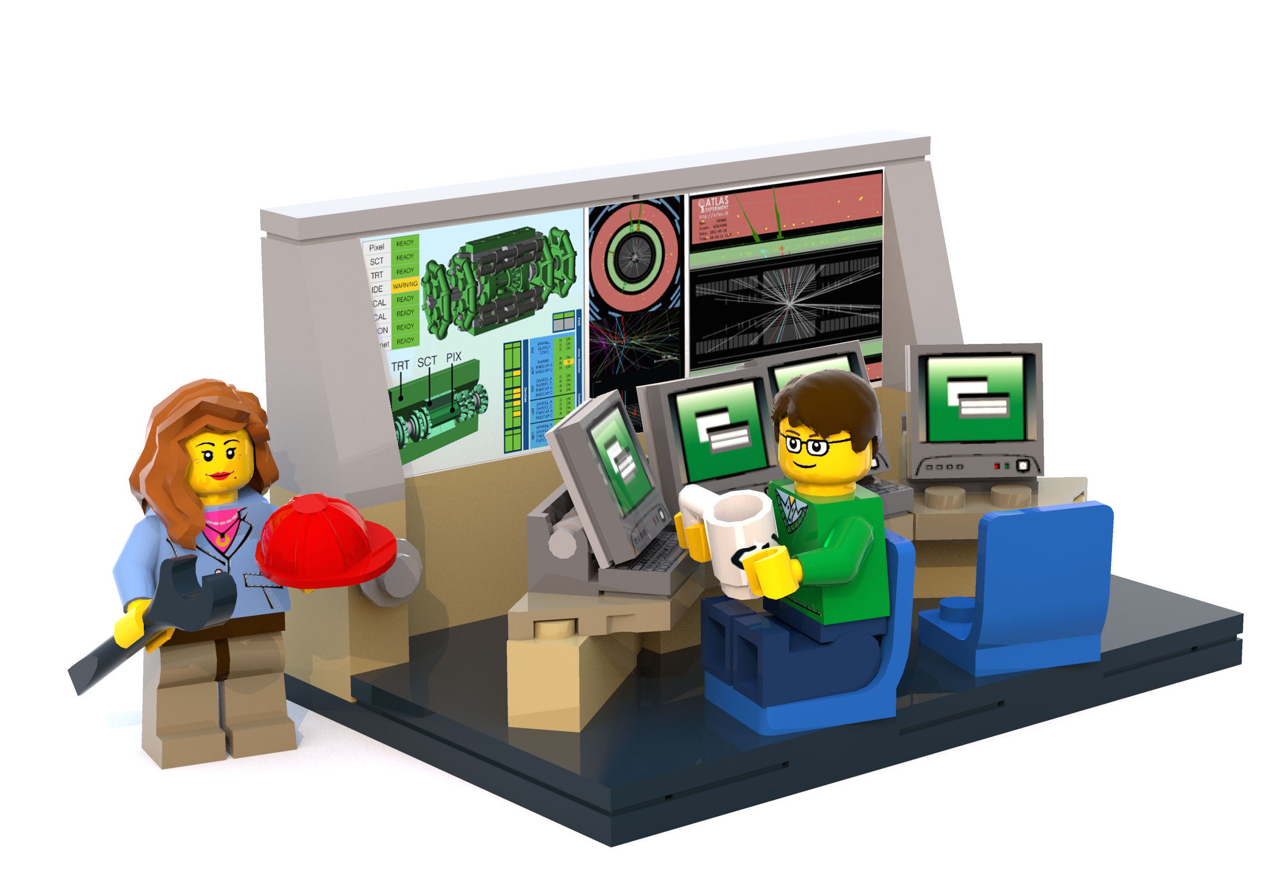

Accelerator Fault Tracker: What is it?
Operators register faults – providing a very broad overview of accelerator behavior, but lacking details for system improvements
AFT is a software application to:
Ensure consistent and objective fault tracking for the CERN accelerator complex
System experts register faults via dedicated tools
(Jira, AMMSs, Excel, etc.) that are not easily shared – resulting in a very detailed system specific view, but lacking information on overall accelerator impact

Slide 3
AFT: Why was it invented?
Beam Performance
KPI
=
Integrated
Luminosity
Hardware Performance
Operational Efficiency
= Availability

Slide 4
AFT: What does it do?
Fast, powerful and objective reporting on accelerator performance
Enabling to:
Prioritize consolidation activities according to impact on availability
Maximize return of investment given allocated budget constraints
Provide input for modelling of accelerator projects

Slide 5
AFT History…
2012
LHC Availability Working Group (AWG) launched (chairs: B. Todd, L. Ponce, sc. Secretary: A. Apollonio), reporting to LHC Machine Committee
2013
Accelerator Fault Tracker (AFT) proposed to have objective view of LHC availability
B. Todd / L. Ponce / A. Apollonio together invented Cardiogram data view
C. Roderick joined as partner from Controls
2014
AFT project launched (combined BE-CO, BE-OP and TE-MPE initiative)
2015
AFT extensively used for LHC availability data analysis and predictive models of accelerator performance
2016
AWG periodic LHC reporting using AFT data
CERN Machine Advisory Committee recommendation: extend AFT to entire CERN complex
2017
AFT extensively used for CERN-wide availability data analysis
2018
AWG began periodic reporting for injectors using AFT data
LHC = B. Todd / A. Apollonio / D. Walsh, Injectors = A. Apollonio, A. Niemi
On-going developments (BE-CO), with requirements from AWG, BE-OP and several ATS equipment groups

Slide 6
Fault Registration Workflow
OP crew registers faults
AWG core reviews faults
System experts review faults
LHC OP
eLogbook
AFT
Statistics
&
Reports
SPS OP
eLogbook
PS OP
eLogbook
PSB OP
eLogbook
Linac OP
eLogbook

Slide 7
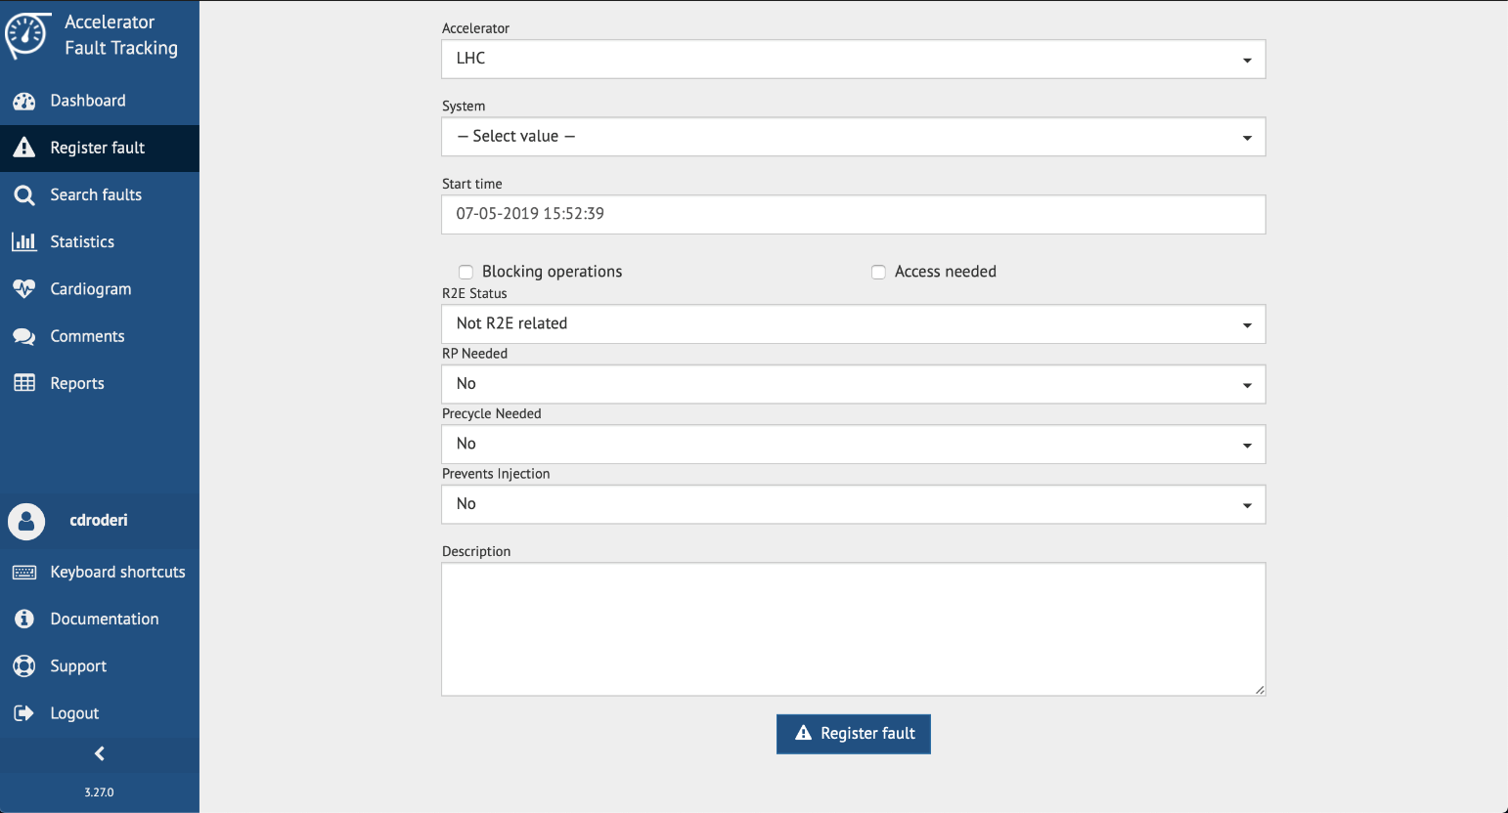
Fault Registration
Operators use existing E-Logbook Tool
AFT Web application also available
In both cases – the fault capture is intended to be as simple as possible
Notes:
Fault registration is typically performed using a dedicated screen in the existing E-Logbook Tool. This was a request from the Operators – not to have an additional tool to interact with.
The AFT Web application also provides a screen from which faults can be registered if the users have the appropriate access rights.
In both cases, the initial fault capture screens are as simple as possible so as not to hinder the process. The fault details are usually then completed later by relevant experts.

Slide 8

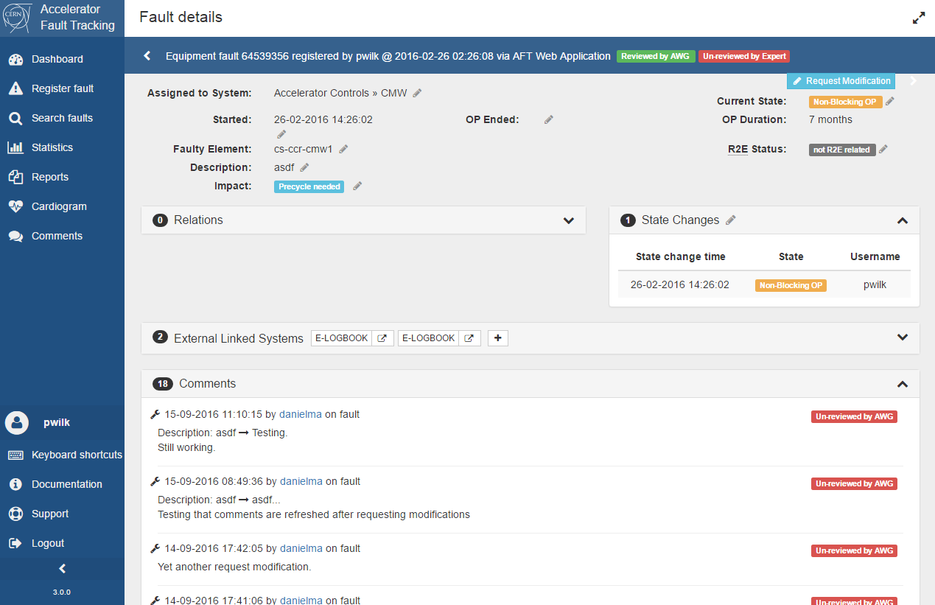




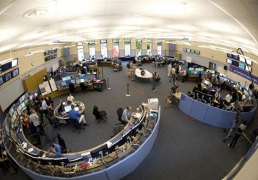
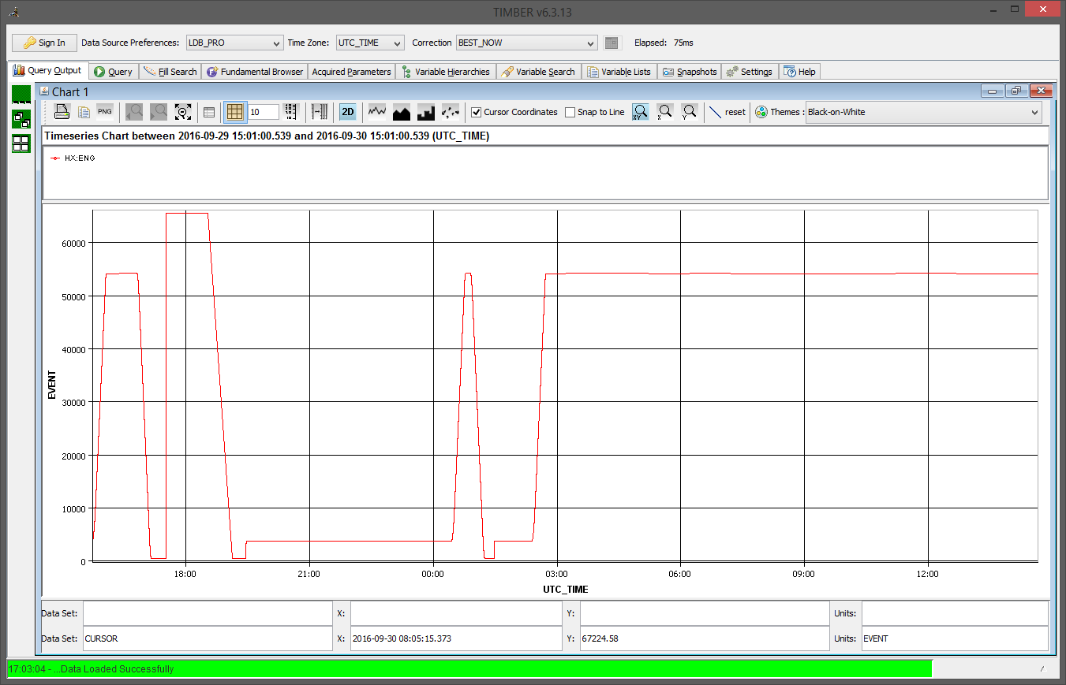
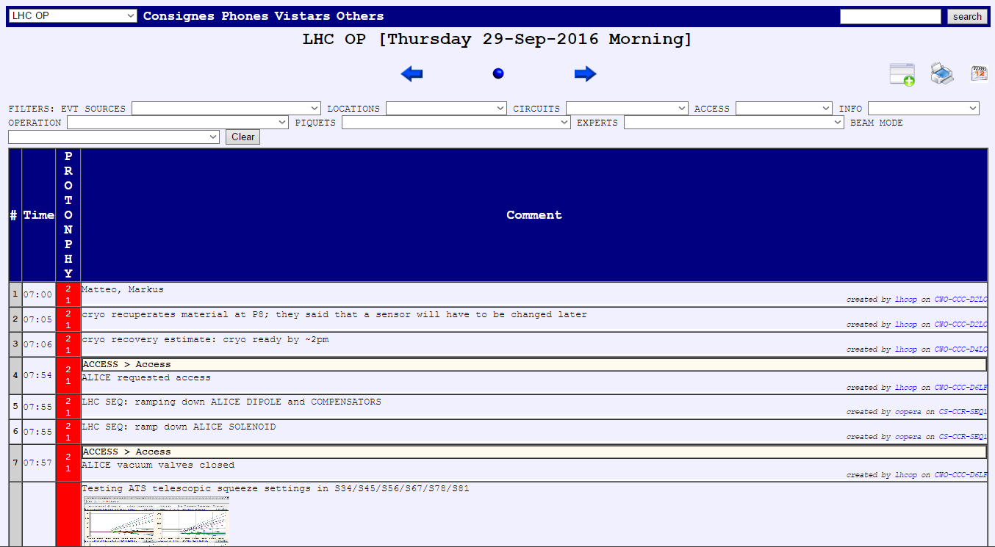
AFT High-Level Overview
Spring JPA
AFT DB
REST API
Storing fault data plus filtered data coming from other systems to be correlated with fault details
Web application: browse, edit and analyse fault data.
AFT server
REST APIs
RMI (REST soon)
Logging Client (Java)
Layout (faulty elements),
ASM (schedule data)
Logging System (archived data) – machine info (beam modes etc.)
eLogbook – basic fault data from Operators
Notes:
At the core of AFT is a redundant, stateless Java server based on Spring Boot. https://it.wikipedia.org/wiki/Spring_framework
As mentioned on the previous slide, faults are typically sent to the AFT server from the E-Logbook application using a Java RMI (Remote Method Invocation) API https://it.wikipedia.org/wiki/Remote_Method_Invocation. It is foreseen to replace the Java RMI client this year with calls to an AFT REST (Representational State Transfer) API. https://it.wikipedia.org/wiki/Representational_State_Transfer
The AFT server persists fault data in an Oracle database together with other complimentary data from other systems, as will be shown in a moment.
Also as mentioned, there is a Web application based on the Angular framework https://it.wikipedia.org/wiki/Angular, which can be used to register, browse, edit and analyse fault data and associated statistics.
Currently a small set of machine activity data is pulled into AFT from CERN’s accelerator data logging (archiving) system and stored together with fault data.
AFT is also integrated with:
CERN’s Layout system for associating functional elements with faults to facilitate follow-up and analysis.
CERN’S Accelerator Schedule Management system to allow people to consult fault data with respect to the different types of events in the accelerator operational schedule.

Slide 9
Alarm and Interlock Systems
Alarm systems are mostly used for diagnostics of faults (accelerators + technical infrastructure)
  Requires accurate configuration
  Easier to use in smaller machines
  Direct interface with operators to identify faults
  Today not in use for LHC, too many alarms, practically unmanageable
Interlock systems are used for machine protection
  Cannot be bypassed by operators
  Reaction time (LHC) ~100 us
  Also provide accurate fault diagnostics via the post-mortem system
  Absolutely vital for LHC operation, extremely stringent reliability requirements

Slide 10
A Data-Driven Approach
AFT is largely data-driven – based on configuration data stored in a relational model. This includes definitions of:
Accelerators (facilities)
Accelerator Specific Fault Properties
(e.g. affected ring for the CERN PSB, LHC R2E status, etc.)
Accelerator Systems
Accelerator System Responsibles
Accelerator System Specific Fault Properties
(e.g. Technical Infrastructure Failure Modes, Electrical Network distribution site locations, Controls JIRA issue keys) etc.
Etc.

Slide 11
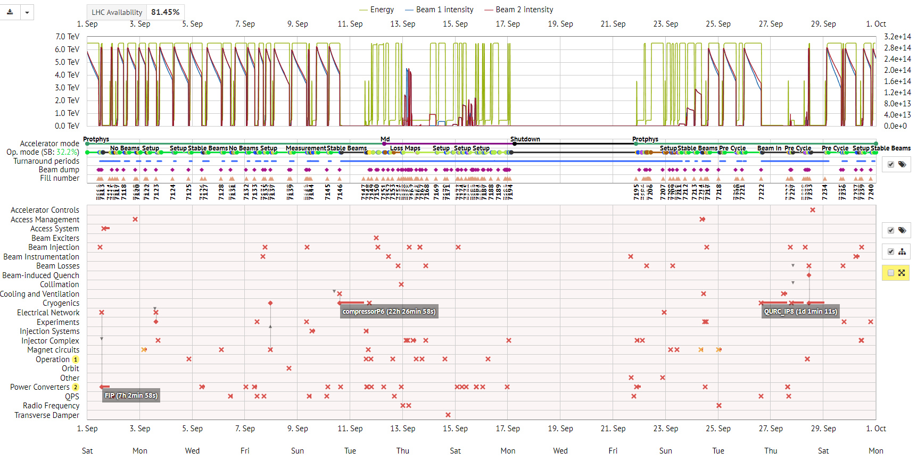
Cardiogram of LHC Operation

Slide 12
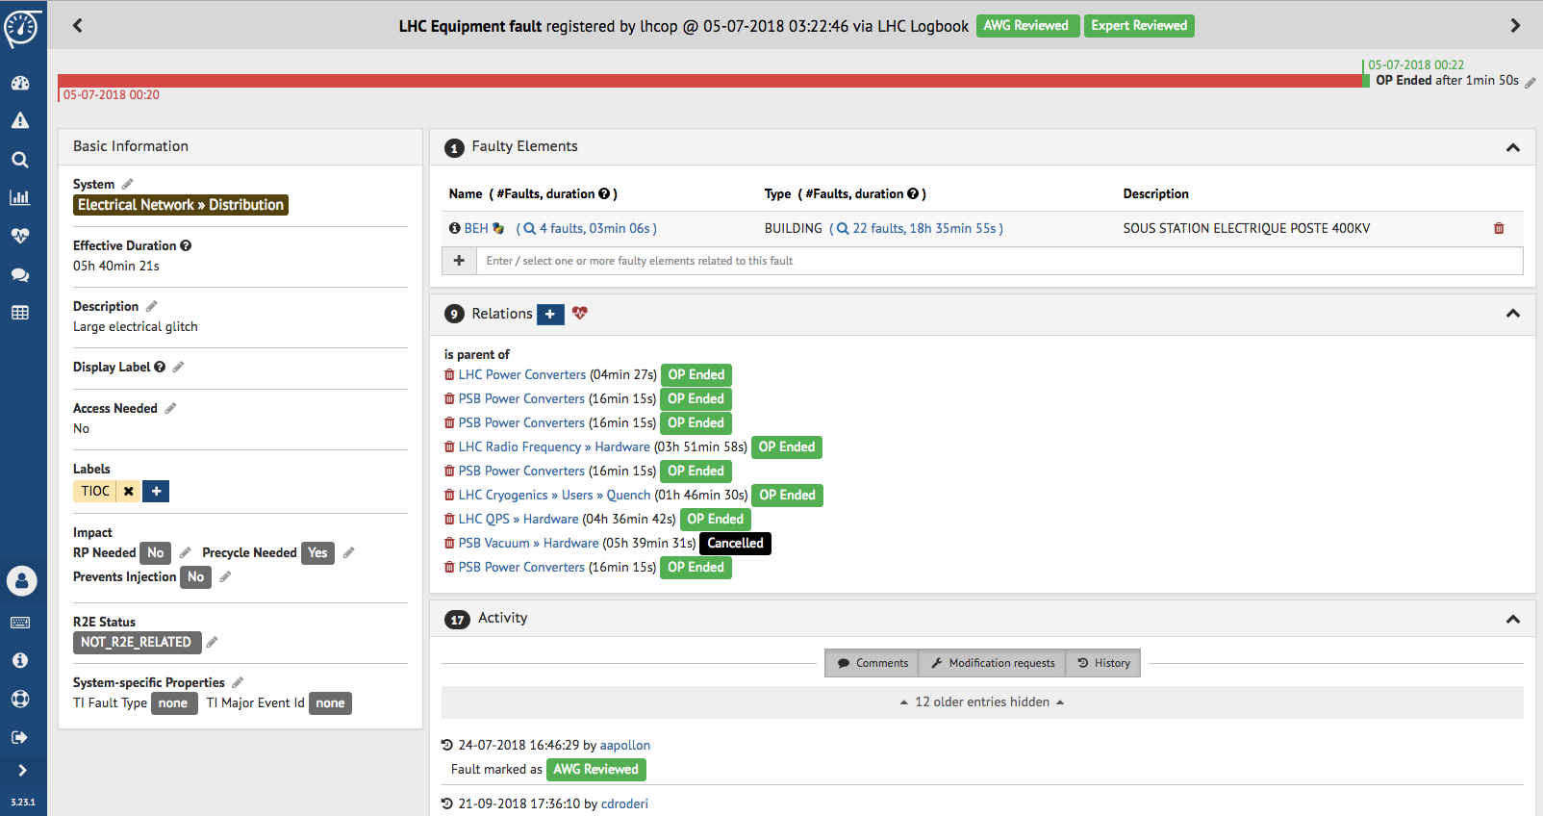
Customisable Event Details
Review Status
Basic Information
Details and History
Event Dependencies
History of changes
Attributes

Slide 13
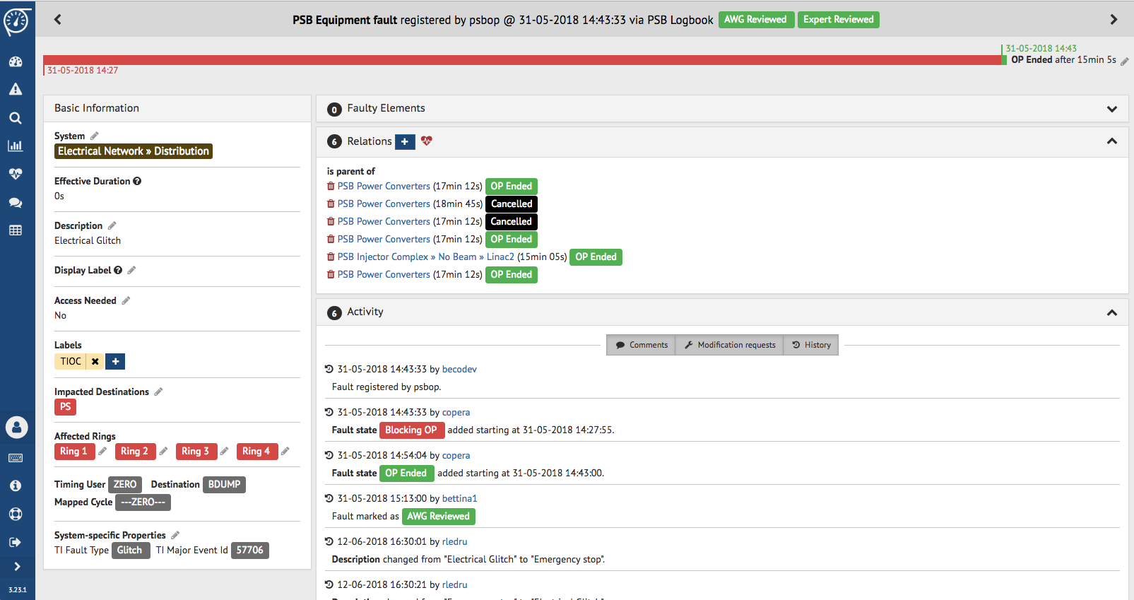
Customisable Event Details
Details and History
Attributes

Slide 14
Objective view of 2017 LHC System Downtime
System Viewpoint =
Integrated fault time logged
Operations Viewpoint =
Corrects for dependencies
parent / child / shadow

Slide 15
Background
Complete & Consistent Tracking will allow to identify:
  Problems as early as possible
    ☞ allowing for timely mitigation
  Key issues which will limit performance of accelerators or equipment (Run3, HL-LHC, …)
Aim: Increase availability, both short and long-term, by dealing with issues ASAP
Track faults in two areas:
Directly affecting accelerator operation – identify root causes
Equipment faults independently of immediate impact on accelerator operation

Slide 16
Current Status
AFT is the common source for regular performance reporting:
Weekly Facilities Operation Meetings, LHC Machine Coordination meetings, Post Technical Stops, Annual Performance workshops (Evian) etc.
Steadily providing new features and improvements
>450 users (~250 regular users)
Extension foreseen to cover SPS North Experimental Area from 2020 onwards

Slide 17
Roles and Privileges
All access requires a login via CERN Single Sign On.
Your role dictates what you can do inside AFT.
Roles use RBAC (Role Based Access Control).
Main Roles:
AWG Members (Availability Working Group) &
Machine Supervisors: power users, responsible for overall data quality, arbitrating between operators and equipment groups, producing periodic reports.
Operators: responsible for initial data entry / edition.
System Experts: responsible for validating and completing data for faults assigned to their system(s).
Other users: have read access, are able to comment etc.

Slide 18
Fault Review Process
AWG members and Machine coordinators meet periodically (weekly for the injectors) to review the faults:
completing missing data, ensuring consistency across the machines, and adding relationships between the faults where applicable.
System Experts are notified of new faults either immediately after they are assigned or periodically (weekly) according to the system experts preferences.
Invited to review the faults assigned to their system - essentially acknowledging the fault.
Able to update certain attributes.
Can request modification of remaining attributes by AWG (e.g. change of times, states, re-assignment to another system etc.).
Workflow behind, whereby the AWG/Machine Coordinators are able to see and accept / reject modification requests.
This is the best / easiest way to work - i.e. don’t just send mails or make comments asking for things to be re-assigned.

Slide 19
Conclusions / Personal remarks
Raising awareness of the importance of fault tracking and fault follow-up in the organization is fundamental
Make fault tracking credible, objective and visible to all accelerator experts
Establish a clear workflow for fault registration and review, involve operations, technical experts, management
Automatic fault registration is the dream…may be not so easy in some cases
Takes time…(several years, if not implemented from the beginning)

Slide 20
aft.cern.ch

Slide 22
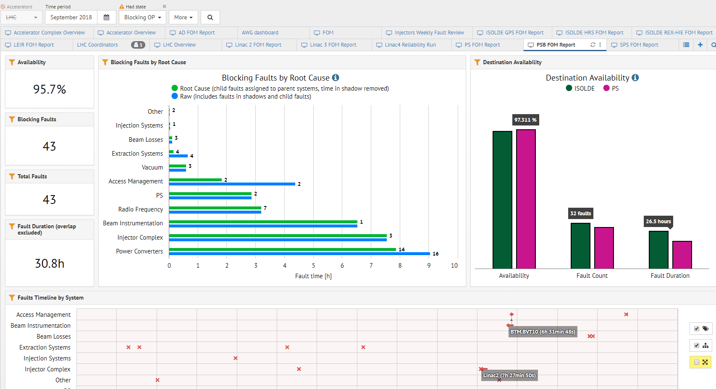

Slide 23
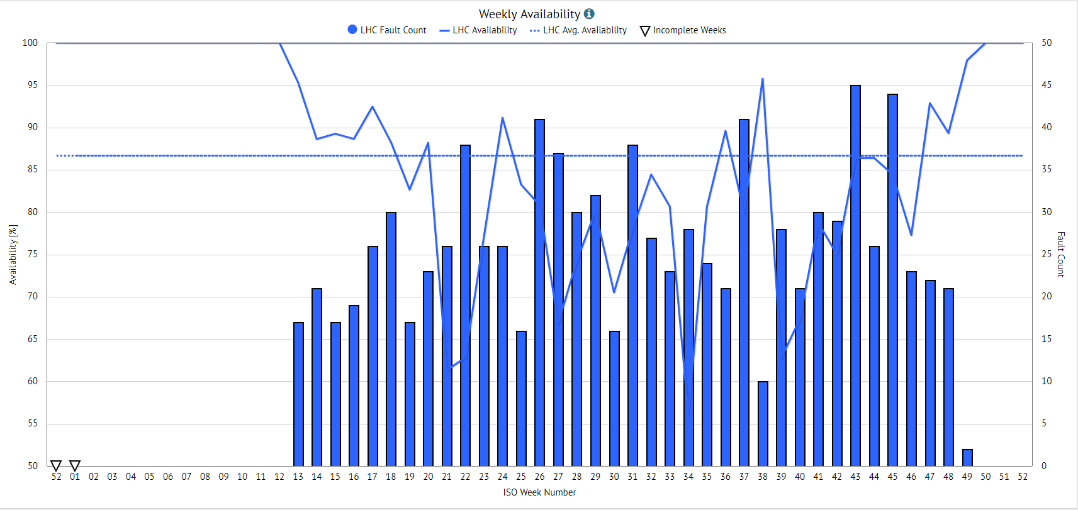

Slide 24
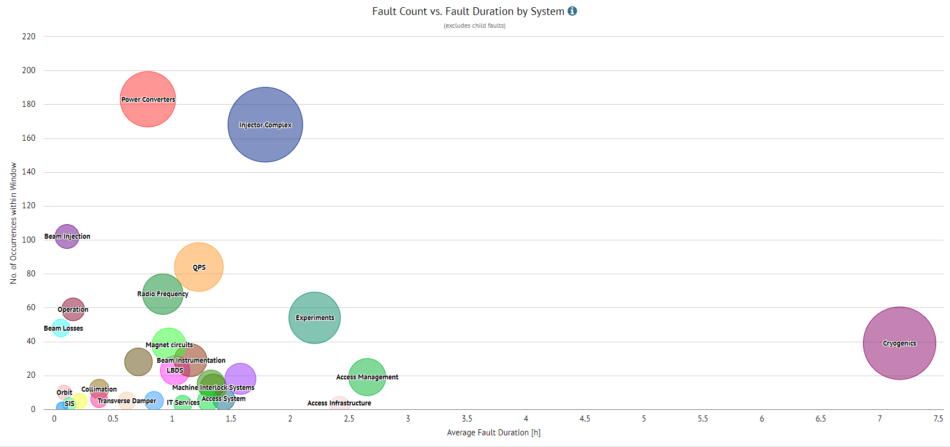

Slide 25
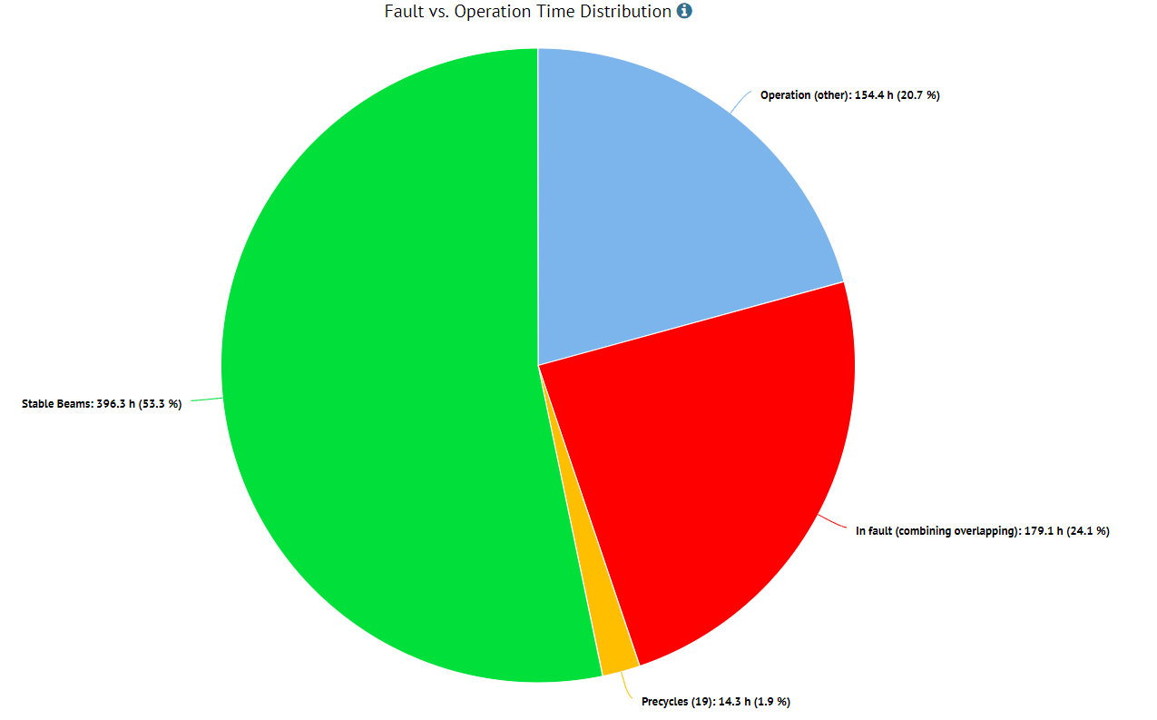

Slide 26
