Slide 1
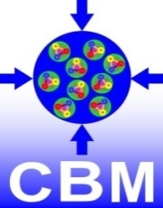
Ladder Assembly for the Silicon Tracking System of the CBM Experiment.
S.Mehta for the CBM collaboration
DPG Spring Meeting, München
18 March, 2019

Slide 2
Outline
Introduction
Components of ladder
Ladder assembly overview in GSI
Assembly procedure
Metrology of sensors
Conclusion and Outlook

Slide 3
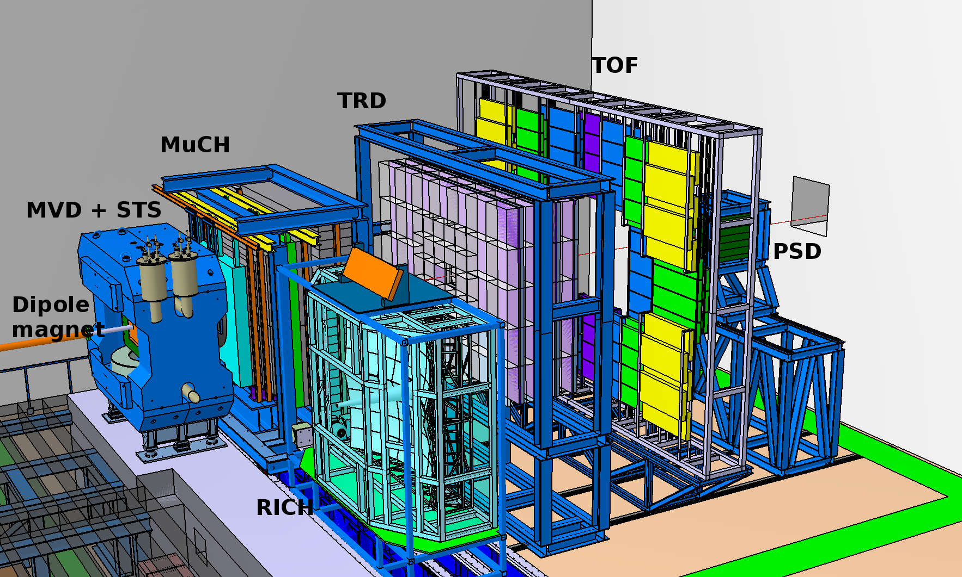
Compressed Baryonic Matter (CBM)
Goal: To explore the QCD phase diagram in the region of high net Baryonic densities.

Slide 4
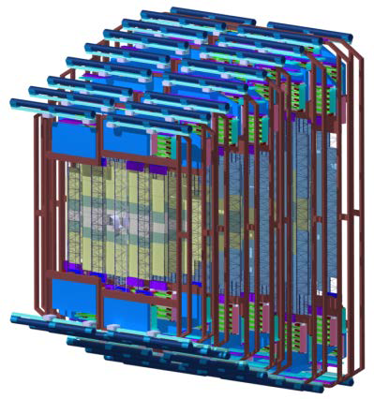
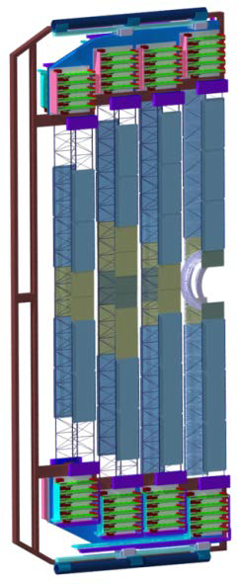
Silicon Tracking System (STS)
Goal: To reconstruct the trajectories and measure the momentum of charged particles
Si
Sensor
STS with 8 tracking
stations
18 mechanical
half-units
Ladder: 8-10 modules per ladder
Module: Sensor, Microcables and FEBs
Core detector of the CBM Experiment
Low material budget ~ 1.5 Xo % per station
896 modules mounted on 106 ladders
Fast self triggering read-out electronics mounted on the top and bottom of individual ladder
~1.8 million read-out channels
~16000 r/o ASICs “STS-XYTER”
I. Momot Wed, 16:30,
HK 44.1

Slide 5
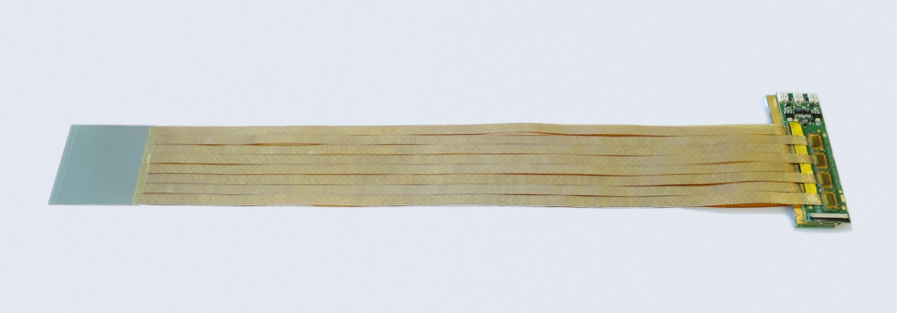
Components of a ladder
Carbon Fiber (CF) ladder produced with the winding technique
Sensor holding structures, L-legs
made of glass fibres
Sensor module: sensors,
micro cables, FEBs
FEBs (Front End Boards) in
cooling box

Slide 6
6
Assembly of CF Ladder
End plates to hold the ladders
Ladder bearing blocks

Slide 7
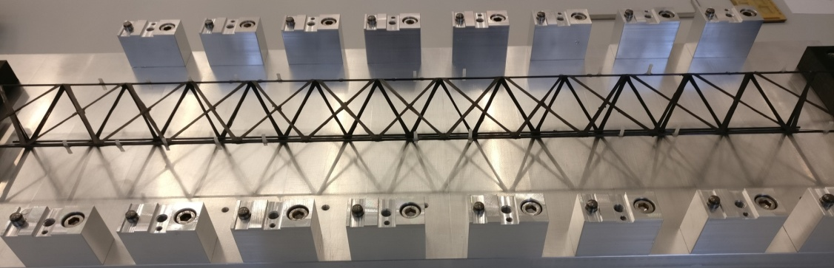
30.11.2018
Ladder assembly procedure
7
Gluing of sensor holders (L-legs) on Ladder
Applying glue on ladder using a 3-D printed guiding tool
L-leg fixture holding
L-legs
L-leg fixture goes onto the rail and the rail fits in the positioning blocks
Araldite 2011 glue
Prototype ladder with 20 L-legs (4 L-legs per sensor) after the glue is cured (~24 hours)

Slide 8
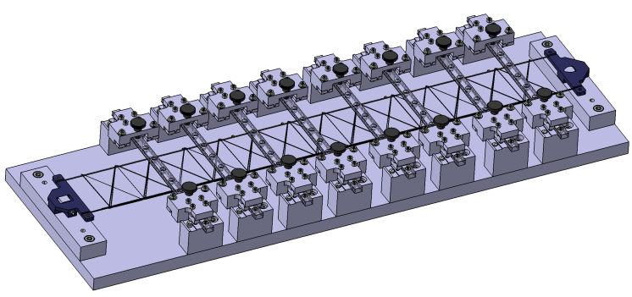
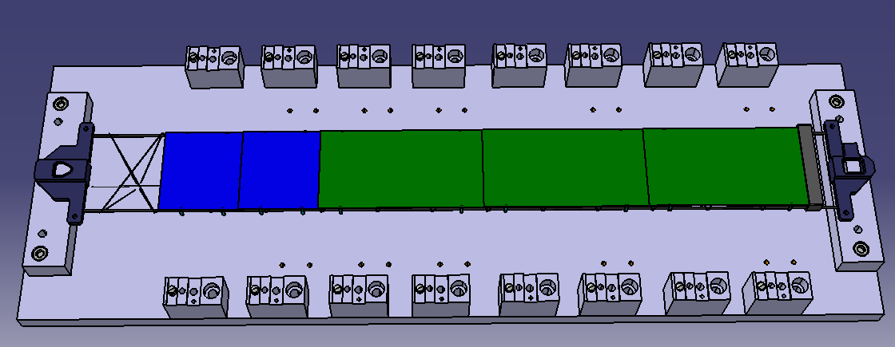
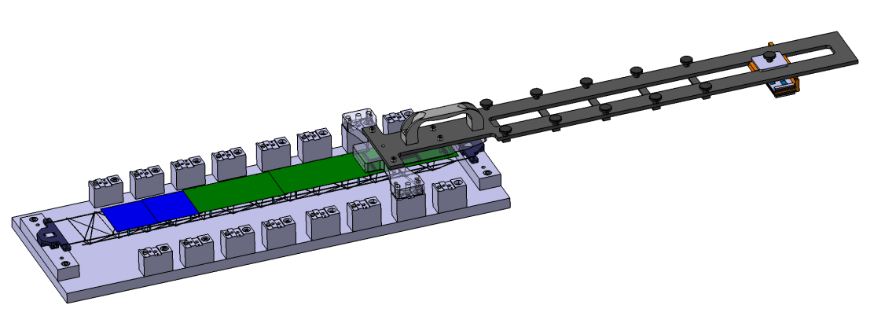
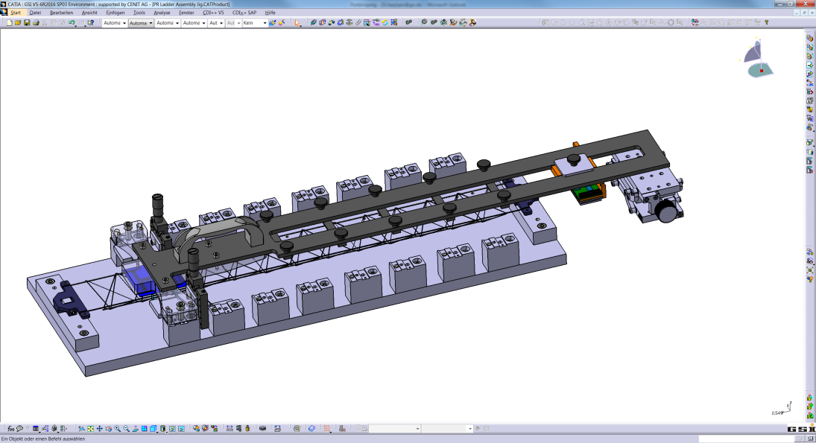
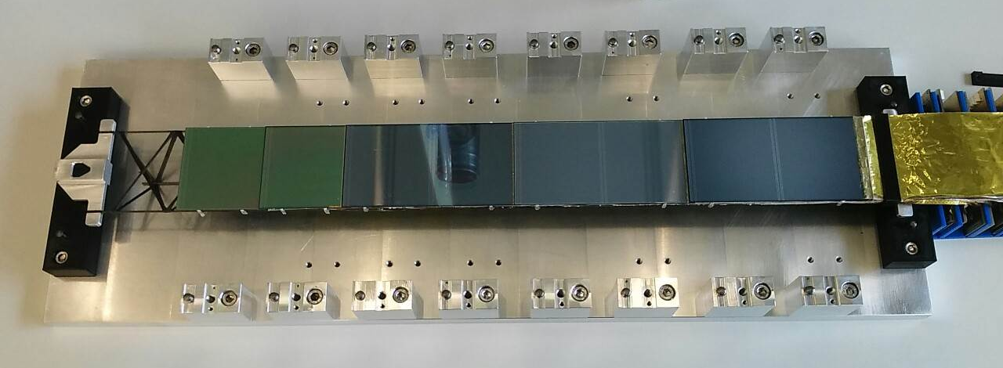
Assembly technique to mount the sensors on
the ladder
Sensor
Edges
Tool to assemble a ladder, can assemble up to 5 modules
Sensor holding tool
Assembly of modules on the ladder
Prototype ladder assembled with
5 non-functional modules

Slide 9
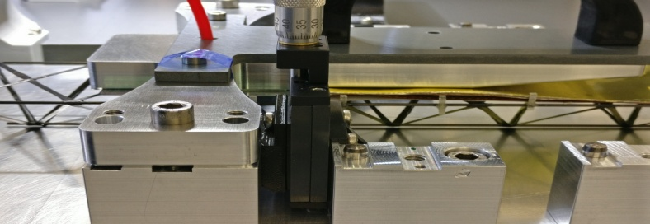
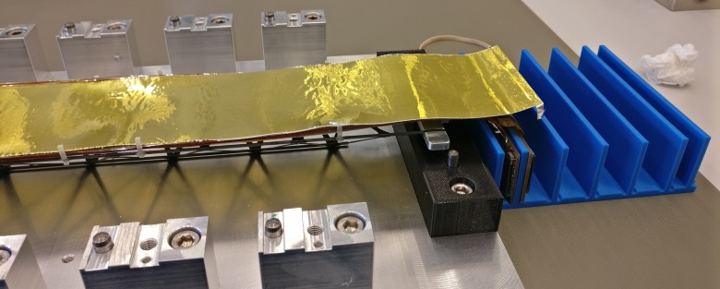
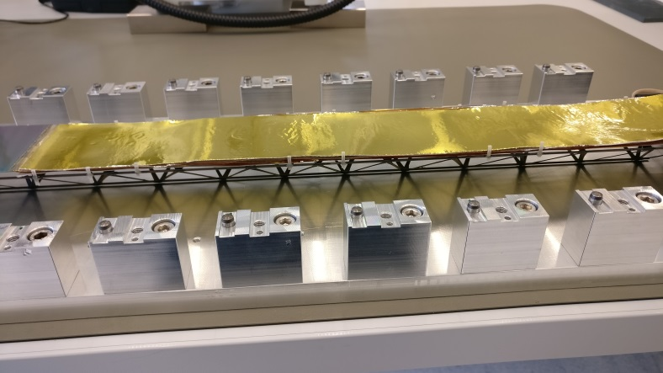
Assembly technique to mount the sensors on
the ladder
I
II
Vacuum is applied on sensor for ~ 24 hours
Module holder holding the module, micro cables are clamped
L- legs glued on the ladder and glue applied on surface of L- legs to put the sensor on it
FEBs goes inside the cooling box
A module glued on the ladder where sensor holder holds the sensor by applying vacuum
Module glued on the ladder

Slide 10
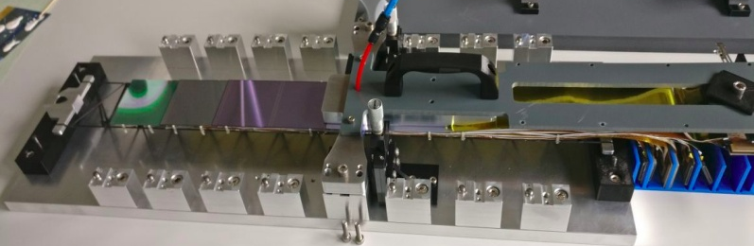
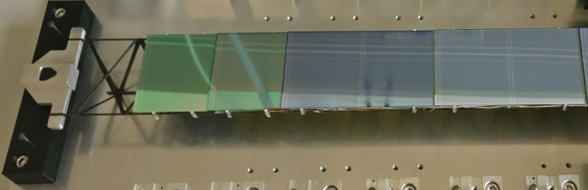
Sequential mounting of all modules
Module - I
Module - II
Module - III
Module - IV
Module - V

Slide 11
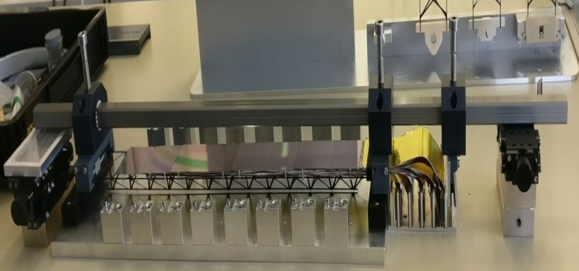
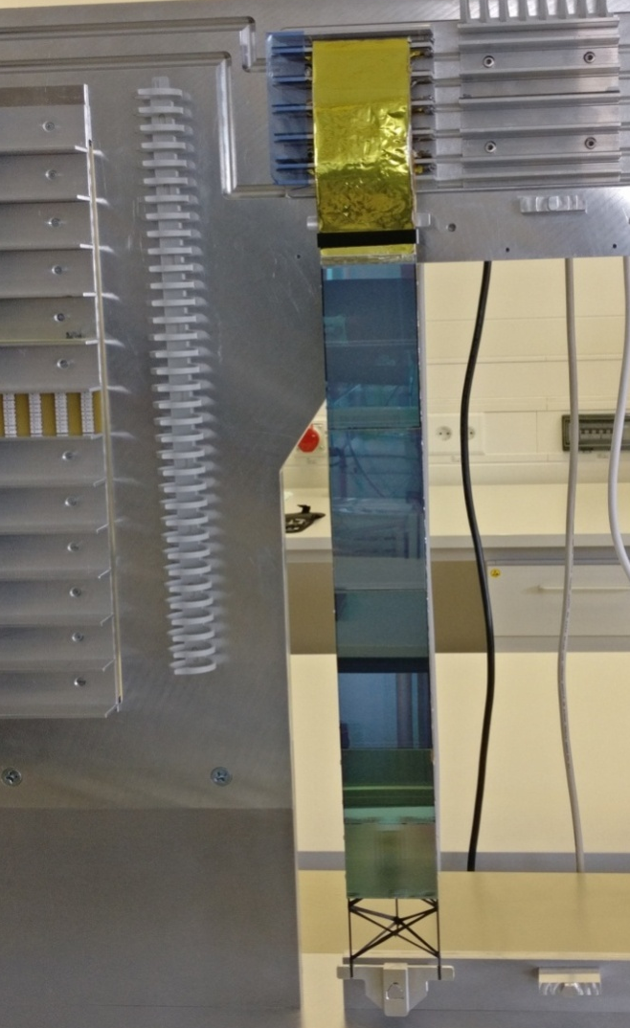
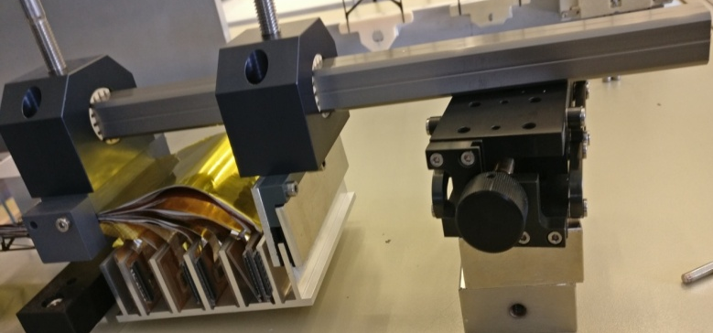
Transfer tool
Handling of ladder before transferring on C-frame
Prototype ladder mounted on C-frame
Transfer tool
C-frame
Vertical stage

Slide 12
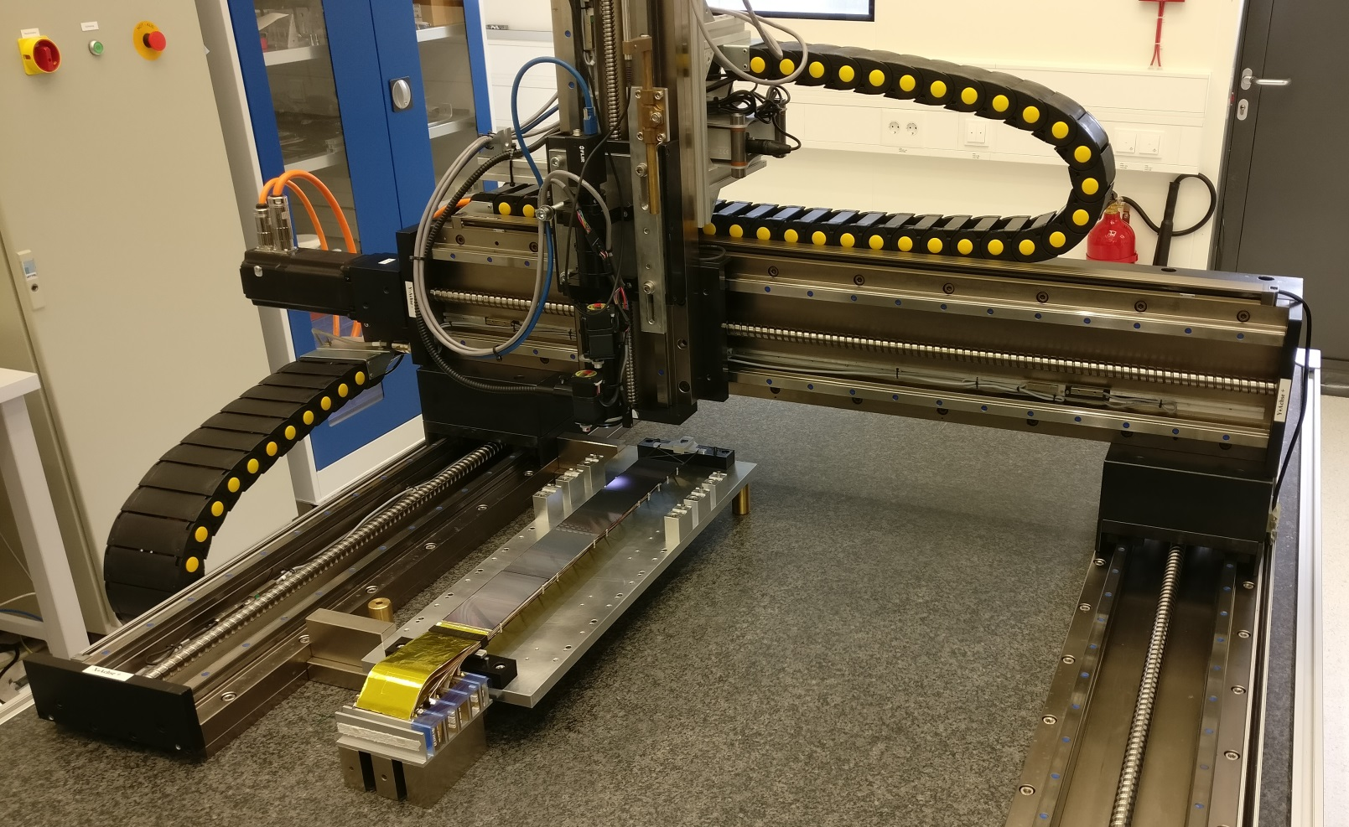
Metrology: Three axis measurement Instrument
Equipped with a camera
Area: 110 x 800 x170 mm
Methods of sensor QA adapted:
Z (Height): Focus variation
X-Y: Pattern recognition

Slide 13
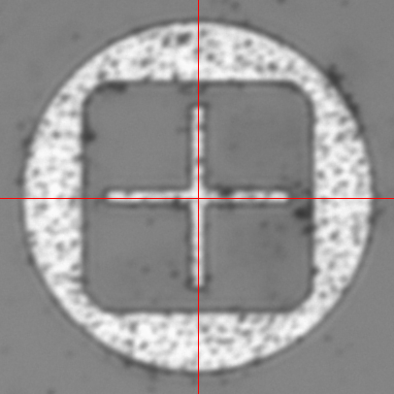
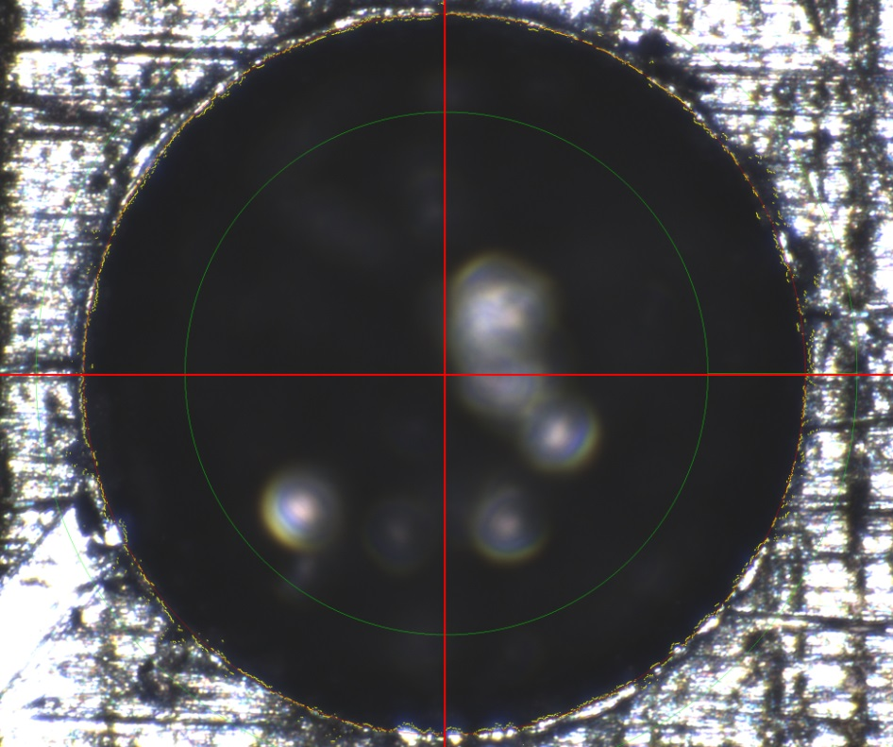
Metrology XY: Pattern Recognition
Marker on sensor
Blind hole on tool

Slide 14
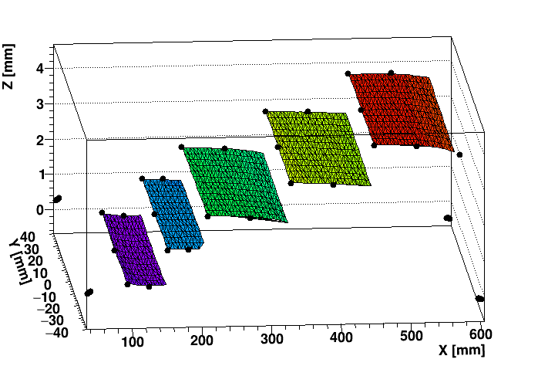
5 Module Ladder : 3D View

Slide 15
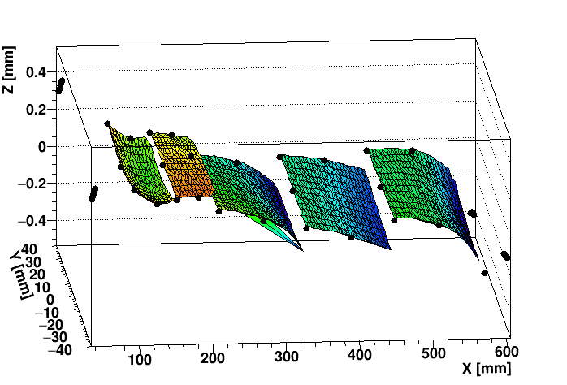
Nominal module Z position shifted to zero

Slide 16
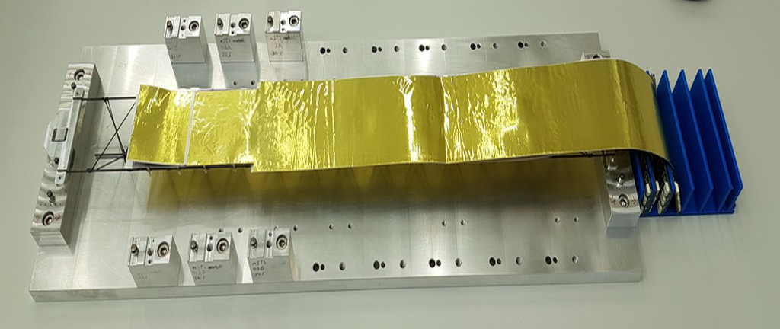
mCBM @ SIS 18
m-CBM is the demonstrator experiment for CBM
Main goal is to test the performance and functioning of detector systems.
Tracking system comprises two STS stations with 13 modules assembled on 5 ladders.
Using the same assembly technique two ladders are assembled with two (6.2 x 6.2 cm²) modules each
Ladders are assembled in the STS box and is currently under the test.
Ladder assembled with modules covered by shielding
STS box with 1st Ladder
STS box with 1st and 2nd Ladders
C.Sturm, Mon, 16:30, HK 15.1

Slide 17
Conclusion and Outlook
The technique used to assemble the ladder with modules equipped on it was feasible.
Based on the same assembly concept, further ladders will be assembled for mSTS.
Mounting tools can be improved for the better precision.
The procedure developed to determine the position of sensors in 3D meets the requirement.
Measured sensor position will be further used as an input for the track based alignment.

