Slide 1
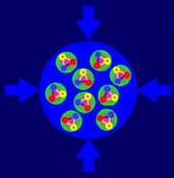
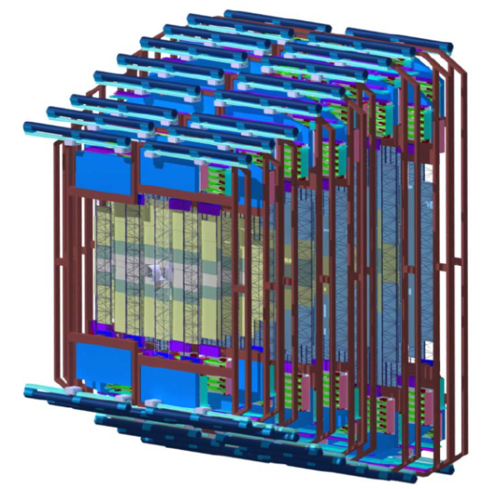

Quality Assurance Tests of The STS Read-out Electronics for The CBM Experiment
CBM
S
T
S
Merve Dogan, Adrian Rodrigues Rodriguez, Christian J. Schmidt
5th Matter and Technology Meeting, Jena 2019

Slide 2
Dipol Magnet:bending charged particles trajectories
Silicon Tracking System:charged particle tracking
Micro-Vertex Detector:secondary vertex reconstruction
Ring Imaging Cherenkov: pion identification
Transition Radiation Detector:electron identification
Time of Flight Detector:hadron identification
MUon Chambers:muon identification
Electromagnetic CALorimeter: electron/photon identification
Projectile Spectator Detector: collision centrality and reaction plane determination
What will be obtained
Exploration of the QCD phase diagram in the region of very high baryon densities
Requirements
High event rates: up to 10 MHz Au+Au reactions/seconds
Self-triggering front-end electronic
high-speed data processing
Radiation hard detectors and front-end Electronics

Slide 3
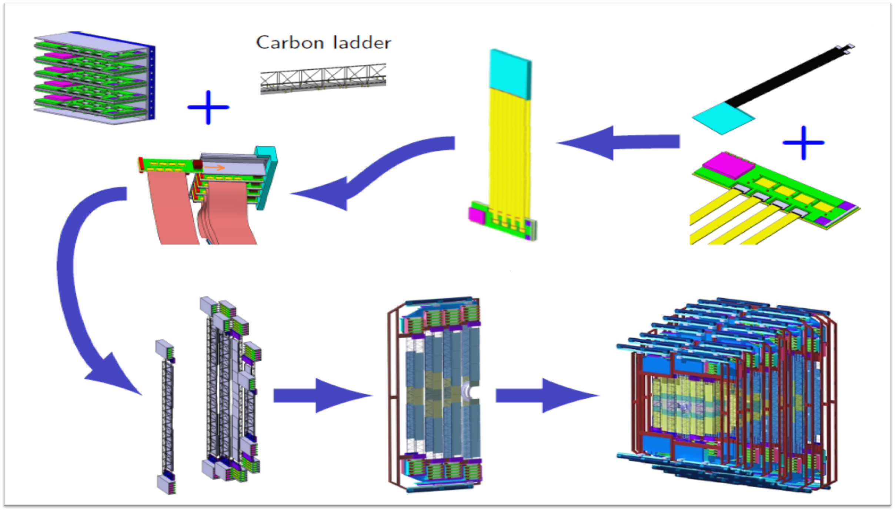
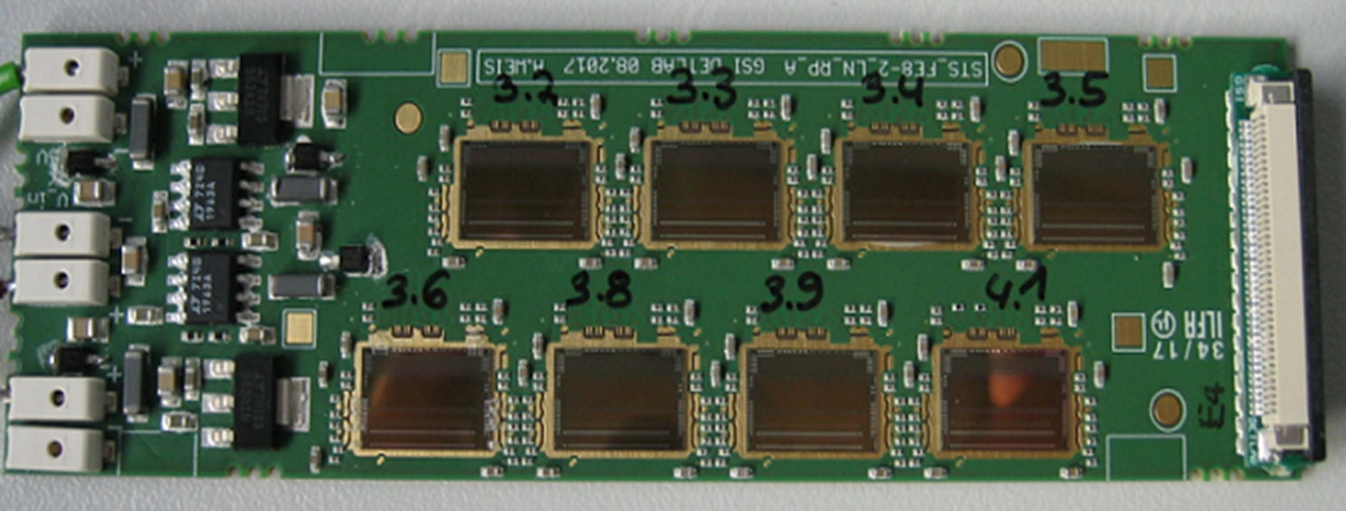
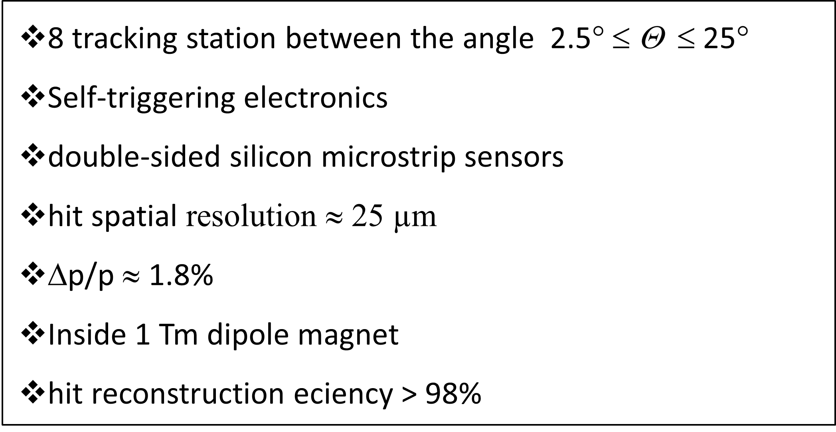
Silicon Tracking System
896 modules
Totally 106 ladders and 4-5 modules per ladder 4-5 modules per ladder

Slide 4
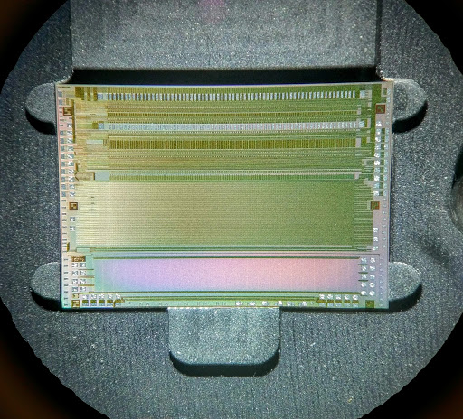
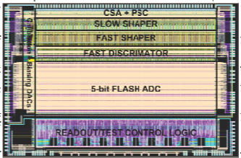
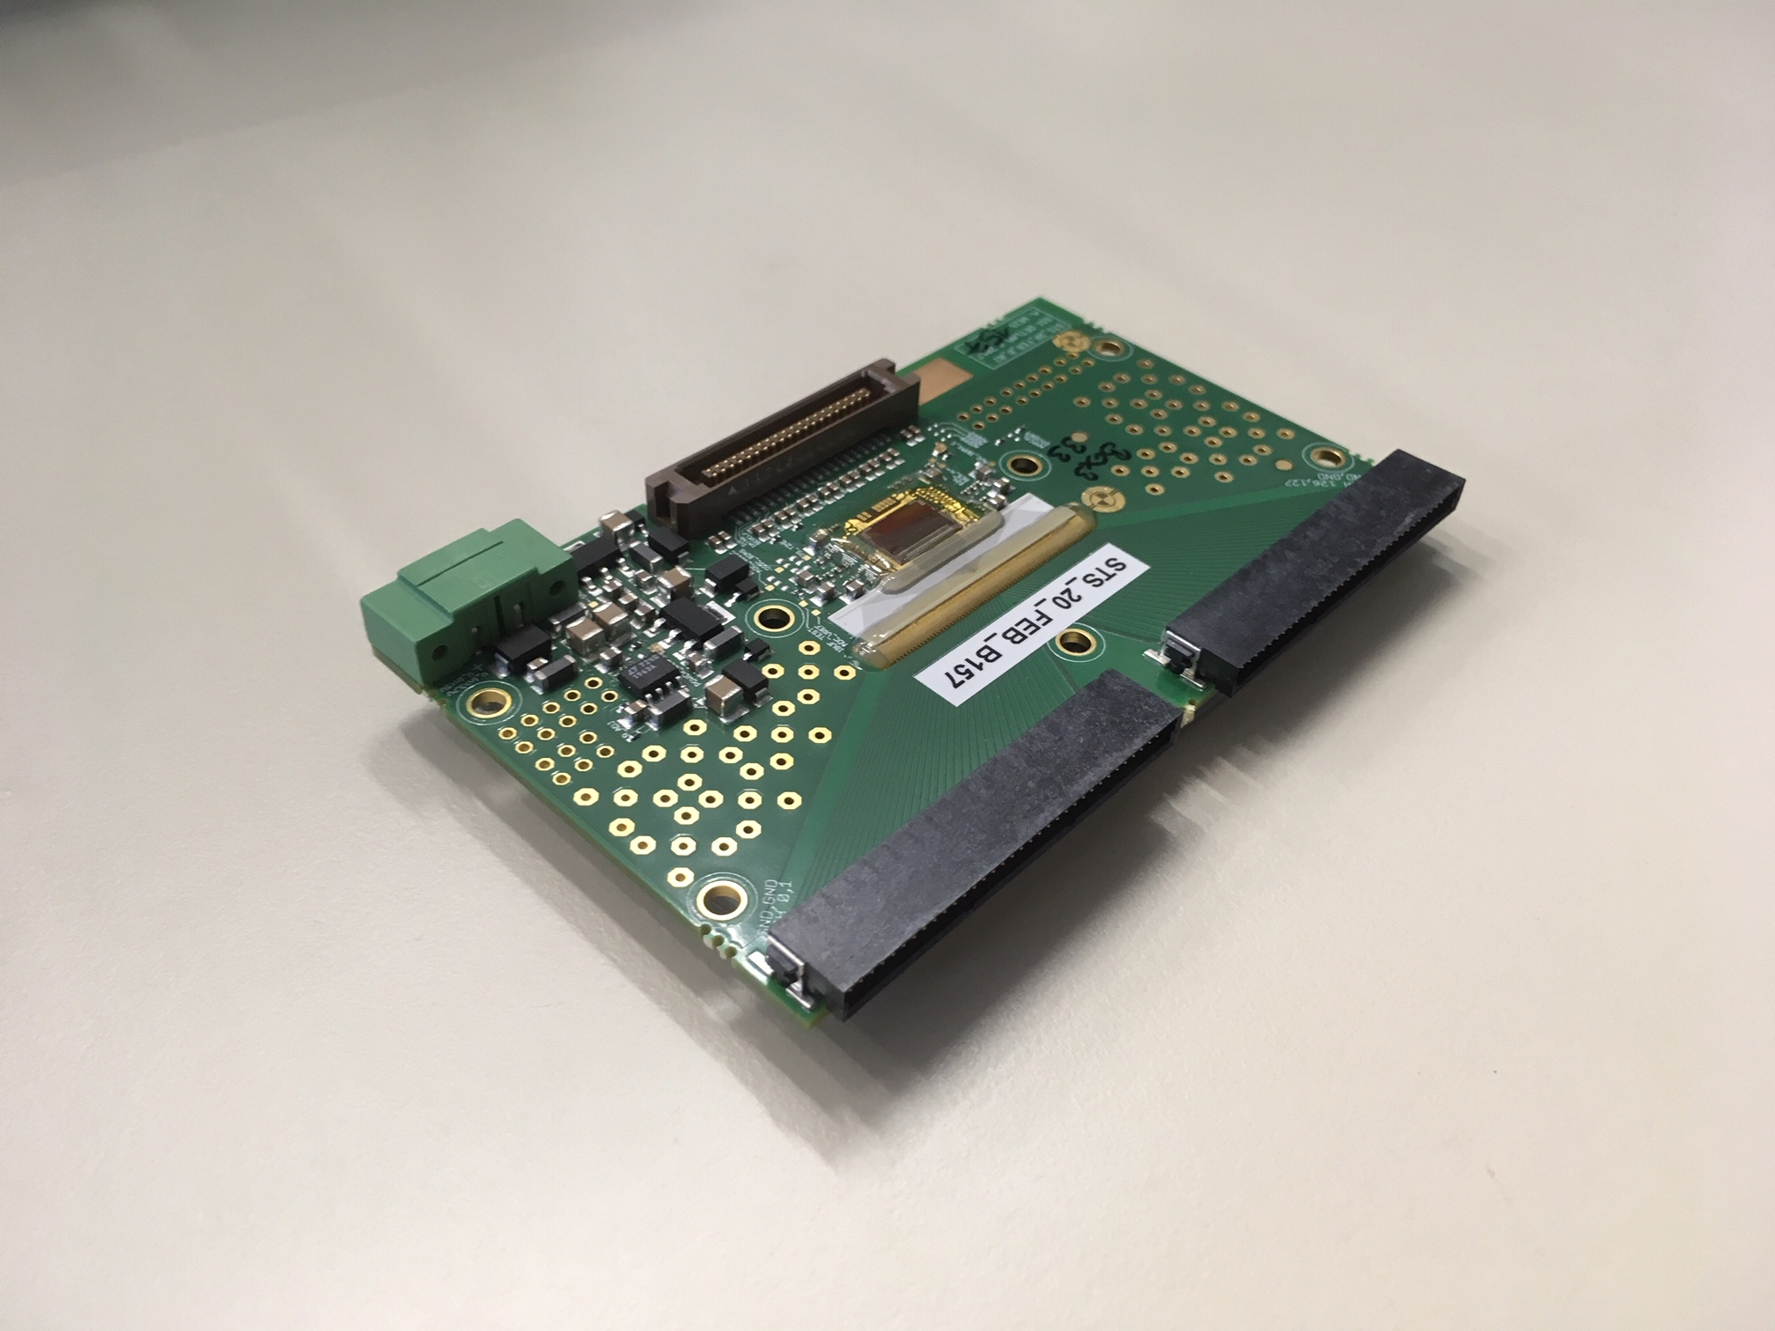
Read-Out Electronics
STS-XYTERv2.0
STS-XYTER version 2.1 is now available and under test
128 channels
Chip size: approximately 10 mm x 6.7 mm
Radiation-hardened design
Energy and time measurement

Slide 5
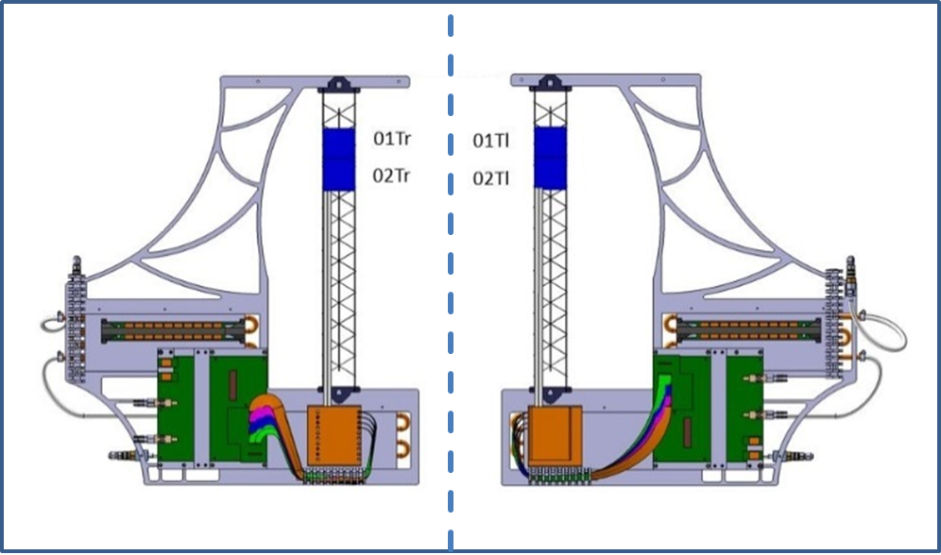
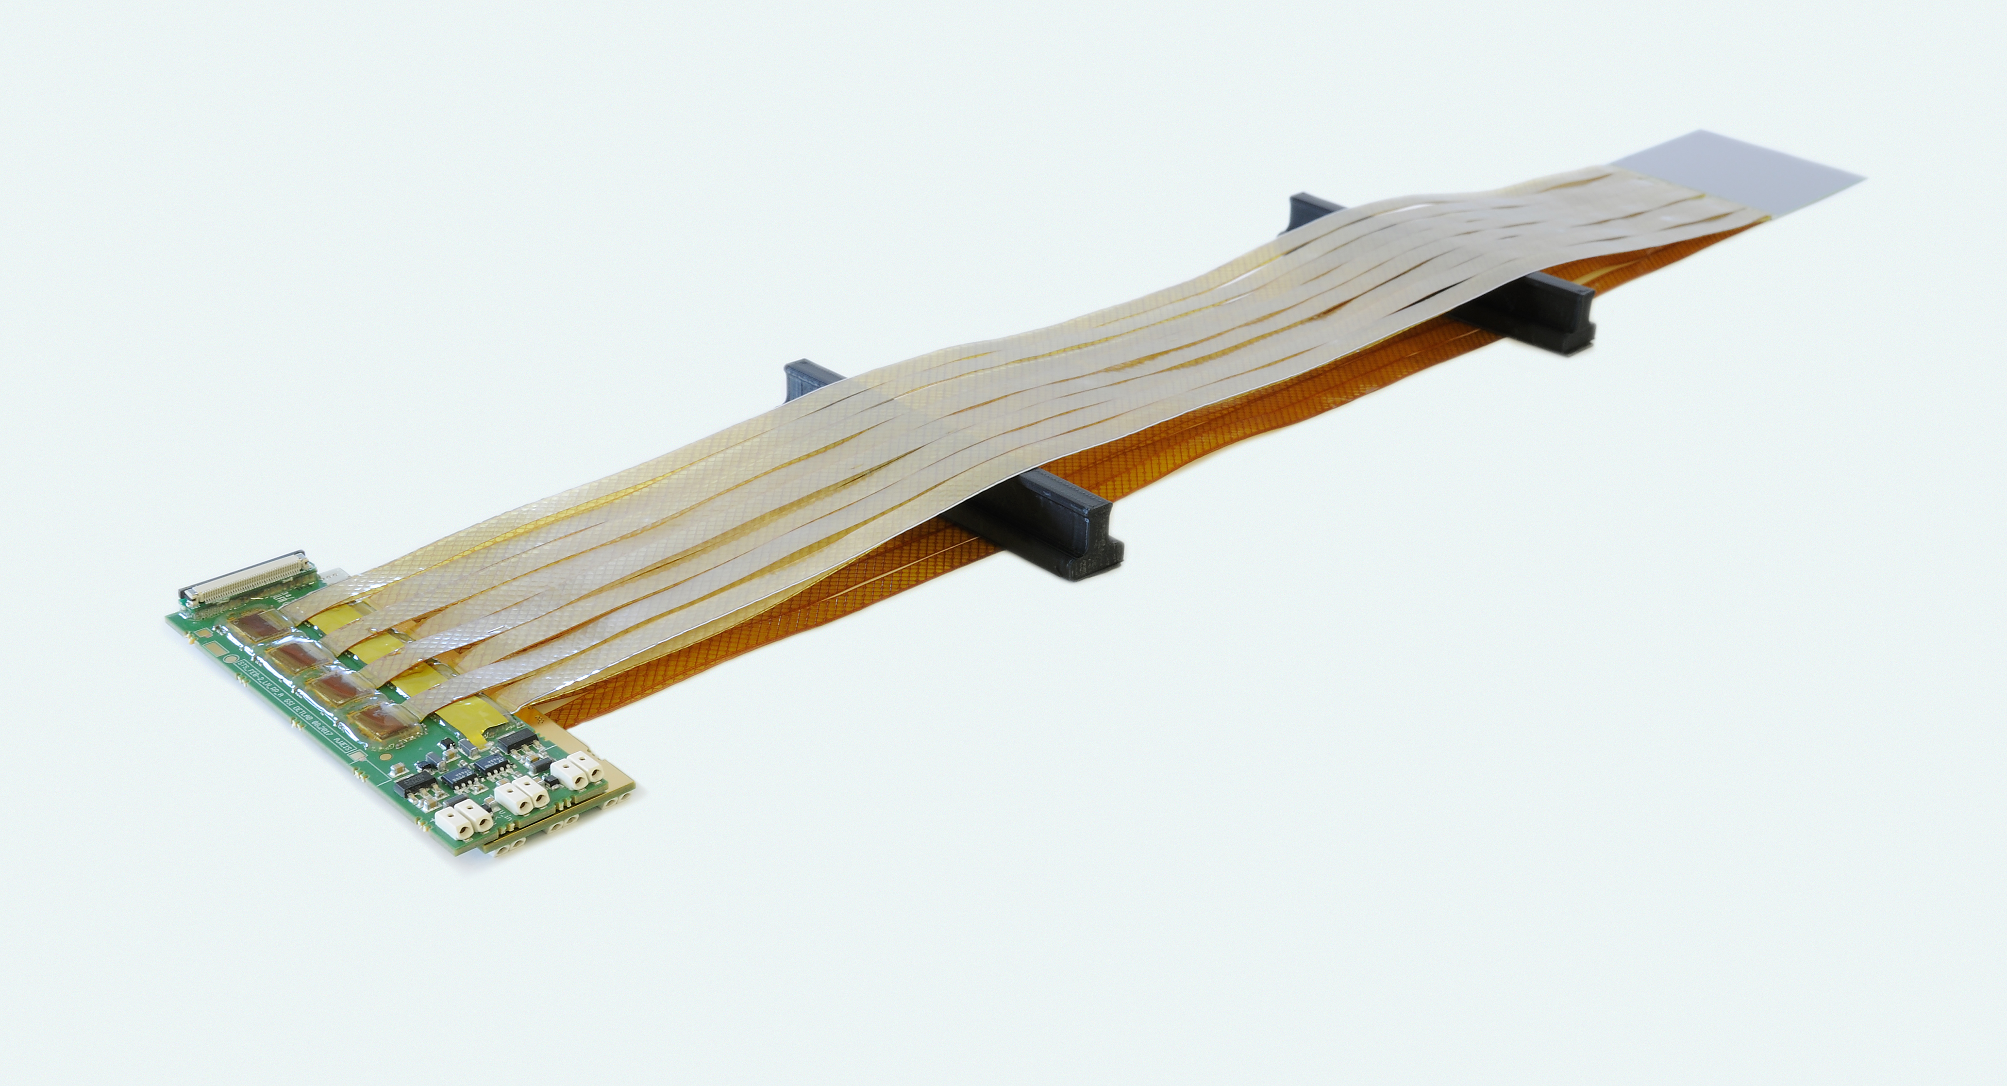
FAIR Phase 0: mCBM and mSTS
mSTS
Two station with left and right orientation
It will allow to test the detector and electronics components developed for the CBM experiment
Module installation has finished
First run was on December 2018, upcoming run in 2019

Slide 6
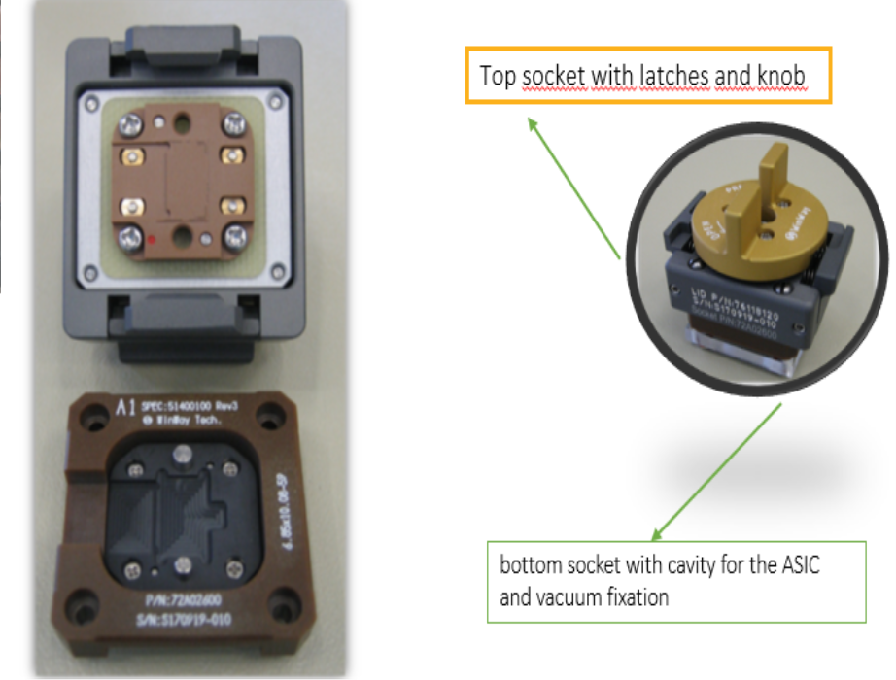
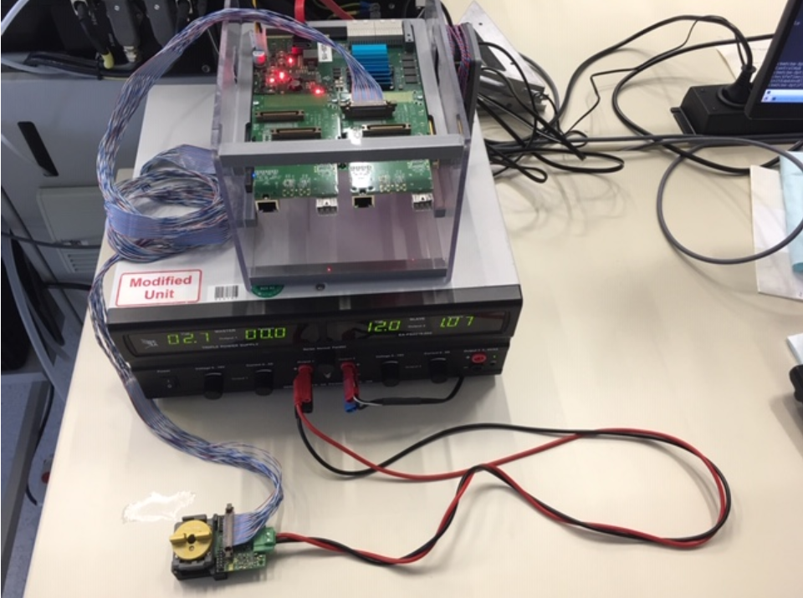
@GSI Clean Room
Test System
Hardware:
Pogo pin station designed at GSI with close collaboration from Cracow team.
The pogo- socket has 53 pogo needles, each one has a diameter of ~100 µm.
Basic experimental set up similar to the one used for FEB test in the LAB:
- Pogo station
- AFCK board with STS-XYTER tester firmware.
- gDPB_FMC interface card.
Software:
Consist (at the moment) of a Python script
What re the measurement values?
Current values, reference voltages values, analog responses, the dynamic range of the ADC for electrons and holes

Slide 7
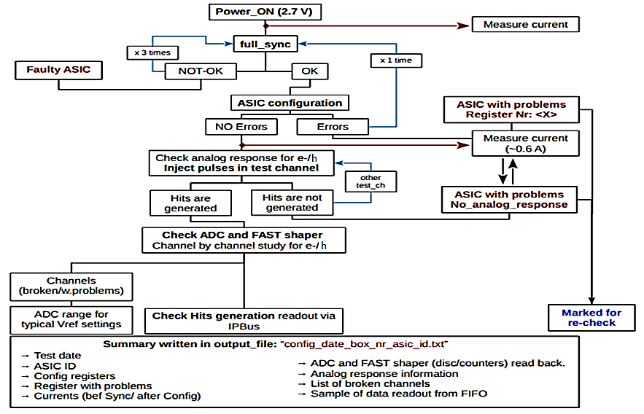
Basic protocol for ASIC testing
1min
5 sec
5 sec
10 sec
TIMELINE
3 min

Slide 8
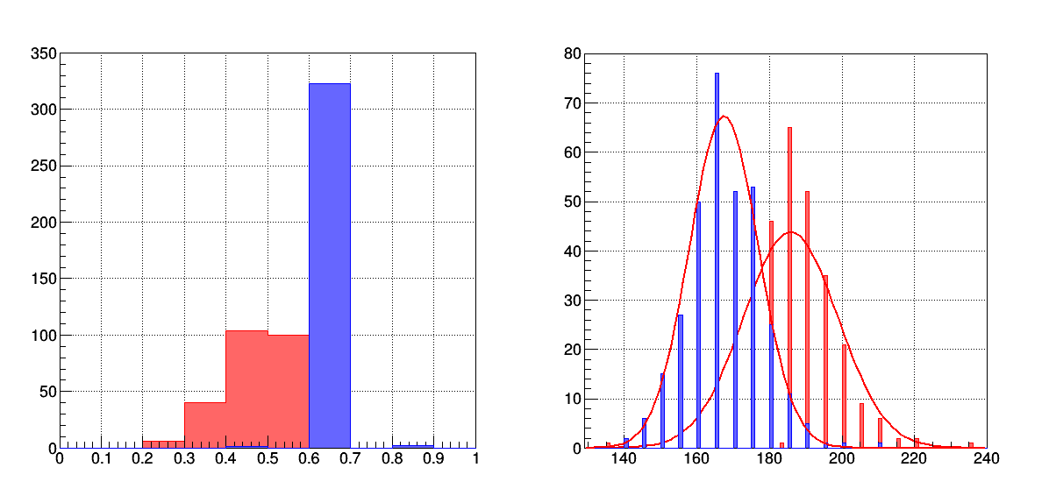
Number of the ASICs
Number of the ASICs
current
ADC range
Before synchronization
Hole
After Configuration
electron
Total Amount of tested ASICs: 339
Problematic ASICs : 20, yield is %94
FEBB Tests
Electrons Holes
ADC Range (Register Value Units) | 185 | 167
ADC Range (mV) | 92.5 | 83.5
Amplifier Gain (ADC units/mV) | 0.33 | 0.37
Total Number of Tested FEBs | 146
Number of FEB with problematic performance | 8
Very high current | 2
No analog response | 1
No fast discriminator response | 1
One or more individual broken channel | 4

Slide 9
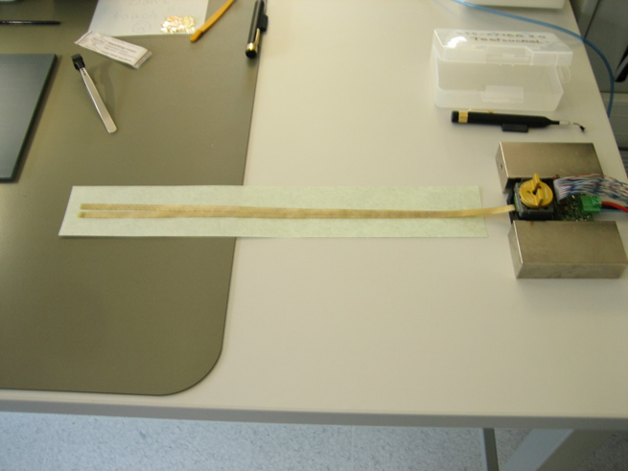
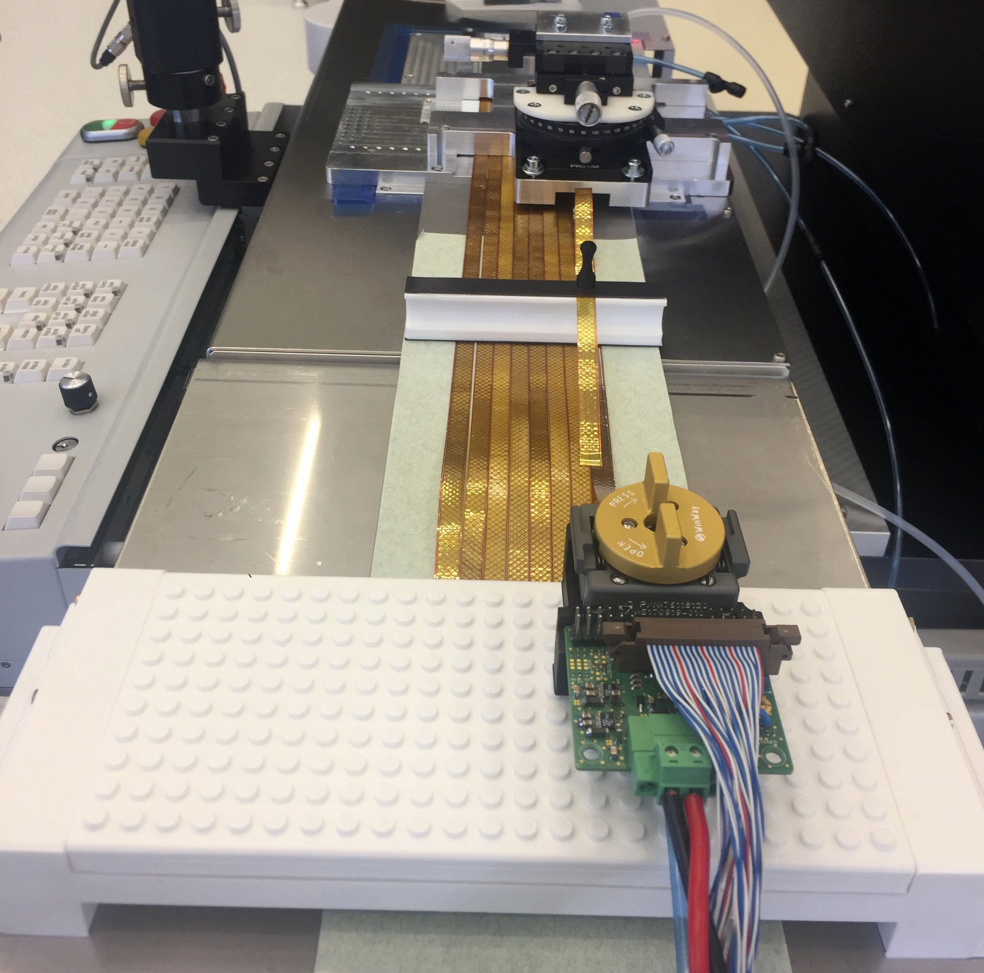
TEST 2: ASIC+Microcable
During Assembly!
The goal is to check electrical connectivity between microcable and ASIC (tab-bonding quality)
Measure the noise level and see the connection of channels
Possible to rebond and bond again on ASIC side
TEST 3: ASIC+Microcable+Sensor
The goal is to check electrical connectivity between microcable, Sensor and ASIC (tab-bonding quality)
Measure the noise level and see the connection of channels
Possible to rebond and bond again on the sensor side

Slide 10
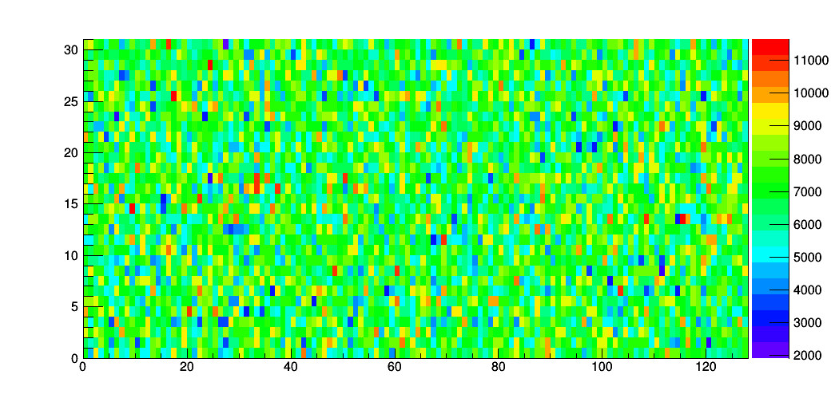
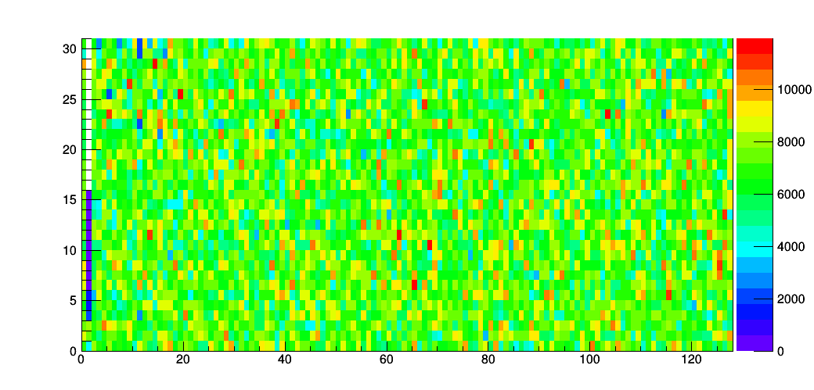
ADC Value
Histograms in root
Read noise hit distribution
Data stored in .txt format
Channel
Unconnected channel
ADC Value
Channel

Slide 11
mCBM
ASSEMBLY STAGE | Number of tested Asıcs | SETUP REQUIREMENT | TEST PURPOSE | TIME/per ASIC | Number of Bad ASICs | Unconnected Channels
ASIC test | 98 | Pogo pin station | Fully calibration & test | 12 min | 10
Module 01T-r | 16 | Pogo pin station | Check electrical connections | 5 min |  | 3
Module 01T-l | 8 (p-side) | Pogo pin station | Check electrical connections | 5 min |  | -
Module 02T-r | 16 (only test with microcable) | Pogo pin station | Check electrical connections | 5 min |  | 2
Module 02T-l | 16 | Pogo pin station | Check electrical connections | 5 min |  | -

Slide 12
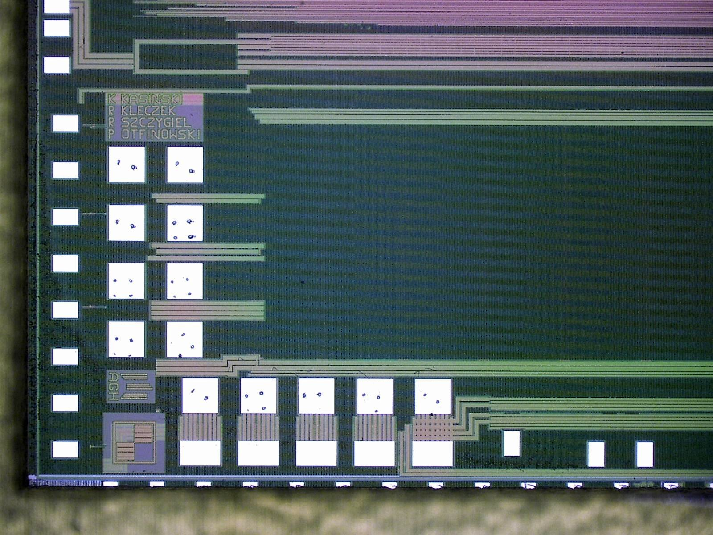
ASICs showed different behaviours during the module test after assembly
forthcoming module productions will be
done with one ASIC test stage only.
Critical lines for short

Slide 13
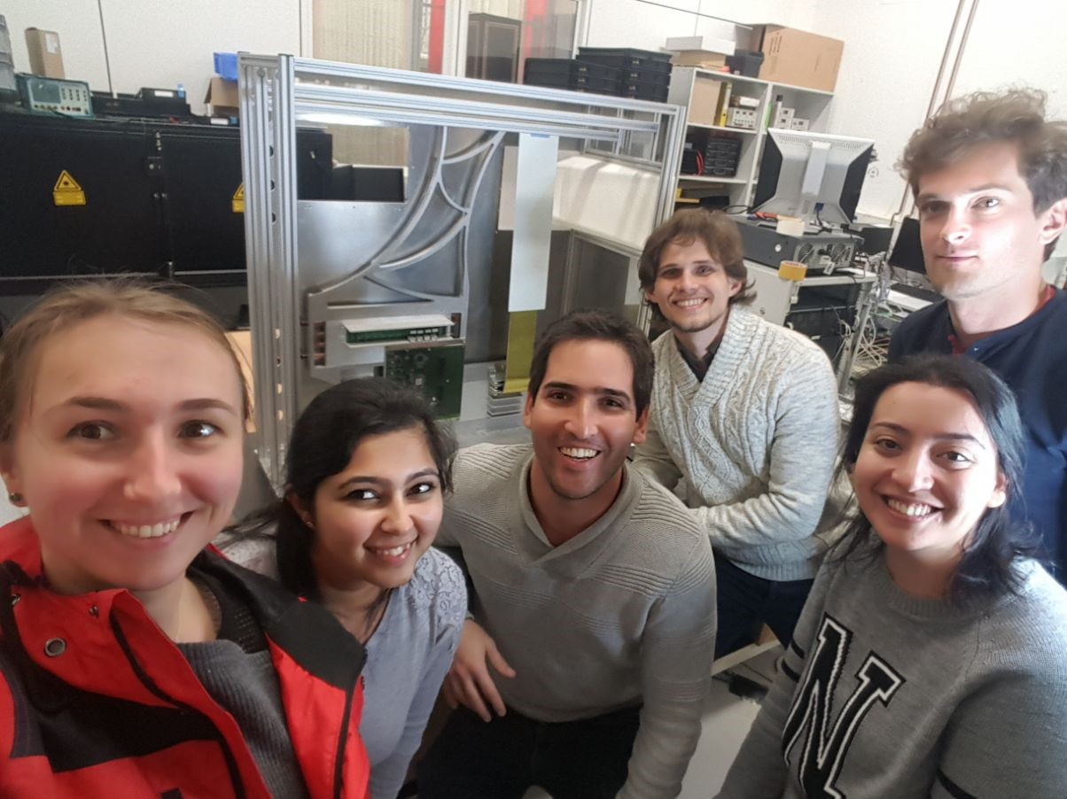
Many thanks to my colleagues…
THANK YOU!

