Slide 1

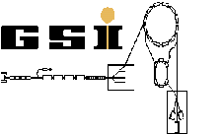






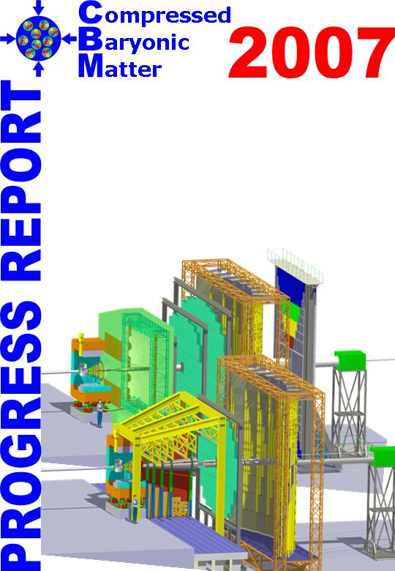
Open charm measurements with CBM
M. Deveaux, Goethe University Frankfurt
on behalf of the CBM collaboration.

Slide 2
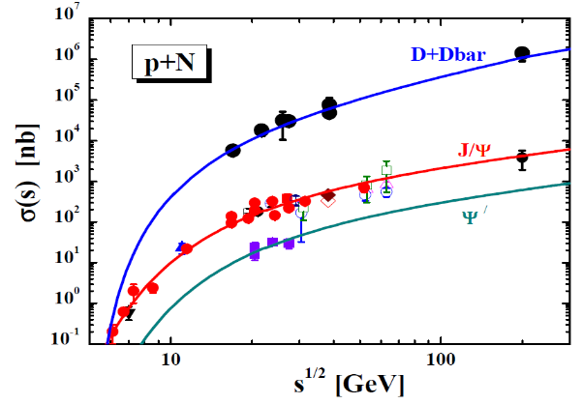
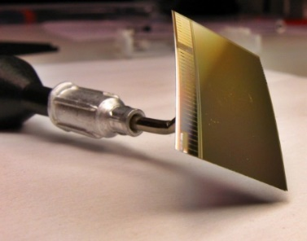
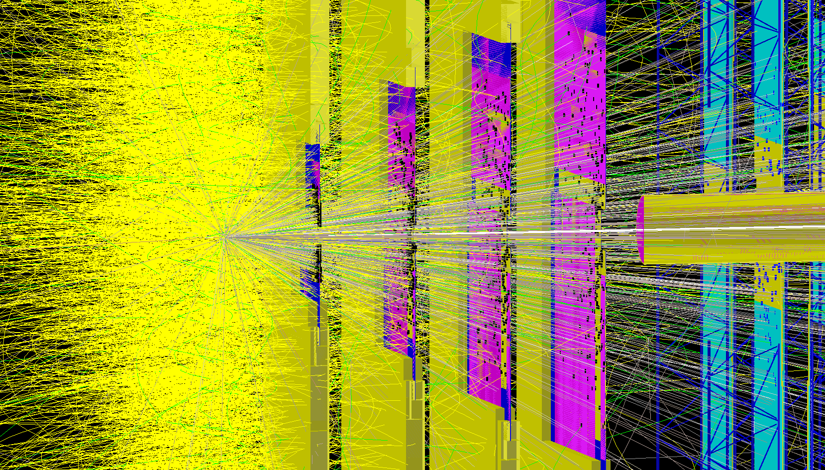
Outline
Physics goals of CBM on open charm
(Physics goals of CBM on charmonium
=> See talk of P.P. Bhaduri)
Status of the detector R&D.
Status of the feasibility studies.

Slide 3
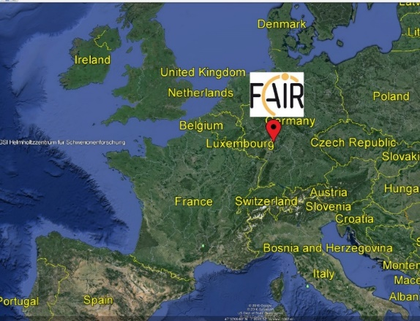
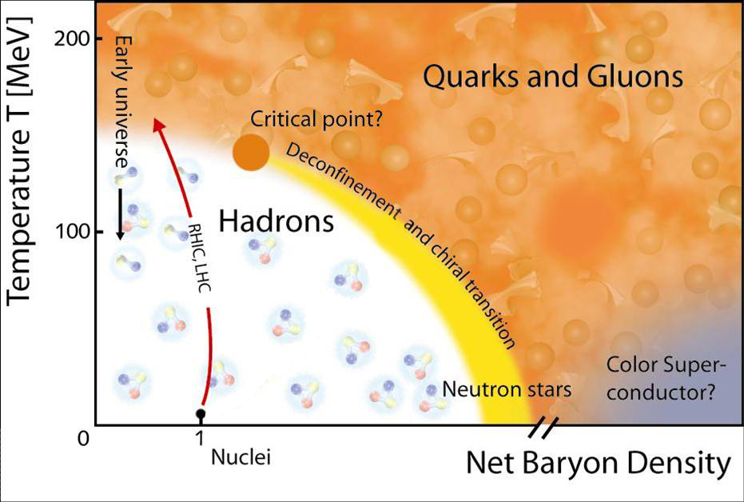
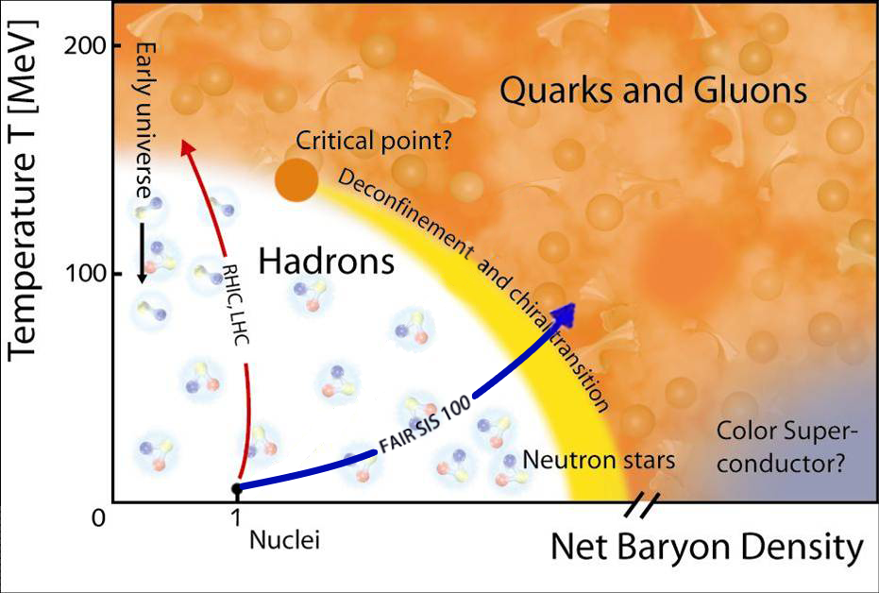
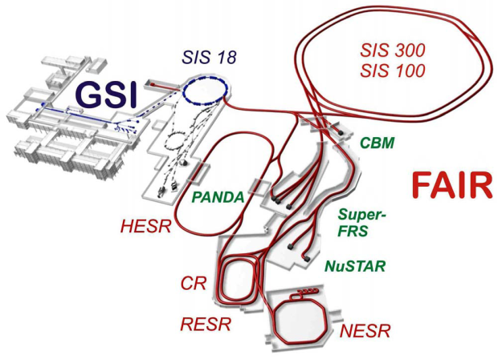
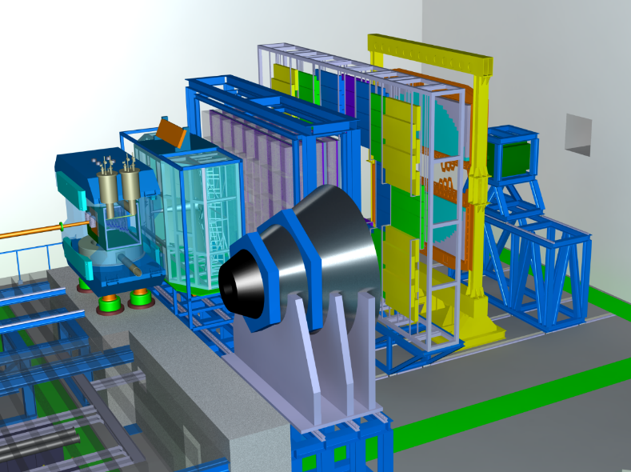
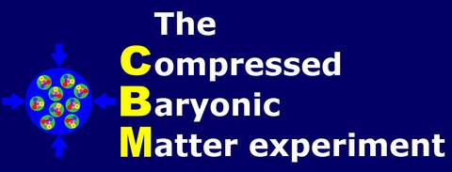
CBM @ FAIR
999
CBM
CBM:
Explore phase diagram at ragion of highest net-baryon density.
Use rare probes.

Slide 4
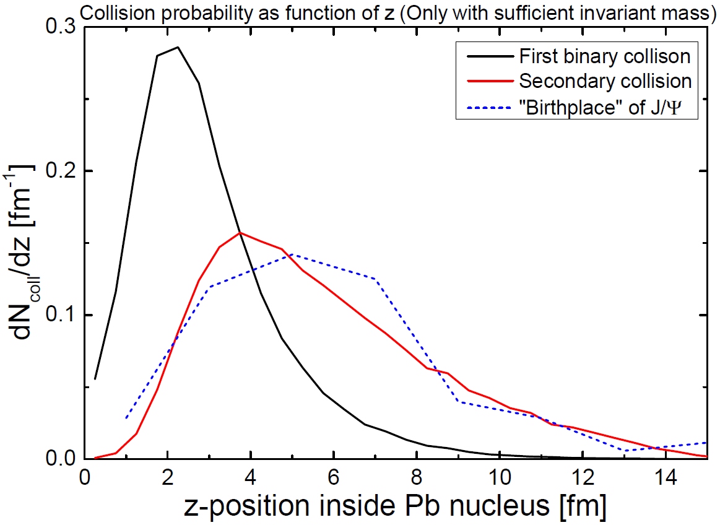

Physics cases of open charm in CBM
Compilation of charm
X-sections, HSD input
Nuclear
core (Pb)

Slide 5

Open charm physics at CBM – basic issues
CBM p-A
Lines: HSD-Input (2008)
Mission 1:
Measure and understand the formation of charmed particles near threshold in p-p (=Be) and p + A.
=> Back up charmonium measurements (see talk of P.P. Bhaduri)

Slide 6
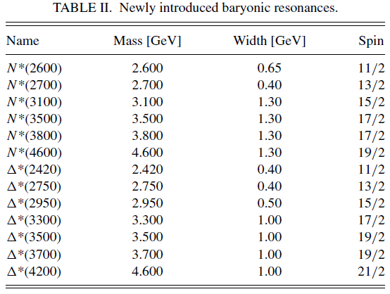
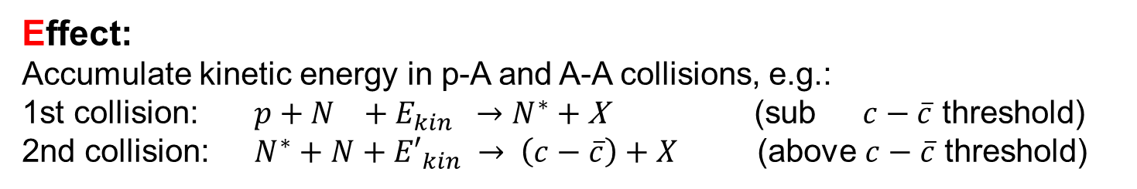
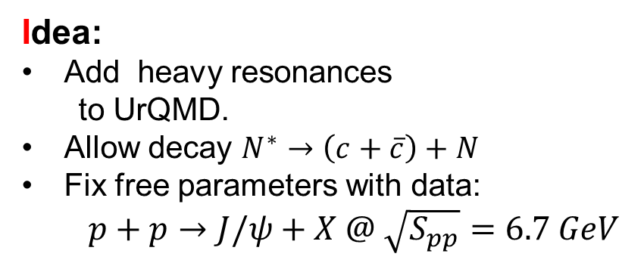
Sub-threshold charm production?
J. Steinheimer, A. Botvina and M. Bleicher,
Phys. Rev. C 95, no. 1, 014911 (2017)an
Idea:
Add heavy resonances
  to UrQMD.
Allow decay $N^{∗}→\left(c+\overline{c}\right)+N$
Fix free parameters with data:
  $p+p→J/ψ+X @ \sqrt{S_{pp}}=6.7 GeV$
Effect:
Accumulate kinetic energy in p-A and A-A collisions, e.g.:
1st collision: $p+N +E_{kin} →N^{∗}$ + X (sub $c−\overline{c}$ threshold)
2nd collision: $N^{∗}+N+{E′}_{kin} → \left(c−\overline{c}\right)+X$ (above $c−\overline{c}$ threshold)
Approach was previously used for strange
particles.
Open: Applicable to charm?
e.g. J. Steinheimer and M. Bleicher, J. Phys. G 43, no. 1, 015104 (2016)

Slide 7
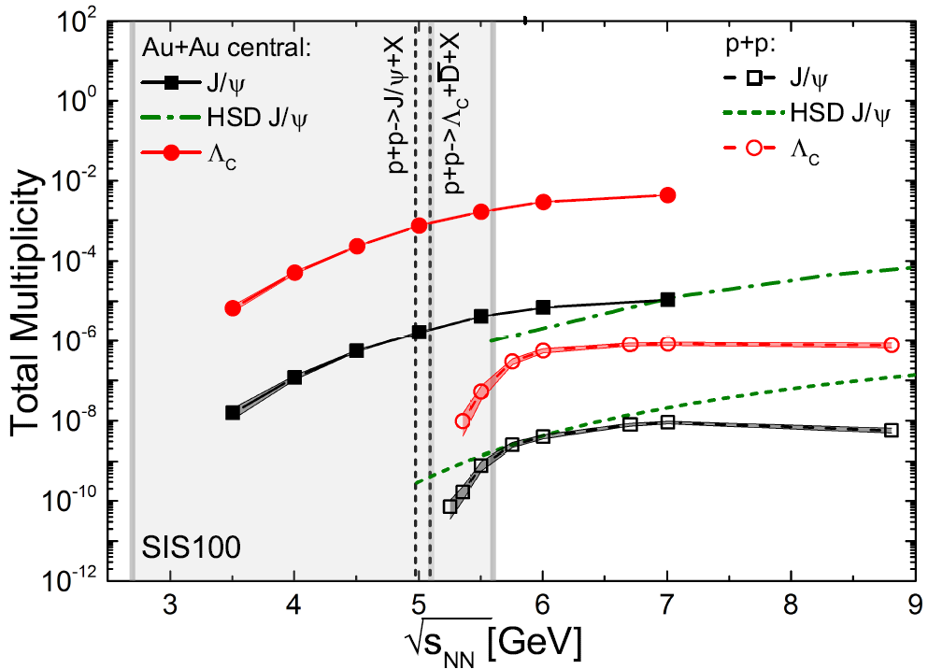
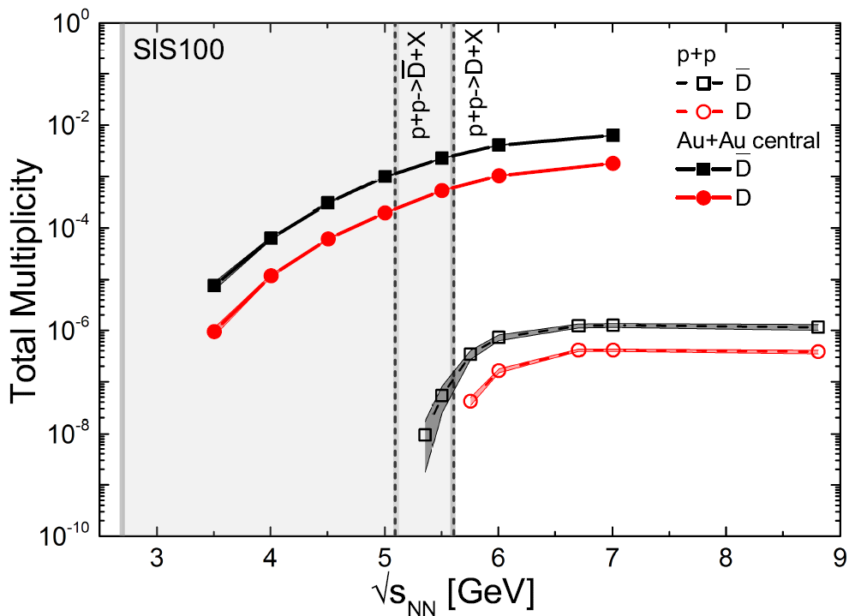
Effect and results
Model predictions:
Substantial yield of J/Psi and D-mesons
Yields for SIS100 energy range roughly equal to HSD yields
for SIS300.
Model might be confirmed by observing sub threshold
charm production with CBM at SIS100.

Slide 8
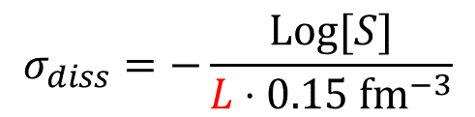
Impact of „Steinheimer model“
Multi-collisions displace birth of J/Psi by ~5fm @ 15 GeV.
Survival probability
L (?)
$$σ_{diss}=−\frac{Log[S]}{L⋅0.15 fm^{−3}}$$
Nuclear
core (Pb)
Plot and simulation: J. Steinheimer, FIAS
L (?)
Path of J/Psi in nuclear matter
Note:
L in Equation = Average path
Displayed qualitatively in figure.
J/Psi production by double collision modifies path length of J/Psi in nuclear matter.
=> Bias of dissociation X-section measurement.

Slide 9
Open Charm Physics at CBM
Instrumentation: Relevant detectors
Time of Flight system
(Hadron identification)
Silicon Tracking System
(Momentum measurement)
Micro Vertex Detector
(Vertexing)

Slide 10
How to measure open charm
z
Target
(Gold)
Detector2
Detector 1
Primary Beam: 28 GeV protons (up to 10⁹/s)
Primary
vertex
Secondary
vertex
Short lived particle
D⁰ (cτ = ~ 120 µm)
Reconstructing open charm requires:
Excellent secondary vertex
resolution (~ 50 µm)
=> Excellent spatial resolution (~5 µm)
=> Very low material budget (few 0.1 % X₀)
=> Detectors in vacuum

Slide 11
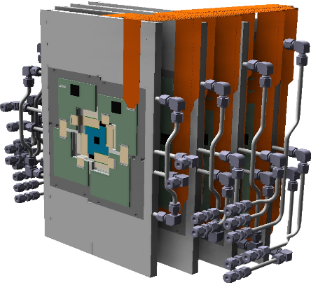
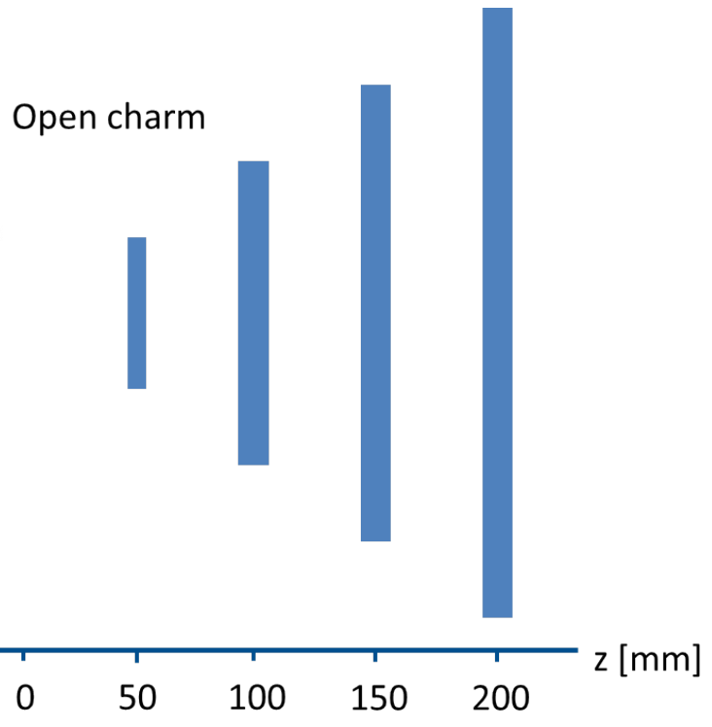
CBM Micro-Vertex-Detector basic concept
0.5% X₀
0.3% X₀
Target
Target
Vacuum
CMOS sensor
The CBM-MVD aims for:
~ 5µm spatial resolution
10⁵ Au+Au/s (11 AGeV)
10⁷ p+Au/s (30 GeV)
CBM

Slide 12
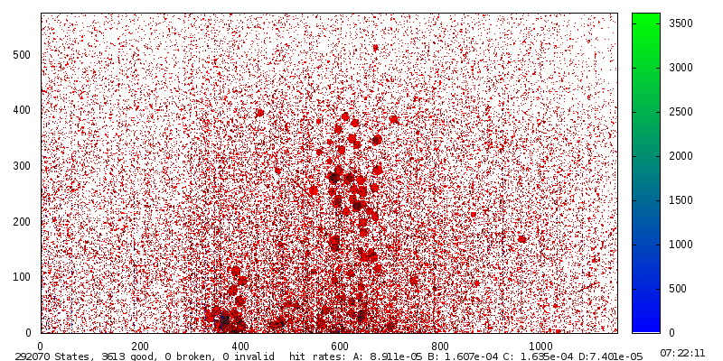

Fixed target – particuar challenges
Delta - electrons
10 AGeV Au+Au
2.5µs integration time.
Need increased rate
capability and rad.
tolerance.
Heavy ion hits
Contineous impacts
of beam ions.
(Here: SPS-Pb beam).
M. Deveaux, SQM 2017
Utrecht/Netherlands
1 cm
Need extended tolerance to heavy ions.
Beam

Slide 13
Why dedicated sensors?
 | ALPIDE (demonstrated) | MVD requirements MIMOSIS (design goal) | Factor
Ion. Rad. Tolerance | 0.5 Mrad | > 3 Mrad | 10
Non. Io. Tolerance | 10¹³ n_{eq}/cm² | > 3x10¹³ n_{eq}/cm² | 3
Heavy ion tolerance | N/A | 1 kHz / cm² | --
Time resolution | <10 µs | 5 µs | 2
Data rate (internal) | ~1 Gbps | 20 Gbps (peak) | 25
Data rate (external) | 1 Gbps | 2.5 Gbps | 3
Data reduction | Trigger | Elastic buffer | --
Not available
in CBM
CBM approach:
Need next generation sensor – MIMOSIS – starting from ALPIDE.
Partner: PICSEL group of IPHC Strasbourg (MIMOSA/ULTIMATE)

Slide 14
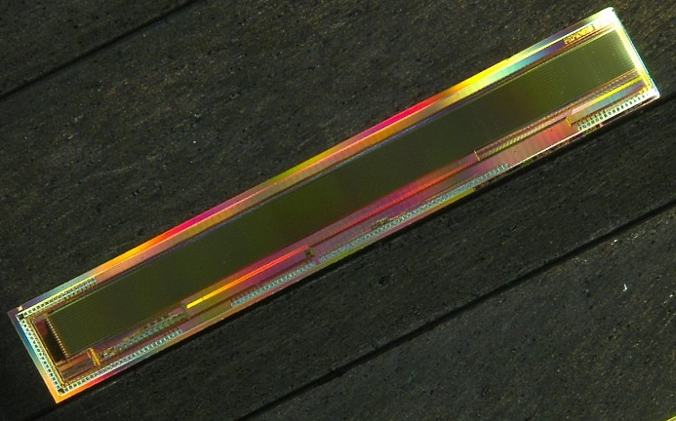
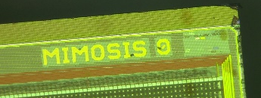
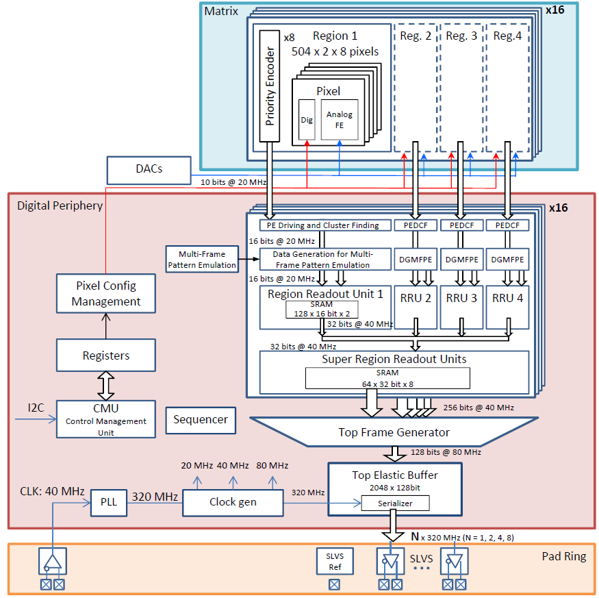
MIMOSIS – Sensor concept
MIMOSIS – Block diagram
Similar to
ALPIDE
MIMOSIS-0
Adapt to CBM:
Internal DAC
Data paths
Slow control
Buffer structure
I/O
Rad. tolerance
SEU tolerance
First prototype (MIMOSIS-0) returned from production.

Slide 15
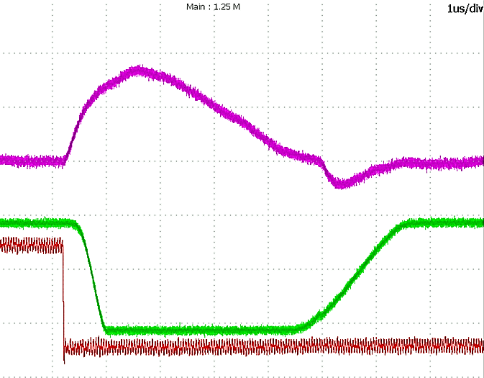
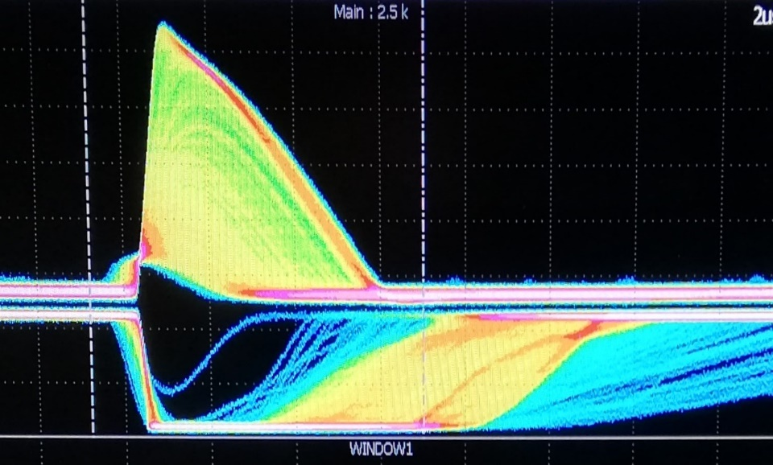
MIMOSIS-0 – first signs of life
Response to injected pulse
Response to ⁵⁵Fe (5.9 keV X-rays)
1µs
2 µs
Sensing part
Amplification
In-pixel Memory
DC coupling
Shaping time few µs
Full custom digital
Bias1
Dual Port
2 words of 1 bit
Amp
Comp
Pixel output
Charge inj.
160 aF
First results look promising… stay tuned.

Slide 16
Integration concept of the MVD
r_{out}
Beam
hole
CBM acceptance
Outside acceptance
Vacuum operation requires actively cooled device.
Use cooling support from diamond to move heat out of acceptance
Put heat sink and FEE outside acceptance

Slide 17
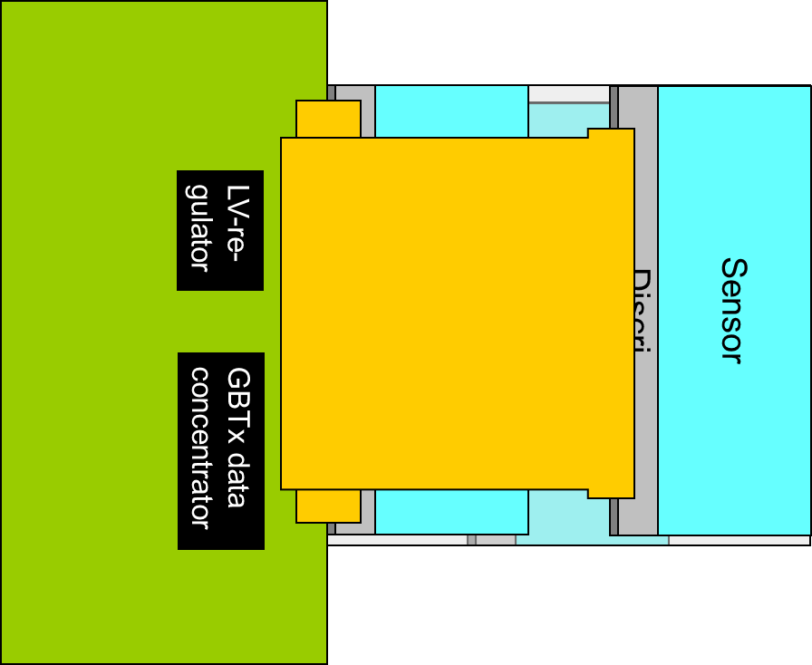
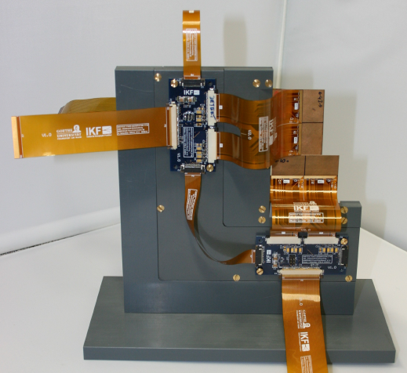
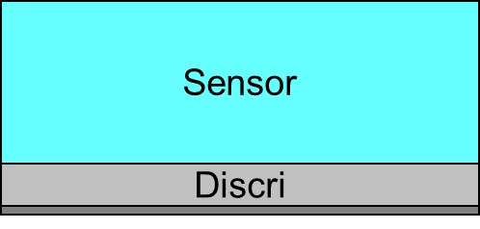
Integration concept of the MVD
Sensor
Discri
Sensor
Discri
MVD Prototype (mock up)
LV-re-
gulator
GBTx data
concentrator
M. Deveaux
17

Slide 18
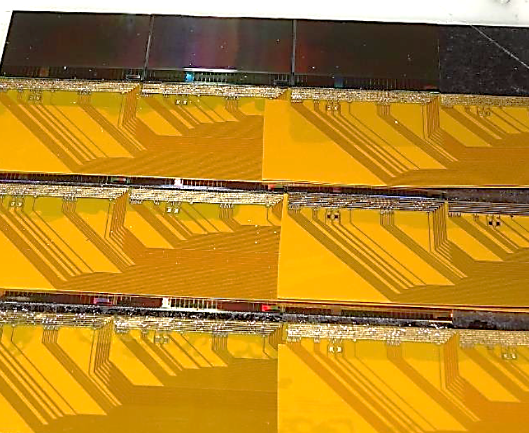
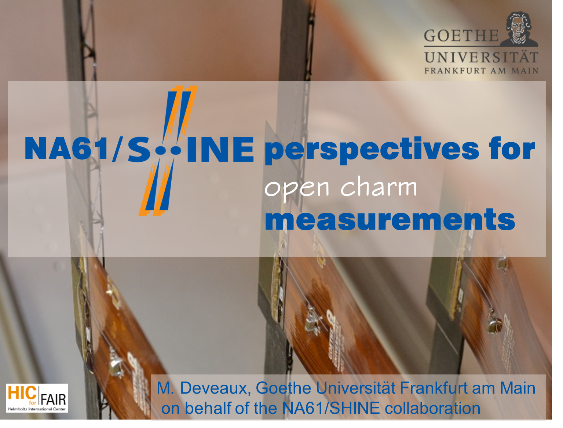
Current status: PRESTO and NA61/SHINE VD
PRESTO:
Prototype of a quarter station incl. sensors (MIMOSA-26),
cables, support etc.
Sensor (3x)
Discri
Cable (2x)
Sensor
(More than) A spin-off:
Discri
Cable (2x)
Sensor
M. Deveaux for NA61/SHINE,
SQM2017, Utrecht, Netherlands
Discri
Integration completed. Test:
Vacuum compatibility
Temperature cycling
…
Cable (2x)
The NA61/SHINE vertex
detector uses (and tests) MVD
prototype/PRESTO electronics

Slide 19
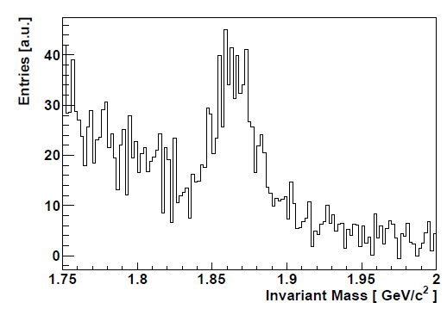
Feasibility studies on open charm production

Slide 20
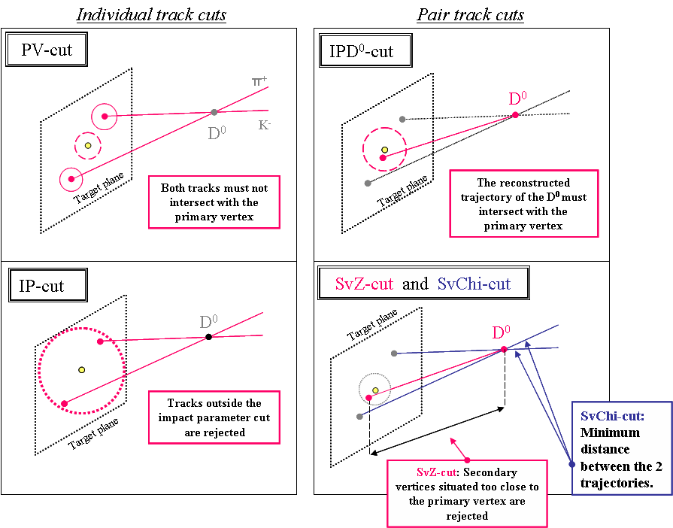
Reconstruction of open charm - Major cuts
Anticipated: Protons are identified and rejected by TOF

Slide 21
Simulation p-C 30 AGeV
D⁺ → K⁻ π⁺π⁺
D⁰ → K⁻ π⁻π⁺π⁺
10¹² central events
3σ cut
M^{D+} _{HSD}=2.7⋅10⁻⁸
BR = 0.095
M^{D0} _{HSD} = 2.9(8.8)⋅10⁻⁸
BR = 7.7%
Eff = 1.7%
K⁻
eff = 11.6 %
I. Vassiliev: 20 CBM Meeting India, Kolkata September 26, 2012
4σ cut
D⁰
π⁺
π⁺
π⁻
Expect peak visible after few days beam on target at 10MHz p-A.
Open charm in p-A is possible at CBM.

Slide 22
Effect and results
Relyable
D-detection
@CBM
More information on simulations:
C. Dritsa: „Design of the Micro Vertex Detector of the CBM experiment: Development of a detector response
model and feasibility studies of open charm measurements.“, Phd Thesis, Frankfurt/Strasbourg 2011
I. Vasiliev: „Open Charm measurement with the CBM detector at FAIR”, HFM2 Kolkata, Feb.4, 2016
Scaled from simulations made for 25 AGeV Au+Au.
=> Significant uncertainties… next generation simulations pending.
However: Hardware improvement since then:
Speed up of MVD sensors x6 => Eases tracking, less background.
4 MVD stations instead of 2 => Eases track matching, less background.
…
Note: Measurement for D-mesons compatible with other physics
cases. No additional beam time required.

Slide 23
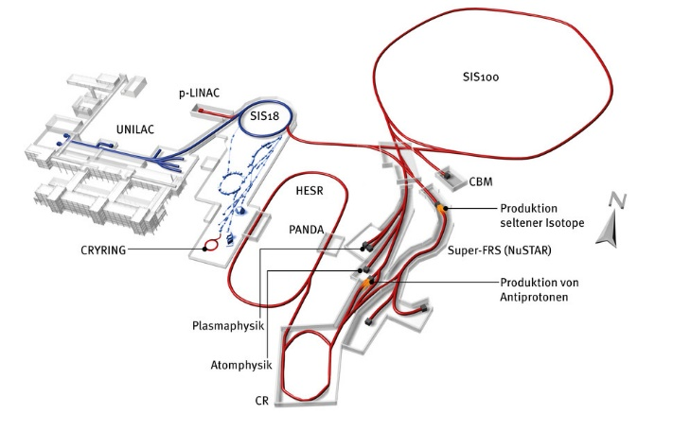
Status of FAIR

Slide 24
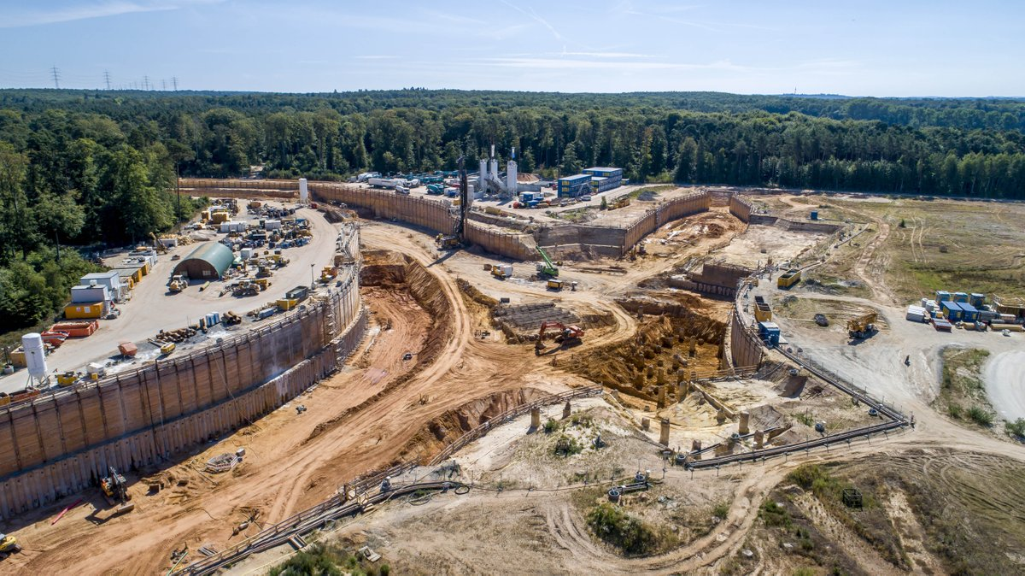
Status of FAIR
CBM cave
SIS100

Slide 25
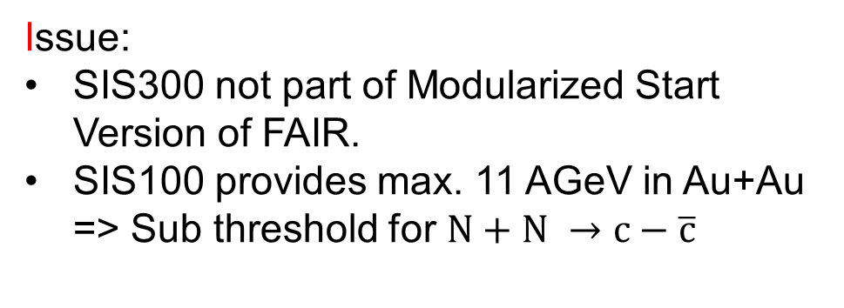
Physics cases of CBM (charm physics)
Initial idea:
Use SIS300 (15-35 AGeV) to do charm physics
close to the threshold.
Issue:
SIS300 not part of Modularized Start Version of FAIR.
SIS100 provides max. 11 AGeV in Au+Au => Sub threshold for $N+N →c−\overline{c}$
Detector hardware R&D is on track. Performance might exceed
initial R&D goals.
Current process: Re-focus physics program to SIS100
Ideas:
Do charm in p + A collision systems (30 GeV) and more.
Study possible sub-threshold charm production in A+A
Work in progress => Help and ideas are welcome.

Slide 26
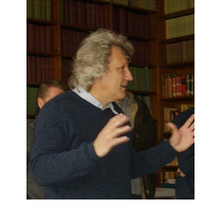
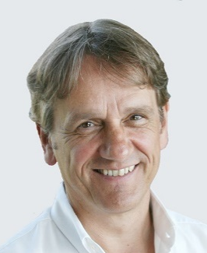
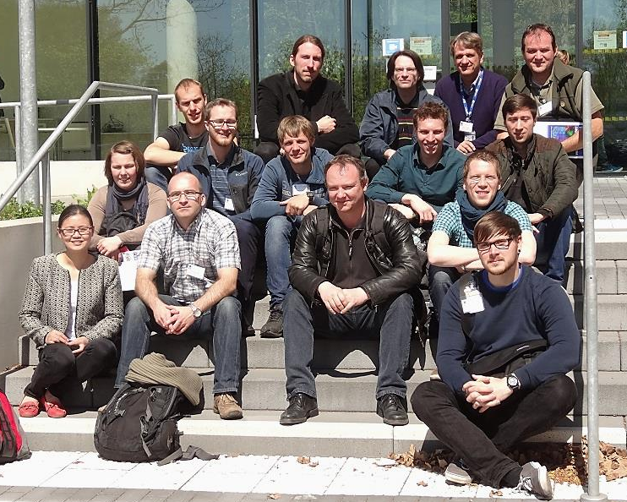
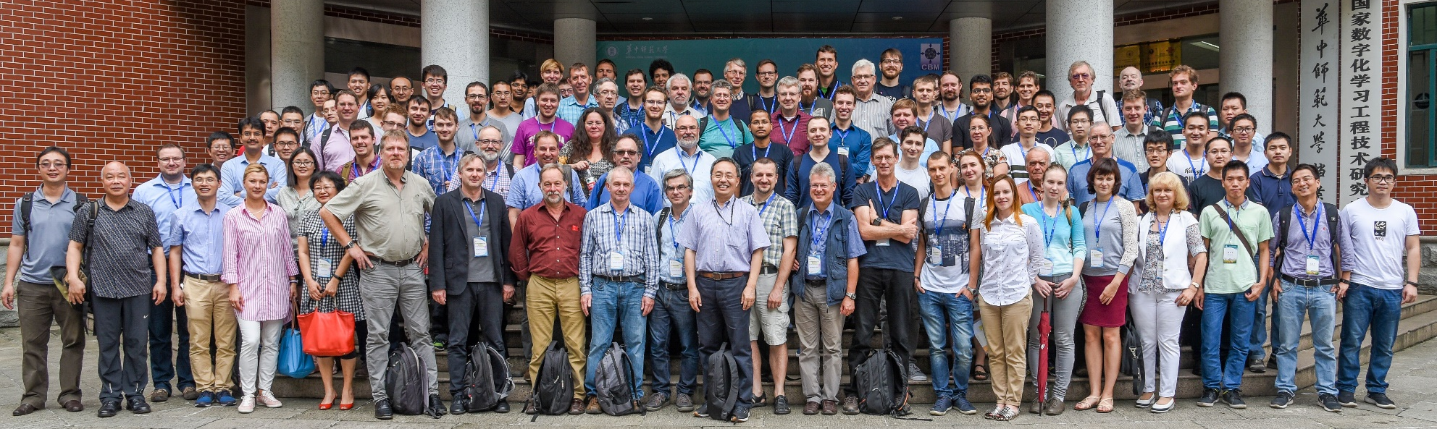
The team
The PICSEL group
of IPHC Strasbourg
Group Prof. J. Stroth,
Goethe Uni Frankfurt/M
The CBM collaboration

Slide 27
Backup

Slide 28
MIMOSIS – 0 – first results
Design goal: << 5000 ns
First results look promising.
MIMOSIS may to exceed CBM target on time resolution

