Slide 1
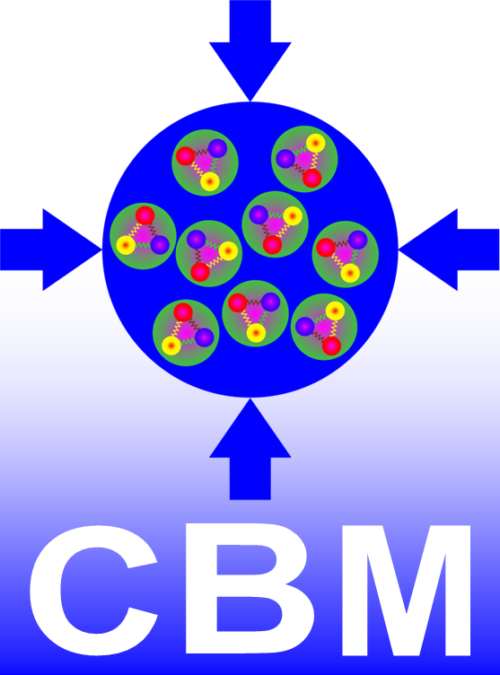
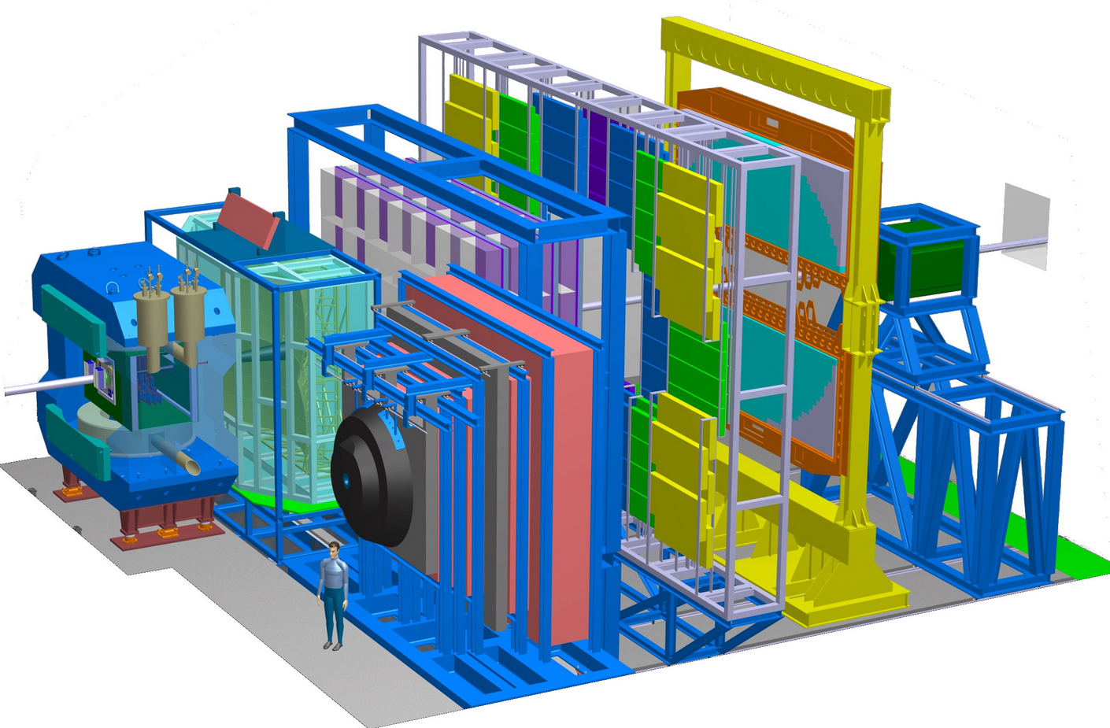
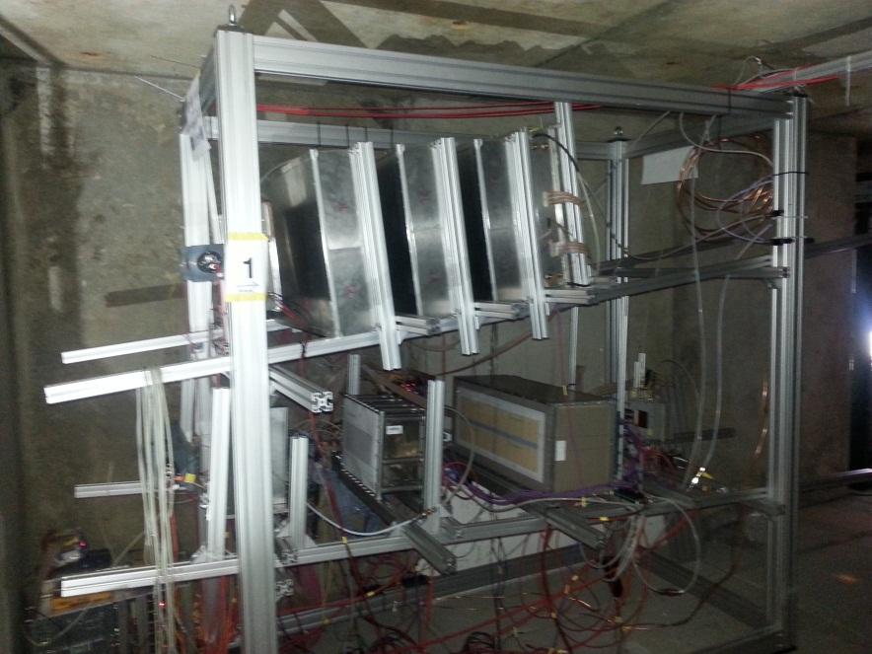
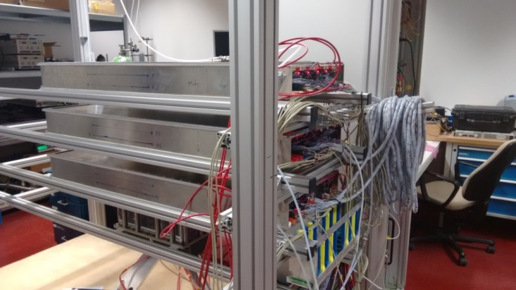
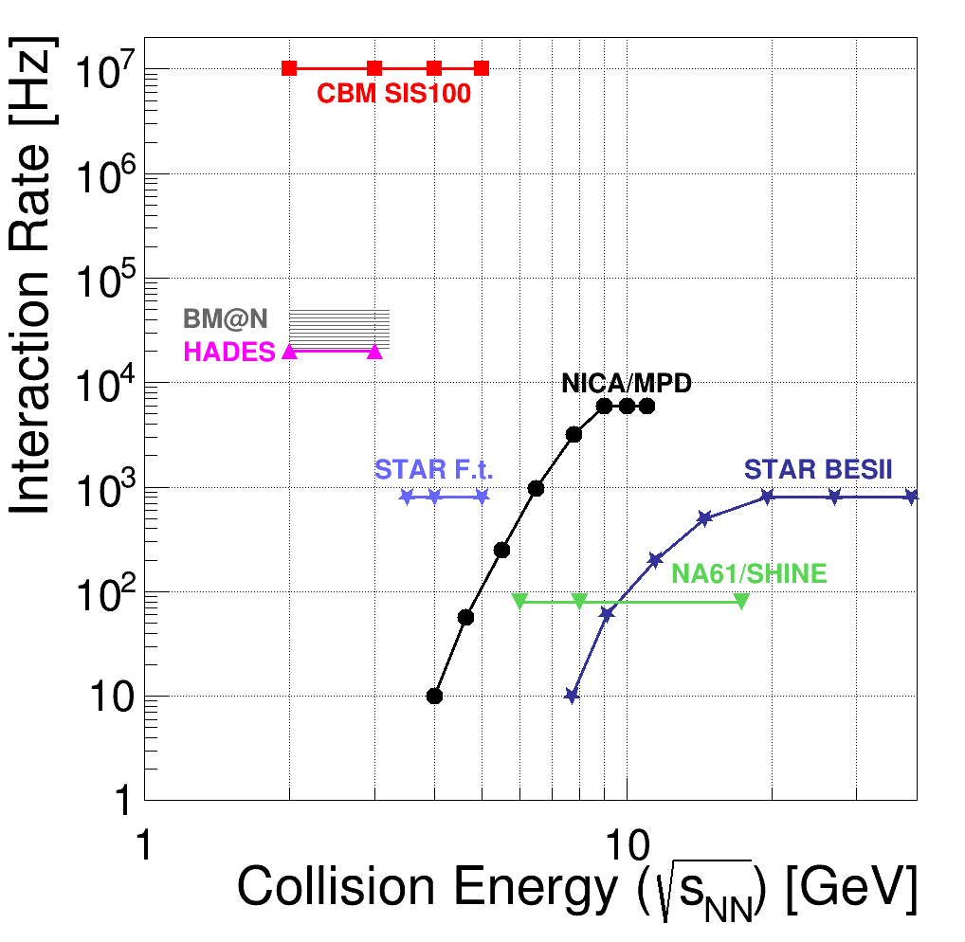
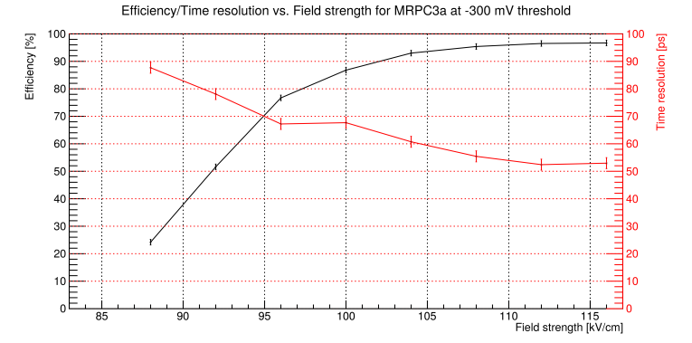
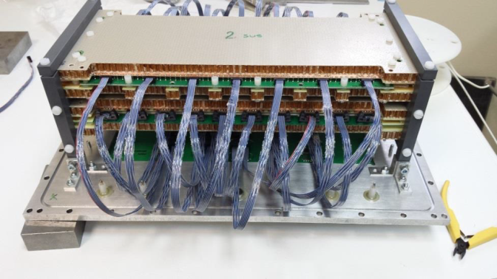
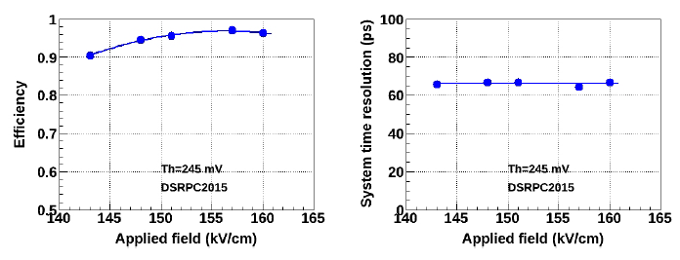
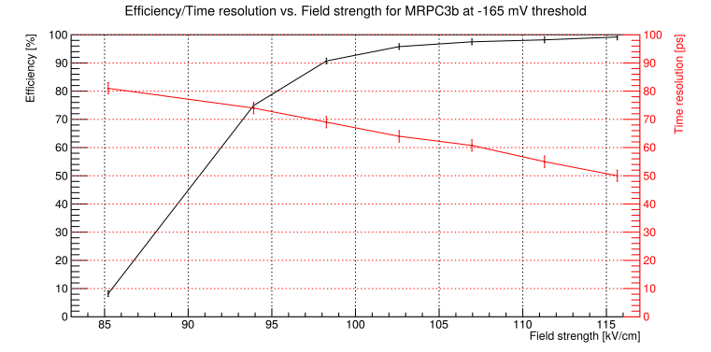
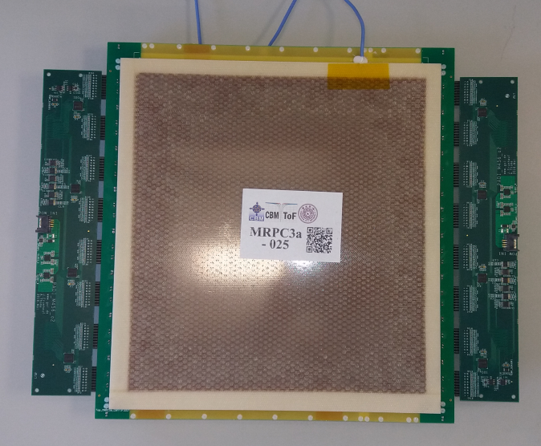
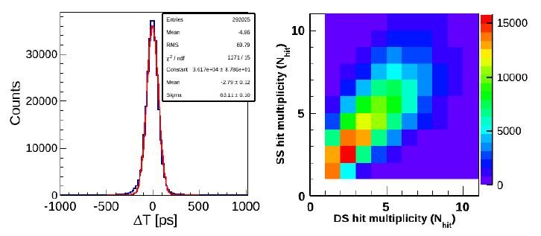
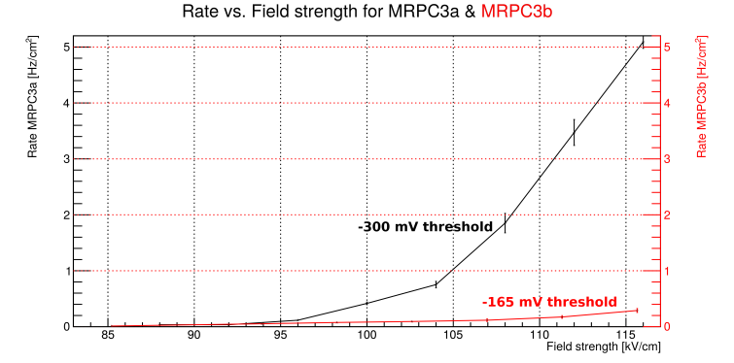
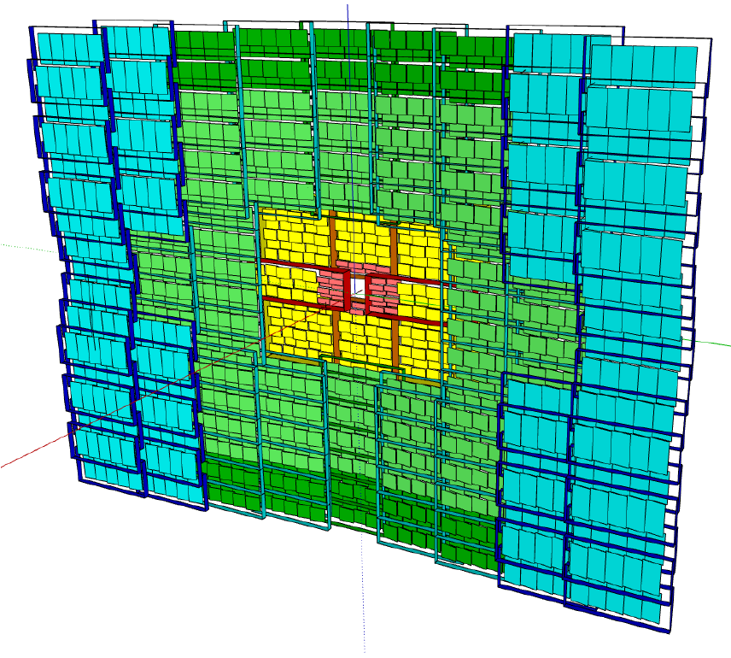
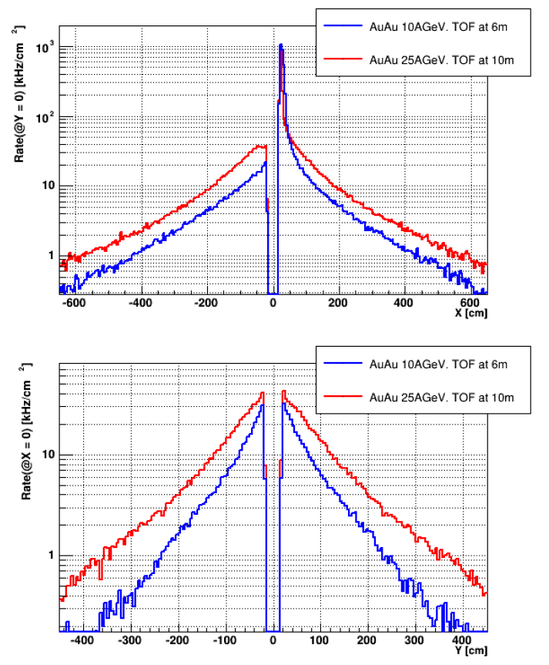
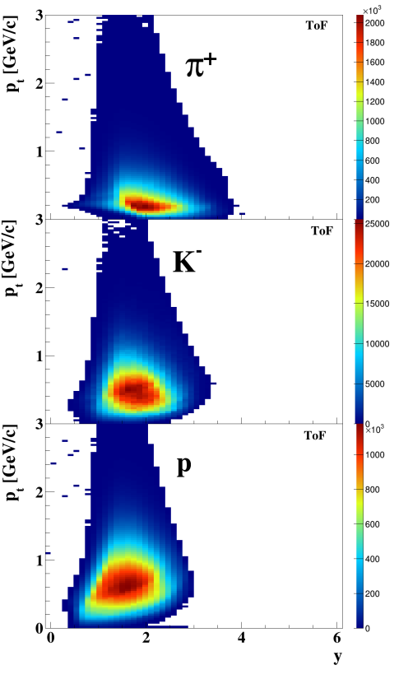
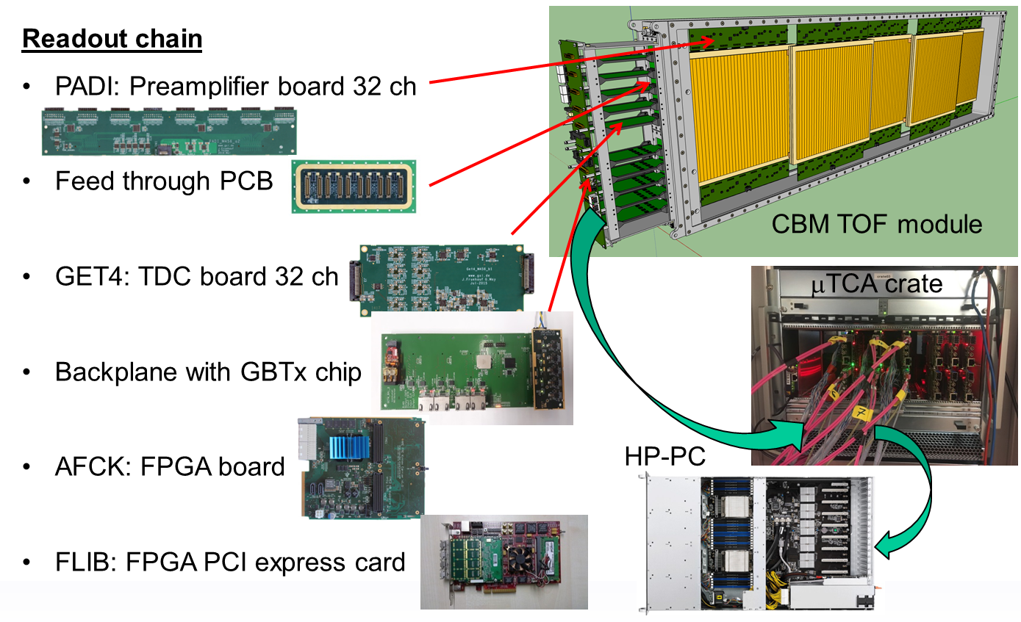
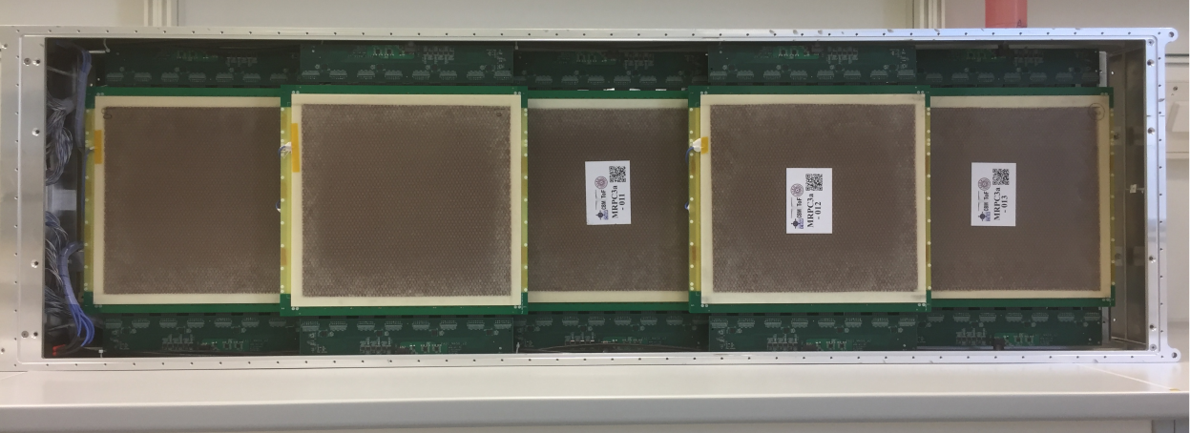
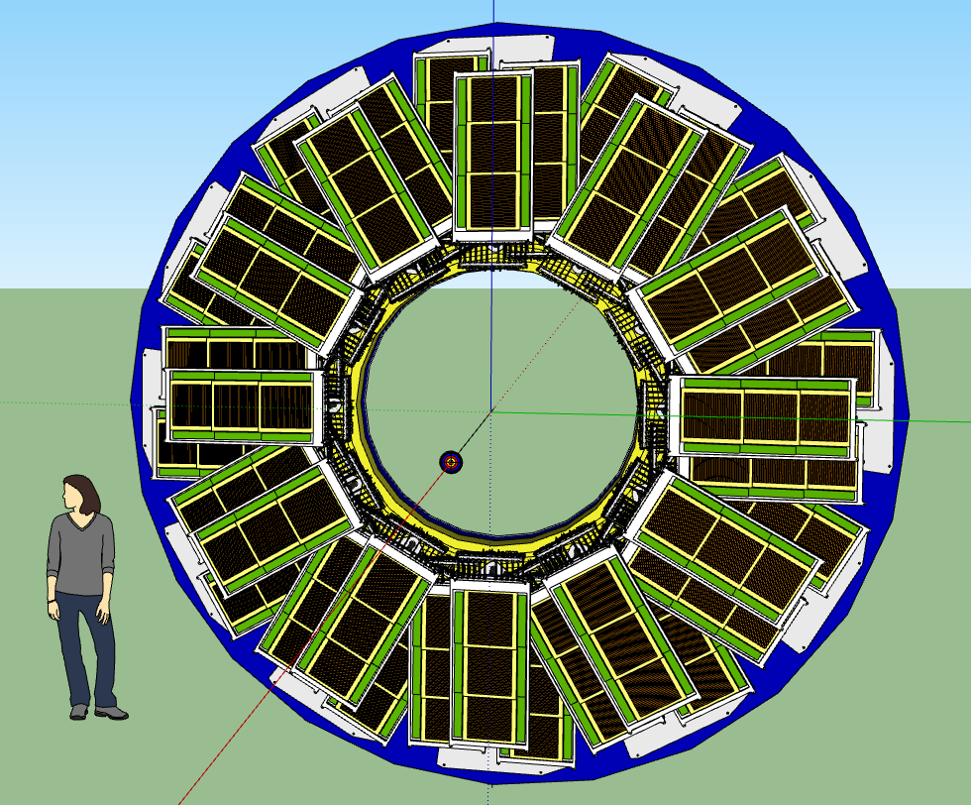
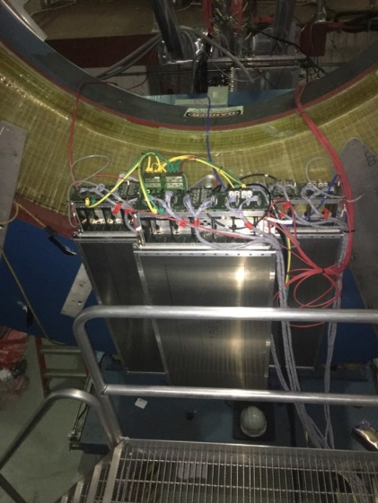
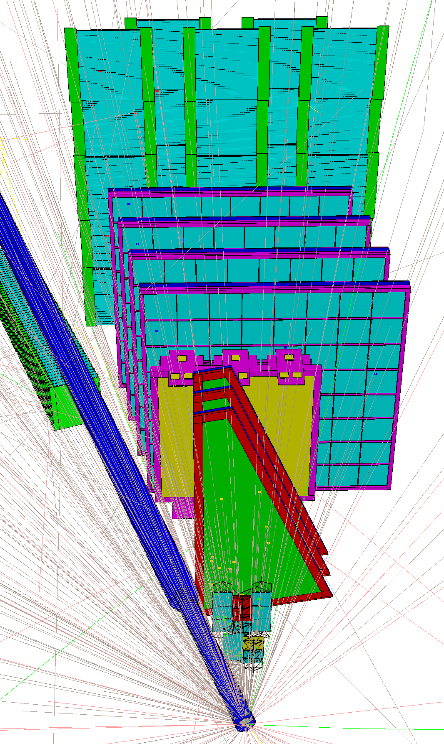
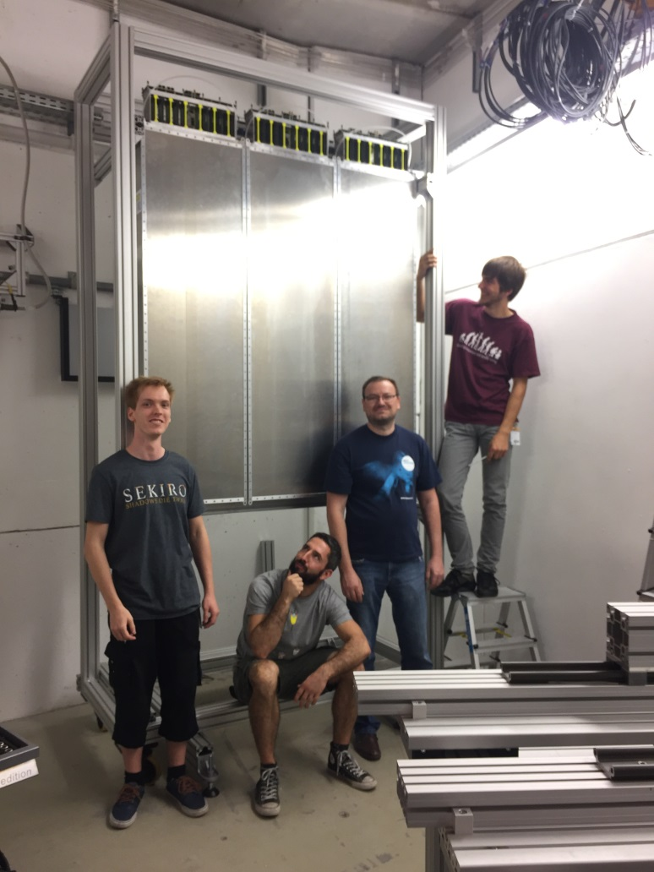
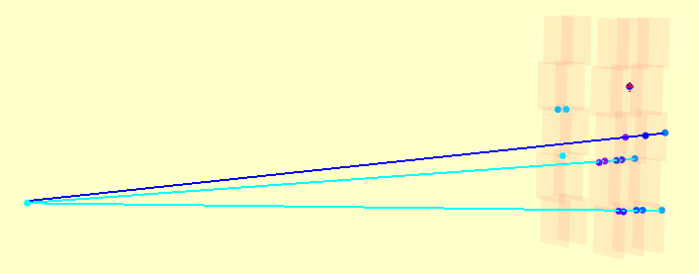
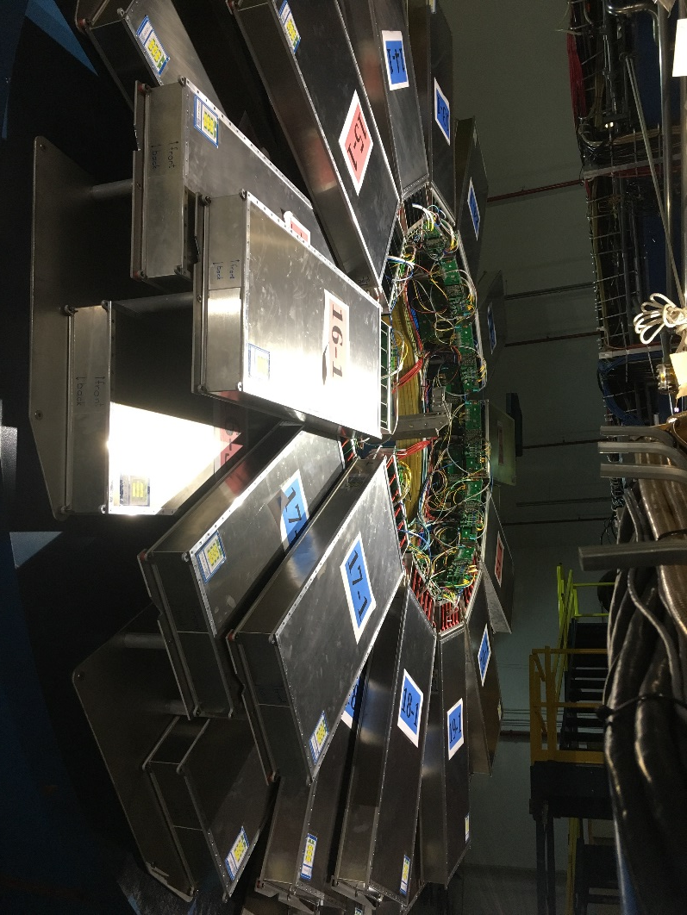
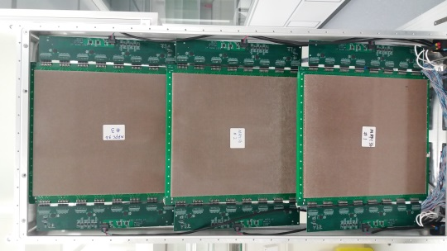
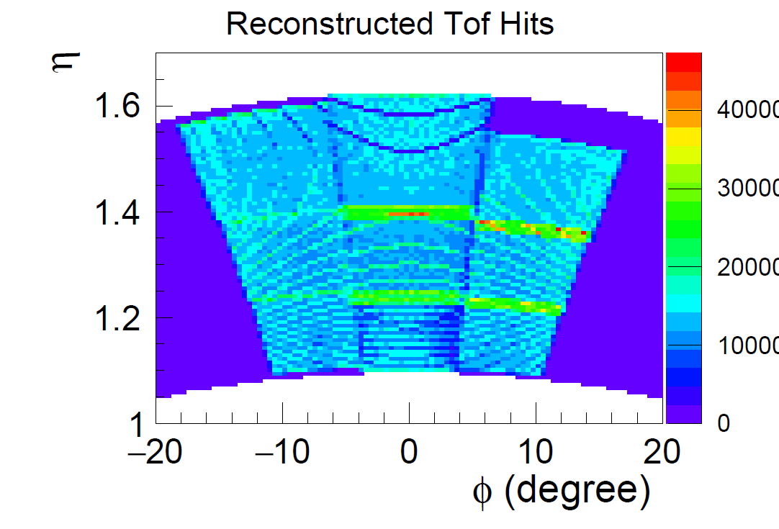
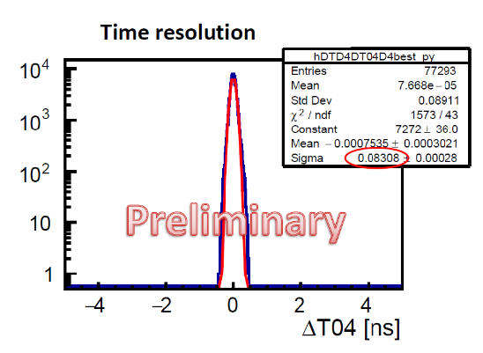
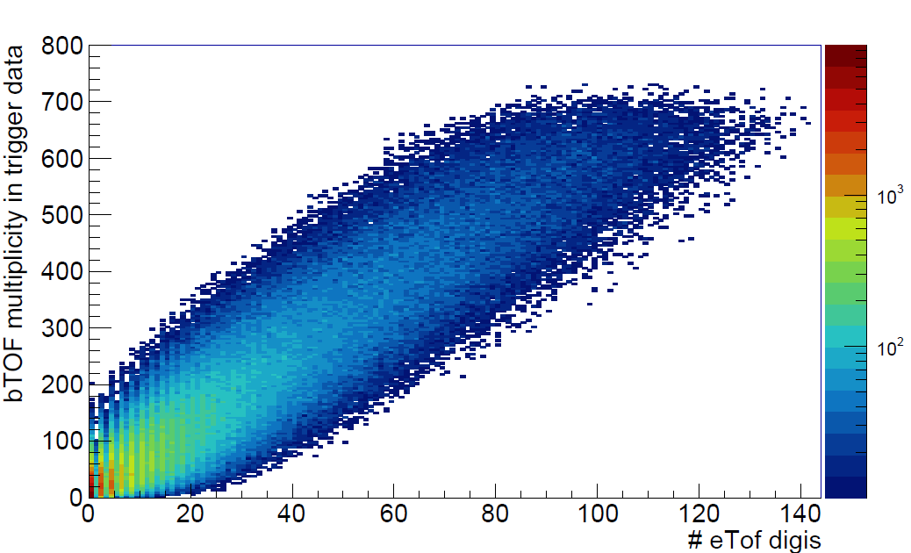







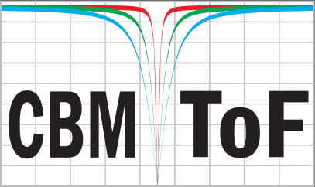





Status and Performance of the
CBM Time-of-Flight system
Ingo Deppner¹ and Norbert Herrmann¹ for the CBM-Collaboration
¹ Physikalisches Institut Uni Heidelberg, Heidelberg, Germany
Exploring the QCD phase diagram at large baryon densities
Charged hadron PID for HI-collisions at kinetic beam energies T_{beam} = 2 – 11 AGeV (for the heaviest system)
High granularity and rate capability for interaction rate R ≤ 10 MHz
Multi-gap Resistive Plate Chamber (MRPC) system with about 120000 timing channels and a system time resolution of σ ≤ 80 ps
Usage in STAR BESII campaign as part of the FAIR phase 0 program as eTOF system with acceptance range 1.0 ≤ η ≤ 1.5
The Compressed Baryonic Matter (CBM) experiment
CBM MRPC prototypes and test performance
Dipole magnet
TRD
TOF
ECAL
PSD
Tracking acceptance: 2° < θ_{Lab} < 25°
Free streaming DAQ
Software based event selection
R_{int} = 10 MHz (Au + Au)
Counter properties
Active area 300 – 864 cm²
Granularities 10 – 27 cm²
Low resistive glass
Rate capability > 30 kHz/cm²
Time resolution about 50 ps
Efficiencies above 95 %
Cluster size about 1.4 - 2
CERN SPS setup
Cosmic stand setup
RICH
∠ = 6°
Upper setup
High net-baryon densities
Beam
∠ = 3.5°
Lower setup
MVD & STS
MRPC1/2
MUCH
MRPC3a/b
The CBM Time-of-Flight wall
Anticipated rate
Phase space
distribution
Electronic readout chain
Compressed Baryonic Matter experiment at FAIR
MRPC1
MRPC2
MRPC3a
MRPC3b
MRPC4
CBM-ToF Requirements
Full system time resolution σ_{T} ~ 80 ps
Efficiency > 95 %
Rate capability ≤ 30 kHz/cm²
Polar angular range 2.5° – 25°
Active area of 120 m²
Occupancy < 5 %
Low power electronics
(~120.000 channels)
Free streaming data acquisition
CBM TOF module M4_001
FAIR phase 0 program: eTOF at STAR/BNL
FAIR phase 0 program: mTOF at mCBM/GSI
3 layers
12 sectors
36 modules
108 MRPCs
6912 channels
Magnet pole tip on east side
Installation of Sector 18 in Jan. 2018
Full installation in Nov. 2018
mCBM@SIS18
mTOF
1st “commissioning” beam-time in Dec. 18
14
13
24
23
22
TPC track matching
Full eTOF wheel is currently in the commissioning phase
mTOF
Event display of an Ag + Au event
15
21
Beam: Ag (42+) @ 0.95AGeV
16
20
Target: Au 10%
3 tracks
17
19
21
mTRD
Diamond T0
3 mTOF modules with 5 MRPC3a each
CBM “STAR” module
Sector counting
match the TPC sectors
18
eTOF – barrel TOF correlation
1st PID plot
MRPC hit rate
MRPC3a (5 counters)
Active area 864 cm²
Dark rate 1 – 2 Hz/cm²
Flux up to 1 kHz/cm²
mMUCH
mSTS
Summary: The CBM Time-of-Flight system is developed by 8 institutions from China, Germany, Romania and Russia. It comprises about 120000 channels and a rate capability up to 30 kHz/cm². The targeted system time resolution is 80 ps at an efficiency above 95%. Test beam experiments have demonstrated counter resolutions in the order of 50 ps. CBM-TOF will participate as part of the FAIR phase 0 program in the BESII campaign of STAR@RHIC and miniCBM@GSI. The CBM-TOF wall will be ready to take beam at FAIR in 2024.

