Slide 1





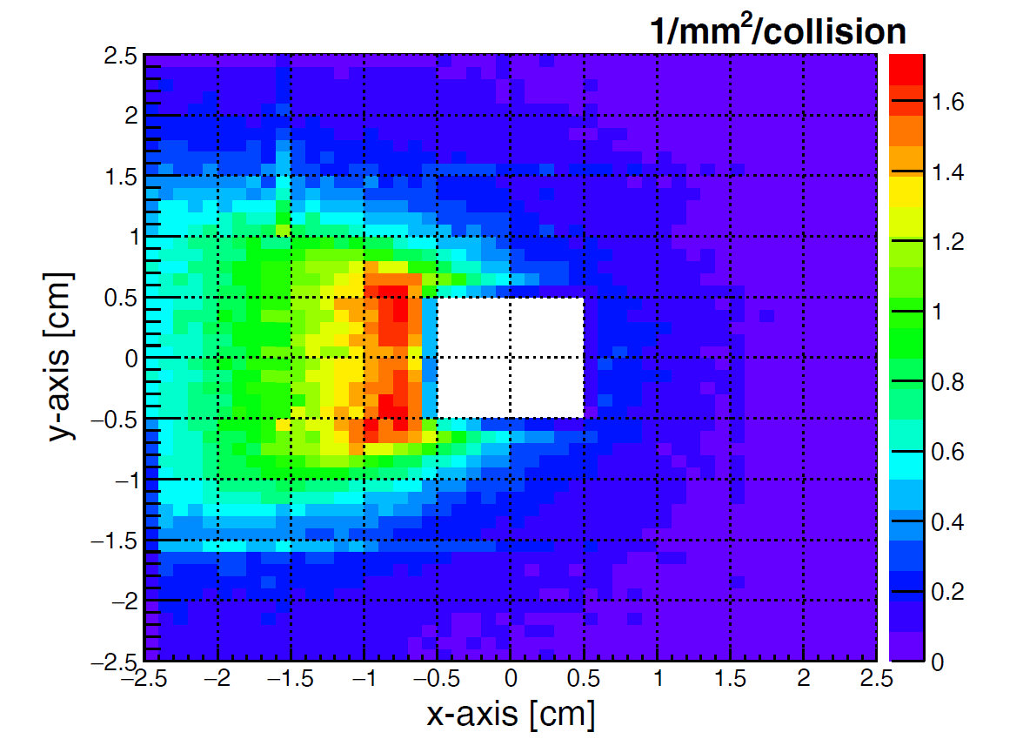
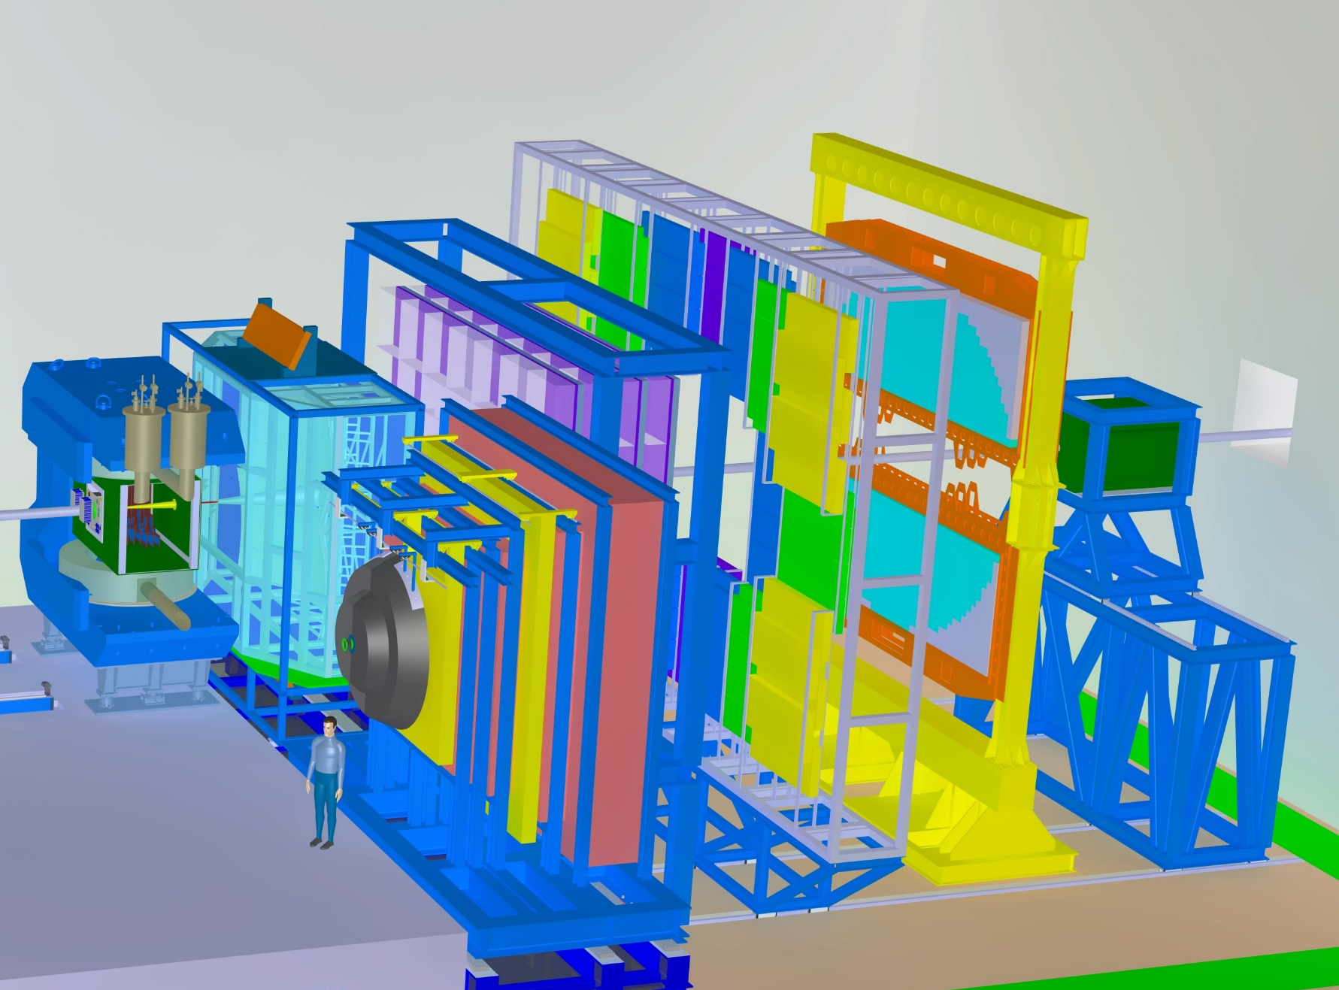
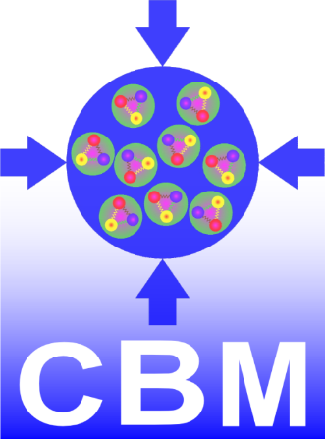
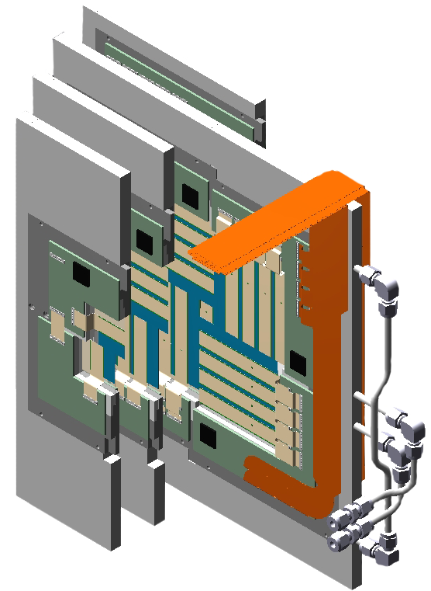
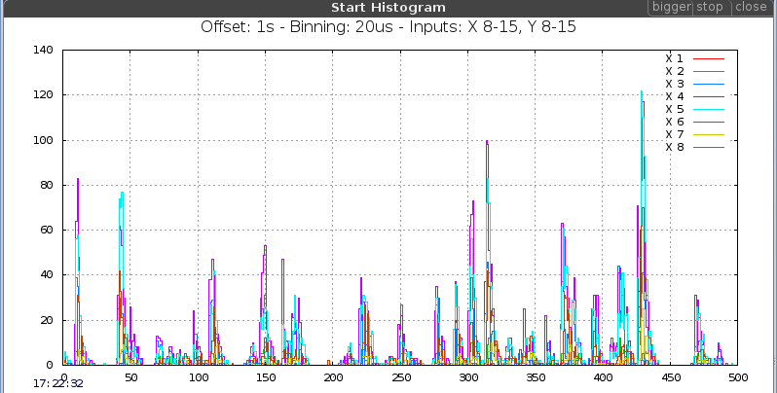
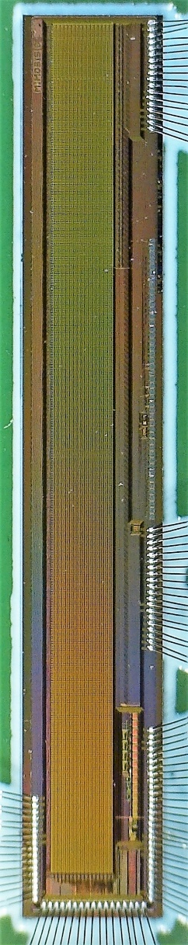
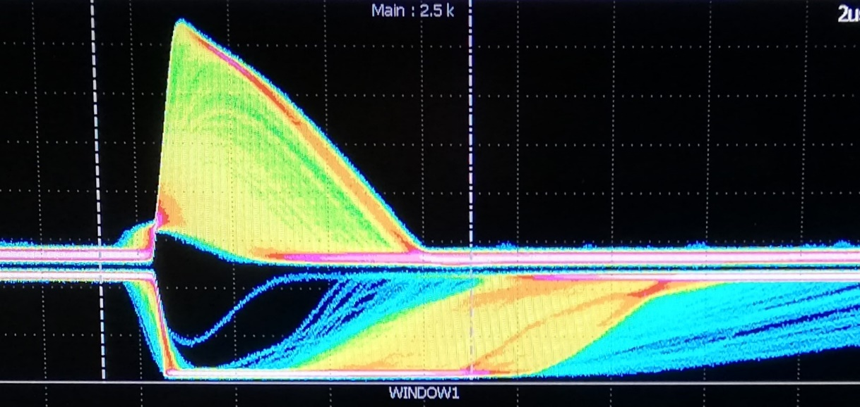
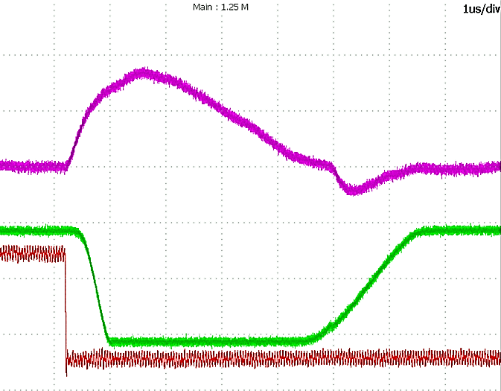
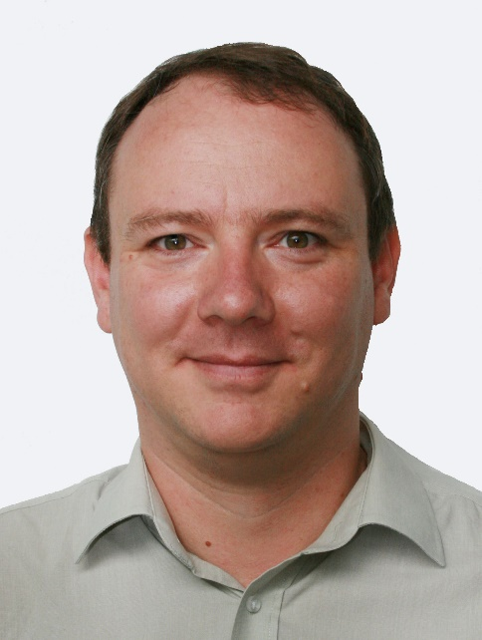
MIMOSIS, a CMOS MAPS
for the CBM Micro Vertex Detector
M. Deveaux, Goethe-University Frankfurt, on behalf of the CBM-MVD collaboration
MIMOSIS requirements:
Optimize for a fixed target environment:
10 AGeV Au+Au
 | MIMOSIS (design goal)
Spatial resolution | ~ 5 µm
Time resolution | ~ 5 µs
Collision rate (with MVD) | 100 kHz Au+Au 10 MHz p+Au
Counting rate | 70 MHz/cm² (peak)
Rad. tolerance | >10¹³n_{eq}/cm² + >3 Mrad
On-chip data reduction | ~20 to 2.6 Gbps (load averaging)
On-chip clustering | 1.5 D
MIMOSIS
Handle large occupancy gradients.
SIS18 beam fluctuations
(measured, not optimized)
Tolerate strong beam fluctuations.
The CBM-MVD will be located 5-20 cm downstream the target.
MIMOSIS-0 prototype, test results:
MIMOSIS-0
32 columns of 504 pixel.
Priority encoder.
AC and DC pixel version.
No data buffers yet.
Amplifier linearity
Pulse duration
Response to ⁵⁵Fe
Signal rise time: ~1µs
Jitter/Time walk
Response to pulsing
Threshold linearity
Ampl.
Pulse length
dt
Dead time
dt
ToT
Pulse inj.
MIMOSIS Sensor Concept:
CMOS Monolithic Active Pixel Sensor.
Pixel with in-pixel discrimination.
1024 x 504 pixel (26.88 x 30.24 µm²).
Shaper analog output (SF)
Internal DACs
Linearity
Comparator analog output(SF)
8-bit trim DACs create reference voltages
One DAC per chip and voltage
Design: 0.2V-1.8V
Sensing part
Amplification
In-pixel Memory
Design: 0V-1.54V
AC-coupled pixel
=> Advanced depletion.
AC coupling
Bias2
Shaping time few µs
Full custom digital
MV Bias1
Amp
Comp
Dual Port
2 words of 1 bit
Pixel output
Charge inj.
160 aF
Radiation test
Radiation test (zoom)
DC-coupled pixel inspired by ALPIDE.
DC coupling
Bias1
Pixel readout by priority
encoder (max. 10% occupancy)
Charge inj.
160 aF
Steering
Chip1 VCasn
Zoom
Pix.
x1008
Region
Zoom
Pixel PE
x8
Pixel PE
8 bit DACs
3-layer data concentrator for
spatial load balancing.
•••
Region PE
•••
Region PE
Region U.
x4
Region U.
Super Region
Tolerance to 20 Mrad seems satisfactory.
Remaining effects understood and being fixed.
Elastic buffer for load balancing in time.
•••
x16
Super Region Unit
•••
Super Region Unit
Thanks for asking questions.
Mux
May use 1-8 parallel outputs to optimize
data rate vs. power dissipation
Elastic Buffer
8 x 320 Mbps max.
supported by BMBF (05P12RFFC7), GSI (F&E) und HIC for FAIR
Michael Deveaux
deveaux@physik.uni-frankfurt.de

