Slide 1
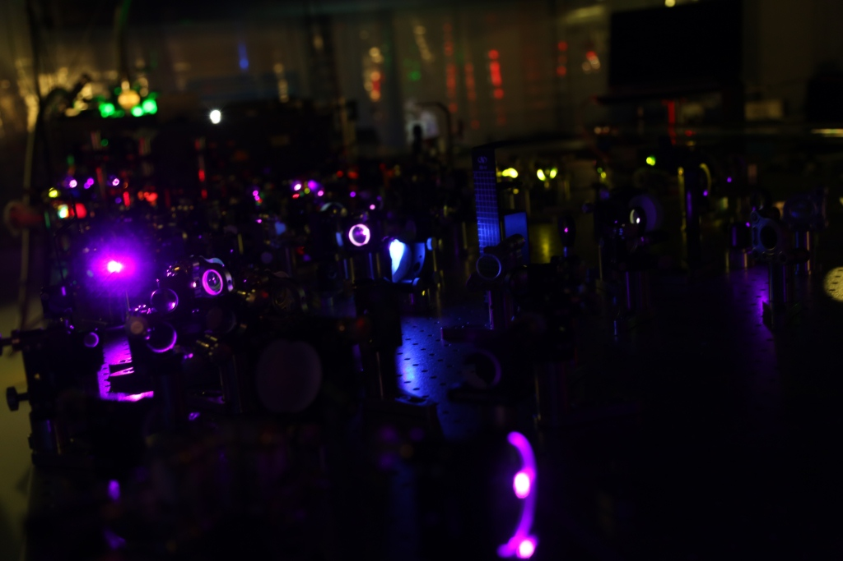






Very High Frequency Accelerators:
THz and IR
Nicholas H. Matlis
Center for Free-Electron Laser Science, DESY, Hamburg, Germany
Ultrafast Optics and X-Rays Group
KfB Strategie Workshop – September 5 - 6, 2019

Slide 2
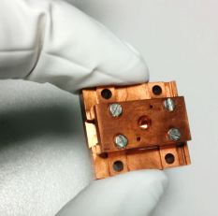
Distance & Time scaling in High-Gradient Accelerators
Technology | Wavelength | timing for 0.1% | Fabrication | bunch charge
Conventional | ~ 100 mm | ~ 300 fs | machining | ~ nC
THz-based | ~ 1 mm | ~ 3 fs | machining | ~ pC
Laser-plasma | ~ 0.01 mm | ~ 0.03 fs | wave excitation | ~ pC
Dielectric laser | ~ 0.001 mm | ~ 0.0003 fs | lithographic | ~ fC
All-optical approach ➞ intrinsic synchronization ➞ important for small scales
Conventional Approach
THz-Driven Approach
Direct Laser-Driven Approach
Gun
LINAC ~ km
D. Zhang et al., Nature Photonics (2018)
E. Nanni et al., Nat. Comm. 6, 8486 (2015)
Gun
LINAC

Slide 3
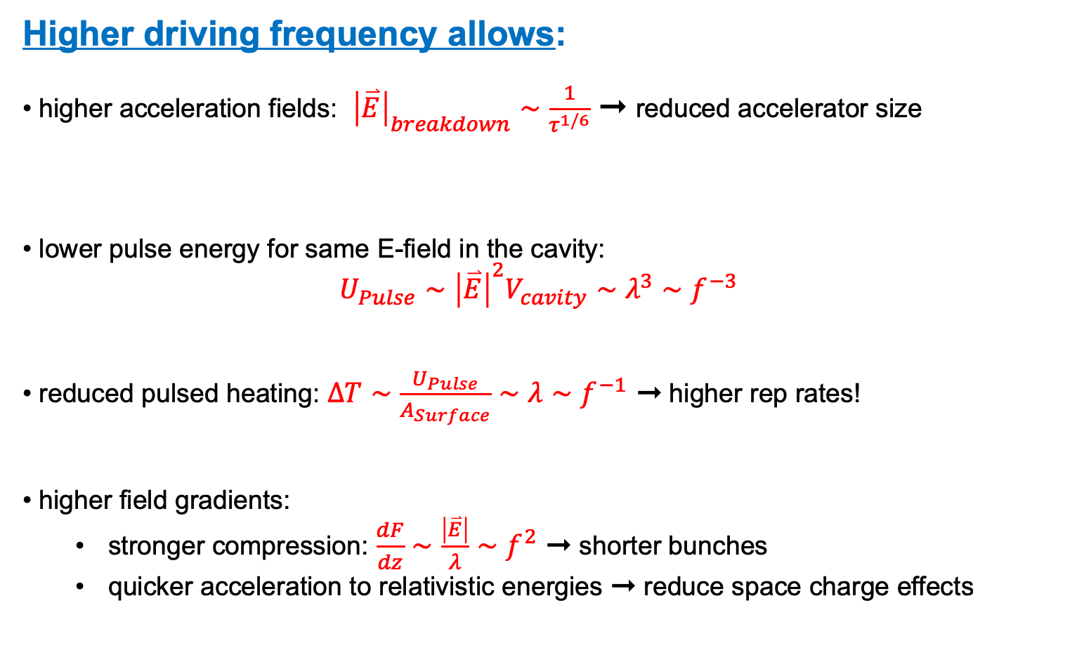
Why explore higher frequencies?
Higher driving frequency allows:
higher acceleration fields: ${\left|\overset{⃑}{E}\right|}_{breakdown}∼\frac{1}{τ^{1/6}}$ ➞ reduced accelerator size
lower pulse energy for same E-field in the cavity:
$U_{Pulse}∼{\left|\overset{⃑}{E}\right|}^{2}V_{cavity}∼λ^{3}∼f^{−3}$
reduced pulsed heating: $ΔT∼\frac{U_{Pulse}}{A_{Surface}}∼λ∼f^{−1}$ ➞ higher rep rates!
higher field gradients:
  stronger compression: $\frac{dF}{dz}∼$ $\frac{\left|\overset{⃑}{E}\right|}{λ}∼f^{2}$ ➞ shorter bunches
  quicker acceleration to relativistic energies ➞ reduce space charge effects
Reduced duration = larger field =
[1] Kilpatrick, W. D., Rev. Sci. Inst. 28, 824 (1957).
[2] Loew, G.A., et al., 13th Int. Symp. on Discharges and Electr. Insulation in Vacuum, Paris, France. 1988.
[3] S. V. Dolgashev, et al. Appl. Phys. Lett. 97, 171501 2010.
[4] M. D. Forno, et al. PRAB. 19, 011301 (2016).
Notes:
Smaller size, lower energy make accelerator more accessible
Reduced heating & higher rep-rate can compensate for lower charge
Higher gradients can lead to shorter bunches
don’t always want highest gradients
want to reach full compression when emittance is frozen: compression must occur with acceleration
grygorii: best emittance happens with lowest frequencies
true for sinusoidal drivers (with alternate waveforms, may not be true)
Rephrase: higher fields allows reaching relativistic energies sooner -> mitigates space charge effects

Slide 4
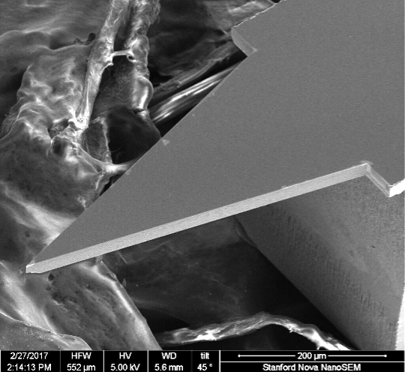
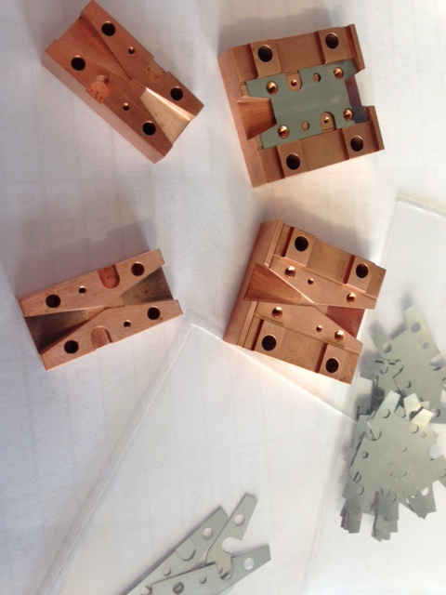
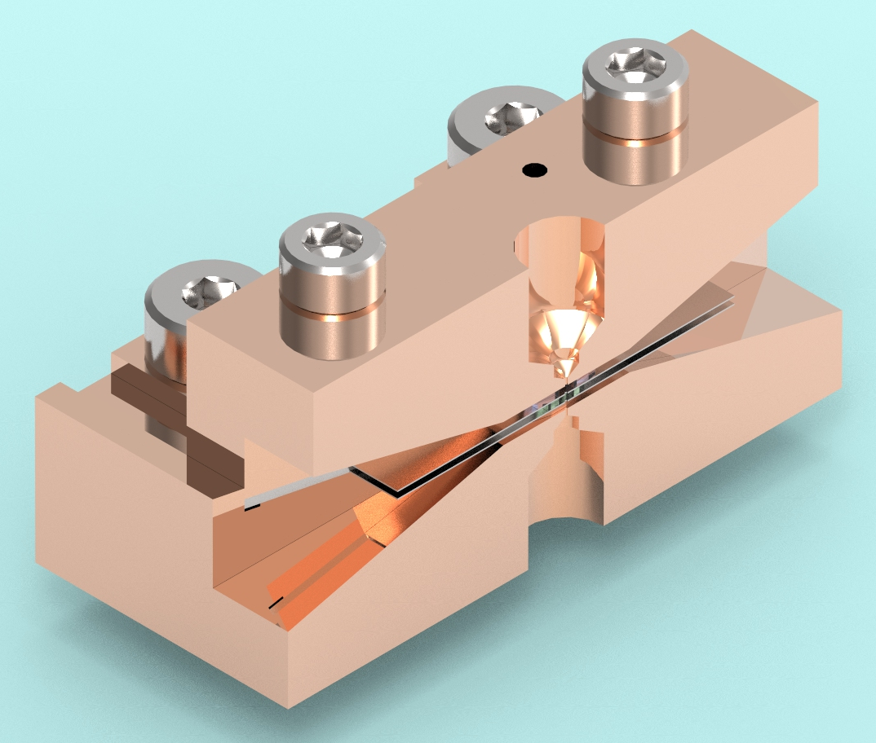
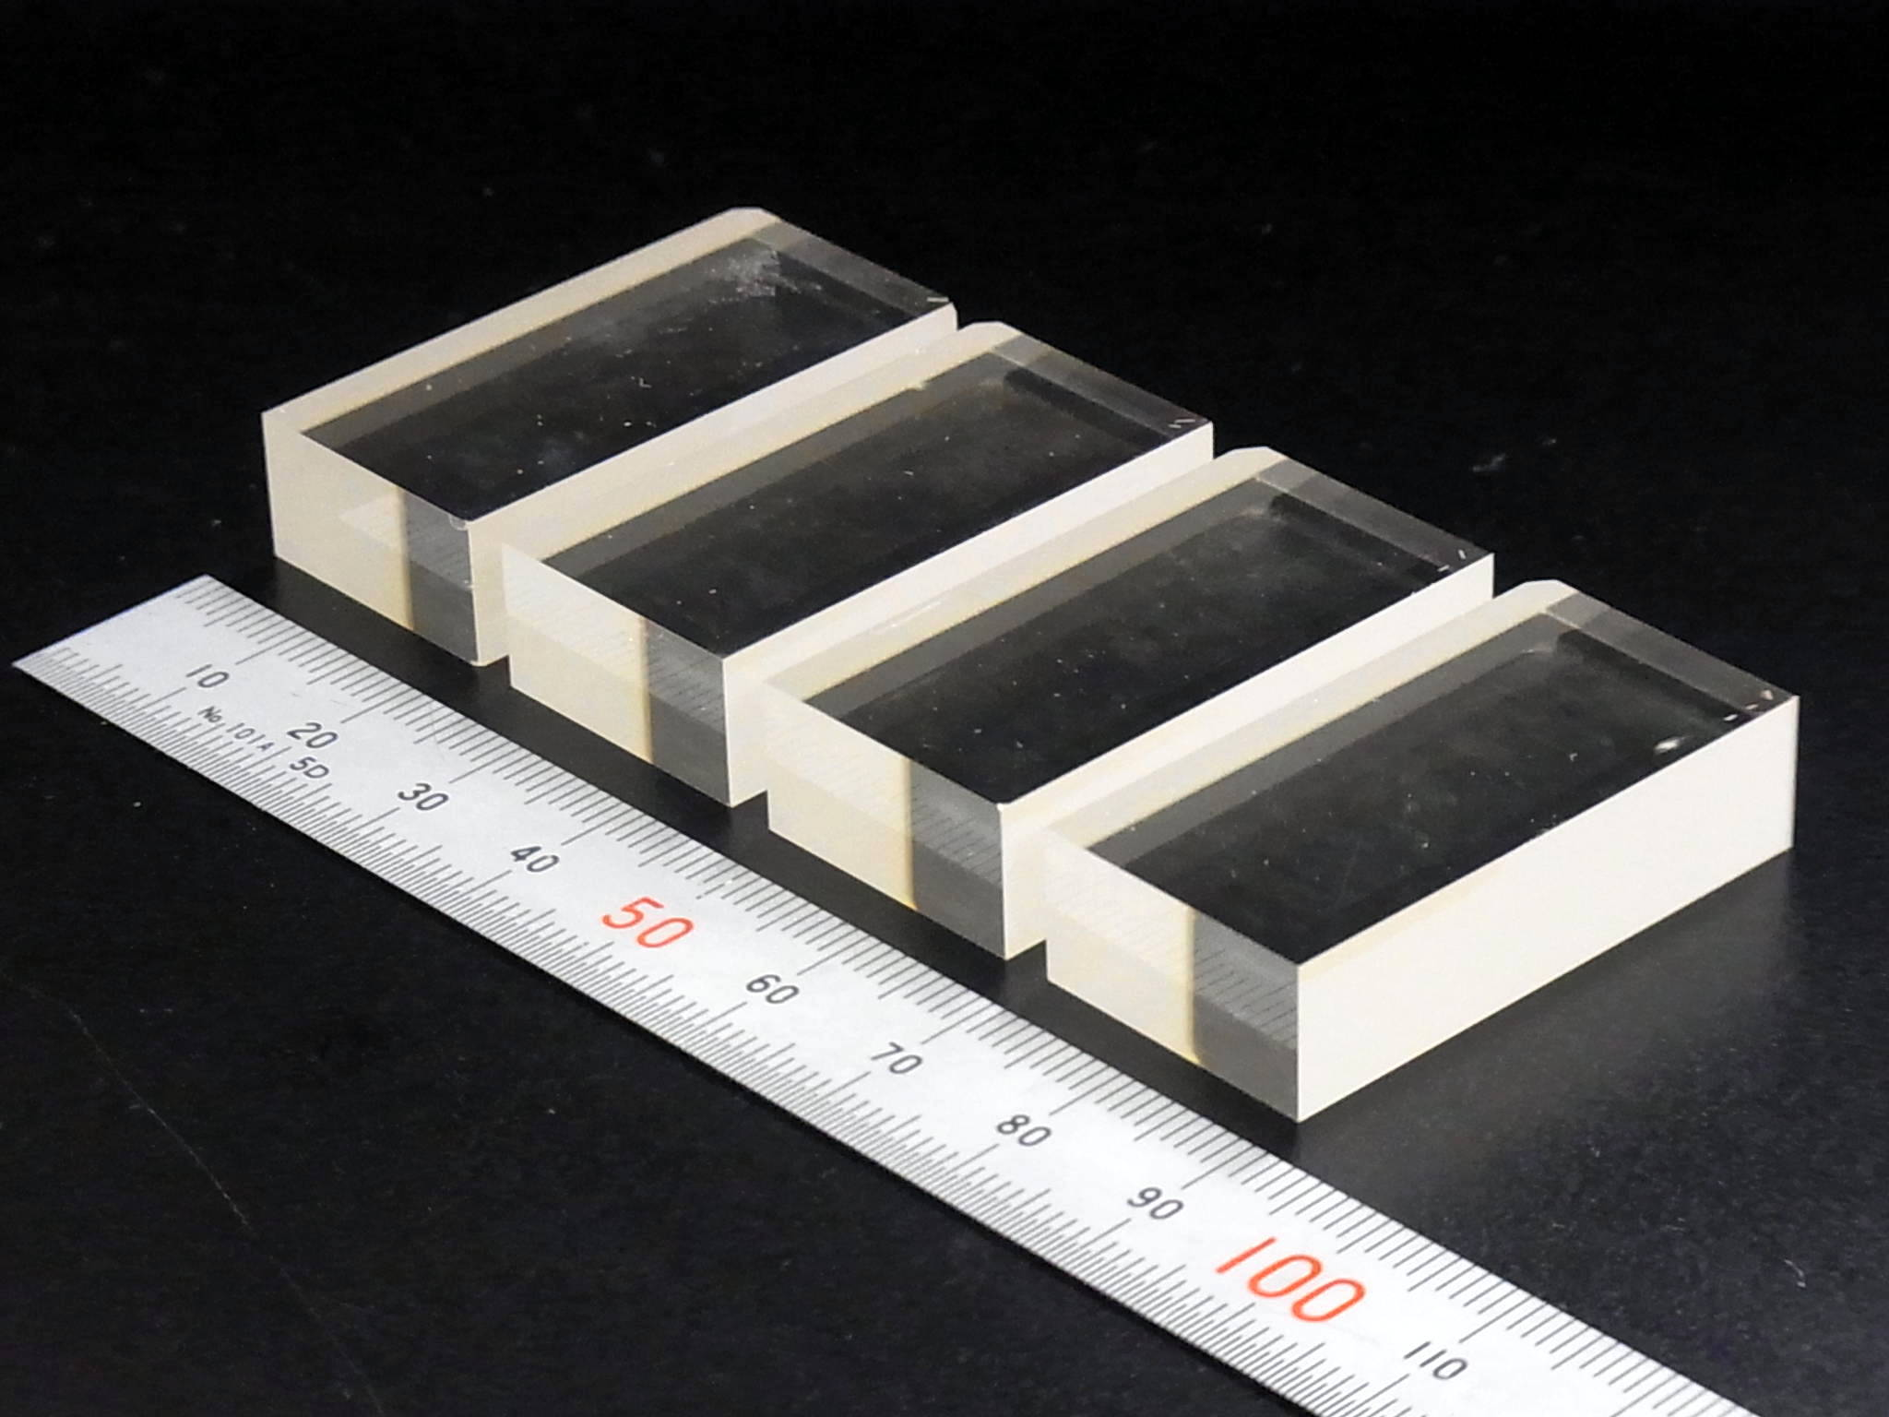
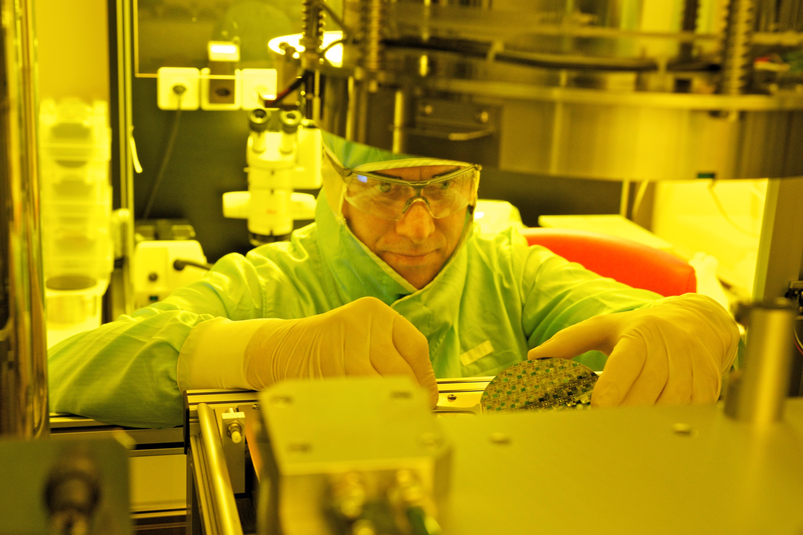
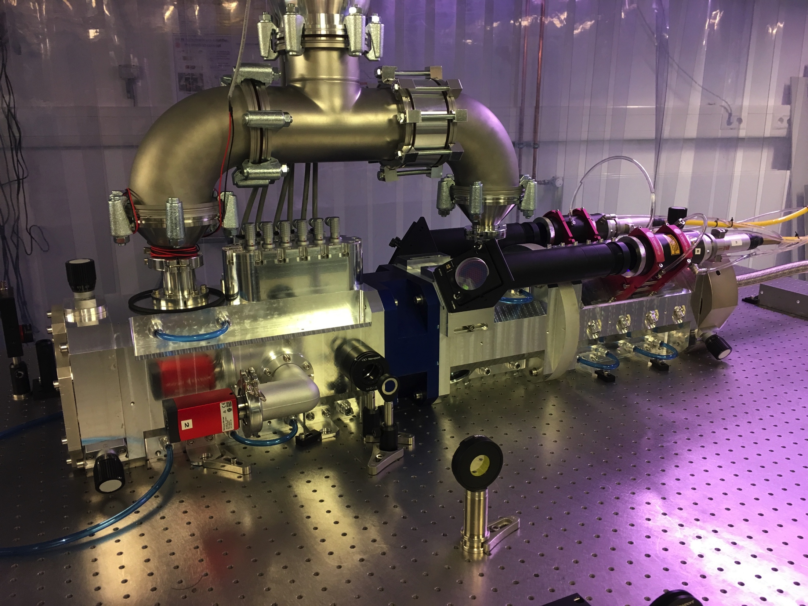
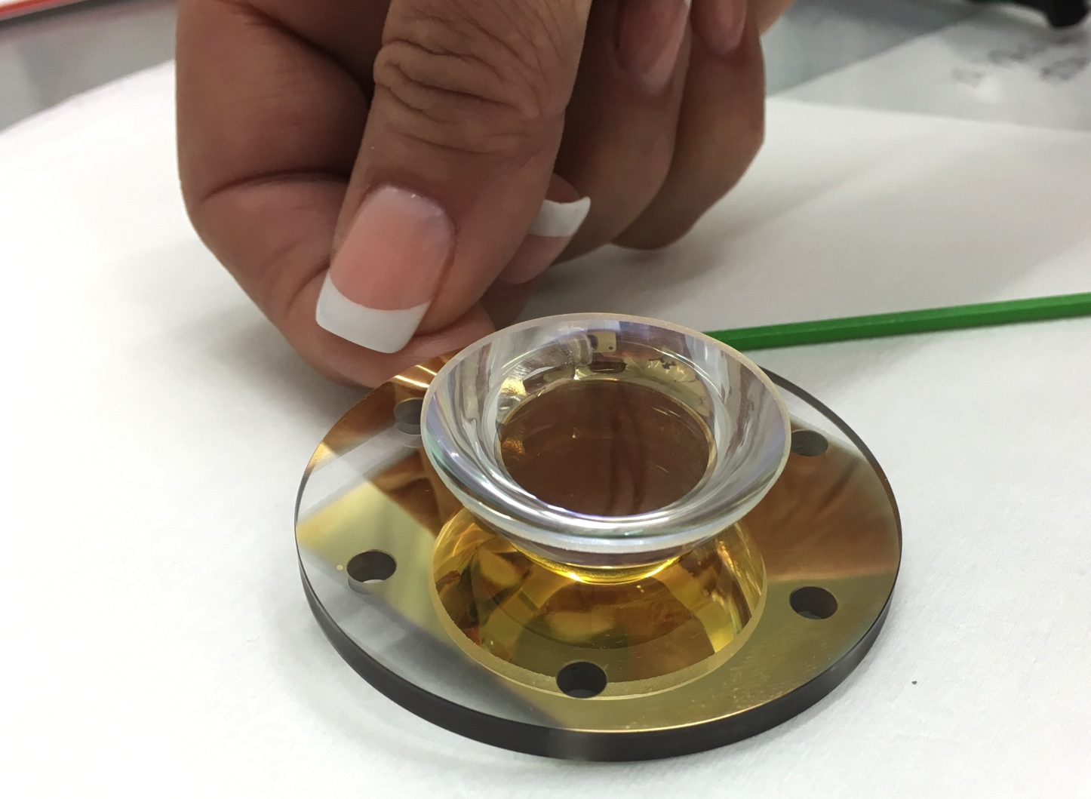
Benefits of Compact Accelerators: Study scaling to shorter wavelength drivers
  lower energy required
    less heating
    smaller drivers -> more available
    higher repetition rates
  more compact
    more accessible
    less costly infrastructure
    allows accelerators to be brought to the problem instead of the problem to the accelerator
    allows diversification of accelerator science in general into new areas
  materials have different responses
    scaling of breakdown with driver duration & frequency
    use of new materials like dielectrics which can support much higher fields
  different manufacturing techniques can be used
    micromachining
    lithography
  shorter field scale lengths -> higher field gradients
    higher resolution streaking
    higher resolution beam manipulation
    stronger forcing on electron bunches
  new applications
    basic science
    conventional accelerator add-ons
  Use of laser drivers
    high field strengths
    inherent synchronization
  Development of new technologies
    New lasers
    high-power THz generation
    electrons on a chip
    compact UED
    compact X-ray light sources

Slide 5
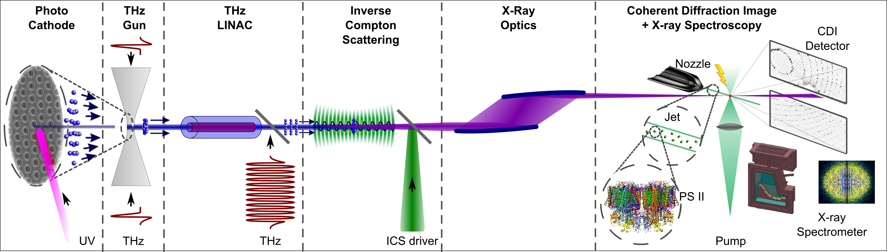
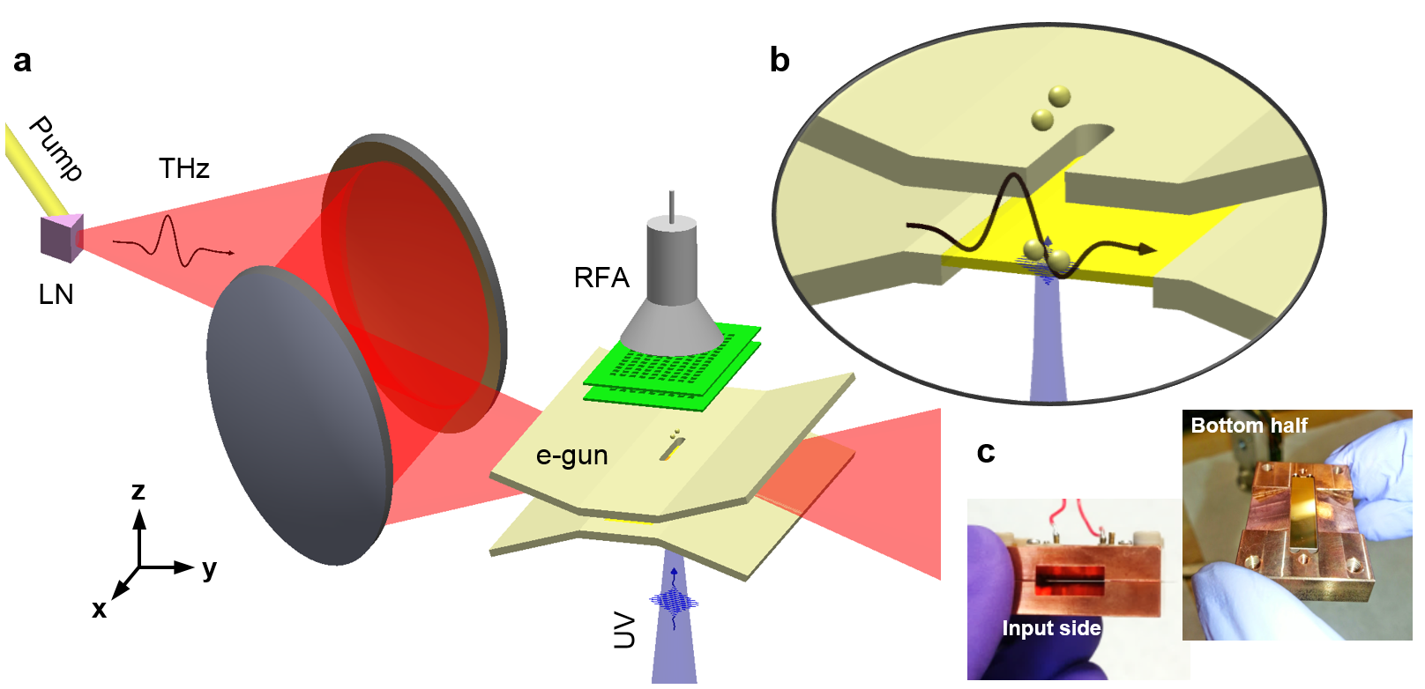
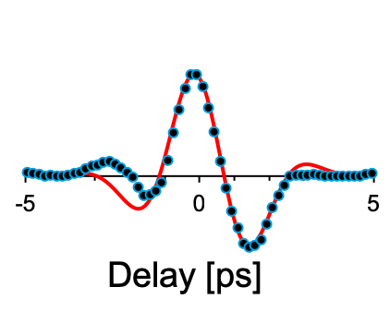
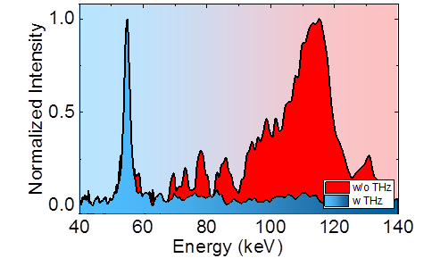

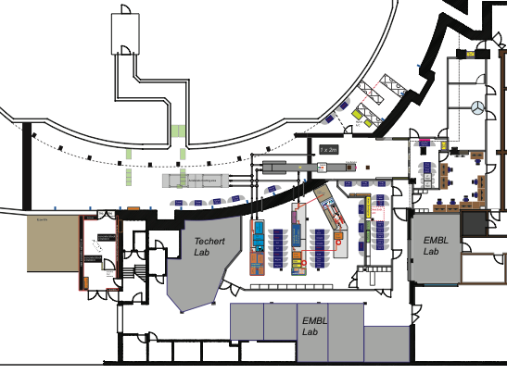
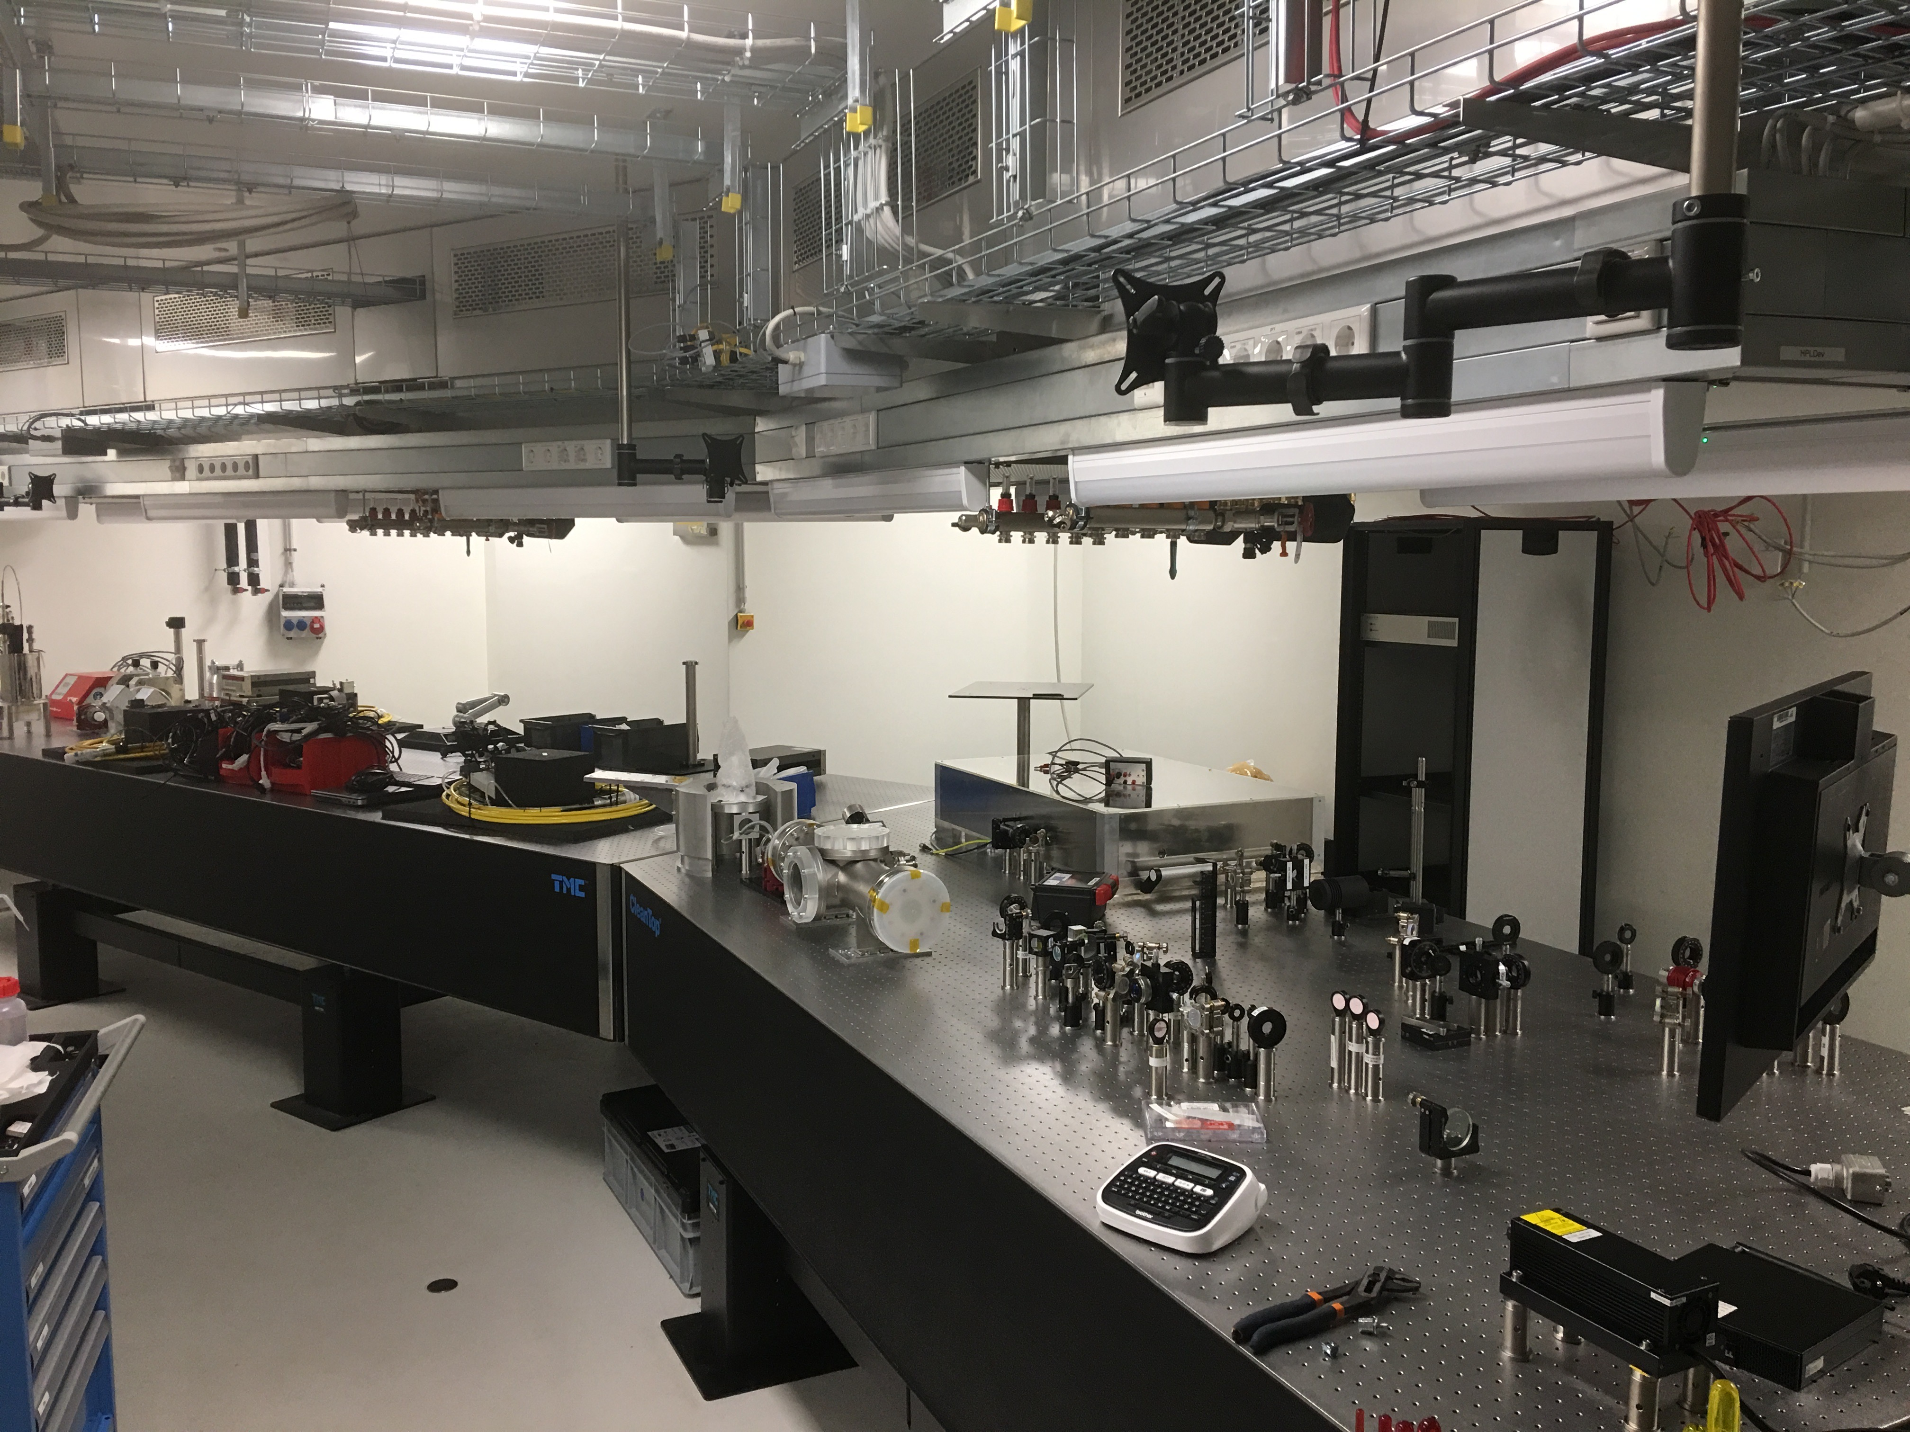
Attosecond X-ray Science – Imaging and Spec. (AXSIS)
Previous Steps
2013 AXSIS project
FXK. et al., doi:10.1016/j.nima.2016.02.080
Optical
Undulator
1st THz acceleration (7 keV) 2015
Yield [a.u.]
2016 1st THz gun (1 keV)
IR
or
0
0.2
0.4
0.6
0.8
Laser driver
Energy gain [keV]
Damage-free structure
Undisturbed electronic structure
0.2 mJ single-cycle THz 2017
has its own science case
seeding of large scale FELs
→ solve access to large facilities
2018 0.6 mJ multicycle THz
structured photocathodes 2007
Next Steps
65 keV
2008 1st THz practical device (65 keV)
1 mJ single-cycle THz
20 mJ multicycle THz
kHz Joule laser 2018
1 MeV THz Gun
2019 multicycle staged acceleration
THz-MeV UED source
20 MeV THz LINAC
AXSIS laboratory 2019
5 keV X-ray source

Slide 6
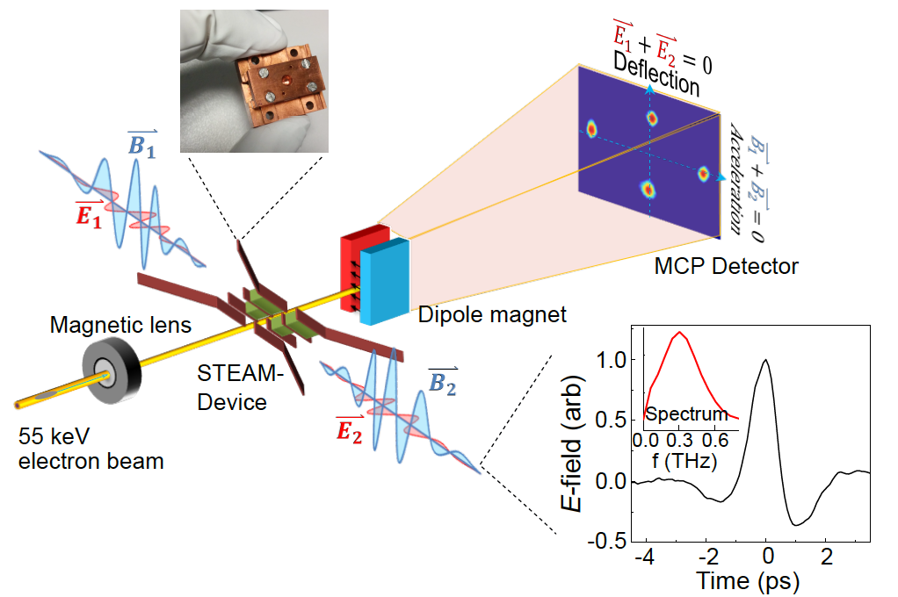
THz device Breakthrough: STEAM / Gun Devices
Electron acceleration & deflection
65 keV
D. Zhang et al., Optica accepted
D. Zhang, et al. Nat. Photonics 12, 336 (2018)

Slide 7
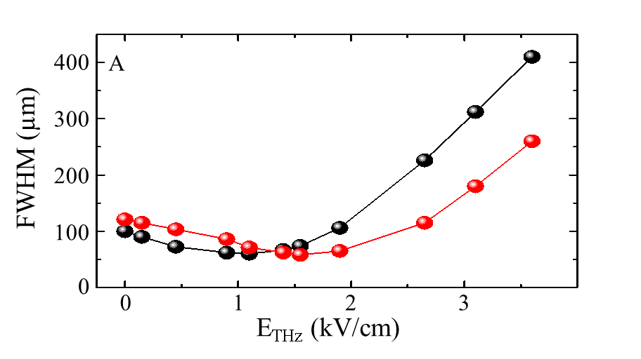
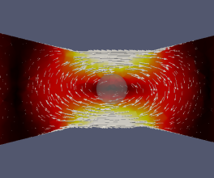
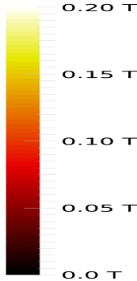
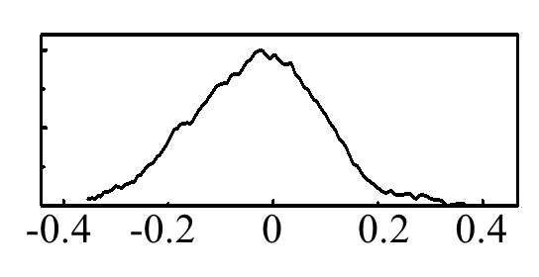
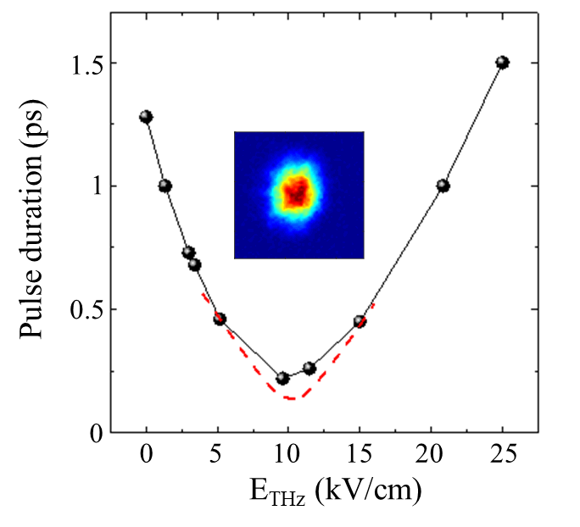

STEAM Device manipulates electrons with high-gradient THz fields
Beam Size
focusing field
0.6 T
STEAM
focusing
$$\frac{∂B_{φ}}{∂r}=2,000 \text{T}\text{/}\text{m}$$
0.3 T
0.0 T
Beam Spatial Mode
Retrieved temporal profile
STEAM
streaking
Unstreaked
beam
Streaked beam
Streaking gradient: 140 µrad/fs
Resolution: sub-10 fs
-4
-2
0
2
4
Deflection (mrad)
Delay(ps)
STEAM
compressor
STEAM
streaker
Compression
From
DC gun
100 nJ
STEAM
compression
2 x 100 nJ
100 nJ
200 mm
Notes:
Velocity bunching
Terahertz-driven electron pulse focusing/defocusing. (A) and (B) The spatial profile of the electrons as a function of THz field at the relative focusing and defocusing phase respectively. (E) and (H) Initial 55 keV electron beam on the detector. (C) and (D) focusing and defocusing field spatial distribution . (E-G) and (H-J) are focused and defocused electron beam on the detector, respectively.
Terahertz-driven electron pulse compression. (A). Measured temporal profiles of the electron pulses as the THz field is increased (red arrow). (B) Measured electron pulse duration (FWHM) versus incident THz field strength (Black dots). The simulation is shown as red dotted line. (Inset) the electron beam spatial profile on the detector at the optimal compressed condition. (C) Simulated bunch length vs position. Inset: longitudinal phase space distribution (D) before the rebunching cavity, (E) after the rebunching cavity and (F) maximally compressed position marked with red dots respectively. This demonstration was performed in the low energy Yb:KYW laser system with three THz setups that generated ~2*0.1 µJ THz for rebunching and ~2 µJ THz for streaking.

Slide 8

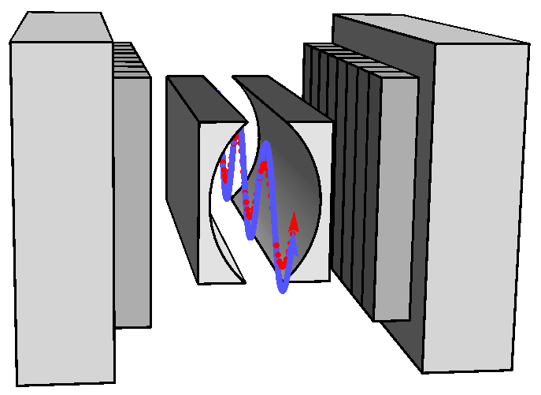
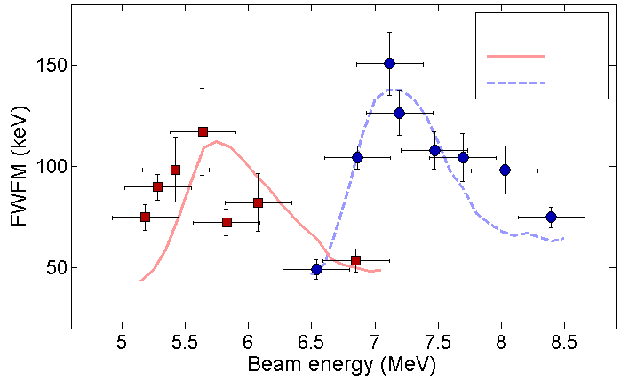
THz based electron manipulation takes up speed
THz Compression @ LMU/MPQ
Kealhofer et al., Science 359, 459 (2016)
Phase-space control & characterization of electron pulses
12x compression from 930 to 75 fs
Avg 1 electron @ 70 keV per pulse
THz IFEL interaction @ Pegasus lab
Curry et al., New J. Phys. 18, 113045 (2016)
Beam Manipulation using 1μJ single-cycle 0.8 THz pulse:
150 keV energy modulation of 7 MeV beam using
Bunch compression by factor of two
CPPWG
Undulator Magnets
THz sub-luminal free-space fields @ ASTeC in Daresbury
Walsh et al., Nature Comm. 8, 421 (2017)
Generation of sub-luminal propagating THz fields in free space
Tunable
Applicable for THz-based acceleration

Slide 9





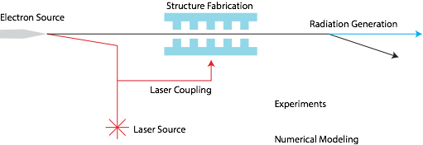







Accelerator on a Chip (ACHIP)
ACHIP Collaboration
ACHIP Concept
Leverage Semiconductor Tech
https://achip.stanford.edu/

Slide 10
Research in ACHIP & Dielectric Laser Accelerators
2013
1st dielectric laser acceleration (250 MeV/m, E0 = 60 MeV, dE = 53 keV, E_opt = 92 uJ)
E.A. Peralta et al., Nature v503, p91
2015
acceleration of sub-relativistic electrons (dE/dz = 200 MV/m, E0 = 96 keV, dE = 1 keV)
K. Leedle et al., Optica v2, p158
2016
acceleration using fs pulses (dE/dz = 690 MV/m, dE = 29 keV)
K.P. Wootton et al., Opt. Lett. v41, p2696
2019
2-sided pumping using a distributed Bragg reflector (dE/dz = 133 MeV/m, E0 = 28 keV, dE = 0.69 keV)
P. Yousefi et al, Opt. Lett. v44, p1520

Slide 11
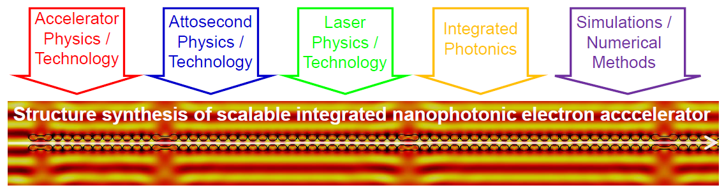
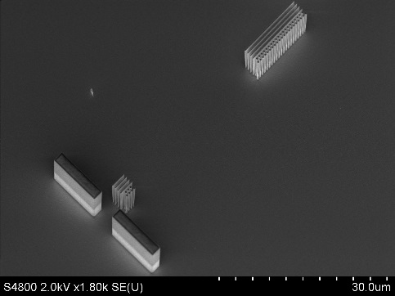
ACHIP & DLA Development at TU Darmstadt
Coupling of laser to structure
Development of structures for acceleration and control of electron properties
Accelerating structure
bunching
Alignment

Slide 12
END

