Slide 1
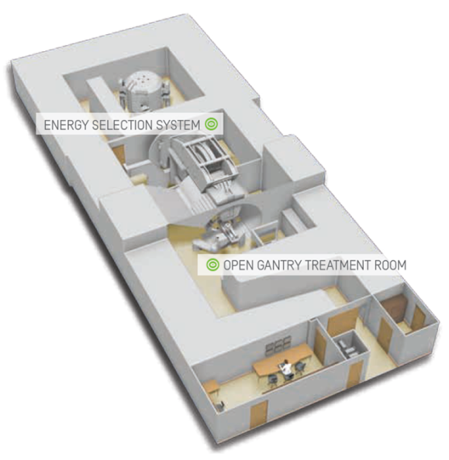
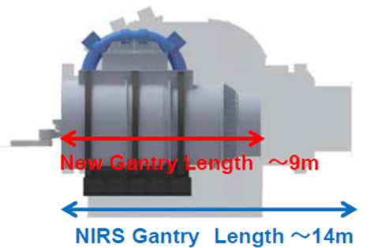
Beschleuniger: Anwendungen in der Medizin
KfB-Strategieworkshop „Beschleunigerphysik 2030“
Dipl.-Phys. Andreas Peters
Leitender Beschleunigerphysiker HIT

Slide 2
Überblick
Elektronenbeschleuniger in der Medizin
Protonenbeschleuniger für Therapiezwecke – Übersicht
Ionenbeschleuniger in der Radioonkologie und weltweite Entwicklungen auf diesem Gebiet, speziell in Japan
Strategievorschlag für Deutschland zur Sicherung dieser Schlüsseltechnologie

Slide 3
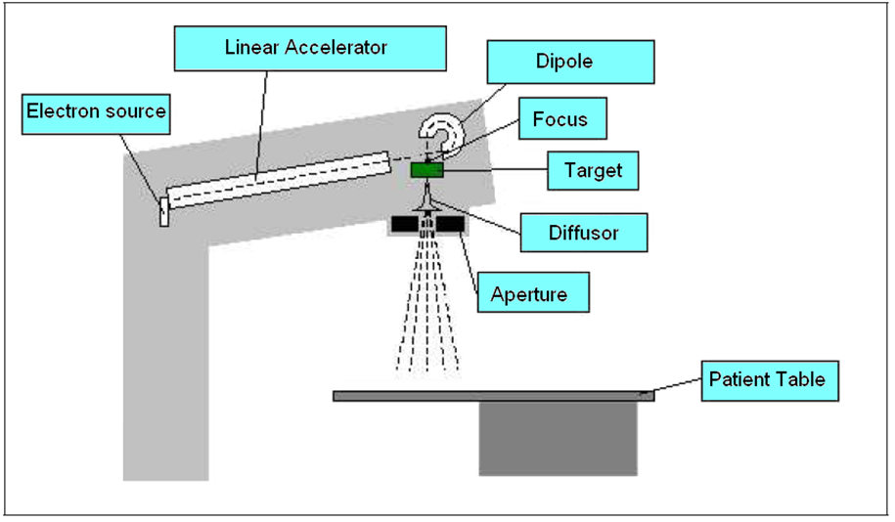
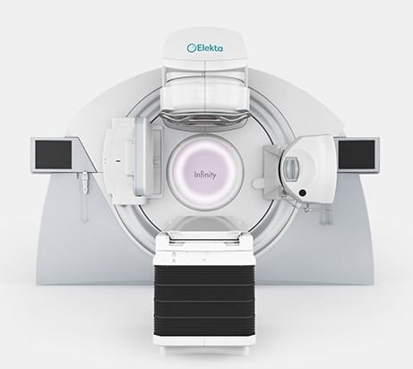
Elektronenbeschleuniger in der Medizin
Prinzip eines Linear-beschleunigers zur Erzeugung von Röntgenstrahlung für die Tumortherapie
Beispiel eines heutigen Medizin- produkts mit integrierter Bildgebung
→ Weitere Optimierungen (fast) nur durch Hersteller wie Accuray, Varian, Elekta, Philips ... ehemals auch Siemens!

Slide 4

Protonenbeschleuniger für Therapiezwecke
Beispiel: „Ein-Raum-Anlage“ mit Protonenzyklotron und Gantry (Fa. IBA, Belgien)
Im weltweiten Markt tummeln sich einige große Hersteller (IBA, Varian, Hitachi) und einige kleinere Firmen (ProTom, ProNova, Mevion) – nur Varian produziert in Deutschland.
→ Weitere Optimierungen (z.B. Einsatz von Supraleitung zur weiteren Kompaktierung) erfolgen ebenfalls weitest-gehend durch die Hersteller!
An ca. 80 Protonenzentren sind bis Ende 2018 weltweit knapp 200.000 Patienten behandelt worden.

Slide 5
Ionenbeschleuniger in der Radioonkologie
Wie sieht es aus bei den Bestrahlungsanlagen, die mit schwereren Teilchen als Protonen eine Bestrahlung ermöglichen (C, He), an denen bislang nur knapp 30.000 Patienten behandelt wurden:
Hier gibt es weltweit nur 4 in Betrieb befindliche Anlagen in Europa (2 * in Deutschland, 1* in Italien, 1 * in Österreich), 6 Anlagen in Japan und drei Anlagen in China. Darunter sind noch sehr viele Zentren, deren Beschleunigeranlagen als Spin-Off großer Forschungszentren (Beispiele: GSI → HIT, CERN → CNAO, MedAustron) entstanden sind.
Die kommerzielle Verwertung dieser Technologie findet derzeit nur in Japan (vor allem durch Toshiba und auch Hitachi) statt und steht kurz vor dem Sprung auf den Weltmarkt.
Auch in China entwickelt sich „etwas“ als Spin-Off rund um das IMP-CAS in Lanzhou.
In Deutschland gab es den TT von GSI an Siemens (TT-Vertrag in 2003), 2011 gab Siemens – noch vor Fertigstellung der Anlagen in Marburg, Kiel und Shanghai – das „Aus“ der Partikeltherapie bekannt.

Slide 6
Ionenbeschleuniger in der Radioonkologie
Die derzeitige Bilanz:
Weltweit wurden bislang rund 30.000 Patienten an Bestrahlungs-zentren mit C, He u.a. behandelt.
HIT behandelt seit rund 10 Jahren Patienten (Stand heute: ca. 5.760 Patienten behandelt, ca. 50% mit C, ca. 50% mit p; mit He-Ionen ab 2020)
CNAO (Pavia, Italien), MIT in Marburg und MedAustron sind im Regelbetrieb mit p und C seit mehreren Jahren mit steigenden Patientenzahlen.
Aber: Die staatlich planmäßig unterstützte Forschung und Entwicklung von Ionenstrahl-Therapieanlagen läuft derzeit – fast ausschließlich – in Japan, dazu ein paar nachfolgende Folien:

Slide 7
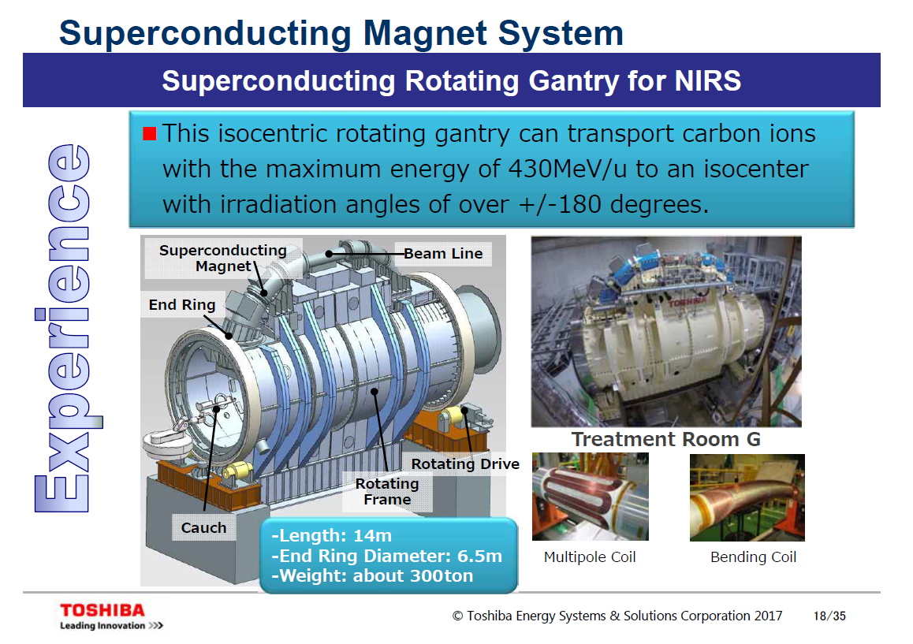

Slide 8
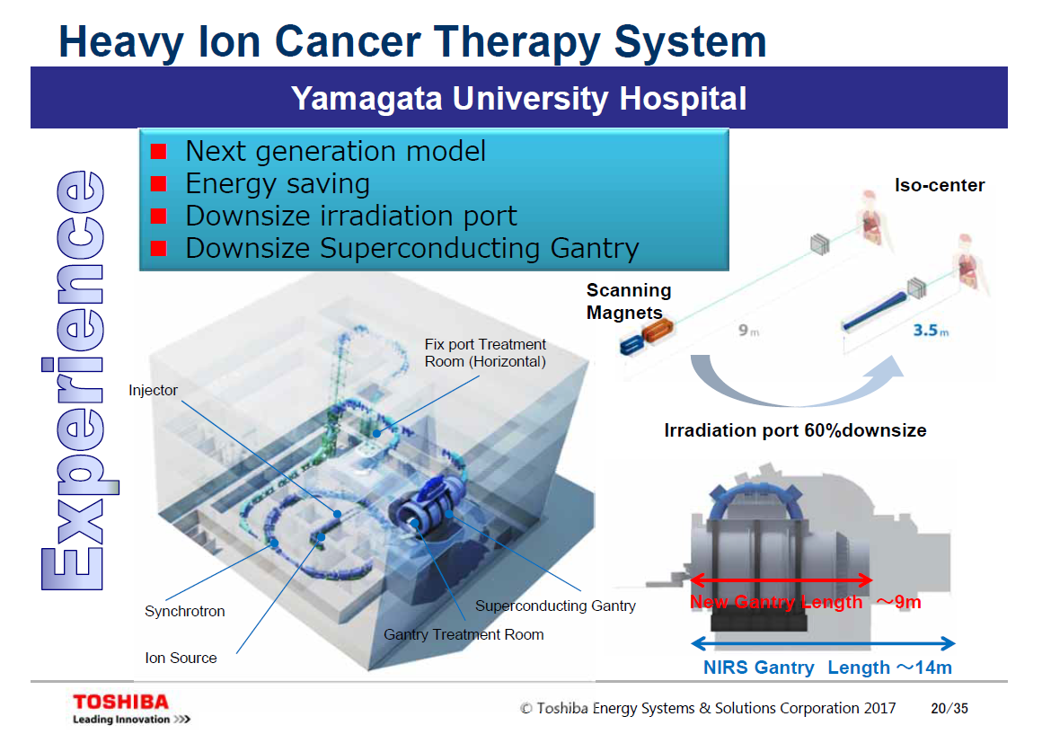

Slide 9
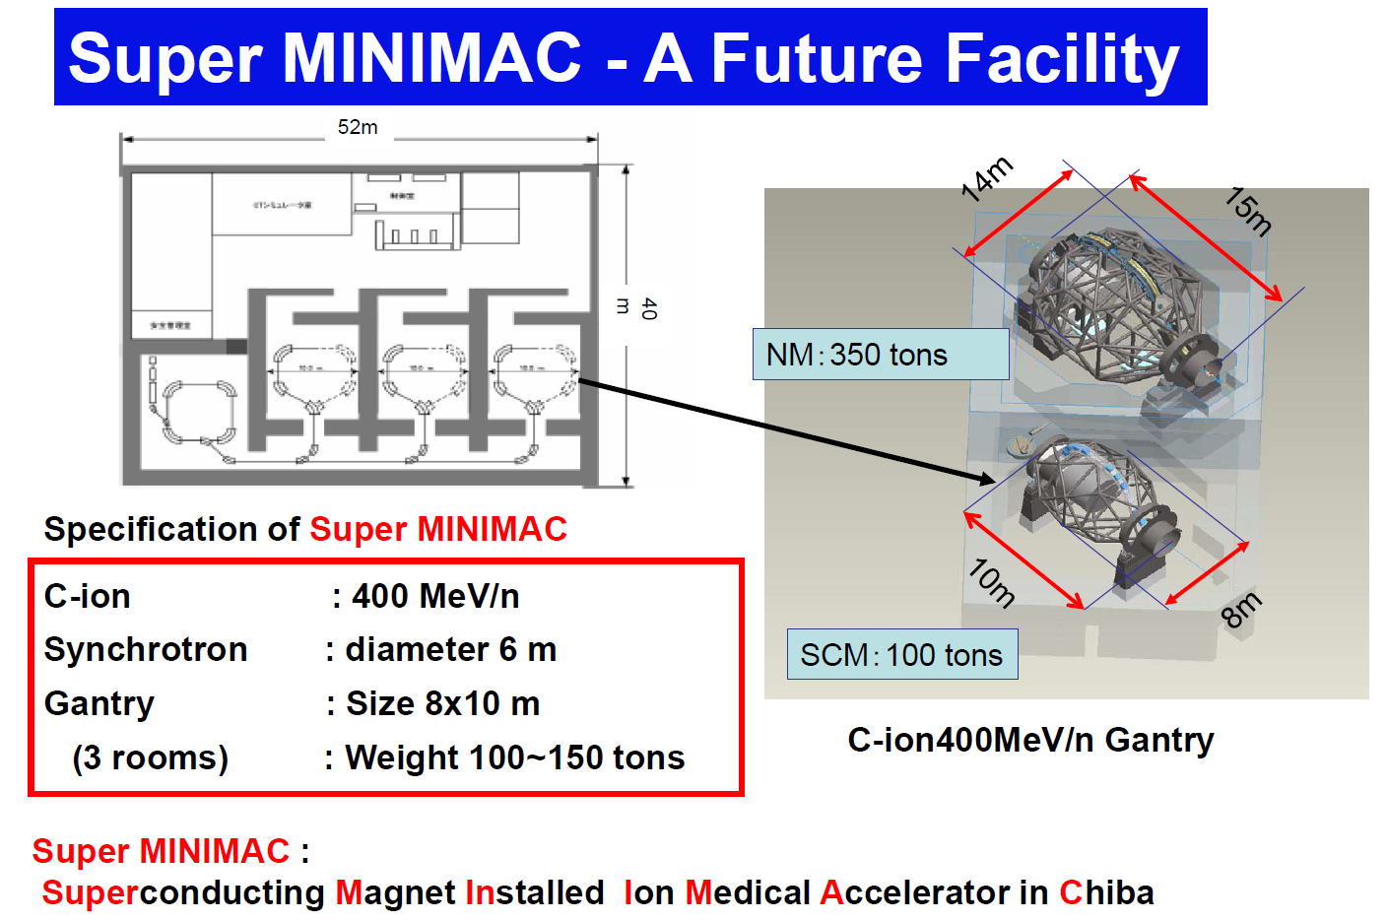
Shrinking the size using superconductivity
See ref. [4], 2012

Slide 10
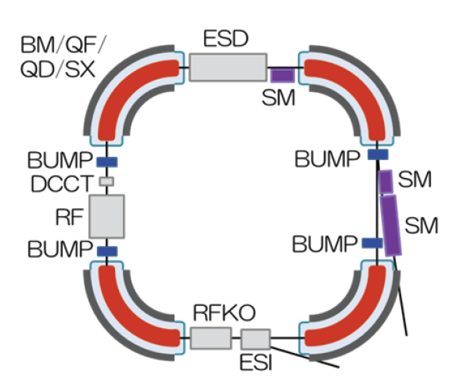
Shrinking the size using superconductivity
Super MINIMAC, advanced NIRS-Design, max. 5T,
Circumference: 20m
→ Challenge: Fast ramping, curved superconducting dipoles
“…we expect that
within 10 years we can produce a CIRT setup that fits within 20 square meters…”
(T. Kamada, 2015)
See ref. [3, 6]

Slide 11
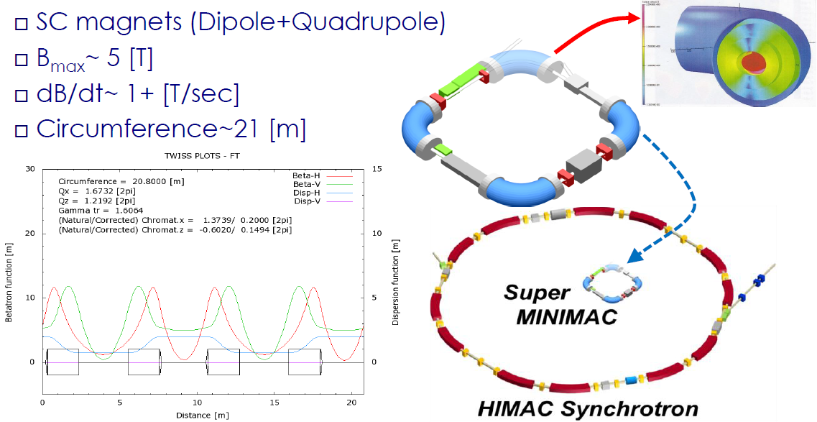
Shrinking the size using superconductivity
(*)
See ref. [7], 2016
(*) Actual value:
dB/dt=0.038 T/s
(HIMAC-Gantry magnets)

Slide 12
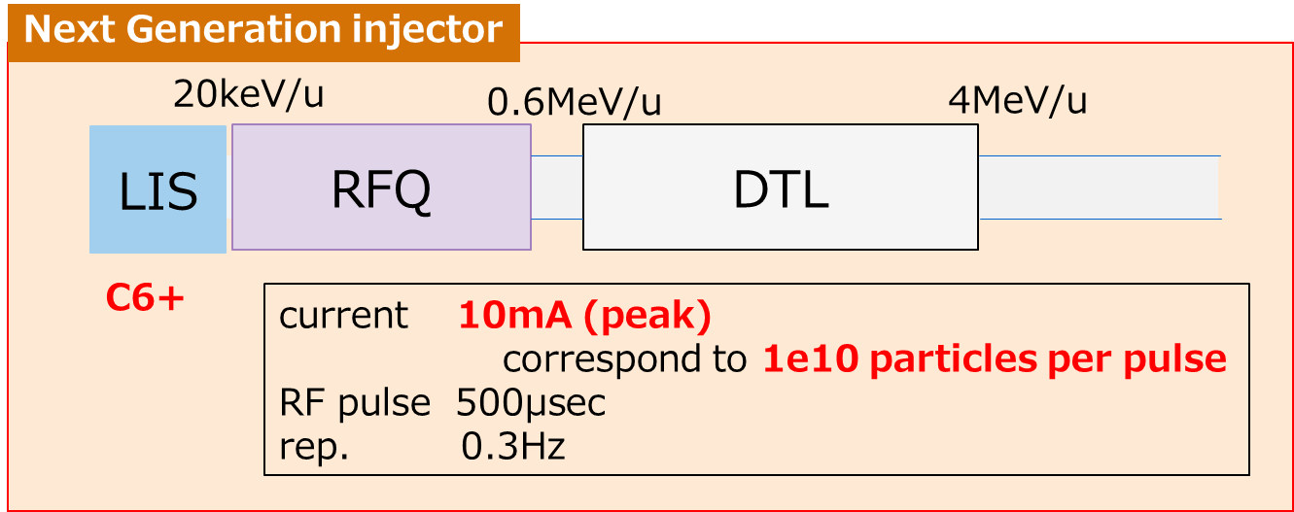
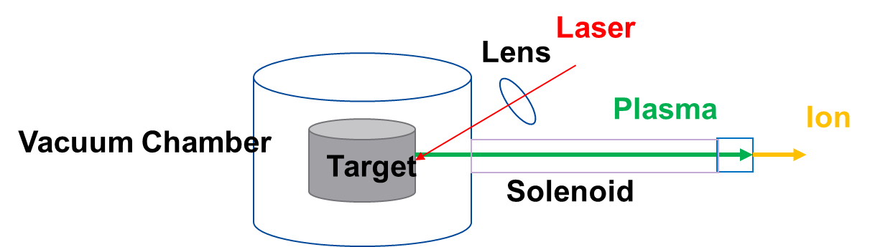
© 2019 Toshiba Energy Systems & Solutions Corporation

Slide 13
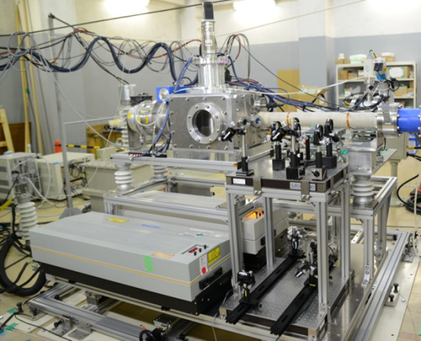
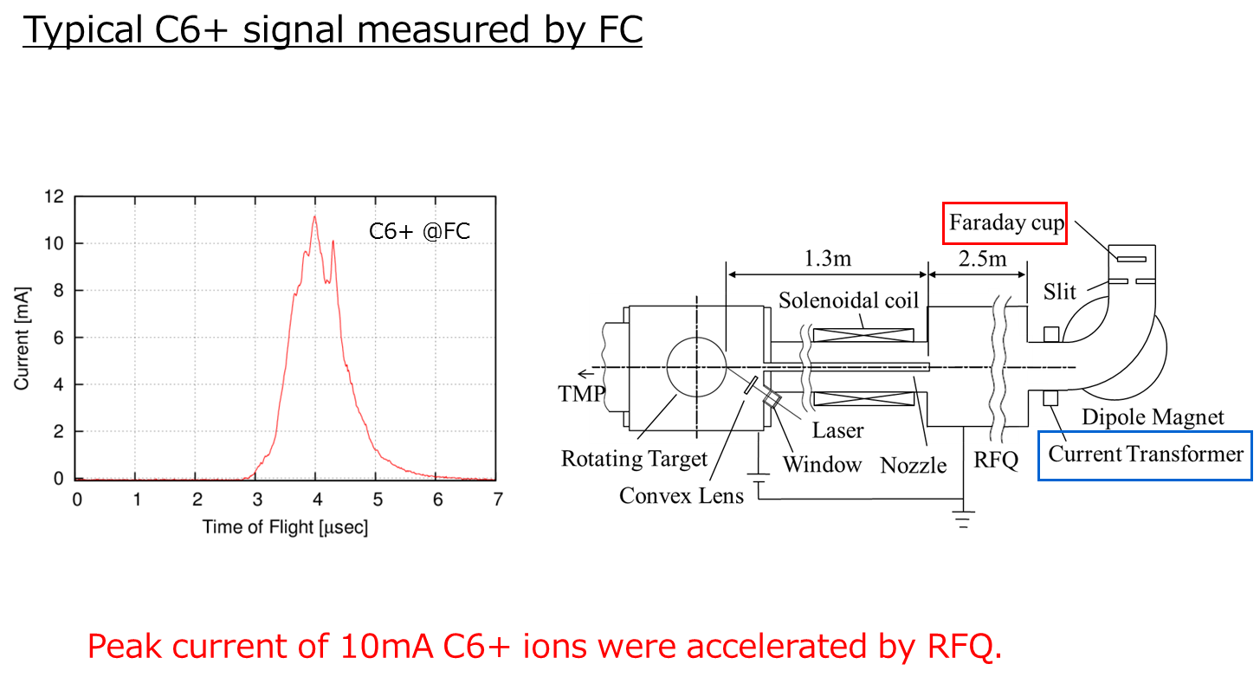
© 2019 Toshiba Energy Systems & Solutions Corporation

Slide 14
Strategievorschlag für Deutschland
Sicherung der Schlüsseltechnologie Ionenbeschleuniger für medizinische Zwecke in einem Verbund von „mittelständischen“ Firmen, die zugrunde liegenden Technologien sind vorhanden:
Supraleitende Magnete (Babcock Noell, Würzburg; Research Instruments, Bergisch Gladbach)
Ionenquellen und Injektoren (Dreebit, Großröhrsdorf; Bevatech, Frankfurt)
Vakuum, Beamlines, Strahldiagnose (FMB Berlin; PINK, Wertheim; Pfeiffer Vacuum, Aßlar; NTG, Gelnhausen)
Kontrollsysteme (Fa. Eckelmann, Wiesbaden)
Im Verbund mit den entsprechenden Forschungseinrichtungen (GSI/FAIR, Helmholtz-Zentrum Dresden Rossendorf, Uni Heidelberg/HIT/DKFZ u.a.) ließe sich „ein zweiter Anlauf“ („nach Siemens“) bei geeigneter Förderung und nationaler (europaweiter?) Koordination realisieren.

Slide 15
Strategievorschlag für Deutschland
Zusätzlich: Stichwort Laserplasma-Beschleuniger:
„Parallel dazu sollte die Grundlagenforschung im Bereich Laserplasmabeschleuniger wie z.B. ELIMED weiter gefördert werden, da diese Technologie für die Medizin – langfristig gesehen – noch große Bedeutung gewinnen kann, auch wenn hier der Blick über die Perspektive 2030 hinausreichen sollte. Noch sind etliche Fragestellungen zu klären wie z.B. die Energieverteilung und Pulsstruktur sowie die Wiederholfrequenz der zukünftig verfügbaren Hochleistungslaser.“

Slide 17
Further developments in the usage of synchrotrons for particle therapy:
  Upgrading of existing synchrotron-based accelerator facilities
  → “Multiple-Energy-Operation”
  Shrinking the size using superconductivity
  → gantries, synchrotrons

Slide 18
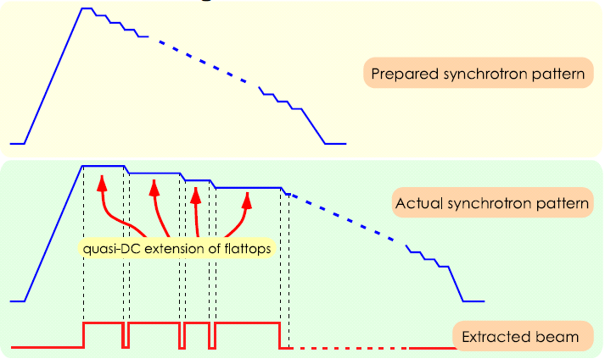
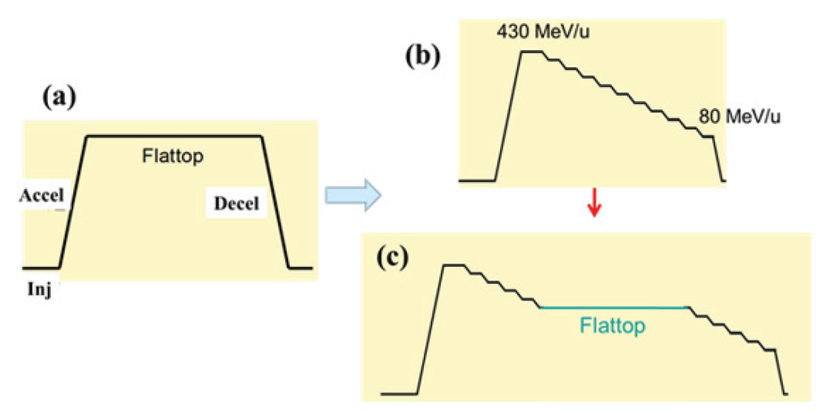
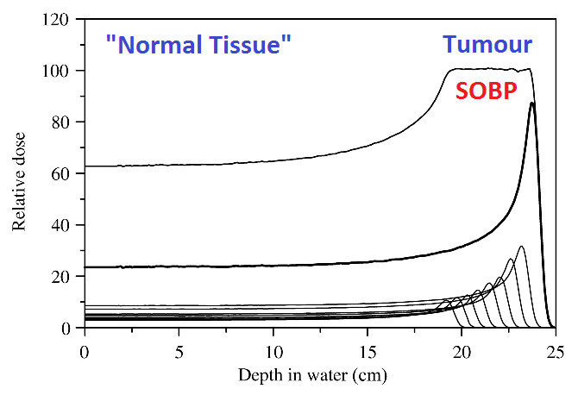
Upgrading the synchrotron operation
Principle idea by HIMAC, Japan of squeezing out the synchrotron based PT method: „Multiple-Energy Operation“
Predefined patterns of multiple extraction energies within one synchrotron cycle!
Energy change within ~100 ms
See ref. [2, 3]
…but all energy steps have to be passed!

Slide 19
“Multiple-Energy Operation” by HIT
The HIT approach of „Multiple-Energy Operation“ aims at a selective choice of energies (#1, #2, #3, …), directly linked to the individual patient treatment plans. Irradiation time may shrink by around 50%!
B
Dipole
IES #3
IES #2
IES #1
t
B
Dipole
IES #3
IES #2
IES #1
t

Slide 20
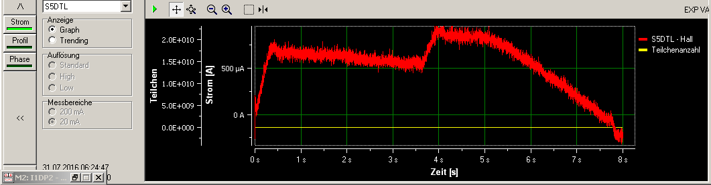
Upgrading the synchrotron operation
First steps in the development of the “multiple-energy-operation” project at HIT are underway:
  Prototype implementation for two-energy-operation (possible within the given HIT-ACS framework of today) is almost finished for the synchrotron and the HEBT.
  First beam tests were done in Q4/2016; example: E#1 << E#2
  (→ more results will be presented at IPAC 2017)
  Demanding task now: Design of a “next generation control system”
1. Acc. 1. Extr. 2. Acc. 2. Extr.

Slide 21
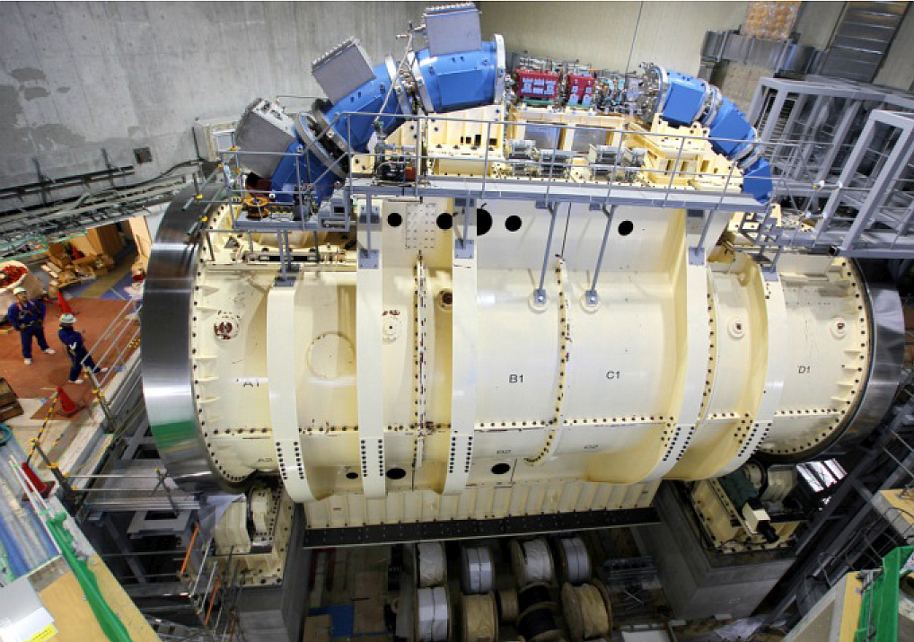
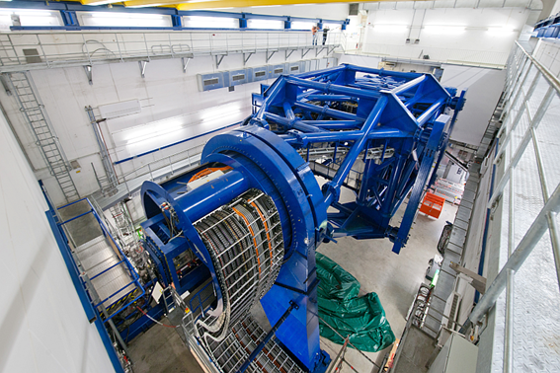
Shrinking the size using superconductivity
See ref. [5]
First gantry prototype with superconducting magnets for carbon ion beams at HIMAC (commissioning in 2016)
Reduced size and weight in contrast to normal conducting version at HIT (below)
TOSHIBA is now working on a 2nd commercial version with 4 – 5 T magnets instead of 3.2 T (HIMAC)

Slide 22
Shrinking the size using superconductivity
See ref. [4], 2012

Slide 23
Shrinking the size using superconductivity
Super MINIMAC, advanced NIRS-Design, max. 5T,
Circumference: 20m
→ Challenge: Fast ramping, curved superconducting dipoles
“…we expect that
within 10 years we can produce a CIRT setup that fits within 20 square meters…”
(T. Kamada, 2015)
See ref. [3, 6]

Slide 24
Shrinking the size using superconductivity
(*)
See ref. [7], 2016
(*) Actual value:
dB/dt=0.038 T/s
(HIMAC-Gantry magnets)

Slide 25
Particle therapy and imaging – combining proton/ion beams with MRI

Slide 26
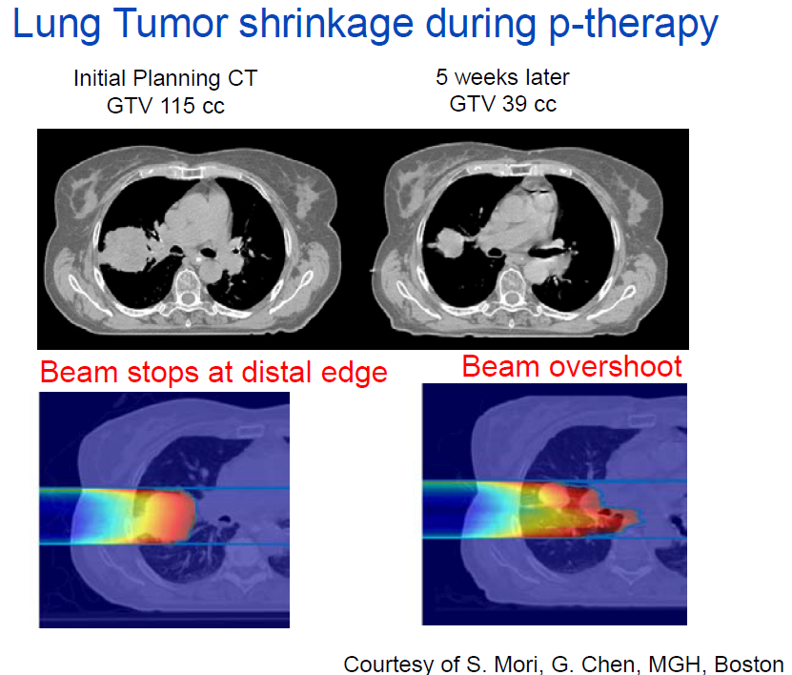
Combining proton/ion beams with MRI
Motivation (ref. [8]):
“Seeing what you treat” → Online diagnostics would be favorable
CT is almost standard today, but MRI causes no further radiation dose (especially important in pediatric treatments!)
Tumor shrinkage during therapy – avoidance of errors in adapted dose
allocation
MR-Linac Systems
(photons) are
currently
being introduced
in radiotherapy

Slide 27
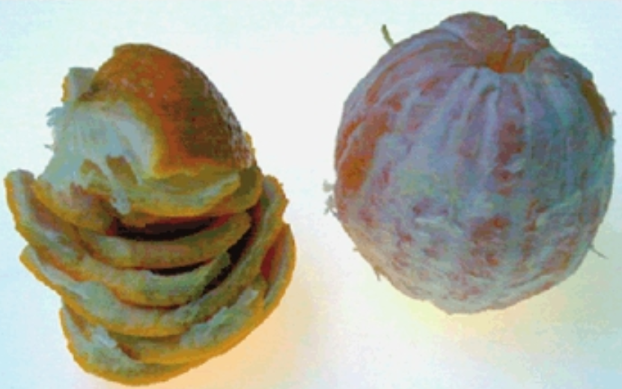
Combining proton/ion beams with MRI
Furthermore:
Doctors normally use large margins around the tumor volume because of possible range uncertainties, movement of the tumor along the irradiation, etc. → Better diagnostics is necessary to shrink these margins!
See ref. [9]
A 6.5 mm thick margin (peel) consists of the same volume as a 5 cm diameter target (orange).

Slide 28
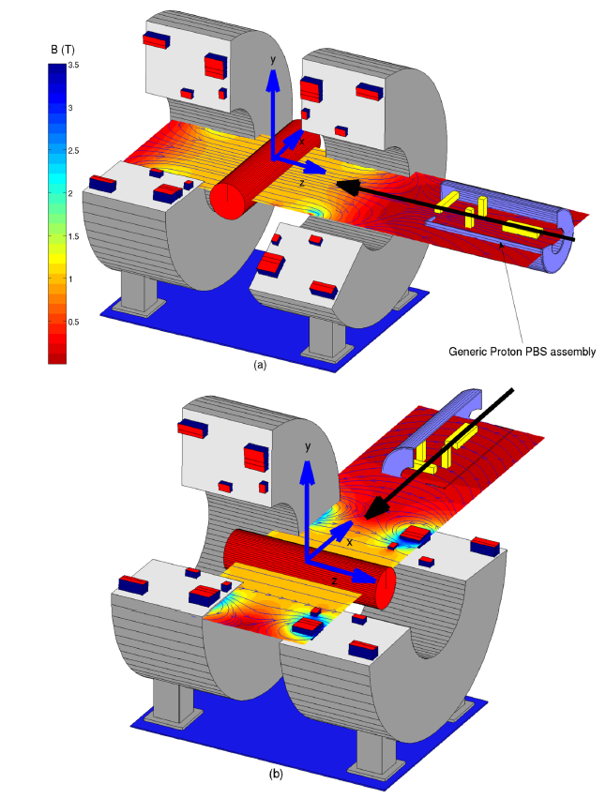
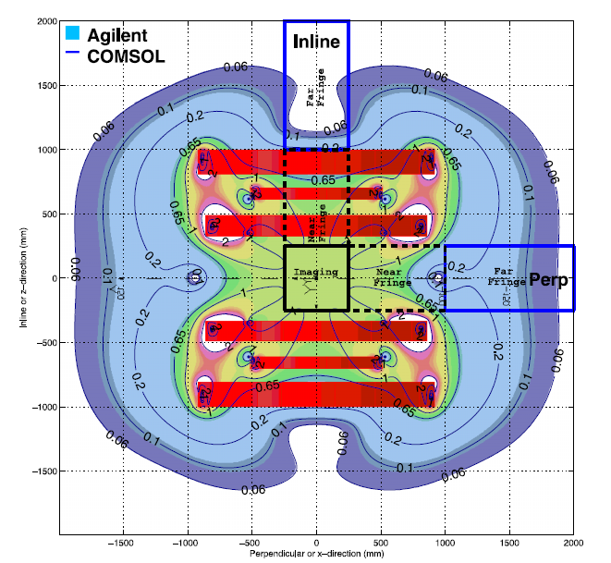
Combining proton/ion beams with MRI
MRI devices have complex magnetic fields, which would interact with proton/ion beams – compensation?
Inline
Perpen-dicular
Possible arrangements of MRI device vs. beam direction
See ref. [10]

Slide 29
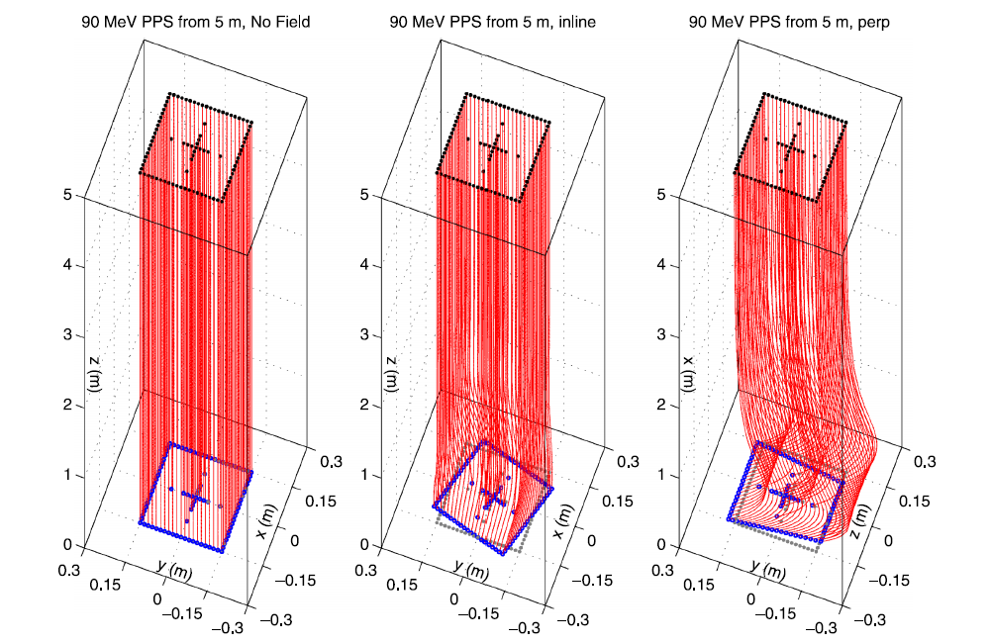
Combining proton/ion beams with MRI
In case of a parallel particle source (PPS) the MRI device causes (complex) distortions and deflections of the beam!
See ref. [10]

Slide 30
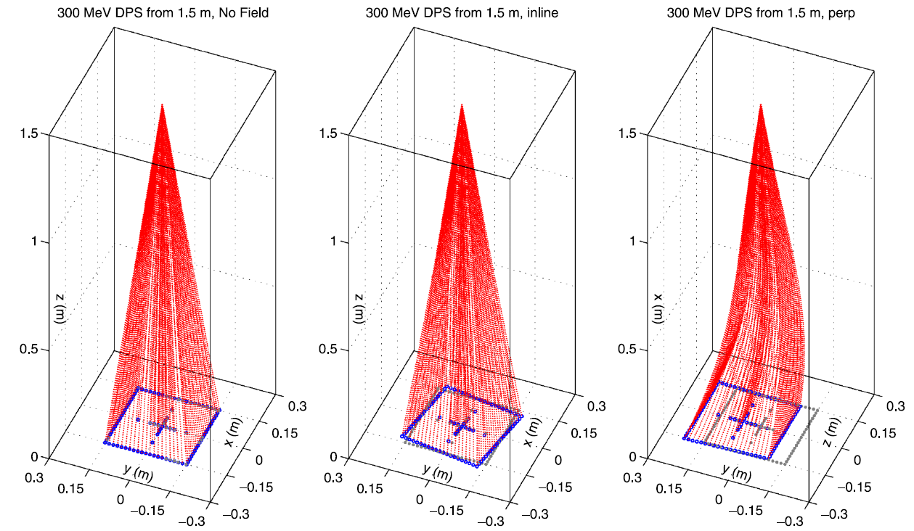
Combining proton/ion beams with MRI
In case of a
Diverging point source (DPS), e.g. a raster scanning system, similar (complex) distortions and deflections of the beam occur!
See ref. [10]
Furthermore: Effects on secondary particles have to be taken into account!

Slide 31
Future concepts: Laser-driven acceleration of protons and (light) ions

Slide 32
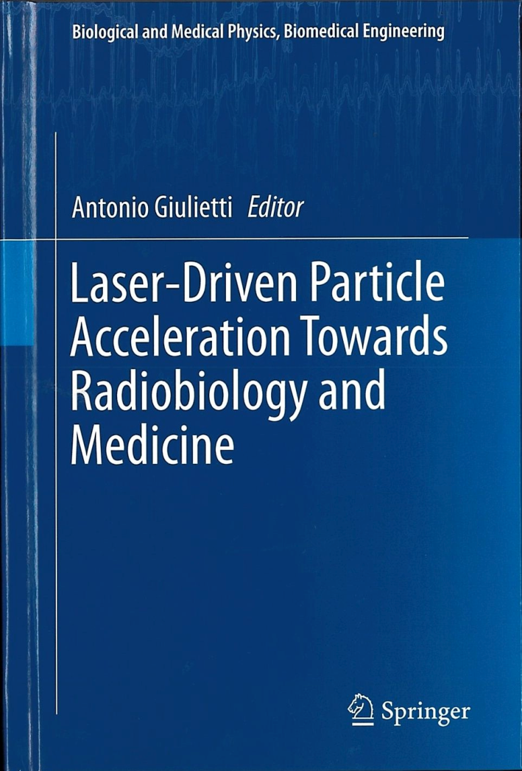
Laser-driven acceleration of protons/ions
There are different acceleration techniques under investigation today for particle therapy (e.g. DWA, FFAG), but the largest interest as well as R&D and possible potential seems to be in the field of “Laser-Driven Acceleration”, some hints:
Large community
High amount of publications from laser physicists up to biophysics related researchers
Development of Tera-/Peta-Watt lasers in industry is still advancing
Some (new) facilities: DRACO, Dresden; SCAPA, Glasgow; ELI(MED), Prague; …
See ref. [11]

Slide 33
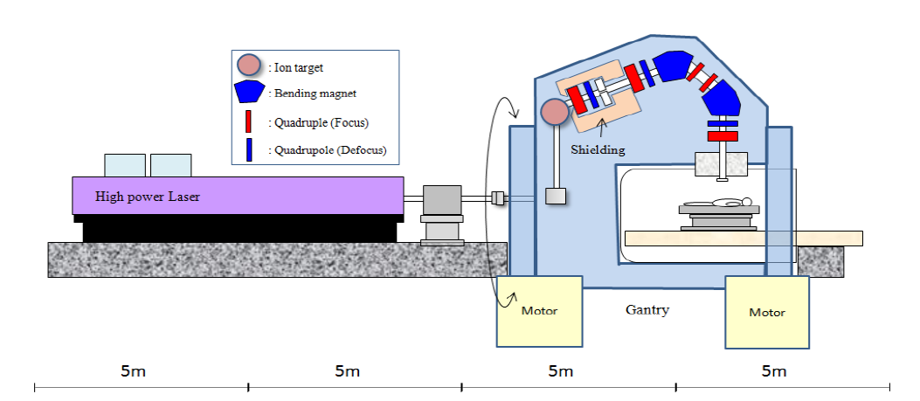
Laser-driven acceleration of protons/ions
Vision of a compact PT facility based on a “High Power Laser”
See ref. [12], 2009

Slide 34
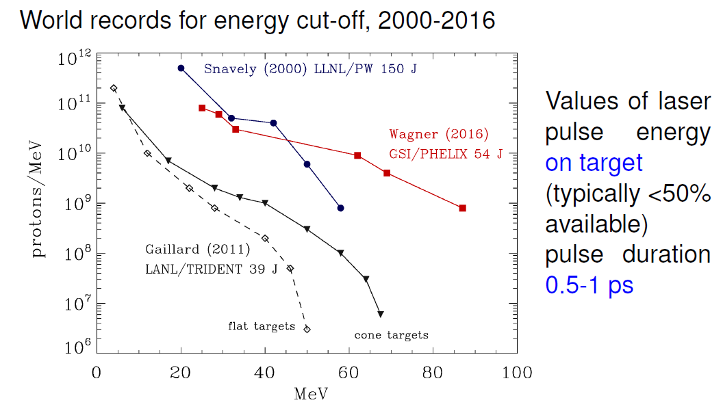
Laser-driven acceleration of protons/ions
What is reached so far? Actual results for protons → energy
See ref. [13], 2016

Slide 35
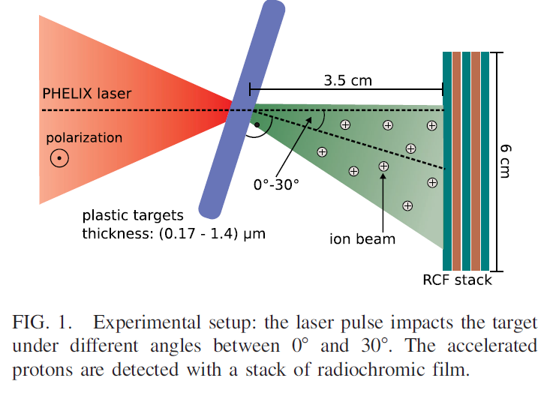
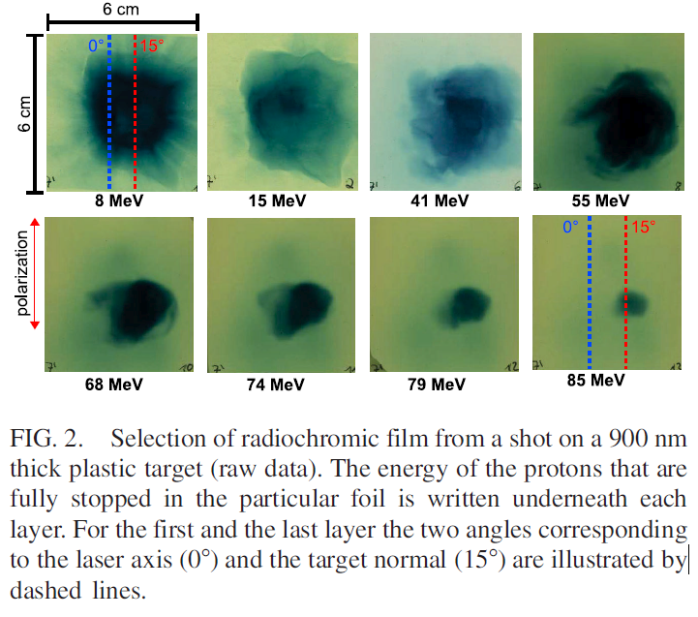
Laser-driven acceleration of protons/ions
“Using laser pulses with high temporal contrast and an intensity of the order of 10²⁰ W/cm² we observe proton beams with cutoff energies in excess of 85 MeV and particle numbers of 10⁹ in an energy bin of 1 MeV around this maximum.”
See ref. [14], 2016

Slide 36
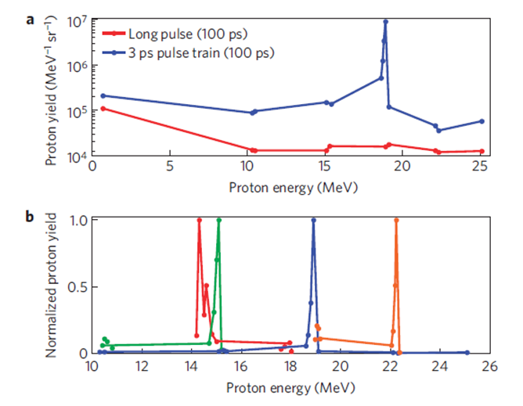
Laser-driven acceleration of protons/ions
Further developments:
Other target scenarios under investigation besides
“target normal sheath acceleration (TNSA)”:
laser breakout afterburner (BOA)
radiation pressure acceleration (RPA)
Collisionless Shock Acceleration (CSA)
Aim: Reduction of energy
spectrum of produced
protons/ions up to mono-
energetic particles!
See ref. [15], 2012

Slide 37
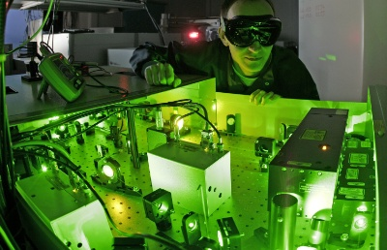
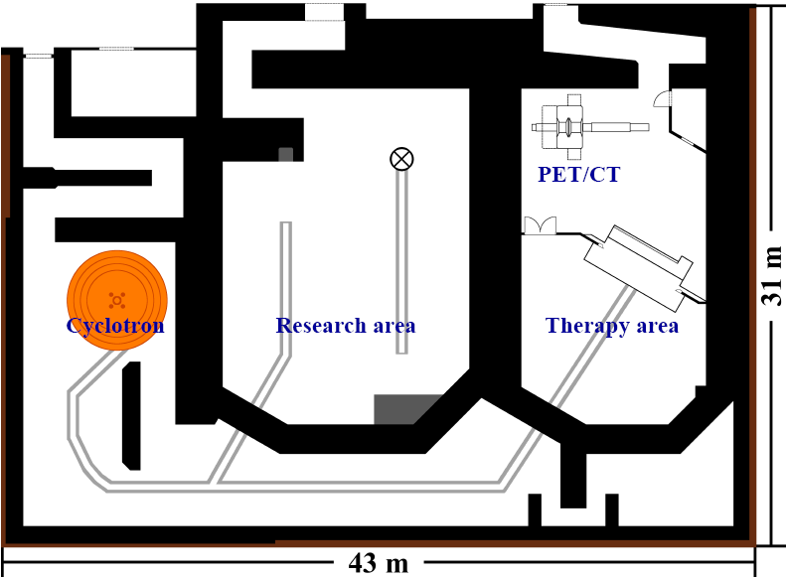
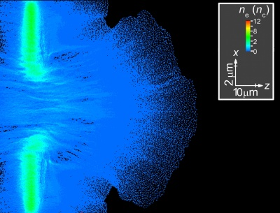
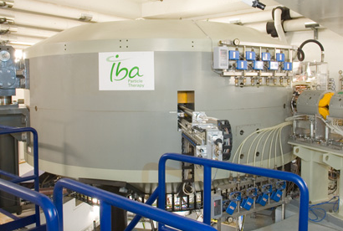
Laser-driven acceleration of protons/ions
Project started in 2008/2012:
150 TW Ti:Saphir Laser DRACO (Dresden laser acceleration source) – meanwhile extended up to
1 Petawatt
Directly
besides
Proton Therapy
Treatment
Facility
Later connection foreseen
Courtesy of Stephan Helmbrecht, Oncoray, Dresden

Slide 38
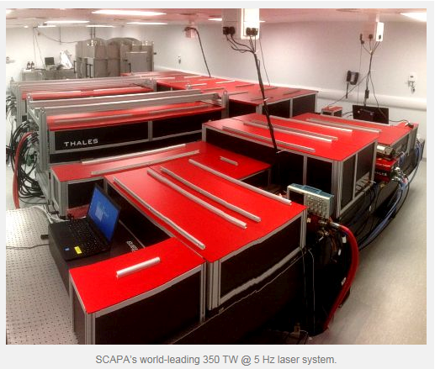
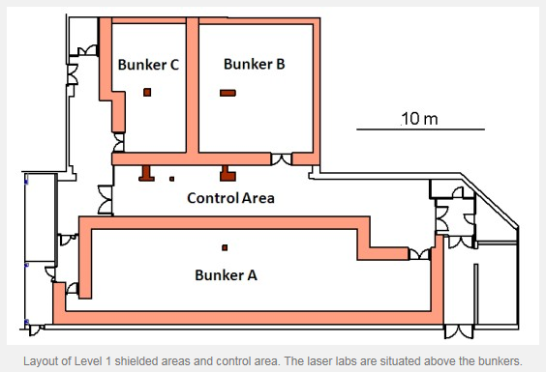
Laser-driven acceleration of protons/ions
Next center in Europe to become operable: SCAPA (Scottish Centre for the Application of Plasma-based Accelerators ) in Glasgow, equipped with laser technology from THALES Optronique:
See ref. [16, 17], 2016
One research aim:
Proton and light ion beams of energy up to 100 MeV/c with 5 Hz

Slide 39
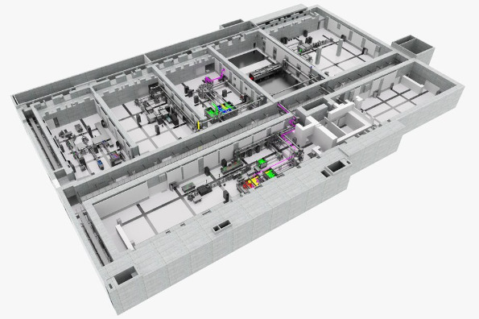

Laser-driven acceleration of protons/ions
ELI, Prague/Research Program 3 - Particle acceleration by lasers:
The goal of this research program is to develop laser-accelerated, versatile sources of ... protons/ions with energies achieving a few GeV.
A particular goal is the development of repetition rate proton/ion quasi-monochromatic sources with energy typically between 60 and 250 MeV.
This research will be focused on improving the stability and quality of the generated beams, in terms of luminosity, emittance, and the energy profile.
Experiment E4:
ELIMAIA (Multidisciplinary Applications of laser-Ion Acceleration) including ELIMED
Ion Beam Features (PW) | Enabling Experiments | Flagship Experiments
Energy range | 3-60 MeV/u | 3-300 MeV/u
Ion No./laser shot | >10⁹ (0.1 nC) in 10% BW | >10¹⁰ (1 nC) in 10% BW
Bunch duration | 1-10 ns | 0.1-10 ns
Energy spread | ±5% | ±2.5%
Divergence | ±0.5° | ± 0.2°
Ion Spot Size | 0.1-10 mm | 0.1-10 mm
Repetition rate | 0.01-1 Hz | 0.01-10 Hz
See ref. [18], 2017

Slide 40
Summary / Perspectives
There is still a lot of potential for the advancements of existing (cyclotron and) synchrotron based facilities, e.g. usage of superconductivity or enhanced “multiple-energy” operation modes.
In Particle Therapy a view on the whole chain – accelerator, irradiation technique, diagnostics – is necessary to lower the costs of such facilities and/or to enhance the functionality, e.g. combining proton/ion treatment with MRI.
One potential candidate for future particle therapy sources are laser driven acceleration schemes, but still a lot of fundamental research is necessary! A closer collaboration of the laser community and the accelerator physicists may help sometimes, e.g. in the field of diagnostics.

Slide 41
References
Laser-driven ion accelerators for tumor therapy revisited, U. Linz, J. Alonso, Physical Review Accelerators And Beams 19, 124802 (2016)
Multiple-Energy Operation With Quasi-DC Extension Of Flattops At HIMAC, Y. Iwata et al., Proceedings of IPAC’10, Kyoto, Japan
Recent Progress and Future Plan of Heavy-Ion Radiotherapy Facility, HIMAC, K. Noda et al., Proceedings of IPAC´14, Dresden, Germany
Carbon Ion Radiotherapy at NIRS – Rationale, Technique, Results and Future, T. Kamada, ESTRO 2012, Uppsala, Sweden
Present Status of a Superconducting Rotating-Gantry for Carbon Therapy, Y. Iwata, Proceedings of HIAT2015, Yokohama, Japan
Twenty Years of Carbon Ion Radiation Therapy at the National Institute of Radiological Sciences: Accomplishments and Prospects, T. Kamada, International Journal of Particle Therapy, 2015
SC Gantry at NIRS and new developments in SC magnets for gantries & synchrotrons, Y. Iwata et al., Workshop at CIEMAT, November 2016, Madrid, Spain, see https://indico.cern.ch/event/537685/
MR guided particle beam radiotherapy, O. Jäkel, Talk held at DGMP, ISMRM-DS, Würzburg, September 7th, 2016 (and citations therein)
High Precision MRI Guided Proton Therapy, J. Hartman et al., UMC Utrecht
Proton beam deflection in MRI fields: Implications for MRI-guided proton therapy, B. M. Oborn et al., Medical Physics 42, 2113 (2015)
Laser-Driven Particle Acceleration Towards Radiobiology and Medicine, Antonio Giulietti et al., Springer Books, 2016
Designing Integrated Laser-Driven Ion Accelerator Systems for Hadron Therapy at PMRC (Photo Medical Research Center), H. Sakaki et al., Proc. IPAC 2009, Vancouver, Canada
Laser-Plasma Ion Acceleration, Andrea Macchi, Talk at Central Laser Facility Laserlab EU training weeks, Rutherford Appleton Laboratory, Didcot (UK), December 1, 2016

Slide 42
References
Maximum Proton Energy above 85 MeV from the Relativistic Interaction of Laser Pulses with Micrometer Thick CH₂ Targets, F. Wagner et al., PRL 116, 205002 (2016)
Collisionless shocks in laser-produced plasma generate monoenergetic high-energy proton beams, Dan Haberberger, Nature Physics 8, 95–99 (2012)
http://www.scapa.ac.uk/
https://www.thalesgroup.com/en/japan/thales-optronique-tosa-lasers
https://www.eli-beams.eu/en/
THANK YOU FOR YOUR ATTENTION!

