Slide 1
Materialforschung für Beschleuniger
M. Bender* and C. Trautmann,
MAT
* m.bender@gsi.de

Slide 2
Next generation accelerators: pushing the limitis of the technically feasible
2010
Performance increase:
Higher energy
Higher intensity / luminosity
Pulsed beams
Cryogenic structures
LHC
MAX IV
FAIR
Spiral 2
HIAF
FRIB
ESS
FCC
…
2020
2025
Technical challenges for
Power
Radiation
Timing
Data
Materials (construction & operation)
Cryo
Vacuum
…
2035

Slide 3
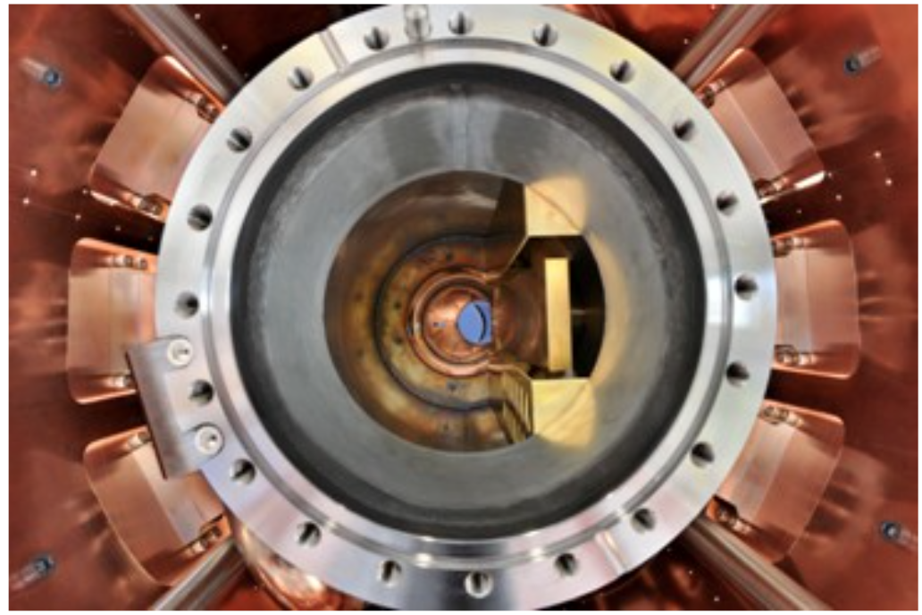
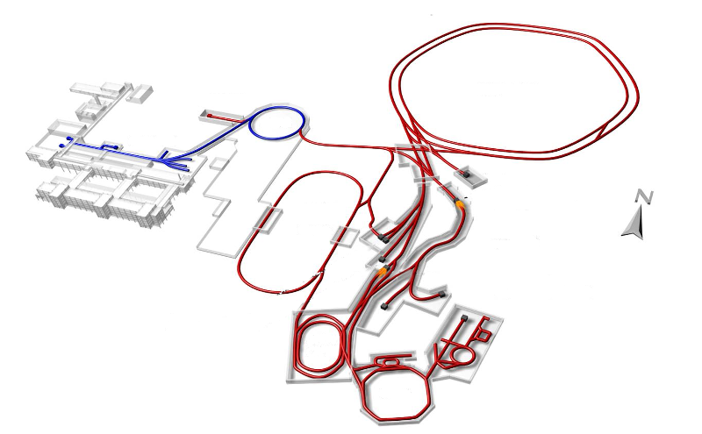
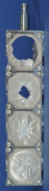
Technical challenges:
Radiation hardness of beam exposed materials
Collimators
Stripper foils
10¹² U s⁻¹
T = 2K
P = 10⁻¹² mbar
SFRS target
130 kJ / bunch
mA - A beam current
365 MJ total
Beam dumps

Slide 4
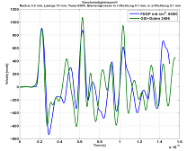
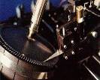
Online test methods, monitoring systems
Problems:
Beam monitoring on target and beam catchers
How to predict and localize failure
In extreme operation conditions
In high radiation fields
  Targets
  Beam catcher
Possible monitor systems to be tested:
Thermal imaging
Laser vibrometer
Eddy current
calc.
data

Slide 5
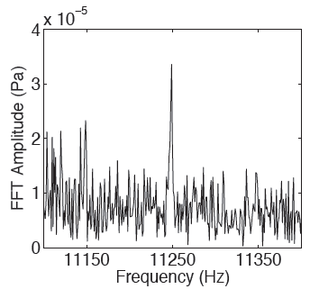
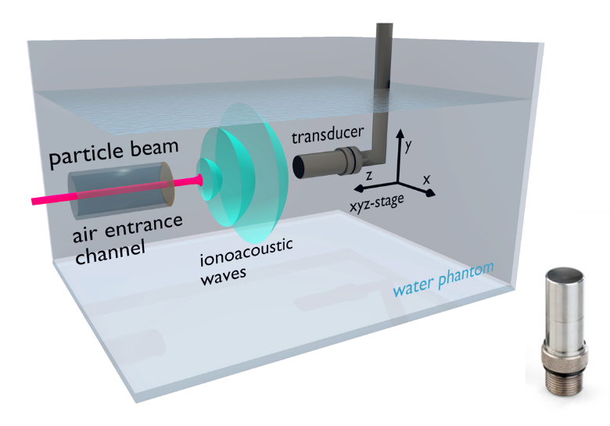
New (old) methods
Acoustic emission monitoring:
LHC collimators (D. Deboy, CERN)

Slide 6
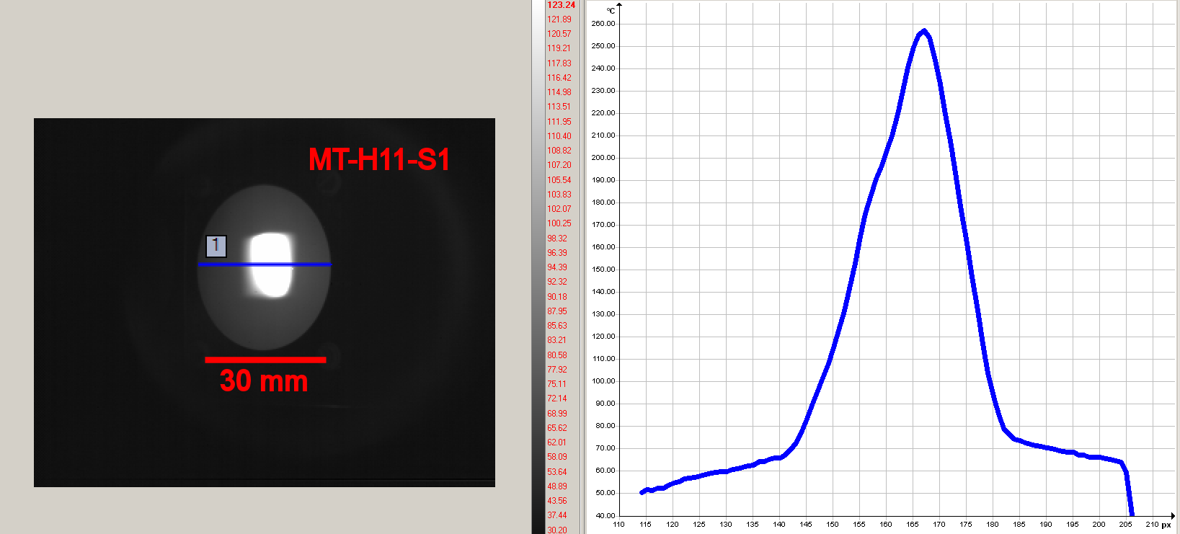
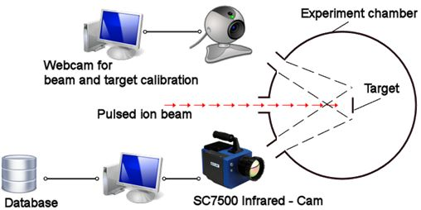
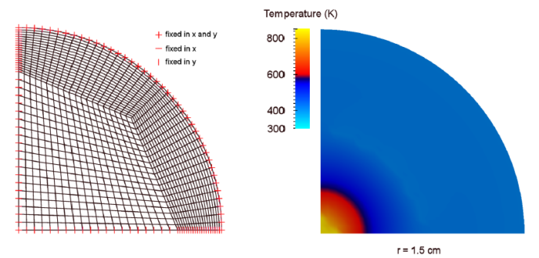
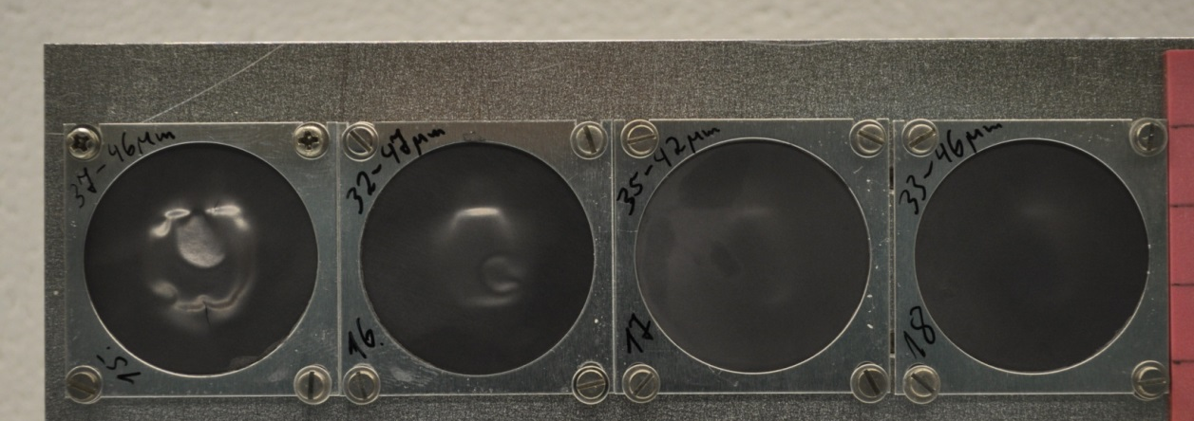
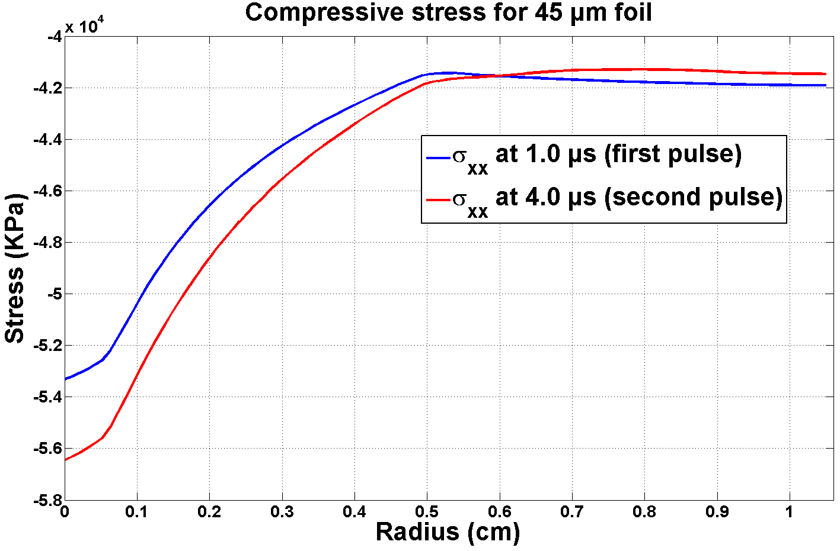
Pressure pulses & shock waves
Finite element simulations
Graphite target / Pulse structure | Maximum compressive stress (MPa) | Maximum tensile stress (MPa)
45 µm (single pulse) | -53.3 | 0.5
45 µm (double pulse) | - 56.4 | 0.7
ΔT = 200 K
Δt = 50 µs
5x10¹⁴ i/cm² 10¹⁴ i/cm² 10¹³ i/cm² 5x10¹² i/cm²
radiation damage ⇨ swelling
stress waves ⇨ compression
stress concentrators + fatigue ⇨ crack

Slide 7
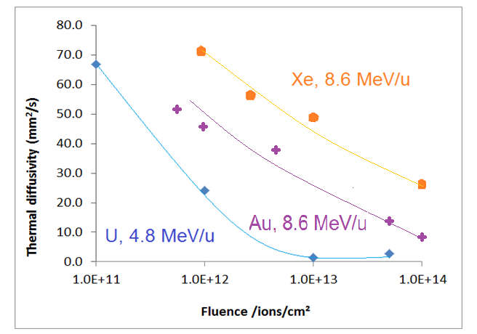
Offline test methods, e.g. degradation of thermal properties
Laser flash analysis of irradiated graphite
Thermal simulation shows cooling problem with radiation-damaged graphite:
- degradation of thermal diffusivity: 70-40 W/(m K) -> 15 W/(m K)

Slide 8
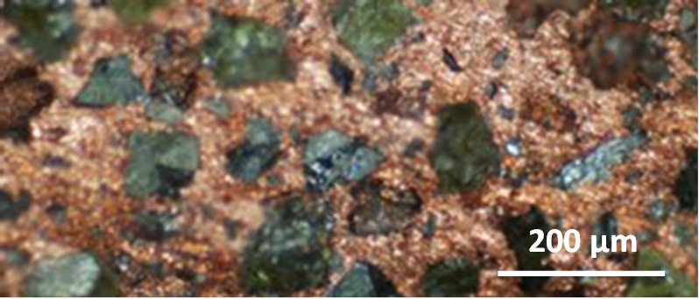
New materials
Figure of merit for materials resistance to ion beam-induced thermal stress
CFC
graphite

Slide 9
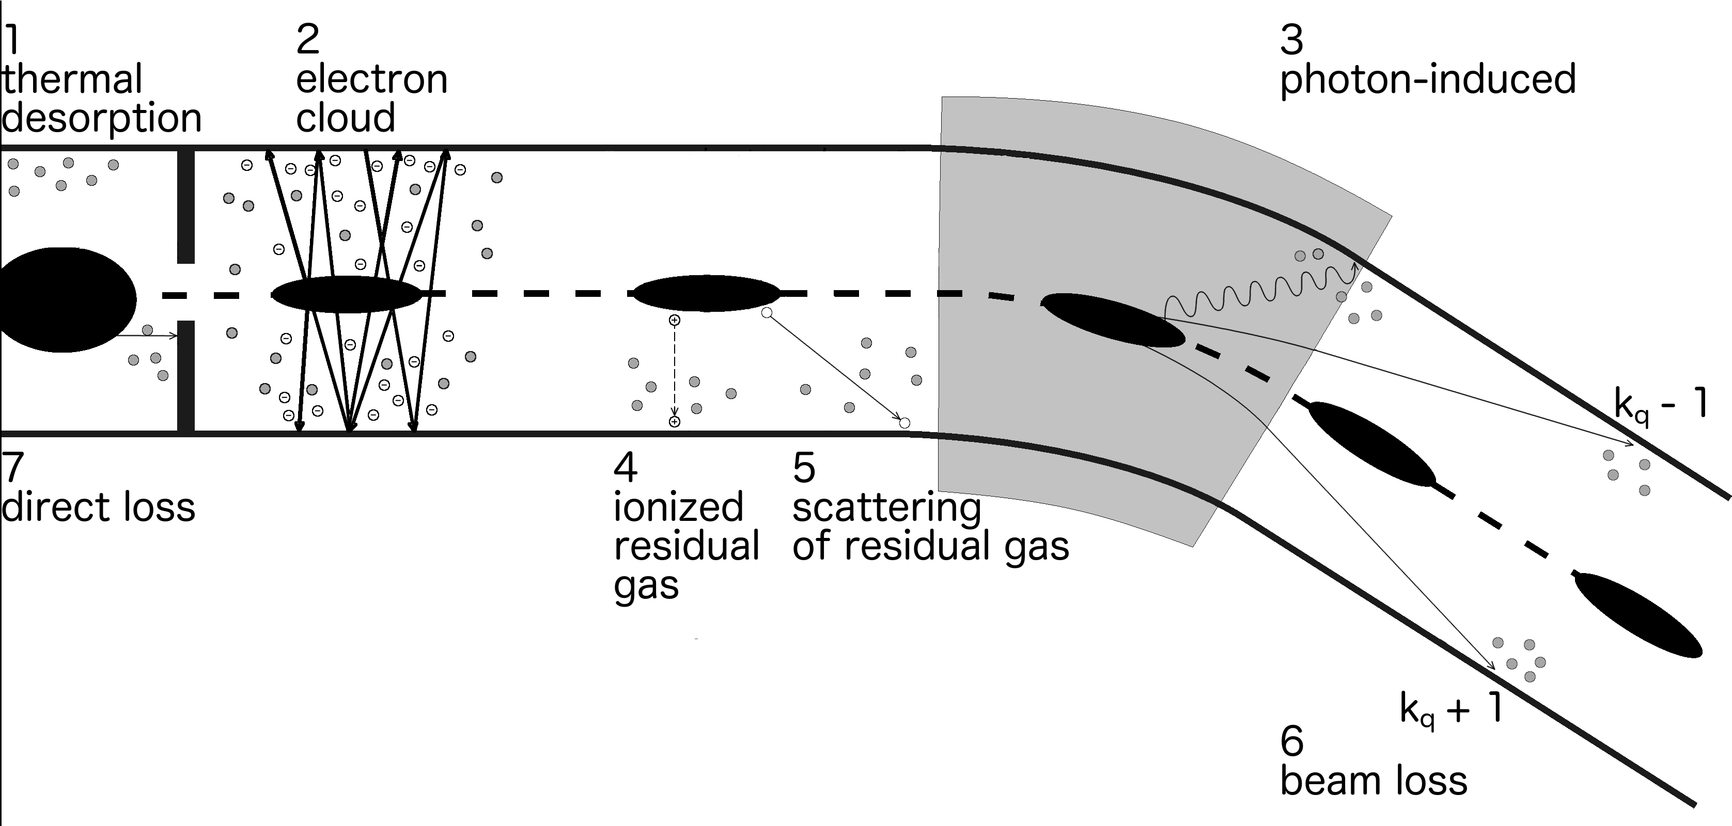
Dynamic vacuum instabilities

Slide 10
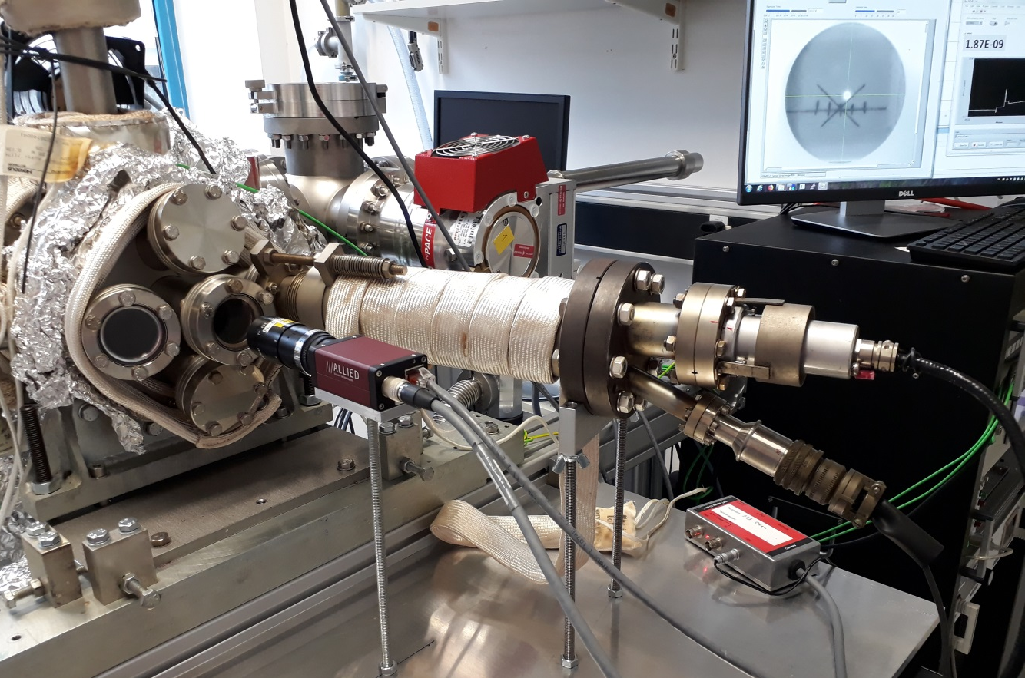
Investigation of dynamic outgassing
Cooled aperture
Vacuum diagnostic
Electron-gun
Sample →
Flange or window
Cooling /Heating
keV-sputter-gun
Bypass-
valve
UHV-Pump
IZ, TSP
Turbo pump
TDS setup operating as standard analysis tool
Additional electron source installed for ESD
Investigation of different materials, treatments and coatings, to find low-desorbing materials
Amount of desorbed gas as function of thermal properties, purity and thickness of coating

Slide 11

Joint research to reduce outgassing channels
desorption
surface diffusion
bulk diffusion
h$ν$
Ion
e-

Slide 12
Conclusion
Due to extreme conditions, materials research is important for next generation accelerators
  Combined radiation, heat, pressure
  Transient processes, pulsed impact
Evolution of new reliable materials in progress
Development of monitoring systems to predict lifetime of materials or detect material failure
Vacuum problematic largely understood
  Startup of database for materials & treatments
Thin film coatings
  NEG getters for vacuum performance
  aC for low secondary electron yields
Thank you for your attention!

