Slide 1
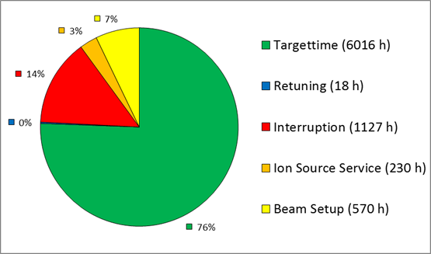
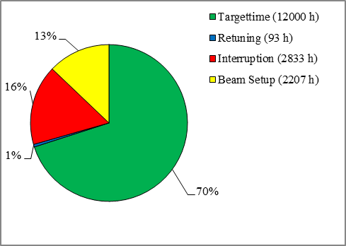
Operations - 26.03.2019
Beam Time ongoing (see very preliminary statistics from Feb 21th – Mar 26th 9:00)
exceptional good availability (incl 3-Source-Operation + all UNILAC-branches in parallel)
Problems/ Issues:
QQ and A4 control is not self protecting, there a certain risk, to badly damage the A4 amplifier in case operators making a simple mistake (critical in night shifts)
scheduled experiments*
2016
2014
*much less complex parallel operation modes compared to 2014/2016 (no ESR, no FRS, no PB, no U)
machine availability | Not in failure mode
UNILAC Users | 87%
UNILAC SIS-Transfer | 97%
SIS18 | 99%
HEST | 90%

Slide 2
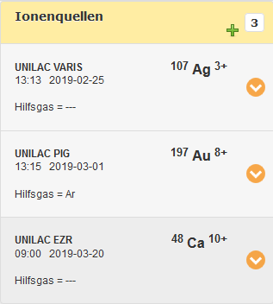
parallel operations example 23.03. late shift – from OLOG

Slide 3
technical problems - top 10
by duration*
by number of events
*independent if any experiment is affected

